Slide 1
K-Means Clustering
Erik & Anthony
(http://thespread.us/) Original Article: WR Clustering

Slide 2
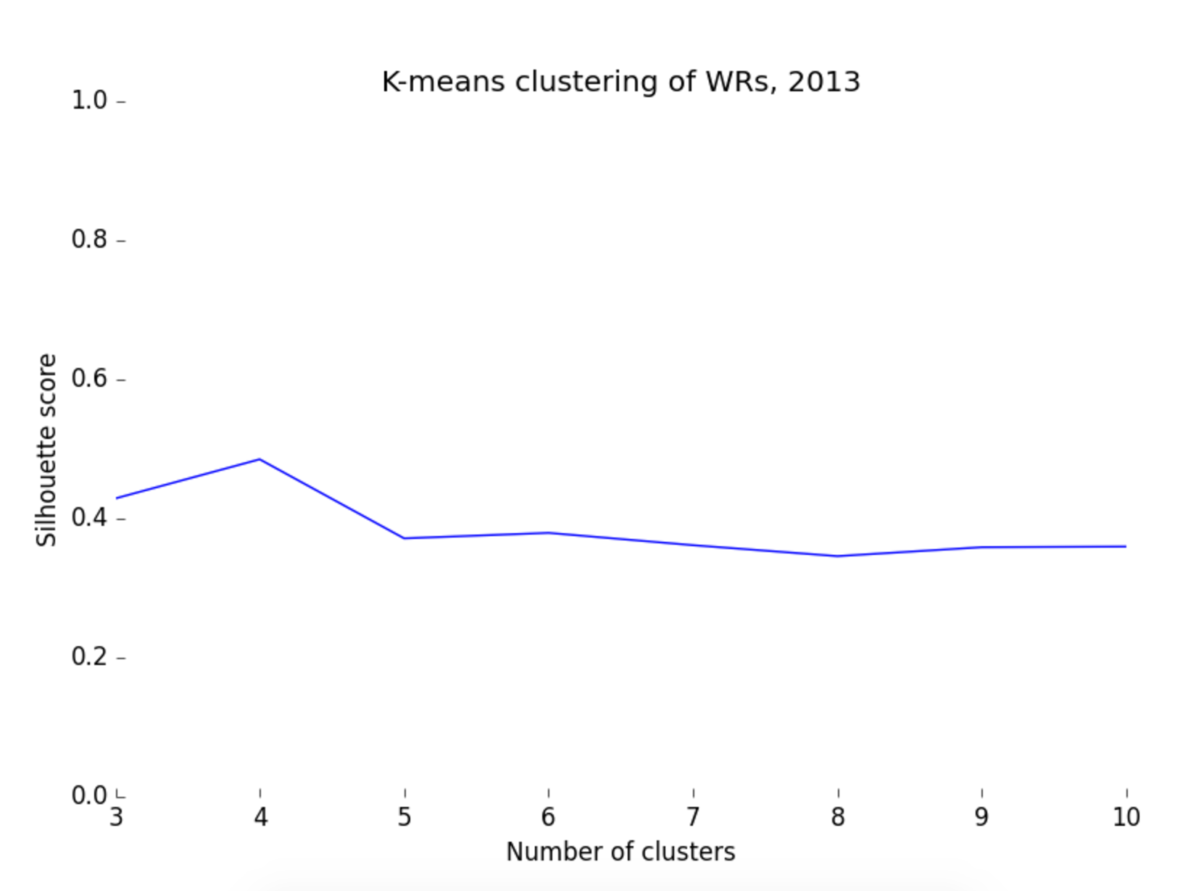

Slide 3
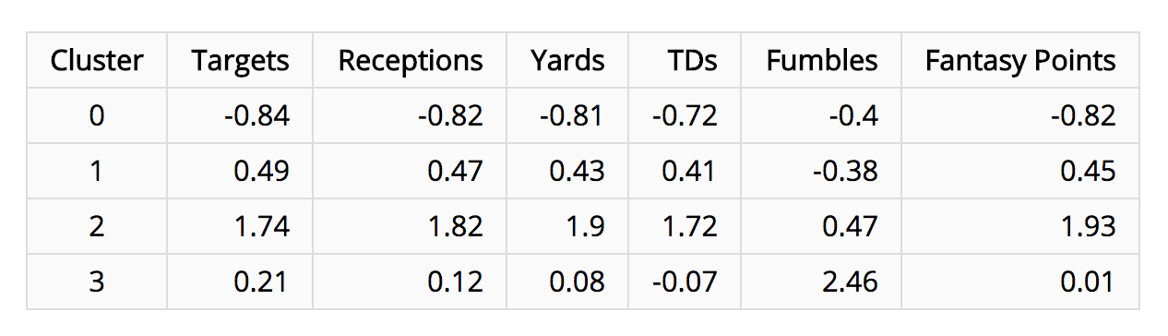

Slide 4
