Slide 1
A Few Useful Things to Know about Machine Learning
Pedro Domingos
Original Article: Few Useful things to Know about Machine Learning
Notes:
Few Useful Things to Know about ML

Slide 2

Introduction
Automatically learn programs from data
Machine Learning ~ Representation + Evaluation + Optimization
Representation: What features do you use to represent the input?
Evaluation: How does the machine score itself?
Often difference between what we optimize for and metrics that matter for products and businesses
Optimization: How do you search for the algorithms that score best on the scoring function?

Slide 3
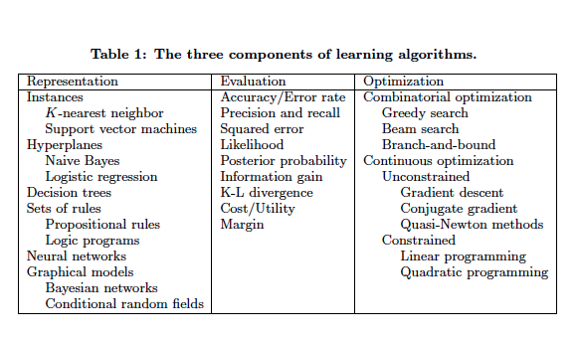

Slide 4
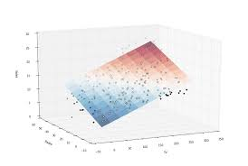

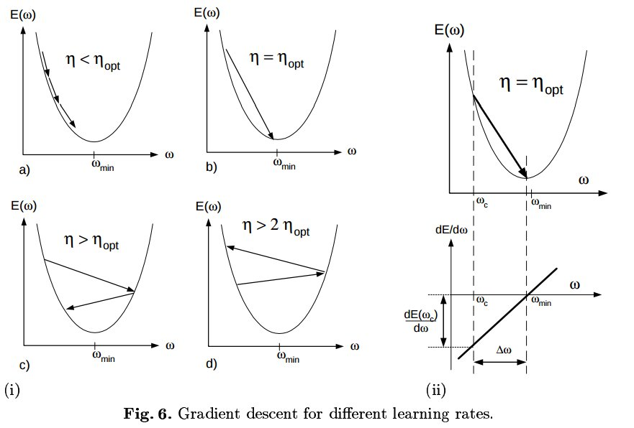
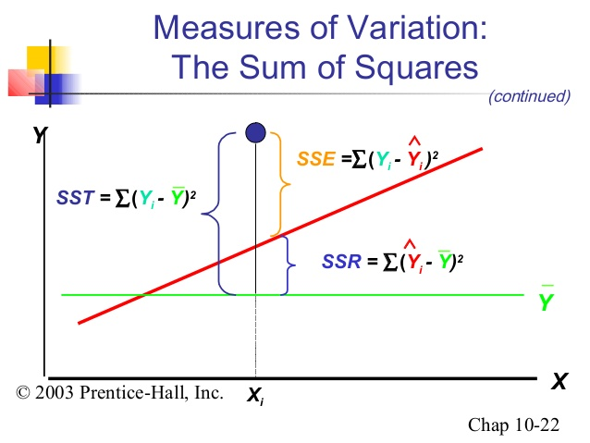
Aside: Linear Regression
Representation
Evaluation
Optimization

Slide 5
It’s Generalization That Counts
Fundamentally goal of ML is to generalize beyond examples in the training set.
Common Mistake for Beginners: Test on the training data
Don’t use your test data to tune the knobs. You can split into train, validation, and test data sets.
If holding out data reduces amount of data for training, cross validate!

Slide 6
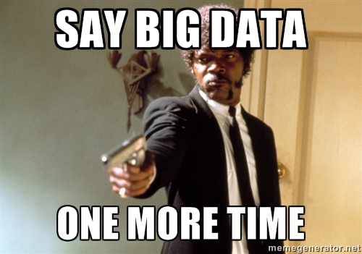
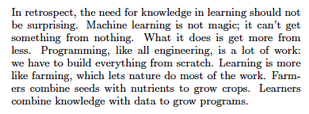
Data Is Not Enough

Slide 7
Lack of Generalization Has Many Faces
Bias-Variance Trade Off
Bias is learner’s tendency to consistently learn the same wrong thing (underfitting)
No Learning on Train or Test
Variance is tendency to learn random things irrespective of the real signal (overfitting)
Example of Overfitting: 100% on Training Data, 50% on Test Data

Slide 8
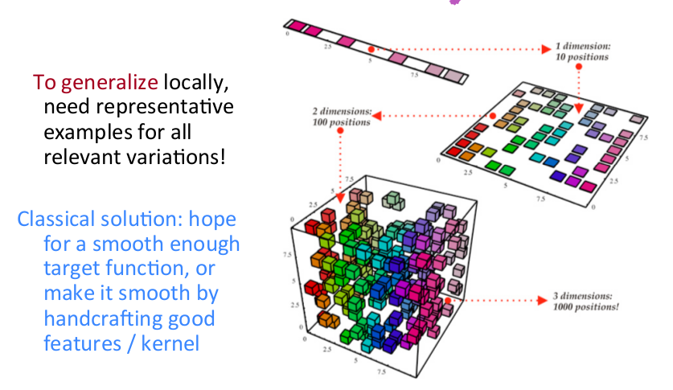
Curse of Dimensionality
Generalization becomes much harder with a larger input space

Slide 9
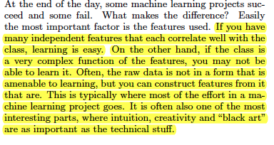
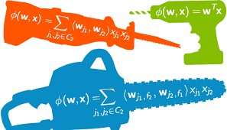
Feature Engineering is the Key

Slide 10
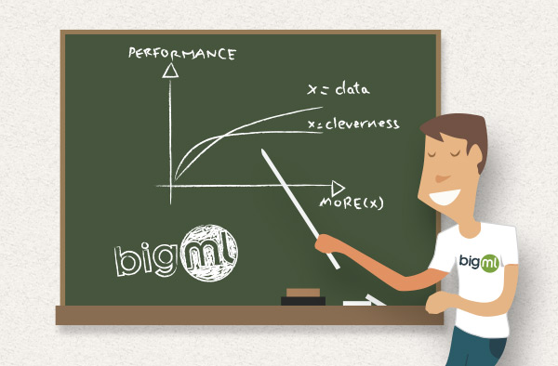
More Data Beats Cleverer Algorithm

Slide 11
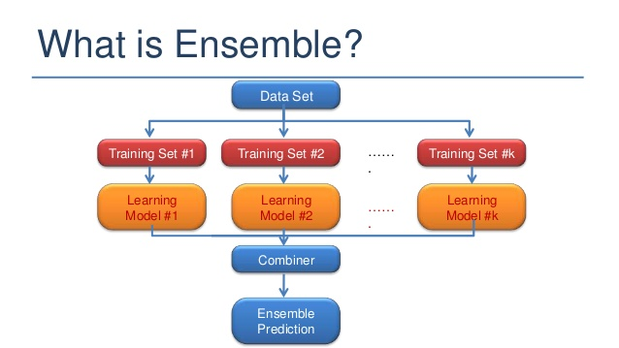
Learn Many Models, Not Just One

Slide 12
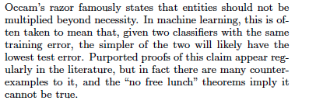
Simplicity Does Not Imply Accuracy

Slide 13
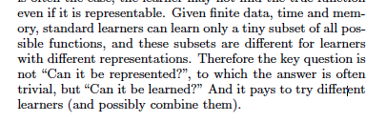
Representable Doesn’t Imply Learnable

Slide 14
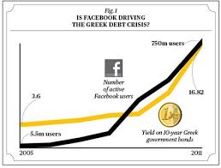
Correlation Does Not Imply Causation

