Slide 1



Management information assistant
July 9, 2018
Navreet Kaur

Slide 2
Intro TO MIA
What is MIA ?
Components of MIA

Slide 3
What is MIA ?
introduction
Explain what it does
Describe its current model
Cras dignissim metus sapien, sit amet lobortis mi egestas vel.
Nam sed tempus diam. Vestibulum at risus ac risus feugiat pretium in eget dui. Morbi sapien sapien, venenatis vitae nisl non, congue molestie tellus. Proin malesuada enim purus, eget auctor erat pretium et. Duis vel sollicitudin odio, id mollis metus. Aliquam erat volutpat.
Quisque eleifend in velit sit amet aliquam.
Phasellus pharetra, dui eu ornare hendrerit, odio quam commodo leo, sed blandit leo urna non justo.
Vivamus eget faucibus urna.
Maecenas justo quam, iaculis eget euismod et, semper vel mauris.
Duis et diam tempus, pellentesque dolor at, feugiat dui.
Nulla molestie pellentesque nisl, nec tincidunt ligula vestibulum sit amet.
Aliquam commodo, tellus et molestie dignissim.

Slide 4
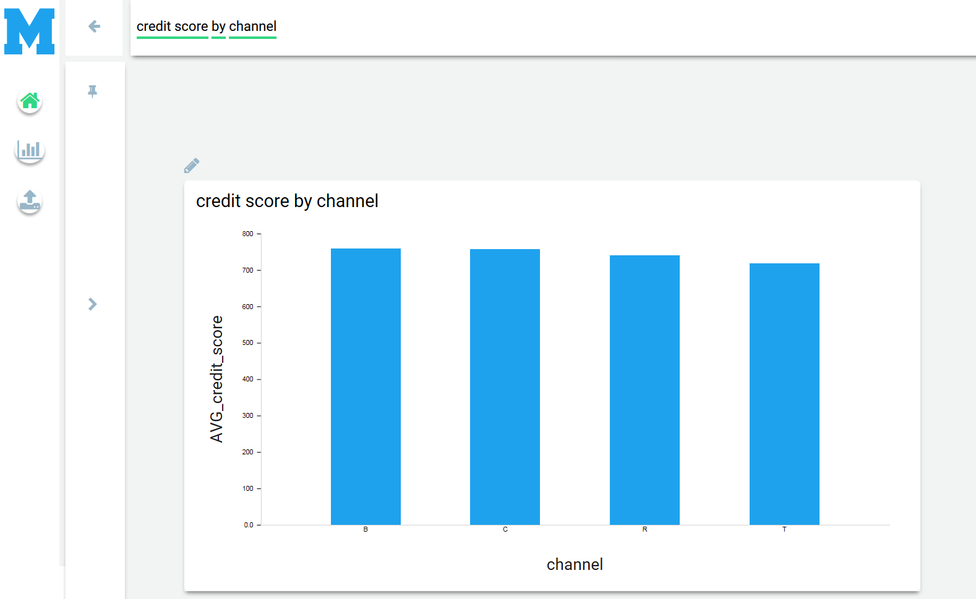
Components of MIA
Introduction
SEARCH
INSIGHTS
INSIGHTS
INSIGHTS

Slide 5
AIM
MIA SEARCH
Synthesize SQL query from Natural Language
Natural Language Query:
What are the top 10 states whose average credit score greater than 500 ?
SQL Query:
SELECT property_state FROM (SELECT AVG(credit_score), property_state FROM freddie_mac_data) AS data WHERE avg_credit_score > 500 GROUP BY property_state ORDER BY avg_credit_score DESC LIMIT 10

Slide 6
Complications
MIA Search
Limitations
Highly dependent on trigger words
Employs linear search
Difficult to extend the model to handle nested queries
Need for new model
Database independence property
Why Machine Learning models cannot be employed?
Minimal preprocessing of database
Using components of previously implemented model
Starling
Metadata
Starling
Metadata
Space
Database1
Column1_1
Column1_2
Database2
Column2_1
Value1_1_1
Value1_1_2
Column1
Datatype
Column2
Datatype
Column3
Datatype
Column4
Datatype

Slide 7

NLQ2SQL
Synthesizing SQL query from Natural Language

Slide 8
Slot Filling of SQL sketch syntax
APPROACH

Slide 9
Features
Proposed model
Rule based system independent of the database
Uses Dependency Parsed tree of the NL query to handle non-linear search
Minimal dependence on trigger words
Separate modules for filling each slot (SELECT, WHERE, GROUP BY, ORDER BY, LIMIT)

Slide 10
Case Study Layout
Page Heading
Cras dignissim metus sapien, sit amet lobortis mi egestas vel.
Nam sed tempus diam. Vestibulum at risus ac risus feugiat pretium in eget dui. Morbi sapien sapien, venenatis vitae nisl non, congue molestie tellus. Proin malesuada enim purus, eget auctor erat pretium et. Duis vel sollicitudin odio, id mollis metus. Aliquam erat volutpat.
Quisque eleifend in velit sit amet aliquam.
Phasellus pharetra, dui eu ornare hendrerit, odio quam commodo leo, sed blandit leo urna non justo.
Expedita
0.00%
Nam sed tempus diam. Vestibulum at risus ac risus feugiat pretium in eget dui.

Slide 11
Executive case study template – to be used only for digital intelligence case studies with x factor multiplier
Left Text
Right Text
Subhead
0.00%
Phasellus pharetra, dui eu ornare hendrerit, odio quam commodo leo.
0.00%
Phasellus pharetra, dui eu ornare hendrerit, odio quam commodo leo.
0.00%
Phasellus pharetra, dui eu ornare hendrerit, odio quam commodo leo.

Slide 12
Sample charts

Slide 13


Slide 14
Feature Layout-2

Slide 15
Slide presentations should help tell a story as a VISUAL AID. Slides should NOT be created as a “final document or leave-behind”
Best practices - Typography
LESS IS MORE!
“Simplicity is the ultimate sophistication.”
Leonardo da Vinci
Use 7 or fewer bullet points per slide
Do not use less than 18 point size font – especially if the presentation will be projected
Use graphics and imagery instead of type when possible
Text and graphics should NEVER partially cover the EXL logo
DO NOT USE CLIENT OR PROSPECT LOGOS
Visual Brand Guide and Templates
https://planetexl.exlservice.com/functions/marketing/Pages/Brand_Assets-Logos-Templates.aspx

Slide 16





Our graphic communication style is clean and bold. Do not over-use visual effects:
Best practices – graphics and images
Do not use 3/D embossing effects
EXL graphic communications
EXL graphic communications
Yes
No
Minimize the use of heavy stroke outlines
When choosing imagery, use real, situational photos.
Do not use clip art, cliché imagery, high digitally-manufactured images, or posed studio photos.
Minimize the use of gradient fills
Minimize the use of stylized effects such as embossing and drop shadows
Yes
No
Reserve using ORANGE for major points of emphasis and highlighting statistics

Slide 17
EXL does NOT have an unlimited enterprise-wide royalty free stock image license.
Image resources
FREE Royalty Free Images
Death to the Stock Photo http://join.deathtothestockphoto.com/
New Old Stock http://nos.twnsnd.co/
Superfamous (requires attribution) http://superfamous.com/
Picjumbo http://picjumbo.com/
The Pattern Library http://thepatternlibrary.com/
Gratisography http://www.gratisography.com/
Getrefe http://getrefe.tumblr.com/
IM Free (requires attribution) http://imcreator.com/free
Jay Mantri http://jaymantri.com/
Women of color in tech https://www.flickr.com/photos/wocintechchat/
Public Domain Archive http://publicdomainarchive.com/
Magdeleine http://magdeleine.co/
Foodiesfeed http://foodiesfeed.com
Picography http://picography.co/
Raumrot http://www.raumrot.com/10/
ISO Republic http://isorepublic.com/
It is the responsibility of the presentation creator to legally obtain all images in a presentation.
Sources for legally obtaining stock photos and graphics:
iStock.com – Images may be purchased by subscription or on a per-image basis – least expensive
Shutterstock.com - Images may be purchased by subscription or on a per-image basis – typically more expensive than iStock
Gettyimages.com – Royalty free and rights-managed images and subscriptions available – the highest quality imagery available – and the most expensive

Slide 18
Checklist for reviewing exl slides
Has the copy/information been reviewed and approved by Content Compliance?
Is the presentation in the correct template and is it applied to all slides?
Are all of the slide titles consistent?
Are all of the slide footers consistent/the same?
Are the graphics and images on-brand? DON’T USE CLIP ART!
See slide 18 for guidelines and best practices
Are the fonts correct? Arial is the branded font for Microsoft application files.
Are the bullets correct and consistent?
Have you run Spell Check?
Review “Notes” section for each slide and remove personal notes, proprietary information, etc.
Is the final Thank You/Contact slide with About EXL boilerplate and legal disclaimer URL included?
Submitting Presentation to Content Compliance
Upload your file for compliance check at: https://exlpedia.corp.exlservice.com/SitePages/Home.aspx
Click: My Workspace/Share Documents
Don’t forget – only send PDFs to external parties.

Slide 19
IMPORTANT
DO NOT EVER use a client or prospect logo in your presentation without advance written permission.
This also applies to proprietary images on client/prospects copied from their web sites.
If advanced written permission is obtained, a copy should be submitted to EXLpedia, Corporate Marketing and EXL Legal.

Slide 20
Closing Layout
Thank you
First Last
Title
emailaddress@exlservice.com
O: +1 XXX.XXX.XXX
M: +1 XXX.XXX.XXX
First Last
Title
emailaddress@exlservice.com
O: +1 XXX.XXX.XXX
M: +1 XXX.XXX.XXX

