Slide 1

Adaptive Memory-based Transformer for Low-Resource Dialect Translation
Enhancing neural machine translation from Barendri Bangla (low-resource dialect) to Standard Bangla using a memory-augmented Transformer.
Authors: Navya Shrivastava (2023114019) · B. Vamsha Vardhan Reddy (2024701028) · Saswata Bose (2023114004)

Slide 2

The Challenge of Dialect Translation
Bangla ranks among the world’s most spoken languages, yet many regional dialects (e.g., Barendri, Chittagong) have scant parallel corpora. Standard MT systems fail on rare tokens, phonetic shifts, and morphological variants.
Two standards: Kolkata (India) vs. Dhaka (Bangladesh)
Low-resource issues: token sparsity, orthographic phonetic reflections, syntax shifts
Focus: Barendri (low divergence) vs. Chittagong (high divergence)

Slide 3
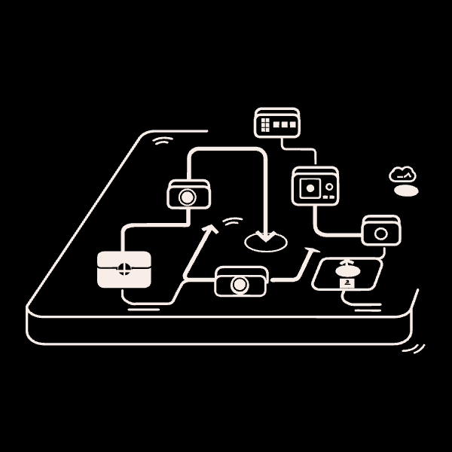
Why Adaptive Memory?
Memory augmentation preserves and recalls rare lexical and phonetic patterns that standard sequence models forget during training. This is essential for dialects where a few low-frequency alternations drive meaning differences.
Goal: retain rare tokens & morphological patterns
Approach: external memory bank integrated into Transformer decoding
Target: improve translation fidelity for Barendri and test on Chittagong

Slide 4

Related Work — Positioning Our Contribution
We build on three areas:
Low-resource MT: back-translation, multilingual pretraining (Hoang 2018; Conneau 2019)
Dialect datasets: Vashantor and regional corpora (Hasan 2023; Chowdhury 2020)
Memory in NMT: Neural Turing Machines, M‑NMT for rare words (Graves 2014; Wang 2017)
Gap: limited work on Indian Bangla dialects and comparative phonetic-distance studies informing memory design.

Slide 5

Curated Barendri–Standard Parallel Corpus
Corpus Summary
Size: 5,050 sentence pairs (80/10/10 train/val/test)
Avg length: 8.5 words/sentence
Vocab: Standard 15K · Barendri 14K
Sources: native elicitations, regional literature, adapted texts
Data released in TSV/JSON for reproducibility; selected examples shown next.

Slide 6

Illustrative Parallel Sentences
Example 1 — Standard: রাই মশাই খুব খুশি হয়ে বলল।Barendri: রাই মশাই খুব খুশি হই কহিলি। (Lexical: বলল → কহিলি)
Example 2 — Standard: আপনার আশীর্বাদে এটা হতেই পারে।Barendri: আপনার আশীর্বাদেত এটা হবাই পারে। (Morphological: হতে → হবাই)
Example 3 — Standard: ওই শত্রুদের আমি এখানে থাকতে দেবো না।Barendri: এই শত্রুদেক মুই এঠাকোনা থাকবা দিম না। (Syntactic reordering)

Slide 7
Phonetic Divergences & Linguistic Distance
We quantify divergence with character edit distance: Barendri = 0.12 (low), Chittagong = 0.28 (high). Key patterns:
Barendri: vowel raising (এই /ei/ → /oi/), consonant softening; ~85% overlap
Chittagong: glottal loss, fricative mergers, loss of semi-vowels — higher orthographic noise
Implication: memory should prioritize rare phonetic/morphological forms for low-divergence dialects

Slide 8

Method: Adaptive Memory-Augmented Transformer
Architecture Highlights
Backbone: mT5‑small (220M parameters) pretrained
Memory bank: stores embeddings for top-k rare tokens (k=512)
Selection strategies: frequency-ascending (freq_asc) and attention-descending (attn_desc) at p25/p50/p75
Integration: cosine-similarity query to memory + adaptive gating λ (based on max attention)
Training stages: baseline train → feature extract & memory train → integrated fine-tune
FFNN mapping between encoder and memory (ReLU, hidden=256) optimized with MSE to align embeddings.

Slide 9
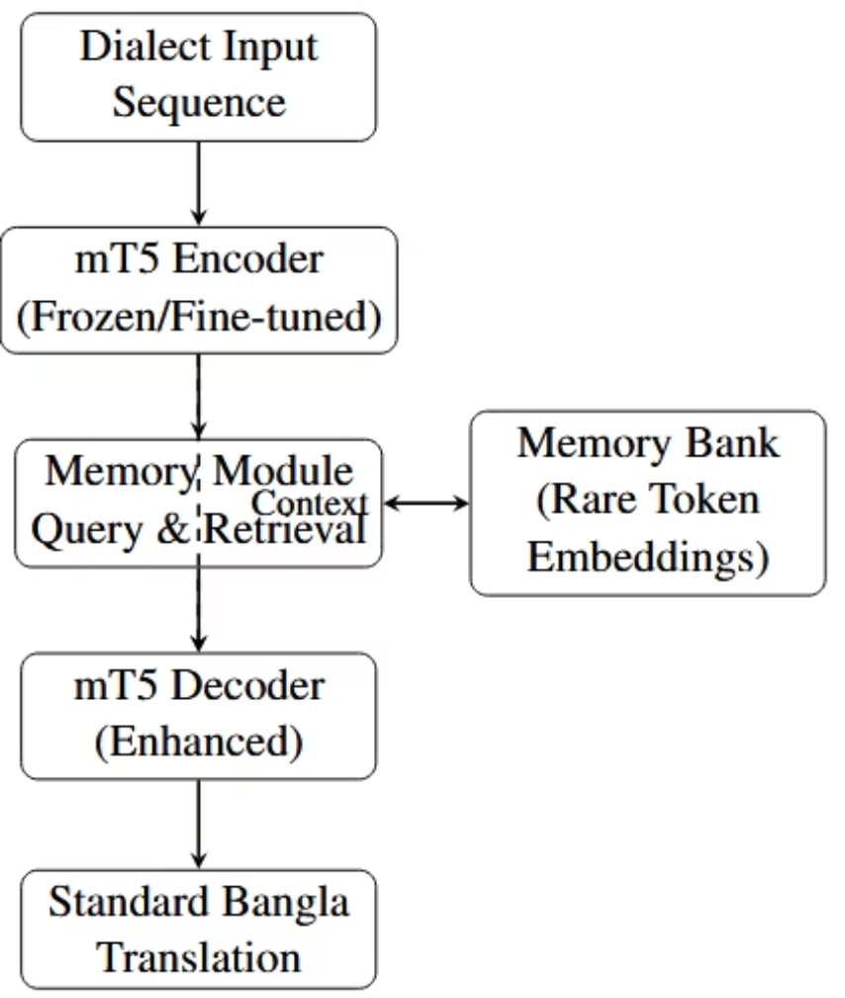

Methodology - Adaptive Memory Module
Memory Bank: Stores embeddings of rare tokens (top-k=512; Selection: Freq/Attention percentiles p25/p50/p75)
FFNN Mapping: Encoder → Decoder embeddings (MSE loss, ReLU, hidden=256)
Integration: Cosine similarity query; Adaptive gating (λ = max attention)
Stages: 1) Baseline train; 2) Feature extract & Memory train; 3) Integrated fine-tune
Key equation: Ãh_j = λ m_out + (1−λ) h_dec — memory interpolated with decoder state

Slide 10
Experiments Setup
Datasets: Barendri (5K pairs); Chittagong (3K adapted)
Metrics: SacreBLEU, METEOR, Char-ROUGE (F1 via Hugging Face)
Baselines: Untrained base, Vanilla mT5
Ablations: Freq-asc vs. Attn-desc at p25/p50/p75 thresholds
Qualitative: 500 human evals (Fluency/Adequacy, Fleiss' κ)

Slide 11
Results - Overall Metrics
Barendri: Memory (freq_asc_p25) → BLEU 26.73 (+10.12 vs. Base 16.61); METEOR 0.467; ROUGE-L 0.821
Chittagong: Memory → BLEU 22.36 (+4.86 vs. Base 17.50); Less gain due to high divergence
Backbone mT5: BLEU 31.41 (strong transfer, but no dialect tuning)
Human Eval: Memory +0.8 Fluency (p<0.05); κ=0.72 agreement
Model/Ablation
Dialect
SacreBLEU
METEOR
ROUGE-L (char)
Base
Barendri
16.61
0.350
0.773
mT5 Backbone
Barendri
31.41
0.496
0.834
Memory (freq_asc_p25)
Barendri
26.73
0.467
0.821
Base
Chittagong
17.50
0.354
0.765
Memory (best)
Chittagong
22.36
0.399
0.799

Slide 12
Results - Ablation Trends
Frequency-Asc (p25): Best for Barendri subtle shifts (BLEU 25.17, +0.74 over Attn)
Attention-Desc: Variance on Chittagong (ROUGE-L p50: 0.765 vs. p75: 0.764)
Key Insight: Freq excels on low-freq phonetics (vowel harmony); Attn struggles with fricatives
Uplift: +10.12 (Barendri low-div) vs. +4.86 (Chittagong high-div)

Slide 13
Qualitative Examples
Barendri Input: ভাইটাক দেখিস গোকুল। | Generated: ভাইটাকে দেখিস গোকুল। (Morph fix: টাক → টাকে)
Chittagong Input: সন্ধ্যার সোমে চোখ মিলি। | Generated: সন্ধ্যার সময় চোখ মেলে। (Phonetic: সোমে → সময়)
Memory Aid: Recovers morphology; Struggles with Chittagong loans (e.g., Arabic fricatives)

Slide 14
Linguistic Ties
Barendri Input: ভাইটাক দেখিস গোকুল। | Generated: ভাইটাকে দেখিস গোকুল। (Morph fix: টাক → টাকে)
Chittagong Input: সন্ধ্যার সোমে চোখ মিলি। | Generated: সন্ধ্যার সময় চোখ মেলে। (Phonetic: সোমে → সময়)
Memory Aid: Recovers morphology; Struggles with Chittagong loans (e.g., Arabic fricatives)

Slide 15
Conclusion
Achieved: 5K dataset; Memory model boosts BLEU +10% on Barendri, +5% on Chittagong
Novelty: Adaptive memory handles phonetic rarities; Ablations reveal freq > attn for low-div
Contributions: Insights on dialect continua; Code on GitHub (navshri7/anlp-project)
Ties to Linguistics: Gains align with phonetic distance—bridges gaps in near-standards

Slide 16
Thank You!

