Slide 1
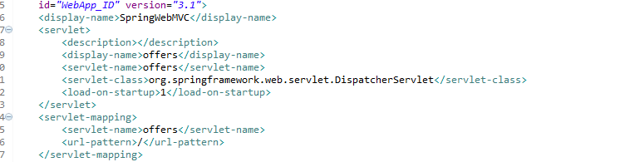
Web.xml
Main Servlet : DispatcherServlet in spring-webmvc jar (Handles all request)
Add DispatcherServlet – spring-webmvc jar

Slide 2
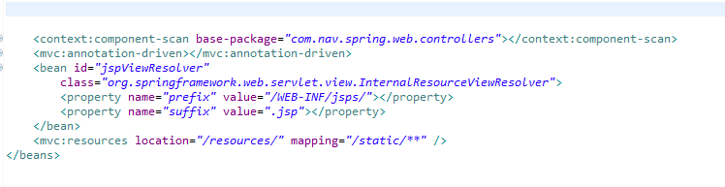
Spring Configuration
In Spring we have to provide configuration for our dispatcher servlet named Offers.
Add an Spring config file name <DispatcherServerlet>-servlet.xml in WEB-INF
Two important tags:
<context:component-scan> - to inform Spring that we want to use annotations for our beans located under given base package
<mvc:annotation-driven> - for our web controllers.
View Resolver Bean - mapping the view name (as returned by web controllers) into the actual JSP, FreeMarker, Tiles or any other view file
Static Resources like css, images go in /resources folder
HTTP request mapped to /static/**

Slide 3
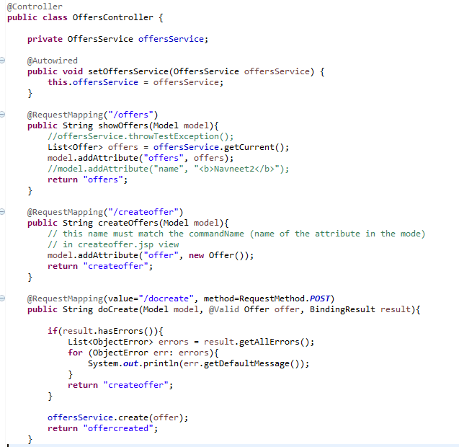
Web Controllers

Slide 4
Service Layer
@Service annotation is used in your service layer and annotates classes that perform service tasks, often you don't use it but in many case you use this annotation to represent a best practice.
For example, you could directly call a DAO class to persist an object to your database but this is horrible. It is pretty good to call a service class that calls a DAO. This is a good thing to perform the separation of concerns pattern.

Slide 5
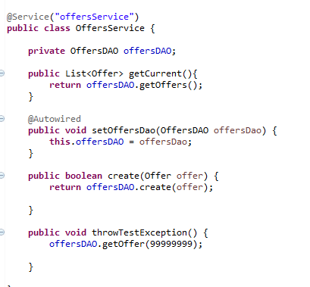
Service Layer

Slide 6
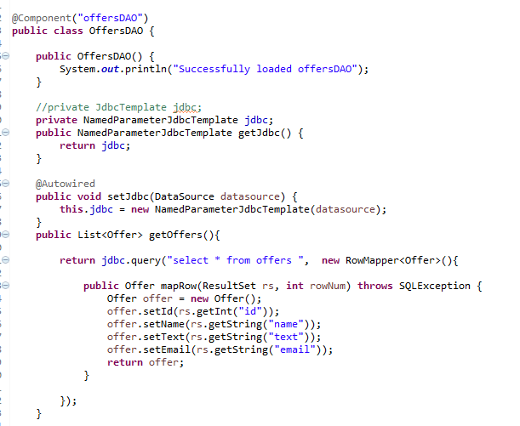
DAO (spring jdbc jar)

Slide 7
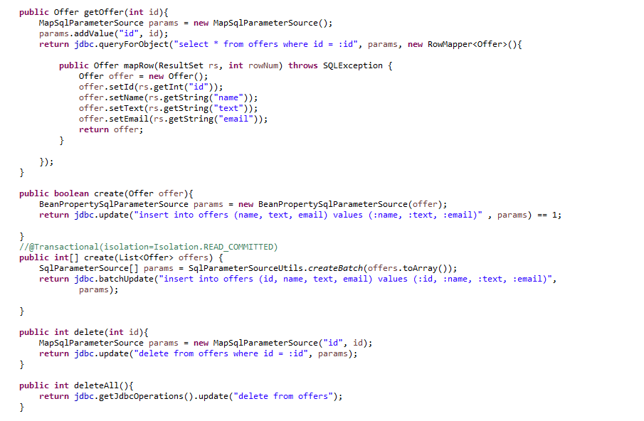
DAO

Slide 8
Spring JDBC Template
public List<Offer> getOffers(){
return jdbc.query("select * from offers ", new RowMapper<Offer>(){
public Offer mapRow(ResultSet rs, int rowNum) throws SQLException {
Offer offer = new Offer();
offer.setId(rs.getInt("id"));
offer.setName(rs.getString("name"));
offer.setText(rs.getString("text"));
offer.setEmail(rs.getString("email"));
return offer;
}
});

Slide 9
Select * => RowMapper<Offer>
public List<Offer> getOffers(){
return jdbc.query("select * from offers ", new RowMapper<Offer>(){
public Offer mapRow(ResultSet rs, int rowNum) throws SQLException {
Offer offer = new Offer();
offer.setId(rs.getInt("id"));
offer.setName(rs.getString("name"));
offer.setText(rs.getString("text"));
offer.setEmail(rs.getString("email"));
return offer;
}
});

Slide 10
Select * where id = :id => RowMapper<Offer> and MapSqlParameterSource()
public Offer getOffer(int id){
MapSqlParameterSource params = new MapSqlParameterSource();
params.addValue("id", id);
return jdbc.queryForObject("select * from offers where id = :id", params, new RowMapper<Offer>(){
public Offer mapRow(ResultSet rs, int rowNum) throws SQLException {
Offer offer = new Offer();
offer.setId(rs.getInt("id"));
offer.setName(rs.getString("name"));
offer.setText(rs.getString("text"));
offer.setEmail(rs.getString("email"));
return offer;
}
});
}

Slide 11
BeanPropertySqlParameterSource
public boolean create(Offer offer){
BeanPropertySqlParameterSource params = new BeanPropertySqlParameterSource(offer);
return jdbc.update("insert into offers (name, text, email) values (:name, :text, :email)" , params) == 1;
}
//@Transactional(isolation=Isolation.READ_COMMITTED)
public int[] create(List<Offer> offers) {
SqlParameterSource[] params = SqlParameterSourceUtils.createBatch(offers.toArray());
return jdbc.batchUpdate("insert into offers (id, name, text, email) values (:id, :name, :text, :email)",
params);
}

Slide 12
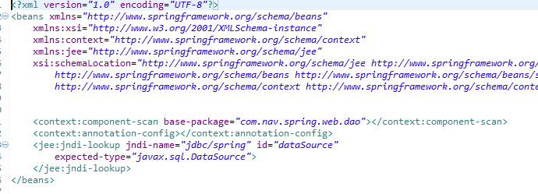

Spring Config Files

Slide 13
DAO Context File

Slide 14
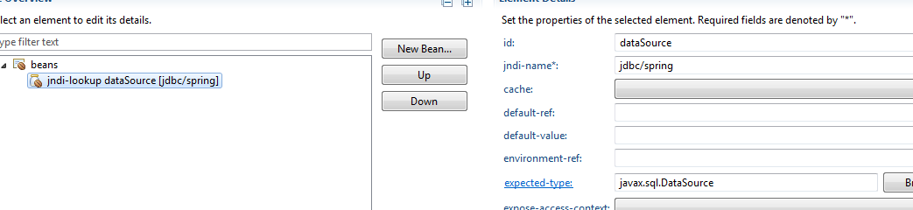

DAO Context File – JNDI entry in Tomcat context

Slide 15
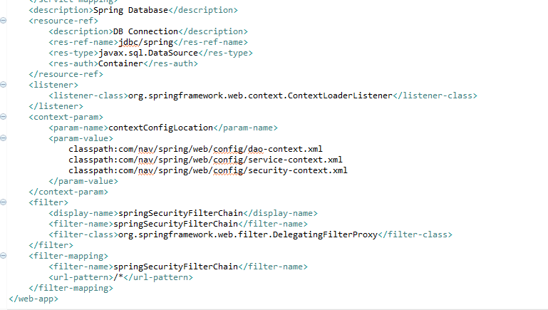
Web.xml – JNDI entry in Tomcat context (and contextLoaderListener)

Slide 16
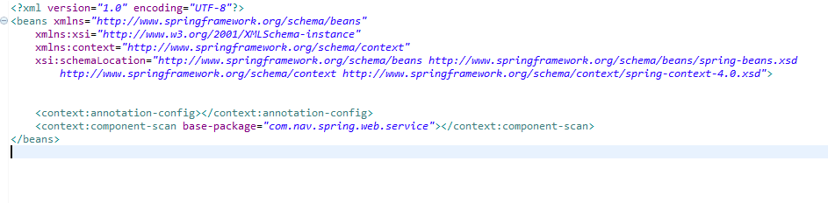
Service Context File – Just vanilla spring config with just component-scan

Slide 17
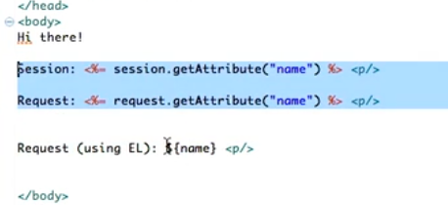
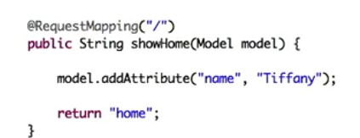

JSTL
Embedded Java
Naked EL expression
(Not recommended)
<%@ taglib prefix="c" uri="http://java.sun.com/jsp/jstl/core"%>
<c:out value="${offers}.id}"></c:out>

Slide 18
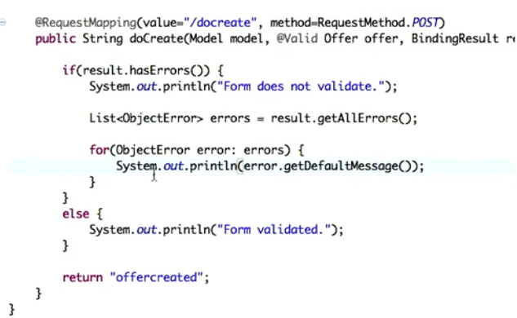
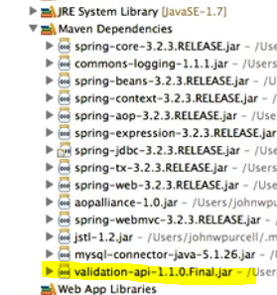
Working with Forms

Slide 19
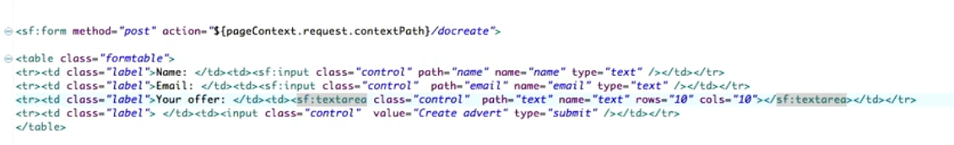
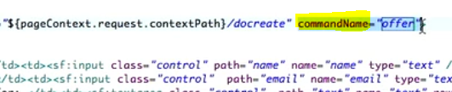
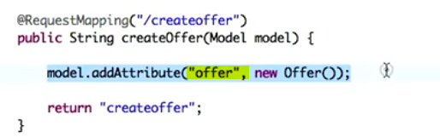
Making form remember the values
Replace <input> and <form> tag with special spring tags in createoffers.jsp

