Slide 1
Can your heartbeat tell us your blood sugar?
Reproducing a Choquet-integral multimodel approach to noninvasive blood glucose estimation from ECG and PPG
B.Tech Final Year Project
Navtesh Maken
Notes:
30s. Do NOT give the conclusion yet - slides 2-5 set up the problem.

Slide 2
Measuring blood glucose means breaking the skin, several times a day, for life
Glucose is the fuel every cell runs on. In Type 1 diabetes the body makes almost no insulin, so it builds up in the blood.
Below 3.9 mmol/L: confusion, seizure, coma - within minutes. Above 10.0: nerve, eye and kidney damage over years.
Today that is managed with finger-pricks 4-10 times daily, or a sensor worn under the skin and replaced fortnightly.
About 590 million adults live with diabetes. All of them manage it by repeatedly breaking their own skin.
Why a heartbeat might know
Low glucose triggers adrenaline, which drives potassium into cells. Potassium controls how heart cells reset after each beat - so the ECG's QT interval lengthens. High glucose suppresses vagal tone and alters ST and T waves.
The mechanism is real and well documented.
But note what the mechanism actually supports
It explains DETECTING a dangerous low or high - a classification problem. It does not promise that the exact number can be read off the waveform, which is regression, and far harder. Published ECG classification reaches 84-94% accuracy; regression consistently does not hold up.
Notes:
90s. Three beats: (1) what glucose is and why both directions are dangerous, (2) today it means breaking skin, 590M adults, (3) the amber box - the biology supports DETECTING an event, not reading the exact number. Classification vs regression. This project attempted the number.

Slide 3
A 2024 IEEE paper reports near-clinical accuracy by fusing two signals and three models
Li et al., "Noninvasive Blood Glucose Monitoring Using Spatiotemporal ECG and PPG Feature Fusion and Weight-Based Choquet Integral Multimodel Approach", IEEE TNNLS 35(10), 2024.
1.49
13.42%
80.1%
99.5%
RMSE (mmol/L)
MARD
Parkes Zone A
Zone A+B
STAGE 1
STAGE 2
STAGE 3
Collect and clean
Describe the signal
Predict and fuse
Record ECG + PPG, filter, cut into 16-second windows paired with a glucose reading
Wavelet statistics plus waveform-shape measurements: 193 numbers per window
Three models each predict; a Choquet integral combines their answers
1.49 mmol/L approaches approved CGM accuracy. The authors published code but not data, so the claim had never been independently checked.
Notes:
90s. IEEE TNNLS, a serious journal. 1.49 mmol/L approaches approved CGM accuracy. They published code but NOT data - so nobody had independently checked it. That is what a reproduction is for. Walk the three stage boxes left to right.

Slide 4
We rebuilt all three stages and ran them on the largest open ECG+PPG+CGM dataset
30,830
193
10
2.519
paired ECG+PPG windows
features per window
Type-1 patients
baseline RMSE to beat
Signal | Rate | Device
ECG | 250 Hz | Zephyr BioHarness chest strap
PPG | 64 Hz | Empatica E4 wristband
Glucose | every 5 min | Dexcom CGM - the reference
PhysioCGM (Scientific Data, 2025)
Public domain, CC0. The only open dataset carrying ECG AND PPG against a CGM reference - exactly the pair this paper needs.
The number that matters most is 2.519 mmol/L - the standard deviation of glucose, and therefore the error of a model that simply guesses the average every time. Nothing counts as learning unless it beats that.
Notes:
90s. SLOW DOWN on the dark box. 2.519 is the standard deviation of glucose, and therefore the error of a model that always guesses the average. It is the score for learning NOTHING. Most papers never report it; we report it beside every result. Everything after this slide depends on them having this.

Slide 5
The Choquet integral assigns importance to GROUPS of models, not just to each one
A weighted average gives each model a number. A fuzzy measure gives every SUBSET a number - so it can say two models overlap, or that two work well together. The Sugeno lambda-measure builds all of them from one density per model:
Each prediction is weighted by how much the group's importance GREW when it was added.
If the densities sum to 1 then lambda = 0 and this is exactly a weighted average - so the Choquet integral generalises it.
Densities come from each model's honest out-of-fold accuracy.
g(A u B) = g(A) + g(B) + lambda*g(A)*g(B)
lambda fixed by 1 + lambda = PROD (1 + lambda*g_i)
Sort predictions largest first, then
C = SUM_j h(j) * [ g(top j) - g(top j-1) ]
Worked example
The intuition, in one sentence
Three doctors give three opinions. Averaging counts a shared view twice if two of them trained together, and ignores that one is far more experienced. A fuzzy measure can express BOTH - because it scores every combination of doctors, not just each doctor.
g = (.30, .25, .20)
h = (9.0, 7.0, 5.0)
w = (.300,.342,.358)
C = 6.88 mean 7.00
Notes:
2 min, densest slide. START WITH THE ANALOGY at bottom left - three doctors, two trained together so averaging double-counts, one is more experienced. A weighted average handles the second but NOT the first. THEN the formulas. Note the weights (.300,.342,.358) are not the densities (.30,.25,.20) - that gap is the integral doing something a weighted average cannot.

Slide 6
Before fusion: how 4000 raw samples become 193 numbers
A heartbeat mixes a sharp spike (QRS) with broad waves (P and T). The db4 wavelet transform splits the window into 8 sub-signals by speed, and each gets the same 10 measurements: 8 x 10 = 80 per signal, x2 signals = the paper's 160.
Symbol | What it measures
Kur, Ske | How spiky / how lopsided
SM, SC | Wiggle rate, and its variation
FD | How jagged the line is
CD | How many processes drive it
C0 | Fraction that is irregular
PSE | Energy spread across frequencies
KE, SE | How unpredictable / how informative
Hjorth parameters (SM, SC):
Mobility = sqrt( var(x') / var(x) )
Complexity = Mobility(x') / Mobility(x)
Shannon entropy (SE), over amplitude bins p_i:
SE = - SUM_i p_i * log2(p_i)
Correlation dimension (CD), the log-log slope:
CD = lim(r->0) d log C(r) / d log r
Plus 33 morphological features
QT and QTc = QT/sqrt(RR), ST level, T-wave amplitude and sharpness, SDNN, RMSSD, pNN50, and PPG pulse shape. Each is citable to the glucose mechanism.
We use the paper's exact choices: db4 wavelet, 7 decomposition levels, these ten features.
Notes:
60s. CUT THIS FIRST if short on time. Key line: a heartbeat mixes fast (QRS, 0.1s) and slow (T wave, 0.3s) things, so measuring the whole window blends them; the wavelet separates them into 8 layers. Then 8 x 10 = 80 per signal. Mention QTc median 0.405s vs textbook 0.35-0.44 as validation.

Slide 7
Finding 1: how you split the data changes the answer more than the model does
Consecutive windows from one person are extremely similar. Shuffle them all and split at random, and the SAME patient appears in training and test - so a model can recognise the person instead of learning about glucose.
1. Random window
2. Subject-aware
3. Leave-one-subject-out
Shuffle everything, split at random
No patient on both sides
Train on 9, test on the 10th
The same patient on both sides. This is what most published work reports.
The model must now generalise across people, not memorise them.
The deployment case: a brand-new patient. (Not completed - we do not claim it.)
A 2026 study re-tested five published PPG-glucose methods this way. The best scored R-squared 0.60 under random splitting and -0.08 under participant-aware splitting - no better than guessing the mean.
Reassessing the Feasibility of PPG-Based Non-Invasive Blood Glucose Level Estimation, arXiv:2608.01820 (2026).
Notes:
90s. THE most important concept in the talk. Walk the three boxes. Then the key insight, said slowly: consecutive windows from one person are very similar, so a random split lets the model recognise the PERSON and recall their typical glucose. That is not learning about glucose - but it scores beautifully. Close with the 2026 study: 0.60 under random, -0.08 under participant-aware.

Slide 8
Our result: honest splits put every method behind the baseline
 | Random | Subject-aware | Leave-one-out
Best single model (R2) | +0.194 | -0.243 | -0.092
Choquet fusion (R2) | +0.149 | -0.223 | -0.097
No-skill baseline (R2) | -0.000 | -0.074 | -0.035
Choquet RMSE (mmol/L) | 2.324 | 2.786 | 2.639
Baseline RMSE (mmol/L) | 2.520 | 2.610 | 2.564
Beats the baseline? | YES | no | no
Read the R2 column first
It is the one metric that exposes a model doing no better than predicting the average. Negative means worse than guessing.
Under the honest split
every model - including the fusion - is WORSE than simply guessing that patient's average glucose.
Same data. Same model. Same code.
Only the split changed.
Note leave-one-out is not worse than subject-aware: it trains on 9 of 10 patients rather than 4 of 5, so it has more data. The invariant is that BOTH honest splits put every method behind the baseline.
Notes:
90s. DEFINE R-SQUARED FIRST - 1 perfect, 0 = same as guessing the average, NEGATIVE = worse than guessing. Then: +0.149 random, -0.223 subject-aware, -0.097 leave-one-out. Same data, same code, only the split changed. RAISE THE ORDERING YOURSELF: LOSO is better than subject-aware because it trains on 9 of 10 rather than 4 of 5. Saying it first is far stronger than being caught.

Slide 9
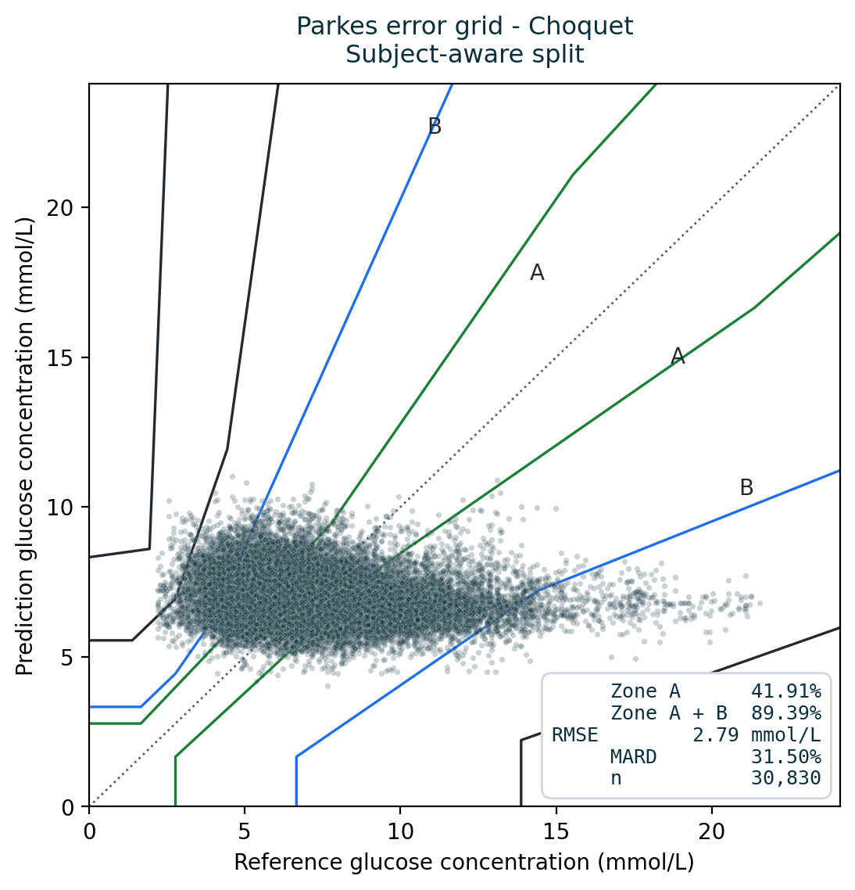
What the failure looks like: predictions form a flat band, whatever the truth
This is the paper's Fig. 10 - the Parkes error grid - drawn on our subject-aware predictions.
The horizontal axis is the true glucose; the vertical axis is what the model predicted.
A good model would produce a diagonal cloud along the dotted line.
Ours is a HORIZONTAL band: whether the patient was at 4 or at 20 mmol/L, the model predicts roughly 6-9.
That is what 'no better than predicting the average' looks like - and it is invisible in the zone percentages, because a flat band still lands inside zones A and B.
30,830 predictions, Choquet fusion, subject-aware split.
Notes:
90s. YOUR BEST SLIDE. Trace the diagonal with your hand - that is what a working model looks like. Then trace the horizontal band - whether the truth was 4 or 20, it predicts 6-9. That is what 'no better than the average' looks like drawn. THEN the sting: that same flat band scores 89.4% Zone A+B. PAUSE. Let it land.

Slide 10
Finding 2: the clinical metric everyone reports cannot tell the difference
The Parkes error grid scores predictions by whether acting on them would harm the patient. Zone A+B is the headline clinical number in this field. Under the subject-aware split:
Method | R2 | Zone A | Zone A+B
Choquet fusion | -0.223 | 41.9% | 89.4%
Random Forest | -0.249 | 40.4% | 88.2%
Gradient Boosting | -0.243 | 40.4% | 88.5%
No-skill baseline | -0.074 | 43.7% | 90.0%
The baseline wins on BOTH
A constant predictor - which explains zero variance by construction - has the best R-squared AND the best clinical score.
Shown only the Parkes column, a reader sees 88-90% across the board and concludes the method works.
Why this happens, and what to do about it
Most glucose readings sit in a narrow band around normal, so predicting a constant already lands the large majority of points in the acceptable zones. Zone metrics cannot certify a model on their own - they must be reported next to a baseline computed on the same folds.
Notes:
75s. Point at the LAST row. The baseline predicts a constant, explains zero variance, and has BOTH the best R-squared (-0.074) and the best clinical score (90.0%). Why: most readings sit in a narrow band, so a constant already lands in A and B. The grid catches DANGEROUS errors, not USELESS ones. Rule: never report a zone score without a baseline beside it.

Slide 11
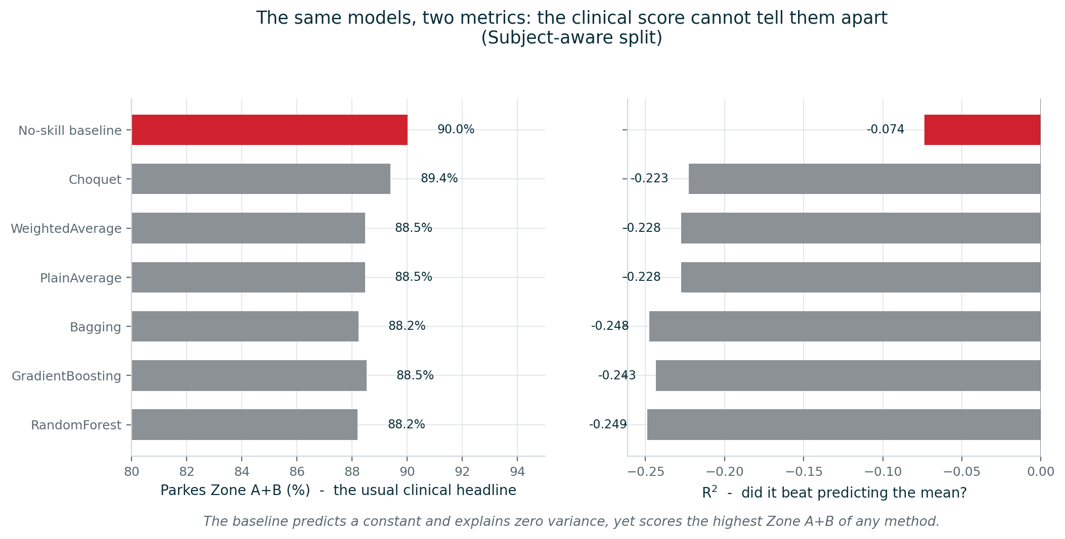
The same seven models, two metrics, opposite verdicts
The red bar is a model that predicts a CONSTANT. On the left it has the LONGEST bar - the best clinical score of anything tested. On the right it has the SHORTEST - because it is the least-bad R-squared. One metric says it is the winner; the other says nothing here works.
Notes:
45s, quick and visual. Red bar = the constant predictor. LONGEST on the left (best clinical score), SHORTEST on the right (least-bad R-squared). One metric says it wins, the other says nothing works. If you only report the left chart, you would ship this.

Slide 12
Finding 3: the fusion had degenerated into a minimum operator
If every model gets the SAME density, the fuzzy measure becomes symmetric - it depends only on how many models are in a group, never which ones. The Choquet integral then reduces to a fixed function of the sorted predictions:
g | w(largest) | w(middle) | w(smallest) | becomes
0.010 | 0.010 | 0.095 | 0.895 | minimum
0.100 | 0.100 | 0.254 | 0.646 | rank-weighted
0.333 | 0.333 | 0.333 | 0.333 | arithmetic mean
w_j = g * beta^(j-1), beta = 1 + lambda*g
j = 1 is the LARGEST prediction
sum(g) < 1 => lambda > 0 => beta > 1
so weight GROWS toward the smallest.
In our runs the densities sat at the 0.01 floor. So we checked the output against min():
0.998
0.04
The published method's distinguishing component was returning min(m1, m2, m3).
correlation with min()
mean gap to min()
(mmol/L)
And it is not only a bug: under honest evaluation the models genuinely cannot generalise, so the densities floor legitimately - the fusion silently turns into min() exactly when you most need it to help.
The symmetric-measure/OWA equivalence is standard theory (Grabisch; Marichal). New here: a saturating density estimator induces it by accident.
Notes:
90s. Start with the two clues: weighted average = plain average byte-identical (impossible if weights differ), and every density at exactly the 0.01 floor. Then the theorem: equal densities make the measure symmetric, so the integral becomes a fixed function of RANK. Weak models -> lambda > 0 -> beta > 1 -> weight grows toward the SMALLEST. At g=0.01 that is 89.5% on the minimum. Confirmation: corr 0.998 with min(). DO NOT SKIP the dark box - it is not only a bug, it fires exactly when the models cannot generalise.

Slide 13
The derivation, so you can reproduce it on a board
With all densities equal to g, the Sugeno measure of a group depends only on its SIZE:
Step 1 is just the Sugeno rule g(A u B) = g(A)+g(B)+lambda*g(A)*g(B) applied repeatedly to identical densities.
Step 2 is the definition of the Choquet weights.
Step 3 uses the geometric series, and the last equality is the boundary condition g(X)=1.
The conclusion: the weights depend only on RANK and on g - never on which model is which.
Sugeno recursion, applied j times:
g(A_j) = [ (1 + lambda*g)^j - 1 ] / lambda
The weight on the j-th largest prediction is the growth:
w_j = g(A_j) - g(A_j-1)
= [ beta^j - beta^(j-1) ] / lambda (beta = 1+lambda*g)
= g * beta^(j-1)
Check it sums to 1:
SUM_j w_j = g*(beta^N - 1)/(beta - 1)
= (beta^N - 1)/lambda = g(X) = 1
Why beta > 1 matters
Weak models give sum(g) < 1, hence lambda > 0, hence beta > 1 - so w_j GROWS with j, piling weight on the smallest prediction.
Notes:
60s. Two points. LEFT: every bar is past the dashed baseline - no subset of the 193 features recovers glucose. And the ordering runs the WRONG WAY: fewer features score better, which is what fitting noise looks like. RIGHT: the worst models by R-squared carry the HIGHEST clinical score. Not weak - inverted. A model predicting a narrow band near the average is never dangerous, just useless - and the grid only catches danger.

Slide 14
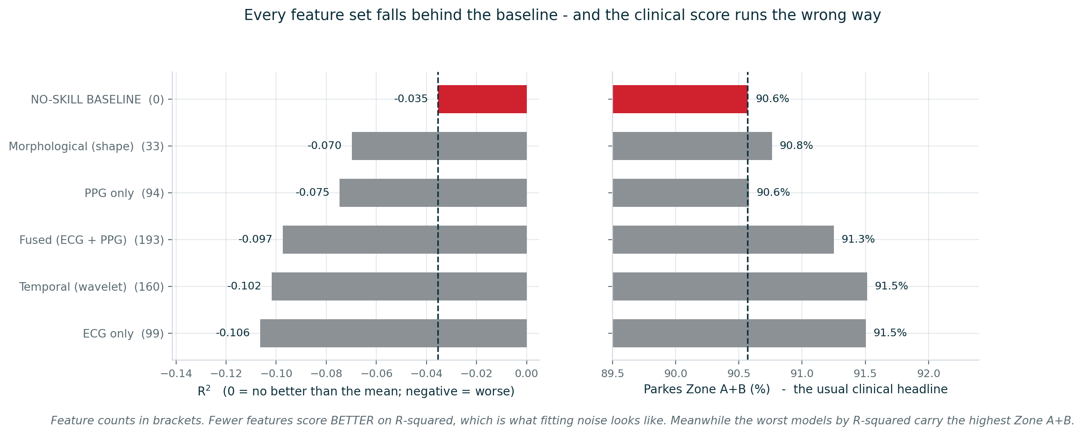
Finding 4: no feature set works - and fewer features work better
Adding information made it worse
And the clinical score runs backwards
33 features score -0.070; 193 score -0.097. When more information makes a model worse, it is fitting noise.
The models with the WORST R-squared (-0.106) carry the HIGHEST Zone A+B (91.5%). Not weak - inverted.
Notes:
60s. CUT IF SHORT - the result is already on slide 12. Three substitutions: apply Sugeno j times, subtract consecutive terms, check the geometric series sums to 1. The red box is the point: weak models force beta > 1, which piles weight on the smallest prediction.

Slide 15
Finding 5: a standard feature library returns different answers for identical input
One of the ten features is the correlation dimension, estimated as the slope of a log-log plot. The library fits that slope with RANSAC - a method that tries RANDOM subsets - and does not seed it.
Slope fitting method | Distinct values from 30 identical calls
RANSAC (the library default) | 5
Ordinary least squares | 1
Why the second number matters
The 177 unchanged features are the control. They prove the differences came from the random fit, not from anything else we changed.
72%
177
of correlation-dimension
values changed
other features:
bit-identical
The fix
One argument - fit the slope with least squares. Both methods agree on the typical value; only one always returns it.
Any result computed from these features was irreproducible - nobody re-running the pipeline, including us, would get the same numbers. Found only because we tested whether identical input gives identical output.
Notes:
60s. RANSAC = random sample consensus, unseeded, so identical input gives different output - 5 distinct values in 30 calls. Up to 72% of correlation-dimension values changed. POINT AT THE SECOND NUMBER: 177 other features bit-identical - that is the control proving it was the slope fit, not anything else we changed. Found only because we tested determinism, which almost nobody does.

Slide 16
What this contributes, and what we cannot claim
1
An open reproduction on open data
All three stages rebuilt from the paper, run on PhysioCGM: 30,830 windows, 193 features, 10 patients.
2
A degeneracy theorem with a runnable diagnostic
When densities saturate, the Sugeno-lambda Choquet integral provably becomes a fixed order statistic. Verified at correlation 0.998.
3
Evidence that the evaluation protocol dominates
R-squared +0.149 to -0.223 on identical data, and a constant predictor beating every model on the clinical metric.
4
A reproducibility failure in a standard library
An unseeded random fit changing up to 72% of values between identical runs.
What we cannot claim
That the method never works. We show it does not work ON THIS DATASET UNDER HONEST EVALUATION, and that its fusion component was inactive. Our morphological branch differs from theirs, ten patients is small, and leave-one-subject-out was not completed - so we do not report it.
Notes:
90s. Four contributions, then the amber box. Say the limits CONFIDENTLY, not apologetically: cannot claim the method never works, only that it does not here under honest evaluation and that its fusion was inactive. Stating limitations is the point of a reproduction, not a weakness.

Slide 17
References
Li, J. et al. "Noninvasive Blood Glucose Monitoring Using Spatiotemporal ECG and PPG Feature Fusion and Weight-Based Choquet Integral Multimodel Approach." IEEE Trans. Neural Networks and Learning Systems, 35(10), 2024.
PhysioCGM: a multimodal physiological dataset for non-invasive blood glucose estimation. Scientific Data, 2025. figshare 28136294 (CC0).
Reassessing the Feasibility of PPG-Based Non-Invasive Blood Glucose Level Estimation. arXiv:2608.01820, 2026.
Parkes, J. L. et al. "A New Consensus Error Grid to Evaluate the Clinical Significance of Inaccuracies in the Estimation of Blood Glucose." Diabetes Care, 23(8), 2000.
Pfutzner, A. et al. "Technical Aspects of the Parkes Error Grid." J. Diabetes Science and Technology, 7(5), 2013.
Eckert, B. & Agardh, C.-D. "Hypoglycaemia leads to an increased QT interval in normal men." Clinical Physiology, 18(6), 1998.
Grabisch, M. "Fuzzy integral in multicriteria decision making." Fuzzy Sets and Systems, 69(3), 1995.
Marichal, J.-L. "On Choquet and Sugeno integrals as aggregation functions." Fuzzy Measures and Integrals, 2000.
Sugeno, M. Theory of fuzzy integrals and its applications. PhD thesis, Tokyo Institute of Technology, 1974.
Hjorth, B. "EEG analysis based on time domain properties." Electroencephalography and Clinical Neurophysiology, 29(3), 1970.
Full technical write-up, including every derivation: WRITEUP.md in the project repository.
Notes:
15s. 'Full write-up with every derivation is in the repository.' Then STOP TALKING. Leave this up, or go back to slide 15 for questions.

