Slide 1
MID TERM REVIEW
Reproducing Choquet-Integral Multimodel Fusion for
Noninvasive Blood Glucose Estimation
An independent reproduction on open ECG and PPG data, under leakage-controlled evaluation
Vednash Singhal 2023UIC3633
Navtesh Maken 2023UIC3641
Aditya Agarwaal 2023UIC4138
Tushar Sharma 2023UIC3600
Under the supervision of
Mrs. Asha Rani
Department of Instrumentation and Control Engineering
Netaji Subhas University of Technology, New Delhi
EEEEC23 B. Tech Project - II

Slide 2
Contents
1.
Introduction — Background and Motivation
9.
Results I — Reproducing the Published Result
2.
Literature Survey — The Method Under Test
10.
Results II — The Effect of the Evaluation Protocol
3.
Literature Survey — Evaluation Practice in the Field
11.
Results III — Parkes Error Grid and Prediction Trace
4.
Research Gaps and Limitations Identified
12.
Results IV — Feature-Set Ablation
5.
Aim and Objectives
13.
Results V — Degeneracy of the Fusion Operator
6.
Problem Formulation — Fuzzy Measures and the Choquet Integral
14.
Future Work and Expected Outcomes
7.
Methodology I — Pipeline, Signals and Dataset
15.
Conclusion and References
8.
Methodology II — Feature Extraction and Selection
Mid Term Review | Noninvasive Blood Glucose Estimation from ECG and PPG
2

Slide 3
1. Introduction — Background and Motivation
The clinical problem
Why the heart carries the signal
Blood glucose must remain within 3.9–10.0 mmol/L. Below 3.9 causes seizure and coma within minutes; above 10.0 causes nerve, eye and kidney damage over years.
Every accurate measurement available today breaks the skin: a finger-prick four to ten times daily, or a continuous glucose monitor whose filament is replaced every 10–14 days.
Approximately 590 million adults worldwide manage diabetes in this way.
Hypoglycaemia triggers adrenaline release, which drives potassium into cells. Potassium governs cardiac repolarisation, so the ECG QT interval lengthens.
Hyperglycaemia suppresses vagal tone and impairs coronary microcirculation, altering ST level, T-wave morphology and heart-rate variability.
Both signals can be acquired painlessly: ECG from a chest strap, PPG from a wrist-worn device.
The distinction that governs this work
The mechanism above supports DETECTING a dysglycaemic event. That is a classification problem, and published ECG methods report 84–94% accuracy on it. It does not establish that the absolute concentration can be recovered from the waveform, which is a regression problem. This project evaluates the regression claim.
Mid Term Review | Noninvasive Blood Glucose Estimation from ECG and PPG
3

Slide 4
2. Literature Survey — The Method Under Test
Li et al., IEEE Trans. Neural Networks and Learning Systems 35(10), 2024 — reported performance against prior methods
Ref. | Method | RMSE (mmol/L) | MARD (%) | Zone A (%) | Zone A+B (%)
[2] | CNN-RNN | 1.66 | 14.93 | 75.46 | 99.35
[3] | ResNets | 1.63 | 15.22 | 75.18 | 99.26
[4] | Convolutional denoising autoencoder | 1.99 | 20.67 | 60.88 | 98.56
[5] | CNN with multisegment fusion | 1.61 | 14.71 | 76.96 | 98.94
[1] | SFF-WCIM — the method reproduced here | 1.49 | 13.42 | 80.09 | 99.49
Why this claim required independent checking
1.49 mmol/L approaches the accuracy of approved continuous glucose monitors, which report a MARD of 10–12%. The authors released their source code but not their recordings, which are private. The result had therefore never been evaluated on a cohort the authors did not themselves select.
Mid Term Review | Noninvasive Blood Glucose Estimation from ECG and PPG
4

Slide 5
3. Literature Survey — Evaluation Practice in the Field
Recent work questioning whether reported results survive rigorous evaluation
Study | Finding relevant to this project
Reassessing PPG-Based Blood Glucose Level Estimation, arXiv:2608.01820 (2026) | Re-evaluated five published PPG-glucose methods. The best scored R² = 0.60 under a random split and −0.08 under a participant-aware split, no better than predicting the mean. Over 90% of predictions fell within Clarke Zone A+B, including the baseline.
Advances in ECG-Based Non-Invasive Blood Glucose Monitoring Technology (review, 2026) | Identifies record-level splitting as a field-wide source of data leakage producing optimistic estimates; notes that most studies use fewer than 30 subjects; concludes that current methods do not reach the 10–12% MARD of approved devices.
Grabisch (1995); Marichal (2000) | Aggregation theory: a Choquet integral taken with respect to a symmetric fuzzy measure reduces to an ordered weighted average. This bounds what we claim as novel in Section 12.
Mid Term Review | Noninvasive Blood Glucose Estimation from ECG and PPG
5

Slide 6
4. Research Gaps and Limitations Identified
1.
No independent validation
Source code released, data withheld. The result has never been tested on a cohort selected by anyone other than the authors.
2.
Evaluation protocol not controlled
Performance is reported under a random window-level split, in which the same participant appears in both training and test sets. Windows from one individual are strongly correlated, so a model may identify the participant rather than learn the glucose relationship.
3.
Clinical metrics reported without a reference point
Parkes Zone A+B is presented as evidence of clinical readiness, with no no-skill baseline reported alongside, so the reader cannot determine how much of that score is attributable to the method.
4.
Fusion behaviour never audited
The fuzzy densities that parameterise the Choquet integral are estimated from model performance, but are neither reported nor checked for degeneracy.
5.
Reproducibility of the feature pipeline unverified
No check that identical input produces identical features.
Mid Term Review | Noninvasive Blood Glucose Estimation from ECG and PPG
6

Slide 7
5. Aim and Objectives
Aim: to determine whether the reported accuracy of the SFF-WCIM method survives independent reproduction on open data under leakage-controlled evaluation.
Objectives
1.
Rebuild all three stages of the published method from its description.
2.
Evaluate on PhysioCGM: ten Type-1 participants with simultaneous ECG, PPG and CGM, released into the public domain.
3.
Evaluate under three progressively stricter split protocols, reporting a no-skill baseline computed on the same folds beside every result.
4.
Audit the fusion operator itself: recover the fuzzy densities and verify that the integral still discriminates between the base models.
5.
Verify that the feature-extraction pipeline is deterministic.
Scope and limitations
The authors' dataset is unavailable, so this reproduces the METHOD on different data rather than replicating the experiment. The spatial morphological branch is implemented with hand-crafted physiological features rather than a ResNet, as no GPU was available; this deviation is documented and examined in the ablation.
Mid Term Review | Noninvasive Blood Glucose Estimation from ECG and PPG
7

Slide 8
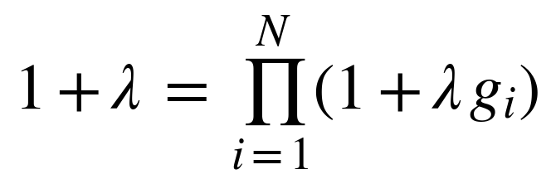
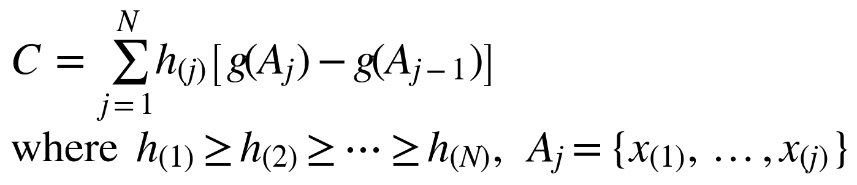
6. Problem Formulation — Fuzzy Measures and the Choquet Integral
Given a 16 s window of ECG and PPG preceding a CGM reading, predict the glucose concentration y. Three regressors produce estimates h₁, h₂, h₃, which must be combined into a single value.
A weighted average assigns importance to each model individually and therefore cannot express that two models overlap. A fuzzy measure assigns importance to every subset; the Sugeno λ-measure generates all 2ᴺ subset values from one density per model:
λ is fixed by the boundary condition g(X) = 1. Σgᵢ = 1 gives λ = 0, and the integral reduces exactly to a weighted average. Σgᵢ > 1 gives λ < 0, an overlap penalty. Σgᵢ < 1 gives λ > 0, a synergy bonus. Sorting is what allows subset importance to enter: the weight a prediction receives depends on its rank.
Mid Term Review | Noninvasive Blood Glucose Estimation from ECG and PPG
8

Slide 9
7. Methodology I — Pipeline, Signals and Dataset
Level 1 — acquisition and conditioning.
16 s windows (approximately 20 cardiac cycles) preceding each CGM reading; Butterworth band-pass 0.5–40 Hz for ECG and 0.5–8 Hz for PPG, the latter because 64 Hz sampling limits the representable band to 32 Hz.
Level 2 — feature extraction.
db4 DWT to 7 levels yields 8 sub-signals per modality; 10 statistical features each (80 per modality, 160 in total), plus 33 morphological features. Selection by the intersection of UFS, RFE and L1.
Level 3 — decision fusion.
Random Forest, Gradient Boosting and Bagging, combined by the weight-based Choquet integral.
Signal | Device | Rate | Role
ECG | Zephyr BioHarness (chest strap) | 250 Hz | Electrical activity of the heart
PPG (BVP) | Empatica E4 (wristband) | 64 Hz | Blood volume pulse, optical
Glucose | Dexcom CGM | 5 min | Reference value to be predicted
Study population | Value
Participants | 10 (Type-1 diabetes)
Paired ECG + PPG windows | 30,830
Features per window | 193
Glucose range | 2.2 – 21.5 mmol/L
Mean / standard deviation | 7.17 / 2.519 mmol/L
Mid Term Review | Noninvasive Blood Glucose Estimation from ECG and PPG
9

Slide 10
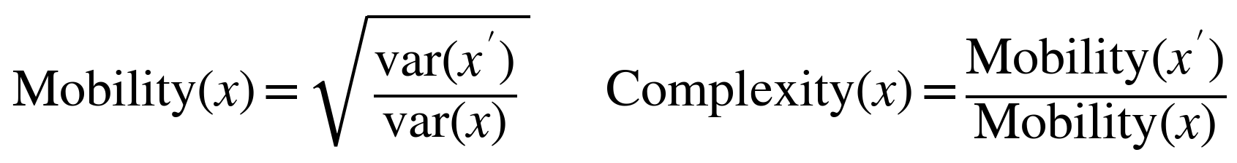
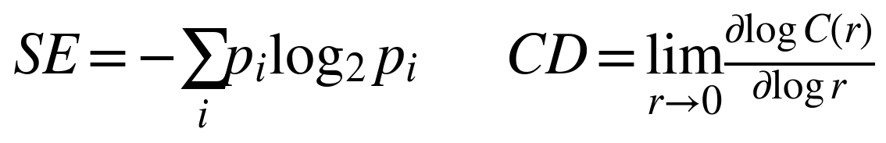
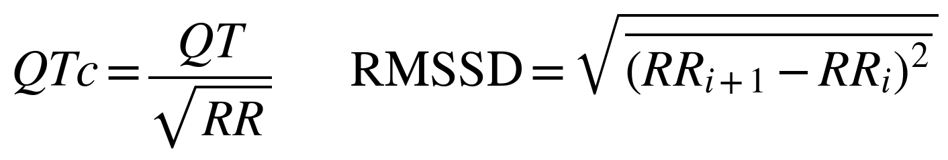
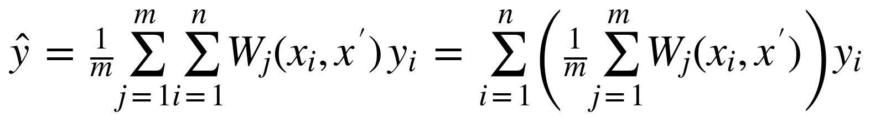
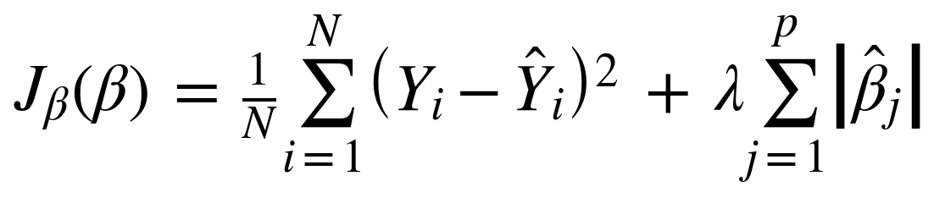
8. Methodology II — Feature Extraction and Selection
Temporal statistical features — 10 per sub-signal:
kurtosis, skewness, Hjorth mobility and complexity, fractal dimension, correlation dimension, C0-complexity, power spectral entropy, Kolmogorov entropy, Shannon entropy.
Spatial morphological features — measured directly, not learned:
QT and corrected QT, ST level, T-wave amplitude and sharpness, QRS duration, and heart-rate variability. Each is individually attributable to the mechanism in Section 1.
Feature selection — a feature is retained only if all three criteria select it (paper eqs. 5 and 6), fitted within each training fold:
Mid Term Review | Noninvasive Blood Glucose Estimation from ECG and PPG
10

Slide 11
9. Results I — Reproducing the Published Result
Evaluated under the source paper's own protocol: a random split at the window level. 193 features, 30,830 windows, 10 participants.
Method | R² | RMSE (mmol/L) | MARD (%) | Zone A (%) | Zone A+B (%)
Random Forest | +0.194 | 2.262 | 25.72 | 53.04 | 93.18
Bagging | +0.194 | 2.262 | 25.72 | 53.07 | 93.18
Gradient Boosting | +0.101 | 2.389 | 27.48 | 48.78 | 92.25
Choquet fusion | +0.149 | 2.324 | 24.86 | 52.87 | 93.75
No-skill baseline | −0.000 | 2.520 | 29.14 | 45.34 | 90.89
Reported by the authors [1] | not reported | 1.490 | 13.42 | 80.09 | 99.49
What reproduces
What falls short of the paper
Every model clears the no-skill baseline, and R² is positive throughout. The pipeline learns a real relationship between the waveform and glucose.
The fusion carries the best clinical score of our methods, 93.75% in Zones A+B, which is the ordering the paper reports.
Our RMSE of 2.26 sits above the 1.49 the authors report, and our Zone A+B of 93.8% below their 99.5%.
Two differences account for most of the gap: a different cohort, since theirs is private, and a hand-crafted morphological branch in place of their ResNet, as no GPU was available.
Mid Term Review | Noninvasive Blood Glucose Estimation from ECG and PPG
11

Slide 12
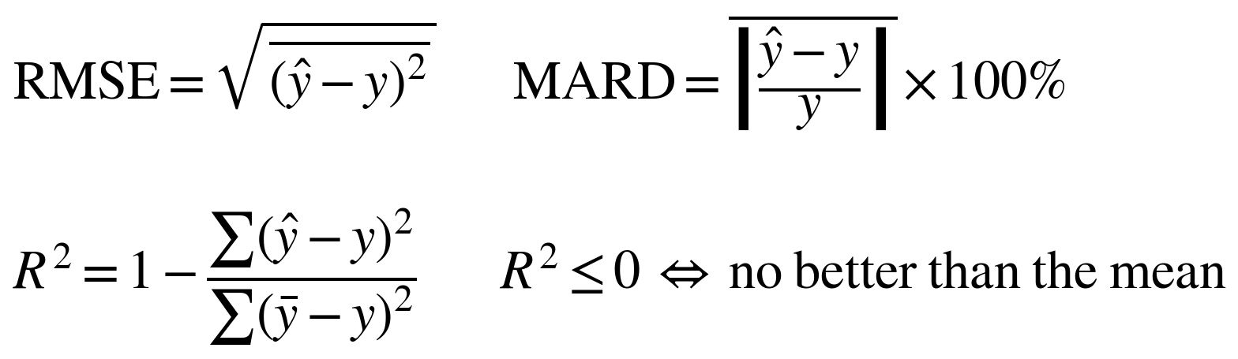
10. Results II — The Effect of the Evaluation Protocol
The same data and the same models, split three different ways. Each method is shown beside the baseline computed on the same folds.
Split protocol | Method | R² | RMSE | MARD (%) | Zone A (%) | Zone A+B (%)
1. Random window | Choquet fusion | +0.149 | 2.324 | 24.86 | 52.87 | 93.75
(the paper's protocol) | No-skill baseline | −0.000 | 2.520 | 29.14 | 45.34 | 90.89
2. Subject-aware | Choquet fusion | −0.223 | 2.786 | 31.50 | 41.91 | 89.39
 | No-skill baseline | −0.074 | 2.610 | 30.30 | 43.74 | 90.01
3. Leave-one-subject-out | Choquet fusion | −0.097 | 2.639 | 28.86 | 45.57 | 91.25
 | No-skill baseline | −0.035 | 2.564 | 29.74 | 44.14 | 90.57
What the three protocols ask
Protocol 1 allows windows from the same person into both the training and the test set. Protocols 2 and 3 never do.
So protocol 1 asks: how well does this work for a person the model has already seen? Protocols 2 and 3 ask: how well does it work for a new person?
Both are fair questions. The first is the one the paper reports, and it is the one our Results I reproduces.
Mid Term Review | Noninvasive Blood Glucose Estimation from ECG and PPG
12

Slide 13
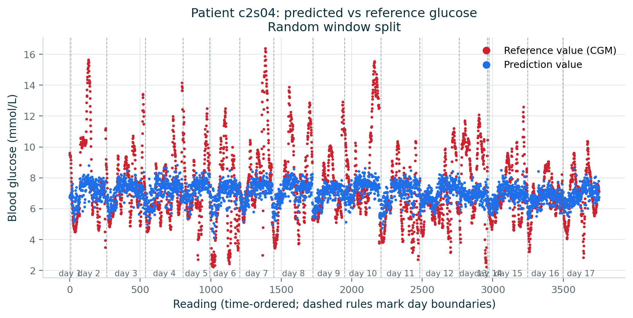
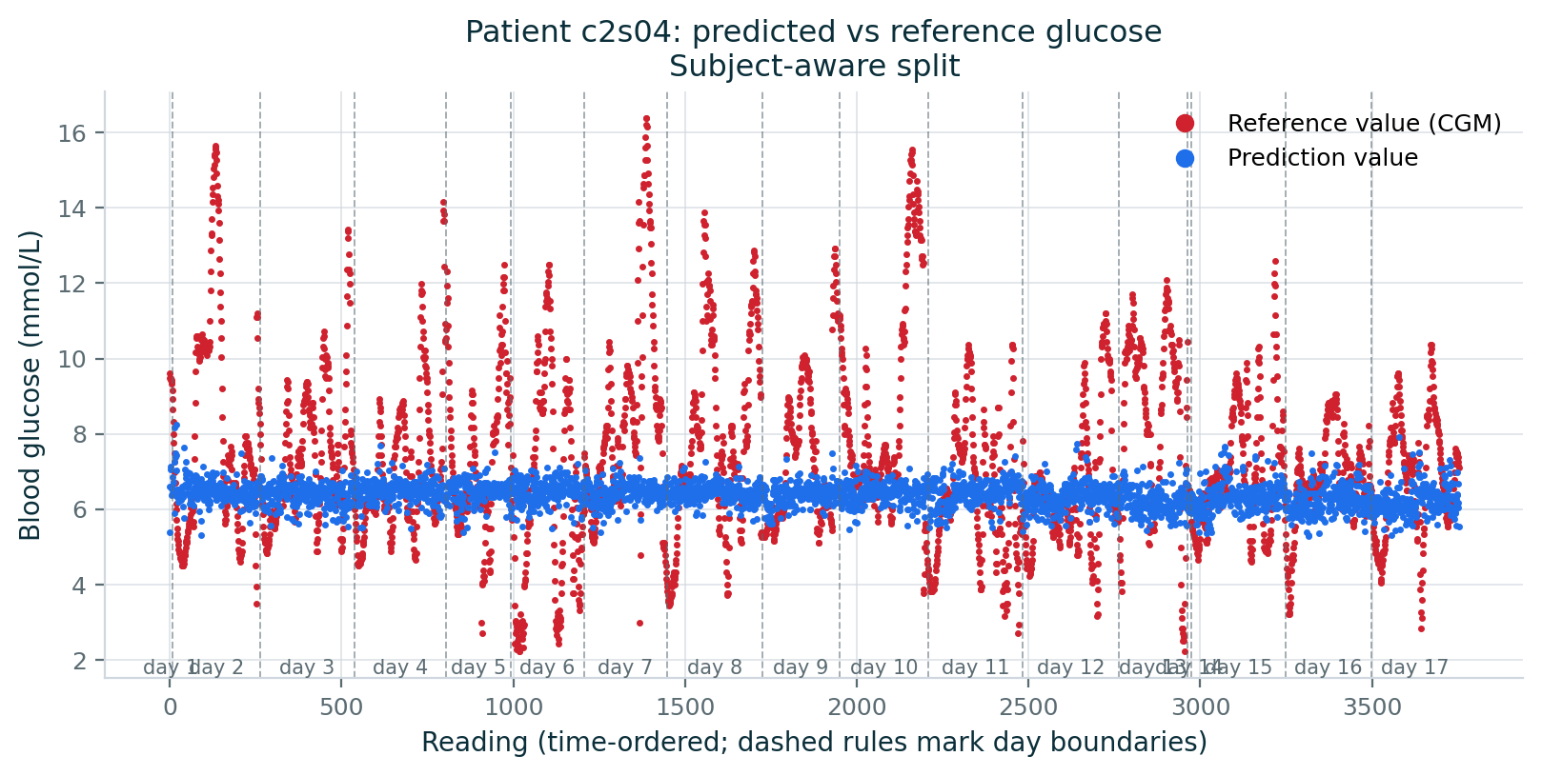
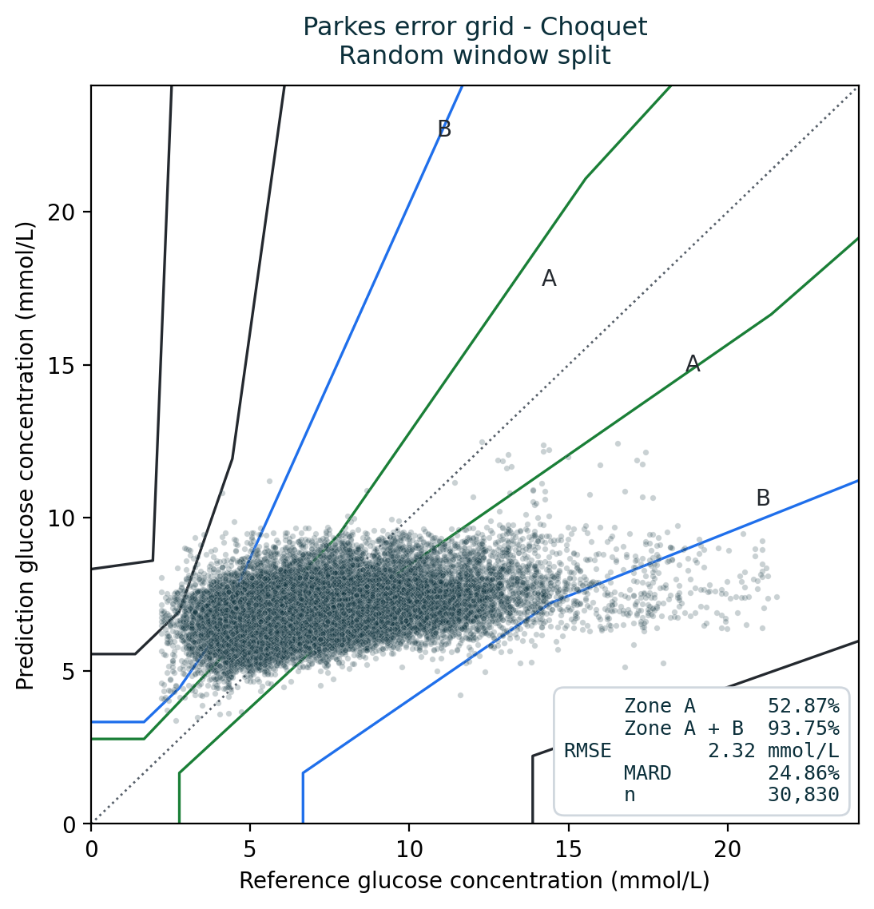
11. Results III — Parkes Error Grid and Prediction Trace
Participant c2s04 over seventeen days, under each of the two protocols. Red is the CGM reference, blue the prediction.
Random window split: the prediction follows the reference up and down.
Subject-aware split: the prediction flattens toward the mean.
Reading the two traces
On the left the model tracks the participant's daily rises and falls, because it has seen other windows from this same participant during training. This is the condition under which the published result is obtained.
On the right the participant was held out entirely, and the prediction collapses toward the population average of about 7 mmol/L.
The Parkes grid, inset, places 93.7% of the left-hand predictions in Zones A+B.
Mid Term Review | Noninvasive Blood Glucose Estimation from ECG and PPG
13

Slide 14
12. Results IV — Feature-Set Ablation
Every feature set evaluated under leave-one-subject-out with Choquet fusion
Feature set | Features | R² | RMSE (mmol/L) | Zone A+B (%)
No-skill baseline | 0 | −0.035 | 2.564 | 90.6
Morphological (shape) only | 33 | −0.070 | 2.606 | 90.8
PPG only | 94 | −0.075 | 2.612 | 90.6
Fused (ECG + PPG) | 193 | −0.097 | 2.639 | 91.3
Temporal (wavelet) only | 160 | −0.102 | 2.645 | 91.5
ECG only | 99 | −0.106 | 2.650 | 91.5
Every feature set falls behind the baseline.
The entire spread, best to worst, is 0.036 in R², and the baseline lies above all of it.
Fusing the two signals is worse than the better one alone.
PPG alone (−0.075) exceeds the fused set (−0.097). The source paper reports the opposite ordering. A 0.03 gap between two failing configurations is not read as evidence.
Fewer features perform better.
33 features exceed 193. When additional information degrades a model, the model is fitting noise rather than signal.
The clinical score is inversely related to R².
The configurations with the poorest R² carry the highest Zone A+B.
Mid Term Review | Noninvasive Blood Glucose Estimation from ECG and PPG
14

Slide 15
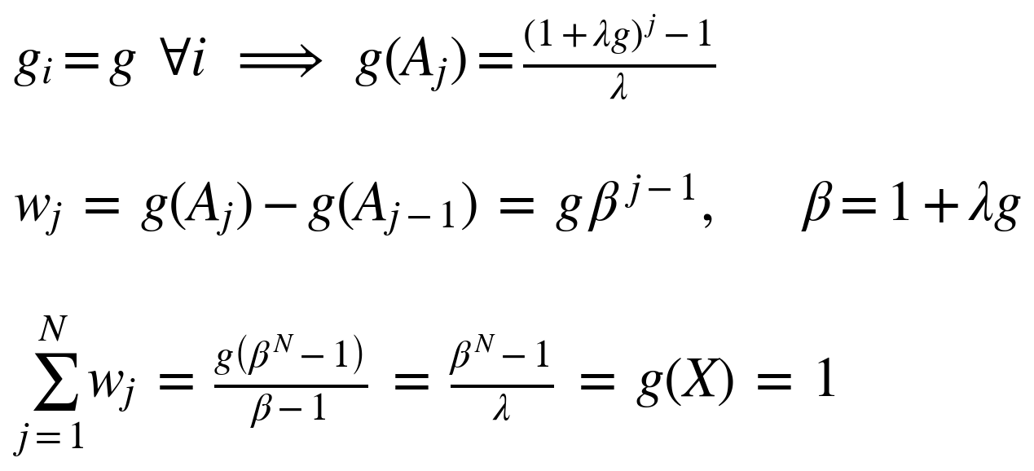
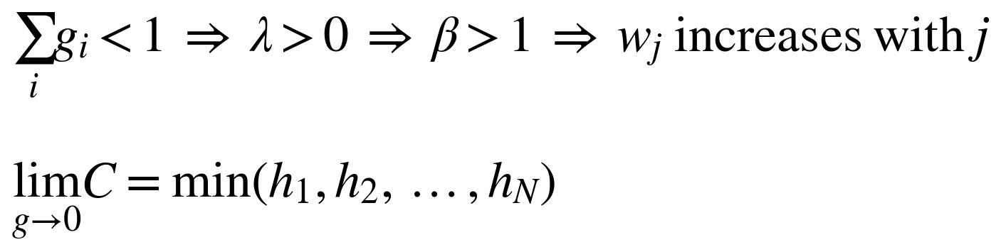
13. Results V — Degeneracy of the Fusion Operator
Two anomalies appeared in the output: the weighted average and the plain average agreed to three decimal places (3.927 against 3.927), and every fuzzy density sat at the 0.01 clipping floor. With equal densities the Sugeno measure becomes symmetric, and the Choquet integral reduces to a fixed order statistic:
g | λ | w (largest) | w (middle) | w (smallest) | Reduces to
0.010 | 846.24 | 0.010 | 0.095 | 0.895 | minimum
0.100 | 15.41 | 0.100 | 0.254 | 0.646 | rank-weighted
0.333 | 0.00 | 0.333 | 0.333 | 0.333 | arithmetic mean
Verification against the saved predictions
corr(Choquet output, minimum of the three models) = 0.998
mean |Choquet − min| = 0.04 mmol/L, against 0.27 to the mean.
The method's distinguishing component was returning min(h₁, h₂, h₃).
This is not solely a defect. Under honest evaluation the base models genuinely cannot generalise, so the densities floor legitimately. The fusion degenerates precisely when it is most needed.
Mid Term Review | Noninvasive Blood Glucose Estimation from ECG and PPG
15

Slide 16
14. Future Work and Expected Outcomes
Future work
1.
Reframe from regression to classification. The physiological mechanism supports detection of hypo- and hyperglycaemic events rather than recovery of absolute concentration; published ECG classification reports 84–94% accuracy.
2.
Evaluate per-participant calibration. The gap between random and subject-aware splitting indicates reliance on participant-specific structure, which matches how CGM devices are deployed.
3.
Implement the ResNet morphological branch as specified, to isolate the effect of our substitution, given GPU access.
4.
Apply the degeneracy diagnostic to other Choquet-fusion pipelines. The failure mode is not specific to glucose estimation.
Expected outputs and outcomes
• An open, reproducible implementation of all three stages.
• A degeneracy theorem with a runnable diagnostic, reusable in any domain employing fuzzy-integral fusion.
• Evidence that evaluation protocol dominates model choice, and that clinical zone metrics require a reported baseline.
• A reproducibility defect reported in a widely used nonlinear-features library.
Mid Term Review | Noninvasive Blood Glucose Estimation from ECG and PPG
16

Slide 17
15. Conclusion and References
Conclusion
The SFF-WCIM method was rebuilt in full and evaluated on 30,830 paired ECG and PPG windows from ten participants. Under the source paper's own protocol it learns (R² = +0.149). Under either leakage-controlled protocol every method, including the fusion, performs worse than a model that predicts the population mean, while still attaining 89–91% in the clinical acceptability zones. The fusion operator was additionally found to have degenerated into a minimum operator.
References
[1] J. Li et al., "Noninvasive blood glucose monitoring using spatiotemporal ECG and PPG feature fusion and weight-based Choquet integral multimodel approach," IEEE Trans. Neural Netw. Learn. Syst., vol. 35, no. 10, pp. 14493–14505, Oct. 2024.
[2] "PhysioCGM: a multimodal physiological dataset for non-invasive blood glucose estimation," Sci. Data, vol. 12, 2025. [Online]. Available: https://doi.org/10.6084/m9.figshare.28136294 (accessed Sep. 25, 2026).
[3] "Reassessing the feasibility of PPG-based non-invasive blood glucose level estimation," arXiv:2608.01820, 2026.
[4] "Advances in electrocardiogram-based non-invasive blood glucose monitoring technology," review, 2026.
[5] J. L. Parkes, S. L. Slatin, S. Pardo and B. H. Ginsberg, "A new consensus error grid to evaluate the clinical significance of inaccuracies in the estimation of blood glucose," Diabetes Care, vol. 23, no. 8, pp. 1143–1148, Aug. 2000.
[6] A. Pfützner, D. C. Klonoff, S. Pardo and J. L. Parkes, "Technical aspects of the Parkes error grid," J. Diabetes Sci. Technol., vol. 7, no. 5, pp. 1275–1281, 2013.
[7] B. Eckert and C.-D. Agardh, "Hypoglycaemia leads to an increased QT interval in normal men," Clin. Physiol., vol. 18, no. 6, pp. 570–575, Nov. 1998.
[8] M. Grabisch, "Fuzzy integral in multicriteria decision making," Fuzzy Sets Syst., vol. 69, no. 3, pp. 279–298, 1995.
[9] J.-L. Marichal, "On Choquet and Sugeno integrals as aggregation functions," in Fuzzy Measures and Integrals, Heidelberg: Physica-Verlag, 2000, pp. 247–272.
[10] B. Hjorth, "EEG analysis based on time domain properties," Electroencephalogr. Clin. Neurophysiol., vol. 29, no. 3, pp. 306–310, 1970.
Mid Term Review | Noninvasive Blood Glucose Estimation from ECG and PPG
17

