Slide 1

Reproducing Choquet-Integral Multimodel Fusion for Noninvasive Blood Glucose Estimation from ECG and PPG
<ROLL NO.> | NAVTESH MAKEN
Mid Term Review
EEEEC23 B. Tech Project - II
Notes:
30s. Name the paper and say plainly that this is a reproduction: we rebuilt a published method and tested whether its result survives on data the original authors never saw.

Slide 2
Contents
Introduction
Literature Survey
Gaps Identified
Aims / Objectives of the Project
Problem Formulation
Solution Methodology
Results
Future Work
Expected Outputs / Outcomes
References
Notes:
15s. Read the headings, do not elaborate.

Slide 3
Introduction
Blood glucose must stay within 3.9 - 10.0 mmol/L. Below 3.9 causes seizure and coma within minutes; above 10.0 damages nerves, eyes and kidneys over years.
Every accurate measurement today breaks the skin: a finger-prick 4-10 times daily, or a CGM filament replaced every 10-14 days. ~590 million adults worldwide manage diabetes this way.
Motivation: ECG and PPG can be recorded painlessly by a chest strap or a smartwatch. If glucose can be inferred from them, monitoring becomes non-invasive and effectively free.
Established mechanism: hypoglycaemia triggers adrenaline, which drives potassium into cells; potassium governs cardiac repolarisation, so the ECG QT interval lengthens. Hyperglycaemia suppresses vagal tone and alters ST and T-wave morphology.
Caveat carried through this work: the mechanism supports DETECTING a dysglycaemic event (classification), not reading the exact concentration (regression). Published classification reaches 84-94% accuracy; regression does not replicate.
Notes:
90s. Three beats: what glucose is and why both directions are dangerous; measuring it today means breaking skin; there IS a real mechanism linking the heart to blood sugar. End on the caveat - it explains the whole result.

Slide 4
Literature Survey (1/2): the method under test
Li et al., IEEE Trans. Neural Networks and Learning Systems 35(10), 2024 - "Spatiotemporal ECG and PPG Feature Fusion and Weight-Based Choquet Integral Multimodel Approach" (SFF-WCIM).
Reported performance on the authors' private cohort, and the methods they compare against:
Ref. | Method | RMSE (mmol/L) | MARD (%) | Zone A (%) | Zone A+B (%)
[21] | CNN-RNN | 1.66 | 14.93 | 75.46 | 99.35
[48] | ResNets | 1.63 | 15.22 | 75.18 | 99.26
[22] | CDA | 1.99 | 20.67 | 60.88 | 98.56
[40] | CNN-MFVW | 1.61 | 14.71 | 76.96 | 98.94
Paper | SFF-WCIM (the method we reproduce) | 1.49 | 13.42 | 80.09 | 99.49
Source: Li et al. 2024, Table V. 1.49 mmol/L approaches the accuracy of approved CGM devices, which is why the claim warranted independent checking.
Notes:
75s. This is the paper's own comparison table. SFF-WCIM is the row we are reproducing. 1.49 approaches approved CGM accuracy - that is why it matters.

Slide 5
Gaps Identified
No independent validation. The authors released code but not data - their recordings are private - so the result had never been tested on a cohort they did not choose.
Evaluation protocol not controlled. Results are reported under a random window-level split, in which the same participant appears in both training and test data. Windows from one person are highly correlated, so a model can identify the person rather than learn about glucose.
Clinical metrics reported without a reference point. Parkes Zone A+B is quoted as evidence of clinical readiness, but no no-skill baseline is reported alongside it, so the reader cannot tell how much of that score is the method.
Fusion behaviour never audited. The Choquet integral's fuzzy densities are estimated from model performance, but the paper does not report them or verify that the fusion is still discriminating between models.
Reproducibility of the feature pipeline unverified - no check that identical input produces identical features.
It's important to note that the specific contents of a slide titled "Research Gaps Identified" will depend on the specific research project and the findings of the research team.
Notes:
75s. Four gaps, each of which became one of our findings. Gap 2 is the most important: the split protocol.

Slide 6
Aims / Objectives of the Project
Aim: to determine whether the reported accuracy of SFF-WCIM survives independent reproduction on open data under leakage-controlled evaluation.
Objectives:
  Rebuild all three stages of the method from the published description.
  Run it on PhysioCGM - 10 Type-1 participants with simultaneous ECG, PPG and CGM, released CC0.
  Evaluate under three progressively stricter split protocols, reporting a no-skill baseline beside every result.
  Audit the fusion operator itself: recover the fuzzy densities and verify the integral is still discriminating between models.
  Verify that the feature pipeline is deterministic.
Scope and limitations: the paper's private dataset is unavailable, so this is a reproduction of the METHOD on different data, not a replication of the experiment. The spatial morphological branch is implemented with hand-crafted physiological features rather than a ResNet (no GPU available); this deviation is documented and its effect examined in the ablation.
You may also include Scope and limitations: This should explain the scope of the research project, including what will be included and excluded from the study. It should also outline any limitations that may affect the study's ability to achieve its objectives.
Notes:
75s. State the aim as a question - does the result survive? - then the five objectives. Be explicit that we could not use their data, and why that makes this a reproduction of the method rather than of the experiment.

Slide 7
Literature Survey (2/2): evaluation practice in this field
Recent work questions whether results in this area survive rigorous evaluation:
Study | Finding relevant to this project
Reassessing PPG-Based BGL Estimation, arXiv:2608.01820 (2026) | Re-tested five published PPG-glucose methods. Best model scored R2 = 0.60 under a random split and -0.08 under a participant-aware split - i.e. no better than the mean. Over 90% of predictions fell in Clarke Zone A+B INCLUDING the baseline.
Advances in ECG-Based Non-Invasive Blood Glucose Monitoring (review, 2026) | Identifies record-level splitting as a field-wide source of data leakage yielding optimistic estimates; notes most studies use fewer than 30 subjects; concludes that current methods do not reach the 10-12% MARD of approved CGM devices.
Grabisch (1995); Marichal (2000) | Aggregation theory: a Choquet integral taken with respect to a SYMMETRIC fuzzy measure reduces to an ordered weighted average (OWA). This is the theoretical basis of our degeneracy result, and is cited as prior work rather than claimed as novel.
The first two motivate our three-protocol design; the third bounds what we claim as new in Finding 3.
Notes:
75s. The first row is the study we independently replicate - on ECG instead of PPG. The third row matters for honesty: the symmetric-measure result is known theory. Our contribution is showing it fires by accident in practice.

Slide 8
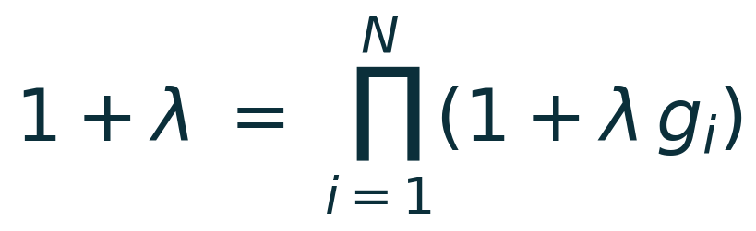
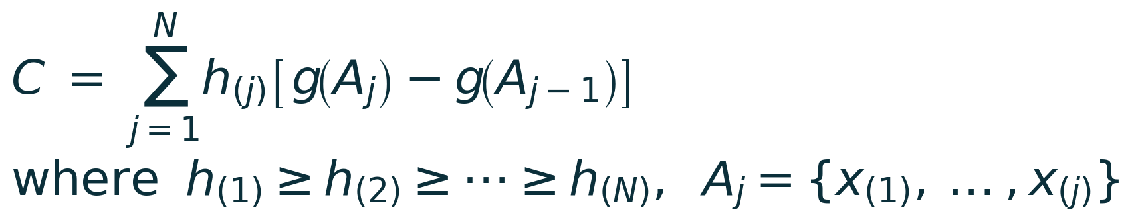
Problem Formulation
Given a 16 s window of ECG and PPG preceding a CGM reading, predict the glucose concentration y (mmol/L). Three regressors produce h1, h2, h3, to be combined into one estimate.
A weighted average assigns importance to each model individually, so it cannot express that two models overlap. A fuzzy measure assigns importance to every SUBSET; the Sugeno lambda-measure generates all 2^N of them from one density per model:
lambda is fixed by the boundary condition g(X) = 1. Sum(g_i) = 1 gives lambda = 0 and the integral reduces to a weighted average; > 1 gives lambda < 0, an overlap penalty; < 1 gives lambda > 0, a synergy bonus.
Notes:
2 min, the densest slide. Open with the analogy: three doctors, two trained together so averaging double-counts them, one far more experienced. A weighted average handles the second but not the first. THEN the equations. Sorting is what lets group importance enter - the weight depends on RANK.

Slide 9
Solution Methodology (1/2): pipeline and dataset
Level 1 - acquisition and conditioning: 16 s windows (~20 cardiac cycles) preceding each CGM reading; Butterworth band-pass 0.5-40 Hz for ECG and 0.5-8 Hz for PPG (64 Hz sampling limits the representable band to 32 Hz).
Level 2 - feature extraction: db4 DWT to 7 levels gives 8 sub-signals per modality; 10 statistical features each (80 per modality, 160 total), plus 33 morphological features. Selection by UFS n RFE n L1.
Level 3 - decision fusion: Random Forest, Gradient Boosting and Bagging, combined by the weight-based Choquet integral.
Signal | Device | Rate | Role
ECG | Zephyr BioHarness (chest strap) | 250 Hz | Electrical activity of the heart
PPG (BVP) | Empatica E4 (wristband) | 64 Hz | Blood volume pulse, measured optically
Glucose | Dexcom CGM | every 5 min | Reference value to be predicted
Study population
Participants | 10 (Type-1 diabetes)
Paired ECG+PPG windows | 30,830
Features per window | 193
Glucose range | 2.2 - 21.5 mmol/L
Mean / standard deviation | 7.17 / 2.519 mmol/L
PhysioCGM (Scientific Data, 2025; figshare 28136294, CC0) - the only open dataset carrying ECG and PPG against a CGM reference. The 2.519 mmol/L standard deviation is the error of a model that always predicts the mean: the no-skill baseline every result is measured against.
Notes:
90s. Walk the three levels, then the two tables. SLOW DOWN on 2.519 - it is the standard deviation of glucose and therefore the RMSE of a model that learns nothing. Everything after this slide is judged against it.

Slide 10
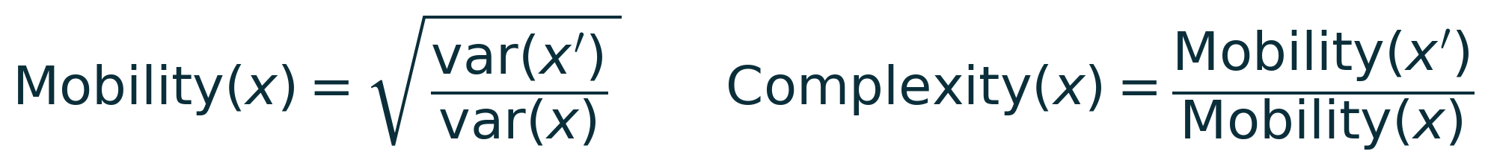
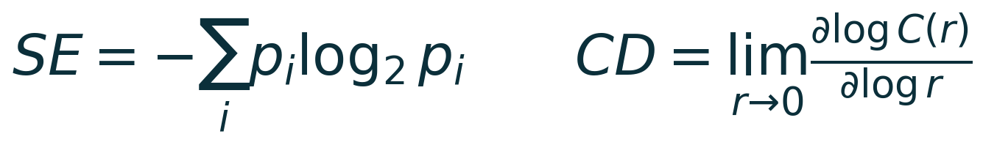
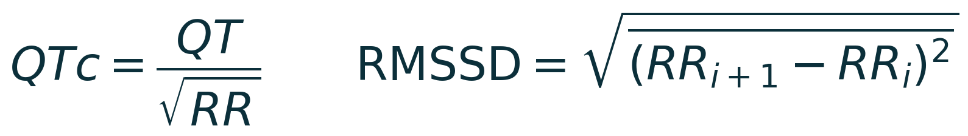
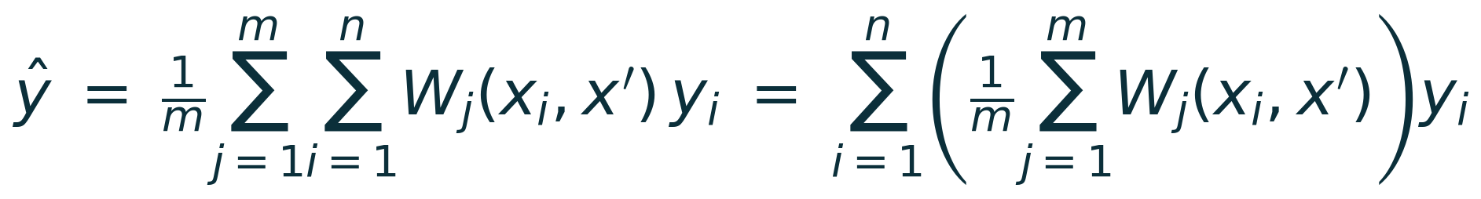
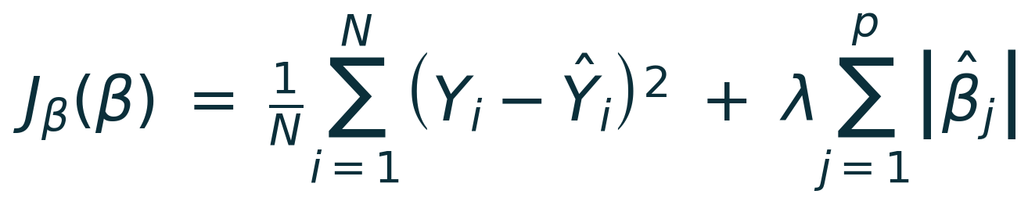
Solution Methodology (2/2): feature extraction and selection
Temporal statistical features - 10 per sub-signal: kurtosis, skewness, Hjorth mobility and complexity, fractal dimension, correlation dimension, C0-complexity, power spectral entropy, Kolmogorov entropy, Shannon entropy.
Spatial morphological features - measured directly rather than learned, because the mechanism is known: QT and corrected QT, ST level, T-wave amplitude and sharpness, QRS duration, and heart-rate variability.
Feature selection - a feature is retained only if all three criteria select it (paper eqs. 5 and 6), fitted on training data within each fold:
193 features per window = 80 ECG temporal + 80 PPG temporal + 19 ECG morphological + 14 PPG morphological. Selection typically retains ~10. Validation: median QTc 0.405 s against a textbook normal of 0.35-0.44 s.
Notes:
90s. Three groups: temporal statistical (the wavelet ones), morphological (measured directly, since we know QT is the mechanism), and selection. Equations 5 and 6 are the paper's own numbering so they can follow in the PDF. Mention that selection runs INSIDE each fold - selecting on the whole dataset leaks test information into the feature choice.

Slide 11
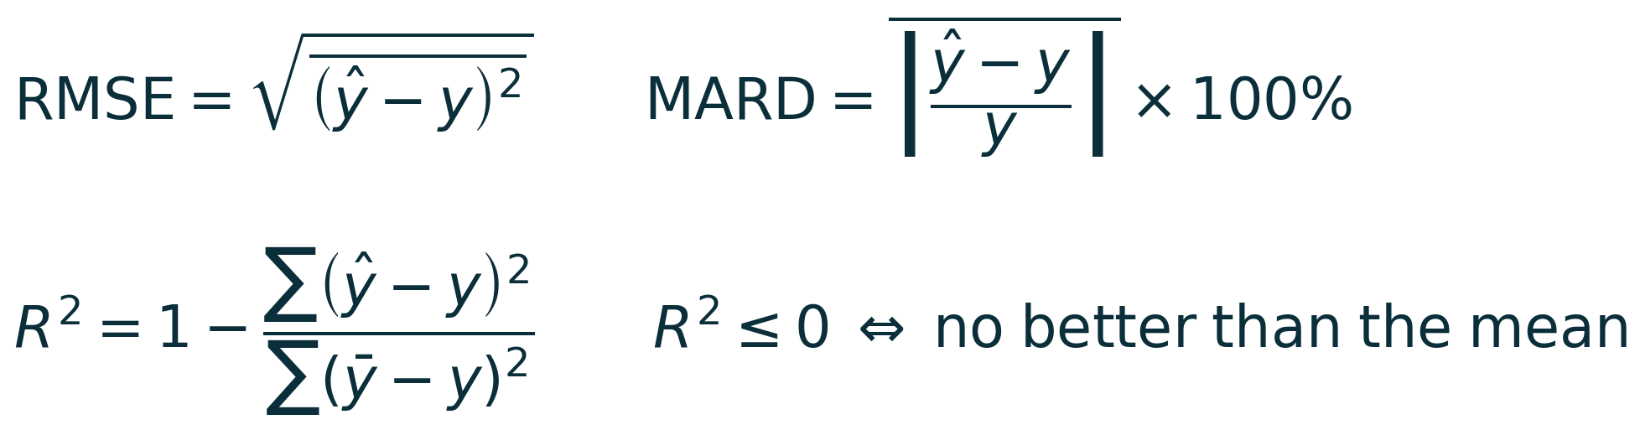
Results (1/4): performance under three split protocols
193 features, 30,830 windows, 10 participants. Every model is reported beside the no-skill baseline computed on the same folds.
Split protocol | Method | R2 | RMSE (mmol/L) | MARD (%) | Zone A (%) | Zone A+B (%)
1. Random window | Choquet fusion | +0.149 | 2.324 | 24.86 | 52.87 | 93.75
(paper's protocol) | No-skill baseline | -0.000 | 2.520 | 29.14 | 45.34 | 90.89
2. Subject-aware | Choquet fusion | -0.223 | 2.786 | 31.50 | 41.91 | 89.39
 | No-skill baseline | -0.074 | 2.610 | 30.30 | 43.74 | 90.01
3. Leave-one-subject-out | Choquet fusion | -0.097 | 2.639 | 28.86 | 45.57 | 91.25
 | No-skill baseline | -0.035 | 2.564 | 29.74 | 44.14 | 90.57
Read the R2 column first.
R2 = 0 means exactly as good as predicting the mean; negative means worse. It is the only metric here that exposes a model that has learned nothing.
Under both honest protocols every method - including the fusion - falls behind the baseline.
Notes:
2 min. Define R-squared FIRST. Then: +0.149 random, -0.223 subject-aware, -0.097 leave-one-out. Same data, same code, only the split changed. RAISE THE ORDERING YOURSELF - leave-one-out beats subject-aware because it trains on 9 of 10 rather than 4 of 5. Saying it first is far stronger than being caught on it.

Slide 12
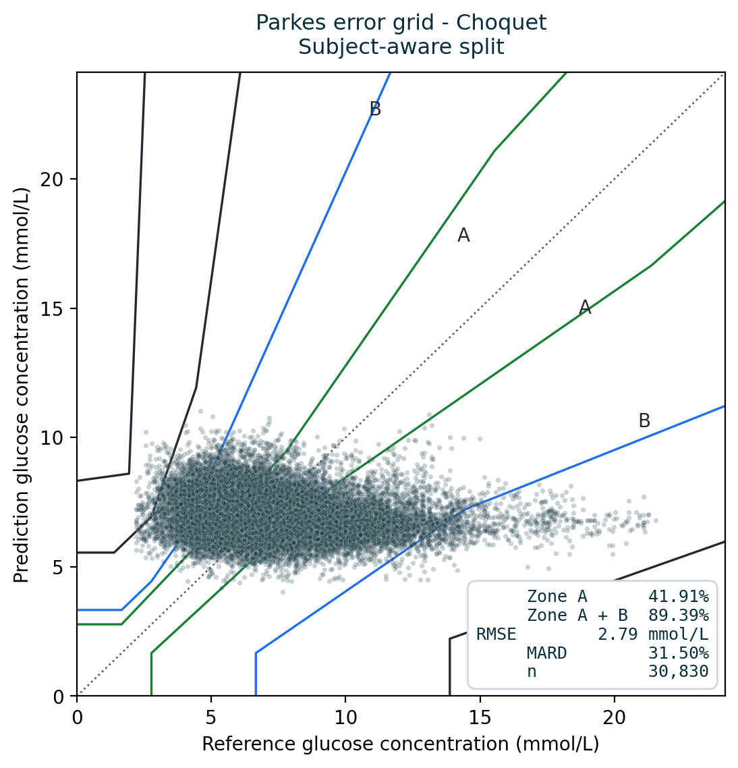
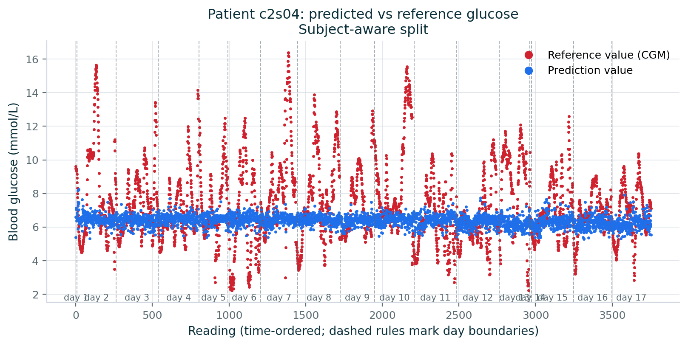
Results (2/4): Parkes error grid and prediction trace
A working model would produce a diagonal cloud along the dotted line.
Ours is a horizontal band: whether the true value was 4 or 20 mmol/L, the prediction is approximately 6-9. That is what "no better than the mean" looks like when drawn.
The same flat band scores 89.4% in Zones A+B - which is why the clinical metric cannot certify a model on its own.
Equivalent to Figs. 9 and 10 of the paper. Subject-aware split, Choquet fusion, 30,830 predictions.
Notes:
90s. YOUR STRONGEST SLIDE. Trace the diagonal with your hand - that is what a working model looks like. Then trace the horizontal band. Then the sting: 89.4% Zone A+B. PAUSE and let it land.

Slide 13
Results (3/4): ablation over feature sets
Every feature set evaluated under leave-one-subject-out, Choquet fusion:
Feature set | Features | R2 | RMSE (mmol/L) | Zone A+B (%)
No-skill baseline | 0 | -0.035 | 2.564 | 90.6
Morphological (shape) only | 33 | -0.070 | 2.606 | 90.8
PPG only | 94 | -0.075 | 2.612 | 90.6
Fused (ECG + PPG) | 193 | -0.097 | 2.639 | 91.3
Temporal (wavelet) only | 160 | -0.102 | 2.645 | 91.5
ECG only | 99 | -0.106 | 2.650 | 91.5
Every set is behind the baseline.
The entire spread, best to worst, is 0.036 in R2 - and the baseline sits above all of it.
Fusing the two signals is worse than the better one alone.
PPG alone (-0.075) beats the fused set (-0.097). The paper found the opposite. We do not read a 0.03 gap between two failing configurations as evidence.
Fewer features score better.
33 features beat 193. When adding information makes a model worse, it is fitting noise.
And the clinical score runs backwards.
The worst models by R2 carry the highest Zone A+B. Not weakly related - inverted.
Equivalent to Tables III and IV of the paper. Feature counts in brackets in the first column.
Notes:
75s. Four observations, in order. The last two are the interesting ones: fewer features do better (fitting noise), and the clinical score is INVERSELY related to R-squared.

Slide 14
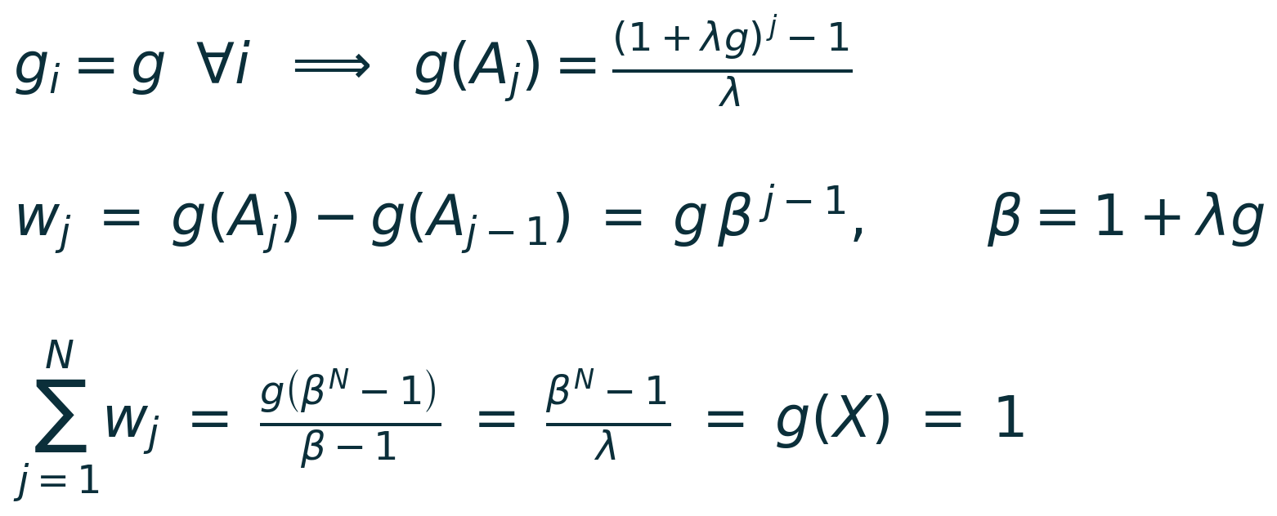
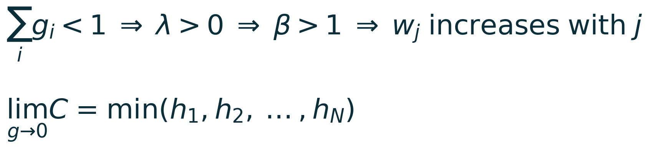
Results (4/4): the fusion operator degenerates
Two anomalies in the output: the weighted average and the plain average agreed to three decimals (3.927 vs 3.927), and every fuzzy density sat at the 0.01 clipping floor. With equal densities the Sugeno measure becomes symmetric, and the Choquet integral reduces to a fixed order statistic:
g | lambda | w (largest) | w (middle) | w (smallest) | Reduces to
0.010 | 846.24 | 0.010 | 0.095 | 0.895 | minimum operator
0.100 | 15.41 | 0.100 | 0.254 | 0.646 | rank-weighted OWA
0.333 | 0.00 | 0.333 | 0.333 | 0.333 | arithmetic mean
Verified against the saved predictions:
corr(Choquet output, min of the three models) = 0.998
mean |Choquet - min| = 0.04 mmol/L, against 0.27 to the mean
The method's distinguishing component was returning min(h1, h2, h3).
Not only a bug: under honest evaluation the base models genuinely cannot generalise, so the densities floor legitimately - the fusion degenerates exactly when it is most needed.
The symmetric-measure/OWA equivalence is established theory (Grabisch; Marichal). The contribution here is identifying it as a practical failure mode of performance-based density estimation, with a closed-form diagnostic.
Notes:
2 min. Start with the two clues, then the derivation, then the table, then the empirical confirmation. DO NOT SKIP the last line - the degeneracy is a symptom as well as a bug, and it fires exactly when the models are weak.

Slide 15
Future work to be done
Reframe the task from regression to classification. The physiological mechanism supports detecting hypo- and hyperglycaemic events, not reading absolute concentration. Reported ECG classification reaches 84-94% accuracy.
Evaluate personalisation. The gap between random and subject-aware splitting indicates the models rely on participant-specific structure; a short per-user calibration matches how CGM devices are actually deployed.
Implement the spatial morphological branch as specified (ResNet) to isolate the effect of our substitution, given GPU access.
Test the degeneracy diagnostic on other Choquet-fusion pipelines. The failure mode is not specific to glucose - it applies wherever fuzzy densities are estimated from model performance.
Planned publication: a short reproducibility paper. Candidate venues - IEEE Journal of Biomedical and Health Informatics, or the ML Reproducibility Challenge.
Notes:
60s. The first point is the most important and the most defensible: the biology supports classification, not regression.

Slide 16
Expected Outputs / Outcomes of the work
An open, reproducible implementation. All three stages, released publicly with the data pipeline, so the method can be tested by others: github.com/navtesh21/btp-project
A degeneracy theorem with a runnable diagnostic. Closed form w_j = g x beta^(j-1); when densities saturate, the Choquet integral provably reduces to a fixed order statistic. Reusable by anyone employing fuzzy-integral fusion, in any domain.
Evidence that evaluation protocol dominates model choice in this field, and that clinical zone metrics cannot certify a model without a baseline reported beside them.
A reproducibility defect reported in a widely used nonlinear-features library: an unseeded random slope fit changes up to 72% of correlation-dimension values between identical runs.
Methodological contribution: three guards that fail loudly rather than guess - timezone detection that refuses when ambiguous, feature selection with no whole-dataset variant, and a per-fold degeneracy report.
Notes:
75s. Four outcomes plus the methodological one. Emphasise that the degeneracy result is reusable outside this problem entirely.

Slide 17
References
[1] J. Li et al., "Noninvasive blood glucose monitoring using spatiotemporal ECG and PPG feature fusion and weight-based Choquet integral multimodel approach," IEEE Trans. Neural Netw. Learn. Syst., vol. 35, no. 10, pp. 14493-14505, Oct. 2024.
[2] "PhysioCGM: a multimodal physiological dataset for non-invasive blood glucose estimation," Sci. Data, vol. 12, 2025. [Online]. Available: https://doi.org/10.6084/m9.figshare.28136294 (accessed Sep. 25, 2026).
[3] "Reassessing the feasibility of PPG-based non-invasive blood glucose level estimation," arXiv:2608.01820, 2026.
[4] "Advances in electrocardiogram-based non-invasive blood glucose monitoring technology," (review), 2026.
[5] J. L. Parkes, S. L. Slatin, S. Pardo, and B. H. Ginsberg, "A new consensus error grid to evaluate the clinical significance of inaccuracies in the estimation of blood glucose," Diabetes Care, vol. 23, no. 8, pp. 1143-1148, Aug. 2000.
[6] A. Pfutzner, D. C. Klonoff, S. Pardo, and J. L. Parkes, "Technical aspects of the Parkes error grid," J. Diabetes Sci. Technol., vol. 7, no. 5, pp. 1275-1281, 2013.
[7] B. Eckert and C.-D. Agardh, "Hypoglycaemia leads to an increased QT interval in normal men," Clin. Physiol., vol. 18, no. 6, pp. 570-575, Nov. 1998.
[8] M. Grabisch, "Fuzzy integral in multicriteria decision making," Fuzzy Sets Syst., vol. 69, no. 3, pp. 279-298, 1995.
[9] J.-L. Marichal, "On Choquet and Sugeno integrals as aggregation functions," in Fuzzy Measures and Integrals, Heidelberg, Germany: Physica-Verlag, 2000, pp. 247-272.
[10] B. Hjorth, "EEG analysis based on time domain properties," Electroencephalogr. Clin. Neurophysiol., vol. 29, no. 3, pp. 306-310, 1970.
Notes:
15s. Do not read these aloud.

Slide 18
Thank You.
<ROLL NO.> | NAVTESH MAKEN
Mid Term Review
EEEEC23 B. Tech Project - II
Notes:
Leave this up, or return to Results (4) for questions.

