Slide 1

🤝 AGENCY GUIDE
Mangoi · MANGOI
Agency User Guide
From enrollment to lessons and settlement, in one book
For · Agency (franchise) operators | www.mangoi.co.kr

Slide 2
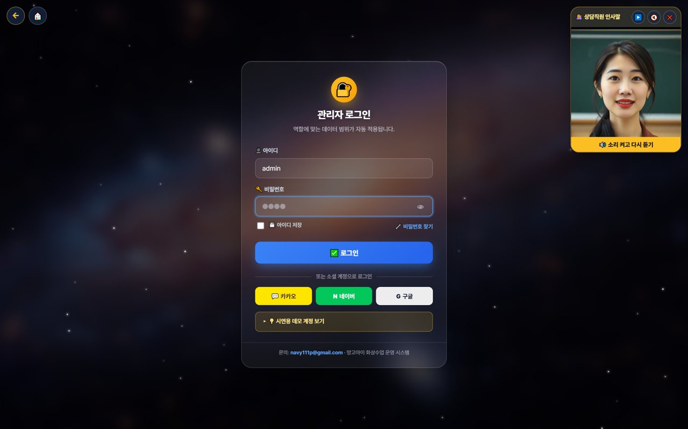
🤝 Mangoi Agency User Guide
Introduction
What is the Agency Admin Page?
The agency page is where you directly manage your agency's students, lessons, payments and settlement. From recruiting and counseling to enrollment, lesson assignment, collection, parent communication and receiving settlement — everything you need to run an agency is here. On login, only 'my agency' data shows, so you can focus on your students.
🤝
My-agency scope, automatic
🧑‍🎓
Recruit·enroll·manage students
Just log in and see only your students/revenue.
From counseling to enrollment and lesson assignment.
💳
Collection·settlement
📈
Learning status·reports
Payments/overdue and receiving branch→agency settlement.
Your students' learning at a glance.
Your Agency Metrics (example)

Slide 3
🤝 Mangoi Agency User Guide
Contents
📑 Contents (1/2)
Introduction
2
10
Agency Settlement
14
01
Agency Login & Permissions
5
11
Prevent Churn (care for students)
15
02
My Page & Admin Dashboard
6
12
New Counseling·Recruiting
16
03
Agency Dashboard
7
13
Support·Help
17
04
Using the AI Assistant
8
14
Korea·Philippines Dual Clock
18
05
Recruit·Enroll·Manage Students
9
15
Chinese Pronunciation Coach
19
06
Parent Communication
10
16
In-class Praise Points (understand & use)
20
07
Booking·Assignment
11
17
Notice Studio (Poster + Popup)
21
08
Payments·Collection
12
18
Command the AI Operations Assistant
22
09
Student Learning·Reports
13

Slide 4
🤝 Mangoi Agency User Guide
Contents
📑 Contents (2/2)
19
Share Library Links via KakaoTalk
23
28
Academy Search Box (find it by name)
32
20
A refreshed admin screen
24
29
New-Payment Screen, Now Step-by-Step
33
21
The interface language sets itself
25
30
Sample Report Card for Parents Without an Account
34
22
Enrolment & payment → automatic lesson creation
26
31
Unified Support Hours & Channel Order (KakaoTalk first)
35
23
Teacher Management, redesigned (roster filters · groups · detail tabs)
27
32
Feature Summary · Data
36
24
Sending the Parent Monthly Report (pentagon)
28
33
Data at a Glance
37
25
Parent Weekly Report (the re-enrolment lever)
29
34
Frequently Asked Questions (FAQ)
38
26
Home Screen Split (first-time parent vs. existing member)
30
35
Checklist
39
27
The Admin Screen Is Much Faster Now
31
36
Conclusion
40

Slide 5
🤝 Mangoi Agency User Guide
How to Use the Main Features
01
🔐 Agency Login & Permissions
Only my agency's data
Logging in with an agency account shows only 'my agency' menus and data. Other agencies or branch-wide data isn't visible, so you can focus on managing your students.
1
ID and pas…
›
2
role (agen…
›
3
'Find pass…
How to use
● Log in with ID and password (social login also works).
● On login, menus/data for your role (agency) are applied automatically.
● Forgot your password? Reset via 'Find password'.
✅ Key Points
● Only your agency's student/revenue data shows.
● Turn on 'Save ID' only on your own trusted PC.
💡 Tip · On shared PCs, turn off auto-login and log out when done.

Slide 6
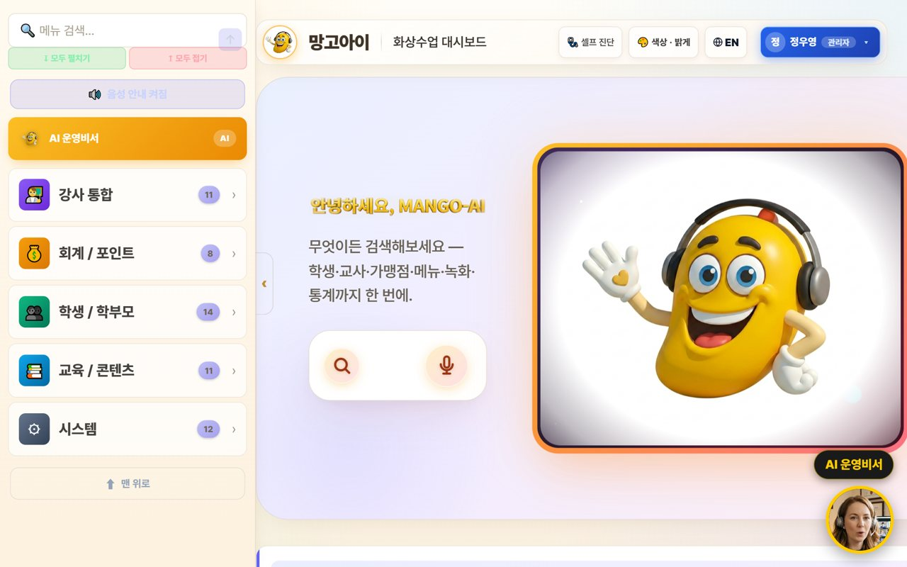
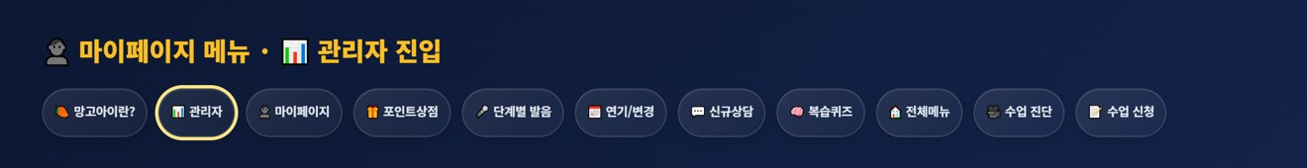
🤝 Mangoi Agency User Guide
How to Use the Main Features
02
👤 My Page & Admin Dashboard
Open the management screen from My Page
Agency operations also start from 'My Page.' After logging in, press the 📊 'Admin' button in the My Page menu to enter the agency-scope admin (operations) dashboard, where you manage students, revenue, lessons and settlement.
1
'👤 My Page…
›
2
📊 'Admin'
›
3
admin dash…
›
4
My Page al…
›
5
EN
How to use
● After logging in, open '👤 My Page'.
● Press the 📊 'Admin' button in the My Page menu. (goes to the admin dashboard)
● On the admin dashboard, check your agency revenue, enrollment and today's lessons.
● My Page also has postpone/change, new inquiry, all-menu, pre-check and more.
● If text looks English, use the EN button to switch language.
✅ Key Points
Good to know · My Page and the admin dashboard open only within the logged-in agency account's permission scope.
💡 Tip · Each day, go My Page → Admin dashboard to check your agency metrics.
● One 'Admin' button takes you straight to the operations dashboard.
● All dashboard data is auto-totaled to 'your agency scope'.
● Menus and data are set automatically by your role (agency).

Slide 7
🤝 Mangoi Agency User Guide
How to Use the Main Features
03
🏠 Agency Dashboard
Your students·revenue·today's lessons
On login, your agency's enrollment, revenue and today's lessons are organized as cards. Find features fast with the search box.
1
today's re…
›
2
category c…
›
3
feature se…
›
4
live (LIVE…
How to use
● Check today's revenue, enrollment and attendance (your agency) at the top.
● Tap features from the category cards (students, accounting, content, etc.).
● Type a word in the feature search box to jump right there.
● Check the live (LIVE) lesson status.
✅ Key Points
● Numbers are auto-totaled to 'your agency scope'.
● If a feature is hard to find, search is fastest.
💡 Tip · A morning metrics check quickly tells you your academy's status.

Slide 8
🤝 Mangoi Agency User Guide
How to Use the Main Features
04
🤖 Using the AI Assistant
Look up/act by voice or text
Speak or type into the search/mic and the AI helps you look up and handle things within your agency scope. Especially handy during busy counseling hours.
1
search/mic
›
2
looks up
›
3
confirmed…
How to use
● Speak or type into the center search/mic. e.g. 'How's today's revenue?'
● The AI looks up or opens a screen. e.g. 'Open student management.'
● Important actions are confirmed with 'Shall I?' first.
✅ Key Points
● Voice is much faster than clicking.
● Only permitted actions are handled, safely.
💡 Tip · Can't find a button? Just say 'open ○○'.

Slide 9

🤝 Mangoi Agency User Guide
How to Use the Main Features
05
🧑‍🎓 Recruit·Enroll·Manage Students
From counseling to enrollment
Take new counseling, enroll students, and manage enrolled students' attendance, grades and history. This is your agency's core work.
1
new counse…
›
2
Students/P…
›
3
Check atte…
›
4
Flag and c…
How to use
● Take new counseling and convert to enrollment.
● Manage the roster/history in Students/Parents.
● Check attendance/reviews/points/chat history by student.
● Flag and care for students who need attention.
✅ Key Points
● The student list is linked to real member data.
● Raising the counsel→enroll conversion is key to growth.
💡 Tip · Keeping thorough counseling notes greatly helps re-counseling and conversion.

Slide 10
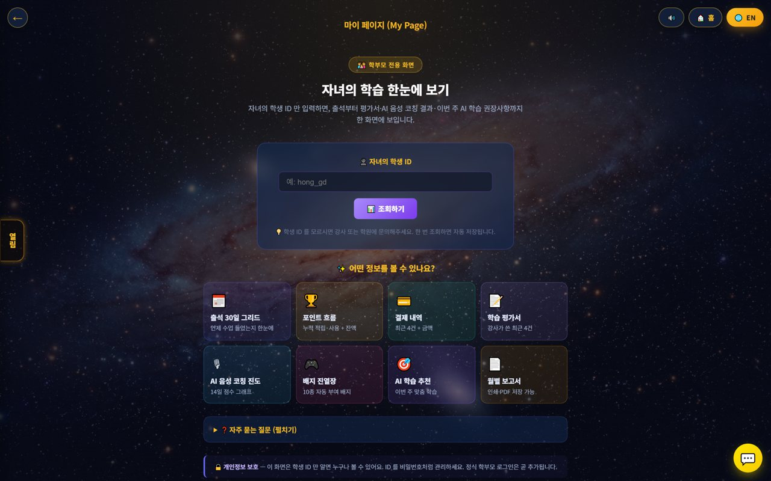
🤝 Mangoi Agency User Guide
How to Use the Main Features
06
👨‍👩‍👧 Parent Communication
Guide My Page
Guide parents to My Page so they can check their child's learning themselves. It reduces inquiries and raises satisfaction and re-enrollment.
1
My Page li…
›
2
child's st…
›
3
monthly re…
How to use
● Share the My Page link with parents.
● Parents check attendance/reviews/payments/reports with the child's student ID.
● Share growth with the monthly report (print/PDF).
✅ Key Points
● Parent satisfaction leads to re-enrollment.
● Advise managing the student ID like a password.
💡 Tip · Reading the review together periodically builds parent trust.

Slide 11
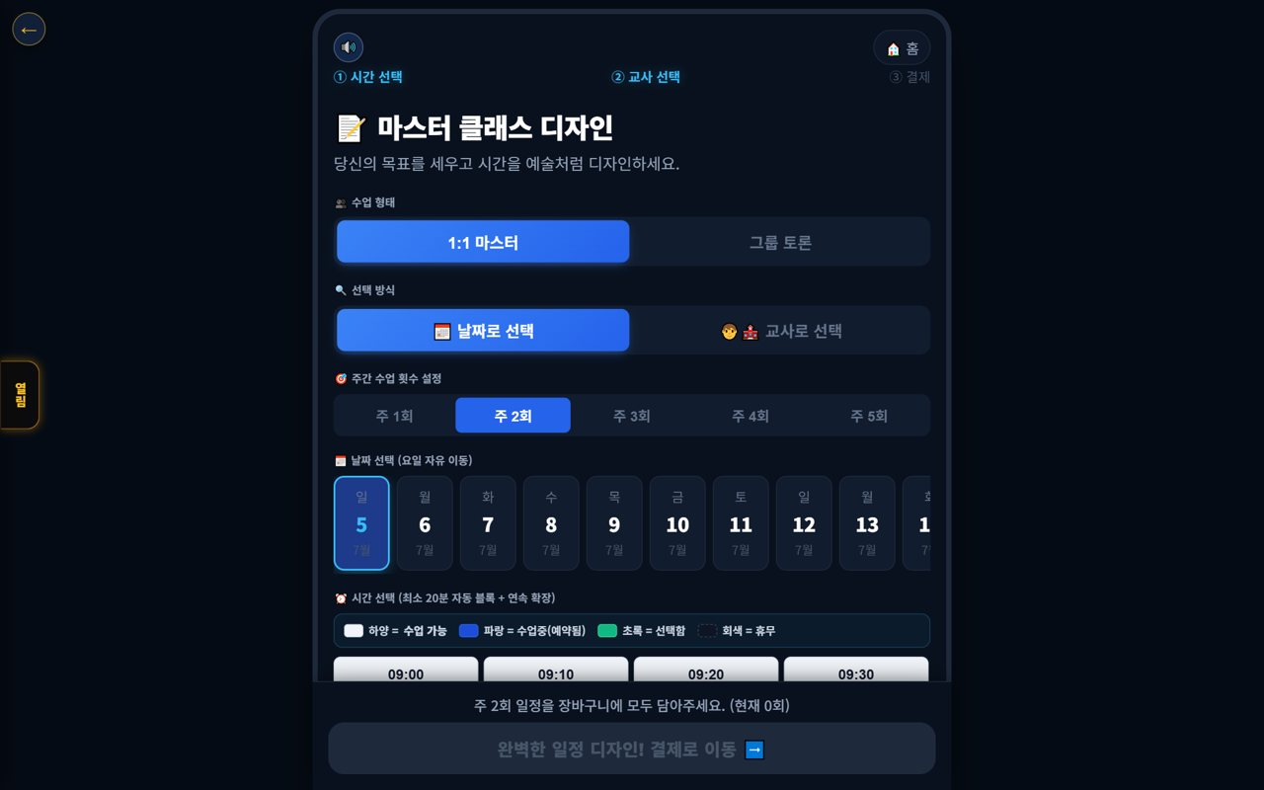
🤝 Mangoi Agency User Guide
How to Use the Main Features
07
📅 Booking·Assignment
Schedule and teacher
Assign a student's lesson type, time and teacher, and manage booking status. Handle postpone/change requests too.
1
Booking
›
2
Check empt…
›
3
postpone/c…
How to use
● Assign lesson type, teacher and time in Booking.
● Check empty slots/overlaps and adjust.
● Handle students' postpone/change requests per policy.
✅ Key Points
● Assign popular slots in advance.
● Announcing the postpone cutoff reduces no-shows.
💡 Tip · Pre-registering each teacher's available times speeds up assignment.

Slide 12
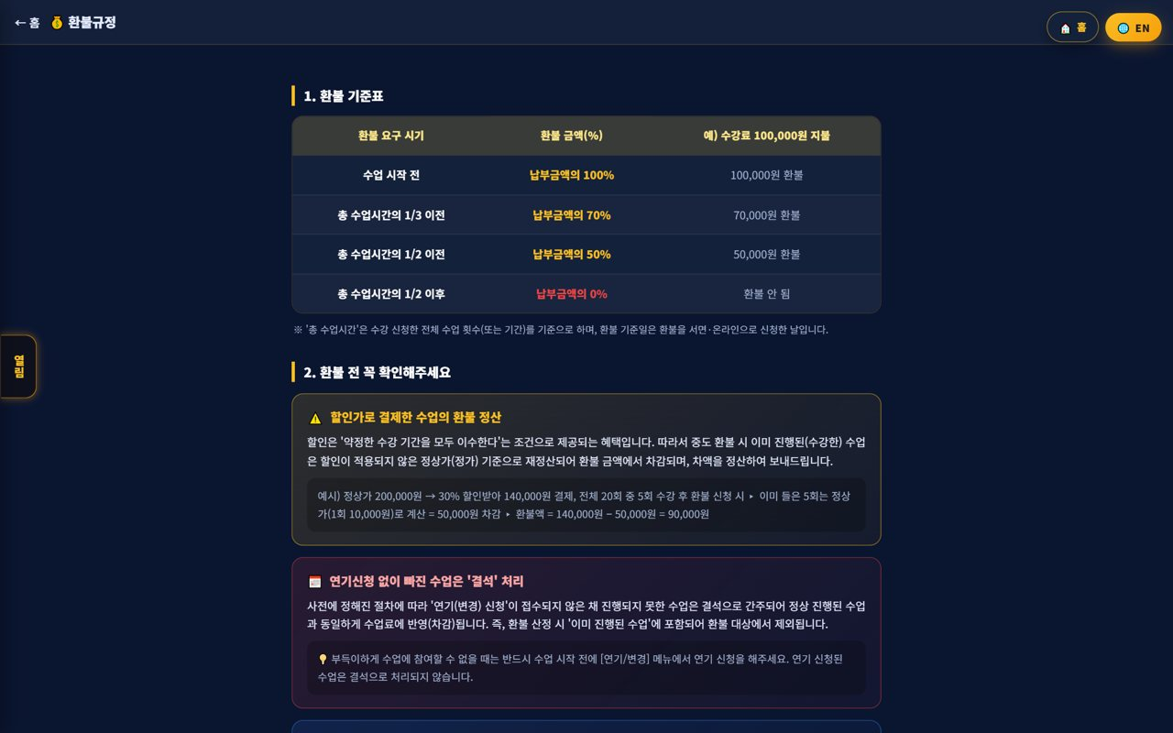
🤝 Mangoi Agency User Guide
How to Use the Main Features
08
💳 Payments·Collection
Payments·overdue·refunds
Process your agency's payments, overdue and refunds. Amounts auto-calculate by policy, and overdue is managed with alerts.
1
Accounting…
›
2
alert-talk…
›
3
refund tab…
How to use
● Process payments/overdue/refunds in Accounting/Points.
● Notify overdue via alert-talk/SMS.
● Amounts are auto-calculated per the refund table.
✅ Key Points
● Automate overdue alerts to raise collection.
● Discounted-payment refunds recalc at list price.
💡 Tip · Reviewing collection status regularly stabilizes revenue.

Slide 13
🤝 Mangoi Agency User Guide
How to Use the Main Features
09
📈 Student Learning·Reports
Progress·performance
Check your students' attendance, reviews and learning progress, and review performance with reports. Use it for parent counseling and re-enrollment persuasion.
1
attendance…
›
2
monthly re…
›
3
parent cou…
How to use
● Check each student's attendance·reviews·progress.
● Summarize performance with the monthly report.
● Use reports in parent counseling.
✅ Key Points
● Showing data builds parent trust.
● Link high-performing students to reviews/referrals.
💡 Tip · Showing performance with a report before re-enrollment makes persuasion easier.

Slide 14
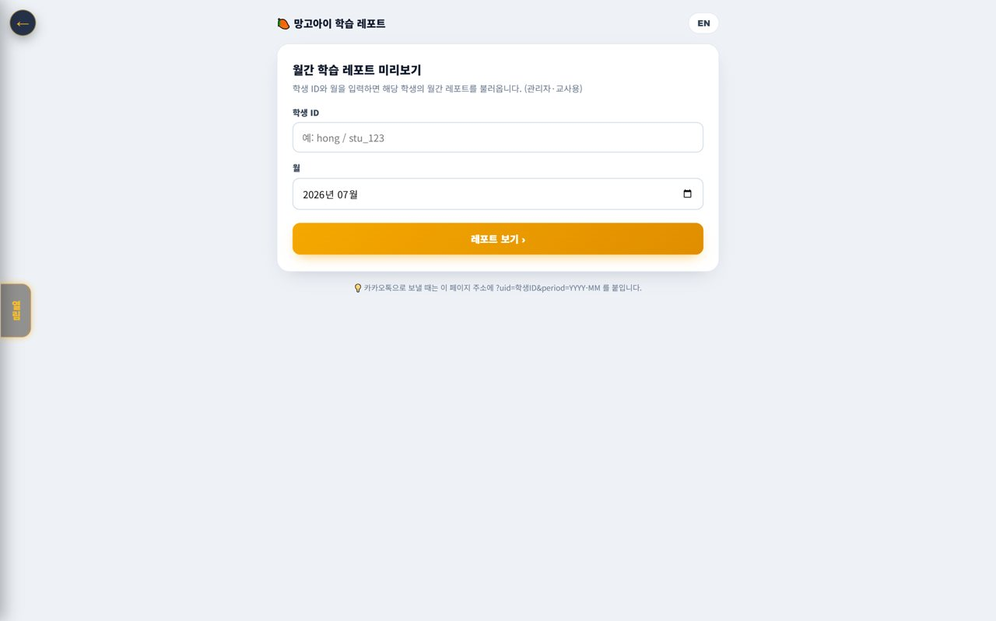
🤝 Mangoi Agency User Guide
How to Use the Main Features
10
🌳 Agency Settlement
Receive branch→agency
Check the settlement coming from the branch to your agency. Revenue and commissions are auto-calculated down the org tree, so you can see your share transparently.
1
branch→age…
›
2
Review the…
›
3
Save (PDF)
How to use
● Check branch→agency settlement (received) by month.
● Review the revenue/commission calculation details.
● Save (PDF) the settlement report to keep.
✅ Key Points
● Settlement is auto-calculated by the org tree.
● Ask the branch/HQ to confirm any off items.
💡 Tip · Viewing revenue and settlement together clarifies your agency's profit structure.

Slide 15
🤝 Mangoi Agency User Guide
How to Use the Main Features
11
🧲 Prevent Churn (care for students)
Spot at-risk early
Find students likely to quit early and care for them. Quickly caring for students with frequent absences or dropping performance raises re-enrollment.
1
churn-risk
›
2
counseling…
›
3
Manage fam…
How to use
● Check churn-risk signals (absences·performance drop).
● Intervene on at-risk students with counseling/alert-talk.
● Manage family/referral relationships too.
✅ Key Points
● Intervening early raises retention.
● Care before re-enrollment season is especially important.
💡 Tip · Caring first for frequently-absent students noticeably cuts churn.

Slide 16

🤝 Mangoi Agency User Guide
How to Use the Main Features
12
💬 New Counseling·Recruiting
Intake·conversion
Take new counseling/inquiries and convert to enrollment. Recruiting is the starting point of agency growth.
1
new counse…
›
2
convert to…
›
3
Drive enro…
How to use
● Take new counseling/inquiries.
● Record the counseling and convert to enrollment.
● Drive enrollment with trial lessons·level tests.
✅ Key Points
● Fast response raises conversion.
● Make the trial→enroll flow smooth.
💡 Tip · Following up after counseling raises conversion.

Slide 17
🤝 Mangoi Agency User Guide
How to Use the Main Features
13
🎧 Support·Help
Get branch·HQ support
If a problem comes up in operations, contact branch/HQ support. System/settlement/policy questions get resolved quickly.
1
Support
›
2
branch/HQ
›
3
Note the f…
How to use
● Use phone, email, Kakao and remote support in Support.
● Route settlement/policy questions to the branch/HQ.
● Note the fix for repeat issues.
✅ Key Points
● System issues resolve fast with remote support.
● For 'can't enter' tickets, check browser/permission first.
💡 Tip · Compiling common inquiries and fixes speeds up counseling.

Slide 18

🤝 Mangoi Agency User Guide
How to Use the Main Features
14
🕐 Korea·Philippines Dual Clock
Two countries' time on screen
A clock on screen shows 🇰🇷 Korea and 🇵🇭 Philippines time together. It lets you check the time difference instantly when coordinating lessons between Philippine teachers and Korean students.
1
dual clock
›
2
Drag
›
3
Tap (click…
How to use
● On the on-screen dual clock, see 🇰🇷 Korea and 🇵🇭 Philippines time at once.
● Drag the clock to move it anywhere you like.
● Tap (click) the clock to go to the home screen.
✅ Key Points
● The Philippines is 1 hour behind Korea (−1 hour).
● You can check booking/entry times in both countries' time.
💡 Tip · When a lesson time is confusing due to the time difference, this clock clears it up instantly.

Slide 19

🤝 Mangoi Agency User Guide
How to Use the Main Features
15
🇨🇳 Chinese Pronunciation Coach
Darakwon Chinese Master Lv1–20
Mangoi offers not only English but also a Chinese course. With a Darakwon Chinese Master (Lv 1–20) pronunciation coach (characters+pinyin, AI voice recognition, native comparison), you can attract and manage students who want Chinese.
1
CN Chinese
›
2
Master ser…
›
3
characters…
›
4
repeat and…
How to use
● In the AI voice coach, pick the CN Chinese level (or go to the Chinese pronunciation coach).
● Choose a Master series (1–6, HSK 1–6) and a unit.
● Read the sentence (characters + pinyin) and compare with 'Play native audio'.
● Practice hard sounds/tones with repeat and slow (0.85x).
✅ Key Points
● Characters and pinyin appear together, so it's easy to read.
● The AI recognizes your voice and compares it to a native speaker.
● The learning games hub supports Chinese too.
💡 Tip · Listen slowly and repeat clearly to nail the four tones.

Slide 20

🤝 Mangoi Agency User Guide
How to Use the Main Features
16
🌟 In-class Praise Points (understand & use)
Linked to motivation·re-enrollment
During class the teacher gives 🌟 praise points (+1P) to students on the spot, and an end-of-class rating (+10P) adds up into the student's total points. Points lead to shop/gift rewards, helping motivation and re-enrollment. Your agency understands and uses this flow for performance.
1
teacher
›
2
It accrues…
›
3
post-class…
›
4
shop/roule…
How to use
● The teacher gives +1P via the 🌟 praise button on a student's video during class.
● It accrues live in the student's 🧺 point basket and sums into their total.
● A post-class star rating gives the student an extra +10P.
● Points connect to shop/roulette/gift rewards.
✅ Key Points
● Instant rewards boost participation and re-enrollment.
● Use your agency students' points/reward response as a performance signal.
Good to know · Teachers give praise points; HQ (admin) configures the shop/reward/gift policy.
💡 Tip · Classes (teachers) where praise points flow well tend to have higher re-enrollment.

Slide 21
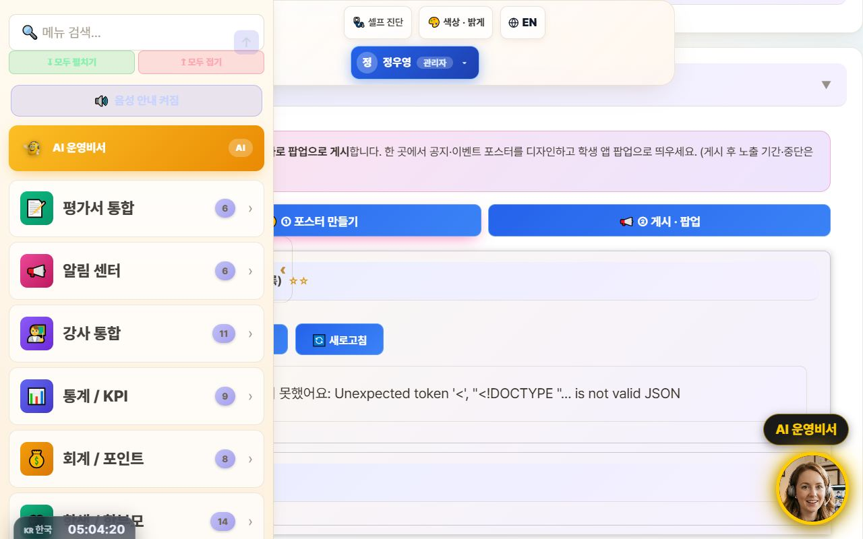
🤝 Mangoi Agency User Guide
How to Use the Main Features
17
📢 Notice Studio (Poster + Popup)
Design notice/event posters and push them as app popups
This merges the old ‘Poster Maker’ and ‘Popup Notice’ tools into one place. In the ①Create tab you design a notice/event poster, then hand it straight to the ②Publish·Popup tab to show it as a popup in your agency's student app.
1
Notificati…
›
2
①Create
›
3
‘📢 Publish…
›
4
display pe…
How to use
● Go to the admin menu Notification Center → 📢 Notice Studio.
● In the ①Create tab, design a poster with text, images, and video (resize · save on server · reuse).
● Press ‘📢 Publish as popup’ on the finished poster to auto-switch to the ②Publish·Popup tab.
● In the publish tab, set the display period / stop and publish it as a student-app popup.
✅ Key Points
Good to know · Existing posters/popups are preserved (it was only merged, nothing was deleted).
💡 Tip · Promoting an event takes just one flow: ‘Create → Publish as popup’ right away.
● Poster creation and popup publishing flow through one screen, two tabs — no more confusion.
● Posters you make can be saved and reused.
● Whichever route you enter from — AI assistant or sidebar search — the correct tab opens.

Slide 22
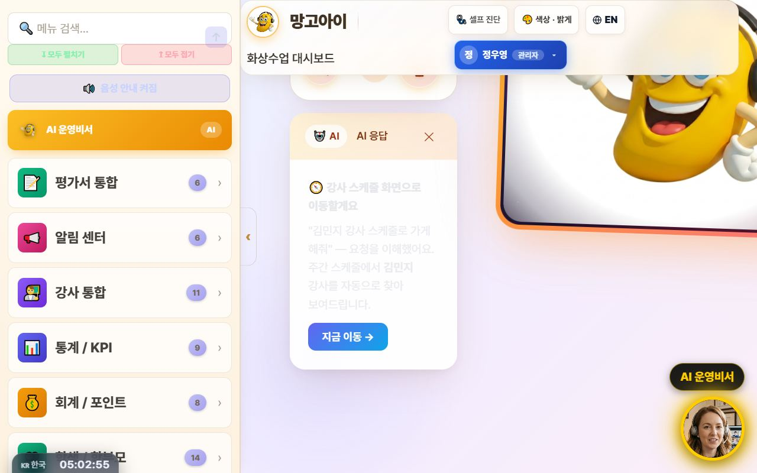
🤝 Mangoi Agency User Guide
How to Use the Main Features
18
🤖 Command the AI Operations Assistant
Navigate with one phrase: “Take me to ○○”
Type what you want to do into the top search bar (or the bottom-right AI assistant) in plain language, and the AI understands and jumps straight to that screen. It now reliably follows navigation commands like ‘Take me to teacher ○○'s schedule’ or ‘Open auto-scheduling’.
1
search bar
›
2
“Take me t…
›
3
“Open auto…
›
4
‘Go now →’
How to use
● Type a command in the top search bar or speak with the 🎤 mic.
● e.g. “Take me to teacher Kim Minji's schedule” → auto-finds that teacher in the weekly schedule and opens it.
● e.g. “Open auto-scheduling,” “Go to settlement” to navigate menus.
● Press ‘Go now →’ on the AI response card to move to that screen.
✅ Key Points
Good to know · Commands that actually change things — ‘register · send · modify’ — ask for one more confirmation (a safety guard).
💡 Tip · When you can't recall a menu name, just say what you want to do — it finds its way there.
● Navigation commands actually navigate — far fewer ‘explain only, do nothing’ replies.
● Searching a schedule by teacher name auto-fills the search box + filters + scrolls.
● For data/statistics questions it also helps with card-style answers.

Slide 23
🤝 Mangoi Agency User Guide
How to Use the Main Features
19
💬 Share Library Links via KakaoTalk
Send videos & docs in original quality
Every guide and video in the library now has a '💬 Copy KakaoTalk link' button. Attaching a file to KakaoTalk crushes the quality, but sending a link plays the original as-is. One tap copies the link — guiding parents and teachers gets much easier.
1
Library
›
2
Paste
›
3
original q…
How to use
● In the admin Library, press 💬 Copy KakaoTalk link next to the file.
● Paste it into the KakaoTalk chat room.
● Recipients tap the link to watch or download in original quality.
✅ Key Points
● For videos, link sharing = original quality; file attachments degrade it.
● Works the same for PDFs, PPTs, and videos anywhere in the library.
Good to know · Anyone with the link can open it. For internal-only material, check who you share with.
💡 Tip · In a parents' group chat, one video-guide link does all the explaining.

Slide 24
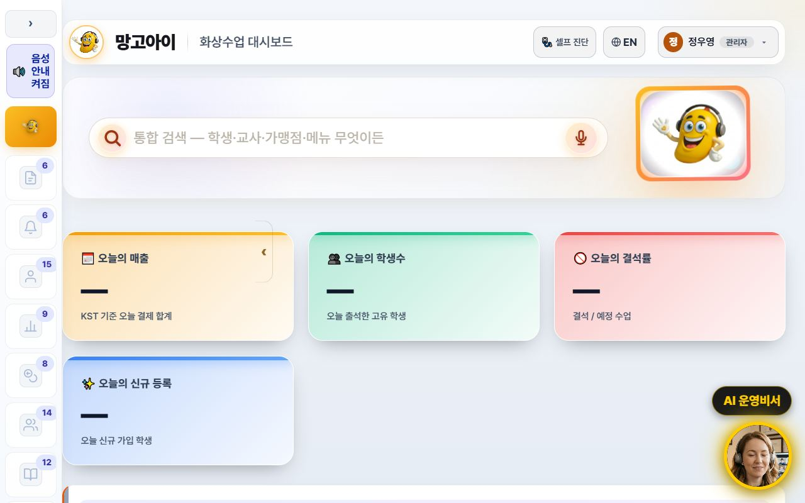
🤝 Mangoi Agency User Guide
How to Use the Main Features
20
🧭 A refreshed admin screen
Collapsible sidebar · lighter background · line icons
The admin screen is now easier on the eyes and wider. The left menu collapses to a narrow icon rail via the ‹ Collapse button, and the background is now a consistent light tone. Menu icons were redrawn as line icons so labels read clearly.
1
‹ Collapse
›
2
›
›
3
remembered…
›
4
menu searc…
How to use
● Press ‹ Collapse at the top of the left menu — it shrinks to an icon rail and the content gets wider.
● Press the › button in the same place to expand it again.
● The collapsed state is remembered for your next visit.
● Too many menus to find one? Type its name into menu search at the top.
✅ Key Points
● Screens full of tables and lists gain a lot of horizontal space.
● 15 sub-pages were moved onto the same light theme, so the colour jump between screens is gone.
● The collapse animation was removed so low-spec PCs don't stutter.
💡 Tip · Wide-table screens like settlement and payroll are far easier to read with the menu collapsed.

Slide 25
🤝 Mangoi Agency User Guide
How to Use the Main Features
21
🌐 The interface language sets itself
Overseas staff and teachers start in English
Filipino teachers and overseas staff now start in English from the first screen. The interface language is decided from the account's nationality, and teacher accounts are always English regardless of name or previous choice. You can still switch any time with the 🌐 EN / KR button at the top.
1
nationalit…
›
2
🌐 EN / KR
›
3
per accoun…
›
4
switch to…
How to use
● If the account has a nationality on file, the right language appears automatically at login.
● To change it manually, press the 🌐 EN / KR button at the top.
● A manual choice is stored per account — several people can share one PC without interference.
● Teacher guide slides and manuals switch to the English editions with it.
Good to know · Accounts with no nationality fall back to the old name/ID heuristic. Please fill in nationality when registering teachers.
💡 Tip · Enter nationality when registering a new teacher and their very first login is in English — fewer support requests.
✅ Key Points
● Teacher accounts are always English — no more getting lost in a Korean screen.
● Accounts with an English name no longer flip to Korean because of a Korean job title.
● Language choice is isolated per account, so an overseas account isn't overwritten by someone else's pick.

Slide 26
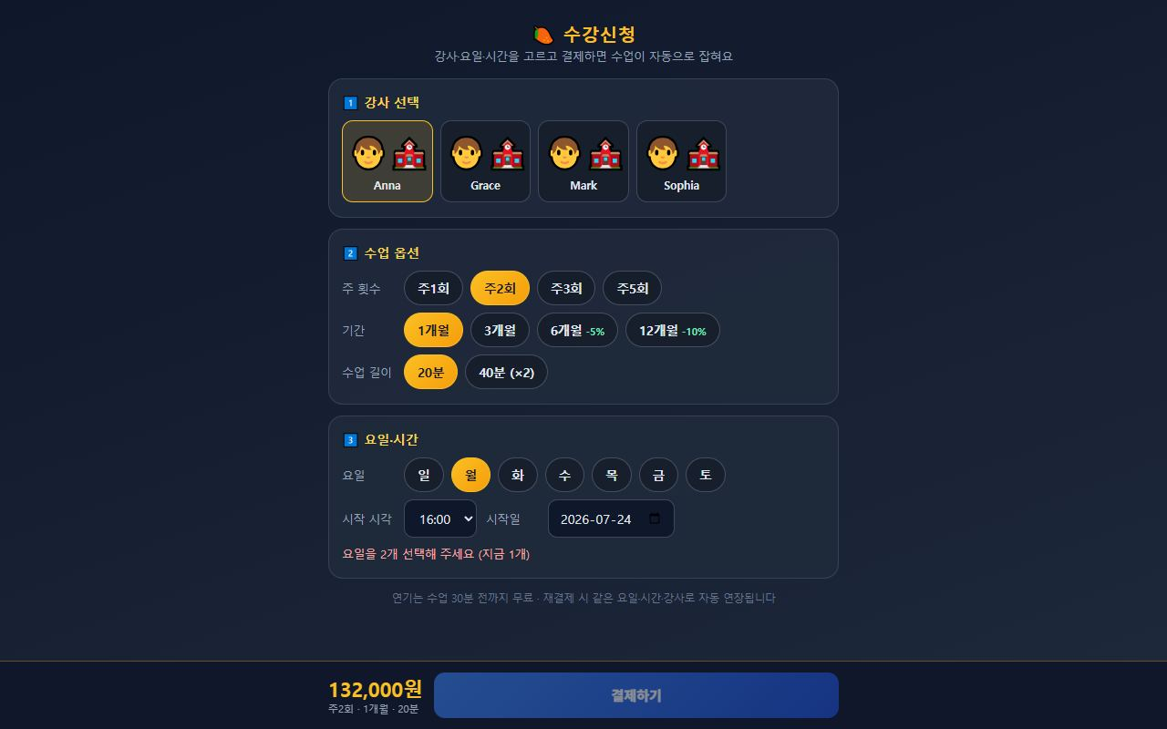
🤝 Mangoi Agency User Guide
How to Use the Main Features
22
💳 Enrolment & payment → automatic lesson creation
Once payment is confirmed, every session is scheduled
On the Enrolment screen a student picks teacher, days and time and pays — and all lesson sessions are created automatically the moment payment is confirmed. The old manual timetable entry after payment is gone. If the slot clashes with an existing lesson, the conflict is detected before payment.
1
enrolment…
›
2
teacher →…
›
3
slot check…
›
4
all sessio…
›
5
pricing sc…
How to use
● Send students and parents the enrolment link.
● They choose teacher → lesson options (weekly count, term, length) → days & time.
● The slot check must pass before the pay button unlocks (payment is blocked on a clash).
● On confirmed payment, all sessions are created at once — verify in the admin lesson list.
● Head-office prices and discount rates are managed on the pricing screen.
✅ Key Points
Good to know · Stage 1 (enrol → pay → auto-create sessions) is live today. Later stages will follow.
💡 Tip · Consultation → level test → send the enrolment link is the smoothest conversion path.
● Idempotent — a duplicated payment callback will not create the sessions twice.
● Clashes with holidays or existing lessons are pushed back so the session count is still met.
● Term discounts (6 months −5%, 12 months −10%) are applied to the amount automatically.

Slide 27
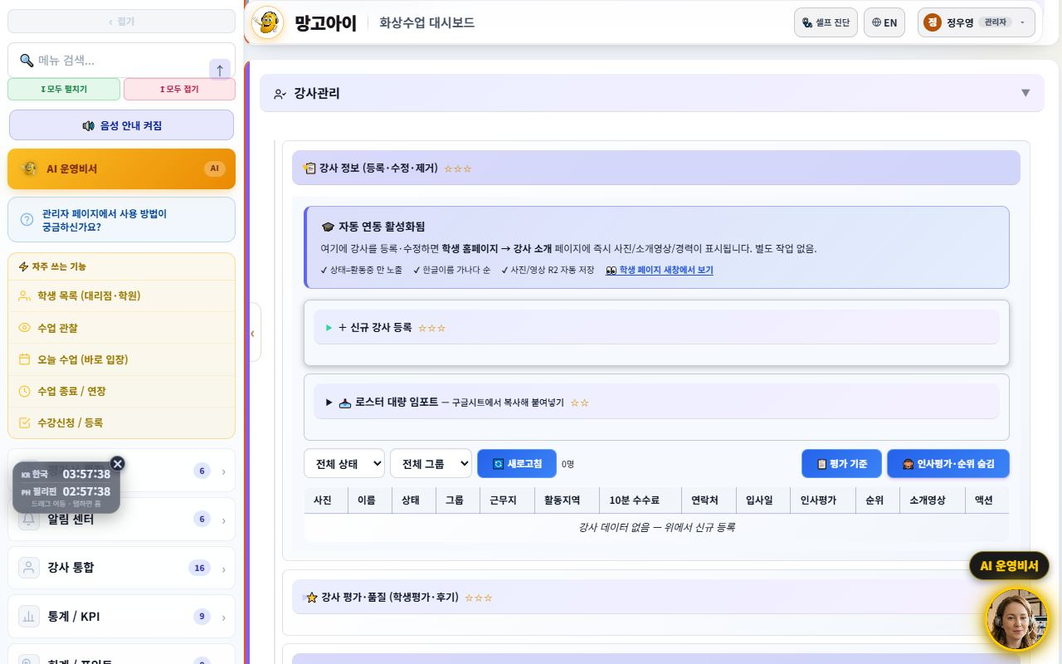
🤝 Mangoi Agency User Guide
How to Use the Main Features
23
🗂️ Teacher Management, redesigned (roster filters · groups · detail tabs)
Easy-to-search roster · detail at a glance
The teacher-management screen is now easier to search and read. Scattered menus are grouped into four bundles in the sidebar, and above the roster there are status/group dropdown filters with applied-filter chips. Tapping a teacher opens a detail view split into Profile / Payroll / Evaluation tabs, with a manager badge and employment status (active / on-leave / left) shown at a glance.
1
Teachers
›
2
status/gro…
›
3
chips
›
4
Profile /…
›
5
summary nu…
How to use
● Open Teachers in the admin menu (menus are tidied into four bundles).
● Filter to just the teachers you want with the status/group dropdowns above the roster.
● Applied filters show as chips; remove a chip to clear it.
● Tap a teacher to open the Profile / Payroll / Evaluation detail tabs.
● The summary numbers on the payroll/evaluation tabs load only as needed when opened.
Good to know · This is a filtering/detail cleanup. Registering, editing and deleting teachers works exactly as before.
💡 Tip · The more teachers you have, the more the status/group filters help. Keep your usual conditions filtered.
✅ Key Points
● Managers are marked with a badge, and status shows as active / on-leave / left (3 states).
● A blank name falls back to the ID, so there are no empty cells.
● Detail tabs reuse existing APIs for speed, and the screen is bilingual (KO/EN).
● The duplicate payroll entry was tidied and bug reports moved to a separate system.

Slide 28

🤝 Mangoi Agency User Guide
How to Use the Main Features
24
🌟 Sending the Parent Monthly Report (pentagon)
Preview the 5-axis report, then share the link
The monthly report sent to parents is renewed as a pentagon 5-axis graph — Pronunciation & Fluency / Vocabulary / Sentence Building / Class Attitude / Participation — at a glance, with attendance, judgment and a teacher's note. Admins and teachers enter a student ID and month to preview, then send the KakaoTalk link.
1
Monthly Re…
›
2
student ID
›
3
Check the…
›
4
?uid=ID&pe…
How to use
● Open the Monthly Report screen.
● Enter a student ID and month, press View Report to preview.
● Check the pentagon and teacher's note; top up evaluations if needed.
● Append ?uid=ID&period=YYYY-MM to the URL and send the KakaoTalk link.
✅ Key Points
● Only axes with real records are filled, so it's trustworthy.
● Compiled on a two-month cycle — conveys change without tiring parents.
● The Print/PDF button makes a paper report for consultations instantly.
Good to know · Report access passes an approval gate — admins via their login session, parents only via the issued link (token).
💡 Tip · Sending the report link ahead of a booked consultation makes the meeting much smoother.

Slide 29
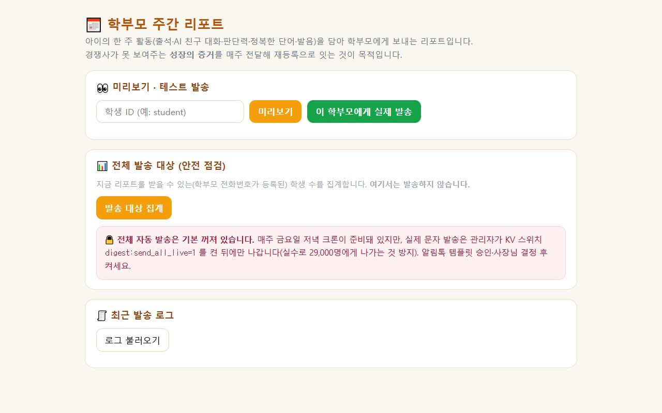
🤝 Mangoi Agency User Guide
How to Use the Main Features
25
📅 Parent Weekly Report (the re-enrolment lever)
Deliver the proof of growth competitors cannot show
A report sent to parents containing the child's week of activity (attendance, AI friend chats, judgment training, words conquered, pronunciation). The purpose is explicit — deliver the proof of growth competitors cannot show, every week, and convert it into re-enrolment. The admin screen covers preview → test send → recipient count → send log.
1
📅 Parent W…
›
2
Preview
›
3
Send to th…
›
4
Count reci…
›
5
Recent sen…
How to use
● Open 📅 Parent Weekly Report in the admin menu.
● Enter a student ID and press Preview to check the content.
● If needed, use Send to this parent to test with a single recipient.
● Use Count recipients to see how many students can receive it (those with a registered phone number).
● Check Recent send log for what actually went out.
Good to know · 🔴 The full automatic send is OFF by default. Real messages only go out after an admin turns on the KV switch — a safeguard against accidentally messaging 29,000 people. Turn it on only after the alert-talk template is approved and management has decided.
💡 Tip · Start with preview → a single test send only. Once the wording is settled, then turn on the full switch.
✅ Key Points
● What the report contains: 📅 attendance days · 🔥 streak · 🤖 AI chats · 📚 words conquered · 🧠 judgment · 🎤 pronunciation.
● Only students with a registered phone number can receive it — the count screen also reports how many are missing one.
● A Friday-evening automatic send (cron) is prepared and ready.

Slide 30

🤝 Mangoi Agency User Guide
How to Use the Main Features
26
🏠 Home Screen Split (first-time parent vs. existing member)
Fewer 'how do I start?' calls, more trial sign-ups
The first screen of the site (the hero) now shows one of two versions depending on who is looking. A first-time parent sees <b>Book a Free Trial</b> as the biggest button; a logged-in member sees <b>Enter Class</b>. We checked four competitors directly (Cambly Kids, Min Byung-chul UPhone, Engoo, Ringle) and all four lead with a new-customer call to action — this change follows that evidence.
1
home URL i…
›
2
Book a Fre…
›
3
Enter Clas…
›
4
plain home…
How to use
● Open the home URL in a private/incognito window to see the guest screen.
● Confirm the two large buttons: Book a Free Trial · Browse Teachers.
● Log in and open the same page — it becomes Enter Class · Chat with AI.
● Use the plain home URL in flyers and text messages — no separate landing page is needed.
✅ Key Points
Good to know · Never remove the small 'Enter Class' link on the guest screen. Existing members also land there when their login expires (30 days) or they switch devices.
💡 Tip · To see what a parent sees, open the home page in an incognito window — that is the exact first impression.
● No new page was created. The same URL decides for itself based on login state.
● The guest screen still keeps a small 'Enter Class' link — this prevents an existing student who changed devices or was logged out from being locked out of class.
● If the check fails for any reason, it always falls back to the guest screen — the page is never blank.
● No flicker. The decision is made before the page paints.

Slide 31
🤝 Mangoi Agency User Guide
How to Use the Main Features
27
⚡ The Admin Screen Is Much Faster Now
The freeze after clicking is gone
We removed the brief freeze that happened whenever you clicked something in the admin screen. The cause was not the feature you clicked — a readability-enhancement routine was recalculating every collapsed card each time. It now skips collapsed cards and never re-touches what it has already processed.
1
Use the ad…
›
2
open immed…
›
3
hard refre…
How to use
● Use the admin screen as usual.
● Check that menus and cards open immediately, with no freeze.
● If it still feels slow, do a hard refresh (Ctrl+F5) in the browser.
✅ Key Points
● Freeze on click dropped 396ms → 57ms; idle load dropped 366ms → 0ms.
● Nothing about the look or colours changed — only the speed.
● The difference is largest on card-heavy screens (teacher and student lists).
Good to know · If your browser still holds an old copy of the page you may not feel the improvement. Do one hard refresh (Ctrl+F5).
💡 Tip · If it is still slow, check whether too many browser tabs are open.

Slide 32
🤝 Mangoi Agency User Guide
How to Use the Main Features
28
🔎 Academy Search Box (find it by name)
No more scrolling the whole list
The academy (branch/agency) list now has a search box so you can find one by typing its name. No more scrolling up and down a long list.
1
academy li…
›
2
search box
›
3
matching a…
›
4
full list
How to use
● Open the academy list screen in the admin menu.
● Type part of an academy name into the search box above the list.
● The list filters to matching academies as you type.
● Clear the box to return to the full list.
✅ Key Points
● A partial name is enough to find it.
● The existing list and its features are unchanged — only the way you find things was added.
💡 Tip · For academies you check often, remember two or three letters of the name — that is enough to filter instantly.

Slide 33
🤝 Mangoi Agency User Guide
How to Use the Main Features
29
💳 New-Payment Screen, Now Step-by-Step
It no longer shows 12 products at once
The new-payment screen now starts with 'who is this for?'. Previously all 12 products appeared at once and parents had no idea where to start. Now they pick from Kids · 1:1 · Group · Business · Test Prep · Corporate and only the matching products remain.
1
New Paymen…
›
2
audience
›
3
Only the p…
›
4
See Full P…
How to use
● Point the parent to the New Payment screen.
● Have them pick the audience first (Kids, 1:1, Group, Business, Test Prep, Corporate).
● Only the products for that audience stay on screen.
● If they want to compare everything, press See Full Price List.
✅ Key Points
● No product card or payment logic was changed — only what is displayed, so it is safe.
● Verified counts: 3 initially (free trial, other, policy) → 4 when Kids is selected → 12 in full view.
● See Full Price List was deliberately kept — hiding prices backfires.
💡 Tip · When a caller says 'I don't know which one to pick', just have them choose the audience first.

Slide 34
🤝 Mangoi Agency User Guide
How to Use the Main Features
30
📋 Sample Report Card for Parents Without an Account
Something to show in front of the login wall
Until now there was nothing to show a prospective parent who had no account. The report-card screen now offers 'No account — view a sample report first', so you can show what the 5-axis scores + teacher comment + AI analysis look like without logging in.
1
report-car…
›
2
No account…
›
3
Walk throu…
›
4
Close with…
How to use
● During a consultation, open the report-card screen for the parent.
● Press No account — view a sample report first.
● Walk through the 5-axis scores, teacher comment and AI analysis together.
● Close with 'this is what you'll receive for your child' and offer the trial.
✅ Key Points
Good to know · The sample uses no real student data. Use it for consultations only.
💡 Tip · Showing the sample report in the first three minutes of a consultation makes 'what do I actually get?' concrete and lifts trial conversion.
● ⚠️ All values are examples. The title and top banner are marked 'Sample'.
● Never remove that marking — if it is mistaken for a real record it becomes a trust problem.

Slide 35
🤝 Mangoi Agency User Guide
How to Use the Main Features
31
📞 Unified Support Hours & Channel Order (KakaoTalk first)
One value across every screen
Support hours previously appeared as 09-22 / 10-20 / 7 p.m. on different screens. They are now unified to 10:00–23:00 (closed weekends and public holidays). The KakaoTalk channel was also moved to first place, and the phone card now notes that KakaoTalk is faster.
1
Contact
›
2
point them…
›
3
10:00–23:0…
How to use
● On the Contact screen, confirm the card order is KakaoTalk → phone.
● When advising parents, point them to the KakaoTalk channel first.
● Quote support hours as 10:00–23:00 (closed weekends and holidays).
✅ Key Points
● Places corrected: contact screen, home menu, FAQ (both languages), AI consultant fact block, student FAQ — all the same value now.
● The unused fax number and placeholder phone numbers were deleted.
● The AI consultant quotes the same hours and the same channel order.
Good to know · If real operating hours change, all of these must be updated together. Changing only one brings the inconsistency straight back.
💡 Tip · If you need the Philippines call-centre numbers listed, provide the real ones — the previous placeholders were removed.

Slide 36
🤝 Mangoi Agency User Guide
Feature Summary · Data
32
📋 Agency Features at a Glance
Feature | What it does | When | Core benefit
Dashboard | Revenue·enrollment·today | Every morning | Quick read
Student mgmt | Recruit·enroll·history | Always | Grow enrollment
Parent comm | Guide My Page | Enroll·re-enroll | Satisfaction ↑
Booking | Schedule·teacher | Assigning lessons | Smooth flow
Payments | Payments·overdue·refunds | Collection | Stable revenue
Reports | Learning performance | Counsel·re-enroll | Persuasion ↑
Settlement | Receive branch→agency | Monthly | Transparent profit
Retention | Care for at-risk | Always | Retention ↑

Slide 37
🤝 Mangoi Agency User Guide
Data at a Glance
33
📊 Data at a Glance
Enrollment Trend (example)
Churn-risk Distribution (example)

Slide 38
🤝 Mangoi Agency User Guide
Frequently Asked Questions (FAQ)
34
❓ Frequently Asked Questions (FAQ)
Q. Where do I log in?
A. Log in at admin.mangoi.co.kr. By role (agency), only your agency's data shows automatically.
Q. Can I see other agencies' data?
A. No. By permission scope, only your agency's data is visible.
Q. How do I grow enrollment?
A. Fast counseling response, a smooth trial→enroll flow, and persuading parents with learning reports are key.
Q. How do I check settlement?
A. Branch→agency settlement (received) is auto-calculated by the org tree; check it in the monthly report.
Q. A student seems about to quit.
A. Watch churn-risk signals (absences·performance drop) and intervene quickly with counseling/alert-talk.

Slide 39
🤝 Mangoi Agency User Guide
Checklist
35
✅ Agency Operations Checklist
Did you check today's revenue/enrollment/attendance?
Did you take and respond to new counseling/inquiries?
Did you check and notify overdue items?
Did you care for at-risk students?
Did you guide parents to the report/My Page?
Did you check this month's settlement (received)?
Did you follow up on trial→enroll?

Slide 40
🤝 Mangoi Agency User Guide
Conclusion
36
🏁 Conclusion · A Practical Guide to Agency Growth
The core of agency operations is the virtuous cycle of 'recruit → enroll → satisfy → re-enroll.' Respond to counseling fast, show learning results with data, and prevent churn early — and your agency grows steadily. Keep this rhythm and operations feel solid.
🔄 The Flow at a Glance
⭐ Key Principles
Morning (5 min)
Check revenue/enrollment/attendance on the dashboard; check live-lesson status
● Respond fast — the faster you handle counseling/inquiries, the higher conversion.
● Persuade with data — showing results via learning reports makes re-enrollment easy.
● Intervene on churn early — care first for frequently-absent students.
● Communicate with parents — build trust with My Page and reports.
● Follow up — following up after counseling completes enrollment.
Late morning
Respond to new counseling·convert; notify overdue
Class hours
Check lesson assignment/progress; guide 'entry' tickets to browser/permission first
Afternoon
Care for at-risk students; parent reports·counseling
Monthly
Check branch→agency settlement; re-enroll·follow-up
📌 Remember
● Log in at admin.mangoi.co.kr; data is auto-limited to your agency scope
● Settlement is auto-calculated by the branch→agency tree
● Most 'can't enter class' tickets are browser/permission issues
● Growth rhythm: 'Recruit → Enroll → Satisfy → Re-enroll'!
🍊 An agency's strength comes from 'the care you give each student.' Respond quickly, show results, and prevent churn early. Your branch and HQ back you up solidly. Questions? Contact support anytime — cheering on your thriving agency! 🍊

Slide 41
Let's grow together with Mangoi!
Questions? Ask the on-site A.i assistant or contact customer support.
🌐 www.mangoi.co.kr 📞 1644-0561 ✉ support@mangoi.co.kr

