Slide 1

🏫 ADMIN GUIDE
Mangoi · MANGOI
Admin User Guide
Everything about running your academy, in one book
For · Academy directors · HQ · operations managers | www.mangoi.co.kr

Slide 2
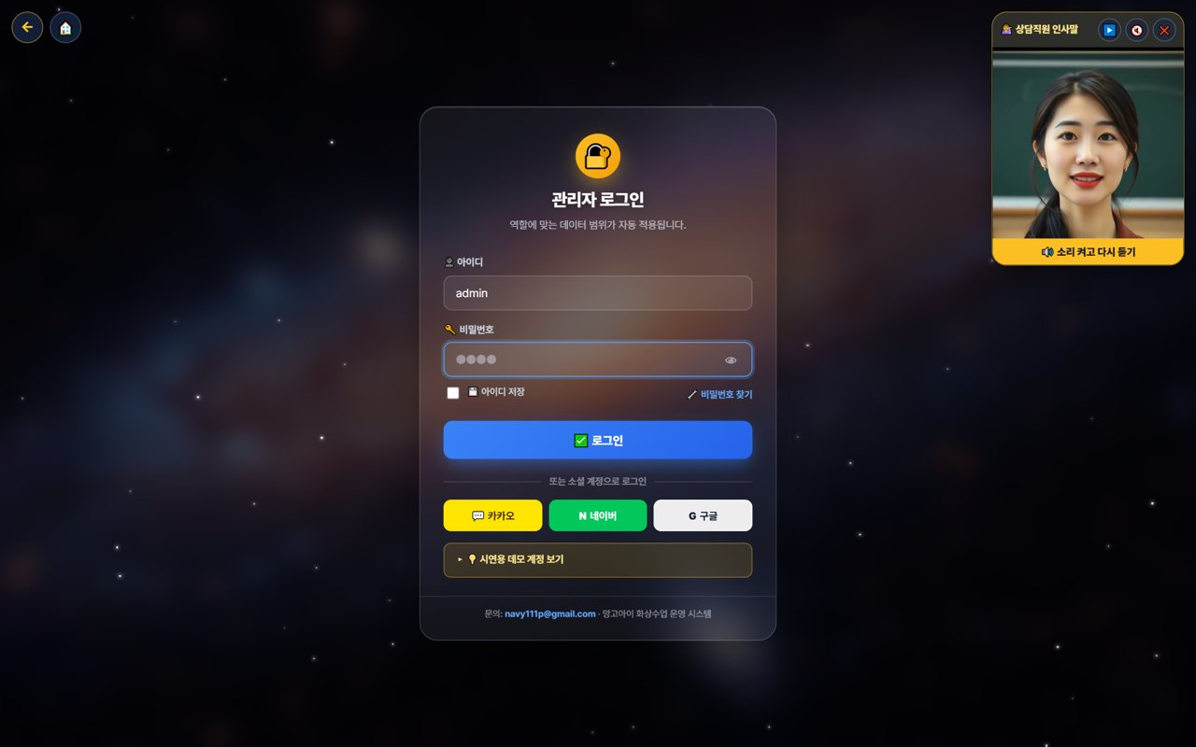
🏫 Mangoi Admin User Guide
Introduction
What is the Admin Page?
The admin page gathers everything you need to run an academy — students, teachers, payments, parents and content — on one screen. In particular, the AI Operations Assistant looks things up and even handles tasks when you tell it by voice or text, making operations much faster. Menus and data scope adjust automatically based on your role (permissions).
🤖
AI Ops Assistant
🔎
Feature search · card menus
Tell it by voice/text; it finds and handles it.
Type part of a name to jump right there.
🧲
Retention Center
🌳
Org settlement
Churn risk · contagion · settlement · coaching hub.
HQ → branch → agency auto-settlement.
Today's Key Metrics (example)

Slide 3
🏫 Mangoi Admin User Guide
Contents
📑 Contents (1/2)
Introduction
2
11
Refund Policy & Processing
15
01
Admin Login & Permissions
5
12
Student · Parent Management
16
02
Dashboard & Feature Search
6
13
Parent My-Page
17
03
AI Operations Assistant
7
14
Booking Management
18
04
Understand Lesson Entry
8
15
Postpone Management
19
05
Understand the Classroom Layout
9
16
Content · Curriculum
20
06
Understand the Classroom Tools
10
17
Retention Center
21
07
In-class Praise Points (give & accrue)
11
18
Org Settlement · Monthly Report
22
08
Teacher Management
12
19
Support · FAQ Operations
23
09
Accounting · Points
13
20
Korea·Philippines Dual Clock
24
10
Points & Reward Policy
14

Slide 4
🏫 Mangoi Admin User Guide
Contents
📑 Contents (2/2)
21
Chinese Pronunciation Coach
25
32
Class Observation (live)
36
22
Notice Studio (Poster + Popup)
26
33
A refreshed admin screen
37
23
Command the AI Operations Assistant
27
34
The interface language sets itself
38
24
Student Voice-Diary Monitor
28
35
Running Judgment Training (student judgment index)
39
25
Teacher AI-Coaching Review (Ops)
29
36
Teacher accounts (password reset · access limits)
40
26
QR Attendance Check-in
30
37
Feature Summary · Data
41
27
Consultation Booking Management
31
38
Data at a Glance
42
28
Friend-Referral Rewards
32
39
Frequently Asked Questions (FAQ)
43
29
Approving Postpone/Change Requests
33
40
Checklist
44
30
Share Library Links via KakaoTalk
34
41
Conclusion
45
31
Enrolment & payment → automatic lesson creation
35

Slide 5
🏫 Mangoi Admin User Guide
How to Use the Main Features
01
🔐 Admin Login & Permissions
Data scope by role, automatically
Logging in with an admin account shows only the menus and data that match your role (director, HQ, staff, etc.). Social login and password reset are supported.
How to use
● Log in with ID and password (Kakao, Naver, Google also work).
● Forgot your password? Reset via 'Find password' (SMS/email/Kakao).
● Visible menus and data scope change automatically by role.
● New here? Preview with 'View demo account'.
✅ Key Points
● Permission settings let you split access per staff member.
● Turn on 'Save ID' only on your own trusted PC.
💡 Tip · On shared PCs, turn off auto-login and always log out when done.

Slide 6
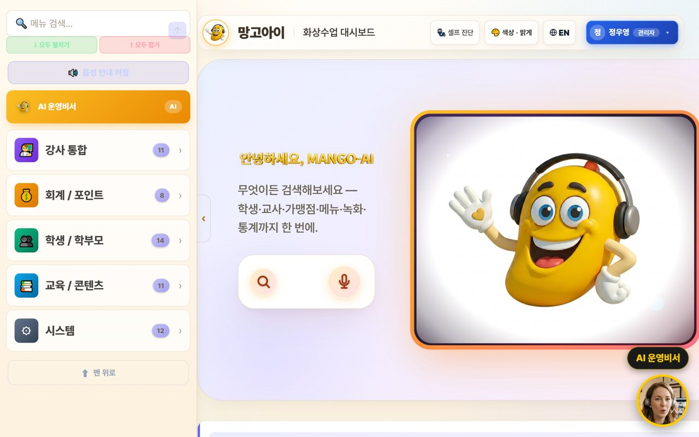
🏫 Mangoi Admin User Guide
How to Use the Main Features
02
🏠 Dashboard & Feature Search
Every feature as a card
After login, categories (Teachers, Accounting, Students, Content, System) are organized as cards. Just type a word in the top search box to jump straight to a feature.
How to use
● From the category cards (Teachers·Accounting·Students·Content·System), tap the feature you want.
● Type a word in the feature search box to jump right there.
● The number beside each category is how many features it holds.
● Use Self-check · Color/Bright · EN at the top to change screen and language.
✅ Key Points
● If you can't find a feature, search is fastest.
● You can also tell the AI assistant 'open ○○' to jump there.
💡 Tip · Remember search terms for features you use often to cut clicks.

Slide 7
🏫 Mangoi Admin User Guide
How to Use the Main Features
03
🤖 AI Operations Assistant
Tell it by voice/text; it acts
Speak or type into the search/mic and the AI looks up numbers or opens screens. Important actions are confirmed first, and it only does what your permissions allow — so it's safe.
How to use
● Speak or type into the center search/mic. e.g. 'How's today's revenue?'
● The AI looks up numbers or opens a screen. e.g. 'Open student management.'
● Important actions are confirmed with 'Shall I?' first. e.g. 'Push Jung Woo-young's next lesson by 1 hour.'
● The assistant only executes tasks you have permission for.
✅ Key Points
● Can't find a button? Just say 'show me ○○'.
● Voice and text both work the same.
💡 Tip · When busy, telling it by voice is much faster than clicking.

Slide 8
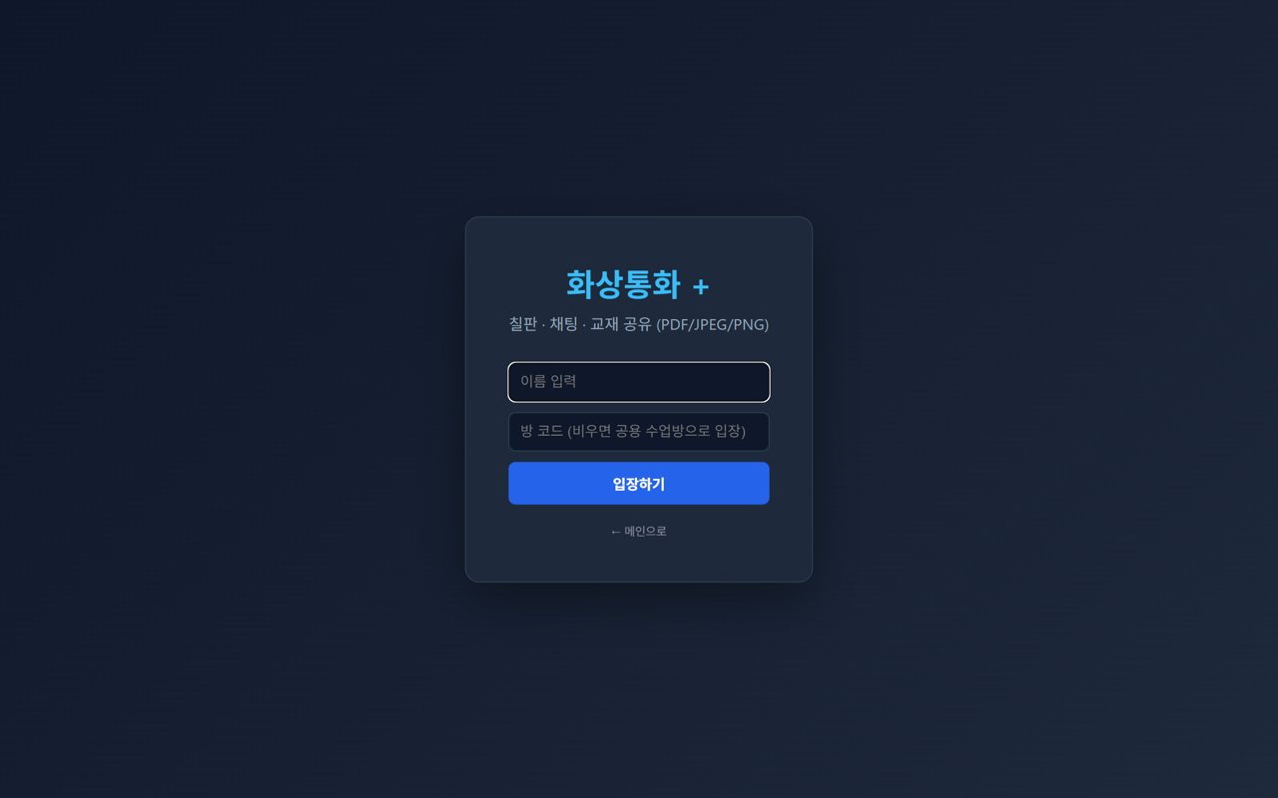
🏫 Mangoi Admin User Guide
How to Use the Main Features
04
🎥 Understand Lesson Entry
To support students & teachers
Even without teaching, admins should know how students and teachers enter so you can answer questions and fix problems. Entry uses a name and a room code (or the shared room).
How to use
● On the entry screen, enter a name and room code, then press Enter.
● If the room code is empty, you go to the shared lesson room.
● Advise that the browser's camera/mic permission is required.
● For trouble, first advise reconnecting in Chrome/Edge.
✅ Key Points
● KakaoTalk's in-app browser blocks the camera — 'open in an external browser' is needed.
● Lessons needing room/token management can be checked from the admin screen.
⚠️ Good to know · Most 'can't enter' tickets are browser permission issues — check permissions and browser first.
💡 Tip · Turn frequent entry questions into an FAQ to cut support load.

Slide 9
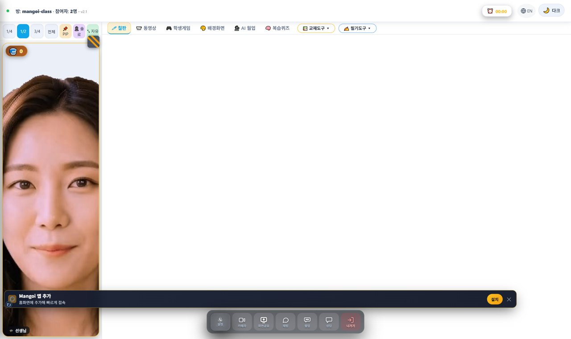
🏫 Mangoi Admin User Guide
How to Use the Main Features
05
🖥️ Understand the Classroom Layout
Screen structure for support
Admins don't teach, but knowing the classroom layout makes support easy. It has a top bar (room info, timer, REC, EN, dark), a center workspace (tab tools), and a bottom control dock (camera, screen share, chat, leave).
How to use
● Top bar: room name · user count · timer · recording (REC) · language (EN) · dark mode.
● Center tabs: Board · Video · Games · Background · AI Warm-up · Review Quiz + Materials Tools · Writing Tools.
● Bottom dock: Settings · Camera · Screen Share · Chat · Native · Leave.
● The 🧺 praise basket at the top-left collects praise during class.
✅ Key Points
● For 'no sound/video' tickets, tell users to check the dock's camera/mic and ⚙️ Settings.
● The REC indicator shows whether a lesson is being recorded.
💡 Tip · Turn common classroom questions into an FAQ with these screenshots.

Slide 10
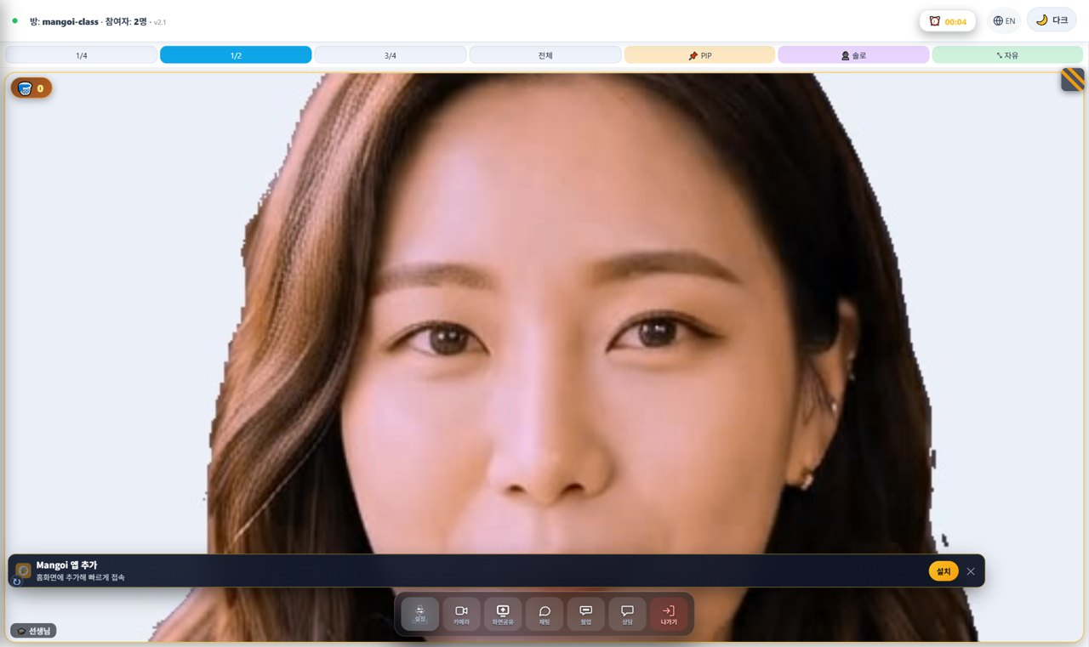
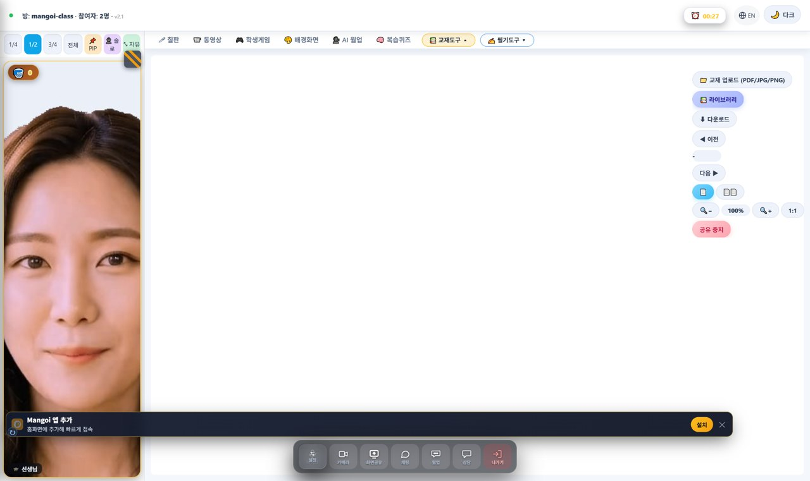
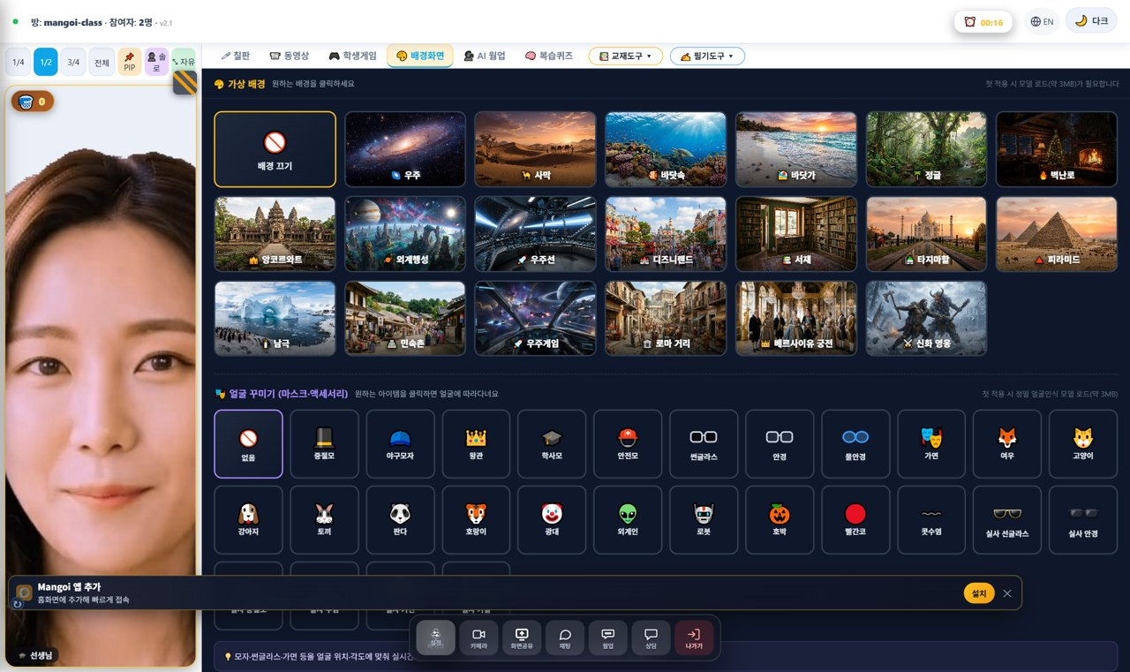
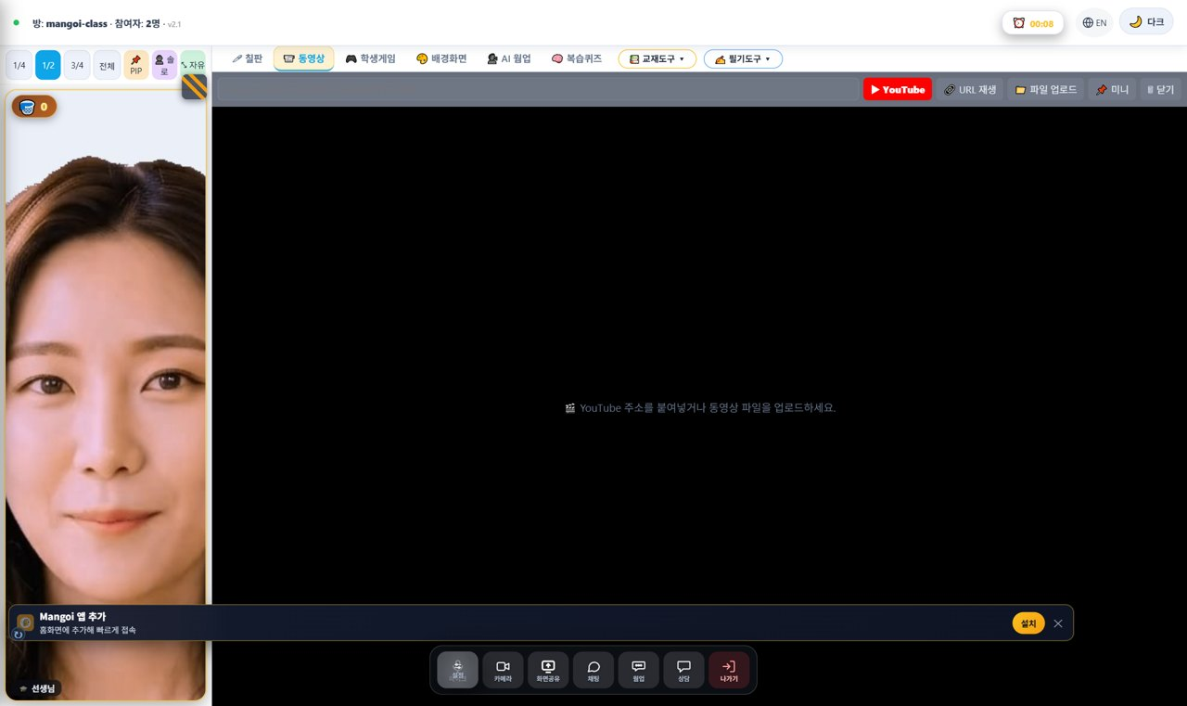
🏫 Mangoi Admin User Guide
How to Use the Main Features
06
🧰 Understand the Classroom Tools
Board · materials · background · video
Knowing the tools students and teachers use makes guidance easier. The core ones are the board (draw/save), materials tools (upload PDF/photos, library), background (backdrop & face decorations), and video (YouTube/file).
How to use
● 🖊 Board: pen, shapes, text, AI shapes, save.
● 📚 Materials Tools: upload (PDF/JPG/PNG), library, page turning, fit-to-screen.
● 🎨 Background: change backdrop, decorate face.
● 📹 Video: share YouTube links / video files.
✅ Key Points
● The materials 'Library' shows textbooks the admin uploaded — it ties into content management.
● Coach teachers on the 'pre-upload materials → share in class' flow.
💡 Tip · A well-stocked textbook library helps teachers prep faster.

Slide 11
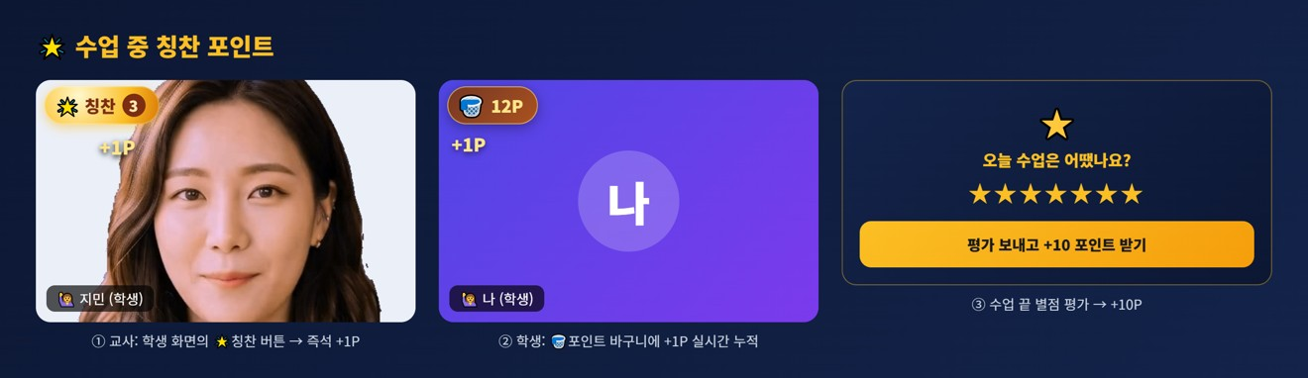
🏫 Mangoi Admin User Guide
How to Use the Main Features
07
🌟 In-class Praise Points (give & accrue)
Teacher gives → adds to student points
During class the teacher instantly gives praise points (+1P) to students, and a post-class star rating adds +10P. These sum into the student's total points and are spent in the point shop, roulette, etc. Admins manage the points policy and shop.
How to use
● The teacher gives +1P instantly via the 🌟 praise button on a student's video.
● It accrues in real time in the student's 🧺 point basket and sums into their total (P).
● A post-class star rating gives the student an extra +10P.
● Accrued points connect to rewards in the point shop / roulette.
● Admins manage accrual/usage policy under Accounting/Points.
✅ Key Points
● Instant rewards help participation and re-enrollment.
● Shaping shop rewards lets you tune learning motivation.
⚠️ Good to know · Praise points are given by the teacher; the points policy and shop are the admin's job.
💡 Tip · Periodically check that points flow well (given & spent) to manage motivation.

Slide 12

🏫 Mangoi Admin User Guide
How to Use the Main Features
08
👩‍🏫 Teacher Management
Payroll · matching · reviews · MBTI
Manage the teacher list, profiles, payroll, matching and reviews in one place. Gather star ratings students leave, by teacher, to use in coaching.
How to use
● In Teachers, check the teacher list, profiles and matching.
● Manage payroll, MBTI/style and student↔teacher matching.
● Gather each teacher's lesson reviews (stars).
✅ Key Points
● Better matching raises re-enrollment.
● Link low-rated teachers to the coaching tab.
💡 Tip · Assign top teachers to popular slots first to boost satisfaction.

Slide 13
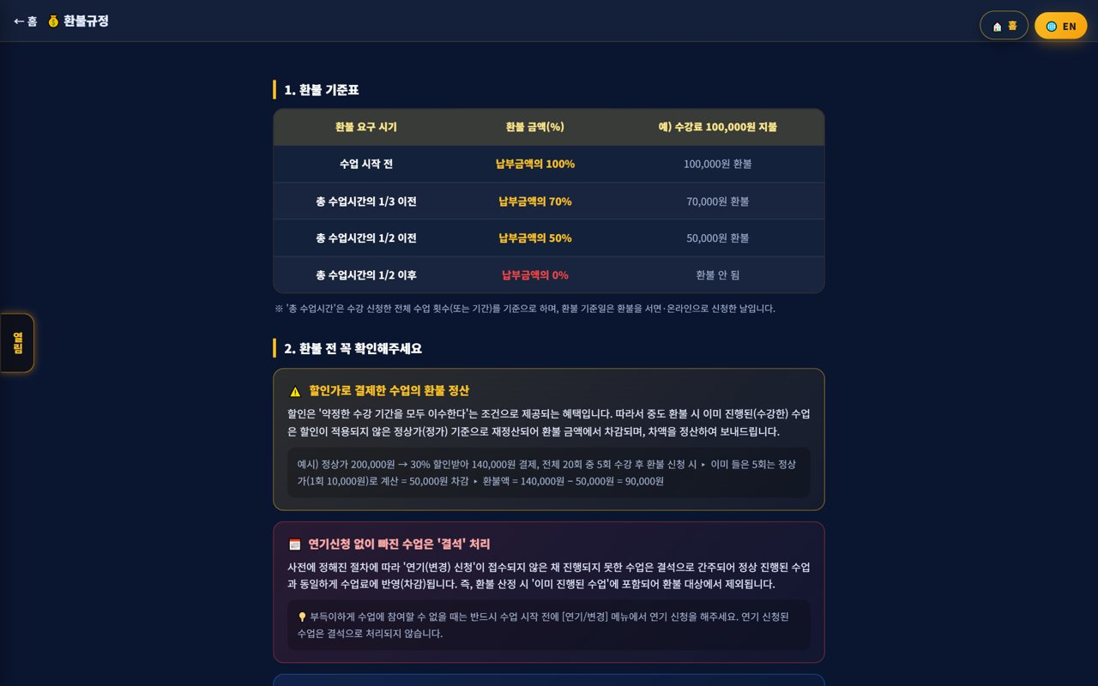
🏫 Mangoi Admin User Guide
How to Use the Main Features
09
💳 Accounting · Points
Payments · overdue · points · gifts
Manage payments, overdue balances and refunds, plus point/gift accrual and use. Amounts are auto-calculated by policy to reduce mistakes.
How to use
● In Accounting/Points, process payments, overdue balances and refunds.
● Check point/gift accrual and usage history.
● Notify overdue items via alert-talk/SMS.
✅ Key Points
● Manage recurring payments and overdue on one screen.
● Points drive learning motivation.
💡 Tip · Automating overdue alerts raises collection rates.

Slide 14
🏫 Mangoi Admin User Guide
How to Use the Main Features
10
🎁 Points & Reward Policy
Praise points → shop → gifts
The 🌟 praise points a student gets during class and the star rating (+10P) all accrue to the student's total points, leading to point-shop, roulette and gift rewards. Admins manage this accrual/usage flow and the reward line-up.
How to use
● Check accrual paths: points build from in-class teacher praise (+1P), end-of-class rating (+10P), game learning, etc.
● In Accounting/Points, check each student's accrual/usage history.
● Manage the point-shop / roulette rewards and gift line-up.
● If abnormal accrual/errors are suspected, look up the history and adjust.
✅ Key Points
● Instant rewards (praise points) boost participation and re-enrollment.
● Shaping rewards lets you tune motivation and cost together.
● Points are summed into the student's top-bar P and My Page.
⚠️ Good to know · Teachers give praise points; admins configure the shop/reward/gift policy.
💡 Tip · Setting stock/limits on popular rewards keeps costs stable.

Slide 15
🏫 Mangoi Admin User Guide
How to Use the Main Features
11
↩️ Refund Policy & Processing
Auto-calculated by the table
Amounts are auto-calculated per the refund table (100% before the lesson starts, tiered by progress). Discounted payments are recalculated at the list price.
How to use
● Check the refund request timing and calculate by the table.
● For discounted payments, apply the list-price recalculation rule.
● Check the absence rule for lessons missed without postponing.
✅ Key Points
● The table reduces disputes.
● Explain the policy to parents before processing.
⚠️ Good to know · For discounted lessons, already-taken lessons are deducted at list price, then the balance is refunded.
💡 Tip · Explaining refund/postpone policies at signup greatly reduces conflict.

Slide 16
🏫 Mangoi Admin User Guide
How to Use the Main Features
12
🧑‍🎓 Student · Parent Management
Real-data roster · attendance · grades
Manage the enrolled roster, attendance and grades. The student list is linked to real member data, and you can see each student's history at a glance.
How to use
● In Students/Parents, check the enrolled roster.
● View attendance/reviews/points/chat history by student.
● Flag students who need counseling/management.
✅ Key Points
● The student list is linked to real members.
● At-risk students link to the Retention Center.
💡 Tip · Counsel frequently-absent students quickly to prevent churn.

Slide 17
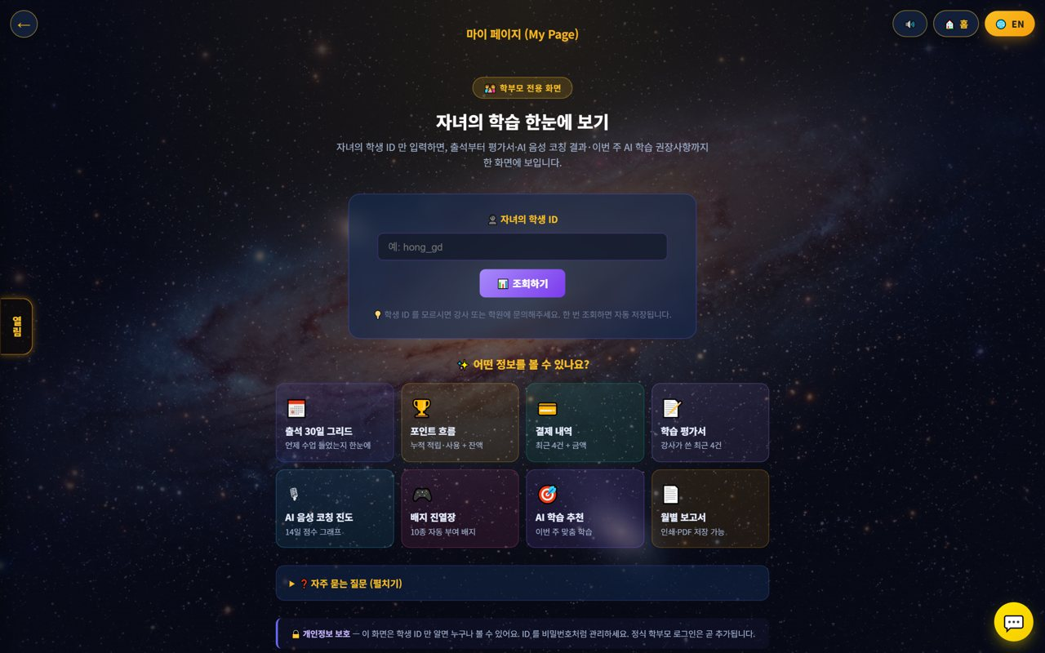
🏫 Mangoi Admin User Guide
How to Use the Main Features
13
👨‍👩‍👧 Parent My-Page
View learning with just a student ID
Parents can see attendance, reviews, payments and AI-recommended study on one screen just by entering their child's student ID. It reduces support questions and raises satisfaction.
How to use
● Share the my-page link with parents.
● The parent enters the child's student ID and looks it up.
● They see 30-day attendance, points, payments, reviews and the monthly report.
✅ Key Points
● Easy access with just the student ID.
● The monthly report can be printed or saved as PDF.
⚠️ Good to know · Advise parents to manage the student ID like a password.
💡 Tip · Explaining my-page at signup reduces questions.

Slide 18
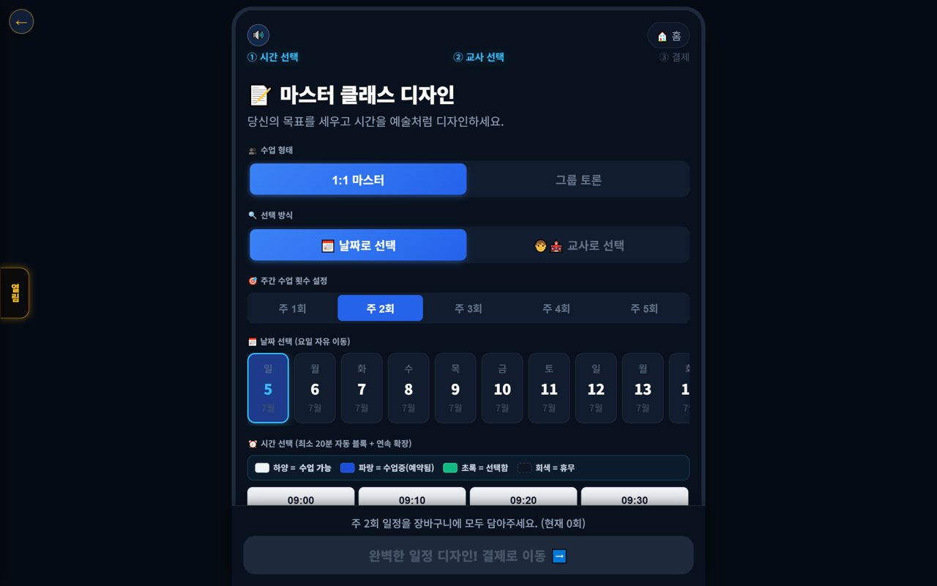
🏫 Mangoi Admin User Guide
How to Use the Main Features
14
📅 Booking Management
Schedule assignment
A booking screen to assign lesson type, teacher, date and time. You can review and adjust students' booking status.
How to use
● In Booking, assign lesson type, teacher and time.
● Check empty slots and overlaps and adjust.
● Once confirmed, students and teachers are notified.
✅ Key Points
● Spread popular slots to balance teacher load.
● Recurring bookings can be set.
💡 Tip · Pre-register each teacher's available times to speed up assignment.

Slide 19
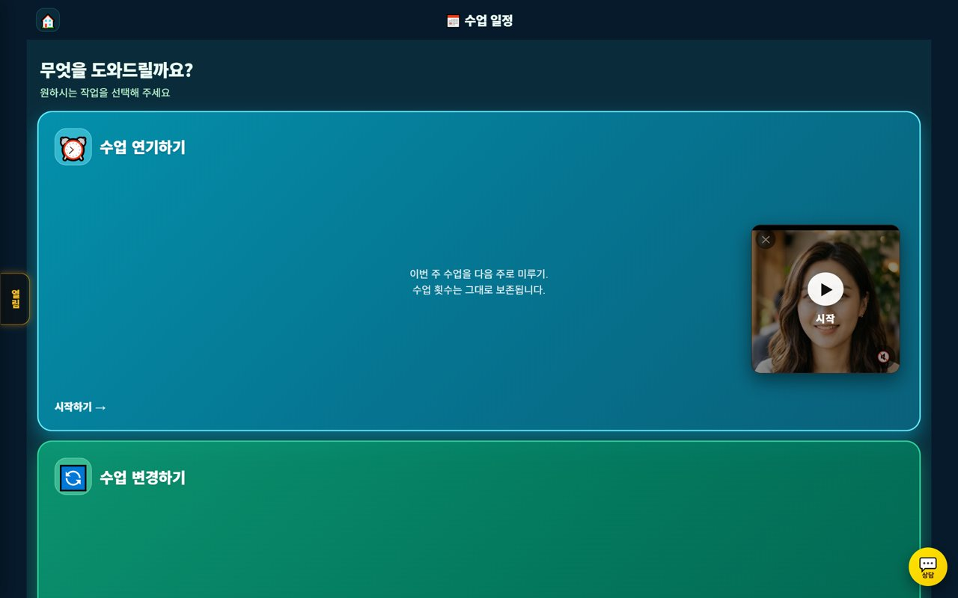
🏫 Mangoi Admin User Guide
How to Use the Main Features
15
🔄 Postpone Management
Review & process requests
Review students' postpone/change requests and process them per policy. Last-minute requests outside policy link to the absence/deduction rule.
How to use
● Check students' postpone/change requests.
● If within policy (advance notice), adjust the schedule.
● Changes are auto-announced to both sides.
✅ Key Points
● Clearly announce the postpone cutoff.
● Guide out-of-policy requests per policy.
💡 Tip · Enforcing the postpone cutoff reduces no-show losses.

Slide 20
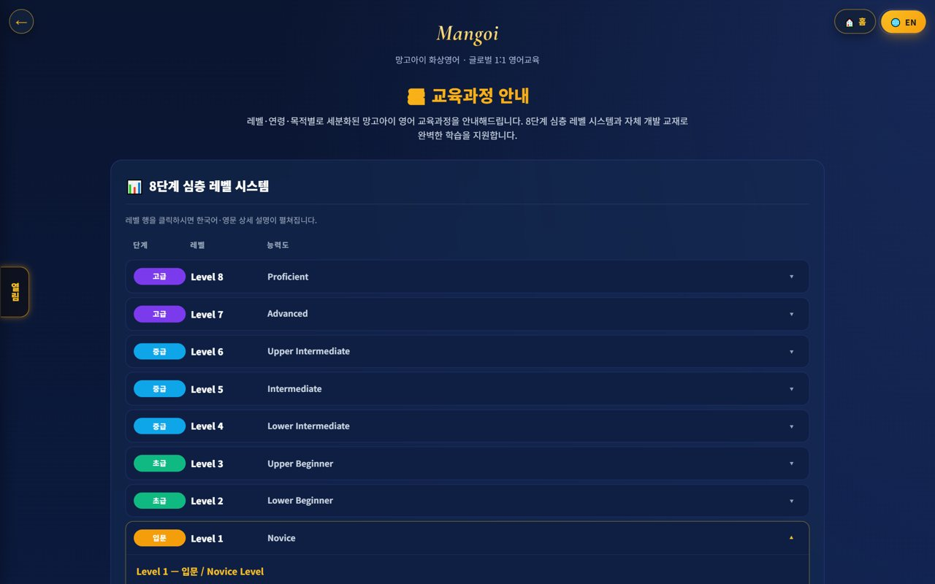
🏫 Mangoi Admin User Guide
How to Use the Main Features
16
📚 Content · Curriculum
Levels · textbooks · game reports
Manage the Levels 1–10 curriculum, textbook status and game learning reports (weak words). Improve content based on learning data.
How to use
● Check the Levels 1–10 curriculum structure.
● Review textbook upload status.
● Find weak words in the game learning report.
✅ Key Points
● Surface weak words more in games/reviews.
● Clear level goals raise achievement.
💡 Tip · Reviewing the curriculum at the start of the year makes it easy.

Slide 21
🏫 Mangoi Admin User Guide
How to Use the Main Features
17
🧲 Retention Center
Churn risk · contagion · settlement · coaching
A hub to find students likely to quit early and to prevent chain churn spread through family, joint lessons and referrals. Manage four tabs in one place.
How to use
● Find at-risk students with the churn-risk graph.
● Prevent chain churn with the churn contagion network.
● Deliver review-based feedback in the teacher coaching tab.
● Intervene on at-risk students with alert-talk/counseling.
✅ Key Points
● Intervening early raises retention.
● Manage family/referral relationships together.
💡 Tip · Just caring for the top at-risk students weekly noticeably cuts churn.

Slide 22
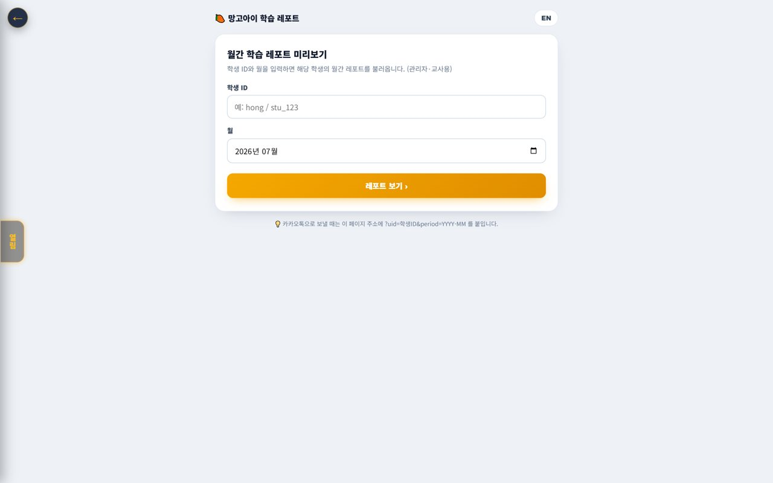
🏫 Mangoi Admin User Guide
How to Use the Main Features
18
🌳 Org Settlement · Monthly Report
HQ → branch → agency
Revenue and commissions auto-settle down the org tree, and the monthly report shows branch/agency performance. AI insights summarize the state.
How to use
● Revenue/commissions auto-settle down the org tree.
● Check branch/agency performance with the monthly report.
● Watch today's revenue, enrollment and attendance daily on the dashboard.
✅ Key Points
● Distributing the settlement report early builds partner trust.
● A 5-minute daily check of the metrics is recommended.
💡 Tip · The sooner you catch warning signs (revenue drop, attendance dip), the easier to respond.

Slide 23
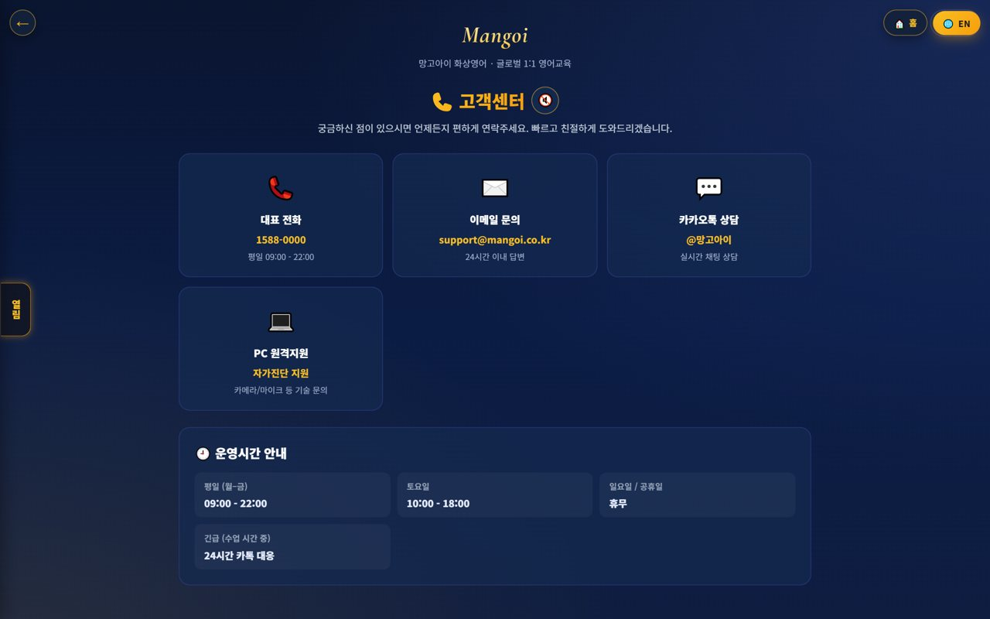
🏫 Mangoi Admin User Guide
How to Use the Main Features
19
🎧 Support · FAQ Operations
Inquiries · refunds · postpone
Guide phone, email, Kakao and remote-support channels, and organize frequent questions into an FAQ to reduce inquiries.
How to use
● In Support, guide channels and hours.
● Share refund/postpone policies with students/parents.
● Add repeat questions to the FAQ.
✅ Key Points
● Growing the FAQ cuts support load.
● Help directly with remote support for hard issues.
💡 Tip · Turn repeat questions like 'can't enter' into an FAQ with screenshots.

Slide 24
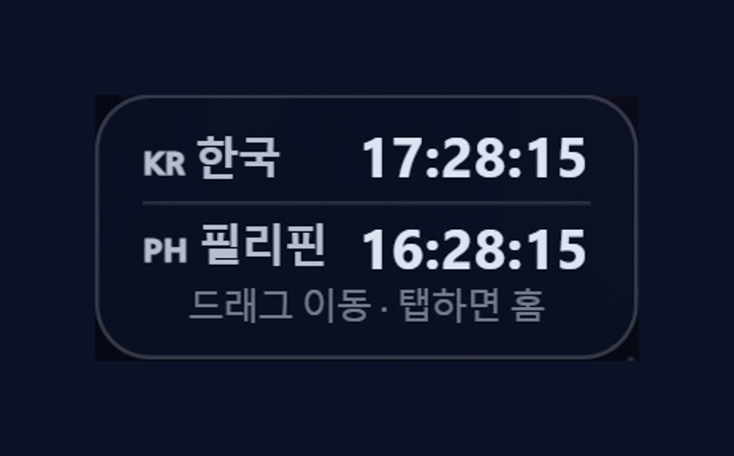
🏫 Mangoi Admin User Guide
How to Use the Main Features
20
🕐 Korea·Philippines Dual Clock
Two countries' time on screen
A clock on screen shows 🇰🇷 Korea and 🇵🇭 Philippines time together. It lets you check the time difference instantly when coordinating lessons between Philippine teachers and Korean students.
How to use
● On the on-screen dual clock, see 🇰🇷 Korea and 🇵🇭 Philippines time at once.
● Drag the clock to move it anywhere you like.
● Tap (click) the clock to go to the home screen.
✅ Key Points
● The Philippines is 1 hour behind Korea (−1 hour).
● You can check booking/entry times in both countries' time.
💡 Tip · When a lesson time is confusing due to the time difference, this clock clears it up instantly.

Slide 25
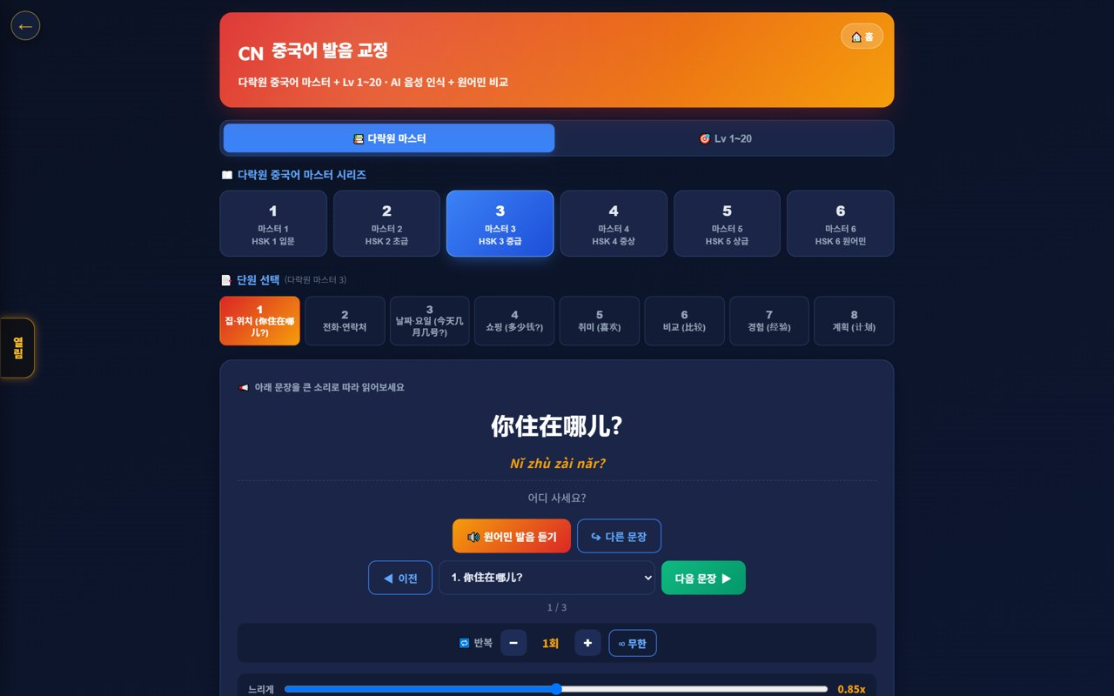
🏫 Mangoi Admin User Guide
How to Use the Main Features
21
🇨🇳 Chinese Pronunciation Coach
Darakwon Chinese Master Lv1–20
Mangoi offers not only English but also a Chinese course. With a Darakwon Chinese Master (Lv 1–20) pronunciation coach (characters+pinyin, AI voice recognition, native comparison), you can attract and manage students who want Chinese.
How to use
● In the AI voice coach, pick the CN Chinese level (or go to the Chinese pronunciation coach).
● Choose a Master series (1–6, HSK 1–6) and a unit.
● Read the sentence (characters + pinyin) and compare with 'Play native audio'.
● Practice hard sounds/tones with repeat and slow (0.85x).
✅ Key Points
● Characters and pinyin appear together, so it's easy to read.
● The AI recognizes your voice and compares it to a native speaker.
● The learning games hub supports Chinese too.
💡 Tip · Listen slowly and repeat clearly to nail the four tones.

Slide 26
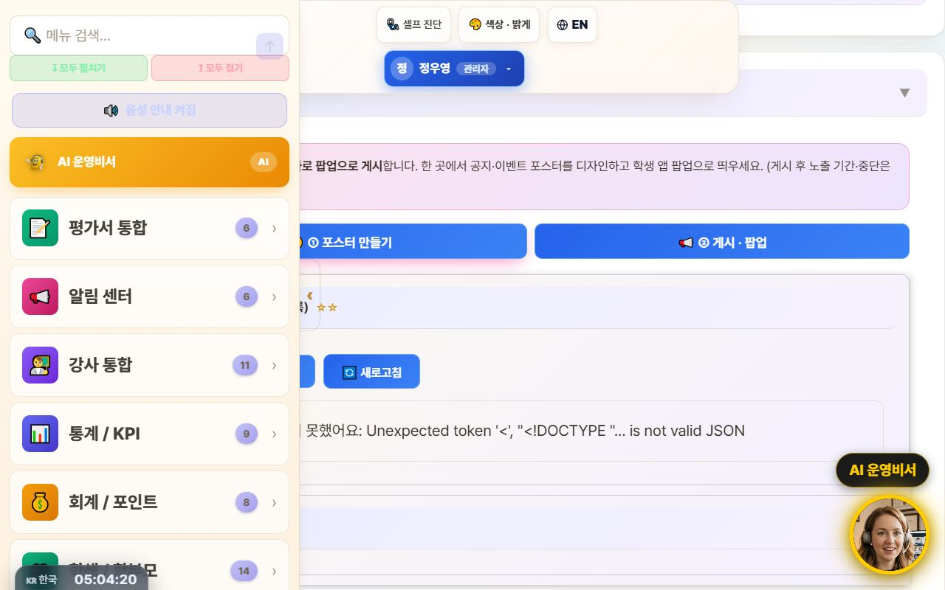
🏫 Mangoi Admin User Guide
How to Use the Main Features
22
📢 Notice Studio (Poster + Popup)
Design notice/event posters and push them as app popups
This merges the old ‘Poster Maker’ and ‘Popup Notice’ tools into one place. In the ①Create tab you design a notice/event poster, then hand it straight to the ②Publish·Popup tab to show it as a popup in your academy's student app.
How to use
● Go to the admin menu Notification Center → 📢 Notice Studio.
● In the ①Create tab, design a poster with text, images, and video (resize · save on server · reuse).
● Press ‘📢 Publish as popup’ on the finished poster to auto-switch to the ②Publish·Popup tab.
● In the publish tab, set the display period / stop and publish it as a student-app popup.
✅ Key Points
● Poster creation and popup publishing flow through one screen, two tabs — no more confusion.
● Posters you make can be saved and reused.
● Whichever route you enter from — AI assistant or sidebar search — the correct tab opens.
⚠️ Good to know · Existing posters/popups are preserved (it was only merged, nothing was deleted).
💡 Tip · Promoting an event takes just one flow: ‘Create → Publish as popup’ right away.

Slide 27
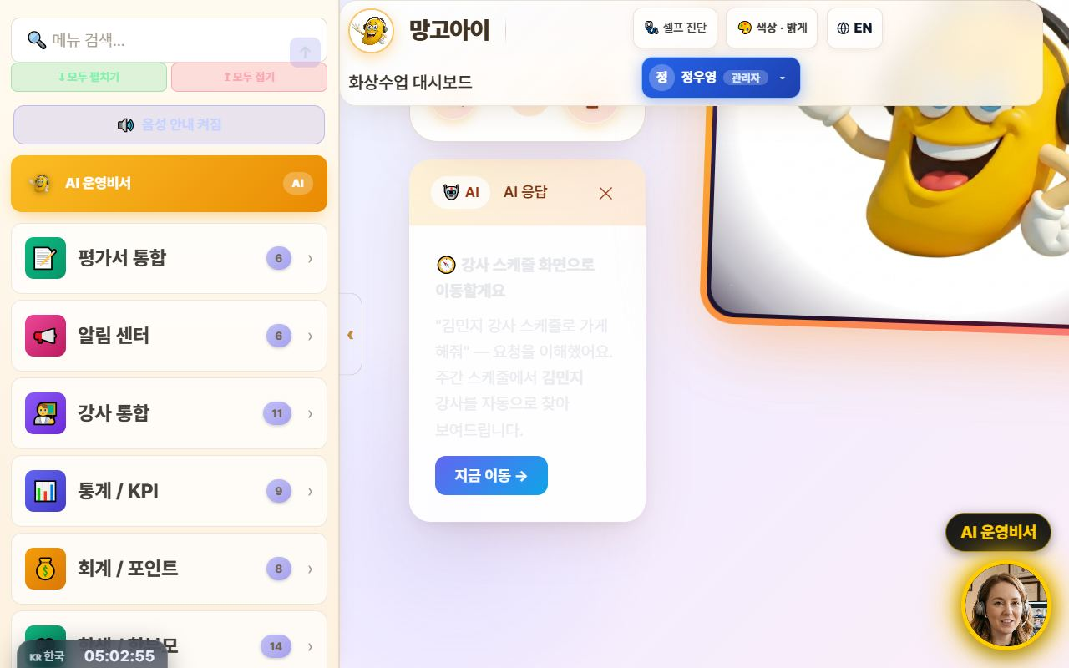
🏫 Mangoi Admin User Guide
How to Use the Main Features
23
🤖 Command the AI Operations Assistant
Navigate with one phrase: “Take me to ○○”
Type what you want to do into the top search bar (or the bottom-right AI assistant) in plain language, and the AI understands and jumps straight to that screen. It now reliably follows navigation commands like ‘Take me to teacher ○○'s schedule’ or ‘Open auto-scheduling’.
How to use
● Type a command in the top search bar or speak with the 🎤 mic.
● e.g. “Take me to teacher Kim Minji's schedule” → auto-finds that teacher in the weekly schedule and opens it.
● e.g. “Open auto-scheduling,” “Go to settlement” to navigate menus.
● Press ‘Go now →’ on the AI response card to move to that screen.
✅ Key Points
● Navigation commands actually navigate — far fewer ‘explain only, do nothing’ replies.
● Searching a schedule by teacher name auto-fills the search box + filters + scrolls.
● For data/statistics questions it also helps with card-style answers.
⚠️ Good to know · Commands that actually change things — ‘register · send · modify’ — ask for one more confirmation (a safety guard).
💡 Tip · When you can't recall a menu name, just say what you want to do — it finds its way there.

Slide 28
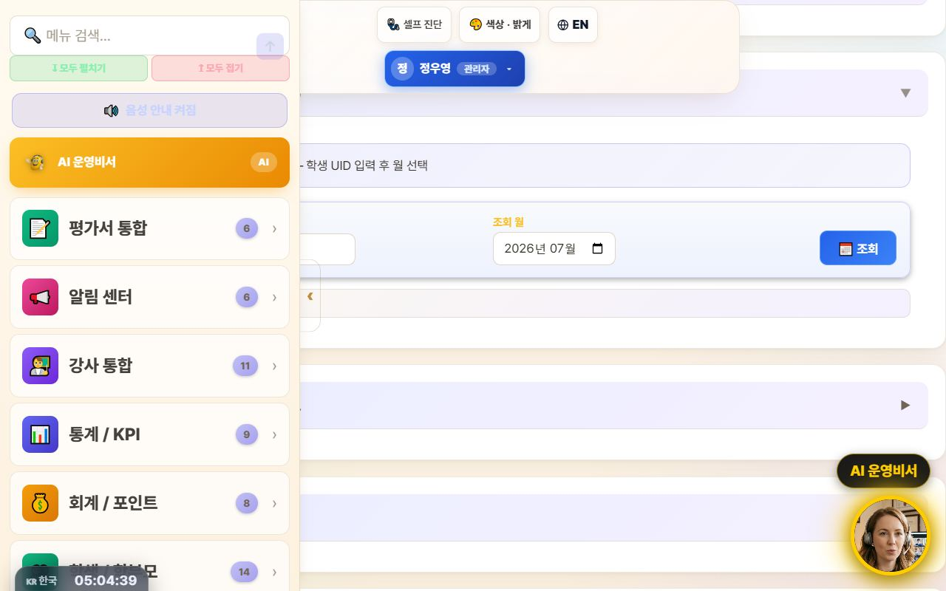
🏫 Mangoi Admin User Guide
How to Use the Main Features
24
📔 Student Voice-Diary Monitor
View each student's English diary · AI correction · score
View the AI voice diaries students leave, right from the admin screen. Per student, check the transcript · AI correction · encouragement · score by month to encourage consistent writers and gauge their learning.
How to use
● Open the 📔 Voice Diary (monitor) card in the admin menu.
● Enter the student UID, pick the month to look up, and press ‘Search’.
● Open an entry from the list to see the transcript · correction · encouragement · score.
✅ Key Points
● It only shows up once a student actually writes a diary (the entry point is the 📔 card on the student home).
● Find consistent writers and connect them to praise/rewards to lock in the habit.
💡 Tip · ‘Nothing shows up’ usually just means that student hasn't left a diary yet.

Slide 29
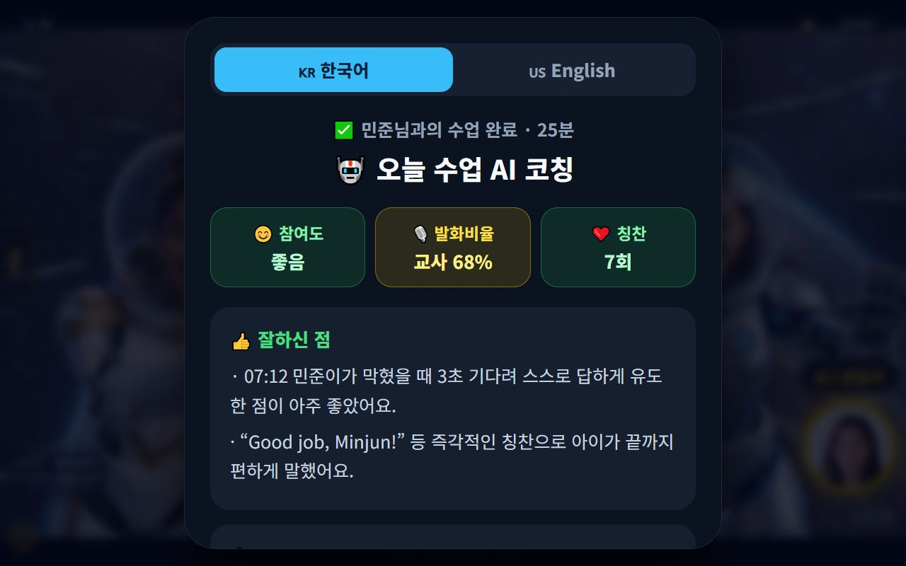
🏫 Mangoi Admin User Guide
How to Use the Main Features
25
🤖 Teacher AI-Coaching Review (Ops)
Collected per-class AI coaching · quality scores
After every class, the AI leaves the teacher a coaching card (strengths · areas to improve · a class-quality score). From the admin screen you can see these gathered by most-recent. Use it as a growth-support / coaching-quality tool — not surveillance.
How to use
● Go to admin 🧲 Retention Center → 💼 Teacher Coaching tab.
● In the ‘🤖 Per-class AI coaching (recent)’ section, review each teacher's latest coaching.
● Use each card's quality score · talk ratio · improvement point to plan coaching and training.
✅ Key Points
● See every teacher's recent coaching at a glance.
● Admins get a monthly rollup focus, so it's low-pressure.
⚠️ Good to know · Coaching text is for a teacher's personal growth. We recommend using it as a support tool, not for evaluation/discipline.
💡 Tip · For teachers whose quality score stays low, coach them together with the teacher training manual.

Slide 30
🏫 Mangoi Admin User Guide
How to Use the Main Features
26
📱 QR Attendance Check-in
One scan and attendance is done
Post an attendance QR code at the entrance, and the moment a student scans it with their phone, attendance is recorded automatically. The admin dashboard shows today's attendance in real time — no more paper rosters.
How to use
● Open the QR Attendance card in the admin menu and generate your academy's QR code.
● Print the QR and post it at the entrance or front desk.
● Students scan with their phone camera and check in on the check-in screen.
● Watch today's arrivals and times live on the dashboard's attendance view.
✅ Key Points
● Arrival times are recorded automatically — fast and accurate.
● Attendance data flows into student management and reports.
⚠️ Good to know · The QR code is unique to your academy. Keep it from being shared outside.
💡 Tip · Stand a tablet at the desk during arrival hours so students can scan without queuing.

Slide 31
🏫 Mangoi Admin User Guide
How to Use the Main Features
27
📞 Consultation Booking Management
From new inquiries to scheduled consults
Take consultation bookings from parents and prospects and manage them on one screen. Track each booking's schedule and status (pending/done) and carry the consult onward toward enrollment.
How to use
● Open the Consultation Booking card in the admin menu.
● Register a new booking (name, contact, preferred time) or review incoming ones.
● After the consult, set the status to done and leave a note.
● Carry it forward: consult → level test → enrollment.
✅ Key Points
● Bookings live in one place, so no consult slips through.
● Consult history makes repeat inquiries easy to handle.
💡 Tip · A quick follow-up call the day after a consult noticeably lifts enrollment conversion.

Slide 32
🏫 Mangoi Admin User Guide
How to Use the Main Features
28
🎁 Friend-Referral Rewards
Track referrals · pay out rewards
See the referral status of enrolled students bringing friends, and process reward payouts. Who referred whom, and whether the reward was paid — all on one screen, turning word-of-mouth into a system.
How to use
● Open the Referral Rewards card in the admin menu.
● Review the list of referrer · referred friend · enrollment status.
● For qualifying cases, process the reward payout (points, gift vouchers, etc.).
✅ Key Points
● Referral history is kept as data — transparent, no disputes.
● Linking rewards to student points and the shop multiplies the effect.
💡 Tip · Pair it with a 'refer a friend' event before each semester and watch inquiries jump.

Slide 33
🏫 Mangoi Admin User Guide
How to Use the Main Features
29
🗓️ Approving Postpone/Change Requests
Review and approve teacher-submitted requests
Class postpone and time-change requests submitted by teachers gather on the admin screen in real time. Check the reason and approve or decline — the schedule updates immediately, replacing phone-and-messenger juggling with one screen.
How to use
● Open the Class Postpone/Change Requests card in the admin menu.
● Review each pending request's teacher · class · reason.
● Press Approve or Decline — the result flows to the schedule and the teacher.
✅ Key Points
● Request and decision history is kept, so everything stays transparent.
● For changes parents should know about, follow approval with a notification.
💡 Tip · Clearing pending requests every morning prevents same-day confusion.

Slide 34
🏫 Mangoi Admin User Guide
How to Use the Main Features
30
💬 Share Library Links via KakaoTalk
Send videos & docs in original quality
Every guide and video in the library now has a '💬 Copy KakaoTalk link' button. Attaching a file to KakaoTalk crushes the quality, but sending a link plays the original as-is. One tap copies the link — guiding parents and teachers gets much easier.
How to use
● In the admin Library, press 💬 Copy KakaoTalk link next to the file.
● Paste it into the KakaoTalk chat room.
● Recipients tap the link to watch or download in original quality.
✅ Key Points
● For videos, link sharing = original quality; file attachments degrade it.
● Works the same for PDFs, PPTs, and videos anywhere in the library.
⚠️ Good to know · Anyone with the link can open it. For internal-only material, check who you share with.
💡 Tip · In a parents' group chat, one video-guide link does all the explaining.

Slide 35
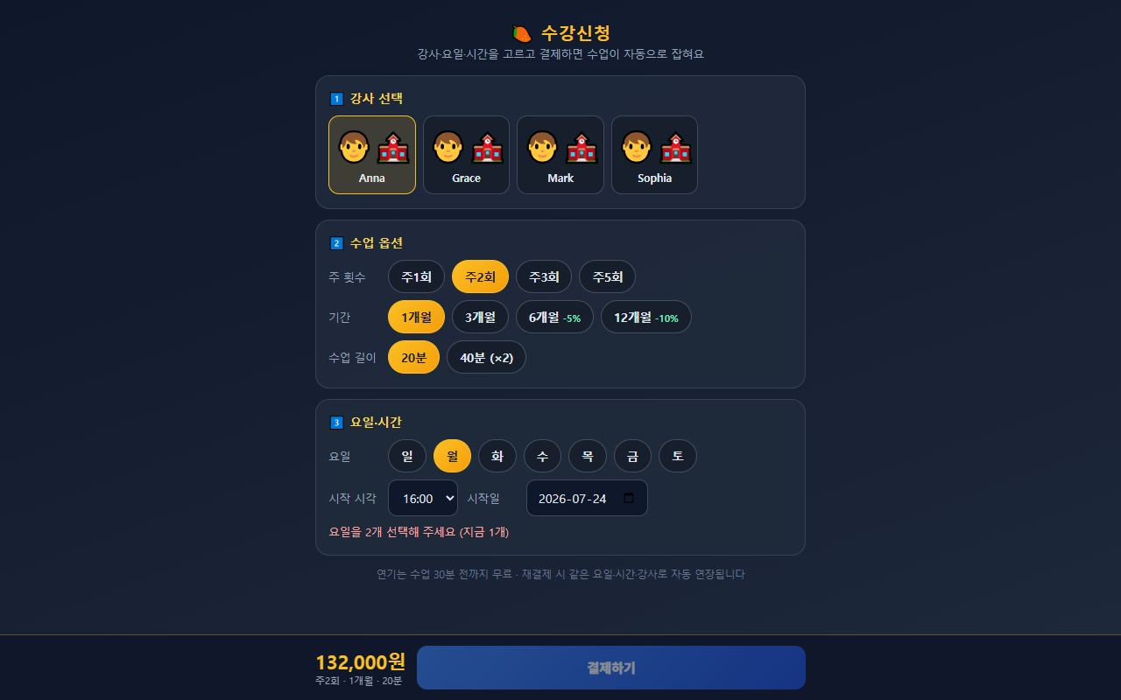
🏫 Mangoi Admin User Guide
How to Use the Main Features
31
💳 Enrolment & payment → automatic lesson creation
Once payment is confirmed, every session is scheduled
On the Enrolment screen a student picks teacher, days and time and pays — and all lesson sessions are created automatically the moment payment is confirmed. The old manual timetable entry after payment is gone. If the slot clashes with an existing lesson, the conflict is detected before payment.
How to use
● Send students and parents the enrolment link.
● They choose teacher → lesson options (weekly count, term, length) → days & time.
● The slot check must pass before the pay button unlocks (payment is blocked on a clash).
● On confirmed payment, all sessions are created at once — verify in the admin lesson list.
● Head-office prices and discount rates are managed on the pricing screen.
✅ Key Points
● Idempotent — a duplicated payment callback will not create the sessions twice.
● Clashes with holidays or existing lessons are pushed back so the session count is still met.
● Term discounts (6 months −5%, 12 months −10%) are applied to the amount automatically.
⚠️ Good to know · Stage 1 (enrol → pay → auto-create sessions) is live today. Later stages will follow.
💡 Tip · Consultation → level test → send the enrolment link is the smoothest conversion path.

Slide 36
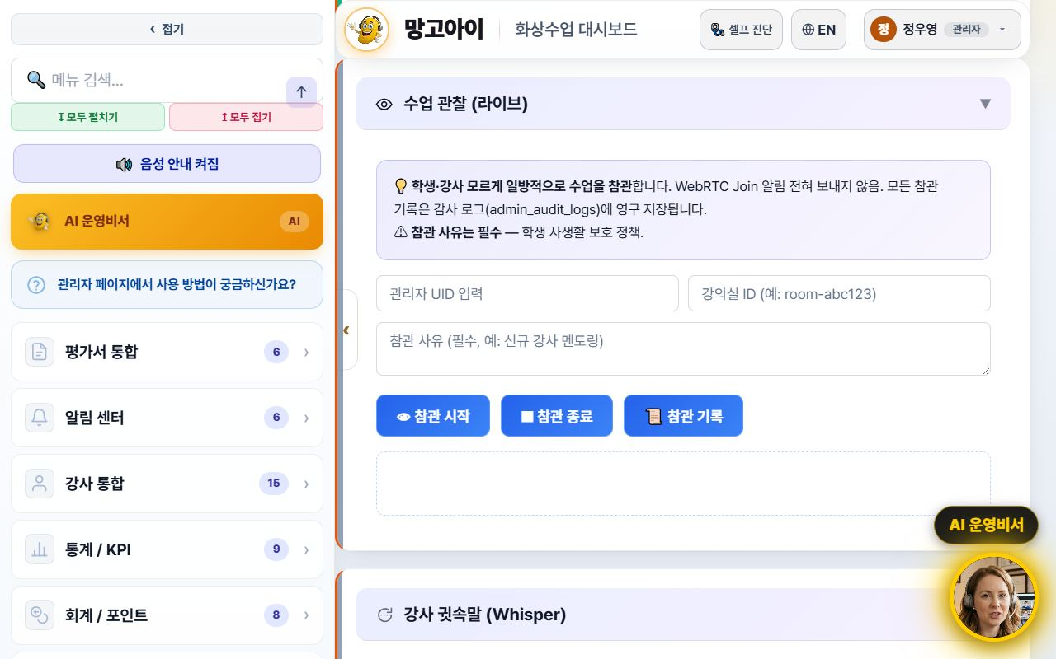
🏫 Mangoi Admin User Guide
How to Use the Main Features
32
👀 Class Observation (live)
Quietly look in on a lesson in progress
You can sit in on a live lesson without the student or teacher knowing. No join notification is sent, so the lesson isn't disturbed — use it for mentoring new teachers, quality checks and parent complaints. Every observation is permanently written to the audit log.
How to use
● Open the Class Observation (Live) card in the admin menu.
● Enter your admin UID and the room ID.
● Write an observation reason — this is required (e.g. new-teacher mentoring).
● Press Start observing; press Stop observing when done.
● Past sessions are listed under Observation log.
✅ Key Points
● While observing, your audio and video are not transmitted.
● A reason is mandatory — this is student privacy policy.
● Who observed, when and why is fully recorded.
⚠️ Good to know · This touches student privacy directly. Use it only when there is a business need, and write a specific reason.
💡 Tip · Observe new teachers once a week for their first two weeks, then coach — quality stabilises quickly.

Slide 37
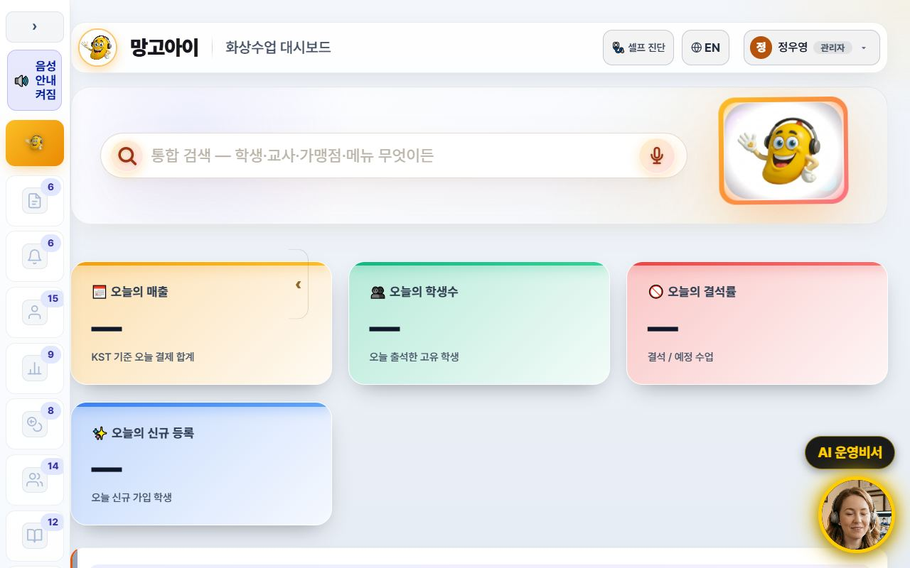
🏫 Mangoi Admin User Guide
How to Use the Main Features
33
🧭 A refreshed admin screen
Collapsible sidebar · lighter background · line icons
The admin screen is now easier on the eyes and wider. The left menu collapses to a narrow icon rail via the ‹ Collapse button, and the background is now a consistent light tone. Menu icons were redrawn as line icons so labels read clearly.
How to use
● Press ‹ Collapse at the top of the left menu — it shrinks to an icon rail and the content gets wider.
● Press the › button in the same place to expand it again.
● The collapsed state is remembered for your next visit.
● Too many menus to find one? Type its name into menu search at the top.
✅ Key Points
● Screens full of tables and lists gain a lot of horizontal space.
● 15 sub-pages were moved onto the same light theme, so the colour jump between screens is gone.
● The collapse animation was removed so low-spec PCs don't stutter.
💡 Tip · Wide-table screens like settlement and payroll are far easier to read with the menu collapsed.

Slide 38
🏫 Mangoi Admin User Guide
How to Use the Main Features
34
🌐 The interface language sets itself
Overseas staff and teachers start in English
Filipino teachers and overseas staff now start in English from the first screen. The interface language is decided from the account's nationality, and teacher accounts are always English regardless of name or previous choice. You can still switch any time with the 🌐 EN / KR button at the top.
How to use
● If the account has a nationality on file, the right language appears automatically at login.
● To change it manually, press the 🌐 EN / KR button at the top.
● A manual choice is stored per account — several people can share one PC without interference.
● Teacher guide slides and manuals switch to the English editions with it.
✅ Key Points
● Teacher accounts are always English — no more getting lost in a Korean screen.
● Accounts with an English name no longer flip to Korean because of a Korean job title.
● Language choice is isolated per account, so an overseas account isn't overwritten by someone else's pick.
⚠️ Good to know · Accounts with no nationality fall back to the old name/ID heuristic. Please fill in nationality when registering teachers.
💡 Tip · Enter nationality when registering a new teacher and their very first login is in English — fewer support requests.

Slide 39
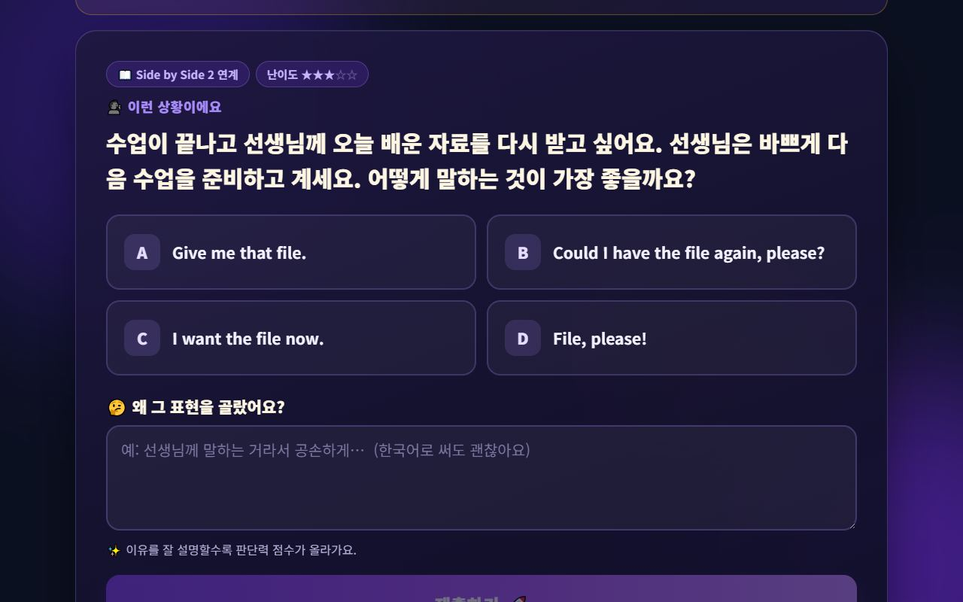
🏫 Mangoi Admin User Guide
How to Use the Main Features
35
🧠 Running Judgment Training (student judgment index)
Not memorisation but judgment — a new outcome metric
In Judgment Training, a student picks the expression that fits a situation and explains why. Results accumulate into a judgment index across 5 axes — evidence you can show in parent consultations that answers “how well do they judge for themselves”, not just “what did they memorise”.
How to use
● The feature lives at AI Learning Tools → Judgment Training on the student screen.
● Per-student results appear on the My Growth screen and in learning reports.
● Show the index trend chart as supporting evidence during consultations.
✅ Key Points
● Recent answers are weighted more (half-life weighting), so current ability shows up fast.
● Partial credit means one wrong answer doesn't crash the index.
● Questions combine 24 topics × 12 angles, so students get different questions.
⚠️ Good to know · Read the judgment index as a growth trend, not an exam score. The direction matters more than the absolute number.
💡 Tip · This is the best material to answer the classic parent question: “They know the words but can't speak.”

Slide 40
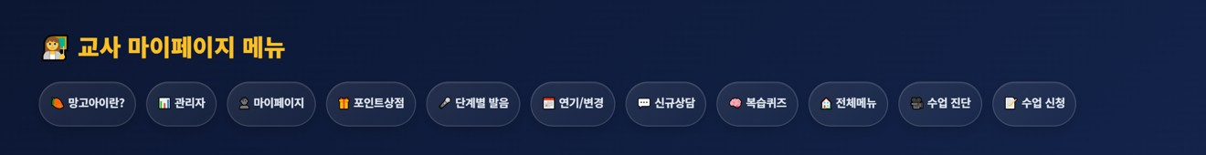
🏫 Mangoi Admin User Guide
How to Use the Main Features
36
🔑 Teacher accounts (password reset · access limits)
Handling lost passwords · scoping permissions
When a teacher forgets their password you can reset it directly from the admin screen. Teacher account access was also tightened so that operations and settlement features a teacher doesn't need simply don't open.
How to use
● Find the teacher under Teachers in the admin menu.
● Use Reset password to issue a temporary password.
● Pass it on and tell them to change it right after logging in.
● If the teacher's nationality is blank, fill it in so their screen opens in English.
✅ Key Points
● Teacher accounts cannot reach operations or settlement features (32 areas blocked).
● Reset actions are logged.
● Teachers with a nationality on file start in English from their first login.
⚠️ Good to know · Send temporary passwords only over a channel where you can verify who you're talking to.
💡 Tip · Fill in nationality and contact details when registering a new teacher — later questions drop sharply.

Slide 41
🏫 Mangoi Admin User Guide
Feature Summary · Data
37
📋 Admin Feature Categories
Category | Key features | Count (ex.) | Core benefit
Teachers | Payroll·matching·reviews·MBTI | 11 | Efficient teacher mgmt
Accounting / Points | Payments·overdue·refunds·points | 8 | Accurate settlement
Students / Parents | Roster·attendance·grades·parents | 14 | Churn prevention
Content | Curriculum·textbooks·game reports | 11 | Learning quality ↑
System | Settings·permissions·logs | 12 | Safe operations
AI Ops Assistant | Look up/act by voice·text | - | Faster operations

Slide 42
🏫 Mangoi Admin User Guide
Data at a Glance
38
📊 Data at a Glance
Features per Category
Churn-risk Distribution (example)

Slide 43
🏫 Mangoi Admin User Guide
Frequently Asked Questions (FAQ)
39
❓ Frequently Asked Questions (FAQ)
Q. Where do I log in?
A. Log in at admin.mangoi.co.kr. Phone, tablet and PC all connect right from the web.
Q. I can't see a feature.
A. Menus vary by role. Use the top feature search or ask the AI assistant by name.
Q. A student can't enter a lesson.
A. Usually a browser permission issue. Advise reconnecting in Chrome/Edge and allowing camera/mic. Inside KakaoTalk, open in an external browser.
Q. Does the AI assistant execute tasks?
A. Look-ups happen instantly; important actions are confirmed with 'Shall I?' It only does what you have permission for.
Q. Refund math is confusing.
A. It's auto-calculated by the refund table; discounted payments are recalculated at list price.
Q. I'm worried about churn.
A. Find at-risk students early with the Retention Center's churn-risk/contagion network and intervene via alert-talk/counseling.

Slide 44
🏫 Mangoi Admin User Guide
Checklist
40
✅ Daily Operations Checklist
Did you check today's revenue, enrollment and attendance?
Did you handle new counseling/inquiries?
Did you check overdue and refund items?
Did you check the live (LIVE) lesson status?
Did you care for students whose churn risk rose?
Did you reflect teacher reviews/coaching feedback?
Did you add repeat questions to the FAQ?

Slide 45
🏫 Mangoi Admin User Guide
Conclusion
41
🏁 Conclusion · A Practical Guide to Stable Academy Operations
You've now reviewed every feature of the admin page. Finally, here's one page on how a day of operations flows and the principles to keep for stable running. Keep just this rhythm and operations get much lighter.
🔄 The Flow at a Glance
⭐ Key Principles
Morning (5 min)
Check today's revenue, enrollment and attendance on the dashboard; read the AI insight summary
● Metrics, 5 minutes each morning — catching revenue/attendance signals early makes response easy.
● Intervene on churn early — the sooner you care for at-risk students, the higher retention.
● Announce policies upfront — sharing refund/postpone policies at signup greatly cuts disputes.
● Turn repeats into FAQ — make frequent questions into an FAQ with screenshots.
● Decide with data — judge and improve by metrics/graphs, not gut feeling.
Late morning
Handle new counseling/inquiries; check overdue/refund items and send alert-talk
Class hours
Monitor live (LIVE) lessons; for 'can't enter' tickets, guide browser/permission first
Afternoon
Care for at-risk students in the 🧲 Retention Center; reflect teacher reviews/coaching
Weekly · Monthly
Distribute org settlement/monthly reports, check points/rewards (shop/gifts), improve the FAQ
📌 Remember
● Log in at admin.mangoi.co.kr; menus and data scope change by role (permissions)
● The AI assistant looks up instantly, confirms important actions, and only does what you're permitted
● Most 'can't enter class' tickets are browser and camera/mic permission issues
● Praise points → student total → shop/gifts; the policy and rewards are the admin's job
🍊 Good operations come not from fancy features but from 'small daily checks.' Watch your metrics, prevent churn early, and announce policies clearly. The AI Operations Assistant and Retention Center help you do it. Questions? Contact support anytime — cheering on your steadily growing academy! 🍊

Slide 46
Let's grow together with Mangoi!
Questions? Ask the on-site A.i assistant or contact customer support.
🌐 www.mangoi.co.kr 📞 1644-0561 ✉ support@mangoi.co.kr

