Slide 1

🤝 AGENCY GUIDE
Mangoi · MANGOI
Agency User Guide
From enrollment to lessons and settlement, in one book
For · Agency (franchise) operators | www.mangoi.co.kr

Slide 2
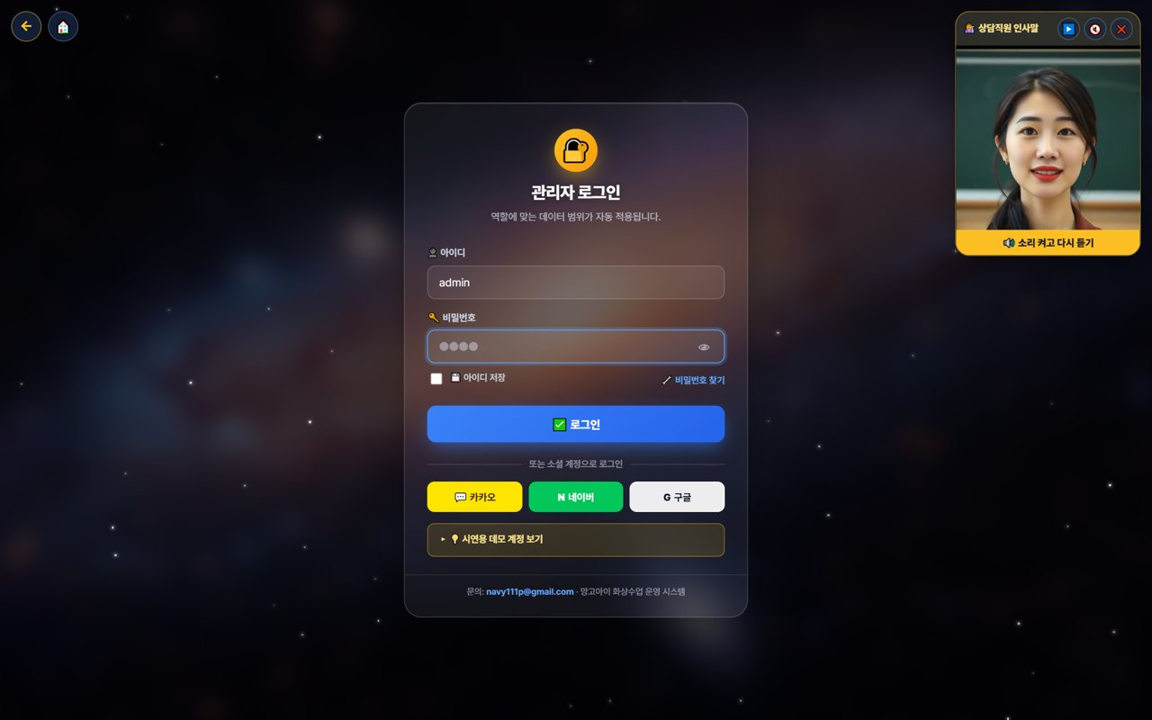
🤝 Mangoi Agency User Guide
Introduction
What is the Agency Admin Page?
The agency page is where you directly manage your agency's students, lessons, payments and settlement. From recruiting and counseling to enrollment, lesson assignment, collection, parent communication and receiving settlement — everything you need to run an agency is here. On login, only 'my agency' data shows, so you can focus on your students.
🤝
My-agency scope, automatic
🧑‍🎓
Recruit·enroll·manage students
Just log in and see only your students/revenue.
From counseling to enrollment and lesson assignment.
💳
Collection·settlement
📈
Learning status·reports
Payments/overdue and receiving branch→agency settlement.
Your students' learning at a glance.
Your Agency Metrics (example)

Slide 3
🤝 Mangoi Agency User Guide
Contents
📑 Contents
Introduction
2
14
Korea·Philippines Dual Clock
17
01
Agency Login & Permissions
4
15
Chinese Pronunciation Coach
18
02
My Page & Admin Dashboard
5
16
In-class Praise Points (understand & use)
19
03
Agency Dashboard
6
17
Notice Studio (Poster + Popup)
20
04
Using the AI Assistant
7
18
Command the AI Operations Assistant
21
05
Recruit·Enroll·Manage Students
8
19
Share Library Links via KakaoTalk
22
06
Parent Communication
9
20
A refreshed admin screen
23
07
Booking·Assignment
10
21
The interface language sets itself
24
08
Payments·Collection
11
22
Enrolment & payment → automatic lesson creation
25
09
Student Learning·Reports
12
23
Feature Summary · Data
26
10
Agency Settlement
13
24
Data at a Glance
27
11
Prevent Churn (care for students)
14
25
Frequently Asked Questions (FAQ)
28
12
New Counseling·Recruiting
15
26
Checklist
29
13
Support·Help
16
27
Conclusion
30

Slide 4
🤝 Mangoi Agency User Guide
How to Use the Main Features
01
🔐 Agency Login & Permissions
Only my agency's data
Logging in with an agency account shows only 'my agency' menus and data. Other agencies or branch-wide data isn't visible, so you can focus on managing your students.
How to use
● Log in with ID and password (social login also works).
● On login, menus/data for your role (agency) are applied automatically.
● Forgot your password? Reset via 'Find password'.
✅ Key Points
● Only your agency's student/revenue data shows.
● Turn on 'Save ID' only on your own trusted PC.
💡 Tip · On shared PCs, turn off auto-login and log out when done.

Slide 5
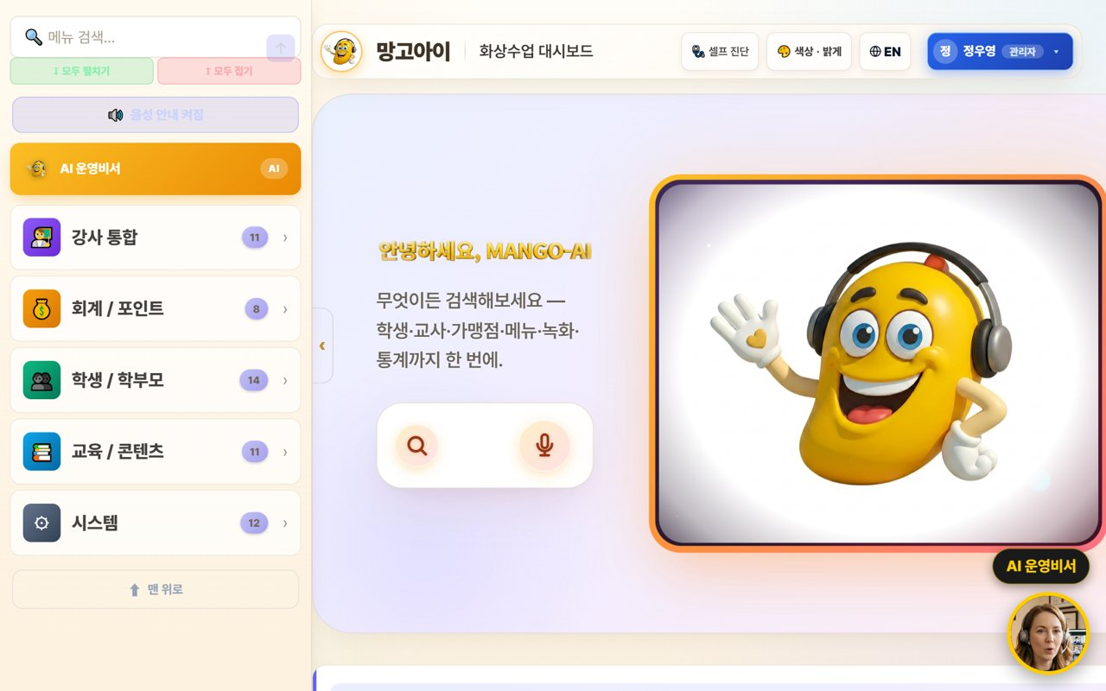
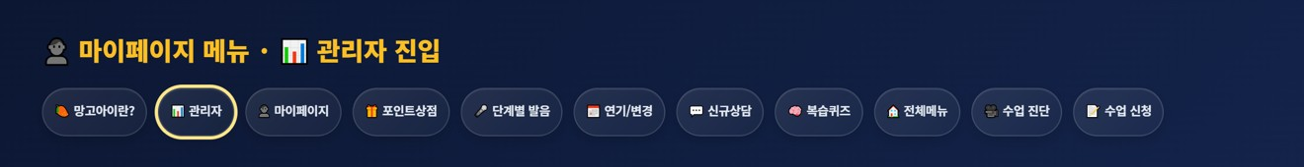
🤝 Mangoi Agency User Guide
How to Use the Main Features
02
👤 My Page & Admin Dashboard
Open the management screen from My Page
Agency operations also start from 'My Page.' After logging in, press the 📊 'Admin' button in the My Page menu to enter the agency-scope admin (operations) dashboard, where you manage students, revenue, lessons and settlement.
How to use
● After logging in, open '👤 My Page'.
● Press the 📊 'Admin' button in the My Page menu. (goes to the admin dashboard)
● On the admin dashboard, check your agency revenue, enrollment and today's lessons.
● My Page also has postpone/change, new inquiry, all-menu, pre-check and more.
● If text looks English, use the EN button to switch language.
✅ Key Points
● One 'Admin' button takes you straight to the operations dashboard.
● All dashboard data is auto-totaled to 'your agency scope'.
● Menus and data are set automatically by your role (agency).
⚠️ Good to know · My Page and the admin dashboard open only within the logged-in agency account's permission scope.
💡 Tip · Each day, go My Page → Admin dashboard to check your agency metrics.

Slide 6
🤝 Mangoi Agency User Guide
How to Use the Main Features
03
🏠 Agency Dashboard
Your students·revenue·today's lessons
On login, your agency's enrollment, revenue and today's lessons are organized as cards. Find features fast with the search box.
How to use
● Check today's revenue, enrollment and attendance (your agency) at the top.
● Tap features from the category cards (students, accounting, content, etc.).
● Type a word in the feature search box to jump right there.
● Check the live (LIVE) lesson status.
✅ Key Points
● Numbers are auto-totaled to 'your agency scope'.
● If a feature is hard to find, search is fastest.
💡 Tip · A morning metrics check quickly tells you your academy's status.

Slide 7
🤝 Mangoi Agency User Guide
How to Use the Main Features
04
🤖 Using the AI Assistant
Look up/act by voice or text
Speak or type into the search/mic and the AI helps you look up and handle things within your agency scope. Especially handy during busy counseling hours.
How to use
● Speak or type into the center search/mic. e.g. 'How's today's revenue?'
● The AI looks up or opens a screen. e.g. 'Open student management.'
● Important actions are confirmed with 'Shall I?' first.
✅ Key Points
● Voice is much faster than clicking.
● Only permitted actions are handled, safely.
💡 Tip · Can't find a button? Just say 'open ○○'.

Slide 8

🤝 Mangoi Agency User Guide
How to Use the Main Features
05
🧑‍🎓 Recruit·Enroll·Manage Students
From counseling to enrollment
Take new counseling, enroll students, and manage enrolled students' attendance, grades and history. This is your agency's core work.
How to use
● Take new counseling and convert to enrollment.
● Manage the roster/history in Students/Parents.
● Check attendance/reviews/points/chat history by student.
● Flag and care for students who need attention.
✅ Key Points
● The student list is linked to real member data.
● Raising the counsel→enroll conversion is key to growth.
💡 Tip · Keeping thorough counseling notes greatly helps re-counseling and conversion.

Slide 9
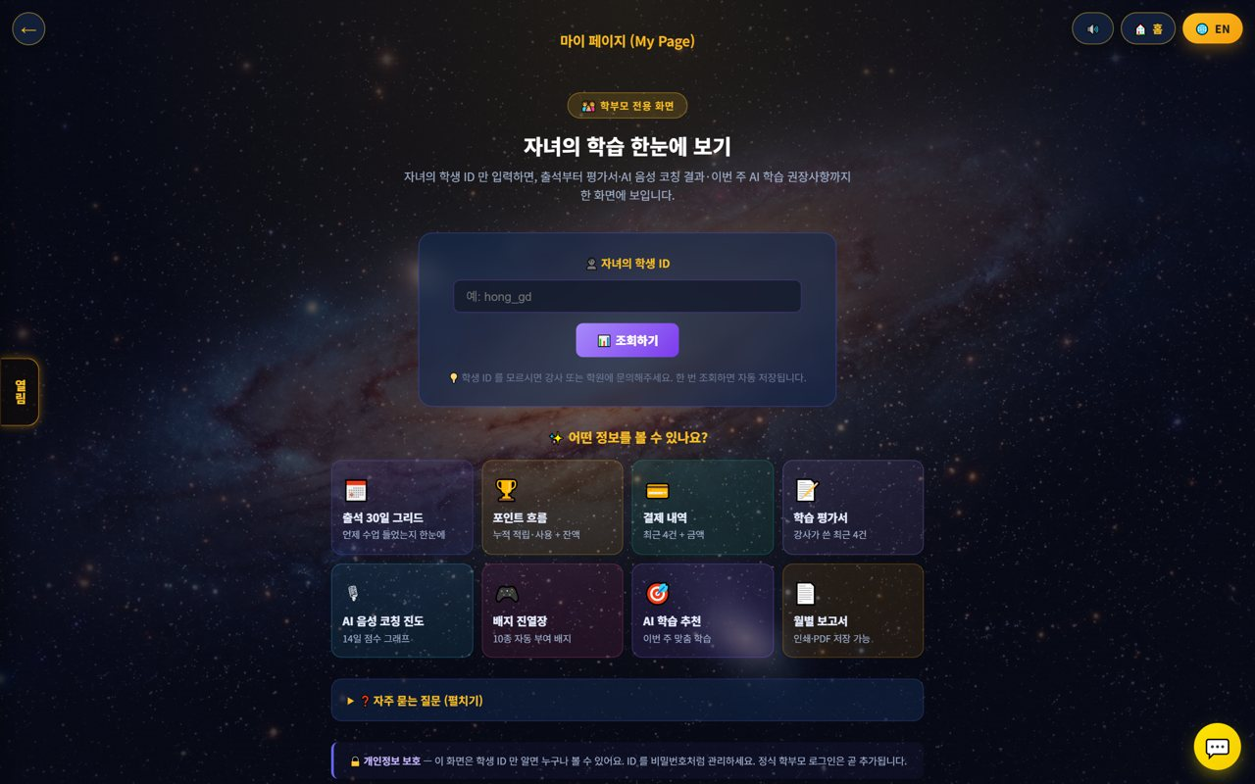
🤝 Mangoi Agency User Guide
How to Use the Main Features
06
👨‍👩‍👧 Parent Communication
Guide My Page
Guide parents to My Page so they can check their child's learning themselves. It reduces inquiries and raises satisfaction and re-enrollment.
How to use
● Share the My Page link with parents.
● Parents check attendance/reviews/payments/reports with the child's student ID.
● Share growth with the monthly report (print/PDF).
✅ Key Points
● Parent satisfaction leads to re-enrollment.
● Advise managing the student ID like a password.
💡 Tip · Reading the review together periodically builds parent trust.

Slide 10
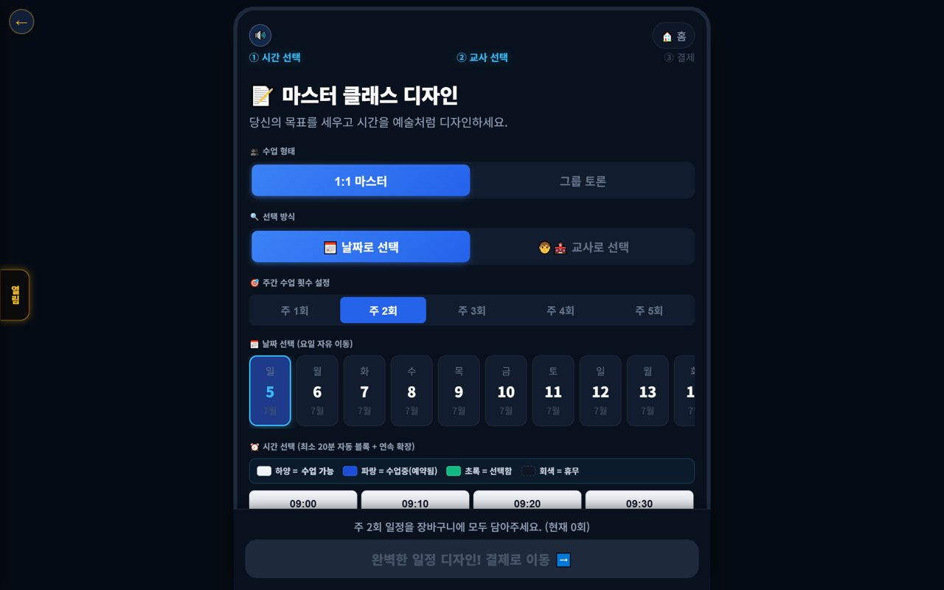
🤝 Mangoi Agency User Guide
How to Use the Main Features
07
📅 Booking·Assignment
Schedule and teacher
Assign a student's lesson type, time and teacher, and manage booking status. Handle postpone/change requests too.
How to use
● Assign lesson type, teacher and time in Booking.
● Check empty slots/overlaps and adjust.
● Handle students' postpone/change requests per policy.
✅ Key Points
● Assign popular slots in advance.
● Announcing the postpone cutoff reduces no-shows.
💡 Tip · Pre-registering each teacher's available times speeds up assignment.

Slide 11
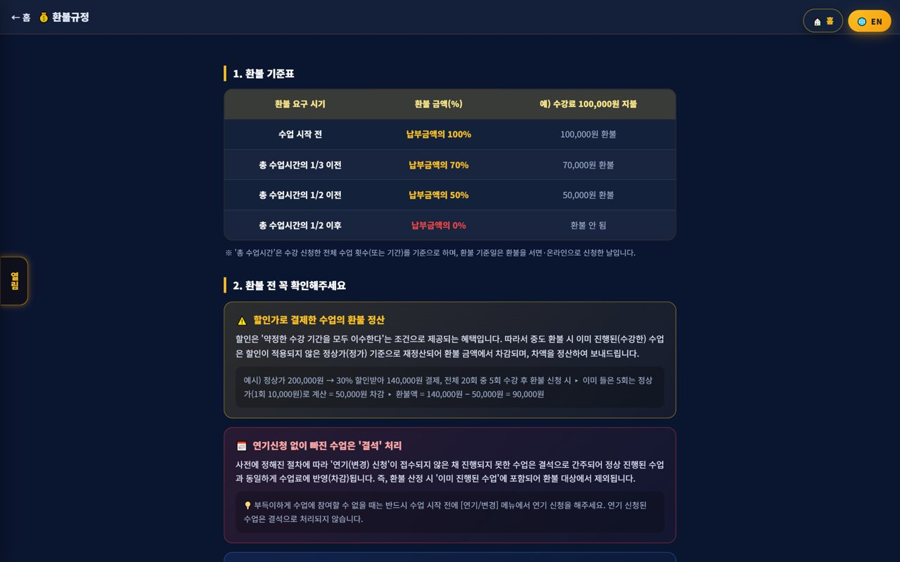
🤝 Mangoi Agency User Guide
How to Use the Main Features
08
💳 Payments·Collection
Payments·overdue·refunds
Process your agency's payments, overdue and refunds. Amounts auto-calculate by policy, and overdue is managed with alerts.
How to use
● Process payments/overdue/refunds in Accounting/Points.
● Notify overdue via alert-talk/SMS.
● Amounts are auto-calculated per the refund table.
✅ Key Points
● Automate overdue alerts to raise collection.
● Discounted-payment refunds recalc at list price.
💡 Tip · Reviewing collection status regularly stabilizes revenue.

Slide 12
🤝 Mangoi Agency User Guide
How to Use the Main Features
09
📈 Student Learning·Reports
Progress·performance
Check your students' attendance, reviews and learning progress, and review performance with reports. Use it for parent counseling and re-enrollment persuasion.
How to use
● Check each student's attendance·reviews·progress.
● Summarize performance with the monthly report.
● Use reports in parent counseling.
✅ Key Points
● Showing data builds parent trust.
● Link high-performing students to reviews/referrals.
💡 Tip · Showing performance with a report before re-enrollment makes persuasion easier.

Slide 13
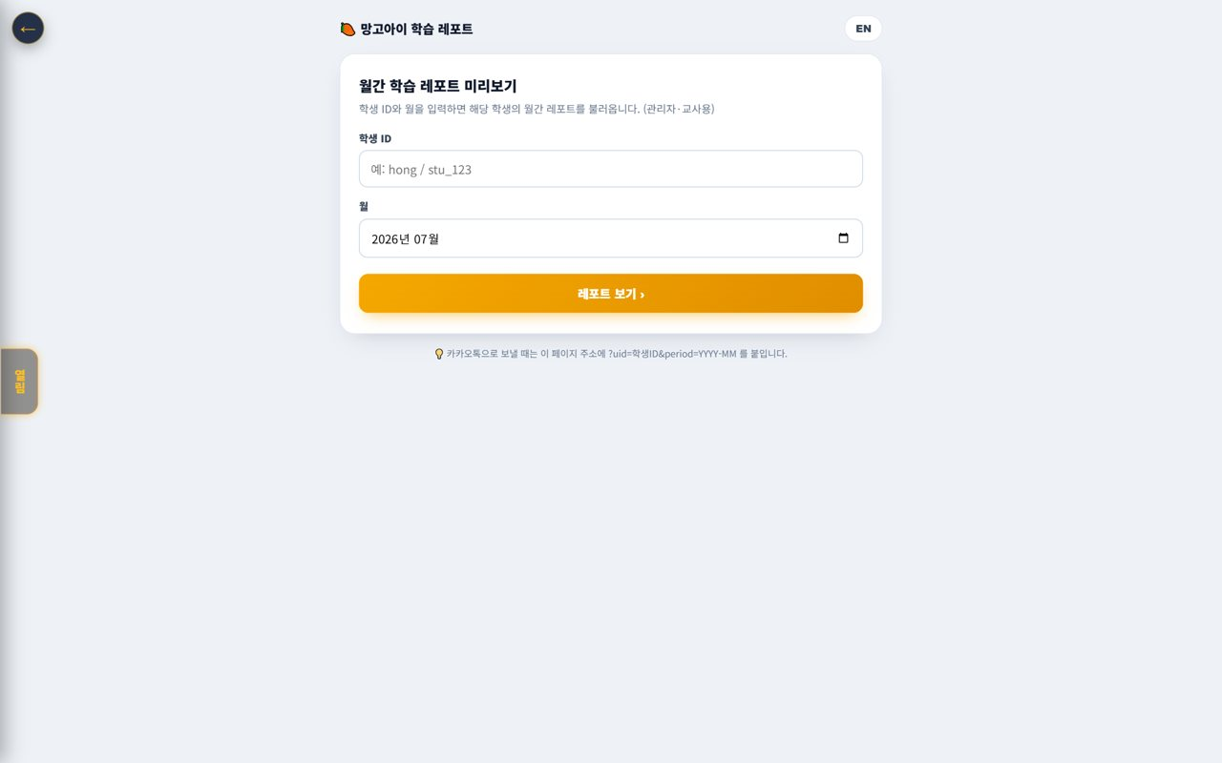
🤝 Mangoi Agency User Guide
How to Use the Main Features
10
🌳 Agency Settlement
Receive branch→agency
Check the settlement coming from the branch to your agency. Revenue and commissions are auto-calculated down the org tree, so you can see your share transparently.
How to use
● Check branch→agency settlement (received) by month.
● Review the revenue/commission calculation details.
● Save (PDF) the settlement report to keep.
✅ Key Points
● Settlement is auto-calculated by the org tree.
● Ask the branch/HQ to confirm any off items.
💡 Tip · Viewing revenue and settlement together clarifies your agency's profit structure.

Slide 14
🤝 Mangoi Agency User Guide
How to Use the Main Features
11
🧲 Prevent Churn (care for students)
Spot at-risk early
Find students likely to quit early and care for them. Quickly caring for students with frequent absences or dropping performance raises re-enrollment.
How to use
● Check churn-risk signals (absences·performance drop).
● Intervene on at-risk students with counseling/alert-talk.
● Manage family/referral relationships too.
✅ Key Points
● Intervening early raises retention.
● Care before re-enrollment season is especially important.
💡 Tip · Caring first for frequently-absent students noticeably cuts churn.

Slide 15
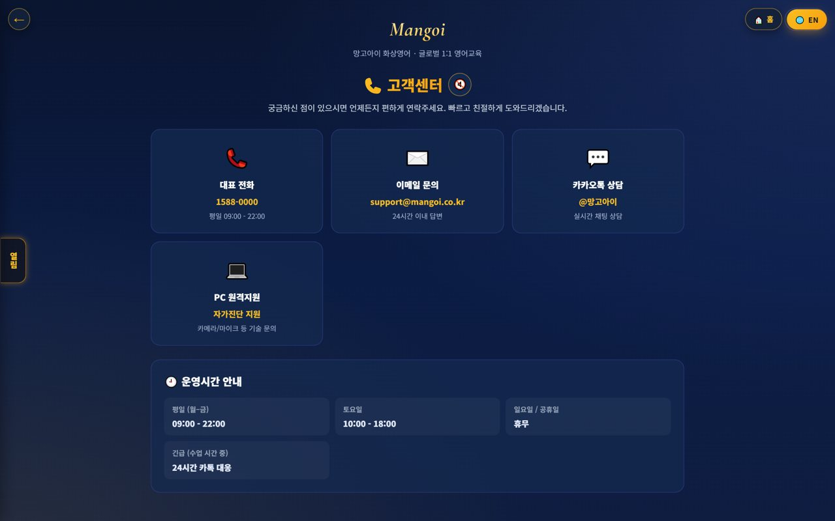
🤝 Mangoi Agency User Guide
How to Use the Main Features
12
💬 New Counseling·Recruiting
Intake·conversion
Take new counseling/inquiries and convert to enrollment. Recruiting is the starting point of agency growth.
How to use
● Take new counseling/inquiries.
● Record the counseling and convert to enrollment.
● Drive enrollment with trial lessons·level tests.
✅ Key Points
● Fast response raises conversion.
● Make the trial→enroll flow smooth.
💡 Tip · Following up after counseling raises conversion.

Slide 16
🤝 Mangoi Agency User Guide
How to Use the Main Features
13
🎧 Support·Help
Get branch·HQ support
If a problem comes up in operations, contact branch/HQ support. System/settlement/policy questions get resolved quickly.
How to use
● Use phone, email, Kakao and remote support in Support.
● Route settlement/policy questions to the branch/HQ.
● Note the fix for repeat issues.
✅ Key Points
● System issues resolve fast with remote support.
● For 'can't enter' tickets, check browser/permission first.
💡 Tip · Compiling common inquiries and fixes speeds up counseling.

Slide 17
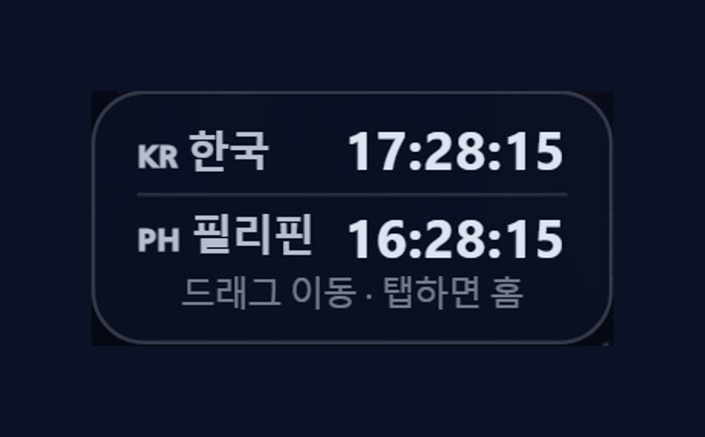
🤝 Mangoi Agency User Guide
How to Use the Main Features
14
🕐 Korea·Philippines Dual Clock
Two countries' time on screen
A clock on screen shows 🇰🇷 Korea and 🇵🇭 Philippines time together. It lets you check the time difference instantly when coordinating lessons between Philippine teachers and Korean students.
How to use
● On the on-screen dual clock, see 🇰🇷 Korea and 🇵🇭 Philippines time at once.
● Drag the clock to move it anywhere you like.
● Tap (click) the clock to go to the home screen.
✅ Key Points
● The Philippines is 1 hour behind Korea (−1 hour).
● You can check booking/entry times in both countries' time.
💡 Tip · When a lesson time is confusing due to the time difference, this clock clears it up instantly.

Slide 18
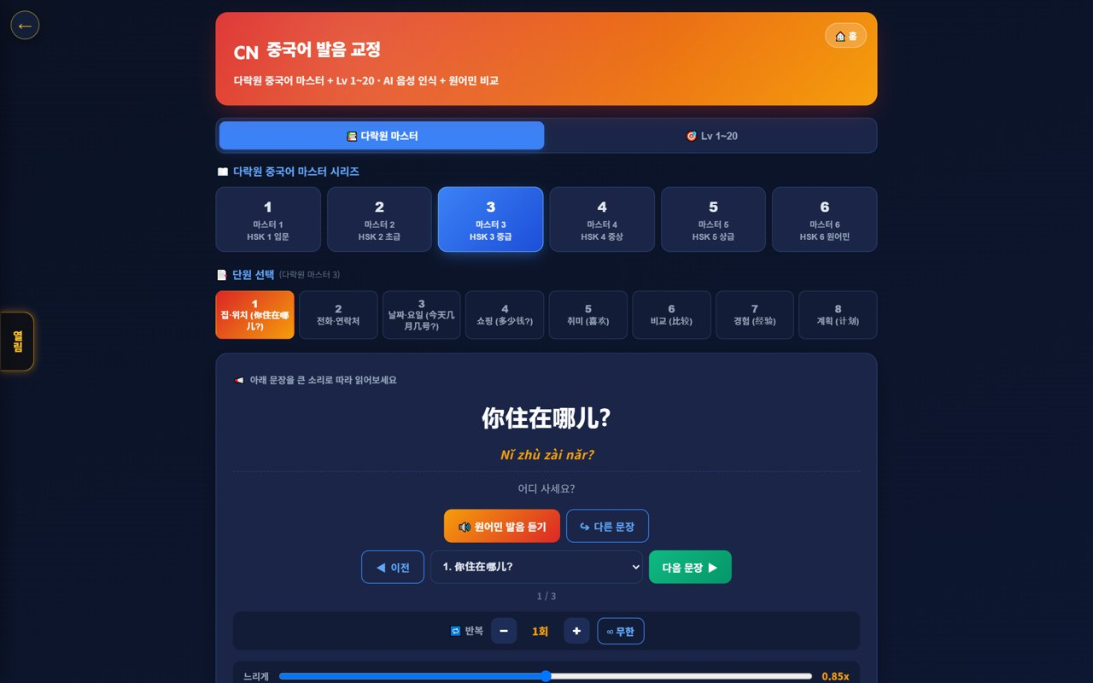
🤝 Mangoi Agency User Guide
How to Use the Main Features
15
🇨🇳 Chinese Pronunciation Coach
Darakwon Chinese Master Lv1–20
Mangoi offers not only English but also a Chinese course. With a Darakwon Chinese Master (Lv 1–20) pronunciation coach (characters+pinyin, AI voice recognition, native comparison), you can attract and manage students who want Chinese.
How to use
● In the AI voice coach, pick the CN Chinese level (or go to the Chinese pronunciation coach).
● Choose a Master series (1–6, HSK 1–6) and a unit.
● Read the sentence (characters + pinyin) and compare with 'Play native audio'.
● Practice hard sounds/tones with repeat and slow (0.85x).
✅ Key Points
● Characters and pinyin appear together, so it's easy to read.
● The AI recognizes your voice and compares it to a native speaker.
● The learning games hub supports Chinese too.
💡 Tip · Listen slowly and repeat clearly to nail the four tones.

Slide 19
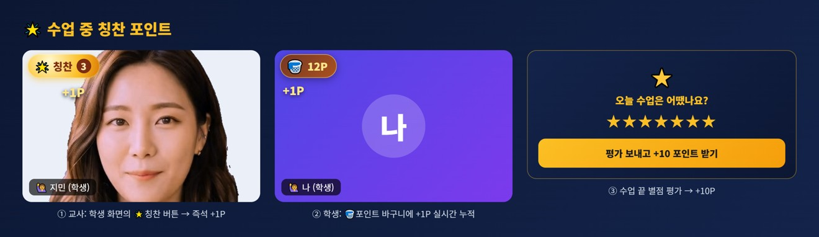
🤝 Mangoi Agency User Guide
How to Use the Main Features
16
🌟 In-class Praise Points (understand & use)
Linked to motivation·re-enrollment
During class the teacher gives 🌟 praise points (+1P) to students on the spot, and an end-of-class rating (+10P) adds up into the student's total points. Points lead to shop/gift rewards, helping motivation and re-enrollment. Your agency understands and uses this flow for performance.
How to use
● The teacher gives +1P via the 🌟 praise button on a student's video during class.
● It accrues live in the student's 🧺 point basket and sums into their total.
● A post-class star rating gives the student an extra +10P.
● Points connect to shop/roulette/gift rewards.
✅ Key Points
● Instant rewards boost participation and re-enrollment.
● Use your agency students' points/reward response as a performance signal.
⚠️ Good to know · Teachers give praise points; HQ (admin) configures the shop/reward/gift policy.
💡 Tip · Classes (teachers) where praise points flow well tend to have higher re-enrollment.

Slide 20
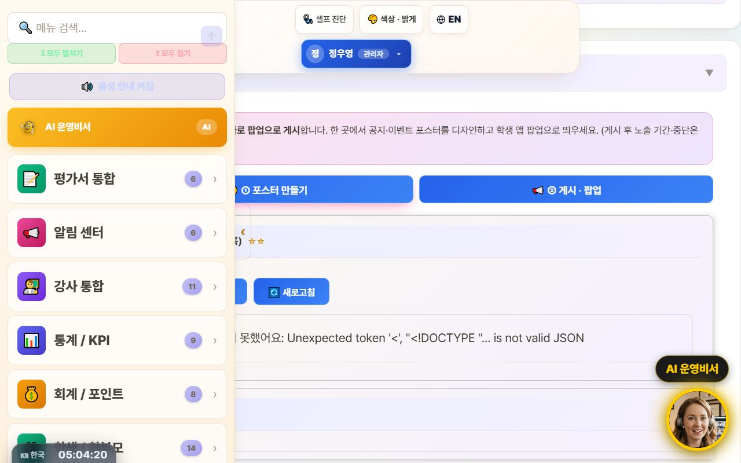
🤝 Mangoi Agency User Guide
How to Use the Main Features
17
📢 Notice Studio (Poster + Popup)
Design notice/event posters and push them as app popups
This merges the old ‘Poster Maker’ and ‘Popup Notice’ tools into one place. In the ①Create tab you design a notice/event poster, then hand it straight to the ②Publish·Popup tab to show it as a popup in your agency's student app.
How to use
● Go to the admin menu Notification Center → 📢 Notice Studio.
● In the ①Create tab, design a poster with text, images, and video (resize · save on server · reuse).
● Press ‘📢 Publish as popup’ on the finished poster to auto-switch to the ②Publish·Popup tab.
● In the publish tab, set the display period / stop and publish it as a student-app popup.
✅ Key Points
● Poster creation and popup publishing flow through one screen, two tabs — no more confusion.
● Posters you make can be saved and reused.
● Whichever route you enter from — AI assistant or sidebar search — the correct tab opens.
⚠️ Good to know · Existing posters/popups are preserved (it was only merged, nothing was deleted).
💡 Tip · Promoting an event takes just one flow: ‘Create → Publish as popup’ right away.

Slide 21
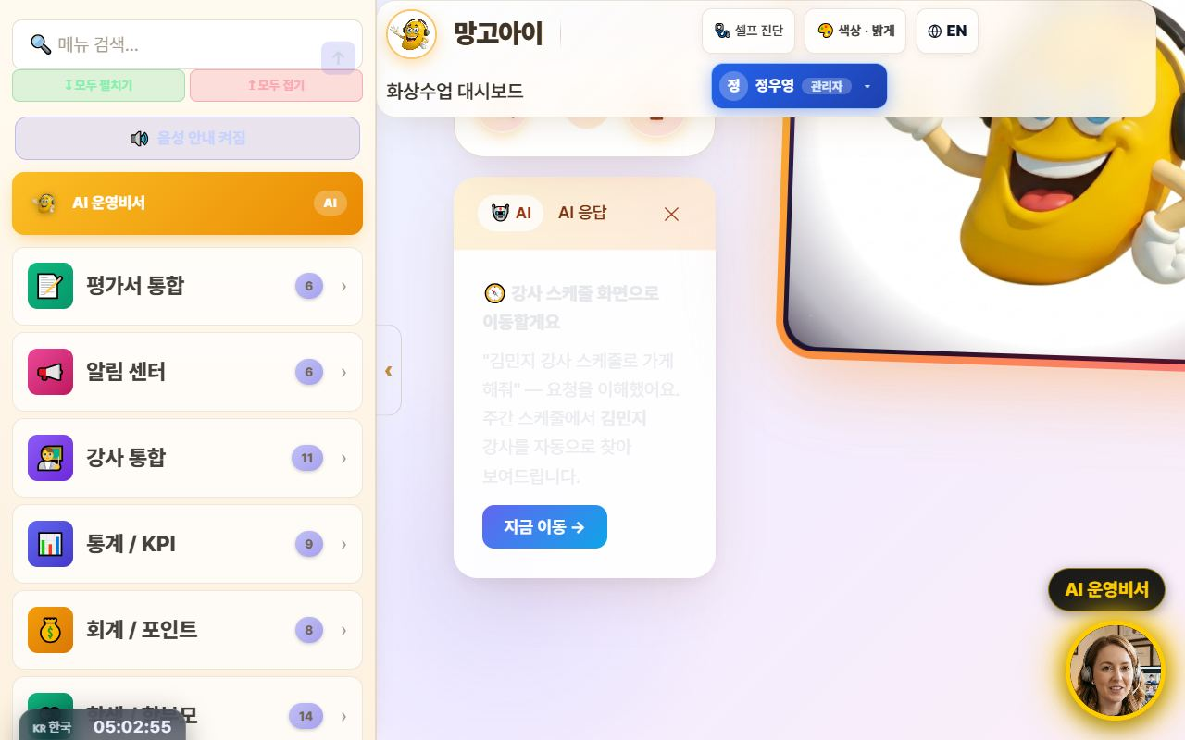
🤝 Mangoi Agency User Guide
How to Use the Main Features
18
🤖 Command the AI Operations Assistant
Navigate with one phrase: “Take me to ○○”
Type what you want to do into the top search bar (or the bottom-right AI assistant) in plain language, and the AI understands and jumps straight to that screen. It now reliably follows navigation commands like ‘Take me to teacher ○○'s schedule’ or ‘Open auto-scheduling’.
How to use
● Type a command in the top search bar or speak with the 🎤 mic.
● e.g. “Take me to teacher Kim Minji's schedule” → auto-finds that teacher in the weekly schedule and opens it.
● e.g. “Open auto-scheduling,” “Go to settlement” to navigate menus.
● Press ‘Go now →’ on the AI response card to move to that screen.
✅ Key Points
● Navigation commands actually navigate — far fewer ‘explain only, do nothing’ replies.
● Searching a schedule by teacher name auto-fills the search box + filters + scrolls.
● For data/statistics questions it also helps with card-style answers.
⚠️ Good to know · Commands that actually change things — ‘register · send · modify’ — ask for one more confirmation (a safety guard).
💡 Tip · When you can't recall a menu name, just say what you want to do — it finds its way there.

Slide 22
🤝 Mangoi Agency User Guide
How to Use the Main Features
19
💬 Share Library Links via KakaoTalk
Send videos & docs in original quality
Every guide and video in the library now has a '💬 Copy KakaoTalk link' button. Attaching a file to KakaoTalk crushes the quality, but sending a link plays the original as-is. One tap copies the link — guiding parents and teachers gets much easier.
How to use
● In the admin Library, press 💬 Copy KakaoTalk link next to the file.
● Paste it into the KakaoTalk chat room.
● Recipients tap the link to watch or download in original quality.
✅ Key Points
● For videos, link sharing = original quality; file attachments degrade it.
● Works the same for PDFs, PPTs, and videos anywhere in the library.
⚠️ Good to know · Anyone with the link can open it. For internal-only material, check who you share with.
💡 Tip · In a parents' group chat, one video-guide link does all the explaining.

Slide 23
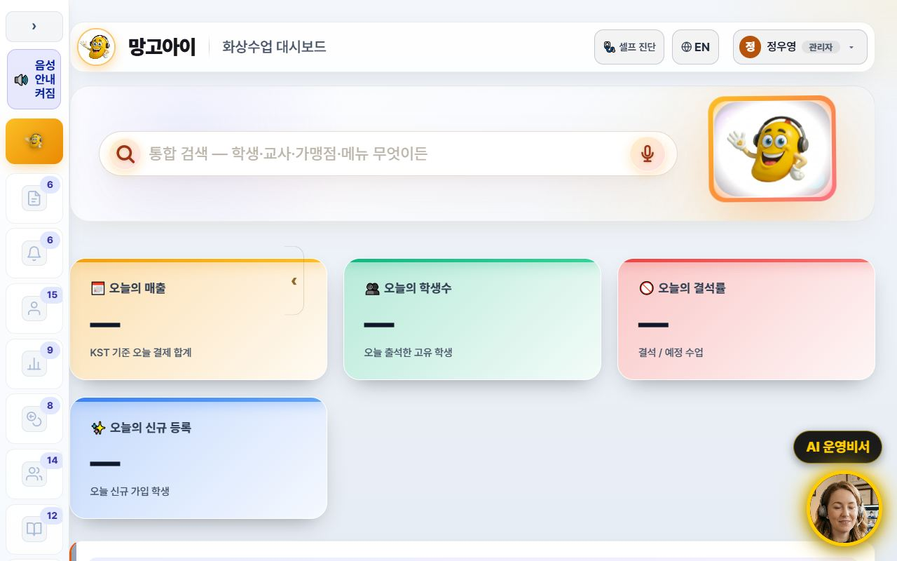
🤝 Mangoi Agency User Guide
How to Use the Main Features
20
🧭 A refreshed admin screen
Collapsible sidebar · lighter background · line icons
The admin screen is now easier on the eyes and wider. The left menu collapses to a narrow icon rail via the ‹ Collapse button, and the background is now a consistent light tone. Menu icons were redrawn as line icons so labels read clearly.
How to use
● Press ‹ Collapse at the top of the left menu — it shrinks to an icon rail and the content gets wider.
● Press the › button in the same place to expand it again.
● The collapsed state is remembered for your next visit.
● Too many menus to find one? Type its name into menu search at the top.
✅ Key Points
● Screens full of tables and lists gain a lot of horizontal space.
● 15 sub-pages were moved onto the same light theme, so the colour jump between screens is gone.
● The collapse animation was removed so low-spec PCs don't stutter.
💡 Tip · Wide-table screens like settlement and payroll are far easier to read with the menu collapsed.

Slide 24
🤝 Mangoi Agency User Guide
How to Use the Main Features
21
🌐 The interface language sets itself
Overseas staff and teachers start in English
Filipino teachers and overseas staff now start in English from the first screen. The interface language is decided from the account's nationality, and teacher accounts are always English regardless of name or previous choice. You can still switch any time with the 🌐 EN / KR button at the top.
How to use
● If the account has a nationality on file, the right language appears automatically at login.
● To change it manually, press the 🌐 EN / KR button at the top.
● A manual choice is stored per account — several people can share one PC without interference.
● Teacher guide slides and manuals switch to the English editions with it.
✅ Key Points
● Teacher accounts are always English — no more getting lost in a Korean screen.
● Accounts with an English name no longer flip to Korean because of a Korean job title.
● Language choice is isolated per account, so an overseas account isn't overwritten by someone else's pick.
⚠️ Good to know · Accounts with no nationality fall back to the old name/ID heuristic. Please fill in nationality when registering teachers.
💡 Tip · Enter nationality when registering a new teacher and their very first login is in English — fewer support requests.

Slide 25
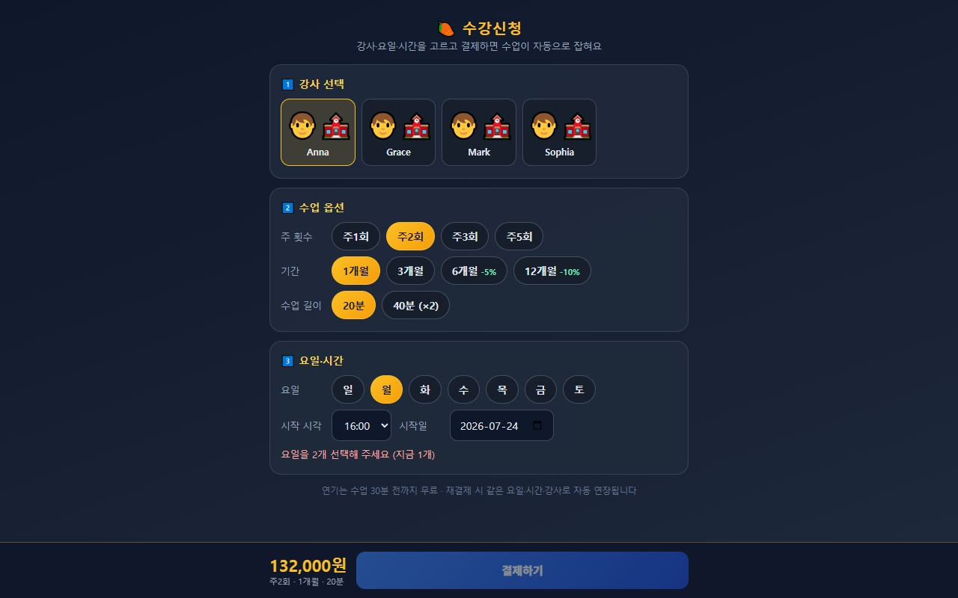
🤝 Mangoi Agency User Guide
How to Use the Main Features
22
💳 Enrolment & payment → automatic lesson creation
Once payment is confirmed, every session is scheduled
On the Enrolment screen a student picks teacher, days and time and pays — and all lesson sessions are created automatically the moment payment is confirmed. The old manual timetable entry after payment is gone. If the slot clashes with an existing lesson, the conflict is detected before payment.
How to use
● Send students and parents the enrolment link.
● They choose teacher → lesson options (weekly count, term, length) → days & time.
● The slot check must pass before the pay button unlocks (payment is blocked on a clash).
● On confirmed payment, all sessions are created at once — verify in the admin lesson list.
● Head-office prices and discount rates are managed on the pricing screen.
✅ Key Points
● Idempotent — a duplicated payment callback will not create the sessions twice.
● Clashes with holidays or existing lessons are pushed back so the session count is still met.
● Term discounts (6 months −5%, 12 months −10%) are applied to the amount automatically.
⚠️ Good to know · Stage 1 (enrol → pay → auto-create sessions) is live today. Later stages will follow.
💡 Tip · Consultation → level test → send the enrolment link is the smoothest conversion path.

Slide 26
🤝 Mangoi Agency User Guide
Feature Summary · Data
23
📋 Agency Features at a Glance
Feature | What it does | When | Core benefit
Dashboard | Revenue·enrollment·today | Every morning | Quick read
Student mgmt | Recruit·enroll·history | Always | Grow enrollment
Parent comm | Guide My Page | Enroll·re-enroll | Satisfaction ↑
Booking | Schedule·teacher | Assigning lessons | Smooth flow
Payments | Payments·overdue·refunds | Collection | Stable revenue
Reports | Learning performance | Counsel·re-enroll | Persuasion ↑
Settlement | Receive branch→agency | Monthly | Transparent profit
Retention | Care for at-risk | Always | Retention ↑

Slide 27
🤝 Mangoi Agency User Guide
Data at a Glance
24
📊 Data at a Glance
Enrollment Trend (example)
Churn-risk Distribution (example)

Slide 28
🤝 Mangoi Agency User Guide
Frequently Asked Questions (FAQ)
25
❓ Frequently Asked Questions (FAQ)
Q. Where do I log in?
A. Log in at admin.mangoi.co.kr. By role (agency), only your agency's data shows automatically.
Q. Can I see other agencies' data?
A. No. By permission scope, only your agency's data is visible.
Q. How do I grow enrollment?
A. Fast counseling response, a smooth trial→enroll flow, and persuading parents with learning reports are key.
Q. How do I check settlement?
A. Branch→agency settlement (received) is auto-calculated by the org tree; check it in the monthly report.
Q. A student seems about to quit.
A. Watch churn-risk signals (absences·performance drop) and intervene quickly with counseling/alert-talk.

Slide 29
🤝 Mangoi Agency User Guide
Checklist
26
✅ Agency Operations Checklist
Did you check today's revenue/enrollment/attendance?
Did you take and respond to new counseling/inquiries?
Did you check and notify overdue items?
Did you care for at-risk students?
Did you guide parents to the report/My Page?
Did you check this month's settlement (received)?
Did you follow up on trial→enroll?

Slide 30
🤝 Mangoi Agency User Guide
Conclusion
27
🏁 Conclusion · A Practical Guide to Agency Growth
The core of agency operations is the virtuous cycle of 'recruit → enroll → satisfy → re-enroll.' Respond to counseling fast, show learning results with data, and prevent churn early — and your agency grows steadily. Keep this rhythm and operations feel solid.
🔄 The Flow at a Glance
⭐ Key Principles
Morning (5 min)
Check revenue/enrollment/attendance on the dashboard; check live-lesson status
● Respond fast — the faster you handle counseling/inquiries, the higher conversion.
● Persuade with data — showing results via learning reports makes re-enrollment easy.
● Intervene on churn early — care first for frequently-absent students.
● Communicate with parents — build trust with My Page and reports.
● Follow up — following up after counseling completes enrollment.
Late morning
Respond to new counseling·convert; notify overdue
Class hours
Check lesson assignment/progress; guide 'entry' tickets to browser/permission first
Afternoon
Care for at-risk students; parent reports·counseling
Monthly
Check branch→agency settlement; re-enroll·follow-up
📌 Remember
● Log in at admin.mangoi.co.kr; data is auto-limited to your agency scope
● Settlement is auto-calculated by the branch→agency tree
● Most 'can't enter class' tickets are browser/permission issues
● Growth rhythm: 'Recruit → Enroll → Satisfy → Re-enroll'!
🍊 An agency's strength comes from 'the care you give each student.' Respond quickly, show results, and prevent churn early. Your branch and HQ back you up solidly. Questions? Contact support anytime — cheering on your thriving agency! 🍊

Slide 31
Let's grow together with Mangoi!
Questions? Ask the on-site A.i assistant or contact customer support.
🌐 www.mangoi.co.kr 📞 1644-0561 ✉ support@mangoi.co.kr

