Slide 1

🏢 BRANCH GUIDE
Mangoi · MANGOI
Branch User Guide
Sub-agencies, settlement & performance in one book
For · Regional branch operators | www.mangoi.co.kr

Slide 2
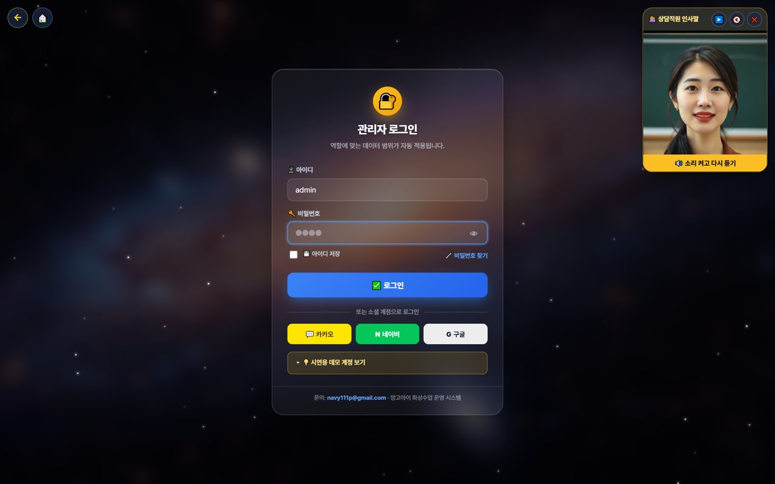
🏢 Mangoi Branch User Guide
Introduction
What is the Branch Admin Page?
The branch page is where you manage your branch and its sub-agencies with authority delegated by HQ. When you log in, only 'my branch' data (revenue, enrollment, attendance, settlement) is shown automatically. You see your sub-agencies' performance at a glance and process the settlement that flows HQ ↔ branch ↔ agency. The layout is the same as the admin page — only the scope differs.
🏢
My-branch scope, automatic
🏬
Manage sub-agencies
Just log in and see only your branch's data.
Agency list, performance and recruiting in one place.
🌳
HQ→branch→agency settlement
📊
Performance reports
Receipt/distribution auto-calculated by the tree.
Branch/agency performance in a monthly report.
Your Branch Metrics (example)

Slide 3
🏢 Mangoi Branch User Guide
Contents
📑 Contents
Introduction
2
14
Chinese Pronunciation Coach
17
01
Branch Login & Permissions
4
15
In-class Praise Points (understand & use)
18
02
My Page & Admin Dashboard
5
16
Notice Studio (Poster + Popup)
19
03
Branch Dashboard
6
17
Command the AI Operations Assistant
20
04
Using the AI Assistant
7
18
Share Library Links via KakaoTalk
21
05
Manage Sub-agencies
8
19
A refreshed admin screen
22
06
Branch Settlement (receive & distribute)
9
20
The interface language sets itself
23
07
Student · Parent Status
10
21
Enrolment & payment → automatic lesson creation
24
08
Payments·Overdue·Refunds (branch)
11
22
Feature Summary · Data
25
09
Branch Retention
12
23
Data at a Glance
26
10
Monthly Report·Performance
13
24
Frequently Asked Questions (FAQ)
27
11
Agency Support·Training
14
25
Checklist
28
12
Support·Inquiries
15
26
Conclusion
29
13
Korea·Philippines Dual Clock
16

Slide 4
🏢 Mangoi Branch User Guide
How to Use the Main Features
01
🔐 Branch Login & Permissions
Only my branch's data shows
Logging in with a branch account shows only 'my branch' menus and data. HQ-wide or other branches' data isn't visible, so you can focus on your branch with peace of mind.
How to use
● Log in with ID and password (Kakao, Naver, Google also work).
● On login, menus/data for your role (branch) are applied automatically.
● Forgot your password? Reset via 'Find password'.
● You can split permission scope among staff.
✅ Key Points
● Only your branch and sub-agency data shows.
● Turn on 'Save ID' only on your own trusted PC.
💡 Tip · On shared PCs, turn off auto-login and always log out when done.

Slide 5
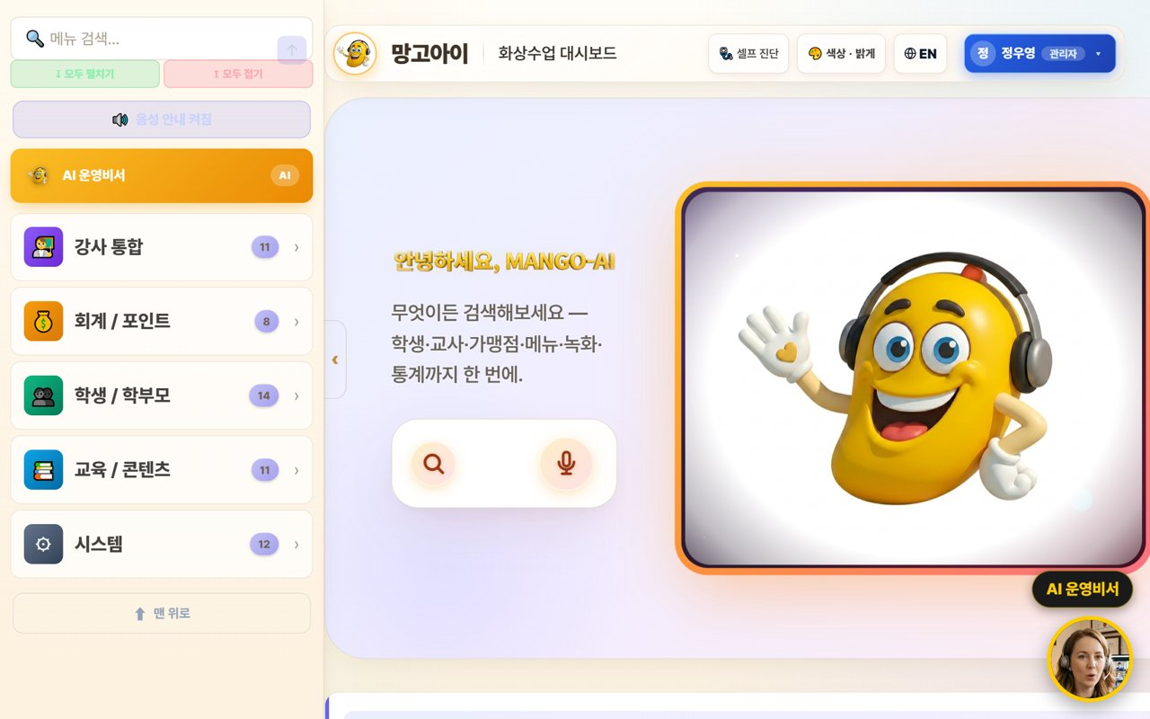
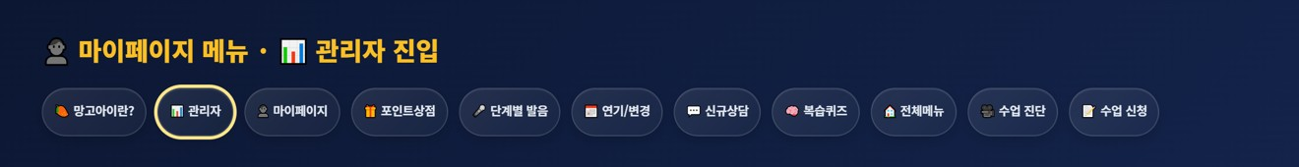
🏢 Mangoi Branch User Guide
How to Use the Main Features
02
👤 My Page & Admin Dashboard
Open the management screen from My Page
Branch operations start from 'My Page.' After logging in, press the 📊 'Admin' button in the My Page menu to enter the branch-scope admin (operations) dashboard, where you manage revenue, enrollment, agencies and settlement.
How to use
● After logging in, open '👤 My Page'.
● Press the 📊 'Admin' button in the My Page menu. (goes to the admin dashboard)
● On the admin dashboard, check your branch revenue, enrollment, attendance and sub-agencies.
● My Page also has postpone/change, new inquiry, all-menu, pre-check and more.
● If text looks English, use the EN button to switch language.
✅ Key Points
● One 'Admin' button takes you straight to the operations dashboard.
● All dashboard data is auto-totaled to 'your branch scope'.
● Menus and data are set automatically by your role (branch).
⚠️ Good to know · My Page and the admin dashboard open only within the logged-in branch account's permission scope.
💡 Tip · Each day, spend 5 minutes: My Page → Admin dashboard → check branch metrics.

Slide 6
🏢 Mangoi Branch User Guide
How to Use the Main Features
03
🏠 Branch Dashboard
Your branch status at a glance
On login, your branch's revenue, enrollment and attendance plus sub-agency status are organized as cards. Type a word in the top search box to jump right to a feature.
How to use
● Check today's revenue, enrollment and attendance (your branch total) at the top.
● Tap features from the category cards (agencies, teachers, accounting, students, content).
● Type a word in the feature search box to jump right there.
● The AI insight summarizes your branch status.
✅ Key Points
● All numbers are auto-totaled to 'your branch scope'.
● If a feature is hard to find, search is fastest.
💡 Tip · A 5-minute morning check of branch metrics catches warning signs early.

Slide 7
🏢 Mangoi Branch User Guide
How to Use the Main Features
04
🤖 Using the AI Assistant
Look up/act by voice or text
Speak or type into the search/mic and the AI looks up numbers or opens screens within your branch scope. Important actions are confirmed first, and it only does what you're permitted.
How to use
● Speak or type into the center search/mic. e.g. 'How's the branch revenue this month?'
● The AI looks up numbers or opens a screen. e.g. 'Open the agency list.'
● Important actions are confirmed with 'Shall I?' first.
● The assistant only executes what you're permitted.
✅ Key Points
● When busy, voice is much faster.
● Results are limited to your branch scope.
💡 Tip · Just say 'show me/open ○○' to jump to the screen you want.

Slide 8

🏢 Mangoi Branch User Guide
How to Use the Main Features
05
🏬 Manage Sub-agencies
List, performance, recruiting
Manage the agencies under your branch as a list and compare each agency's enrollment, revenue and performance. Recruiting and onboarding new agencies is handled here too.
How to use
● Check each agency's enrollment, revenue and activity in the agency list.
● Compare strong/weak agencies to set support priorities.
● Manage new-agency recruiting/onboarding progress.
● Set goals/incentives per agency if needed.
✅ Key Points
● Link agencies with big performance gaps to coaching/support.
● Share top agencies' methods with the others.
⚠️ Good to know · Agency data is also managed by each agency's own login; the branch sees the whole picture.
💡 Tip · Sharing a monthly performance report at month-start boosts partner motivation.

Slide 9
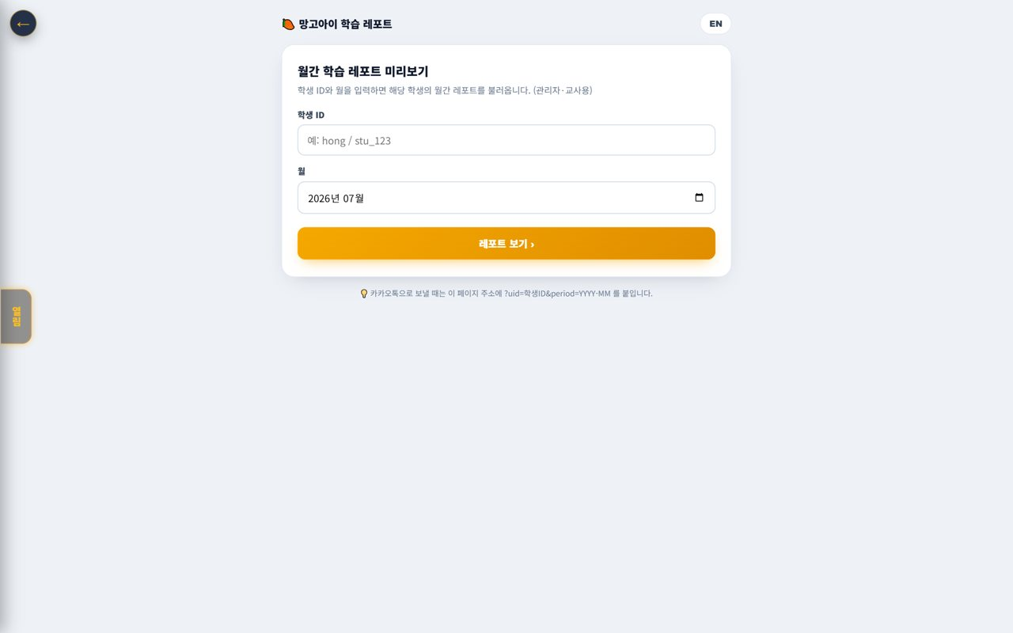
🏢 Mangoi Branch User Guide
How to Use the Main Features
06
🌳 Branch Settlement (receive & distribute)
HQ→branch→agency
Receive the settlement coming from HQ to your branch and check the amount distributed from the branch to sub-agencies. Revenue and commissions are auto-calculated down the org tree.
How to use
● Check HQ→branch settlement (received) by month.
● Branch→agency distribution is auto-calculated by the tree.
● Review/save the settlement in a monthly report (PDF).
● If an item looks off, look up the details to confirm.
✅ Key Points
● Settlement is auto-calculated down the org tree (HQ·branch·agency).
● Distributing the settlement report early builds agency trust.
💡 Tip · Announcing settlement terms (rate·timing) to agencies in advance reduces disputes.

Slide 10
🏢 Mangoi Branch User Guide
How to Use the Main Features
07
🧑‍🎓 Student · Parent Status
Branch-scope enrollment·attendance·grades
Check the status of students in your branch (enrollment, attendance, grades). View by agency or as a branch total.
How to use
● Check branch-scope enrolled students in Students/Parents.
● Compare attendance/grades by agency and overall.
● Flag students/agencies that need attention.
✅ Key Points
● The student list is linked to real member data.
● At-risk students link to the Retention Center.
💡 Tip · Find agencies whose attendance/enrollment is dipping and support them quickly.

Slide 11
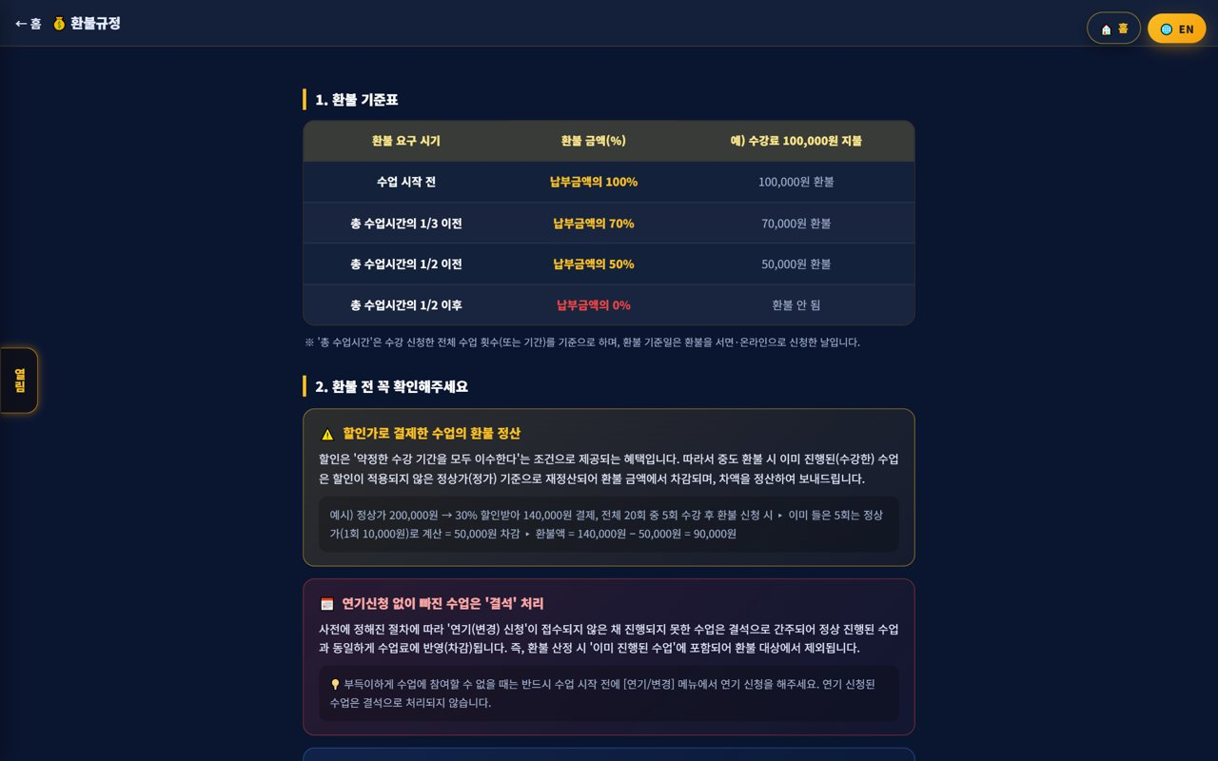
🏢 Mangoi Branch User Guide
How to Use the Main Features
08
💳 Payments·Overdue·Refunds (branch)
Branch-scope accounting
Check payments, overdue and refunds in your branch scope and review amounts auto-calculated by policy. Also see collection status by agency.
How to use
● Check branch-scope payments/overdue/refunds in Accounting/Points.
● Compare collection rate by agency.
● Amounts are auto-calculated per the refund table.
✅ Key Points
● Strengthen alerts/support for agencies with high overdue.
● Discounted-payment refunds recalc at list price.
💡 Tip · Advise agencies with low collection to automate reminders.

Slide 12
🏢 Mangoi Branch User Guide
How to Use the Main Features
09
🧲 Branch Retention
Churn risk·contagion·coaching
Find at-risk students across your branch/agencies early and prevent chain churn through family/referral. It ties into agency and teacher coaching.
How to use
● Find at-risk students/agencies with the churn-risk graph.
● Prevent chain churn with the contagion network.
● Link high-risk spots to alert-talk/counseling/coaching.
✅ Key Points
● Intervening early raises retention.
● Compare churn patterns by agency to support them.
💡 Tip · Just caring weekly for the top at-risk agencies/students noticeably cuts churn.

Slide 13
🏢 Mangoi Branch User Guide
How to Use the Main Features
10
📊 Monthly Report·Performance
Branch·agency performance
Summarize your branch and sub-agencies' performance in a monthly report. See revenue, enrollment, attendance and settlement at a glance and save/print to share.
How to use
● Check branch/agency performance with the monthly report.
● Compare metrics (revenue·enrollment·attendance·settlement) vs prior month/year.
● Save the report as print/PDF to share.
✅ Key Points
● The AI insight helps summarize performance.
● The report also works as agency motivation material.
💡 Tip · Making monthly report sharing routine keeps branch operations transparent.

Slide 14
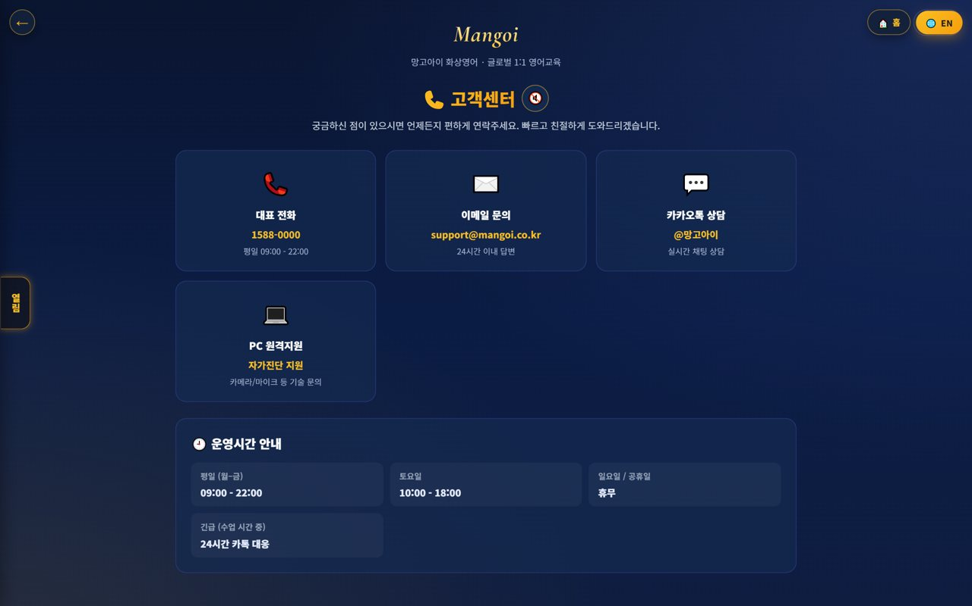
🏢 Mangoi Branch User Guide
How to Use the Main Features
11
🎓 Agency Support·Training
Onboarding·ops coaching
Support sub-agencies to operate well with onboarding and ops coaching. Guide the user guide/FAQ/support channels and share best practices.
How to use
● Guide new agencies to the user guide·ops guide.
● Organize frequent questions into an FAQ and distribute.
● Share top-agency cases to level everyone up.
✅ Key Points
● Early onboarding largely decides an agency's success.
● Turn repeat questions into FAQ to cut support load.
💡 Tip · Quarterly agency meetings help review performance and pain points together.

Slide 15
🏢 Mangoi Branch User Guide
How to Use the Main Features
12
🎧 Support·Inquiries
Get HQ support
If a problem comes up in operations, contact HQ support channels. System/settlement/policy questions get resolved quickly.
How to use
● Use phone, email, Kakao and remote support in Support.
● Route settlement/policy questions to the HQ contact.
● Note the fix for repeat issues.
✅ Key Points
● System issues resolve fast with remote support.
● Inquiries within business hours are faster.
💡 Tip · Compile common inquiries and fixes and share them with agencies too.

Slide 16
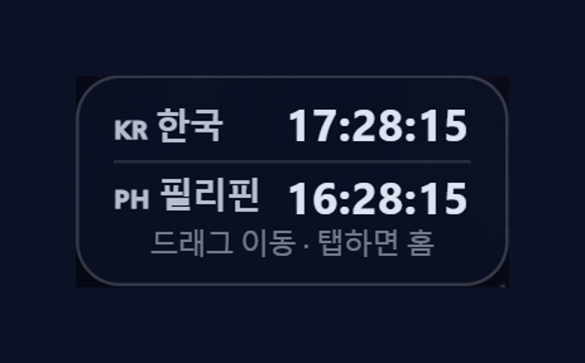
🏢 Mangoi Branch User Guide
How to Use the Main Features
13
🕐 Korea·Philippines Dual Clock
Two countries' time on screen
A clock on screen shows 🇰🇷 Korea and 🇵🇭 Philippines time together. It lets you check the time difference instantly when coordinating lessons between Philippine teachers and Korean students.
How to use
● On the on-screen dual clock, see 🇰🇷 Korea and 🇵🇭 Philippines time at once.
● Drag the clock to move it anywhere you like.
● Tap (click) the clock to go to the home screen.
✅ Key Points
● The Philippines is 1 hour behind Korea (−1 hour).
● You can check booking/entry times in both countries' time.
💡 Tip · When a lesson time is confusing due to the time difference, this clock clears it up instantly.

Slide 17
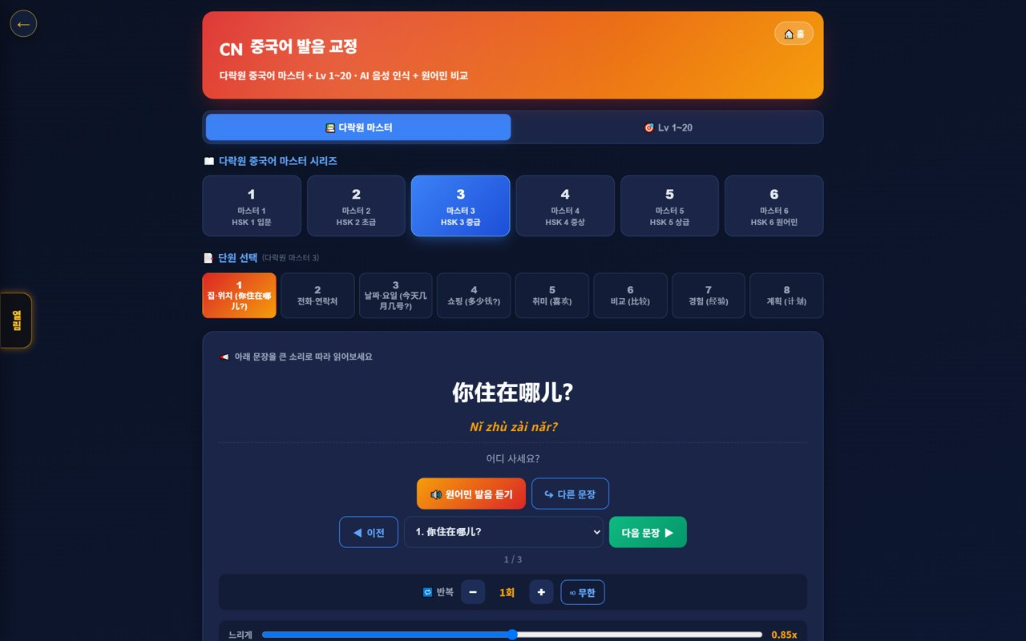
🏢 Mangoi Branch User Guide
How to Use the Main Features
14
🇨🇳 Chinese Pronunciation Coach
Darakwon Chinese Master Lv1–20
Mangoi offers not only English but also a Chinese course. With a Darakwon Chinese Master (Lv 1–20) pronunciation coach (characters+pinyin, AI voice recognition, native comparison), you can attract and manage students who want Chinese.
How to use
● In the AI voice coach, pick the CN Chinese level (or go to the Chinese pronunciation coach).
● Choose a Master series (1–6, HSK 1–6) and a unit.
● Read the sentence (characters + pinyin) and compare with 'Play native audio'.
● Practice hard sounds/tones with repeat and slow (0.85x).
✅ Key Points
● Characters and pinyin appear together, so it's easy to read.
● The AI recognizes your voice and compares it to a native speaker.
● The learning games hub supports Chinese too.
💡 Tip · Listen slowly and repeat clearly to nail the four tones.

Slide 18
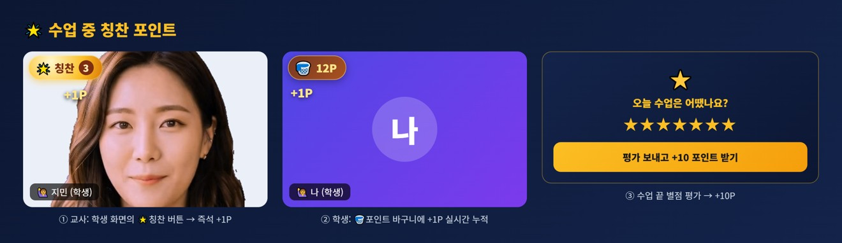
🏢 Mangoi Branch User Guide
How to Use the Main Features
15
🌟 In-class Praise Points (understand & use)
Linked to motivation·re-enrollment
During class the teacher gives 🌟 praise points (+1P) to students on the spot, and an end-of-class rating (+10P) adds up into the student's total points. Points lead to shop/gift rewards, helping motivation and re-enrollment. Your branch understands and uses this flow for performance.
How to use
● The teacher gives +1P via the 🌟 praise button on a student's video during class.
● It accrues live in the student's 🧺 point basket and sums into their total.
● A post-class star rating gives the student an extra +10P.
● Points connect to shop/roulette/gift rewards.
✅ Key Points
● Instant rewards boost participation and re-enrollment.
● Use your branch students' points/reward response as a performance signal.
⚠️ Good to know · Teachers give praise points; HQ (admin) configures the shop/reward/gift policy.
💡 Tip · Classes (teachers) where praise points flow well tend to have higher re-enrollment.

Slide 19
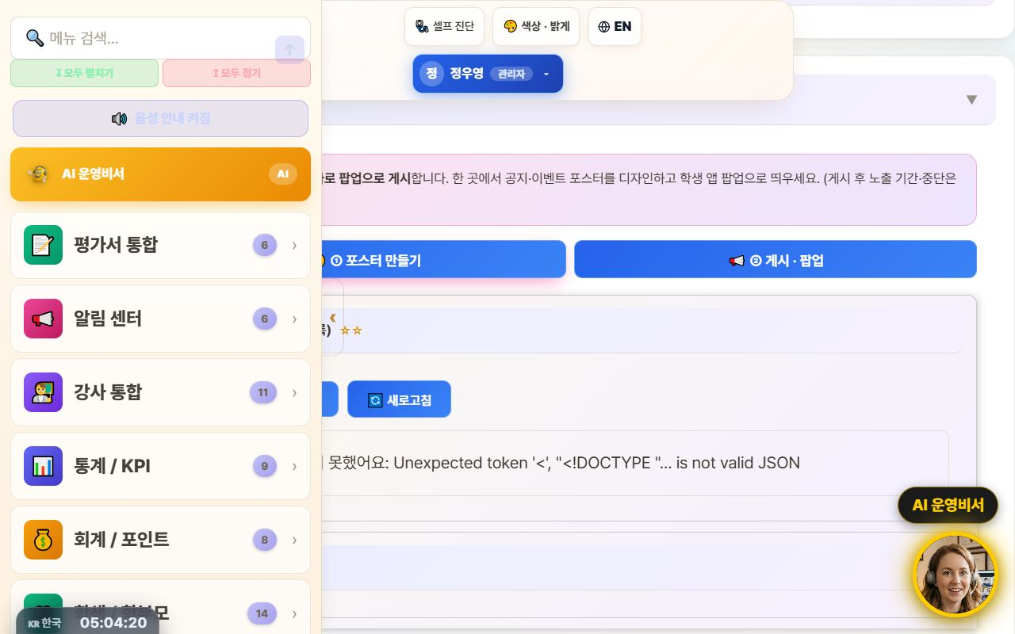
🏢 Mangoi Branch User Guide
How to Use the Main Features
16
📢 Notice Studio (Poster + Popup)
Design notice/event posters and push them as app popups
This merges the old ‘Poster Maker’ and ‘Popup Notice’ tools into one place. In the ①Create tab you design a notice/event poster, then hand it straight to the ②Publish·Popup tab to show it as a popup in your branch's student app.
How to use
● Go to the admin menu Notification Center → 📢 Notice Studio.
● In the ①Create tab, design a poster with text, images, and video (resize · save on server · reuse).
● Press ‘📢 Publish as popup’ on the finished poster to auto-switch to the ②Publish·Popup tab.
● In the publish tab, set the display period / stop and publish it as a student-app popup.
✅ Key Points
● Poster creation and popup publishing flow through one screen, two tabs — no more confusion.
● Posters you make can be saved and reused.
● Whichever route you enter from — AI assistant or sidebar search — the correct tab opens.
⚠️ Good to know · Existing posters/popups are preserved (it was only merged, nothing was deleted).
💡 Tip · Promoting an event takes just one flow: ‘Create → Publish as popup’ right away.

Slide 20
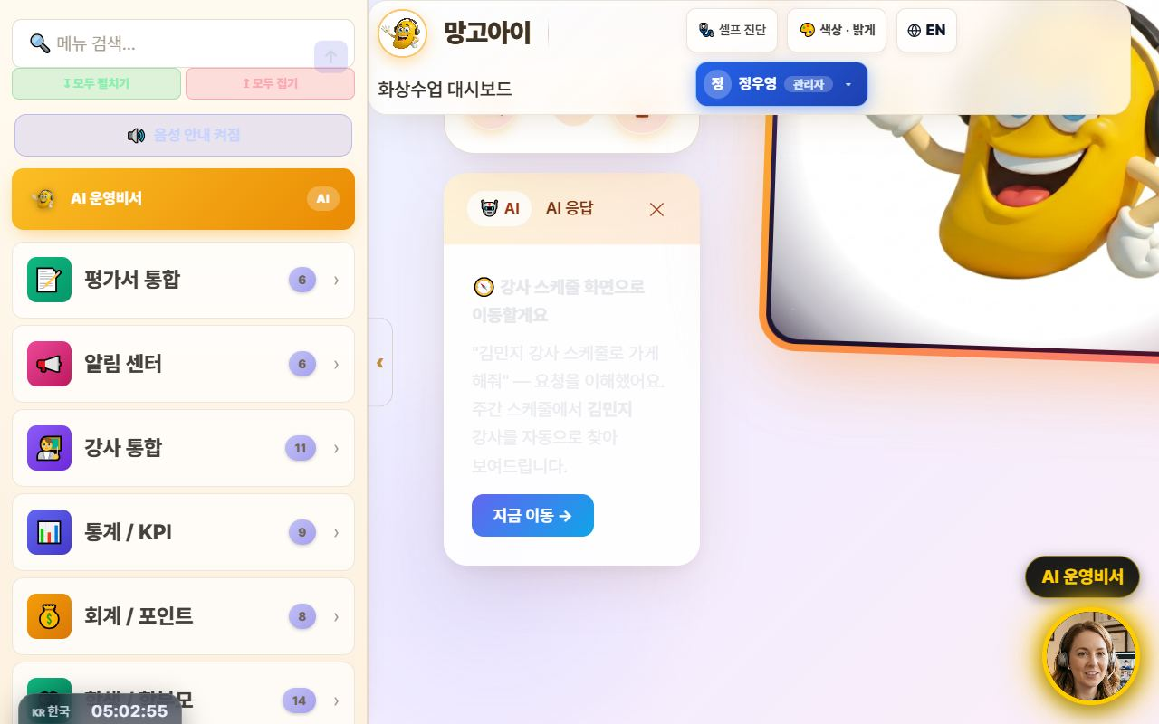
🏢 Mangoi Branch User Guide
How to Use the Main Features
17
🤖 Command the AI Operations Assistant
Navigate with one phrase: “Take me to ○○”
Type what you want to do into the top search bar (or the bottom-right AI assistant) in plain language, and the AI understands and jumps straight to that screen. It now reliably follows navigation commands like ‘Take me to teacher ○○'s schedule’ or ‘Open auto-scheduling’.
How to use
● Type a command in the top search bar or speak with the 🎤 mic.
● e.g. “Take me to teacher Kim Minji's schedule” → auto-finds that teacher in the weekly schedule and opens it.
● e.g. “Open auto-scheduling,” “Go to settlement” to navigate menus.
● Press ‘Go now →’ on the AI response card to move to that screen.
✅ Key Points
● Navigation commands actually navigate — far fewer ‘explain only, do nothing’ replies.
● Searching a schedule by teacher name auto-fills the search box + filters + scrolls.
● For data/statistics questions it also helps with card-style answers.
⚠️ Good to know · Commands that actually change things — ‘register · send · modify’ — ask for one more confirmation (a safety guard).
💡 Tip · When you can't recall a menu name, just say what you want to do — it finds its way there.

Slide 21
🏢 Mangoi Branch User Guide
How to Use the Main Features
18
💬 Share Library Links via KakaoTalk
Send videos & docs in original quality
Every guide and video in the library now has a '💬 Copy KakaoTalk link' button. Attaching a file to KakaoTalk crushes the quality, but sending a link plays the original as-is. One tap copies the link — guiding parents and teachers gets much easier.
How to use
● In the admin Library, press 💬 Copy KakaoTalk link next to the file.
● Paste it into the KakaoTalk chat room.
● Recipients tap the link to watch or download in original quality.
✅ Key Points
● For videos, link sharing = original quality; file attachments degrade it.
● Works the same for PDFs, PPTs, and videos anywhere in the library.
⚠️ Good to know · Anyone with the link can open it. For internal-only material, check who you share with.
💡 Tip · In a parents' group chat, one video-guide link does all the explaining.

Slide 22
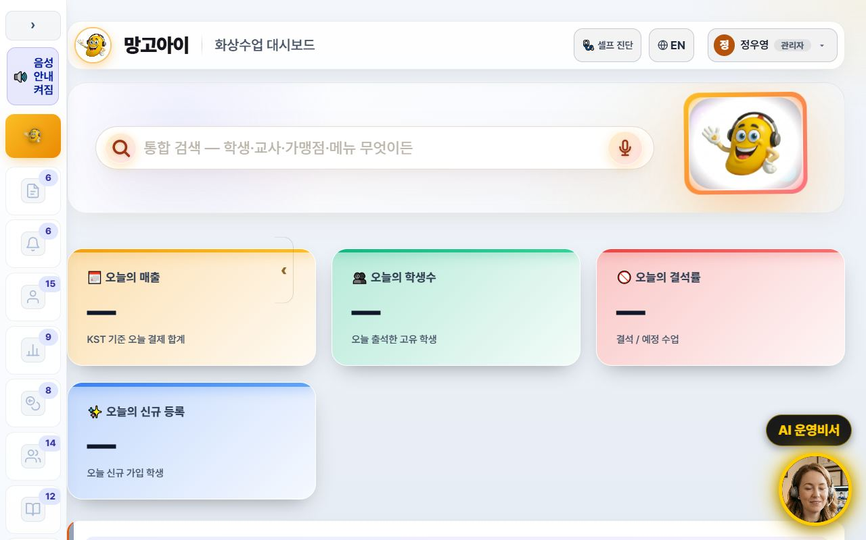
🏢 Mangoi Branch User Guide
How to Use the Main Features
19
🧭 A refreshed admin screen
Collapsible sidebar · lighter background · line icons
The admin screen is now easier on the eyes and wider. The left menu collapses to a narrow icon rail via the ‹ Collapse button, and the background is now a consistent light tone. Menu icons were redrawn as line icons so labels read clearly.
How to use
● Press ‹ Collapse at the top of the left menu — it shrinks to an icon rail and the content gets wider.
● Press the › button in the same place to expand it again.
● The collapsed state is remembered for your next visit.
● Too many menus to find one? Type its name into menu search at the top.
✅ Key Points
● Screens full of tables and lists gain a lot of horizontal space.
● 15 sub-pages were moved onto the same light theme, so the colour jump between screens is gone.
● The collapse animation was removed so low-spec PCs don't stutter.
💡 Tip · Wide-table screens like settlement and payroll are far easier to read with the menu collapsed.

Slide 23
🏢 Mangoi Branch User Guide
How to Use the Main Features
20
🌐 The interface language sets itself
Overseas staff and teachers start in English
Filipino teachers and overseas staff now start in English from the first screen. The interface language is decided from the account's nationality, and teacher accounts are always English regardless of name or previous choice. You can still switch any time with the 🌐 EN / KR button at the top.
How to use
● If the account has a nationality on file, the right language appears automatically at login.
● To change it manually, press the 🌐 EN / KR button at the top.
● A manual choice is stored per account — several people can share one PC without interference.
● Teacher guide slides and manuals switch to the English editions with it.
✅ Key Points
● Teacher accounts are always English — no more getting lost in a Korean screen.
● Accounts with an English name no longer flip to Korean because of a Korean job title.
● Language choice is isolated per account, so an overseas account isn't overwritten by someone else's pick.
⚠️ Good to know · Accounts with no nationality fall back to the old name/ID heuristic. Please fill in nationality when registering teachers.
💡 Tip · Enter nationality when registering a new teacher and their very first login is in English — fewer support requests.

Slide 24
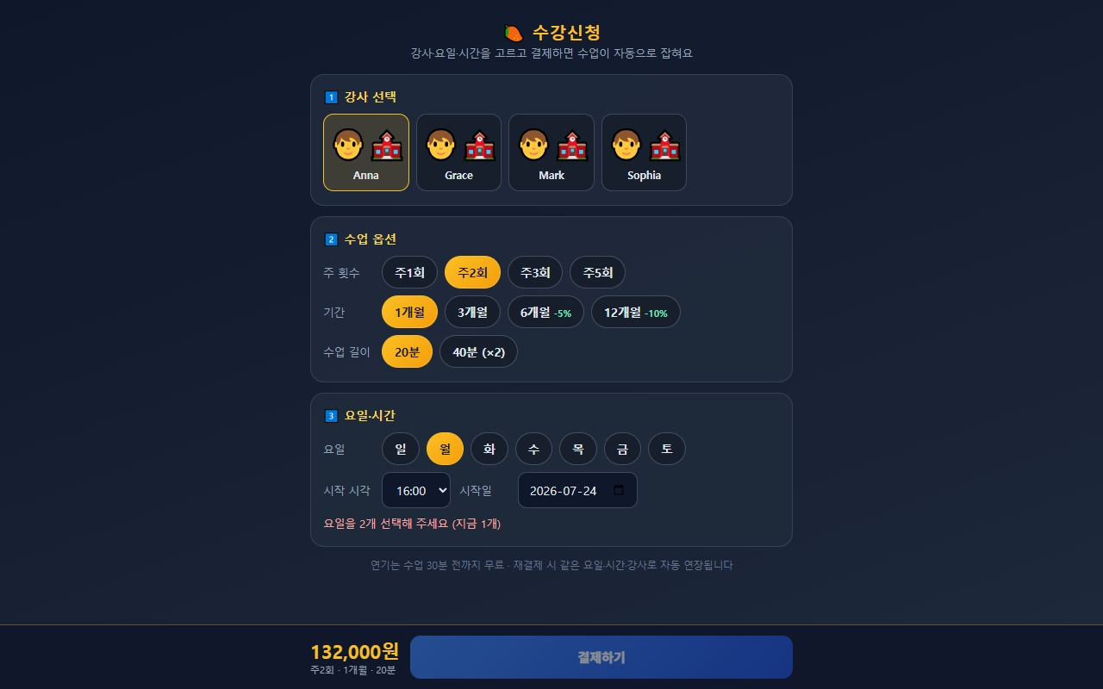
🏢 Mangoi Branch User Guide
How to Use the Main Features
21
💳 Enrolment & payment → automatic lesson creation
Once payment is confirmed, every session is scheduled
On the Enrolment screen a student picks teacher, days and time and pays — and all lesson sessions are created automatically the moment payment is confirmed. The old manual timetable entry after payment is gone. If the slot clashes with an existing lesson, the conflict is detected before payment.
How to use
● Send students and parents the enrolment link.
● They choose teacher → lesson options (weekly count, term, length) → days & time.
● The slot check must pass before the pay button unlocks (payment is blocked on a clash).
● On confirmed payment, all sessions are created at once — verify in the admin lesson list.
● Head-office prices and discount rates are managed on the pricing screen.
✅ Key Points
● Idempotent — a duplicated payment callback will not create the sessions twice.
● Clashes with holidays or existing lessons are pushed back so the session count is still met.
● Term discounts (6 months −5%, 12 months −10%) are applied to the amount automatically.
⚠️ Good to know · Stage 1 (enrol → pay → auto-create sessions) is live today. Later stages will follow.
💡 Tip · Consultation → level test → send the enrolment link is the smoothest conversion path.

Slide 25
🏢 Mangoi Branch User Guide
Feature Summary · Data
22
📋 Branch Features at a Glance
Feature | What it does | Scope | Core benefit
Branch dashboard | Revenue·enrollment·attendance | My branch | Quick read
Agency mgmt | List·performance·recruiting | Sub-agencies | Level up
Branch settlement | Receive·distribute auto-calc | HQ↔branch↔agency | Accurate settlement
Students·parents | Enrollment·attendance·grades | Branch scope | Churn prevention
Accounting | Payments·overdue·refunds | Branch scope | Healthy collection
Retention | Churn risk·contagion | Branch·agency | Retention ↑
Monthly report | Performance analysis | Branch·agency | Transparent ops

Slide 26
🏢 Mangoi Branch User Guide
Data at a Glance
23
📊 Data at a Glance
Enrollment by Agency (example)
Settlement Split (example)

Slide 27
🏢 Mangoi Branch User Guide
Frequently Asked Questions (FAQ)
24
❓ Frequently Asked Questions (FAQ)
Q. Where do I log in?
A. Log in at admin.mangoi.co.kr. By role (branch), only your branch's data shows automatically.
Q. Can I see other branches' data?
A. No. By permission scope, only your branch and sub-agency data is visible.
Q. How is settlement calculated?
A. Revenue/commissions are auto-calculated down the org tree (HQ→branch→agency). Check the monthly report.
Q. An agency is underperforming.
A. Find causes via retention/accounting/reports and support with onboarding/coaching/incentives; sharing best cases helps.
Q. A system problem occurred.
A. Contact HQ support (phone·email·Kakao·remote) for a quick fix.

Slide 28
🏢 Mangoi Branch User Guide
Checklist
25
✅ Branch Operations Checklist
Did you check today's branch revenue/enrollment/attendance?
Did you spot and support underperforming agencies?
Did you review this month's settlement (receive·distribute)?
Did you check overdue/refund items?
Did you care for at-risk students/agencies?
Did you onboard new agencies?
Did you share the monthly report?

Slide 29
🏢 Mangoi Branch User Guide
Conclusion
26
🏁 Conclusion · A Practical Guide to Branch Growth
A branch is the bridge between HQ and agencies. Watch your branch metrics, support your agencies to grow, and process settlement transparently — and the whole branch grows together. Keep this rhythm and operations get far more stable.
🔄 The Flow at a Glance
⭐ Key Principles
Morning (5 min)
Check revenue/enrollment/attendance on the branch dashboard; read the AI insight
● Metrics, 5 minutes each morning — catch branch/agency signals early.
● Agencies as partners — close performance gaps with coaching/support.
● Transparent settlement — announcing terms upfront builds trust.
● Intervene on churn early — care for at-risk agencies/students first.
● Spread best practices — share top agencies' methods branch-wide.
Late morning
Review performance/collection by agency; check overdue/refunds
Afternoon
Support/coach underperforming agencies; care for at-risk students (retention)
Weekly
Onboard new agencies; share best practices
Monthly
Check/distribute HQ→branch→agency settlement; share the monthly report
📌 Remember
● Log in at admin.mangoi.co.kr; data is auto-limited to your branch scope
● Settlement is auto-calculated by the HQ→branch→agency tree
● Most field inquiries like 'can't enter' are browser/permission issues
● Ops rhythm: 'Check → Support → Settle → Report'!
🍊 A good branch is one that helps its agencies thrive. Read the situation with metrics, support your partners, and keep settlement transparent — and branch and agencies grow together. Questions? Contact HQ support anytime — cheering on your solid branch operations! 🍊

Slide 30
Let's grow together with Mangoi!
Questions? Ask the on-site A.i assistant or contact customer support.
🌐 www.mangoi.co.kr 📞 1644-0561 ✉ support@mangoi.co.kr

