Slide 1

🎒 STUDENT GUIDE
Mangoi · MANGOI
Student User Guide
Easy on your own — the complete Mangoi guide
For · Students learning with Mangoi | www.mangoi.co.kr

Slide 2
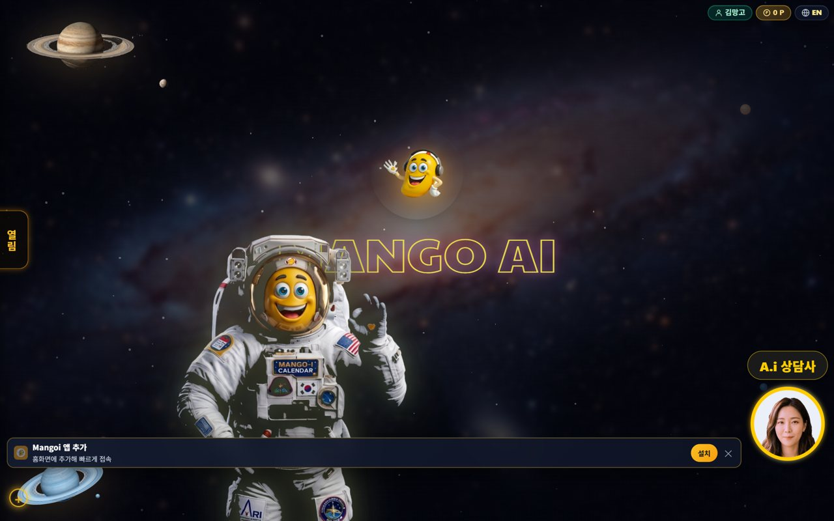
🎒 Mangoi Student User Guide
Introduction
What is Mangoi?
Mangoi brings together live 1:1 video English lessons with a native-speaker teacher and AI learning & games you can do on your own before and after class. Connect right from your web browser (Chrome/Edge) on a phone, tablet or PC — no app install needed. Just follow this guide and even first-timers can use it easily on their own.
📹
1:1 native video lessons
🔥
AI warm-up · pronunciation coach
Meet your teacher face-to-face and talk in English at set times.
Warm up before class and get instant pronunciation fixes.
🎮
10 learning games
🏅
Points · badges · streak
Review today's words and sentences through fun games.
The more you study, the more points and badges you collect.
Recommended Daily Routine (min)

Slide 3
🎒 Mangoi Student User Guide
Contents
📑 Contents (1/2)
Introduction
2
14
After Class — Review & Rating
18
01
Getting Started & Home
5
15
Pre-class Device Check
19
02
Enter a Video Lesson
6
16
Warm Up with AI
20
03
The Classroom at a Glance
7
17
AI Pronunciation Coach
21
04
Switching the 6 Top Tabs
8
18
Take a Level Test
22
05
Board Tools, One by One
9
19
My Level · Curriculum
23
06
Materials Tools (share PDF/photos)
10
20
Learning Games Hub
24
07
Writing Tools (annotate on top)
11
21
3D Battle
25
08
Watch Video Together
12
22
Shooting · Mastery Games
26
09
Background & Face Decorations
13
23
Word Fighter (zombies)
27
10
Resize & Arrange the Screen
14
24
Suspect Mystery
28
11
Praise Points During Class
15
25
Speaking Quiz
29
12
Bottom Dock & Praise Basket
16
26
Review Quiz
30
13
How to Join In During Class
17
27
My Vocab
31

Slide 4
🎒 Mangoi Student User Guide
Contents
📑 Contents (2/2)
28
AI Friend (Mango)
32
42
1:1 Private Chat & File Sharing
46
29
AI Writing
33
43
Home Screen: Bright · Dark
47
30
Attendance Streak · Badges
34
44
Judgment Training (pick the right words)
48
31
MBTI Style Test
35
45
Grammar Pizza Master (word order)
49
32
Book a Lesson
36
46
Word Tetris
50
33
Postpone · Change a Lesson
37
47
Tank Battle · Language Ace
51
34
[Parents] See Your Child's Learning
38
48
Log in with your face or fingerprint (passkey)
52
35
[Parents] Payment · Postpone · Refund
39
49
Your speaking isn't cut off any more · a smarter AI friend
53
36
Korea·Philippines Dual Clock
40
50
Enrol and pay in one go
54
37
Chinese Pronunciation Coach
41
51
Feature Summary · Data
55
38
AI Voice Diary
42
52
Data at a Glance
56
39
Where to next? (Learning-flow guide)
43
53
Frequently Asked Questions (FAQ)
57
40
Ask the A.i Assistant
44
54
Checklist
58
41
New Classroom Comforts
45
55
Conclusion
59

Slide 5
🎒 Mangoi Student User Guide
How to Use the Main Features
01
🚀 Getting Started & Home
Access · login · screen layout
Mangoi opens right away when you type the address in Chrome or Edge. After you log in, a space-themed home screen appears, and from here you move to lessons, games and learning menus.
How to use
● Go to www.mangoi.co.kr in your browser and log in (social login works too).
● Check your name and points (P) at the top-right to confirm you're logged in.
● Tap the 'Open' tab on the left to expand the menu sidebar.
● Ask the A.i assistant at the bottom-right anything you're curious about.
● Use the EN button to switch the on-screen text to English.
✅ Key Points
● No app install — a web browser is all you need.
● 'Add Mangoi app' at the bottom of home creates a home-screen icon.
● Study on phone, tablet or PC with the same account, anywhere.
💡 Tip · Turn on auto-login only on your own trusted device so you don't type it every time.

Slide 6
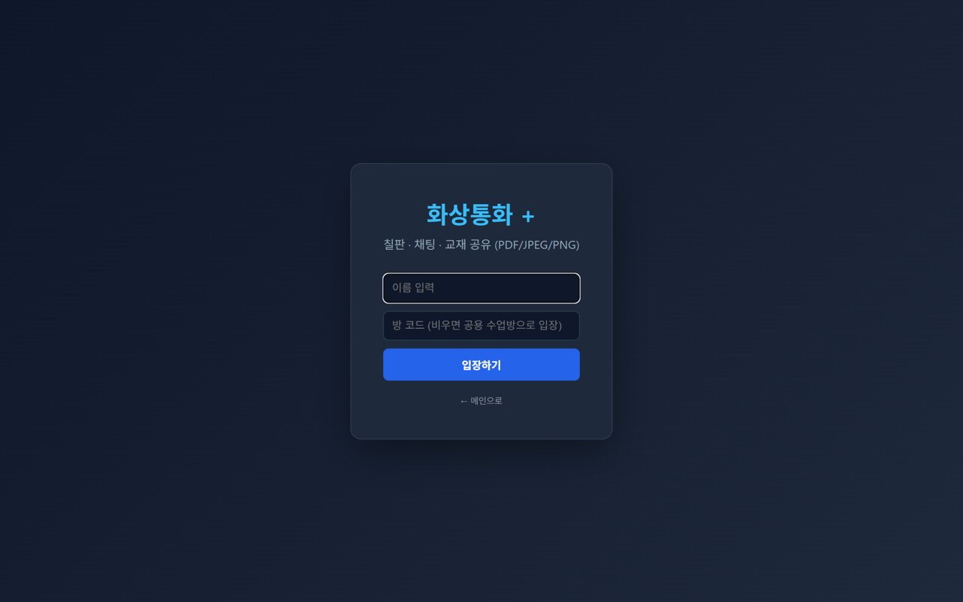
🎒 Mangoi Student User Guide
How to Use the Main Features
02
🎥 Enter a Video Lesson
Meet your teacher 1:1 (30 seconds!)
When it's lesson time, join the classroom and study face-to-face with your native teacher. It feels new at first, but just follow the steps and you'll be in quickly.
How to use
● Tap the invite link you received, or the today's lesson card on the site.
● Enter your name (the room code is usually filled in; if empty, you go to the shared room).
● Press the Enter button.
● When the browser asks, press 'Allow' for camera and mic — that connects your face and voice.
● When you see your teacher, say hello and start the lesson!
✅ Key Points
● It works best opened in Chrome or Edge.
● Opening the link inside KakaoTalk may block the camera → choose 'open in another browser'.
● A headset makes the sound clearer and cuts noise.
⚠️ Good to know · If sound/video won't work, refresh the page and 'Allow' camera and mic again.
💡 Tip · Enter 5 minutes early to check your face and sound — it puts you at ease.

Slide 7
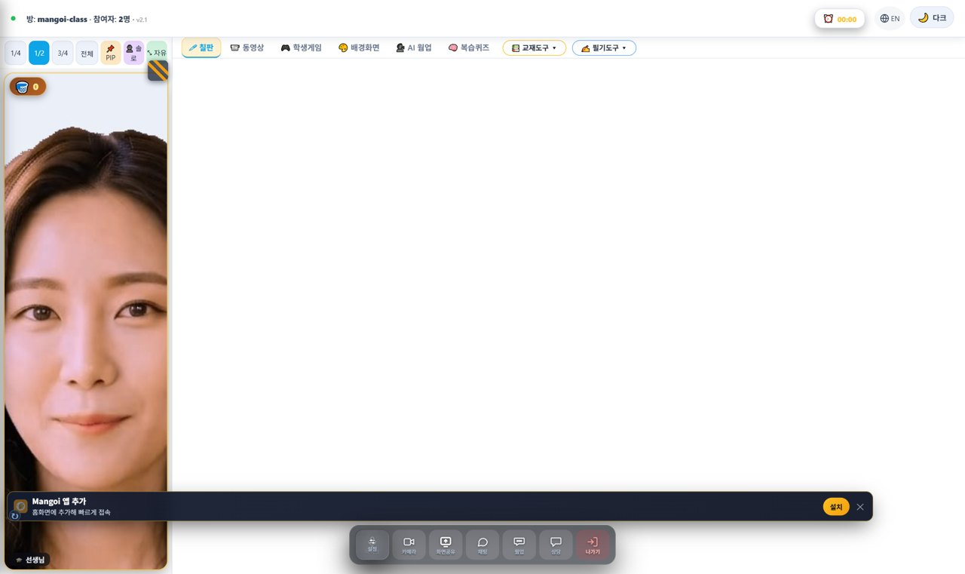
🎒 Mangoi Student User Guide
How to Use the Main Features
03
🖥️ The Classroom at a Glance
What does the lesson screen look like?
When you enter a lesson, the screen has three main areas: ① the top bar (room info, timer, language, dark mode), ② the large center workspace (where the board, materials, video, etc. open), and ③ the bottom control dock (camera, chat, leave). Your face video and the praise basket sit in a small window at the top-left.
How to use
● Top-left: `Room: mangoi-class · Users: 2` — the room name and how many people are connected.
● Top-right: ⏰ Timer (lesson time), 🔴 REC (recording indicator), 🌐 EN (switch language), 🌙 Dark (dark screen).
● Center: the tool you pick from the top tabs (board, materials, video…) opens here.
● Bottom-center: the control dock — camera, screen share, chat and leave buttons.
● Small window, top-left: your face video and the 🧺 praise basket (how many praises you received).
✅ Key Points
● Hover over a button to see its name (tooltip).
● If text looks Korean, press EN at the top-right to switch language.
● If the screen is too bright, switch to 🌙 Dark.
💡 Tip · It looks like a lot of buttons at first, but the four you use most are board, materials, camera and chat.

Slide 8
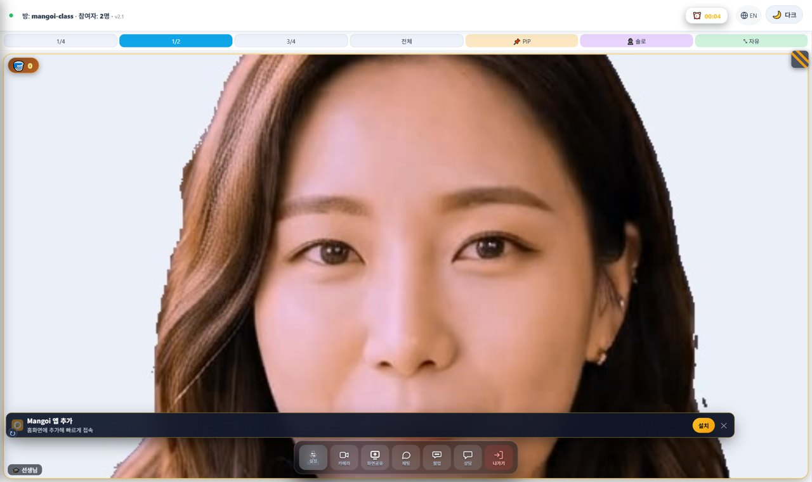
🎒 Mangoi Student User Guide
How to Use the Main Features
04
🗂️ Switching the 6 Top Tabs
Board · Video · Games · Background · AI Warm-up · Review Quiz
At the top of the center workspace there are six tab buttons. Click one to switch to that tool. The active tab is highlighted.
How to use
● 🖊 Board: a whiteboard for writing and drawing while explaining.
● 📹 Video: watch a YouTube link or a video file together.
● 🎮 Games: open learning games during class (may be limited during lesson time).
● 🎨 Background: change the backdrop behind your video and decorate your face.
● 🗣️ AI Warm-up: an English warm-up before the lesson.
● 🧠 Review Quiz: an AI-made quiz matched to this lesson's textbook and level.
✅ Key Points
● Your face video stays visible even after switching tabs.
● At the far right of the tabs there are also 📚 Materials Tools ▾ and ✍️ Writing Tools ▾.
💡 Tip · Lessons mostly use the 🖊 Board and 📚 Materials the most.

Slide 9
🎒 Mangoi Student User Guide
How to Use the Main Features
05
🖊️ Board Tools, One by One
Pen · eraser · shapes · text · save
Open the 🖊 Board tab and a row of drawing tools appears at the top. Let's go through each button from left to right.
How to use
● ✏️ Pen: draw freely. / 🧽 Eraser: erase what you drew.
● 📏 Line / ⬜ Rectangle / ⭕ Circle: draw straight lines and shapes.
● 📝 Text: type letters with the keyboard.
● 🎨 Color (color box): pick the pen color. / Thickness (slider): adjust line width.
● ✨ AI Shapes: even rough drawings snap into neat shapes automatically.
● ✍️ AI Text: recognizes handwriting and turns it into clean typed text.
● 🗑️ Clear All: wipe the whole board. / 💾 Save: save the board as an image.
✅ Key Points
● Change color and thickness to highlight key parts so they stick.
● AI Shapes / AI Text auto-tidy when turned on (experimental).
⚠️ Good to know · Pressing Save (💾) downloads the current board as an image you can use for review.
💡 Tip · Save (💾) the board before class ends to keep exactly what you learned today.

Slide 10
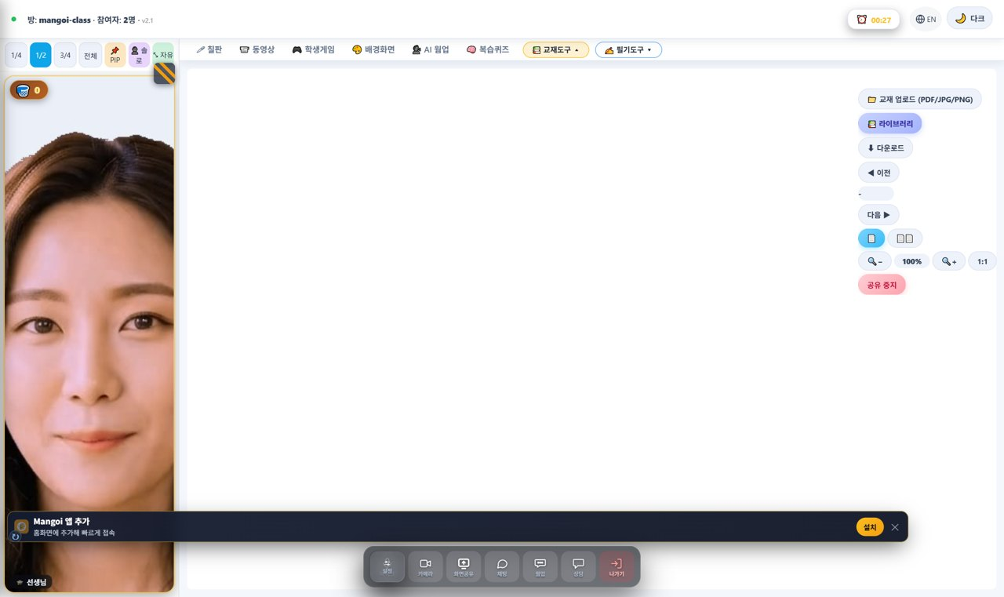
🎒 Mangoi Student User Guide
How to Use the Main Features
06
📚 Materials Tools (share PDF/photos)
Upload · library · turn pages
Click 📚 Materials Tools ▾ at the right of the tabs and a menu drops down. This is where you upload textbooks (PDF/photos) to view together.
How to use
● 📁 Upload (PDF/JPG/PNG): upload a textbook file from your device to share.
● 📚 Library: pick from textbooks the academy (admin) uploaded.
● ⬇ Download: download the file you're currently viewing.
● ◀ Prev / Next ▶: turn textbook pages.
● 🔲 Fit / 100% / 1:1: fit the page to the screen or view at real size.
● ⏹ Stop sharing: end textbook sharing.
✅ Key Points
● The moment you upload, the other person sees the exact same page.
● Not only PDFs — JPG and PNG photos work too.
💡 Tip · Upload the textbook before class for a smooth start.

Slide 11
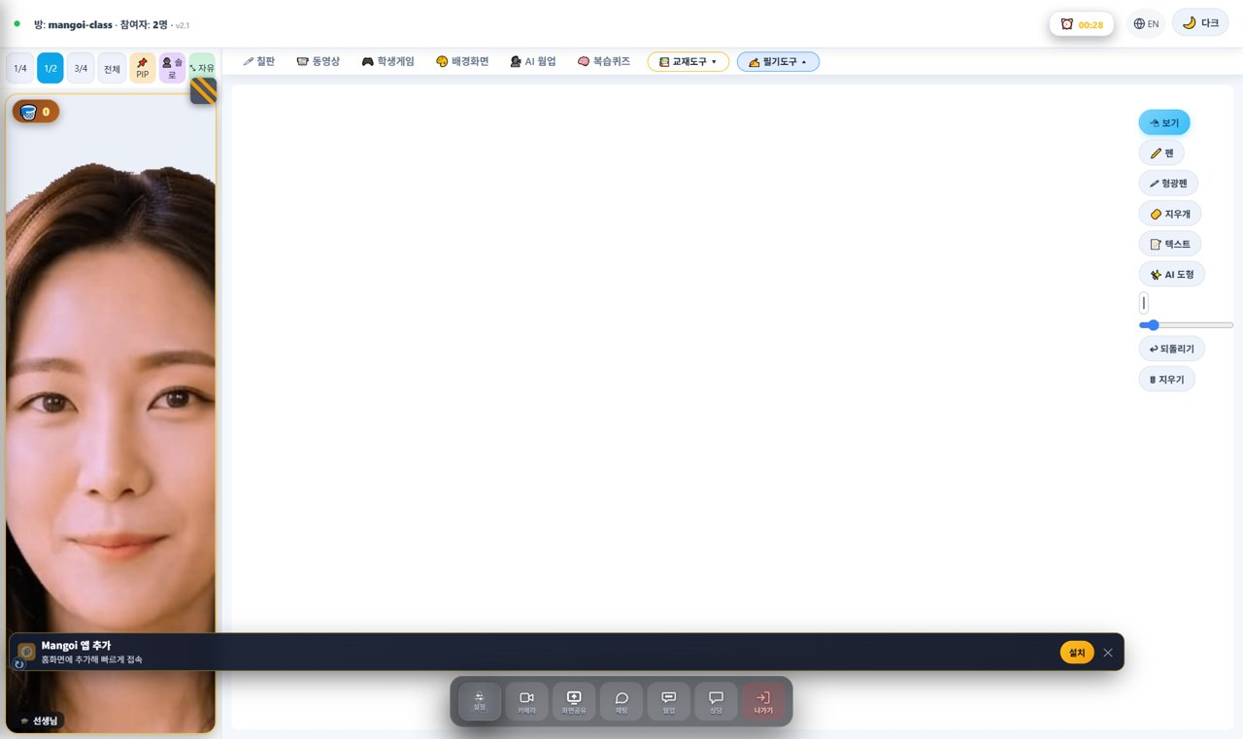
🎒 Mangoi Student User Guide
How to Use the Main Features
07
✍️ Writing Tools (annotate on top)
Pen · highlighter · text · undo
Click ✍️ Writing Tools ▾ at the right of the tabs and the writing menu drops down. Use it to write directly on top of a textbook or the screen.
How to use
● 🖊 Pen: write freely on the screen. / 🖍 Highlighter: brightly mark important spots.
● 🧽 Eraser: erase your writing. / 📝 Text: type letters.
● ✨ AI Shapes: tidy your drawn shapes.
● Thickness (slider): adjust the pen width.
● ↩ Undo: cancel your last mark. / 🗑 Clear: erase all writing.
✅ Key Points
● With a textbook open, your writing appears right on top of it.
● Highlight key words to make them stand out.
💡 Tip · Made a mistake? One tap on ↩ Undo cleans it up.

Slide 12
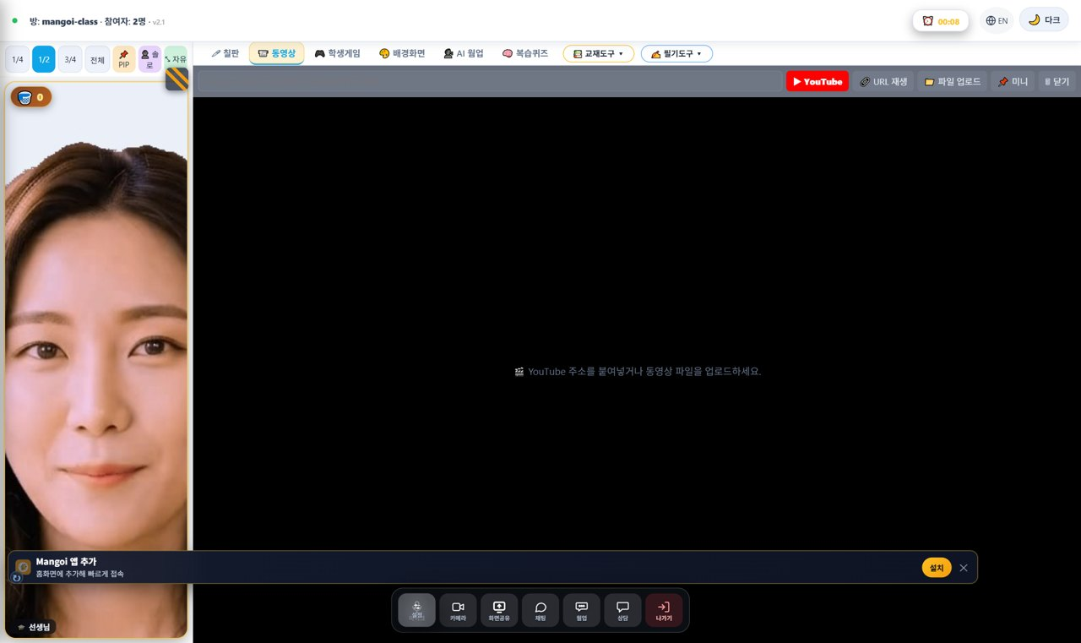
🎒 Mangoi Student User Guide
How to Use the Main Features
08
📹 Watch Video Together
Share YouTube · video files
In the 📹 Video tab you can paste a YouTube link or upload a video file to watch together — great for songs and video materials.
How to use
● Paste a YouTube link (URL) into the box, or upload a video file.
● Press ▶ Play URL / Play to start the video.
● Use New video to switch to a different one.
✅ Key Points
● The video plays on the other person's screen too.
● For sound-heavy material, earphones help you hear better.
💡 Tip · Prepare the video link in advance so you can play it instantly in class.

Slide 13
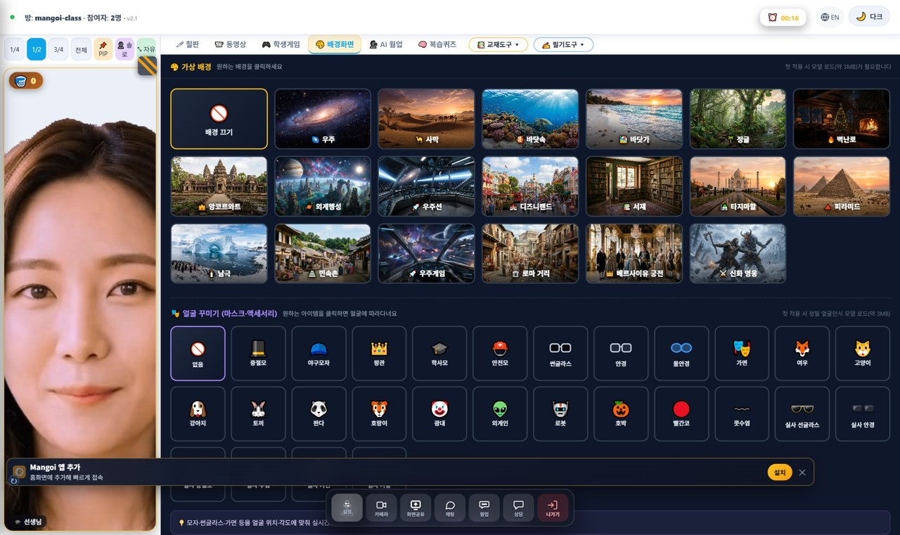
🎒 Mangoi Student User Guide
How to Use the Main Features
09
🎨 Background & Face Decorations
Change backdrop · masks · accessories
In the 🎨 Background tab you can change the backdrop behind your face and add fun decorations. Just click what you want in the grid.
How to use
● In the background grid, tap a backdrop (space, desert, forest, cherry blossom, beach, pyramids…).
● Tap Background off to return to your normal camera view.
● Below, in Face Decorations (masks/accessories), pick glasses, hats, animals and more.
● Don't like it? Tap again to turn it off.
✅ Key Points
● Changing the background keeps your face visible.
● Very flashy decorations can distract from the lesson.
💡 Tip · Use a clean background for class and fun decorations for break time.

Slide 14
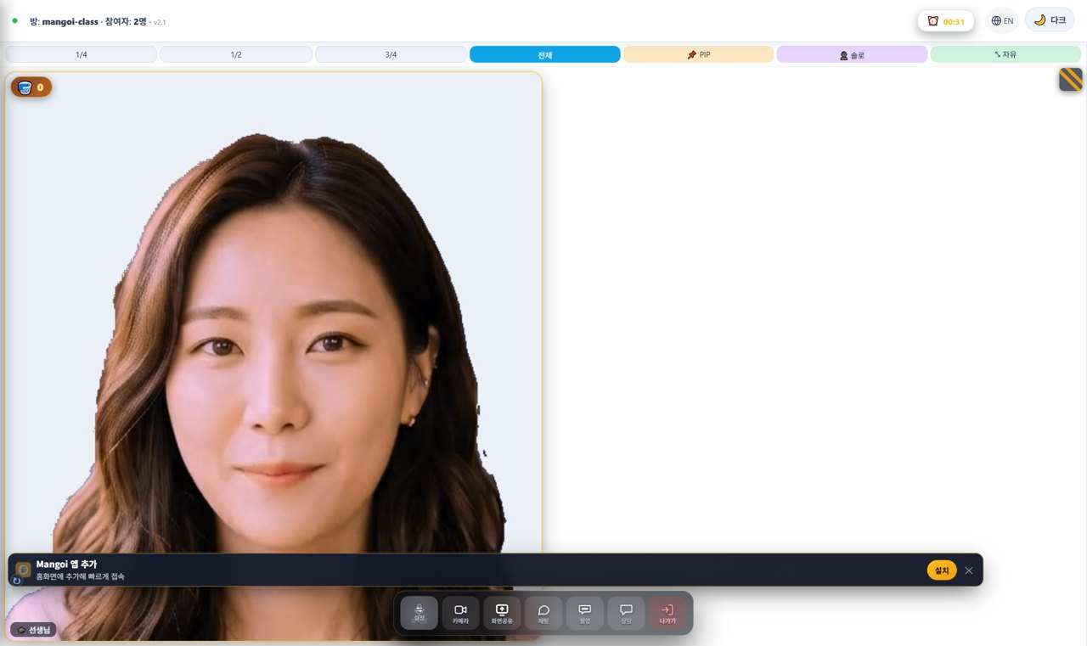
🎒 Mangoi Student User Guide
How to Use the Main Features
10
🔲 Resize & Arrange the Screen
1/4 · 1/2 · 3/4 · Full · PIP · Solo · Free
The size bar above the video lets you change the size and layout of your face-video window. The current size is shown in blue.
How to use
● 1/4 · 1/2 · 3/4 · Full: make the video window 1/4 up to full-screen.
● 📌 PIP: float the video as a small overlay on top of the board/materials.
● 👤 Solo: hide others and see only your own screen larger.
● ⤡ Free: drag the title bar to move it, drag the bottom-right corner to resize freely.
✅ Key Points
● Make the video small (1/4) when reading materials, large (Full) when presenting.
● 📌 PIP is great when you want to see the textbook and faces at once.
💡 Tip · On a small screen, shrink the video to 1/4 and view the textbook large.

Slide 15
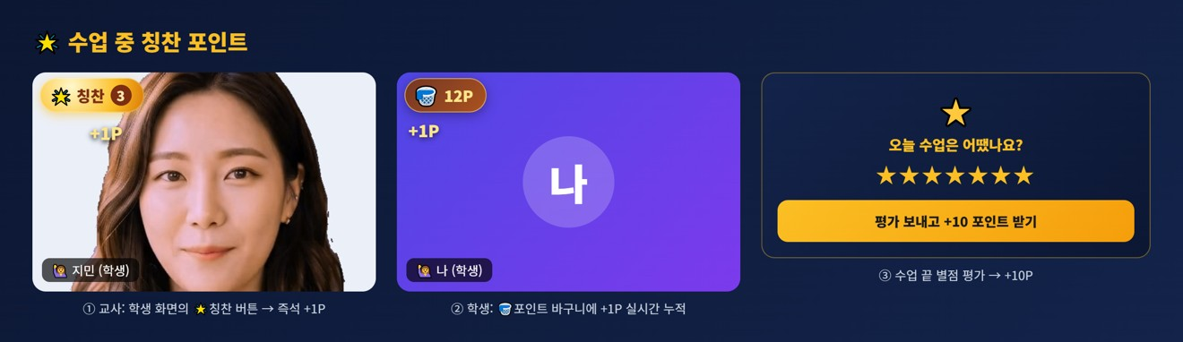
🎒 Mangoi Student User Guide
How to Use the Main Features
11
🌟 Praise Points During Class
Teacher gives → +1P in student's basket
When you do well, the teacher can give praise points on the spot. When the teacher taps the 🌟 'Praise' star button on your video, that student instantly gets +1P, and it piles up in real time in the 🧺 point basket on the student's screen.
How to use
● Teacher: tap the 🌟 'Praise' button at the top-left of a student's video → that student gets +1P. (the count builds up next to the star)
● With several students, you can also pick a student from the 'Give Praise' bar.
● Student: +1P flies into the 🧺 point basket at the top-left of your screen in real time.
● When class ends, the student leaves a star rating to get an extra +10P.
● Collected points are spent as rewards in the point shop, roulette, etc.
✅ Key Points
● The more praise you get, the faster points pile up.
● The praise star has an anti-spam cooldown, so it may briefly turn gray.
● The basket shows points earned this class; your total P (top bar) is the running sum.
⚠️ Good to know · Praise points are given by the teacher — students can't add them by themselves.
💡 Tip · Teachers: praise 🌟 the moment a student does well — instant rewards motivate best.

Slide 16
🎒 Mangoi Student User Guide
How to Use the Main Features
12
🎛️ Bottom Dock & Praise Basket
Camera · screen share · chat · leave · praise
The control dock at the bottom-center holds the buttons you use most during class. Let's also look at the small 🧺 praise basket at the top-left.
How to use
● ⚙️ Settings: pick camera/mic devices and check their status.
● 📷 Camera / 🎤 Mic: turn your face and sound on/off.
● 🖥️ Screen Share: show your computer screen to the other person.
● 💬 Chat: talk in text (great for words and links).
● 🗣️ Native: call the native-speaker helper / interpreter feature.
● 🚪 Leave: end the lesson and exit the room.
● 🧺 Praise Basket (top-left): the praise (stars/stickers) you receive during class collects here.
✅ Key Points
● Before leaving (🚪), make sure you saved the board / notes.
● No sound? Check the mic/speaker devices in ⚙️ Settings.
⚠️ Good to know · Screen share asks the browser which window to share — pick the screen and allow it.
💡 Tip · When your praise basket fills up, it means you're doing great!

Slide 17
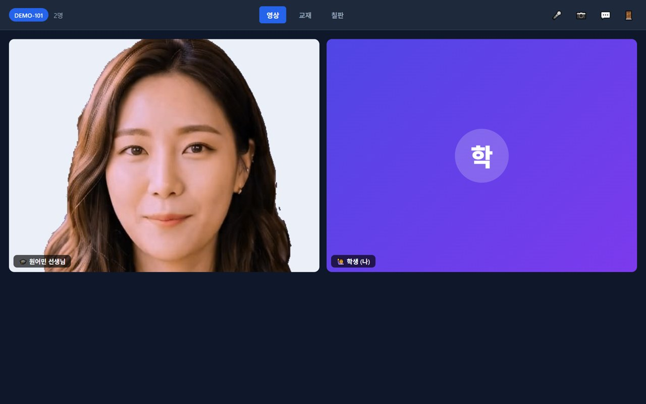
🎒 Mangoi Student User Guide
How to Use the Main Features
13
🙋 How to Join In During Class
Speak, ask, write together
A video lesson isn't a lesson you just watch — it's one you do together. Don't only listen; the more you join in with the ways below, the faster your English grows.
How to use
● When the teacher asks, turn on your 🎤 mic and answer out loud. (turn it on only when speaking to cut noise)
● If you can't hear or you're curious, ask in 💬 chat. Check unknown words in text too.
● 🖊 Write on the board together — with the teacher's OK, use the pen to write or draw answers.
● 📄 Turn textbook pages together and follow the page you're on.
● 📷 Keep your camera on — the teacher helps more when they can see your face.
✅ Key Points
● The more you speak, the better. Mistakes are fine!
● Do well and the teacher gives you 🌟 praise points (see earlier page).
● Earphones in a quiet place make the sound clear.
💡 Tip · Memorize phrases like 'One more time, please' to make class easier.

Slide 18
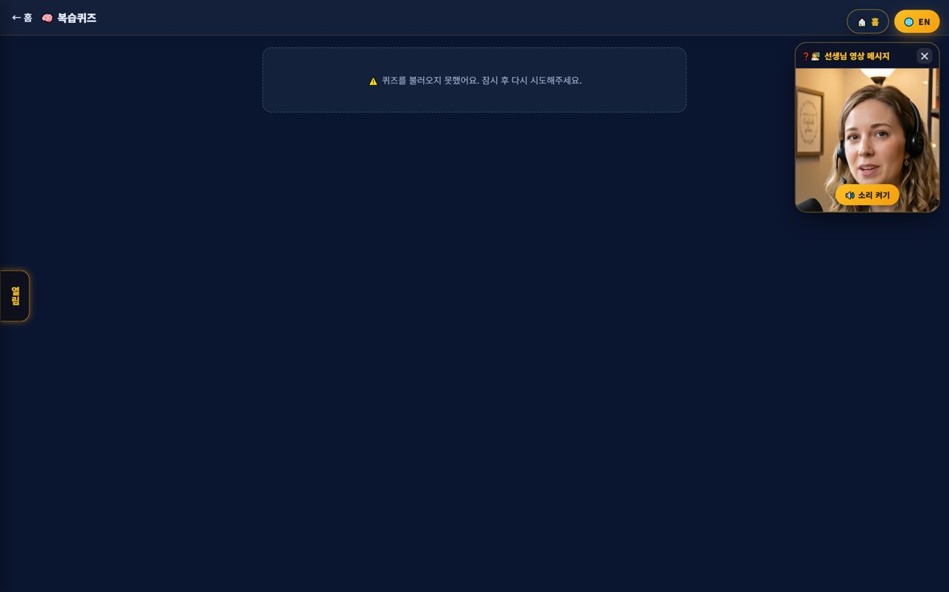
🎒 Mangoi Student User Guide
How to Use the Main Features
14
🏁 After Class — Review & Rating
Review quiz & rating for +10P
When class ends, tidy up what you learned right away. A 'Take the review quiz?' popup appears, and leaving a star rating earns you points too.
How to use
● When class ends, a 'Take the review quiz? Yes / No' popup appears.
● Press 'Yes' and a review quiz matched to today's class appears automatically.
● Leave a star rating (How was today's class? 7 stars) to get +10P.
● Then review today's words once more with a learning game to make it perfect.
✅ Key Points
● Reviewing right after class stays in memory longest.
● The rating helps your teacher, and you get points too.
⚠️ Good to know · You must leave a star rating to exit the class (it's OK to be honest).
💡 Tip · Review quiz → game → vocabulary, in that order, makes today's lesson truly yours.

Slide 19
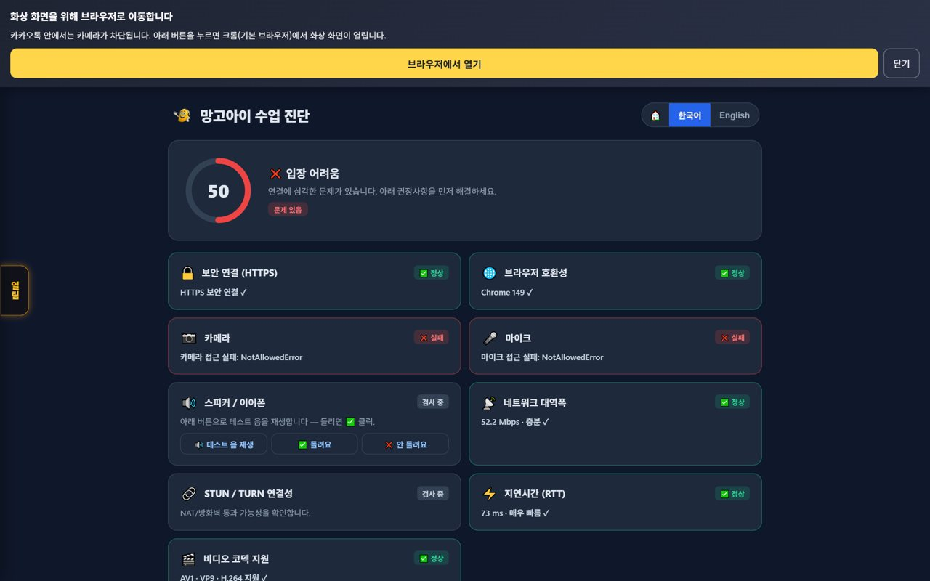
🎒 Mangoi Student User Guide
How to Use the Main Features
15
🩺 Pre-class Device Check
Check camera, mic and internet first
This screen checks your camera, mic, network and lighting before class. A score and traffic-light signals tell you right away whether things are good, preventing drop-outs mid-lesson.
How to use
● The check screen tests camera, mic, network and lighting all at once.
● Read the overall score and each item's signal (green/yellow/red).
● If red appears, follow the tips to turn on a light or move seats and check again.
✅ Key Points
● When your face is well-lit, the teacher can read your expression and help more.
● If Wi-Fi is weak, moving closer to the router helps.
💡 Tip · Do the check 5 minutes before class — fixing issues early keeps the lesson smooth.

Slide 20
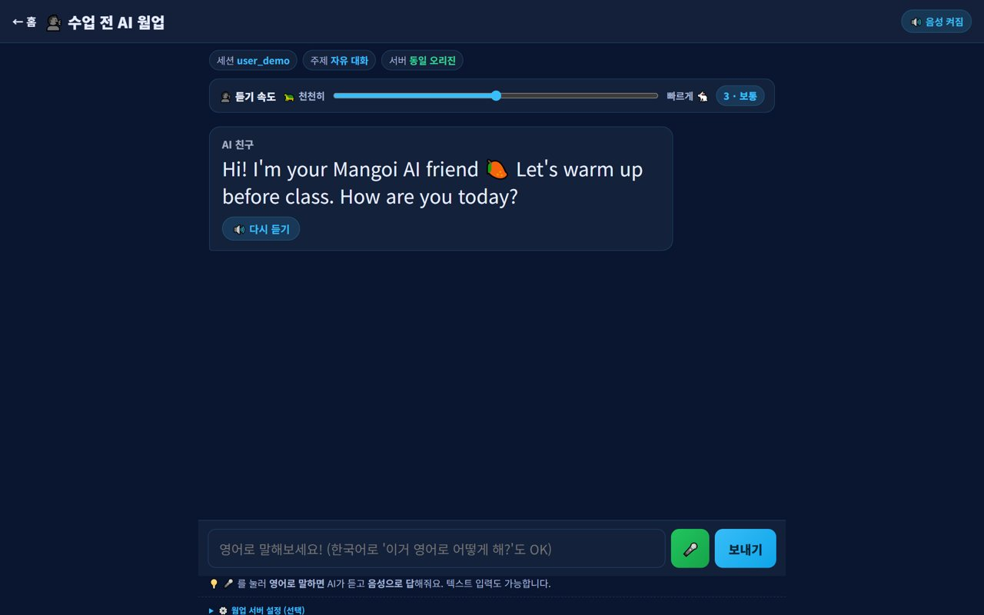
🎒 Mangoi Student User Guide
How to Use the Main Features
16
🔥 Warm Up with AI
A 3-minute warm-up before class
Before class, an AI friend asks English questions tied to today's textbook. Answering casually loosens you up so the first 5 minutes of class feel much easier.
How to use
● Before class, the AI friend greets you in English — reply casually.
● Questions linked to today's textbook appear so you get a feel in advance.
● Use the speak/listen buttons to answer by voice or type.
✅ Key Points
● Your teacher can see your warm-up, so class flows naturally from it.
● Mistakes are fine — it's just a warm-up, so relax!
💡 Tip · Make the warm-up a habit before every class and you'll start speaking sooner.

Slide 21
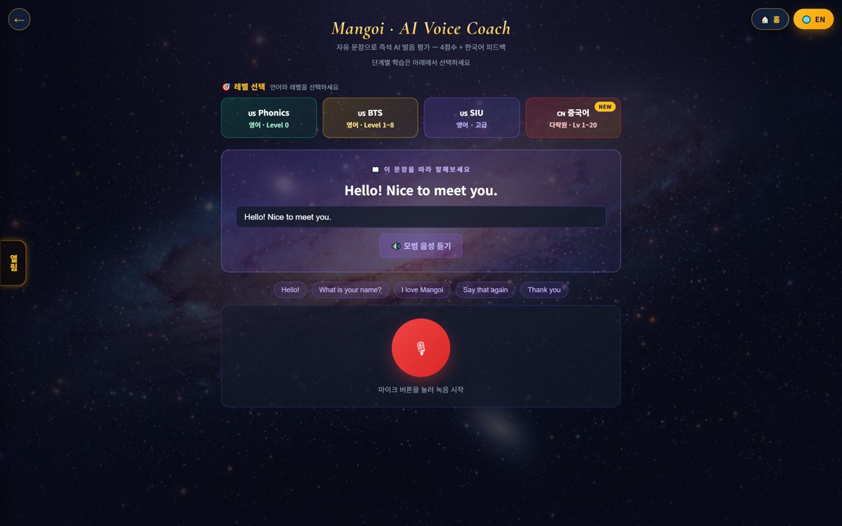
🎒 Mangoi Student User Guide
How to Use the Main Features
17
🎙️ AI Pronunciation Coach
Fixes your pronunciation instantly
Read a sentence at your level, record it with the mic, and the AI tells you a pronunciation score and what to fix. You can also replay the native audio and correct yourself.
How to use
● Pick a level (Phonics, BTS, SIU, etc.) to get sentences at your level.
● Read the sentence on screen and press the red mic button to record.
● The AI shows your pronunciation score and what to fix.
● Use 'replay' to hear the native audio and practice once more.
✅ Key Points
● Start with short sentences, clearly — your score rises faster.
● Repeating sentences from class here makes them stick.
💡 Tip · Five sentences a day and your pronunciation noticeably improves.

Slide 22
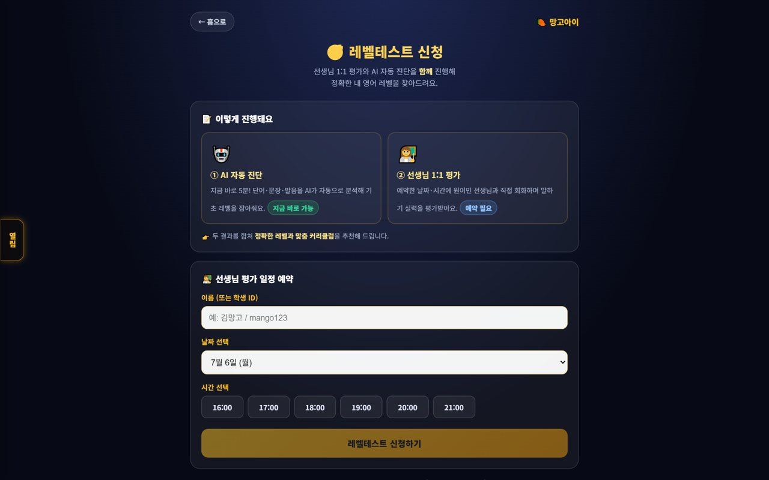
🎒 Mangoi Student User Guide
How to Use the Main Features
18
📈 Take a Level Test
Find out your English level
A test that shows your current English level. The result feeds into your curriculum, so you avoid lessons that are too easy or too hard.
How to use
● On the level test request screen, pick a method (AI/teacher) and a date/time.
● Follow the guide and answer the speaking and listening questions.
● The result is reflected in your curriculum (my level).
✅ Key Points
● We recommend taking it once when you first start.
● Retake it periodically to see how much you've improved.
💡 Tip · Relax — the goal is just to know your level accurately.

Slide 23
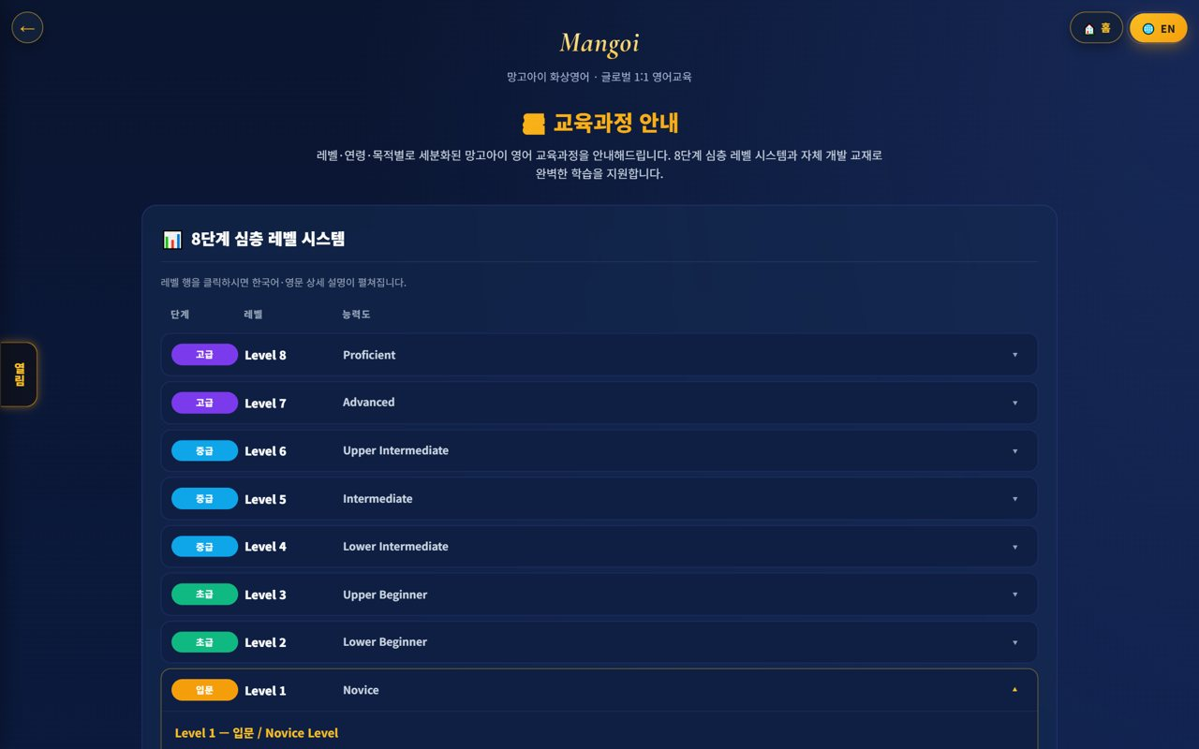
🎒 Mangoi Student User Guide
How to Use the Main Features
19
🗺️ My Level · Curriculum
See how far you've come
Levels 1–10 show where you are now and what you'll learn next. As you take lessons and play games, you move up to the next level.
How to use
● Check which of Levels 1–10 you're at now.
● Tap a level to see what you learn and the goals.
● Set a target level and keep challenging yourself.
✅ Key Points
● As levels rise, the sentences get longer and more practical.
● Setting a goal with your teacher boosts motivation.
💡 Tip · Knowing your level means games and reviews use the right words for you.

Slide 24
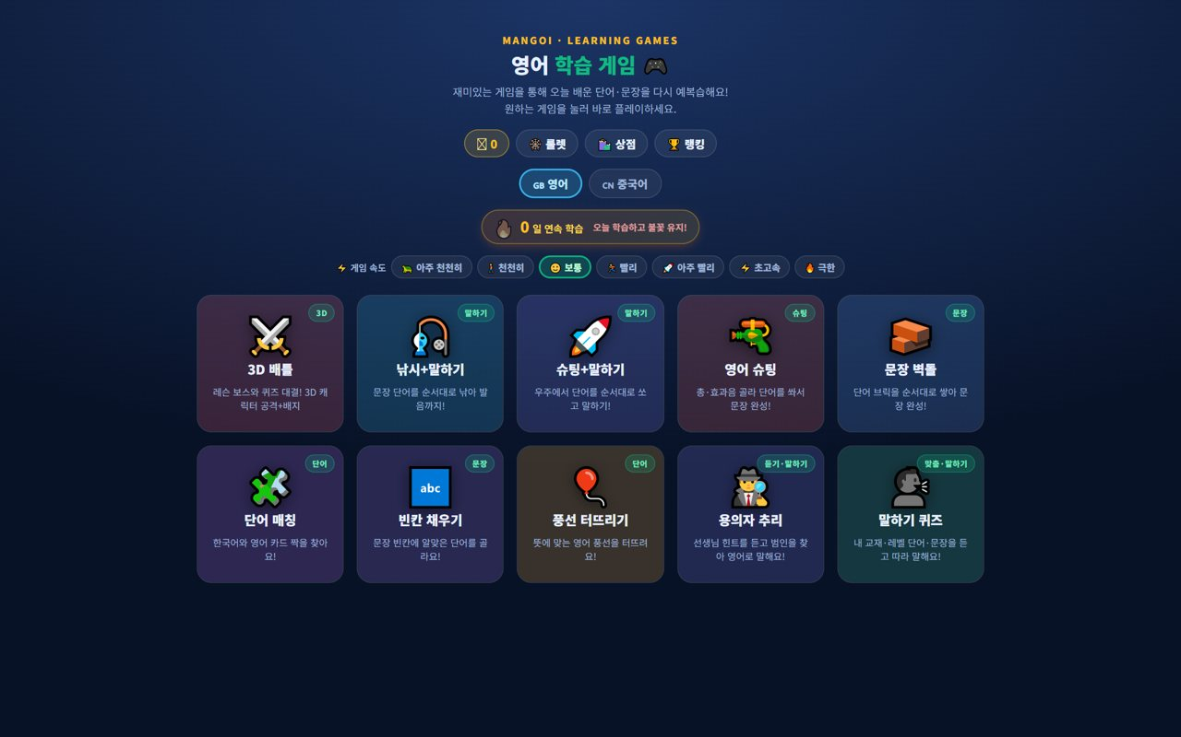
🎒 Mangoi Student User Guide
How to Use the Main Features
20
🎮 Learning Games Hub
Review with 10 games
The Games menu has 10 games. Today's textbook and level words appear in them, so you review naturally while playing and earn points.
How to use
● In Games, tap a game card to start right away.
● At the top, choose English/Chinese and the game speed.
● Correct answers earn points and keep your learning streak flame going.
● Fill 10 correct answers to see your result and highlights.
✅ Key Points
● Game words are linked to what you learned today.
● Games marked 'speaking' score better when you say the answer aloud.
💡 Tip · Games are review. When class words appear in a game, they stick longer.

Slide 25
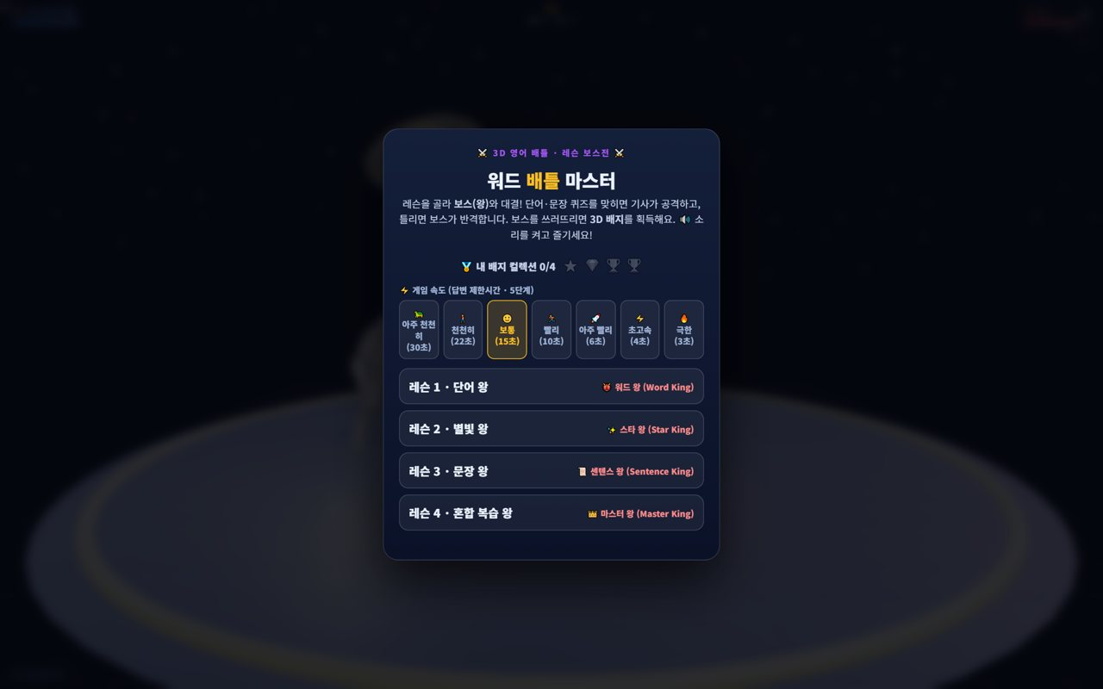
🎒 Mangoi Student User Guide
How to Use the Main Features
21
⚔️ 3D Battle
Quiz duel with a boss!
A boss-battle game where you attack with a 3D character by answering questions. The more you get right, the stronger you get and the more badges you earn.
How to use
● Enter the lesson boss battle and attack by solving questions.
● The more correct answers, the stronger you get and the more badges you earn.
● Wrong is fine — try again and learn the words.
✅ Key Points
● Turn on sound for extra excitement with sound effects.
● Beat the boss for a special badge.
💡 Tip · Too hard? Change the game speed to 'slow'.

Slide 26
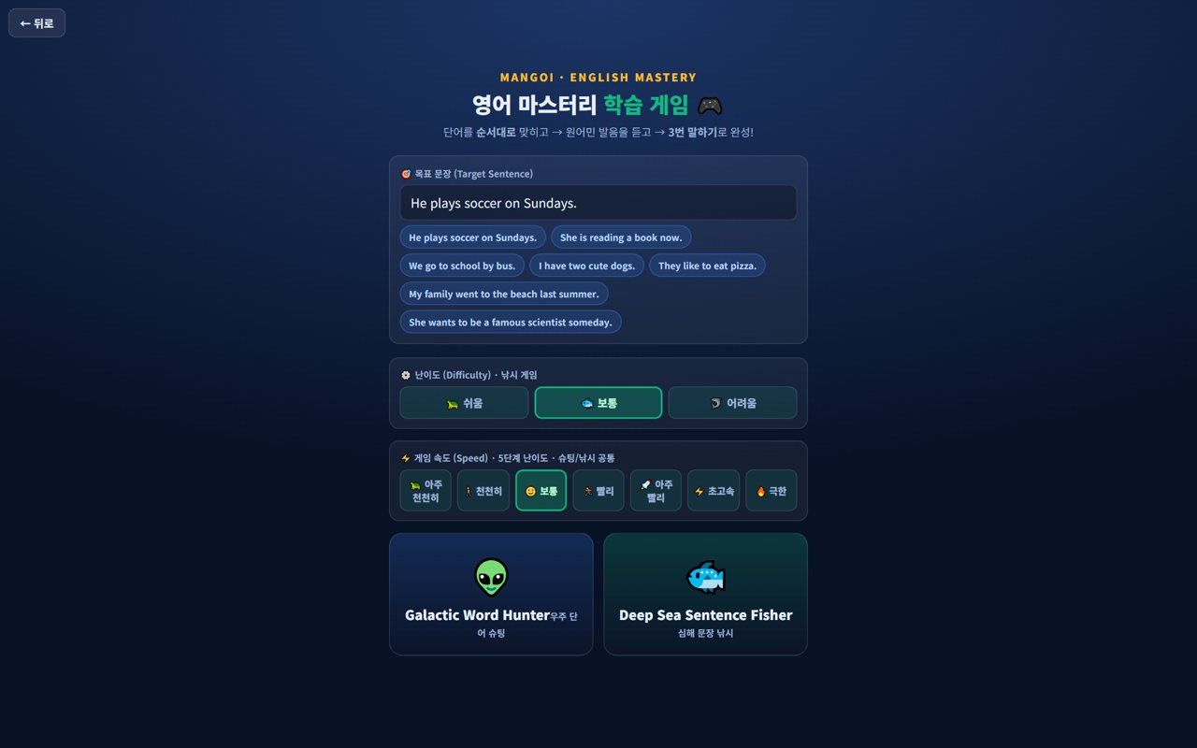
🎒 Mangoi Student User Guide
How to Use the Main Features
22
🚀 Shooting · Mastery Games
Shoot and fish while speaking
Shoot words in space (Shooting + Speaking) or build target sentences by hunting and fishing words (Mastery). Pick a difficulty and speed to suit you.
How to use
● Shooting + Speaking: shoot words in order to complete a sentence.
● Mastery (word hunt / sentence fishing): build the target sentence while speaking.
● Change difficulty and speed to pick your challenge.
✅ Key Points
● Speaking games score better when you say answers aloud.
● Reading the target sentence loudly helps memory.
💡 Tip · Start at 'easy/normal' and raise it as you get comfortable.

Slide 27
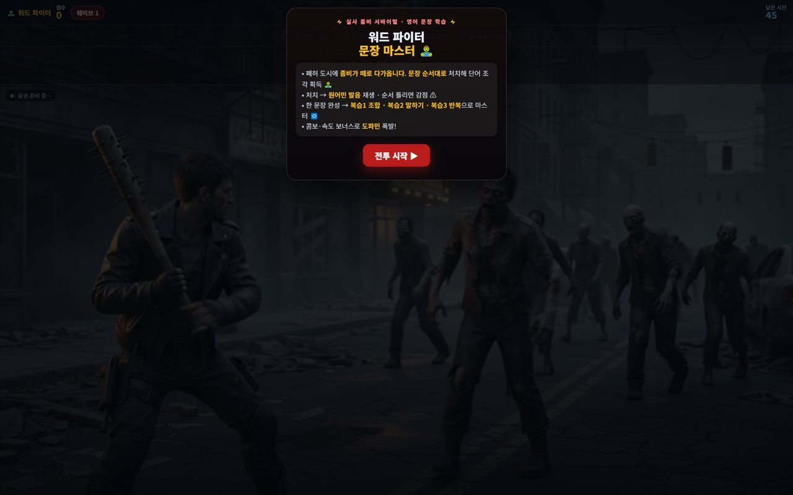
🎒 Mangoi Student User Guide
How to Use the Main Features
23
🧟 Word Fighter (zombies)
Beat zombies with words
An action game where you fend off oncoming zombies with words and sentences. It trains you to recall words quickly under pressure.
How to use
● Type or speak to match the word/sentence on screen to stop zombies.
● The faster you answer, the higher your score and combo.
● Get as many right as you can before you run out of lives.
✅ Key Points
● Great for quick-reaction practice.
● Don't skip unknown words — check their meaning.
💡 Tip · Nervous? Breathe — accuracy matters more than speed.

Slide 28
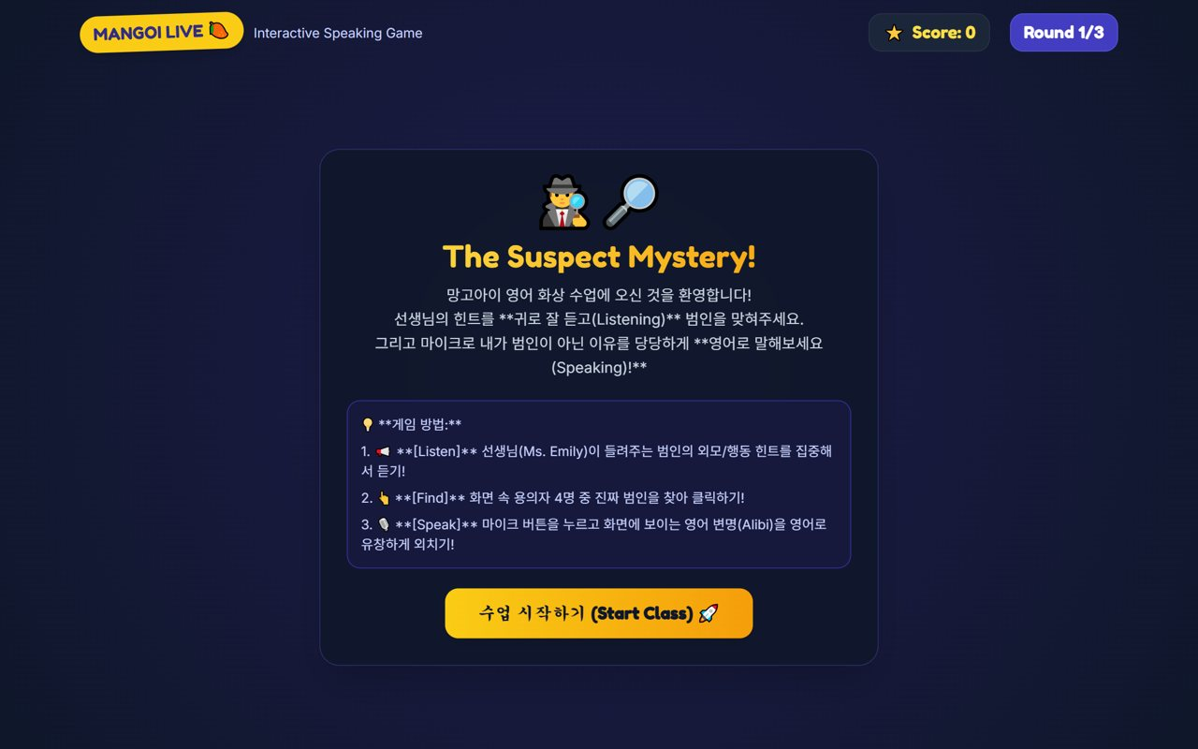
🎒 Mangoi Student User Guide
How to Use the Main Features
24
🕵️ Suspect Mystery
Listening & speaking through story
A mystery game where you listen to the teacher's (AI) English hints, find the culprit, and explain in English. You practice listening and speaking at the same time inside a story.
How to use
● Press 'Start Class' to begin the case.
● Listen to the English hints and gather clues.
● Pick the culprit and explain your reason in English.
✅ Key Points
● Improves listening focus.
● Practices giving reasons in English.
💡 Tip · Missed a hint? Use replay to check it.

Slide 29
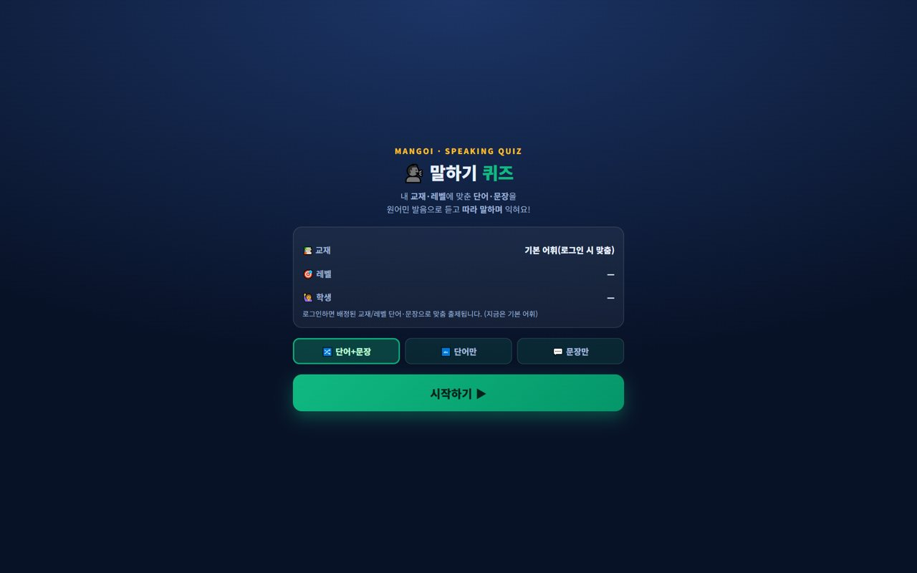
🎒 Mangoi Student User Guide
How to Use the Main Features
25
🗣️ Speaking Quiz
Listen and repeat
A quiz where you listen to a sentence and repeat it to check pronunciation and sentences. A great way to review today's lesson out loud.
How to use
● Press 'Start' to get questions.
● Listen and repeat each sentence.
● Fill 10 correct answers to see your result and pronunciation feedback.
✅ Key Points
● The more you speak aloud, the more you improve.
● A quiet place helps recognition.
💡 Tip · Doing it right after class doubles what you remember.

Slide 30
🎒 Mangoi Student User Guide
How to Use the Main Features
26
✅ Review Quiz
A quick check of the lesson
After class, a short quiz checks today's content. It tells you what you did well and what to review more.
How to use
● Take the review quiz that pops up after class.
● Recheck wrong questions with the explanation.
● Note the words to review more from your result.
✅ Key Points
● It's short, so you can do it every time without pressure.
● Wrong words link to the vocabulary book and games.
💡 Tip · Review quiz → game, in that order, is perfect.

Slide 31
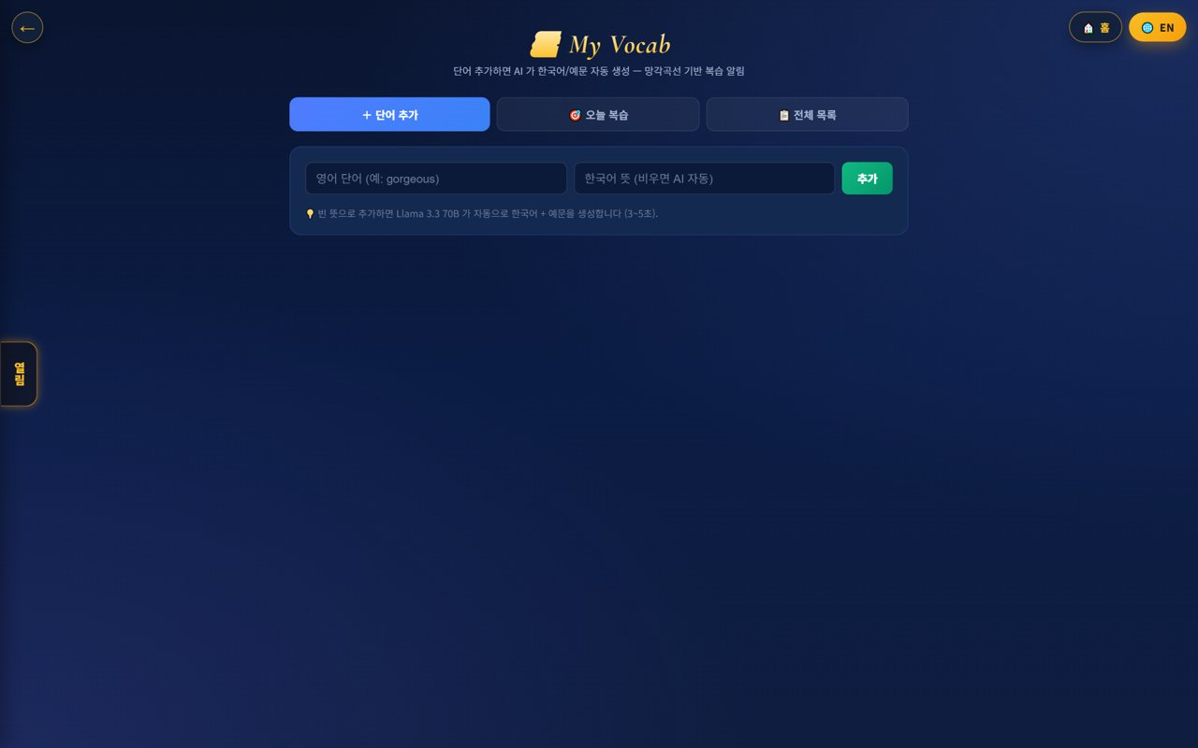
🎒 Mangoi Student User Guide
How to Use the Main Features
27
📚 My Vocab
Memorize with word cards
Your own vocabulary book to memorize collected words as cards. Check meanings and pronunciation and review even on the go.
How to use
● Flip through your word cards in the vocabulary book.
● Check the meaning and pronunciation on each card.
● Split known and unknown words and repeat.
✅ Key Points
● Words from games and lessons collect here.
● Perfect for spare moments on the go.
💡 Tip · Just 10 words a day is 300 words in a month.

Slide 32
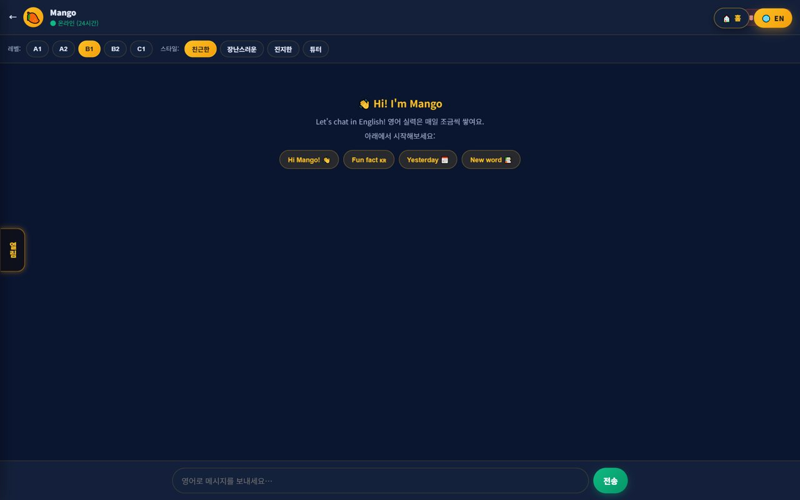
🎒 Mangoi Student User Guide
How to Use the Main Features
28
🤖 AI Friend (Mango)
Free English chat
Chat freely in English with your AI friend Mango to practice conversation. Mistakes aren't embarrassing, so you can speak as much as you like.
How to use
● Open the AI friend screen.
● Type or say what you want in English.
● Read Mango's reply and keep the conversation going naturally.
✅ Key Points
● Mistakes are fine — practice freely!
● Great for chatting in English when bored.
💡 Tip · Learn by asking things like 'What is …?'

Slide 33
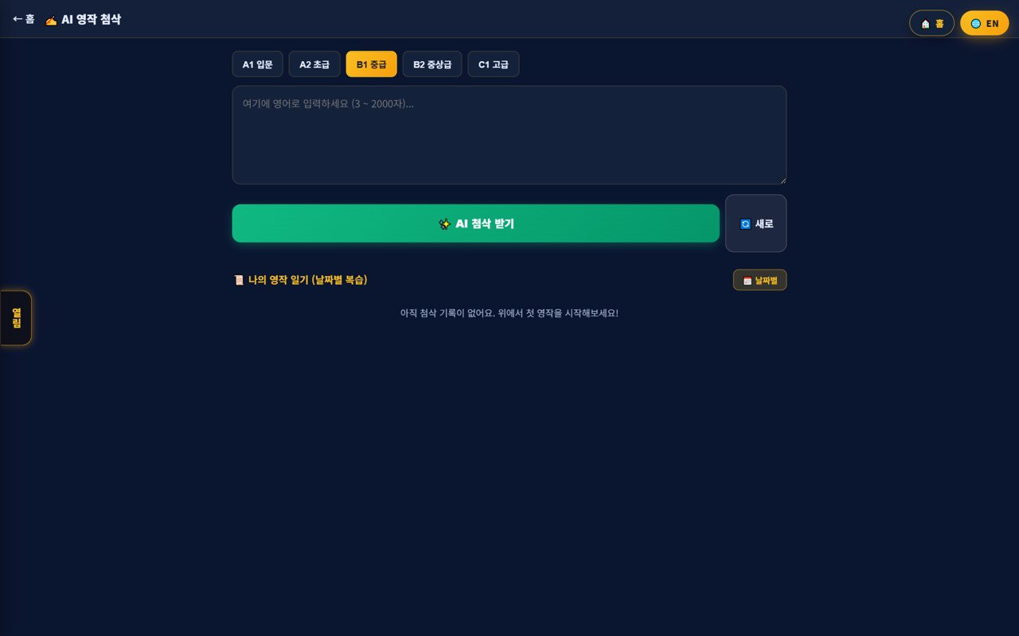
🎒 Mangoi Student User Guide
How to Use the Main Features
29
✍️ AI Writing
Make your sentences natural
Enter a sentence you want to write and the AI rewrites it into natural English. Learn why it changes and build your writing skills.
How to use
● Type the sentence you want to write.
● Press the AI Writing button.
● Check the corrected sentence and the reason, then copy it.
✅ Key Points
● Great for diary and self-introduction practice.
● Memorizing the fixes speeds up your growth.
💡 Tip · Read the corrected sentence aloud — it helps speaking too.

Slide 34
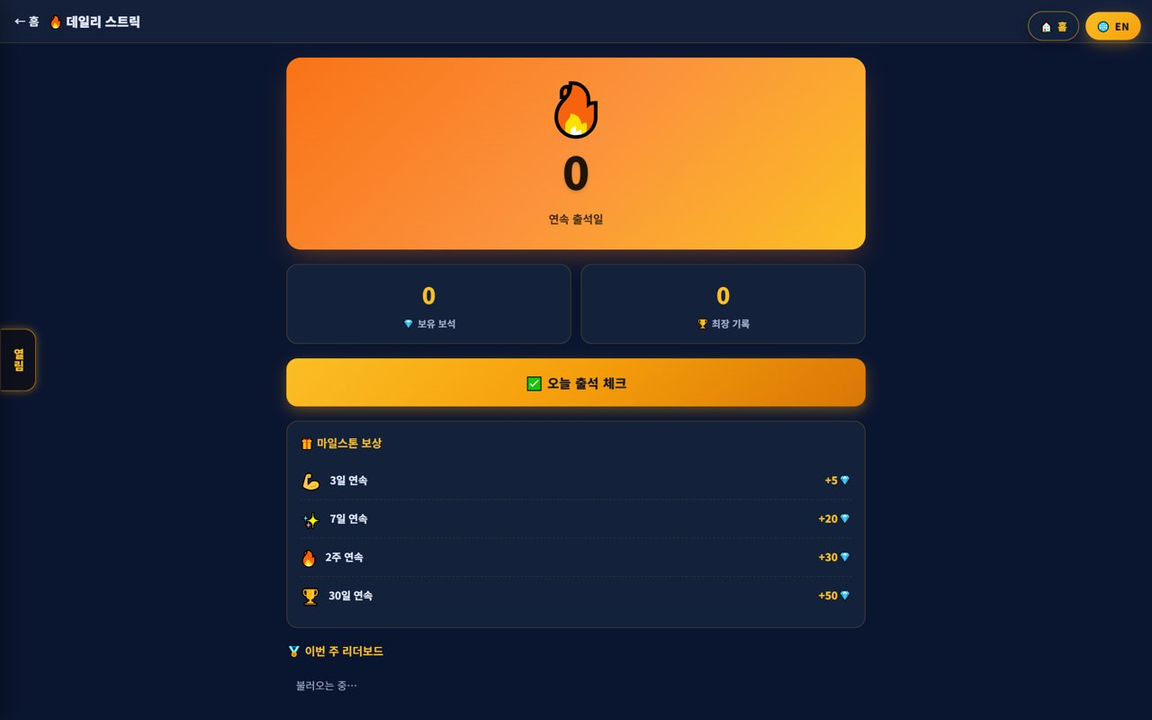
🎒 Mangoi Student User Guide
How to Use the Main Features
30
🔥 Attendance Streak · Badges
Consistency is skill!
Study every day to keep the flame (streak) going, and meet conditions to auto-collect 10 kinds of badges. Consistency adds up to real skill.
How to use
● Do 'today's study' every day to keep the flame going.
● Skip a day and the flame goes out — so do a little every day.
● Meet the conditions and receive badges automatically.
✅ Key Points
● Doing a little every day matters most.
● Collecting badges builds the habit for fun.
💡 Tip · Just pressing 'today's study' keeps your streak alive.

Slide 35
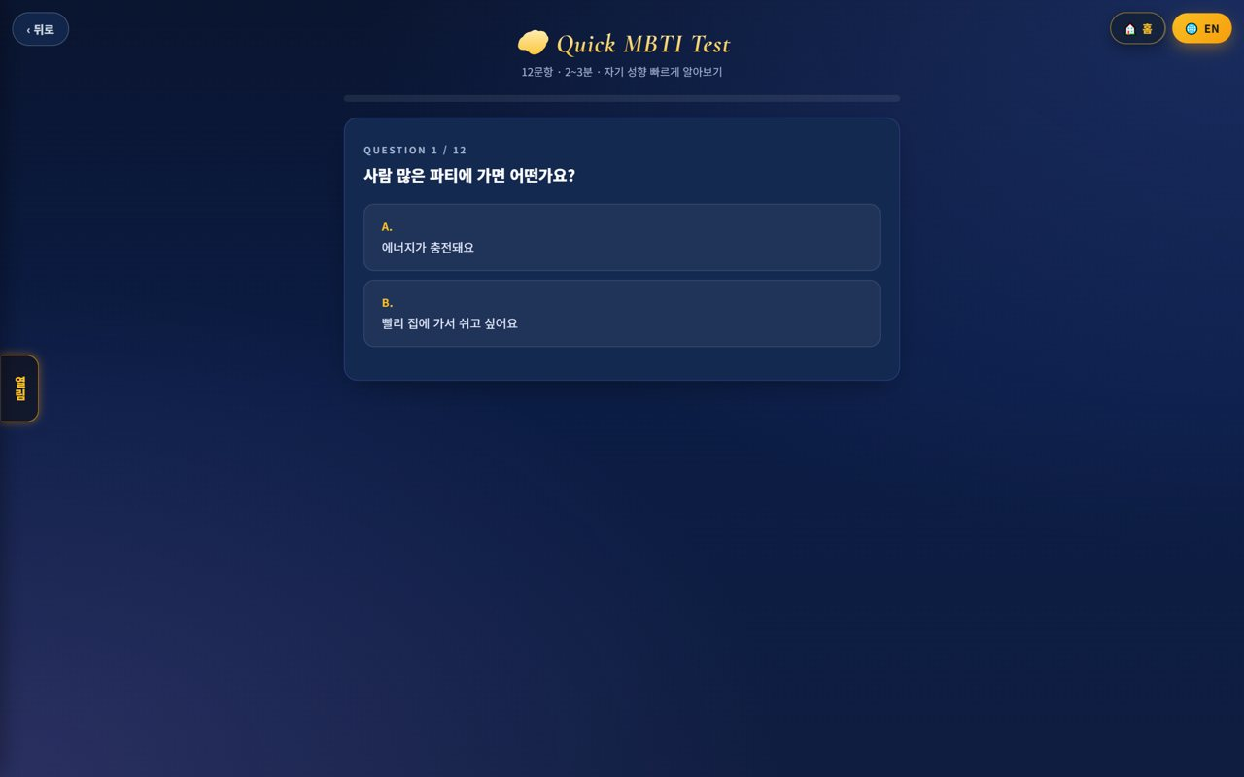
🎒 Mangoi Student User Guide
How to Use the Main Features
31
🧭 MBTI Style Test
Know your learning style
A short quiz to learn your learning style. It helps you find study methods that suit you.
How to use
● Answer the questions casually.
● See your style and study tips in the result.
● Apply the recommended methods to lessons and games.
✅ Key Points
● Enjoy it and get to know yourself.
● Pick games that fit your style, too.
💡 Tip · Share the result with your teacher for tailored coaching.

Slide 36
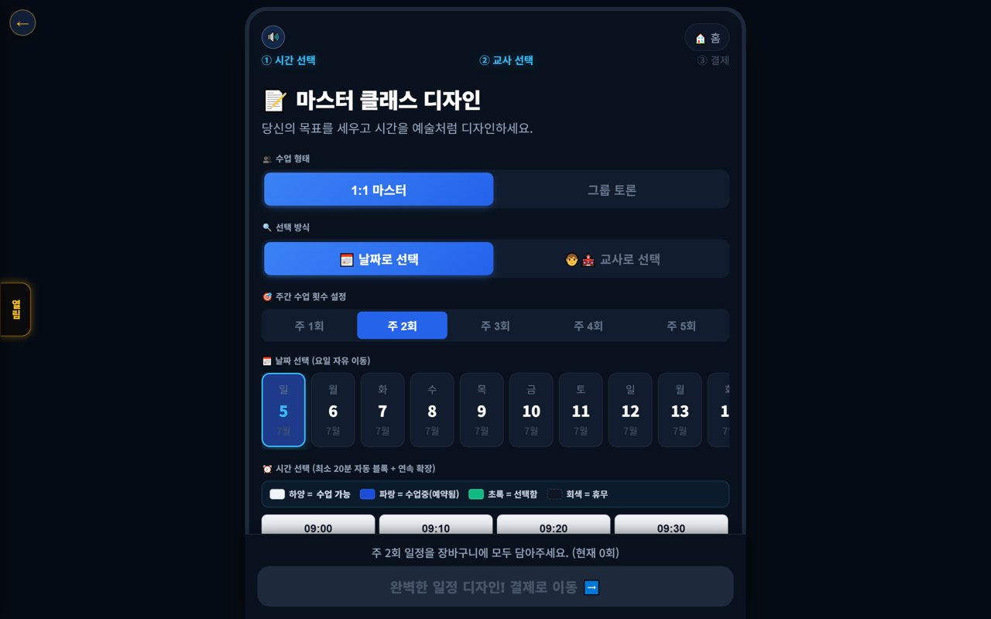
🎒 Mangoi Student User Guide
How to Use the Main Features
32
📅 Book a Lesson
Set your own schedule
A screen to book by choosing lesson type (1:1/group), date and time on a calendar. Once booked, your remaining count and next lesson are organized automatically.
How to use
● Pick the lesson type (1:1/group).
● Select the date and time on the calendar.
● Set the weekly count and move to payment/confirm.
✅ Key Points
● Available times are color-coded for easy picking.
● You can also choose by teacher.
💡 Tip · Popular slots fill fast — book early.

Slide 37
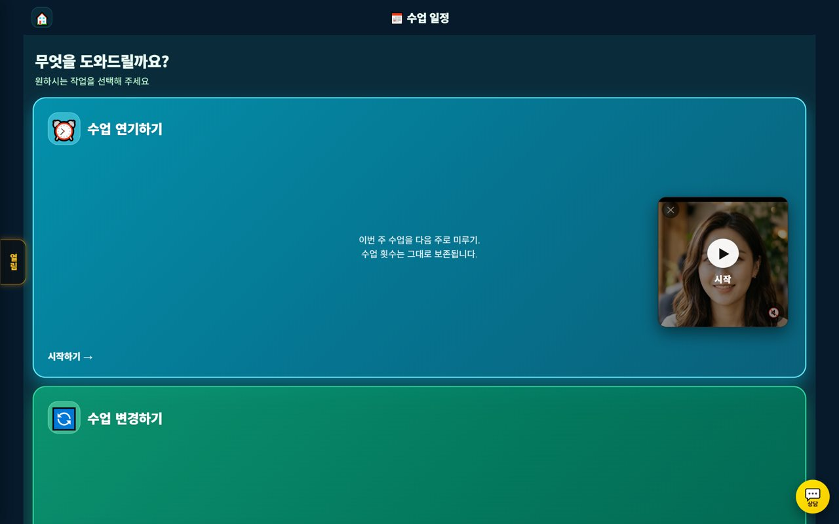
🎒 Mangoi Student User Guide
How to Use the Main Features
33
🔄 Postpone · Change a Lesson
When something comes up
A screen to push a lesson to later or change its time when something comes up. The changed schedule is announced automatically.
How to use
● Choose Postpone / Change.
● Set the date and time to move to.
● Confirm and your lesson count stays preserved.
✅ Key Points
● Requesting early makes it easier to get the time you want.
● Postponing never removes your lesson count.
⚠️ Good to know · Postponing right before a lesson may not be possible (check the postpone/refund policy).
💡 Tip · If your plans might change, request at least a day ahead.

Slide 38
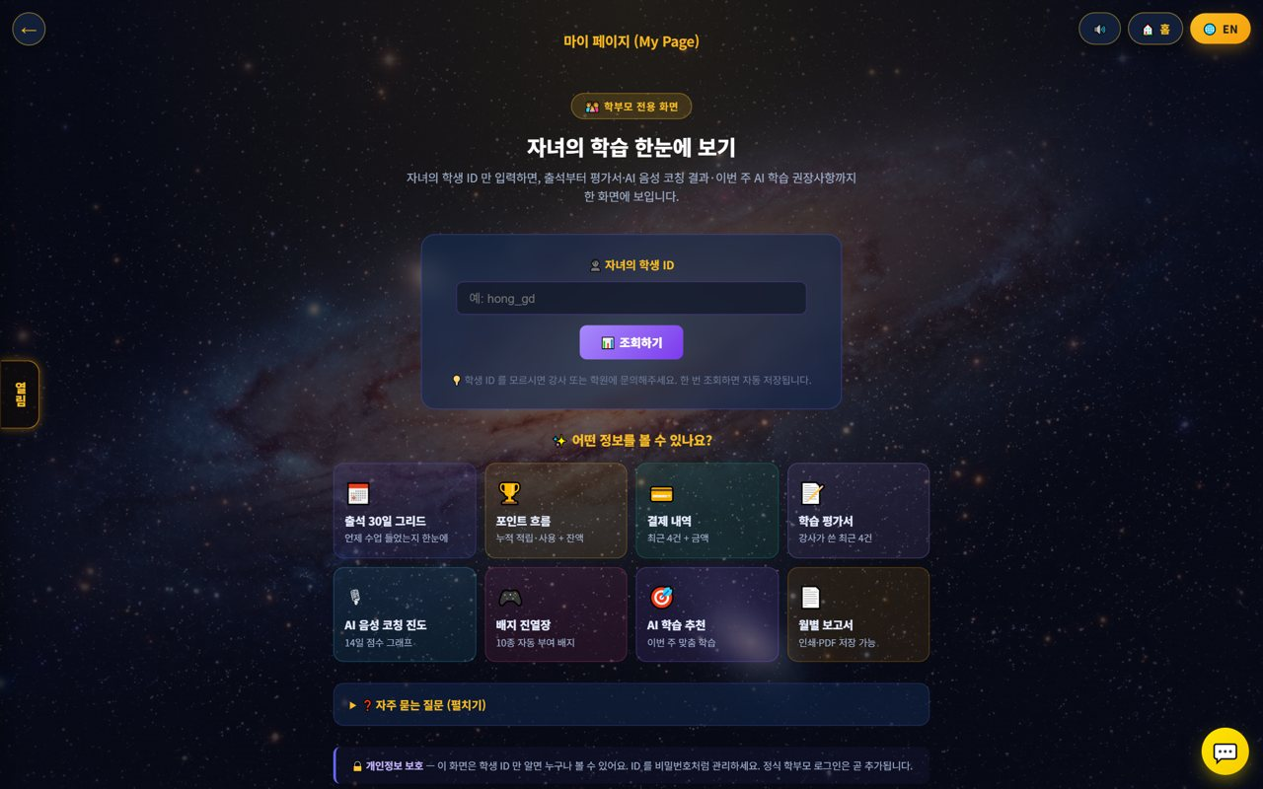
🎒 Mangoi Student User Guide
How to Use the Main Features
34
👨‍👩‍👧 [Parents] See Your Child's Learning
Just a student ID
Parents can see how well their child is doing on one screen in 'My Page' just by entering the child's student ID. No app install — check it right from the web.
How to use
● Open My Page (the parent screen).
● Enter the child's student ID and press Look up. (it's saved after one look-up)
● Check the 30-day attendance grid for when they had class, and point flow for accrual/use.
● See the learning report (teacher's latest reviews), AI voice-coaching progress and badge shelf.
● Wrap up the month with AI study recommendations and the monthly report (print/PDF).
✅ Key Points
● Attendance, reviews, points and coaching progress are all on one screen.
● The monthly report can be printed or saved as PDF.
● If you don't know the student ID, ask the teacher/academy.
⚠️ Good to know · Manage the student ID like a password — anyone with it can view.
💡 Tip · Reading the review together the day after class and praising your child boosts their motivation a lot.

Slide 39
🎒 Mangoi Student User Guide
How to Use the Main Features
35
💳 [Parents] Payment · Postpone · Refund
Tuition and schedule
Tuition payment, postponing/changing a lesson when something comes up, and the refund policy — useful things for parents to know. It's all handled on the web and auto-calculated by policy.
How to use
● Book/Pay: choose the lesson type (1:1/group) and count, then pay.
● Postpone/Change: if something comes up, request in advance to move it later. (lesson count is preserved)
● Refund: auto-calculated per the refund table (100% before the lesson starts, etc.).
● Questions? Contact support (phone, email, Kakao).
✅ Key Points
● The earlier you request a postpone, the easier to get the time you want.
● Refunds on discounted lessons are recalculated at list price.
● Overdue/payment notices can arrive via alert-talk/SMS.
⚠️ Good to know · Lessons missed without postponing may be marked absent. Check the policy in advance.
💡 Tip · Checking the postpone/refund policy at signup avoids confusion later.

Slide 40
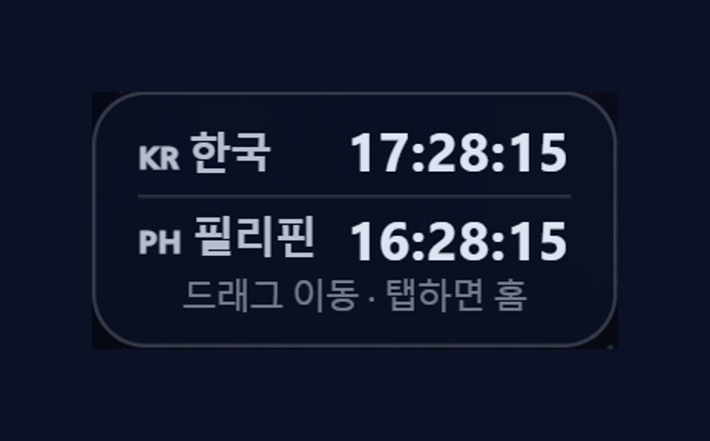
🎒 Mangoi Student User Guide
How to Use the Main Features
36
🕐 Korea·Philippines Dual Clock
Two countries' time on screen
A small clock on screen shows 🇰🇷 Korea time and 🇵🇭 Philippines time together. Our native teachers are in the Philippines, so seeing both times keeps you from mixing up lesson times.
How to use
● On the on-screen dual clock, see 🇰🇷 Korea and 🇵🇭 Philippines time at once.
● Drag the clock to move it anywhere you like.
● Tap (click) the clock to go to the home screen.
✅ Key Points
● The Philippines is 1 hour behind Korea (−1 hour).
● You can check booking/entry times in both countries' time.
💡 Tip · When a lesson time is confusing due to the time difference, this clock clears it up instantly.

Slide 41
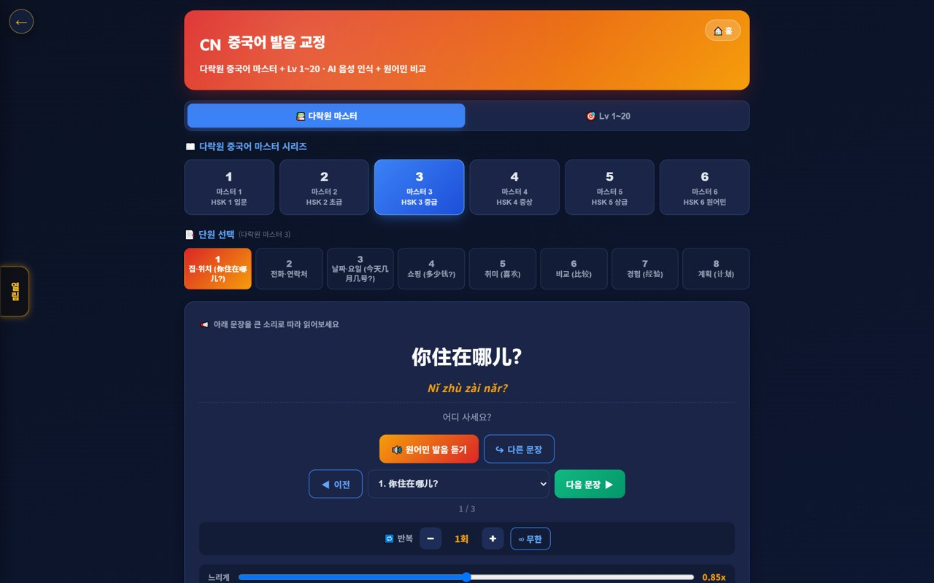
🎒 Mangoi Student User Guide
How to Use the Main Features
37
🇨🇳 Chinese Pronunciation Coach
Darakwon Chinese Master Lv1–20
You can get coaching not just in English but in Chinese pronunciation too! Read sentences along the 'Darakwon Chinese Master' textbook (Lv 1–20) and the AI recognizes your voice and compares it to a native speaker. Characters and pinyin (pronunciation) appear together.
How to use
● In the AI voice coach, pick the CN Chinese level (or go to the Chinese pronunciation coach).
● Choose a Master series (1–6, HSK 1–6) and a unit.
● Read the sentence (characters + pinyin) and compare with 'Play native audio'.
● Practice hard sounds/tones with repeat and slow (0.85x).
✅ Key Points
● Characters and pinyin appear together, so it's easy to read.
● The AI recognizes your voice and compares it to a native speaker.
● The learning games hub supports Chinese too.
💡 Tip · Listen slowly and repeat clearly to nail the four tones.

Slide 42
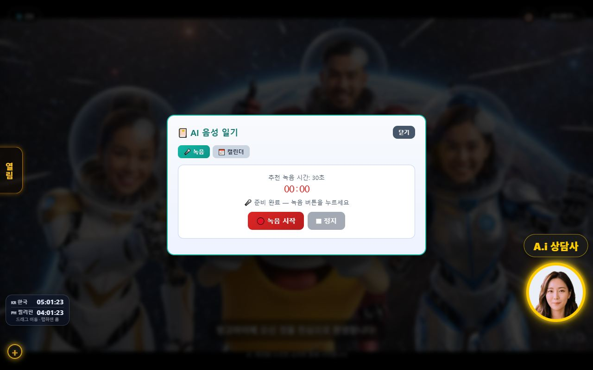
🎒 Mangoi Student User Guide
How to Use the Main Features
38
📔 AI Voice Diary
Speak about your day in English and AI corrects it
Say what happened today in English, and AI transcribes your speech, polishes the sentences, and leaves a score and encouragement. A little every day builds your own English diary!
How to use
● On the home menu, tap the 📔 AI Voice Diary card (next to the English/Chinese pronunciation coach).
● In the 🎤 Record tab, press ‘Start recording’ and talk about your day in English (about 30 seconds is plenty!).
● Press ‘Stop’ and AI automatically does transcribe → correct → score & encourage.
● The 📅 Calendar tab lets you revisit past entries by date.
✅ Key Points
● Turns your spoken English into text and rewrites awkward sentences naturally.
● A score (0–100) and a word of encouragement keep you motivated daily.
● Doing it daily also connects to attendance streaks and badges.
⚠️ Good to know · Recording requires you to be logged in. Speaking clearly in a quiet place makes the transcription more accurate.
💡 Tip · It doesn't have to be perfect. The habit of saying even ‘one sentence’ a day matters most!

Slide 43
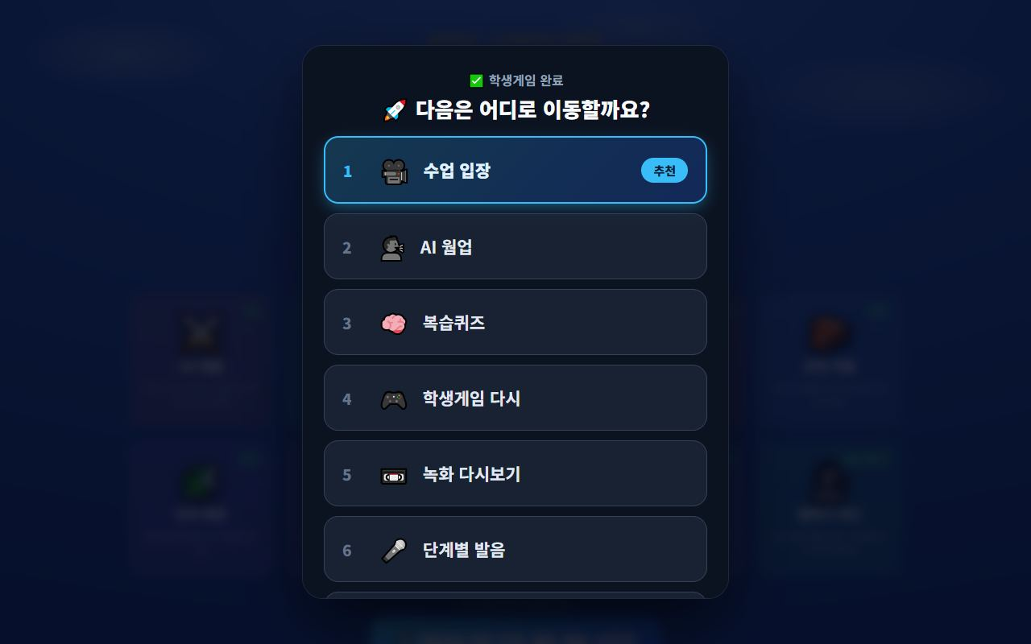
🎒 Mangoi Student User Guide
How to Use the Main Features
39
🚀 Where to next? (Learning-flow guide)
Finish one activity and get the next one suggested
When you finish an activity — warm-up, game, class, review, pronunciation — a ‘🚀 Where would you like to go next?’ menu pops up. No need to hunt for menus again; just follow the recommended (⭐) item to flow into your next activity.
How to use
● Fully complete a warm-up, student game, review quiz, class, or step-by-step pronunciation.
● Look for the ‘🚀 Choose next activity’ button (or the menu that appears automatically).
● Pick from Enter Class · AI Warm-up · Review Quiz · Student Games · Replay Recording · Pronunciation, etc.
● The recommended (⭐) item is a good next step for right now.
✅ Key Points
● Suggested flow: Warm-up → Game → Class → Review → Pronunciation → Game, naturally connected.
● Choosing ‘Replay Recording’ instantly replays your last class video.
● Even without playing a game/quiz, the list screen's ‘🚀 Go next’ button opens the menu.
💡 Tip · When you're unsure what to do, open this menu to keep today's study flowing smoothly.

Slide 44
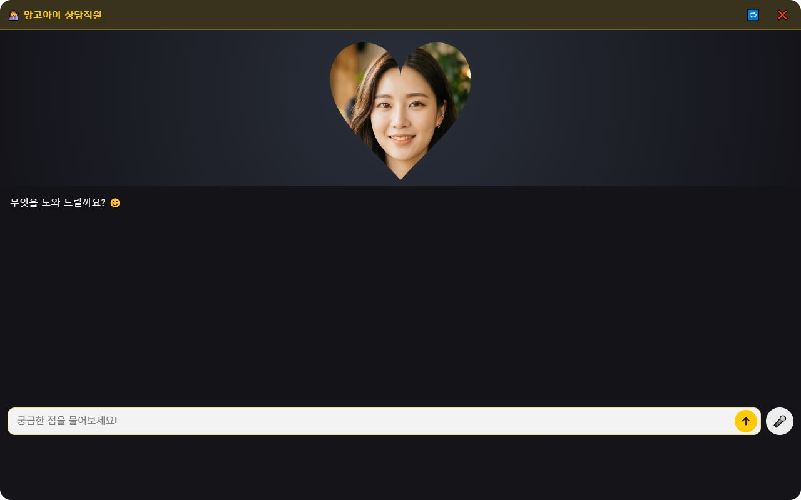
🎒 Mangoi Student User Guide
How to Use the Main Features
40
🤖 Ask the A.i Assistant
The consultant avatar at the bottom-right
Tap the ‘A.i Assistant’ at the bottom-right of the screen to ask anything, anytime. It explains how to use features and where they are, and can take you straight to the right menu.
How to use
● Tap the A.i Assistant icon at the bottom-right of the home screen.
● Type your question freely (e.g. “Where do I take the review quiz?”).
● The assistant answers and guides you to the right menu.
● You can also speak your question using the 🎤 mic.
✅ Key Points
● Points you straight to features like student games, pronunciation coach, or voice diary.
● Available anytime (nights & weekends too) so you can use everything on your own.
⚠️ Good to know · Requests that need a human — billing, operations — are routed to KakaoTalk chat or customer support.
💡 Tip · Say what you want to do, like “I want to ○○,” and it takes you to that screen.

Slide 45
🎒 Mangoi Student User Guide
How to Use the Main Features
41
🎛️ New Classroom Comforts
Hide my face · teacher first · mobile tool dock
The lesson screen got more comfortable. A 🙈 button hides your own face for a moment, the teacher's face now appears first and large when you enter, and on phones the bottom tools stay tucked away behind a ⋯ button — so you can focus on the lesson itself.
How to use
● Tap the 🙈 button on your own tile to hide your face for a bit. Tap the 🙂 chip to bring it back.
● When you enter, the teacher's face is placed on top, large, automatically — no hunting.
● On a phone (portrait), the default screen is faces on top and the textbook below.
● The mobile bottom dock opens only when you tap ⋯, keeping the screen roomy.
✅ Key Points
● Hiding your face doesn't turn the camera off — it only hides it on screen, so class continues.
● Rotate to landscape and it auto-arranges to faces left · textbook right.
⚠️ Good to know · Hide your face only for a moment when you're shy — lessons are much more fun with eye contact!
💡 Tip · If the screen feels cramped, fold the dock away with the ⋯ button.

Slide 46
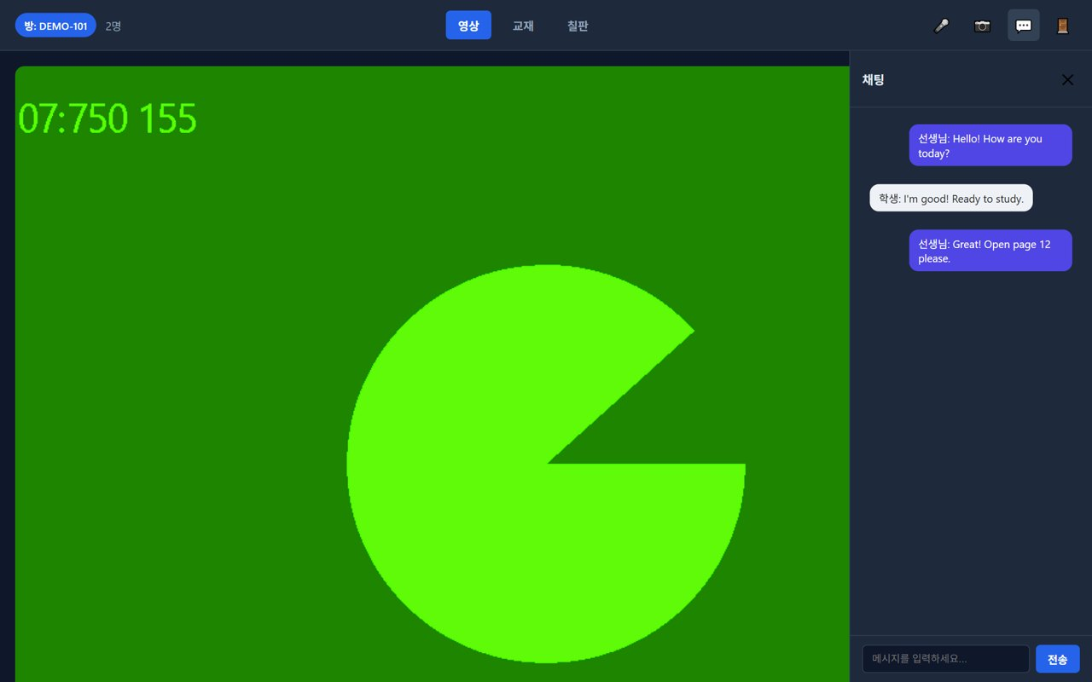
🎒 Mangoi Student User Guide
How to Use the Main Features
42
💬 1:1 Private Chat & File Sharing
Whisper messages only your teacher sees + share any file
Class chat now supports 1:1 private messages (DM). Send a message only a specific teacher can see, and share any file — PDF, image, document — through chat; it appears on the other side as a download card.
How to use
● Open 💬 Chat from the bottom dock.
● Switch the recipient from Everyone to a teacher's name to whisper 1:1.
● Use the 📎 file button to upload a PDF, photo, or document — a download card appears for them.
● Received files are saved with the card's ⬇ Save button.
✅ Key Points
● Private chats are visible only to the two of you.
● Homework files and notes get exchanged in one step during class.
⚠️ Good to know · Private chats are not stored on the server and disappear after class. Keep important things as files.
💡 Tip · Perfect for quietly asking a question without interrupting anyone else.

Slide 47
🎒 Mangoi Student User Guide
How to Use the Main Features
43
🌗 Home Screen: Bright · Dark
Auto by time of day, or pick your own
The home screen now switches automatically — bright by day, dark at night. Or use the Bright / Auto / Dark 3-way chip to set the mood yourself, anytime.
How to use
● Find the 🌗 theme chip at the top of the home screen.
● Pick Bright · Auto · Dark.
● Leave it on Auto and it brightens in the morning and dims at night on its own.
✅ Key Points
● Late-night studying is easier on the eyes.
● Your chosen theme is remembered next time you sign in.
💡 Tip · Dark for bedtime review, bright for a morning warm-up — it changes the mood too!

Slide 48
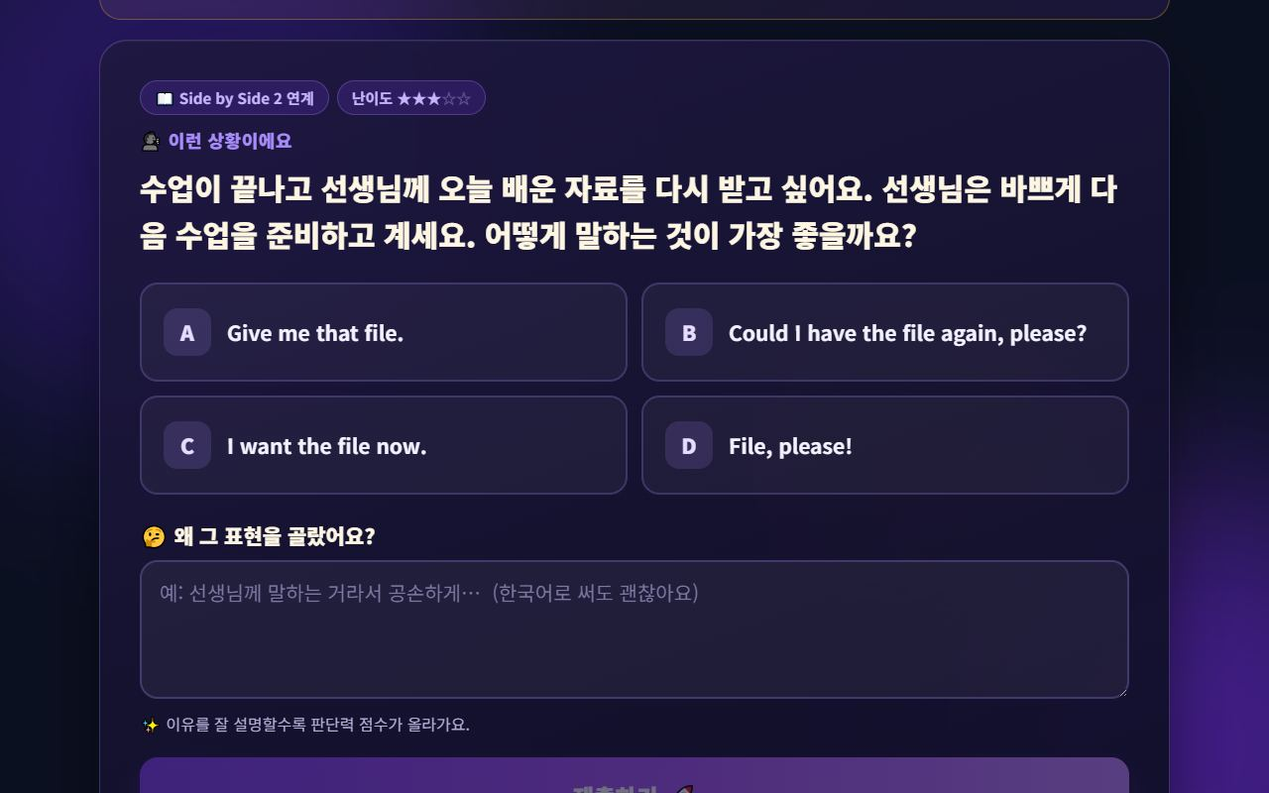
🎒 Mangoi Student User Guide
How to Use the Main Features
44
🧠 Judgment Training (pick the right words)
Not memorising answers — what fits right now?
The AI creates a situation that could really happen, and you pick the expression that fits that situation best — then write one line saying why you chose it. “Give me that!” works with a friend, but “Could I have that, please?” is right for a teacher. Real English ability isn't how much you know; it's judging which words fit right now.
How to use
● On the student home, open AI Learning Tools → 🧠 Judgment Training.
● Read Here's the situation and pick one of A–D.
● In Why did you choose it?, write your reason. Your own language is fine.
● Press Submit — the AI scores it and explains why another option may fit better.
● Tap 🏅 My Growth (top right) to see your judgment index and its 5 axes.
✅ Key Points
● Every option carries partial credit — only a clearly wrong choice scores low.
● The better you explain your reason, the higher the score — it trains thinking in words.
● Questions are linked to your textbook (e.g. Side by Side 2), so they stay in range.
● Each round comes from a different topic and angle, so questions never repeat.
⚠️ Good to know · The AI needs a few seconds to write a question. The next one is prepared while you answer, so it usually appears instantly.
💡 Tip · Getting it wrong is fine. Writing why you thought so is the whole point of this training.

Slide 49
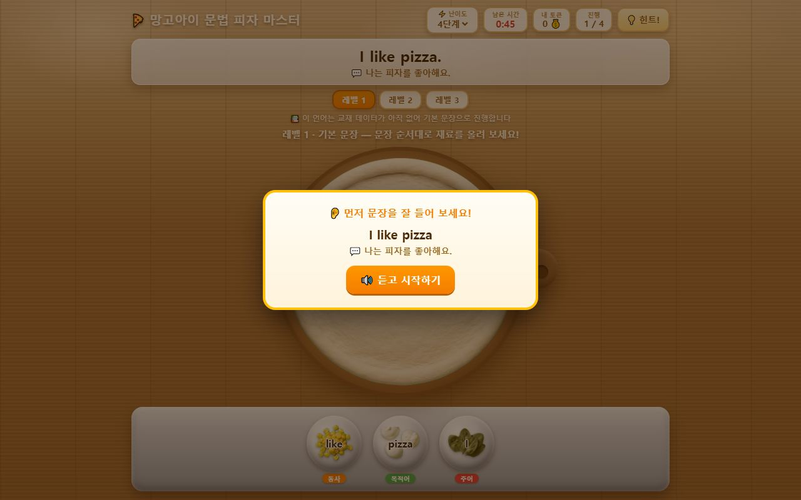
🎒 Mangoi Student User Guide
How to Use the Main Features
45
🍕 Grammar Pizza Master (word order)
Stack the toppings in sentence order
Words arrive as pizza toppings. Listen to the sentence first, then place the toppings in sentence order to finish the pizza. Subject, verb and object are colour-coded, so English word order sinks in visually.
How to use
● Open 🍕 Grammar Pizza Master in the games hub.
● Press Listen and start to hear the sentence first.
● Place the toppings below in sentence order onto the pizza.
● Stuck? Tap 💡 Hint! at the top right.
● Sentences grow longer from Level 1 → 2 → 3.
✅ Key Points
● Each topping is labelled subject / verb / object, so word order becomes natural.
● If a textbook is assigned, sentences come from that book.
● A time limit keeps the drill fast and focused.
💡 Tip · Read each word aloud as you place it — the order sticks far faster.

Slide 50
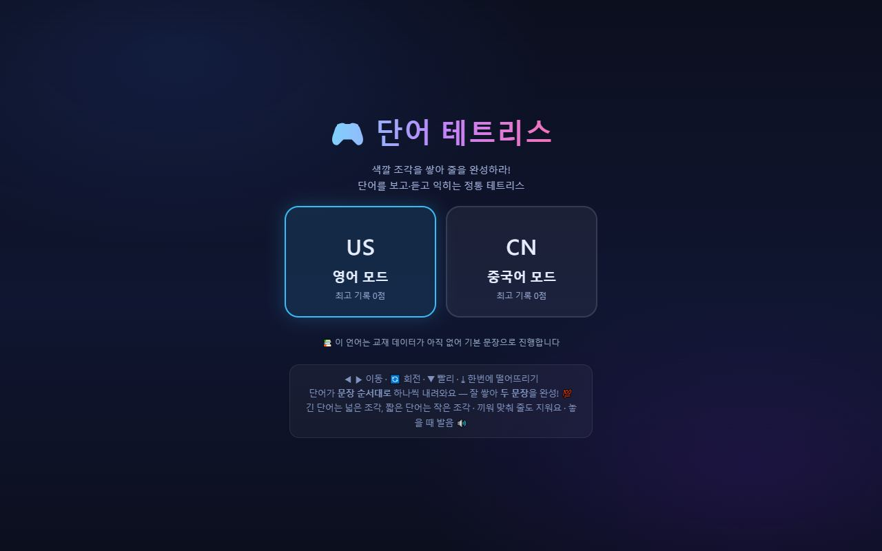
🎒 Mangoi Student User Guide
How to Use the Main Features
46
🧱 Word Tetris
Stack word blocks and complete two lines
Classic Tetris with words on top. Words fall one at a time in sentence order — stack them well and clear a line to complete the sentence. Long words are wide blocks, short words are small ones; fitting them together makes the vocabulary stick.
How to use
● Open 🧱 Word Tetris in the games hub.
● Choose US English mode or CN Chinese mode.
● Use ◀ ▶ to move, rotate, ▼ to speed up, ↓ to drop instantly.
● Each time a block lands you hear the word — repeat it aloud.
✅ Key Points
● English and Chinese modes play exactly the same way.
● Your high score is saved so you can beat it next time.
● Tidied up so nothing is cut off on a phone screen.
💡 Tip · Lay the long words down low first — clearing lines gets much easier.

Slide 51
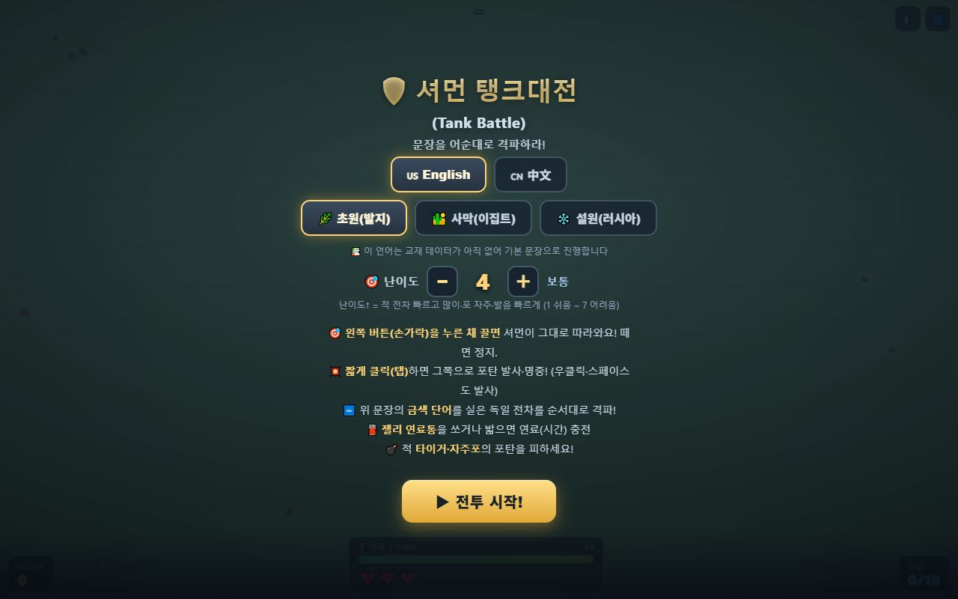
🎒 Mangoi Student User Guide
How to Use the Main Features
47
🛡️ Tank Battle · Language Ace
Destroy in word order · action learning
Two new action-style learning games. In Tank Battle you destroy enemy tanks in the sentence's word order; in Language Ace you fly and answer as you go. Hands stay busy, so focus is high and repetition never feels dull.
How to use
● Open 🛡️ Tank Battle or ✈️ Language Ace in the games hub.
● For Tank Battle pick English / 中文, a battlefield (grass · desert · snow) and difficulty 1–7.
● Hold and drag the left button to move; short tap fires in that direction.
● Destroy the tanks carrying the gold words of the sentence above, in order.
● Pick up jelly fuel cans to gain more time.
✅ Key Points
● Higher difficulty means faster enemies and faster speech — listening practice included.
● If a textbook is assigned, its sentences are used.
● Fully playable by touch on phones and tablets.
⚠️ Good to know · These games are motion-heavy. On a slower device, lower the difficulty.
💡 Tip · Games work best as review after the lesson, not before it.

Slide 52
🎒 Mangoi Student User Guide
How to Use the Main Features
48
🔐 Log in with your face or fingerprint (passkey)
No password needed in the app
You can now log in with your face or fingerprint in the Mangoi Android app. Register once and you're in with a glance or a touch — no ID and password to type. Your secret never leaves your phone, so it's safer too.
How to use
● Update the app to the latest version (v1.9 or later).
● Log in once with your ID and password as usual.
● When prompted, tap Register passkey and enrol your face or fingerprint.
● From then on, log in with your face or fingerprint.
✅ Key Points
● The credential stays only on your phone and is never sent to the server.
● Changed phones? Just register once more on the new device.
● Devices without passkey support keep working with the usual ID + password.
⚠️ Good to know · This is an app-only feature. In a web browser, log in the usual way.
💡 Tip · Younger students forget passwords constantly. Registering a passkey cuts those requests dramatically.

Slide 53
🎒 Mangoi Student User Guide
How to Use the Main Features
49
🎤 Your speaking isn't cut off any more · a smarter AI friend
It waits even when you speak slowly
The microphone used to shut off while you were still thinking mid-sentence — that's fixed. The waiting time now adapts to the situation, and if your phone kills the microphone by itself it restarts automatically. The AI friend (Mango) no longer repeats itself, asks again when your speech is cut off, and actually slows down when you say “speak slowly”.
How to use
● Press the 🎤 button in Speech Coach, AI Warm-up or AI Friend and talk.
● Pausing to think is fine — it waits until you're really finished.
● Say “Please speak slowly” to the AI friend and it will slow down.
● Choose the voice: male · female · alternating.
✅ Key Points
● Sudden microphone cut-outs on Android phones now recover automatically.
● The AI friend never repeats the same sentence.
● If your speech is clipped, the AI asks “Did you mean this?”
⚠️ Good to know · Noisy surroundings hurt recognition. Speak clearly in a quiet place.
💡 Tip · Using an earphone microphone raises recognition accuracy noticeably.

Slide 54
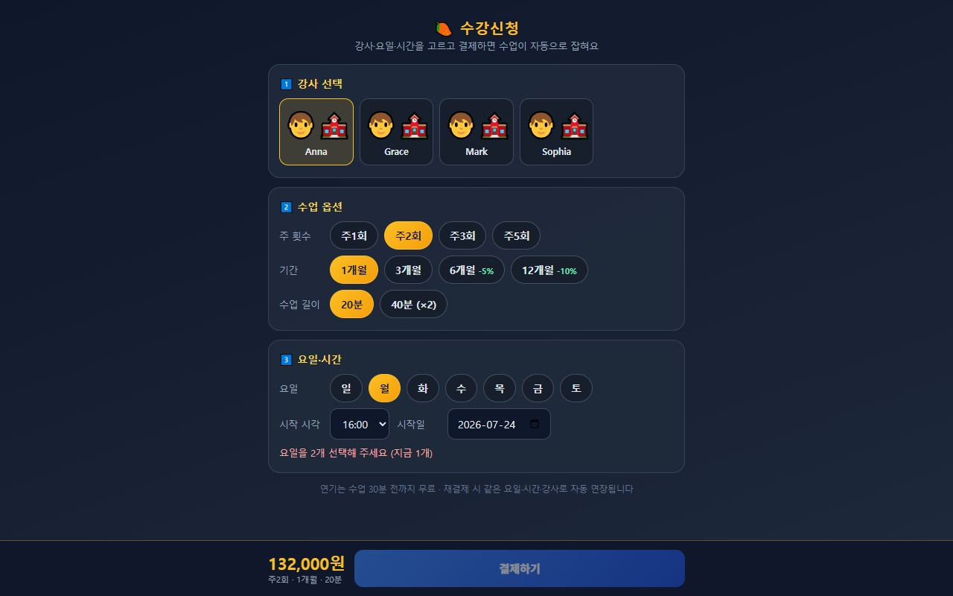
🎒 Mangoi Student User Guide
How to Use the Main Features
50
💳 Enrol and pay in one go
Pick teacher, days and time — lessons are scheduled automatically
You can now choose your teacher, days and time yourself and pay — and your whole schedule is created automatically. No more phoning after payment to arrange a timetable. If a slot already clashes with another lesson, you're told before you pay.
How to use
● Open the Enrolment screen.
● ① Choose a teacher.
● ② Lesson options — times per week (1–5), term (1 / 3 / 6 / 12 months), length (20 or 40 min).
● ③ Days & time — pick as many days as your weekly count, then the start time and start date.
● When ✅ Available appears, press Pay at the bottom.
● Once payment completes, every session is created at once. Check it on My Page.
✅ Key Points
● Longer terms are cheaper — 6 months −5%, 12 months −10%.
● If the slot is taken, an ❌ appears so you can change it before paying.
● Postponing is free up to 30 minutes before the lesson; renewing extends the same day, time and teacher.
⚠️ Good to know · Lessons are created after payment is confirmed. Wait a moment right after paying and the schedule will appear.
💡 Tip · Avoid days with school commitments. Choosing well up front beats rescheduling later.

Slide 55
🎒 Mangoi Student User Guide
Feature Summary · Data
51
📋 Student Features at a Glance
Menu | What it does | When to use | What you gain
Video lesson | 1:1 native lesson | At set lesson times | Speaking skill ↑
Class toolbar | Video·materials·board·chat | During class | Tool mastery
AI warm-up | Pre-class warm-up | 5 min before class | An easy start
AI voice coach | Record & fix pronunciation | Daily self-study | Accurate sounds
Games | Review by playing | After class | Points·memory
Vocabulary | Memorize word cards | On the go | Vocabulary ↑
AI friend | Free English chat | When bored | Speaking confidence
Streak | Daily study flame | Every day | Badges·habit
Level test | Assess your level | Start & periodically | Tailored lessons

Slide 56
🎒 Mangoi Student User Guide
Data at a Glance
52
📊 Data at a Glance
Skills Each Game Practices
Keep it up and… (example points)

Slide 57
🎒 Mangoi Student User Guide
Frequently Asked Questions (FAQ)
53
❓ Frequently Asked Questions (FAQ)
Q. What do I use to connect?
A. Phone, tablet and PC all work. We recommend Chrome or Edge. No app install needed.
Q. How do I enter a lesson?
A. Tap the invite link or lesson card, enter your name, press 'Enter', then 'Allow' camera and mic.
Q. No sound or video.
A. Check that you pressed 'Allow' for camera/mic, and reopen in Chrome/Edge. Inside KakaoTalk, choose 'open in another browser'.
Q. How do I see the textbook in class?
A. Press the 'Materials' tab at the top to see what the teacher uploaded. Switch board/chat with tabs too.
Q. What are points for?
A. Use points earned from studying and games to get rewards in the shop, roulette, etc.
Q. English feels hard.
A. The AI friend and voice coach are fine with mistakes. A level test matches your level so it gets easier.

Slide 58
🎒 Mangoi Student User Guide
Checklist
54
✅ Pre-class Checklist
Did you connect with Chrome/Edge?
Did you 'Allow' the camera and mic?
Is your face well-lit and visible?
Did you connect earphones (a headset)?
Did you warm up with the AI before class?
Are your textbook and pen ready?
Did you enter 5 minutes before class?

Slide 59
🎒 Mangoi Student User Guide
Conclusion
55
🏁 Conclusion · Your Mangoi Routine — Easy on Your Own!
Now you know how to use Mangoi! Finally, here's one page on how to study through the day and the habits that make you improve fast. Keep just this page in mind and you can study on your own with ease.
🔄 The Flow at a Glance
⭐ Key Principles
Before class (5–10 min)
My Page → 🎥 Pre-check camera/mic, warm up with the 🔥 AI warm-up
● A little every day — even short, daily practice keeps your attendance flame alive.
● Speak a lot — mistakes are fine! The more you say aloud, the faster you grow.
● Review right after class — a quiz/game right away doubles what you remember.
● Have fun with games — today's words appear in games, so you review while playing.
● Check what you don't know — don't skip unknown words; check meaning and pronunciation.
Enter class
🎥 Enter Class button → type your name → 'Allow' camera and mic
During class
🎤 Answer with your mic · 💬 ask in chat · 🖊 write on the board together · 🌟 earn praise points
After class
🧠 Review quiz 'Yes' → ⭐ star rating (+10P) → 🎮 review today's words with a game
A little every day
🔥 Keep your attendance flame · 📚 vocabulary · 🤖 AI friend · 🎙️ voice-coach pronunciation
📌 Remember
● Connect in Chrome/Edge and be sure to 'Allow' camera·mic (inside KakaoTalk, open another browser)
● Points build from study, games and in-class 🌟 praise — spend them in the shop/roulette
● If English is hard, the AI friend/voice-coach are fine with mistakes; use the level test to match your level
● Study rhythm: 'Warm-up → Class → Praise → Review'!
🍊 The friend who keeps at it a little every day ends up best at English. Don't fear mistakes — speak all you want. Your Mangoi friends are always cheering for you. You've got this today too! 🍊

Slide 60
Let's grow together with Mangoi!
Questions? Ask the on-site A.i assistant or contact customer support.
🌐 www.mangoi.co.kr 📞 1644-0561 ✉ support@mangoi.co.kr

