Slide 1

👩‍🏫 TEACHER GUIDE
Mangoi · MANGOI
Teacher User Guide
Follow the lesson flow — how to use the site
For · Native-speaker teachers and Korean instructors | www.mangoi.co.kr

Slide 2
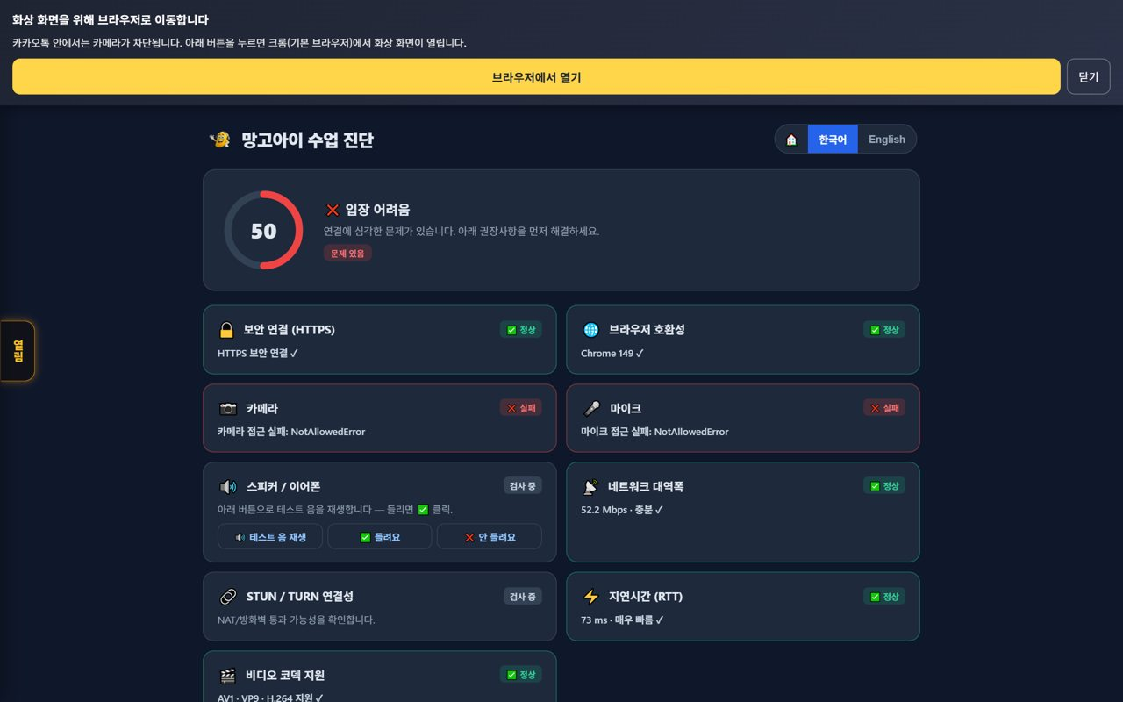
👩‍🏫 Mangoi Teacher User Guide
Introduction
What is the Teacher Site Guide?
This guide explains how a teacher who runs video lessons uses the Mangoi site. From pre-class device checks to entering the classroom, the materials/board/chat tools, using the AI warm-up and pronunciation coach, writing lesson reviews, praising students and learning reports — it follows the real lesson flow. (This is a 'how to use the site' guide, not a teaching methodology.)
🩺
Pre-class detailed check
🎥
Classroom tools
Camera·mic·network·lighting scores.
Video·materials·board·chat·recording.
📝
Lesson review · praise
📊
Learning reports
Post-class review and star/sticker praise.
Game weak words·reports for next lesson prep.
25-min Lesson Time Split (ex., min)

Slide 3
👩‍🏫 Mangoi Teacher User Guide
Contents
📑 Contents (1/2)
Introduction
2
11
Background & Face Decorations
15
01
Pre-class Detailed Check
5
12
Resize & Arrange the Screen
16
02
Enter a Lesson from My Page
6
13
Praise Points During Class
17
03
Make the Most of My Page
7
14
Bottom Dock & Praise Basket
18
04
Enter the Classroom
8
15
Pre-upload Materials
19
05
The Classroom at a Glance
9
16
Start with the AI Warm-up
20
06
Switching the 6 Top Tabs
10
17
Use the Pronunciation Coach
21
07
Board Tools, One by One
11
18
Write the Lesson Review
22
08
Materials Tools (share PDF/photos)
12
19
Leave Student Praise
23
09
Writing Tools (annotate on top)
13
20
Game Learning Report
24
10
Watch Video Together
14

Slide 4
👩‍🏫 Mangoi Teacher User Guide
Contents
📑 Contents (2/2)
21
Reports · Lesson Management
25
32
Textbook PDF — annotations that stay · faster page jumps
36
22
Handle Lesson Postpones
26
33
It rides out a slow connection by itself
37
23
Support · Inquiries
27
34
Using Judgment Training in class
38
24
Korea·Philippines Dual Clock
28
35
Replay a recorded lesson
39
25
Chinese Pronunciation Coach
29
36
Your account (password · interface language)
40
26
AI Coaching After Class
30
37
Feature Summary · Data
41
27
Tab Sync (Your Screen Leads)
31
38
Data at a Glance
42
28
1:1 Private Chat & File Sharing
32
39
Frequently Asked Questions (FAQ)
43
29
Requesting a Postpone / Change
33
40
Checklist
44
30
Checking My Lesson-Fee Settlement
34
41
Conclusion
45
31
Three class controls (focus · background lock · exit guard)
35

Slide 5
👩‍🏫 Mangoi Teacher User Guide
How to Use the Main Features
01
🩺 Pre-class Detailed Check
Check devices before entering
A screen that checks camera, mic, network and lighting at once before class. An overall score and per-item signals catch problems early and prevent drop-outs mid-lesson.
How to use
● Check camera, mic, network and lighting on the check screen.
● Read the overall score and each item's signal (normal/warning).
● For red items, adjust lighting, seat or connection and check again.
✅ Key Points
● Do the check 5–10 minutes before class.
● Fix issues before the student enters.
💡 Tip · Put the light in front of your face so your expression shows and student focus rises.

Slide 6
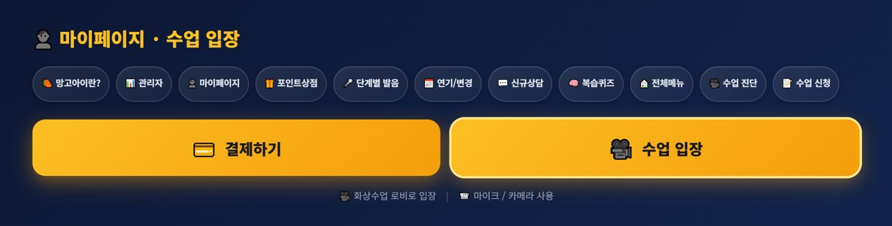
👩‍🏫 Mangoi Teacher User Guide
How to Use the Main Features
02
👤 Enter a Lesson from My Page
The first button to the lesson room
Teachers enter a lesson the same way students do — with the 'Enter Class' button on My Page. After logging in, open My Page and you'll find the gold 'Enter Class' button; pressing it takes you to the video-class lobby.
How to use
● After logging in, press the '👤 My Page' button.
● Find the gold '🎥 Enter Class' button below (in a row with '💳 Payment').
● Press 'Enter Class' and you go to the video-class lobby.
● Check the hint '🎥 Enter video class lobby · 📹 Mic/Camera required'.
● Then in the lobby, confirm your name → Allow camera/mic → enter the classroom (see next page).
✅ Key Points
● One 'Enter Class' button takes you straight to the lobby.
● My Page also has pre-check, postpone/change, all-menu and more.
● Students enter with the same 'Enter Class' button.
⚠️ Good to know · Even after pressing the button, your face/sound won't connect unless you allow camera/mic.
💡 Tip · Enter early from My Page 5–10 minutes before class to check your devices.

Slide 7
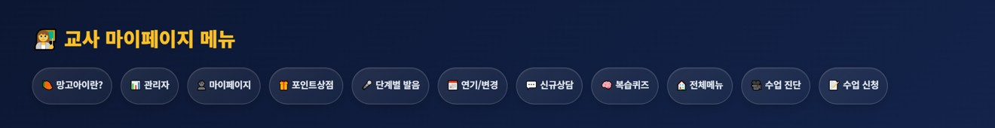
👩‍🏫 Mangoi Teacher User Guide
How to Use the Main Features
03
🧭 Make the Most of My Page
Every entry point you need for class
My Page has more than just 'Enter Class' — every menu you need for a lesson is gathered here. Knowing the buttons you use most makes prep much faster.
How to use
● 🎥 Pre-check: check camera, mic, network and lighting before class. (a must 5–10 min before)
● 🎥 Enter Class: go to the video-class lobby. (see earlier page)
● 📅 Postpone/Change: adjust the schedule per a student's request or your situation.
● 🧠 Review Quiz · 🎤 Curriculum Pronunciation: preview review/pronunciation material for students.
● 💬 New Inquiry · 🏠 All Menu · 📝 Book Class: go to intake and all features.
✅ Key Points
● Make 'Pre-check → Enter Class' a habit.
● If text looks Korean, switch to English with the EN button.
● You can also tell the AI search/assistant 'open ○○' to jump there.
💡 Tip · Pre-class routine: ① Pre-check devices → ② pre-upload the textbook → ③ Enter Class.

Slide 8
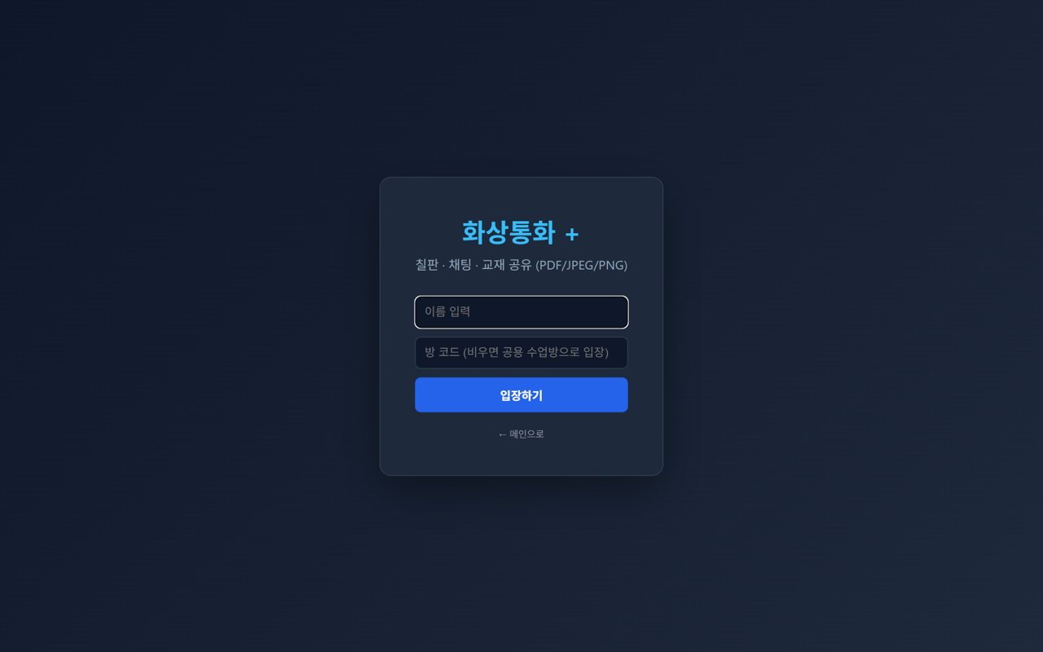
👩‍🏫 Mangoi Teacher User Guide
How to Use the Main Features
04
🎥 Enter the Classroom
Getting into the lesson room
On the entry screen, enter your name and room code to join. Allow camera and mic, then wait for the student.
How to use
● Enter your name on the entry screen.
● Check the room code (empty = shared lesson room).
● Press Enter and click Allow for camera/mic.
● Wait for the student and check screen/sound.
✅ Key Points
● Enter early to check your camera framing and sound.
● Chrome/Edge recommended; avoid the KakaoTalk in-app browser.
⚠️ Good to know · If a student can't enter, have them check browser permissions and type first.
💡 Tip · A 30-second check of background, lighting and sound after entering makes the lesson smooth.

Slide 9
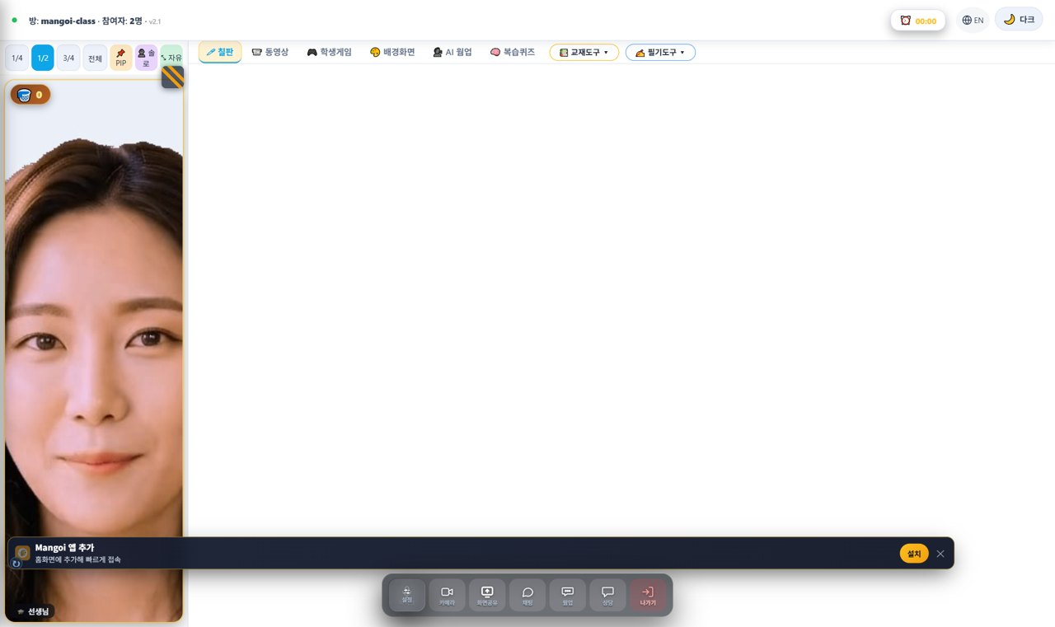
👩‍🏫 Mangoi Teacher User Guide
How to Use the Main Features
05
🖥️ The Classroom at a Glance
What does the lesson screen look like?
When you enter a lesson, the screen has three main areas: ① the top bar (room info, timer, language, dark mode), ② the large center workspace (where the board, materials, video, etc. open), and ③ the bottom control dock (camera, chat, leave). Your face video and the praise basket sit in a small window at the top-left.
How to use
● Top-left: `Room: mangoi-class · Users: 2` — the room name and how many people are connected.
● Top-right: ⏰ Timer (lesson time), 🔴 REC (recording indicator), 🌐 EN (switch language), 🌙 Dark (dark screen).
● Center: the tool you pick from the top tabs (board, materials, video…) opens here.
● Bottom-center: the control dock — camera, screen share, chat and leave buttons.
● Small window, top-left: your face video and the 🧺 praise basket (how many praises you received).
✅ Key Points
● Hover over a button to see its name (tooltip).
● If text looks Korean, press EN at the top-right to switch language.
● If the screen is too bright, switch to 🌙 Dark.
💡 Tip · It looks like a lot of buttons at first, but the four you use most are board, materials, camera and chat.

Slide 10
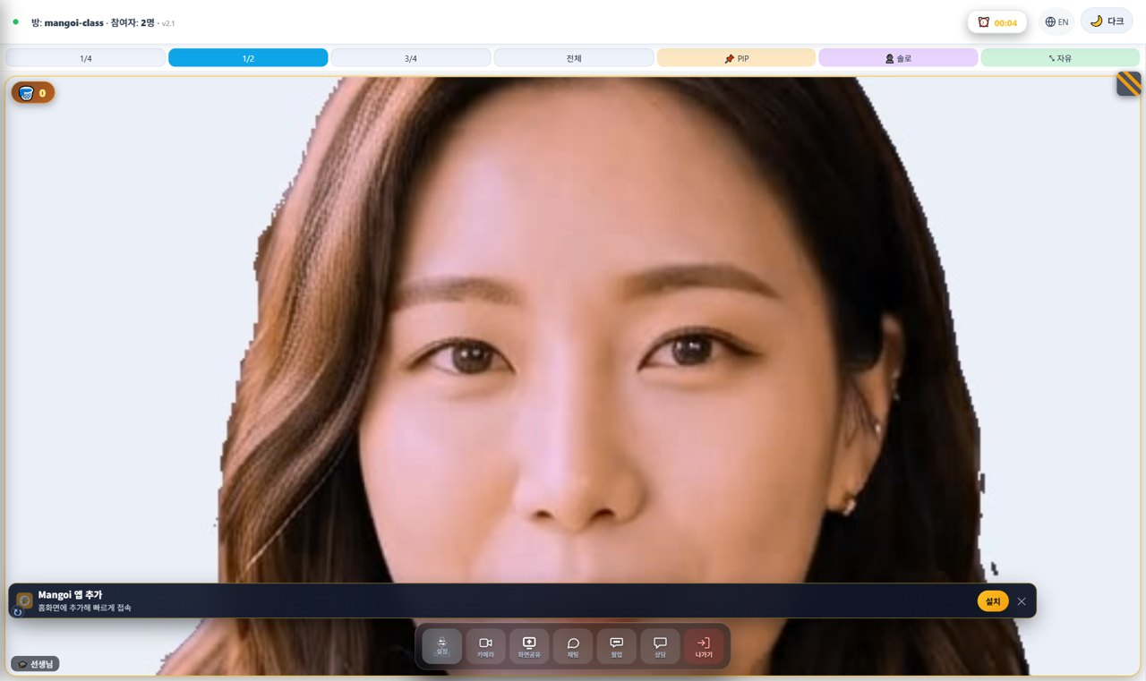
👩‍🏫 Mangoi Teacher User Guide
How to Use the Main Features
06
🗂️ Switching the 6 Top Tabs
Board · Video · Games · Background · AI Warm-up · Review Quiz
At the top of the center workspace there are six tab buttons. Click one to switch to that tool. The active tab is highlighted.
How to use
● 🖊 Board: a whiteboard for writing and drawing while explaining.
● 📹 Video: watch a YouTube link or a video file together.
● 🎮 Games: open learning games during class (may be limited during lesson time).
● 🎨 Background: change the backdrop behind your video and decorate your face.
● 🗣️ AI Warm-up: an English warm-up before the lesson.
● 🧠 Review Quiz: an AI-made quiz matched to this lesson's textbook and level.
✅ Key Points
● Your face video stays visible even after switching tabs.
● At the far right of the tabs there are also 📚 Materials Tools ▾ and ✍️ Writing Tools ▾.
💡 Tip · Lessons mostly use the 🖊 Board and 📚 Materials the most.

Slide 11
👩‍🏫 Mangoi Teacher User Guide
How to Use the Main Features
07
🖊️ Board Tools, One by One
Pen · eraser · shapes · text · save
Open the 🖊 Board tab and a row of drawing tools appears at the top. Let's go through each button from left to right.
How to use
● ✏️ Pen: draw freely. / 🧽 Eraser: erase what you drew.
● 📏 Line / ⬜ Rectangle / ⭕ Circle: draw straight lines and shapes.
● 📝 Text: type letters with the keyboard.
● 🎨 Color (color box): pick the pen color. / Thickness (slider): adjust line width.
● ✨ AI Shapes: even rough drawings snap into neat shapes automatically.
● ✍️ AI Text: recognizes handwriting and turns it into clean typed text.
● 🗑️ Clear All: wipe the whole board. / 💾 Save: save the board as an image.
✅ Key Points
● Change color and thickness to highlight key parts so they stick.
● AI Shapes / AI Text auto-tidy when turned on (experimental).
⚠️ Good to know · Pressing Save (💾) downloads the current board as an image you can use for review.
💡 Tip · Save (💾) the board before class ends to keep exactly what you learned today.

Slide 12
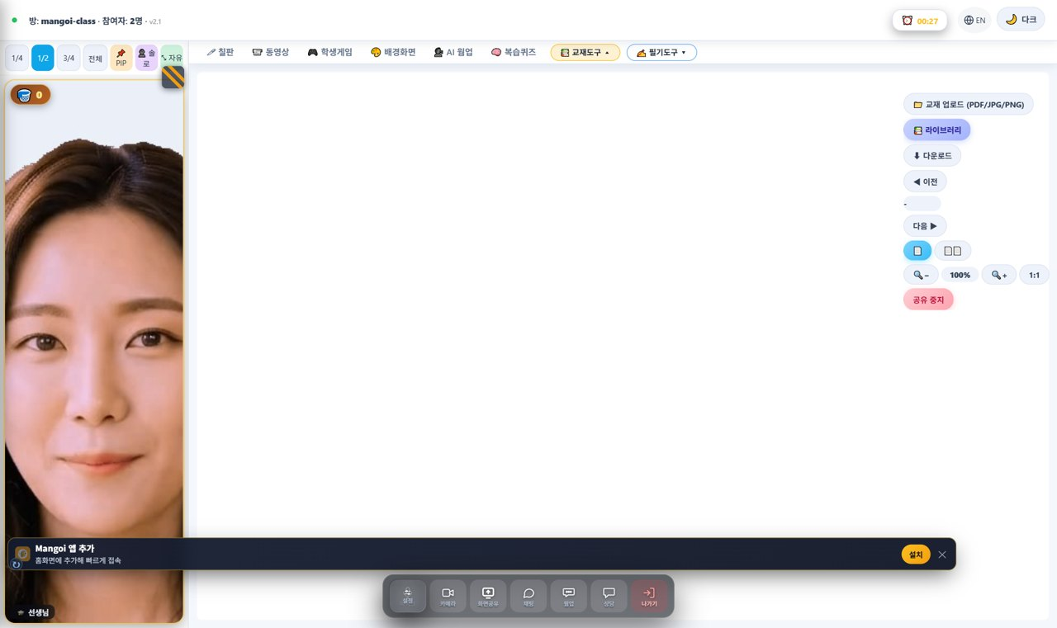
👩‍🏫 Mangoi Teacher User Guide
How to Use the Main Features
08
📚 Materials Tools (share PDF/photos)
Upload · library · turn pages
Click 📚 Materials Tools ▾ at the right of the tabs and a menu drops down. This is where you upload textbooks (PDF/photos) to view together.
How to use
● 📁 Upload (PDF/JPG/PNG): upload a textbook file from your device to share.
● 📚 Library: pick from textbooks the academy (admin) uploaded.
● ⬇ Download: download the file you're currently viewing.
● ◀ Prev / Next ▶: turn textbook pages.
● 🔲 Fit / 100% / 1:1: fit the page to the screen or view at real size.
● ⏹ Stop sharing: end textbook sharing.
✅ Key Points
● The moment you upload, the other person sees the exact same page.
● Not only PDFs — JPG and PNG photos work too.
💡 Tip · Upload the textbook before class for a smooth start.

Slide 13
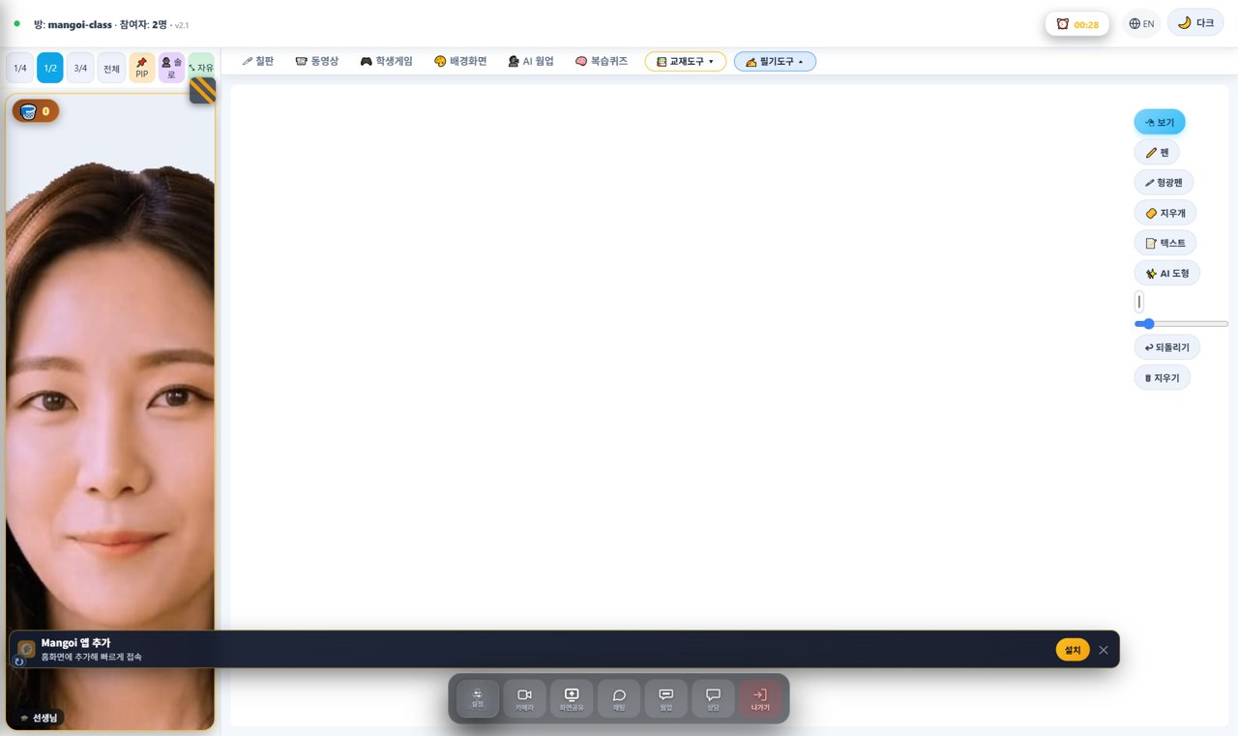
👩‍🏫 Mangoi Teacher User Guide
How to Use the Main Features
09
✍️ Writing Tools (annotate on top)
Pen · highlighter · text · undo
Click ✍️ Writing Tools ▾ at the right of the tabs and the writing menu drops down. Use it to write directly on top of a textbook or the screen.
How to use
● 🖊 Pen: write freely on the screen. / 🖍 Highlighter: brightly mark important spots.
● 🧽 Eraser: erase your writing. / 📝 Text: type letters.
● ✨ AI Shapes: tidy your drawn shapes.
● Thickness (slider): adjust the pen width.
● ↩ Undo: cancel your last mark. / 🗑 Clear: erase all writing.
✅ Key Points
● With a textbook open, your writing appears right on top of it.
● Highlight key words to make them stand out.
💡 Tip · Made a mistake? One tap on ↩ Undo cleans it up.

Slide 14
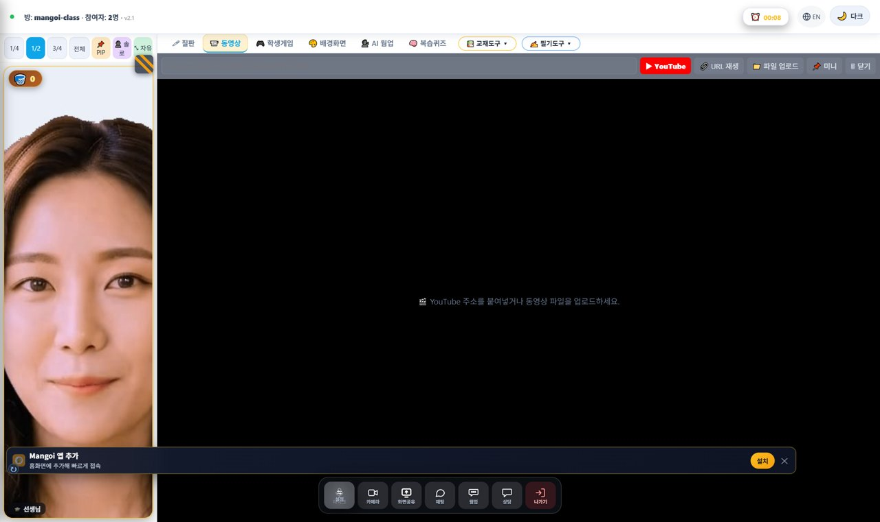
👩‍🏫 Mangoi Teacher User Guide
How to Use the Main Features
10
📹 Watch Video Together
Share YouTube · video files
In the 📹 Video tab you can paste a YouTube link or upload a video file to watch together — great for songs and video materials.
How to use
● Paste a YouTube link (URL) into the box, or upload a video file.
● Press ▶ Play URL / Play to start the video.
● Use New video to switch to a different one.
✅ Key Points
● The video plays on the other person's screen too.
● For sound-heavy material, earphones help you hear better.
💡 Tip · Prepare the video link in advance so you can play it instantly in class.

Slide 15
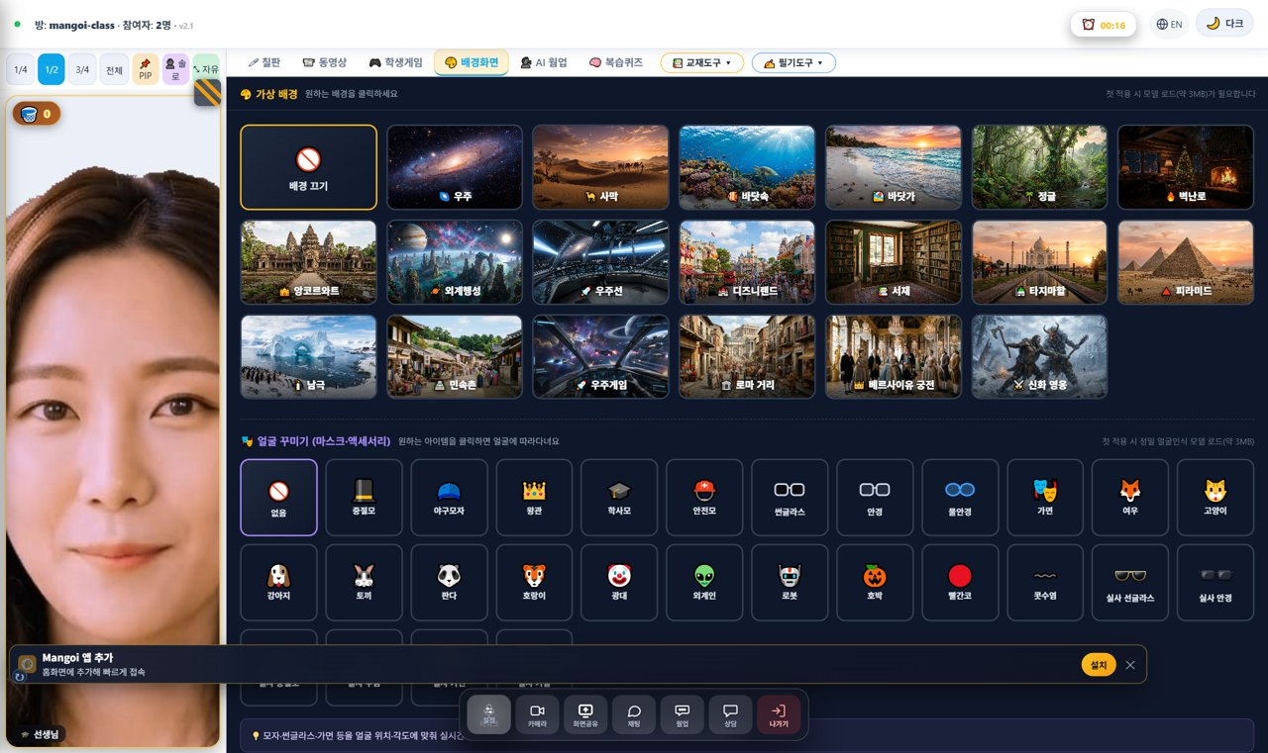
👩‍🏫 Mangoi Teacher User Guide
How to Use the Main Features
11
🎨 Background & Face Decorations
Change backdrop · masks · accessories
In the 🎨 Background tab you can change the backdrop behind your face and add fun decorations. Just click what you want in the grid.
How to use
● In the background grid, tap a backdrop (space, desert, forest, cherry blossom, beach, pyramids…).
● Tap Background off to return to your normal camera view.
● Below, in Face Decorations (masks/accessories), pick glasses, hats, animals and more.
● Don't like it? Tap again to turn it off.
✅ Key Points
● Changing the background keeps your face visible.
● Very flashy decorations can distract from the lesson.
💡 Tip · Use a clean background for class and fun decorations for break time.

Slide 16
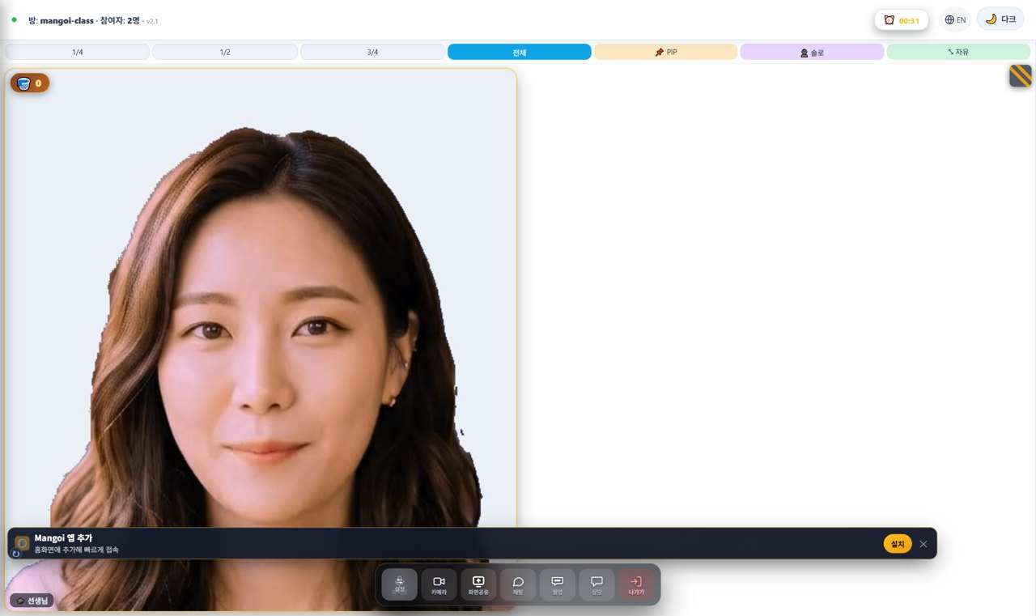
👩‍🏫 Mangoi Teacher User Guide
How to Use the Main Features
12
🔲 Resize & Arrange the Screen
1/4 · 1/2 · 3/4 · Full · PIP · Solo · Free
The size bar above the video lets you change the size and layout of your face-video window. The current size is shown in blue.
How to use
● 1/4 · 1/2 · 3/4 · Full: make the video window 1/4 up to full-screen.
● 📌 PIP: float the video as a small overlay on top of the board/materials.
● 👤 Solo: hide others and see only your own screen larger.
● ⤡ Free: drag the title bar to move it, drag the bottom-right corner to resize freely.
✅ Key Points
● Make the video small (1/4) when reading materials, large (Full) when presenting.
● 📌 PIP is great when you want to see the textbook and faces at once.
💡 Tip · On a small screen, shrink the video to 1/4 and view the textbook large.

Slide 17
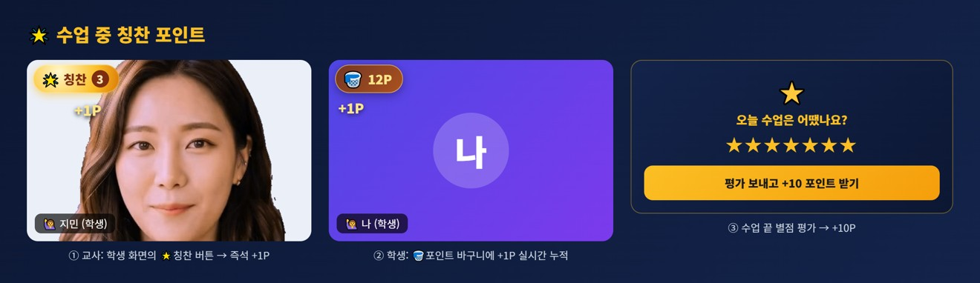
👩‍🏫 Mangoi Teacher User Guide
How to Use the Main Features
13
🌟 Praise Points During Class
Teacher gives → +1P in student's basket
When you do well, the teacher can give praise points on the spot. When the teacher taps the 🌟 'Praise' star button on your video, that student instantly gets +1P, and it piles up in real time in the 🧺 point basket on the student's screen.
How to use
● Teacher: tap the 🌟 'Praise' button at the top-left of a student's video → that student gets +1P. (the count builds up next to the star)
● With several students, you can also pick a student from the 'Give Praise' bar.
● Student: +1P flies into the 🧺 point basket at the top-left of your screen in real time.
● When class ends, the student leaves a star rating to get an extra +10P.
● Collected points are spent as rewards in the point shop, roulette, etc.
✅ Key Points
● The more praise you get, the faster points pile up.
● The praise star has an anti-spam cooldown, so it may briefly turn gray.
● The basket shows points earned this class; your total P (top bar) is the running sum.
⚠️ Good to know · Praise points are given by the teacher — students can't add them by themselves.
💡 Tip · Teachers: praise 🌟 the moment a student does well — instant rewards motivate best.

Slide 18
👩‍🏫 Mangoi Teacher User Guide
How to Use the Main Features
14
🎛️ Bottom Dock & Praise Basket
Camera · screen share · chat · leave · praise
The control dock at the bottom-center holds the buttons you use most during class. Let's also look at the small 🧺 praise basket at the top-left.
How to use
● ⚙️ Settings: pick camera/mic devices and check their status.
● 📷 Camera / 🎤 Mic: turn your face and sound on/off.
● 🖥️ Screen Share: show your computer screen to the other person.
● 💬 Chat: talk in text (great for words and links).
● 🗣️ Native: call the native-speaker helper / interpreter feature.
● 🚪 Leave: end the lesson and exit the room.
● 🧺 Praise Basket (top-left): the praise (stars/stickers) you receive during class collects here.
✅ Key Points
● Before leaving (🚪), make sure you saved the board / notes.
● No sound? Check the mic/speaker devices in ⚙️ Settings.
⚠️ Good to know · Screen share asks the browser which window to share — pick the screen and allow it.
💡 Tip · When your praise basket fills up, it means you're doing great!

Slide 19
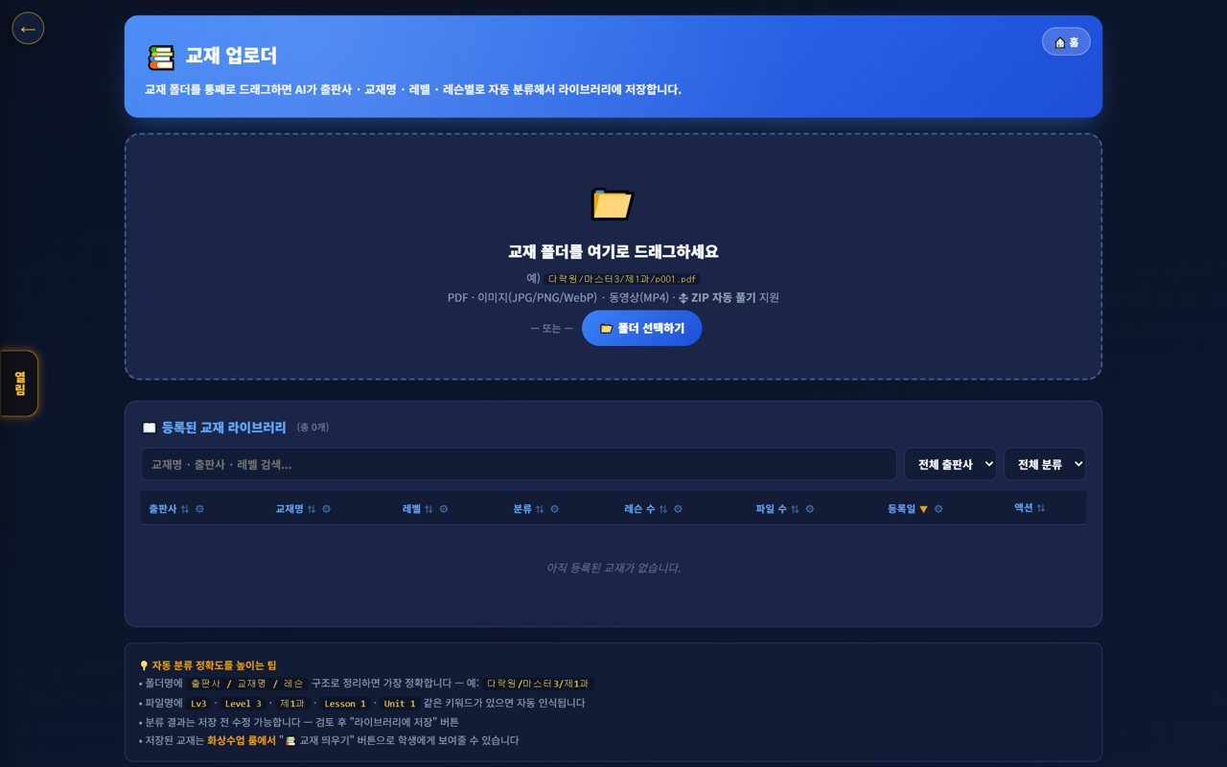
👩‍🏫 Mangoi Teacher User Guide
How to Use the Main Features
15
📤 Pre-upload Materials
Prepare lesson files in advance
Pre-upload lesson files to the materials uploader so you can share them instantly in class. Being prepared makes the lesson far smoother.
How to use
● Drag files into or select them in the materials uploader to upload.
● Review uploaded materials in the materials viewer.
● In class, bring them up instantly via materials-tab sharing.
✅ Key Points
● Uploading before class saves time.
● Both PDFs and images are supported.
💡 Tip · Naming files by lesson number makes them easy to find.

Slide 20
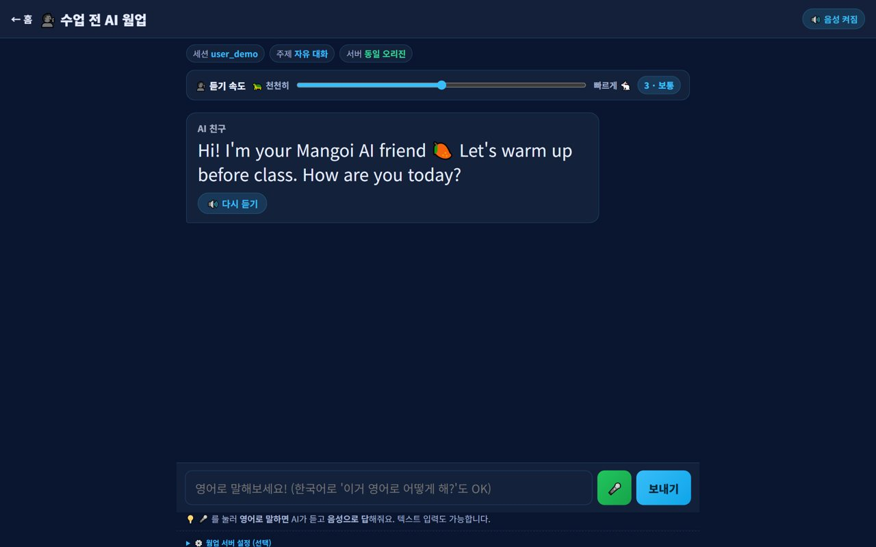
👩‍🏫 Mangoi Teacher User Guide
How to Use the Main Features
16
🔥 Start with the AI Warm-up
A 3-minute icebreaker
Use the student's pre-class AI warm-up to open the conversation naturally. The warm-up is tied to today's textbook, so it leads straight into the main lesson.
How to use
● Open the conversation using the student's AI warm-up content.
● Carry the warm-up questions into the main lesson topic.
● For students who skipped it, ease in with 1–2 light questions.
✅ Key Points
● Mentioning the warm-up raises student engagement.
● A smooth intro improves the lesson rhythm.
💡 Tip · 'You said … in the warm-up, right?' instantly breaks the ice.

Slide 21
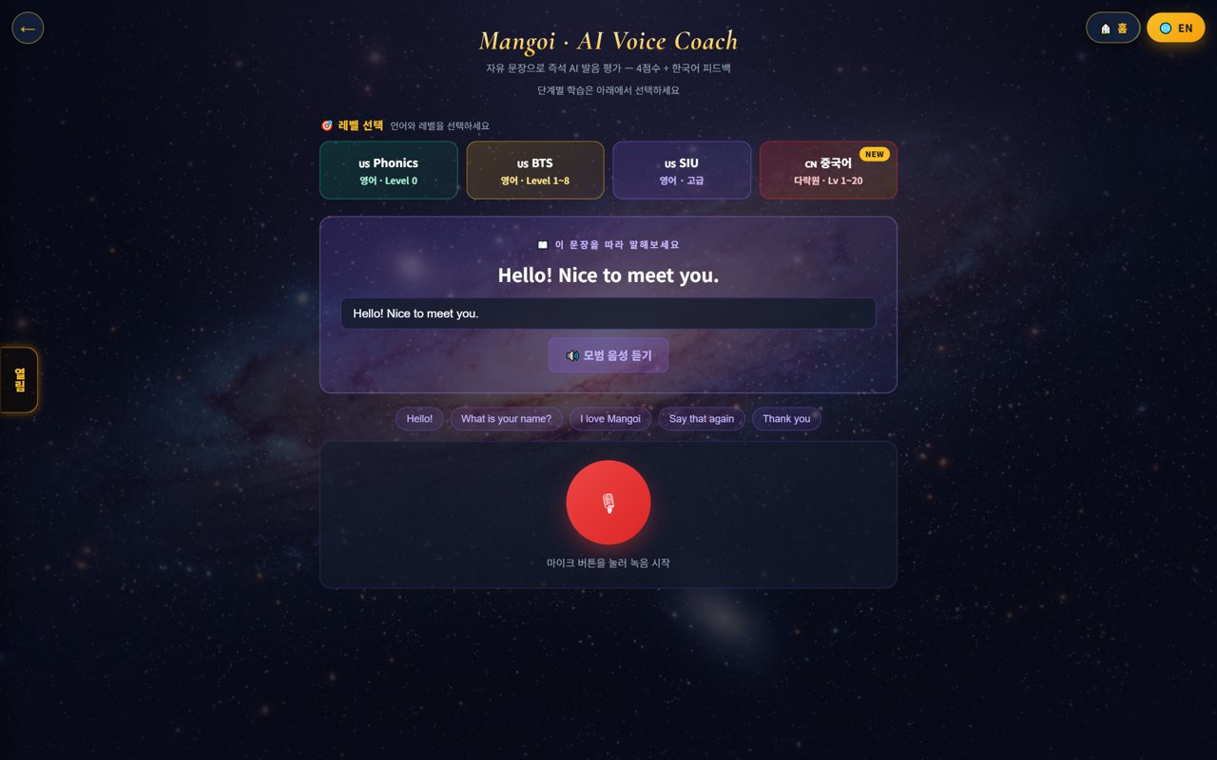
👩‍🏫 Mangoi Teacher User Guide
How to Use the Main Features
17
🎙️ Use the Pronunciation Coach
Correct with the AI voice coach
Practice AI voice-coach sentences with students who struggle with pronunciation. Guide them to self-correct through record → score → replay.
How to use
● Pick voice-coach sentences at the student's level together.
● Have them self-correct via record → score → replay.
● Link the lesson sentences to voice-coach homework.
✅ Key Points
● The 'lesson sentence → voice-coach repeat' routine is effective.
● Scores give a sense of achievement to keep going.
💡 Tip · For tough sounds (r, th), repeat with short words first.

Slide 22
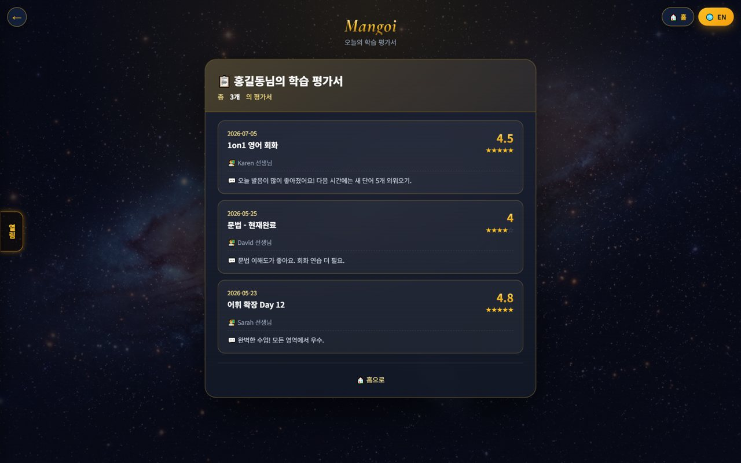
👩‍🏫 Mangoi Teacher User Guide
How to Use the Main Features
18
📝 Write the Lesson Review
Record post-class feedback
After class, record today's lesson in the review. Leave per-item stars and comments on strengths and areas to improve; it's reflected in the parent my-page and reports.
How to use
● Record today's lesson on the review screen.
● Leave per-item stars and comments.
● Once saved, it's reflected in the report/parent page.
✅ Key Points
● One praise + one improvement, short and specific.
● Writing right after class is most accurate.
💡 Tip · Adding a concrete example ('today's r sound was great') builds trust.

Slide 23
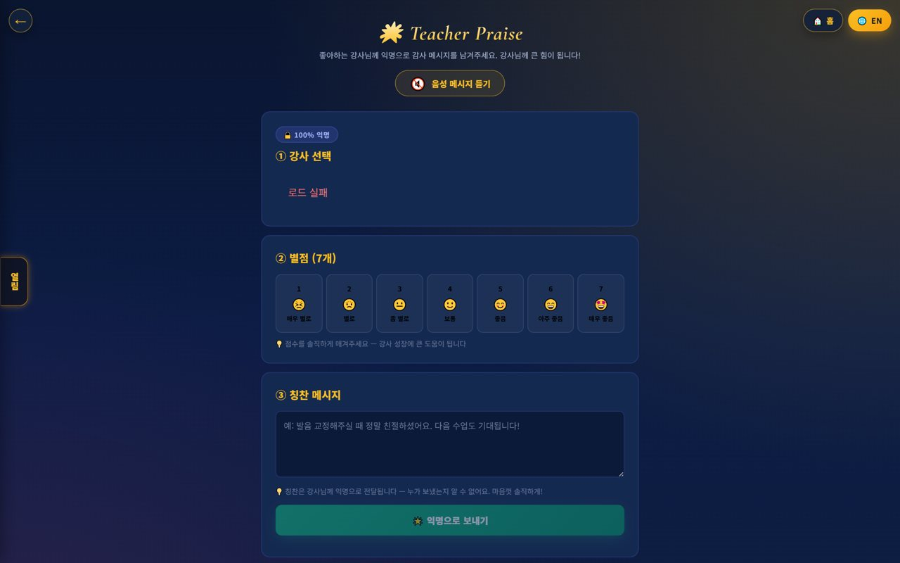
👩‍🏫 Mangoi Teacher User Guide
How to Use the Main Features
19
🌟 Leave Student Praise
Stars · stickers · comments
On the Teacher Praise screen, pick the student and items and leave stars, stickers and comments. It shows to the student and parents and motivates them.
How to use
● Pick the student and items in Teacher Praise.
● Leave stars (7 items) and stickers/comments.
● Once saved, it shows to the student and parents.
✅ Key Points
● Leaving it right after class is most effective.
● Specific praise beats vague praise.
💡 Tip · Praising even small wins improves participation next lesson.

Slide 24
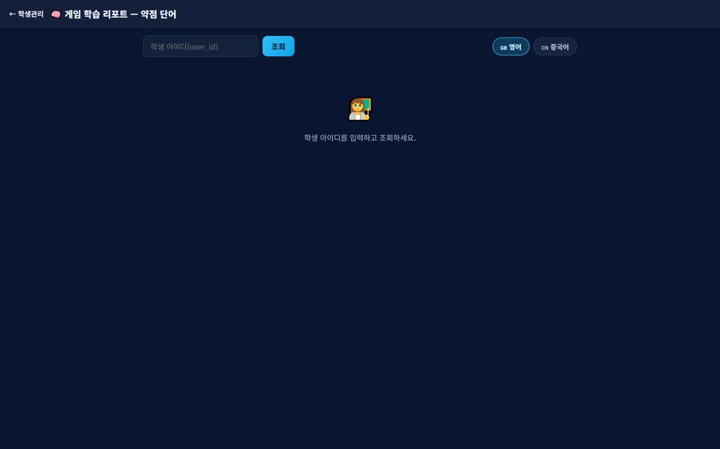
👩‍🏫 Mangoi Teacher User Guide
How to Use the Main Features
20
🧠 Game Learning Report
Check a student's weak words
Look up by student ID to see the words most often missed in games. Adding those words to the next lesson's intro for review is effective.
How to use
● Enter the student ID in the game learning report and look up.
● Check the weak words (often missed).
● Review them intensively in the next lesson.
✅ Key Points
● Pinpoints weaknesses with data.
● Even 3 words gives a clear review effect.
💡 Tip · Put weak words on the chat/board and repeat them.

Slide 25
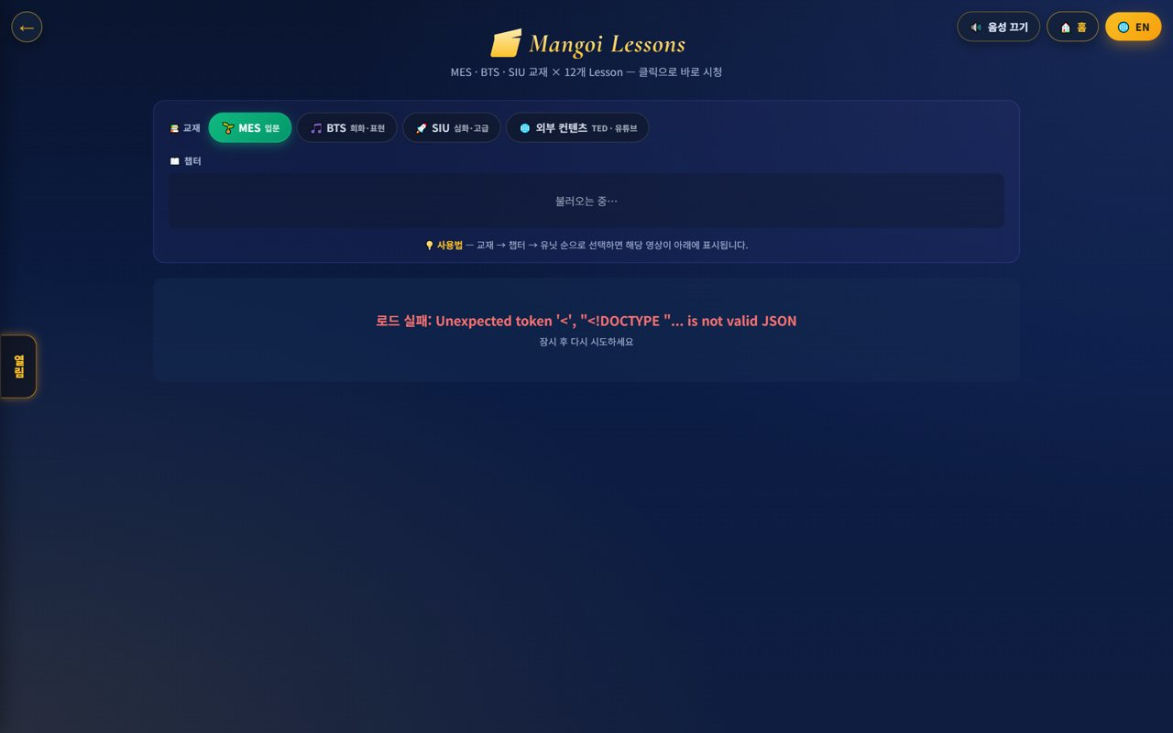
👩‍🏫 Mangoi Teacher User Guide
How to Use the Main Features
21
📄 Reports · Lesson Management
Check progress & performance
Check a student's learning progress and performance in reports, and organize past/upcoming lessons and progress in lesson management. Use it to set the next lesson's goal.
How to use
● Check learning progress/performance in reports.
● Organize past/upcoming lessons in lesson management.
● Set the next lesson goal in one line.
✅ Key Points
● Progress continuity improves.
● Writing goals makes lesson direction clear.
💡 Tip · Noting the next goal at the end of each lesson makes handover easy too.

Slide 26
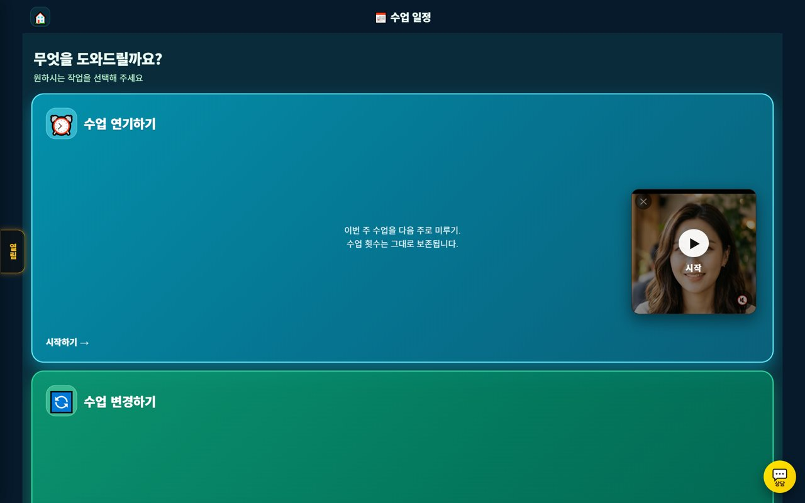
👩‍🏫 Mangoi Teacher User Guide
How to Use the Main Features
22
🔄 Handle Lesson Postpones
Respond to student requests
Review students' postpone/change requests and adjust the schedule per policy. Changes are auto-announced to both sides.
How to use
● Check students' postpone/change requests.
● If within policy, adjust the schedule.
● Confirm the change is auto-announced.
✅ Key Points
● Guide out-of-policy last-minute requests per policy.
● Postponing preserves the student's lesson count.
💡 Tip · Tell students the postpone cutoff in advance.

Slide 27
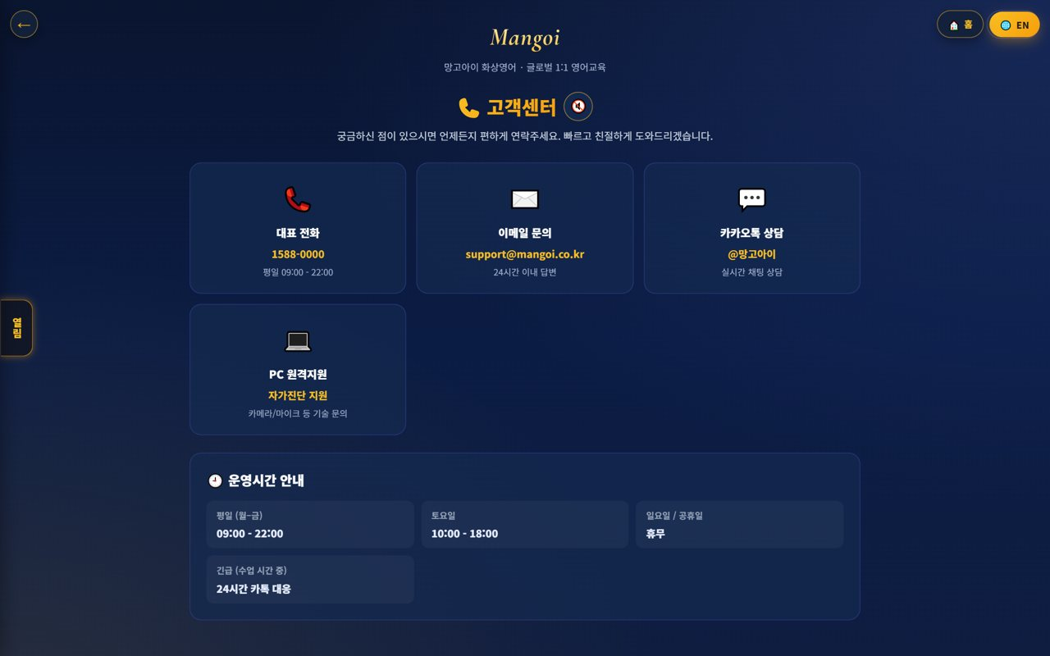
👩‍🏫 Mangoi Teacher User Guide
How to Use the Main Features
23
🎧 Support · Inquiries
When something goes wrong
If there's a technical issue or a question during class, contact support channels. Knowing common issues in advance lets you respond quickly.
How to use
● Use phone, email, Kakao and remote support in Support.
● For urgent issues, get direct help via remote support.
● Note the fix for repeat issues.
✅ Key Points
● 'No sound/video' — check permissions and browser first.
● Inquiries within business hours are faster.
💡 Tip · Keeping notes of common issues and fixes reduces lesson loss.

Slide 28
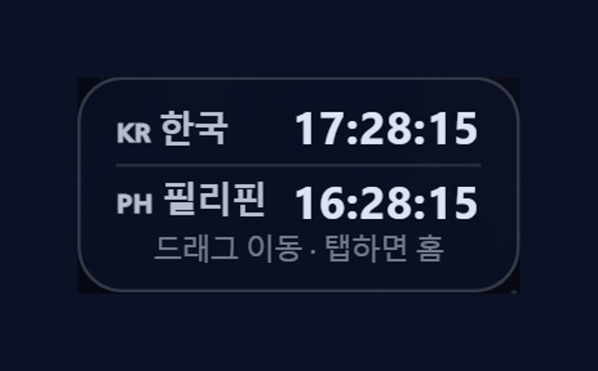
👩‍🏫 Mangoi Teacher User Guide
How to Use the Main Features
24
🕐 Korea·Philippines Dual Clock
Two countries' time on screen
A clock on screen shows 🇰🇷 Korea time and 🇵🇭 Philippines (local) time together. Students use Korea time, you use Philippines time — seeing both lets you match lesson times exactly.
How to use
● On the on-screen dual clock, see 🇰🇷 Korea and 🇵🇭 Philippines time at once.
● Drag the clock to move it anywhere you like.
● Tap (click) the clock to go to the home screen.
✅ Key Points
● The Philippines is 1 hour behind Korea (−1 hour).
● You can check booking/entry times in both countries' time.
💡 Tip · When a lesson time is confusing due to the time difference, this clock clears it up instantly.

Slide 29
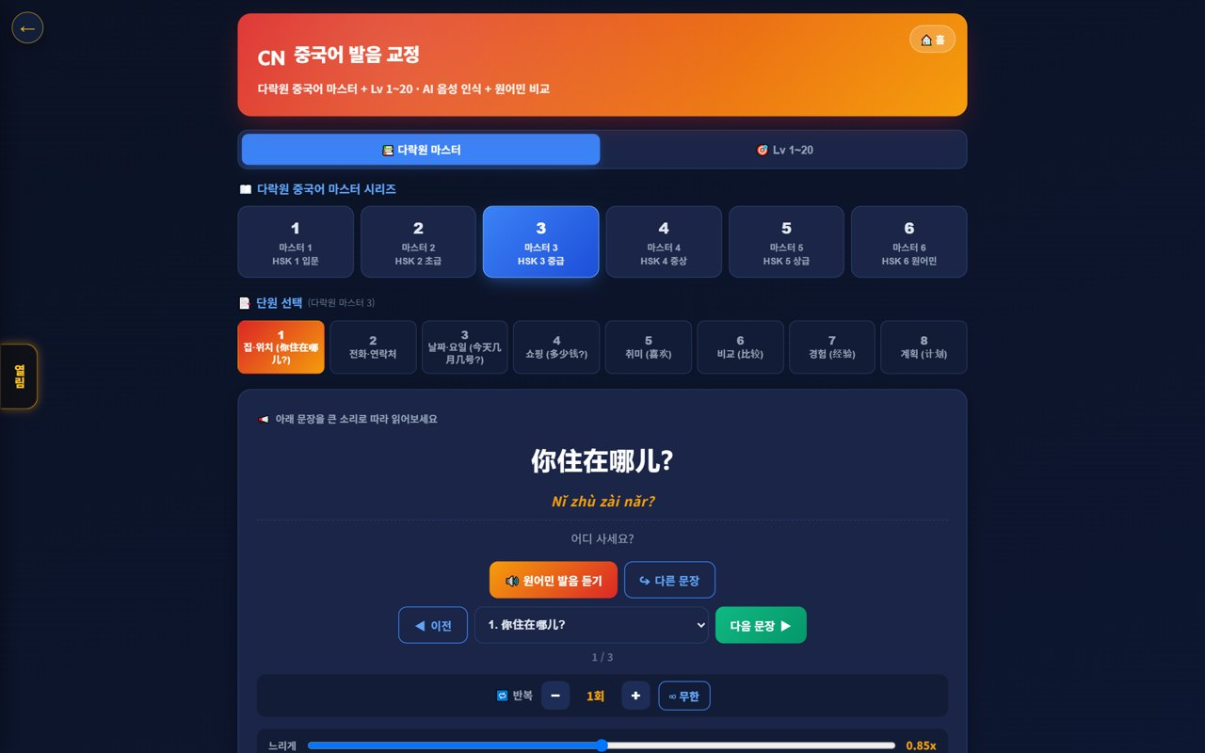
👩‍🏫 Mangoi Teacher User Guide
How to Use the Main Features
25
🇨🇳 Chinese Pronunciation Coach
Darakwon Chinese Master Lv1–20
If a student also learns Chinese, guide them to the Chinese pronunciation coach. They read Darakwon Chinese Master (Lv 1–20) sentences and compare with a native speaker to fix pronunciation and tones.
How to use
● In the AI voice coach, pick the CN Chinese level (or go to the Chinese pronunciation coach).
● Choose a Master series (1–6, HSK 1–6) and a unit.
● Read the sentence (characters + pinyin) and compare with 'Play native audio'.
● Practice hard sounds/tones with repeat and slow (0.85x).
✅ Key Points
● Characters and pinyin appear together, so it's easy to read.
● The AI recognizes your voice and compares it to a native speaker.
● The learning games hub supports Chinese too.
💡 Tip · Listen slowly and repeat clearly to nail the four tones.

Slide 30
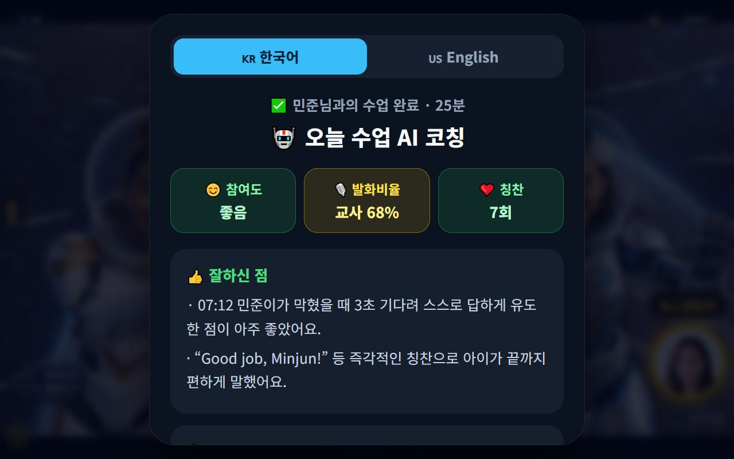
👩‍🏫 Mangoi Teacher User Guide
How to Use the Main Features
26
🤖 AI Coaching After Class
Strengths · areas to improve · one action for today
When you finish and leave a class, the AI analyzes it and shows a coaching card with ‘What you did well / Areas to improve / One action for today’ in both Korean and English. Based on real class signals — talk ratio, engagement, praise count — it helps in a warm coaching tone, not surveillance.
How to use
● End the video class with ‘Leave’ and the coaching card appears automatically.
● Toggle 🇰🇷 Korean / 🇺🇸 English to read it in the language you prefer.
● Check the engagement · talk-ratio · praise-count summary and the strengths · improvements · one action.
● Press ‘Full report’ to see class details plus recent coaching history (quality score · summary).
✅ Key Points
● English is the default for native-speaker teachers, with Korean provided alongside.
● A class-quality score (0–100) and a detailed summary help you find your own growth points.
● Even if the AI is briefly slow, baseline coaching in both languages is always provided.
⚠️ Good to know · Coaching is meant to support your own growth. Admins only receive a monthly rollup.
💡 Tip · Trying just the ‘one action for today’ in your next class visibly improves how you draw out student speech.

Slide 31
👩‍🏫 Mangoi Teacher User Guide
How to Use the Main Features
27
🔄 Tab Sync (Your Screen Leads)
Switch a tab and students follow instantly
When you switch top tabs — Board → Video → Review Quiz — the students' screens follow to the same tab automatically. No more saying “tap the ○○ tab”; you carry the lesson flow yourself.
How to use
● Switch the top tabs as usual (Board · Video · Games · Background · AI Warm-up · Review Quiz).
● Watch the student's screen switch to the same tab automatically.
● Textbook and file sharing carry over to students the same way.
✅ Key Points
● Even young learners follow along without hunting for buttons.
● The lesson rhythm never breaks, so pacing gets faster.
⚠️ Good to know · Sync works while you're in the room together. If a screen doesn't follow, ask the student to re-enter.
💡 Tip · A quick heads-up before jumping to a video or quiz keeps students from being startled.

Slide 32
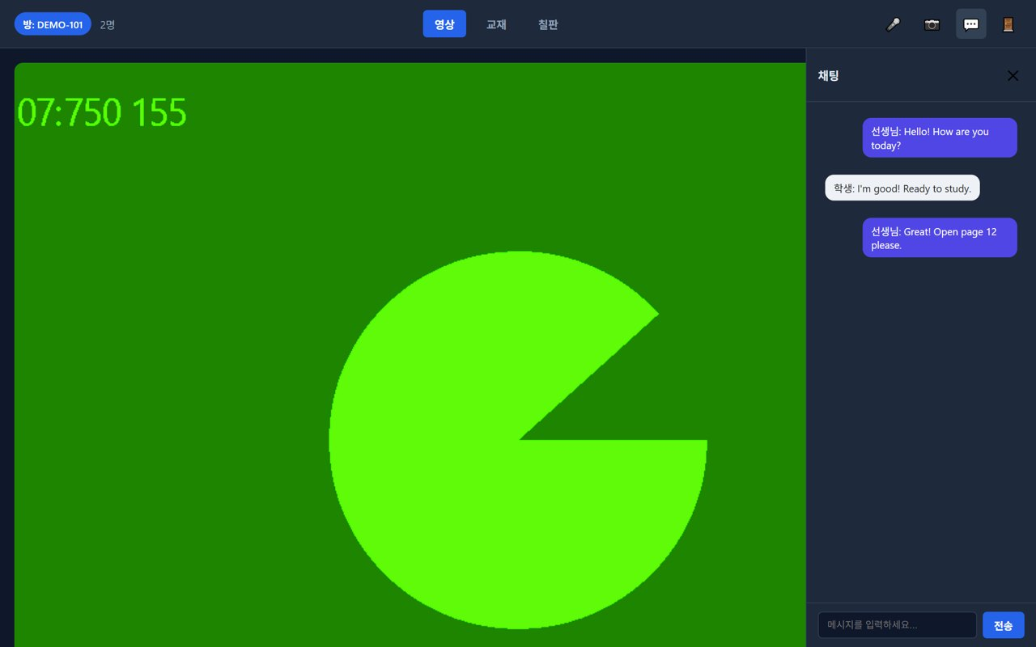
👩‍🏫 Mangoi Teacher User Guide
How to Use the Main Features
28
💬 1:1 Private Chat & File Sharing
Whisper messages only your student sees + share any file
Class chat now supports 1:1 private messages (DM). Send a message only a specific student can see, and share any file — PDF, image, document — through chat; it appears on the other side as a download card.
How to use
● Open 💬 Chat from the bottom dock.
● Switch the recipient from Everyone to a student's name to whisper 1:1.
● Use the 📎 file button to upload a PDF, photo, or document — a download card appears for them.
● Received files are saved with the card's ⬇ Save button.
✅ Key Points
● Private chats are visible only to the two of you.
● Homework files and notes get exchanged in one step during class.
⚠️ Good to know · Private chats are not stored on the server and disappear after class. Keep important things as files.
💡 Tip · Perfect for quietly asking a question without interrupting anyone else.

Slide 33
👩‍🏫 Mangoi Teacher User Guide
How to Use the Main Features
29
🗓️ Requesting a Postpone / Change
Something came up? Submit right on the site
When something urgent comes up, you can now request a class postponement or time change right on the site. Your request reaches the admin in real time, and once approved it's applied to the schedule automatically.
How to use
● Pick the class in My Page → class schedule.
● Press Request postpone/change and write the reason and preferred time.
● After admin approval it's applied to the schedule automatically — you can track the status too.
✅ Key Points
● It's an official, recorded request — no phone calls or messengers needed.
● The original schedule holds until approval, so request early (ideally a day ahead).
⚠️ Good to know · Last-minute changes need time to notify students and parents. If it's urgent, also alert support.
💡 Tip · Offering 2–3 preferred times gets you approved much faster.

Slide 34
👩‍🏫 Mangoi Teacher User Guide
How to Use the Main Features
30
🧾 Checking My Lesson-Fee Settlement
See this month's classes and pay yourself
In My Page's 🧾 Settlement tab, you can check this month's class count and lesson-fee settlement yourself. Settlement data is protected so only you can see yours, and past months are available too.
How to use
● Open the 🧾 Settlement tab in My Page.
● Check this month's class count and settlement amount.
● Switch the month to review previous months as well.
✅ Key Points
● Settlement details are visible only to you — safe and private.
● Class records connect to settlement automatically, so nothing gets missed.
⚠️ Good to know · If a figure looks wrong, don't fix it yourself — contact the admin (HQ).
💡 Tip · Make it a habit to skim last month's statement at the start of each month.

Slide 35
👩‍🏫 Mangoi Teacher User Guide
How to Use the Main Features
31
🔒 Three class controls (focus · background lock · exit guard)
Fewer distractions and accidental exits
Three controls the teacher can switch on and off. Focus mode stops the student drifting to other screens during the lesson, background lock stops them changing backgrounds and face decorations over and over, and exit guard catches an accidental back-button press before they leave the lesson.
How to use
● Open ⚙️ Settings in the bottom dock of the lesson screen.
● Turn on Focus mode to pin the student's screen to the lesson.
● Turn on Background lock so backgrounds and face decorations can't be changed.
● Leave Exit guard on and the student is asked to confirm before leaving.
● All three release automatically when the lesson ends.
✅ Key Points
● A brief disconnection does not end the lesson — the student picks up where they left off.
● No-shows are counted automatically and appear on the admin screen.
● Especially effective with younger classes.
⚠️ Good to know · These are tools for helping focus, not for punishing. Explain them to the student at the start of the lesson.
💡 Tip · Rather than switching them on only for restless students, leave them on from lesson one — it feels more natural.

Slide 36
👩‍🏫 Mangoi Teacher User Guide
How to Use the Main Features
32
✍️ Textbook PDF — annotations that stay · faster page jumps
Turn the page and come back; your marks are still there
Annotations you draw on a textbook PDF now survive turning the page and coming back. Navigation is faster with ◀ ▶ buttons and direct page-number entry, and a new light mode keeps page turns smooth on older devices and slow connections.
How to use
● Open the Textbook tab and load the PDF.
● Underline and circle with the writing tools.
● Move with ◀ ▶, or type a page number to jump.
● Go back a page and your earlier marks are still there.
● If the screen feels slow, turn on light mode.
✅ Key Points
● Annotations are stored per page, so they never mix up.
● Light mode trades a little sharpness for much smoother page turns.
● The student sees the same page with the same annotations.
💡 Tip · Note down the page numbers you use most before class and jumping becomes instant.

Slide 37
👩‍🏫 Mangoi Teacher User Guide
How to Use the Main Features
33
🔉 It rides out a slow connection by itself
Video may fold away, but the voice keeps going
When the line degrades, the system lowers video quality by itself, and if that isn't enough it switches automatically to a voice-first (audio-only) mode so the lesson doesn't break. When the connection recovers, video comes back. Built with unstable connections — like on-site in the Philippines — in mind.
How to use
● There is nothing to press — it happens automatically.
● If the picture blurs or freezes, carry on by voice.
● Video returns on its own once the line improves.
● If it stays unstable, ask the student to move closer to their Wi-Fi.
✅ Key Points
● Voice is protected to the very last — the lesson can continue by speech alone.
● A brief drop never auto-ends the lesson.
● If the far side freezes to black, it attempts self-recovery.
⚠️ Good to know · If nothing returns after 90 seconds, a notice card appears. That's the moment to contact the student.
💡 Tip · For students who drop often, have them run the device check screen once before class.

Slide 38
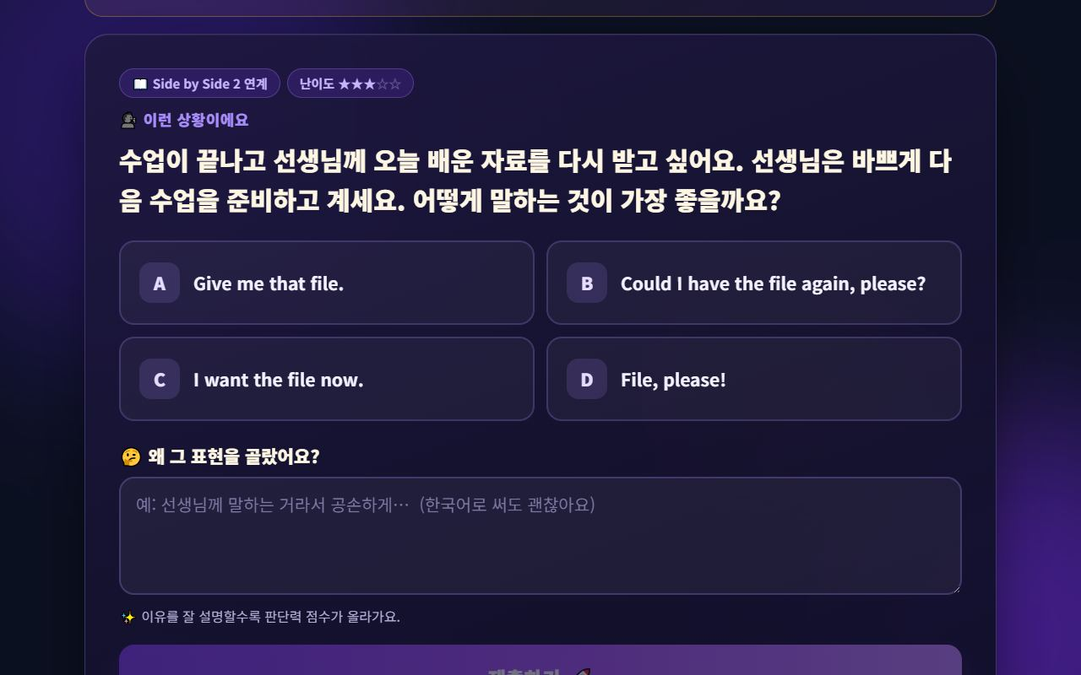
👩‍🏫 Mangoi Teacher User Guide
How to Use the Main Features
34
🧠 Using Judgment Training in class
Turn the student's reasoning into lesson material
Judgment Training works well as an in-class activity. Because the student's choice and their stated reason are both recorded, you can respond to *how they thought* rather than just right/wrong. Judgments made during class feed into the student's growth metrics.
How to use
● Ask the student to open 🧠 Judgment Training and solve one question together.
● Have them read out their choice and the reason they wrote.
● Explain why the other options fit less well — by listener, tone, and situation.
● After class, check the judgment index trend in the student report.
✅ Key Points
● Partial credit means a near-miss still earns points — students don't feel punished.
● Recent answers are weighted more heavily, so a student who improves lately climbs quickly.
● Students who recover after a wrong answer are identified separately.
💡 Tip · Ask “Why did you think so?” in English and let them answer in their own language. The reasoning comes first.

Slide 39
👩‍🏫 Mangoi Teacher User Guide
How to Use the Main Features
35
🎥 Replay a recorded lesson
Play back a recording where you found it
A lesson recorded with REC can now be played back directly from the management screen. No download needed — one click plays it, and the old bug that threw you back to the login screen is fixed.
How to use
● Press REC at the top during the lesson to record.
● After class, find the lesson under Lesson log / Recordings.
● Press ▶ Play to review it right there.
● If a parent needs a copy, ask an administrator.
✅ Key Points
● Playback no longer bounces you to the login screen.
● Recordings are kept on the server and cleaned up per the storage policy.
● They contain student faces — external sharing is prohibited.
⚠️ Good to know · Record only with student and parent consent.
💡 Tip · Watching five minutes of your own lesson afterwards visibly improves your pace and question ratio.

Slide 40
👩‍🏫 Mangoi Teacher User Guide
How to Use the Main Features
36
🔑 Your account (password · interface language)
When you forget your password · English screen
If you forget your password, ask an administrator and it's reset straight away. Teacher accounts also now always open in English, so no one gets lost looking for a menu on a Korean screen.
How to use
● Forgot your password? Ask the admin (operations team) for a reset.
● Once you receive a temporary password, log in and change it immediately.
● Switch the interface language with the 🌐 EN / KR button at the top.
● If you use the app, registering a face / fingerprint passkey is the easiest option.
✅ Key Points
● Teacher accounts default to the English interface.
● A language you pick yourself is saved to your account only.
● Always replace the temporary password.
💡 Tip · If you forget passwords often, register an app passkey — a glance gets you in.

Slide 41
👩‍🏫 Mangoi Teacher User Guide
Feature Summary · Data
37
📋 Tools by Lesson Stage
Stage | Screen used | What you do | Tip
Before class | Detailed check | Check devices·lighting | 5–10 min early
Entry | Classroom | Enter name·allow | Enter early
Toolbar | Board·materials·video | Switch·control screen | Guide tabs
Prep | Materials uploader | Upload·share files | Pre-upload
Intro | AI warm-up | Icebreaker | Mention warm-up
Main | Materials·board·chat | Explain together | Same page
Practice | AI voice coach | Record·fix pronunciation | Link homework
Wrap-up | Review·praise | Feedback·stars | 1 praise + 1 fix
After | Game report·reports | Check weak points·progress | Next goal

Slide 42
👩‍🏫 Mangoi Teacher User Guide
Data at a Glance
38
📊 Data at a Glance
Pre-check Items (example scores)
Elements of a Good Lesson

Slide 43
👩‍🏫 Mangoi Teacher User Guide
Frequently Asked Questions (FAQ)
39
❓ Frequently Asked Questions (FAQ)
Q. How do I enter a lesson?
A. On the classroom entry screen, enter your name, press 'Enter', then allow camera and mic.
Q. How do I share materials?
A. In the materials tab, upload PDF/JPEG/PNG to share with all participants. Use prev/next and fit-to-screen to view larger.
Q. How do I use the board?
A. In the board tab, write with pen/shapes/color/thickness, and save the board as an image if needed.
Q. A student can't enter.
A. Often a browser permission issue. Advise reconnecting in Chrome/Edge and allowing camera/mic.
Q. When do I write the review?
A. Writing right after class is most accurate. Leave stars and a short comment and it's reflected in the report.
Q. How do I know a student's weak points?
A. Look up by student ID in the game learning report to see often-missed weak words.

Slide 44
👩‍🏫 Mangoi Teacher User Guide
Checklist
40
✅ Lesson Checklist
Did you run the detailed check 5–10 min before class?
Did you pre-upload the materials?
Did you check camera framing and sound?
Did you check the student's AI warm-up?
Did you prepare the materials/board/chat tools?
Did you write the lesson review after class?
Did you leave praise (stars/comment)?
Did you check weak words in the game report?

Slide 45
👩‍🏫 Mangoi Teacher User Guide
Conclusion
41
🏁 Conclusion · A Practical Guide to Great Lessons
You've now learned how to use the Mangoi site 'along the real lesson flow.' Finally, here's one page summarizing how a single lesson unfolds and the principles to keep every time. Keep just this page nearby and your lessons will run far more smoothly and reliably.
🔄 The Flow at a Glance
⭐ Key Principles
Before class (5–10 min)
My Page → 🎥 Pre-check camera, mic, network, lighting; pre-upload the textbook
● Preparation is half the battle — pre-check and pre-upload keep the lesson from stalling.
● Make them speak a lot — students should speak more than the teacher to improve.
● Praise instantly — the moment they do well, 🌟praise! Instant rewards are the strongest motivator.
● Keep records — the review and 'next goal in one line' power the next lesson and handovers.
● Reinforce with data — put the game report's weak words into the next lesson's intro.
Enter
🎥 Enter Class → confirm name → allow camera/mic → check background/sound while waiting
Intro (2–3 min)
Open lightly by mentioning the student's AI warm-up; state today's goal in one line
Main lesson
Share the same page via materials tools · write on the board · key words in chat; draw out plenty of student speech
Praise
The moment they do well, tap the 🌟 Praise button (+1P) → piles up live in the 🧺 basket
📌 Remember
Practice
Link weak-pronunciation sentences to AI voice-coach homework for repetition
● No sound/video → check Chrome/Edge + camera·mic permission first (KakaoTalk in-app → external browser)
● Praise points are given by the teacher; the student's star rating earns +10P
● Handle postpone requests after checking policy; guide out-of-policy last-minute requests per policy
● Run every lesson in the rhythm of 'Check → Engage → Praise → Record'!
Wrap-up (3 min)
Summarize today → prompt the review quiz & rating (+10P) → leave the next goal in one line
After class
Write the review (1 praise + 1 improvement) · leave praise · check weak words in the game report
🍊 A teacher's warm words and instant praise build a child's confidence in English. Keep this guide beside you and lead every lesson with it. Praise even the small wins and students will look forward to the next class. Questions? Contact support anytime — cheering you on for lessons that grow together! 🍊

Slide 46
Let's grow together with Mangoi!
Questions? Ask the on-site A.i assistant or contact customer support.
🌐 www.mangoi.co.kr 📞 1644-0561 ✉ support@mangoi.co.kr

