Slide 1
Admin User Guide
For HQ / office staff · Admin page mangoi.ai/admin
As of 2026-10-09 · current screens

Slide 2
Contents
1. Getting in · Finding your way
2. Student list · Adding a student
3. Today’s classes
4. Adding classes (booking · enrollment)
5. Postponing · Changing classes
6. Cancelling classes
7. Timetable (weekly · daily)
8. Payroll
9. Approvals · Daily handover

Slide 3
Before you start
• The address is https://mangoi.ai/admin. (The old mangoi.co.kr site is a different server and does not have these features.)
• All class times are Korea time (KST). The Philippines is 1 hour earlier — KST 19:30 = PH 18:30.
• What you can do depends on your account. Cancelling classes, splitting weekly classes, registering students and payroll need an HQ account. Teacher, branch and agency accounts are refused by the server.
• The students, teachers (Emma Kim, Teacher Anna …) and numbers in the screenshots are sample data. Your screen shows real ones.
• Red box = the place to press.

Slide 4
1. Getting in · Finding your way
Log in, and find any screen with the left menu or search.

Slide 5
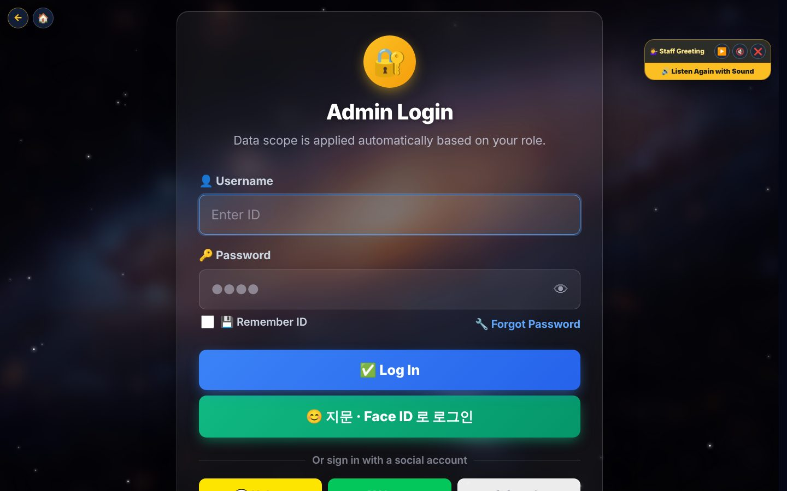
1. Getting in · Finding your way — Log in
• Open mangoi.ai/admin.
• Enter your ID and password and press Log in. If you registered a fingerprint / Face ID, use the green button.
• Links opened inside KakaoTalk may lose the login — open them in Chrome.

Slide 6
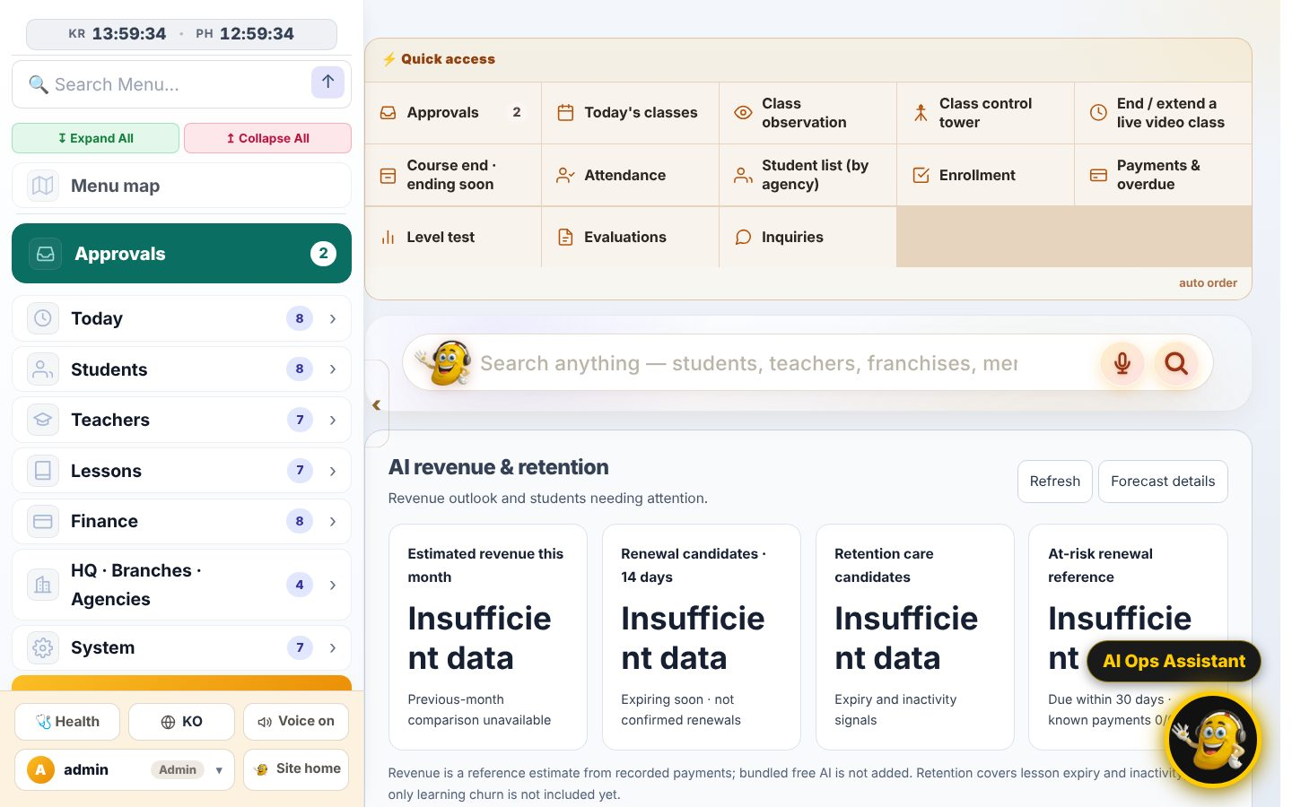
1. Getting in · Finding your way — Home screen
• The Frequently used tiles at the top jump to Today’s classes, Approvals, Enrollment and more.
• The search box in the middle finds students, teachers, academies and menus.
• You can also ask the AI assistant (bottom right) in words, e.g. “show today’s classes”.

Slide 7
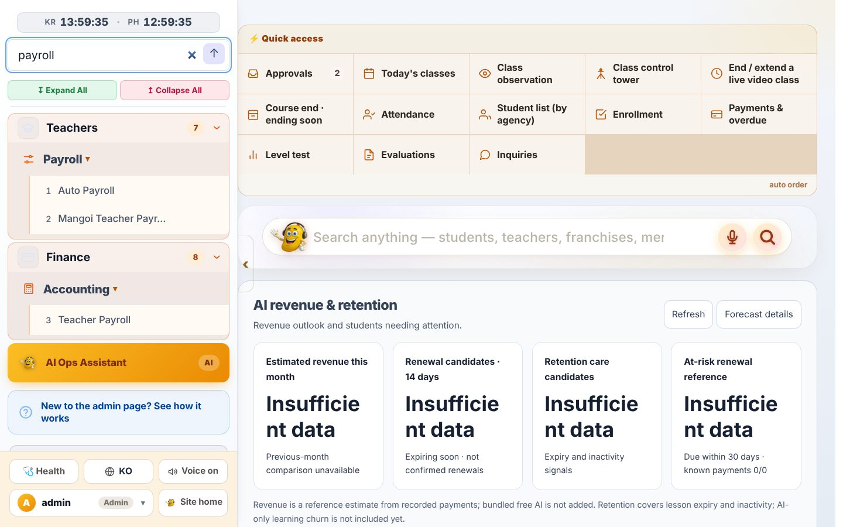
1. Getting in · Finding your way — Left menu (7 groups) and menu search
• Groups: Today · Students · Teachers · Lessons · Finance · HQ/Branches/Agencies · System. Approvals is pinned on top.
• Type in 🔍 Menu search (top left), e.g. “payroll”, to filter the menu.
• Items with ▸ open sub-items.
• At the bottom: EN/KO language, and admin ▾ for password change and logout.

Slide 8
2. Student list · Adding a student
Find students, create a new student account, and open the student detail page.

Slide 9
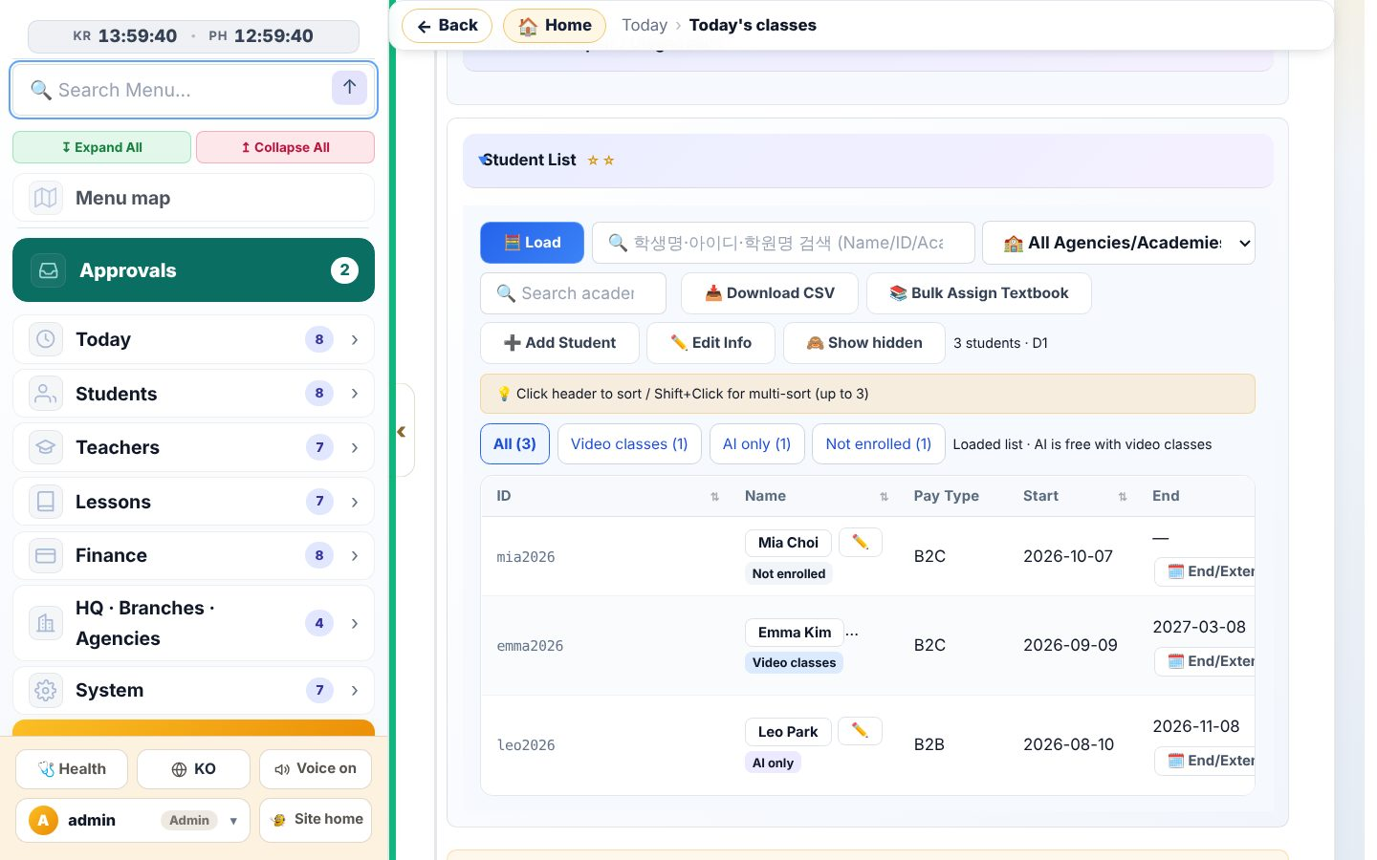
2. Student list · Adding a student — Open the student list
• Menu Students › Students → Load.
• Search by name, ID or academy, or pick one academy from the list.
• The chips (All · Video class · AI only · Not enrolled · Check needed) filter the kind of student.
• Click a column header to sort; Shift+click to sort by several columns.

Slide 10
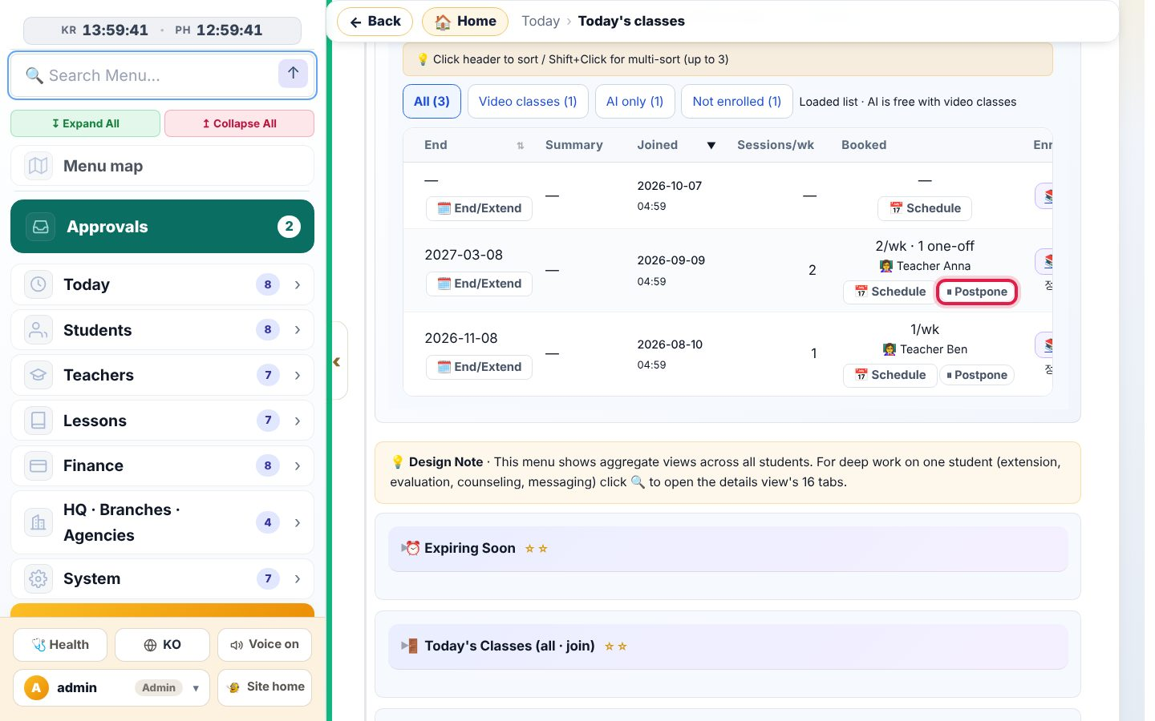
2. Student list · Adding a student — Row buttons sit in the related columns
• Click the student name to open the detail page; ✏️ next to it edits contacts.
• Under End date: 🗓️ End/Extend.
• The Bookings column shows “2/wk · 1 one-off” and the teacher, with 📅 Schedule and ⏸ Postpone (only when there are bookings).
• 📚 Enrollment pre-fills an enrollment form for that student.
• (The old “Details” column was removed on 2026-10-09.)

Slide 11
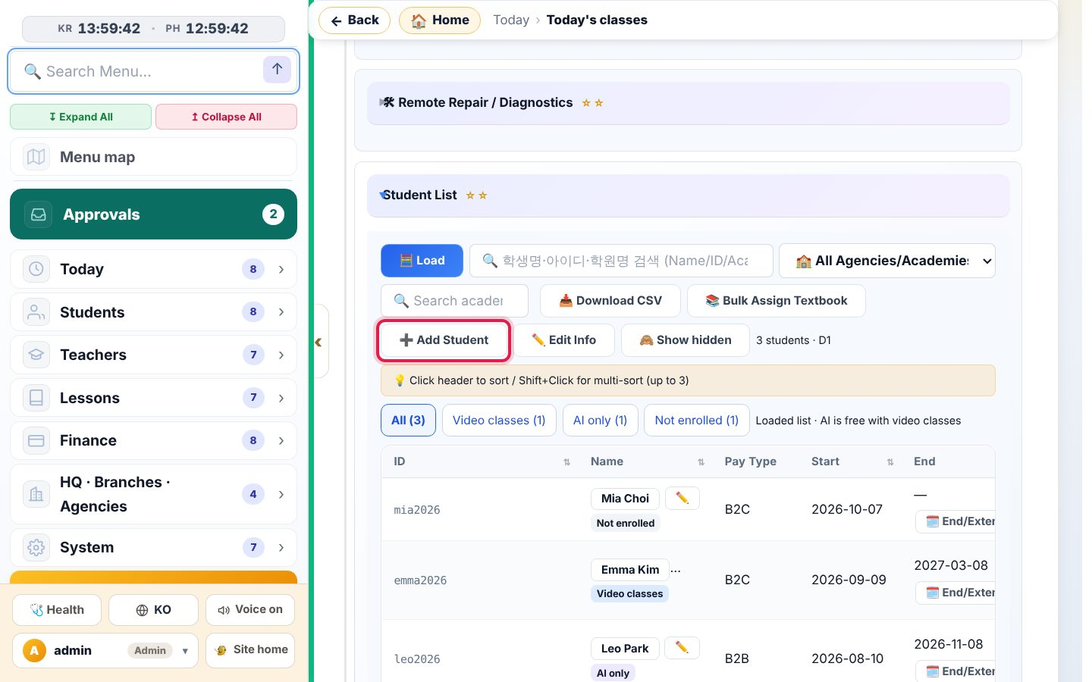
2. Student list · Adding a student — Press «➕ Add Student»
• Press ➕ Add Student above the list.
• Search the name first. If the student already exists, do not create a second account.

Slide 12
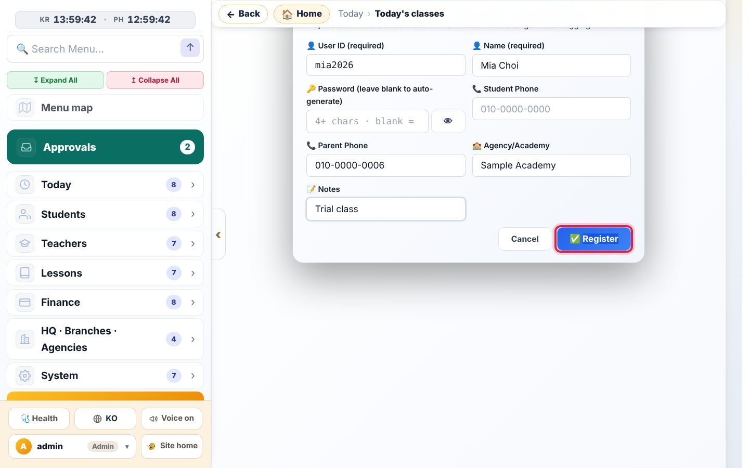
2. Student list · Adding a student — Fill in the student’s information
• User ID (required): 4–20 letters/numbers/underscore, small letters.
• Name (required). Leave Password blank to get a temporary one.
• Please enter the Parent phone — class reminder texts go there.
• Pick the Agency/Academy from the list. Press Register.

Slide 13
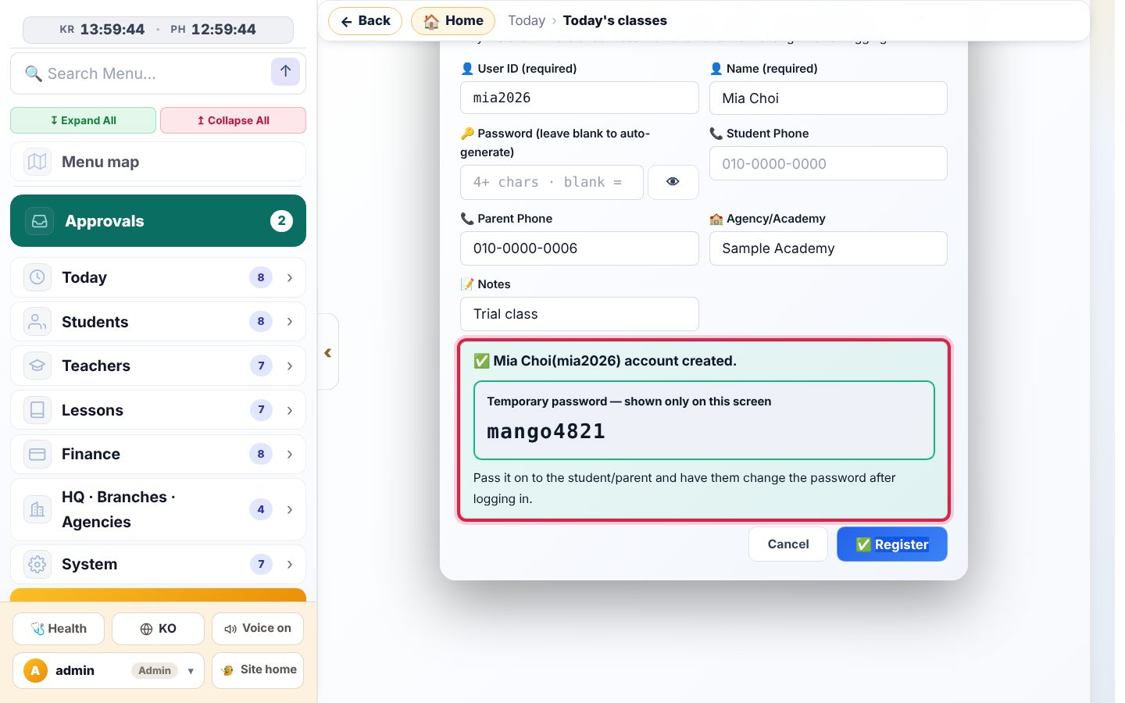
2. Student list · Adding a student — The temporary password is shown once
• Copy the temporary password now and send it to the parent.
• It is not shown again after you close the window.

Slide 14
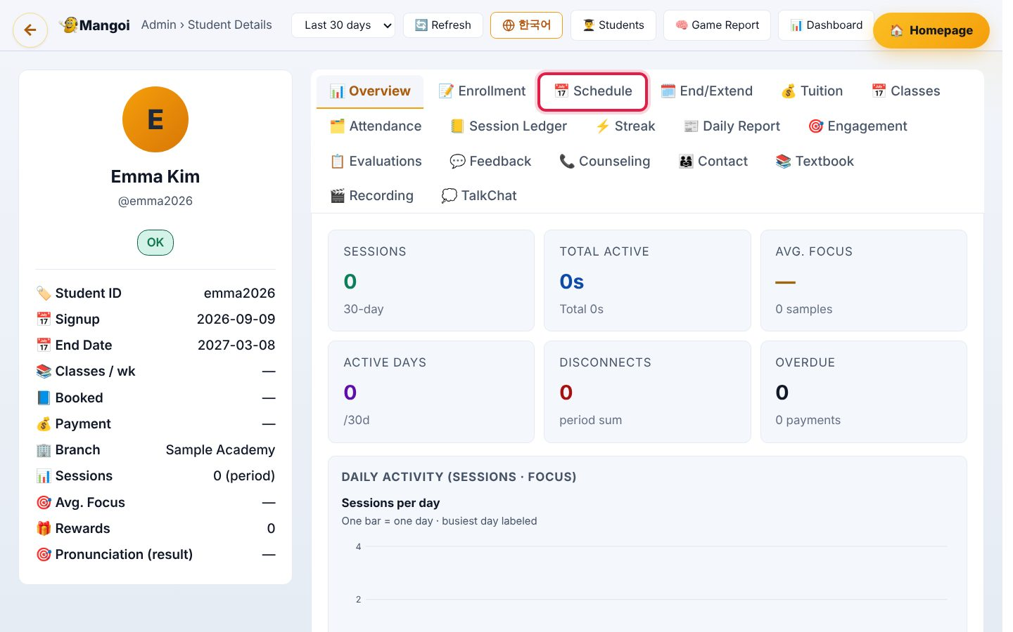
2. Student list · Adding a student — Student detail page
• Summary on the left, tabs on top.
• Tabs: Overview · Enrollment · 📅 Schedule · End/Extend · Payment · Attendance · Evaluations · Contacts · Textbook · Recordings …
• Adding, postponing and changing classes is all done in the 📅 Schedule tab (next chapters).

Slide 15
3. Today’s classes
All of today’s classes in one table — join, observe, postpone or change right there.

Slide 16
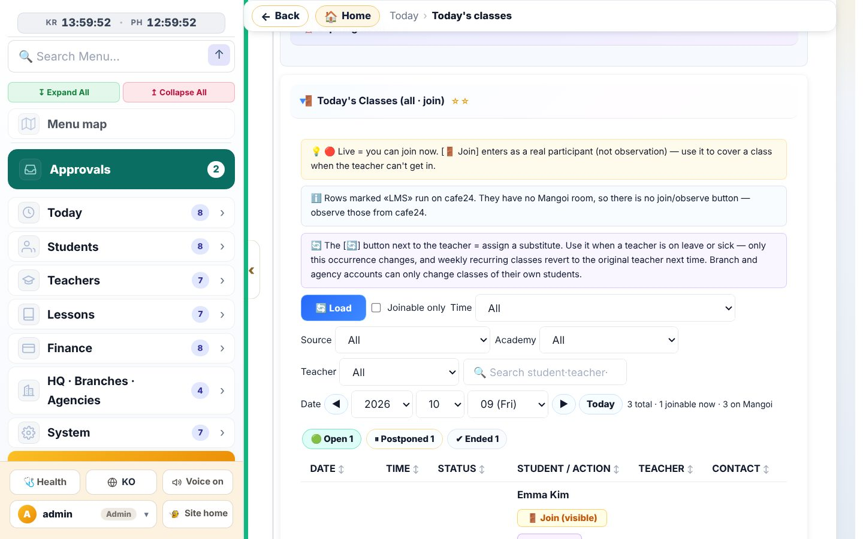
3. Today’s classes — Today’s class table
• Menu Today › Today’s classes → Load.
• The chips count classes by status: Joinable · ⏸ Postponed · Ended.
• Change the date to see another day. Filter by source (Mangoi/Cafe24), academy or teacher.
• Cafe24 classes have no Mangoi room, so you cannot join or observe them.

Slide 17
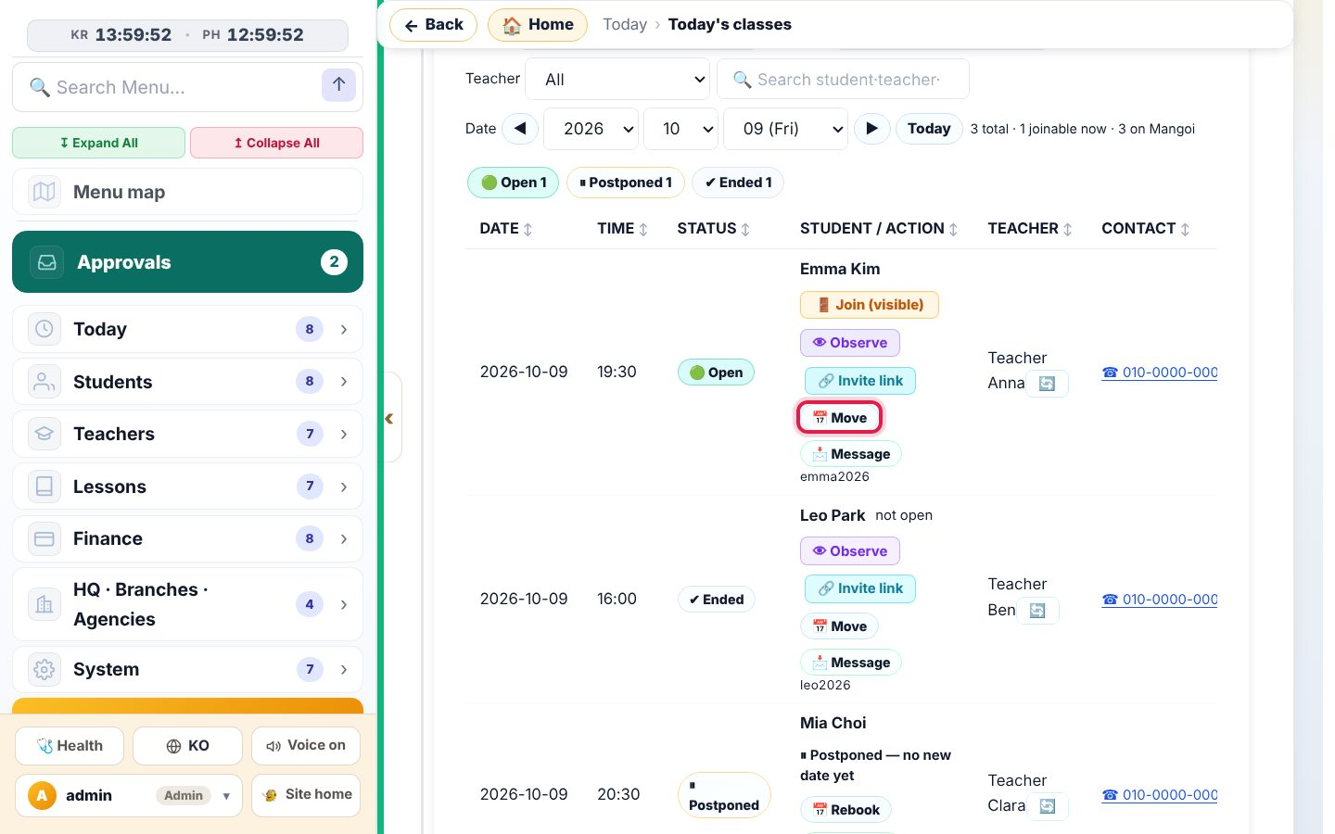
3. Today’s classes — Actions on one row
• 🚪 Join (visible) enters the class (students see you).
• 👁 Observe watches invisibly. 🔗 Invite link copies the room link.
• 📅 Postpone/Change (red box) postpones, changes or cancels this one class — the same window as chapter 5.
• 💬 Message texts the student.
• Postponed classes show “⏸ Postponed — no new date” and a 📅 New date button.

Slide 18
4. Adding classes (booking · enrollment)
Two ways: ① from the student detail page ② with an enrollment form (many students).

Slide 19
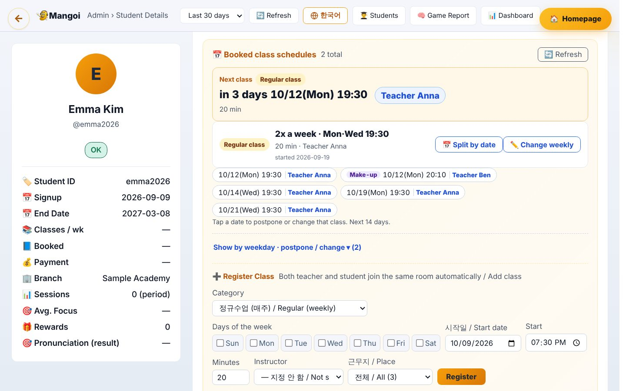
4. Adding classes (booking · enrollment) — Student detail › 📅 Schedule
• The Next class card shows date, time and teacher.
• A weekly pattern shows as one line, e.g. “2x a week · Mon·Wed 19:30”, with date chips for the next 14 days below.
• Each chip shows the teacher’s name, so substitutes are easy to see.

Slide 20
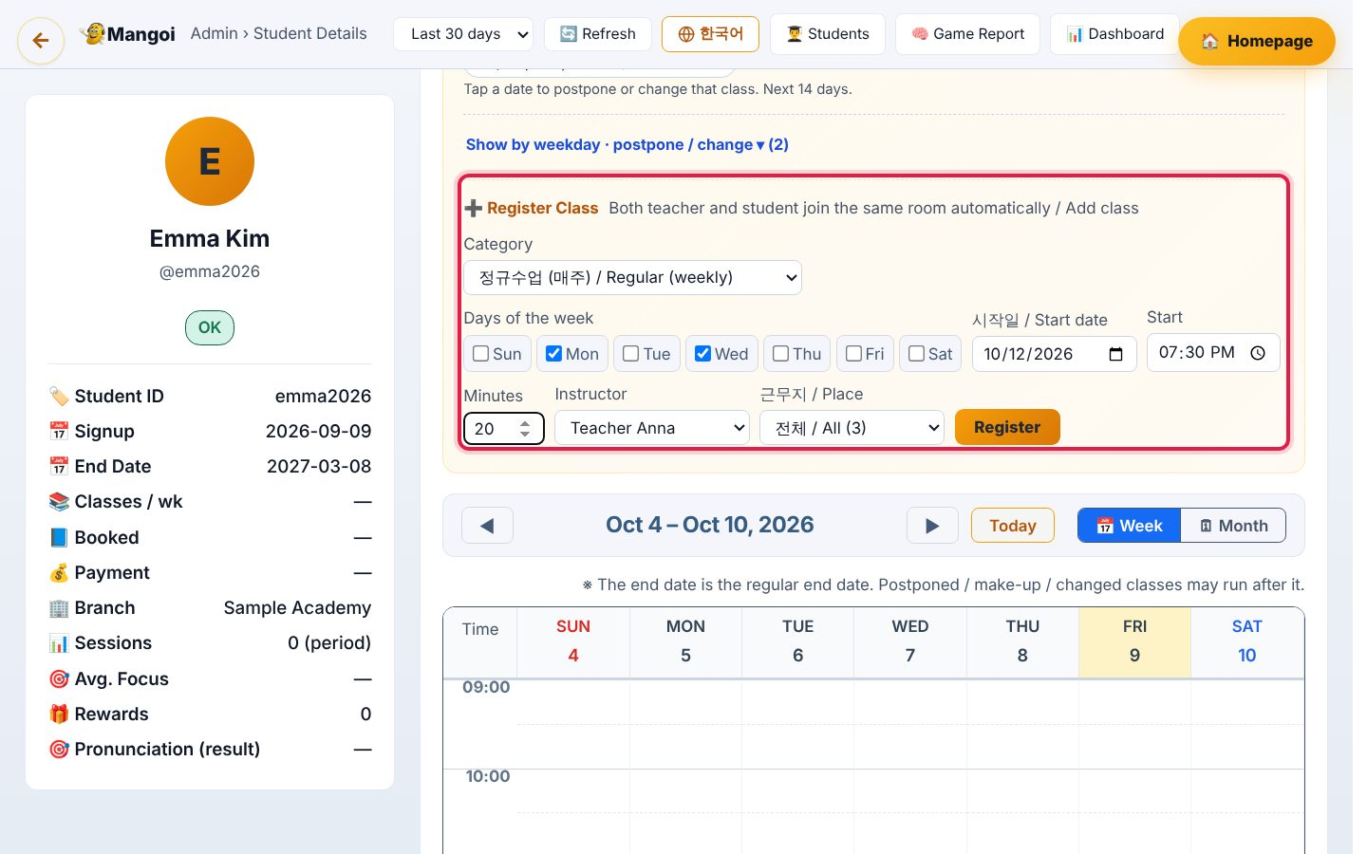
4. Adding classes (booking · enrollment) — Add a regular (weekly) class
• In ➕ Add class, set Type = Regular (weekly).
• Tick the days (e.g. Mon + Wed), the start date, start time (KST) and minutes (usually 20).
• Pick the teacher. Place (All/Home/Office) narrows the list; teachers who left are hidden by default.
• Press Add. If it warns about a clash, check that teacher’s schedule first.
• Teacher and student then join the same room automatically, no room code.

Slide 21
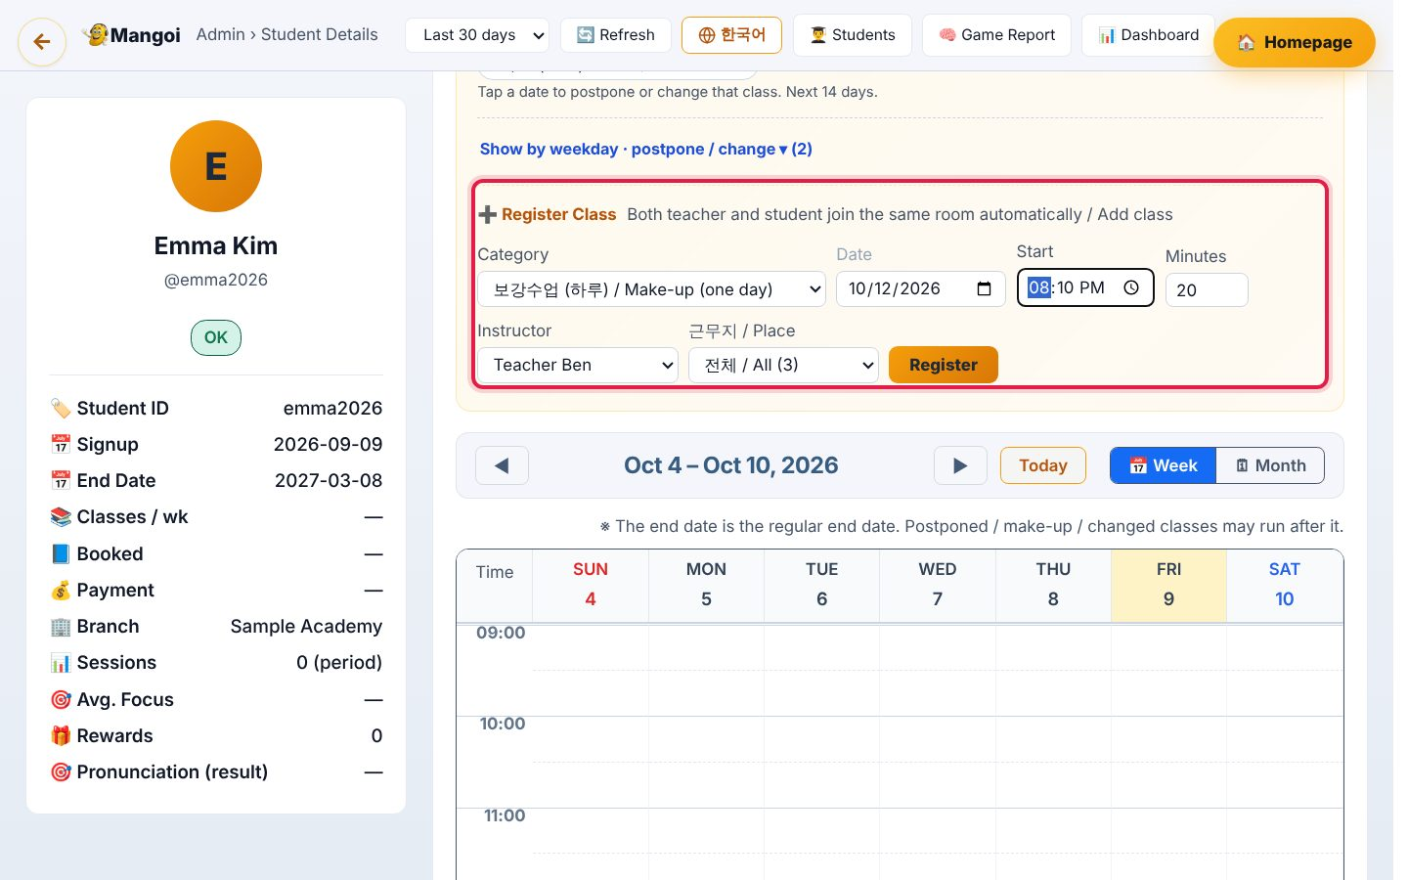
4. Adding classes (booking · enrollment) — One-day classes (make-up · trial · level test)
• Choose Make-up / Trial / Level test: you pick one date instead of days.
• Colours: Regular amber · Make-up purple · Trial green · Level test blue.
• One-day classes show “this day only”, and “⌛ past” after the date.

Slide 22
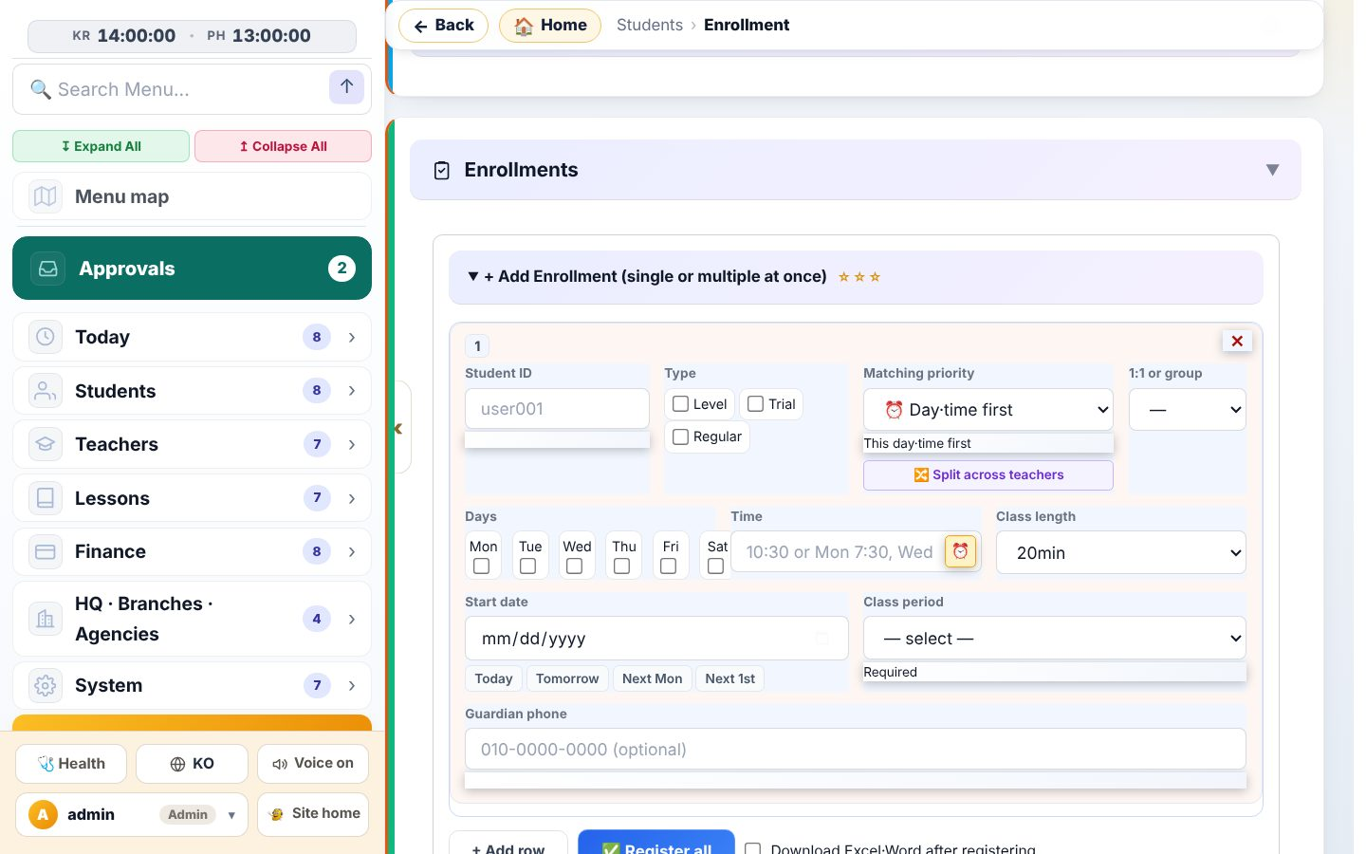
4. Adding classes (booking · enrollment) — Enrollment form (many students at once)
• Menu Students › Enrollment → + Add enrollment.
• One row per student: ID · level · priority (day/time or teacher) · days · time · length · start date · period · parent phone.
• + Add row, then ✅ Register all. You can also download an Excel/Word/Kakao form, fill it in and upload it.
• Registered rows are confirmed automatically and classes are created for the whole period (6 months = 6 months of classes).
• Dates where the student already has a class at that time are skipped and reported.

Slide 23
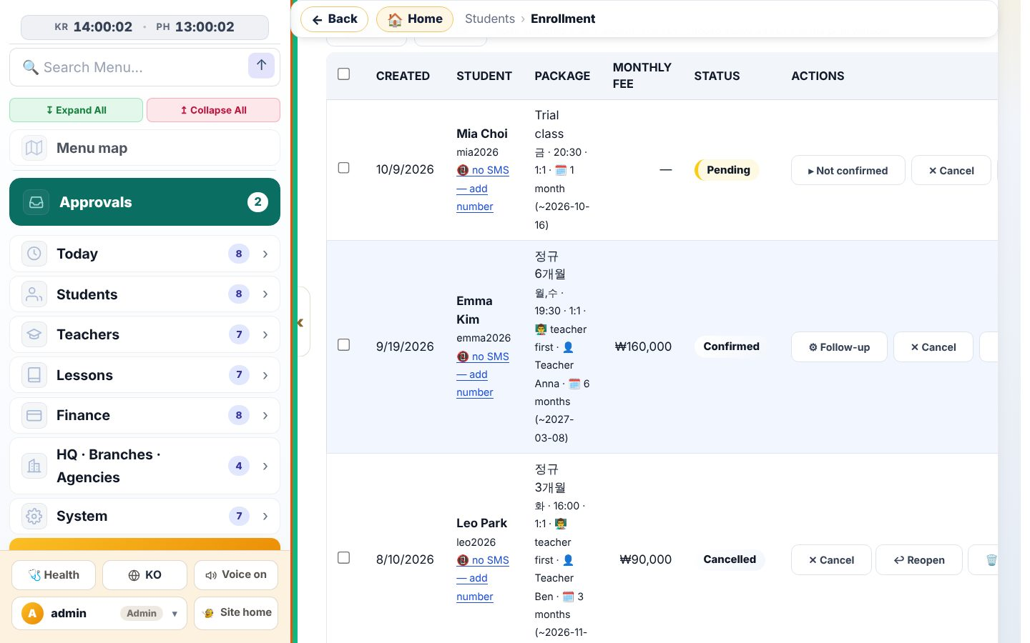
4. Adding classes (booking · enrollment) — Enrollment list
• Status: Pending · Confirmed · Active · Cancelled · Ended.
• ▸ Not confirmed / ⚙ Follow-up shows the confirmation steps (link student, assign teacher, create classes).
• For ✕ Cancel and ↩ Restore see chapter 6.

Slide 24
5. Postponing · Changing classes
«Postpone» = move just this one class. «Change» = from this class on, every time. The same window opens from everywhere.

Slide 25
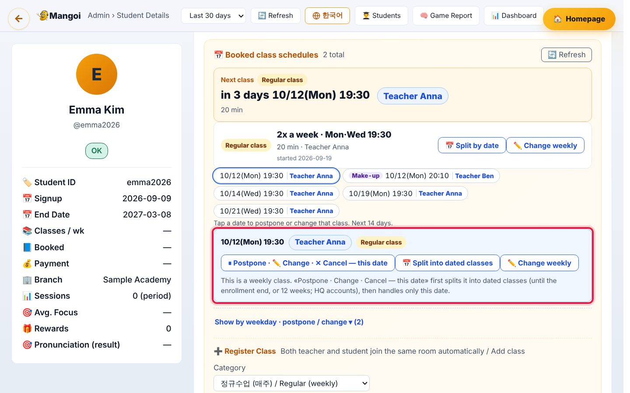
5. Postponing · Changing classes — Way in ① date chips
• In Student detail › 📅 Schedule, press a date chip; the actions open below.
• One-day class: ⏸ Postpone · ✏️ Change · ✕ Cancel.
• Weekly class: “… — this day only” — only that week changes, other weeks stay.
• 📅 Split by date turns a weekly pattern into separate dated classes (HQ account).

Slide 26
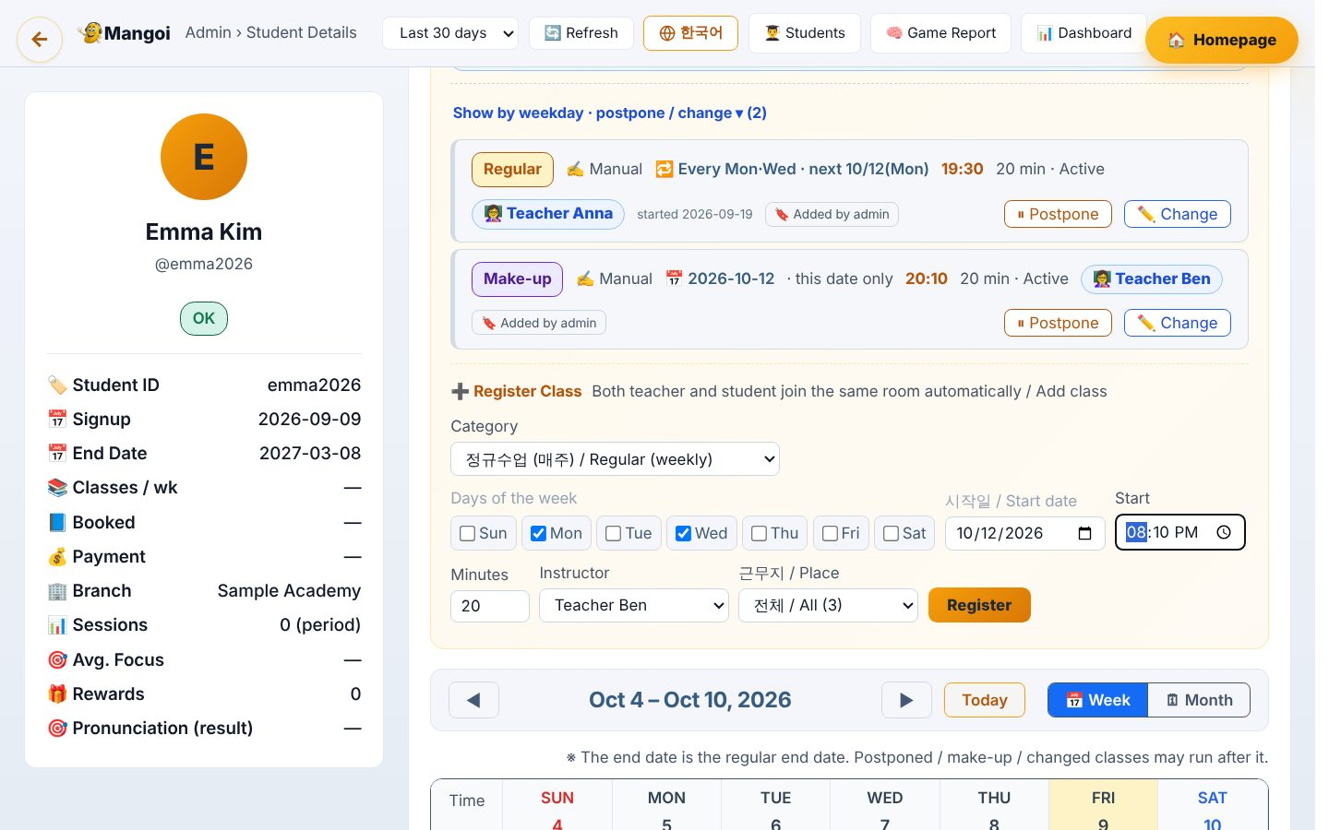
5. Postponing · Changing classes — Way in ② weekly rows
• Open By weekday · Postpone/Change ▾: each row has ⏸ Postpone and ✏️ Change.
• They list the next 28 days of classes; pick a date to open the same window.
• To change the weekly time itself use ✏️ Change weekly.

Slide 27
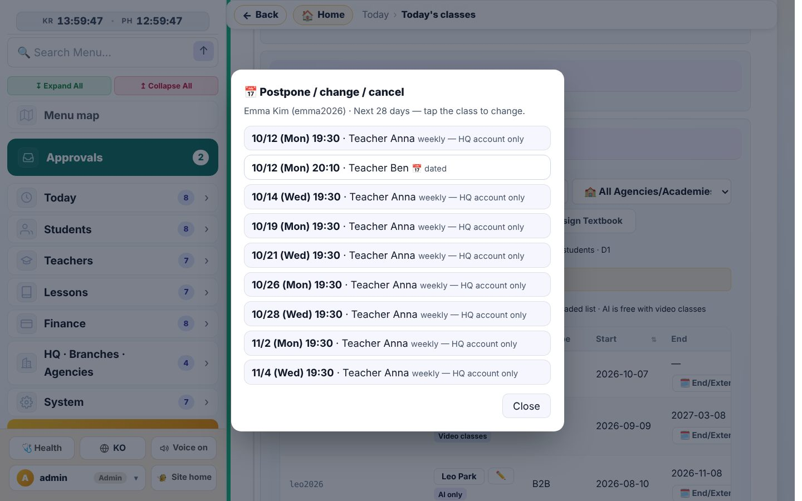
5. Postponing · Changing classes — Way in ③ student list · today’s classes
• ⏸ Postpone in the student list and 📅 Postpone/Change in Today’s classes open the same picker.
• “weekly — split first” means that day is separated first, then handled.
• Cafe24 weekly classes must be changed in Cafe24 (the nightly sync would undo it here).

Slide 28
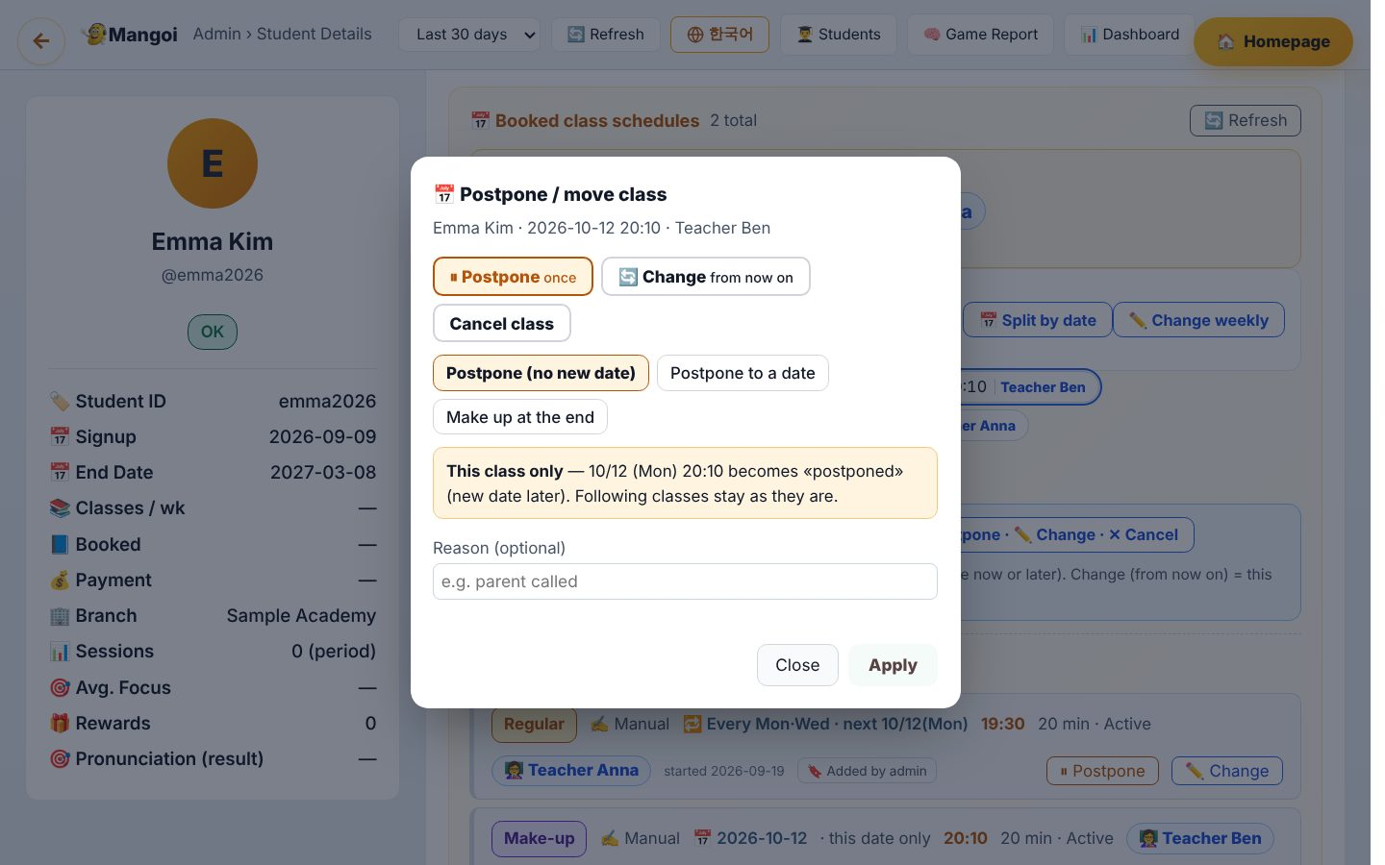
5. Postponing · Changing classes — The postpone/change window
• Top: student · date · time · teacher.
• Three buttons: ⏸ Postpone (once) · 🔄 Change (from now on) · Cancel class (HQ only).
• The reason is saved in the history. A confirm box appears before anything is saved.

Slide 29
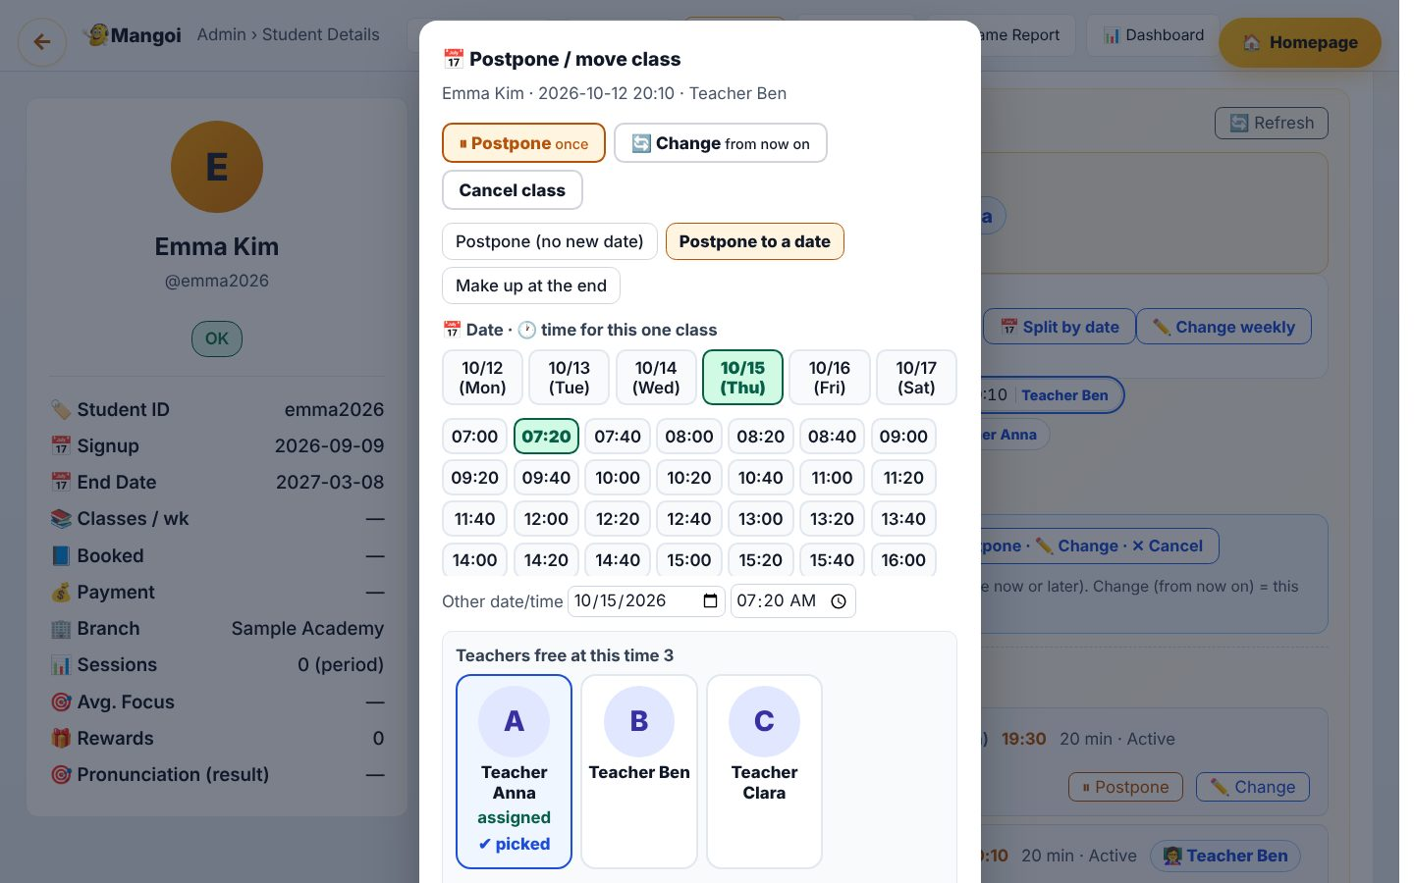
5. Postponing · Changing classes — Postpone ① to a set date
• Postpone to a date → pick a day chip and a time chip (10-minute steps), or type below.
• Available teachers appear as cards. If the usual teacher is busy you can pick another (HQ account).
• Teachers who cannot take it (other class, leave, substituting) are left out with the reason.

Slide 30
5. Postponing · Changing classes — Postpone ② on hold (no date yet)
• Use it when the new date is not known. The class stays as “⏸ Postponed”; set the date later with 📅 New date.
• Postponed classes are left out of Today’s classes, joining and absence alerts.

Slide 31
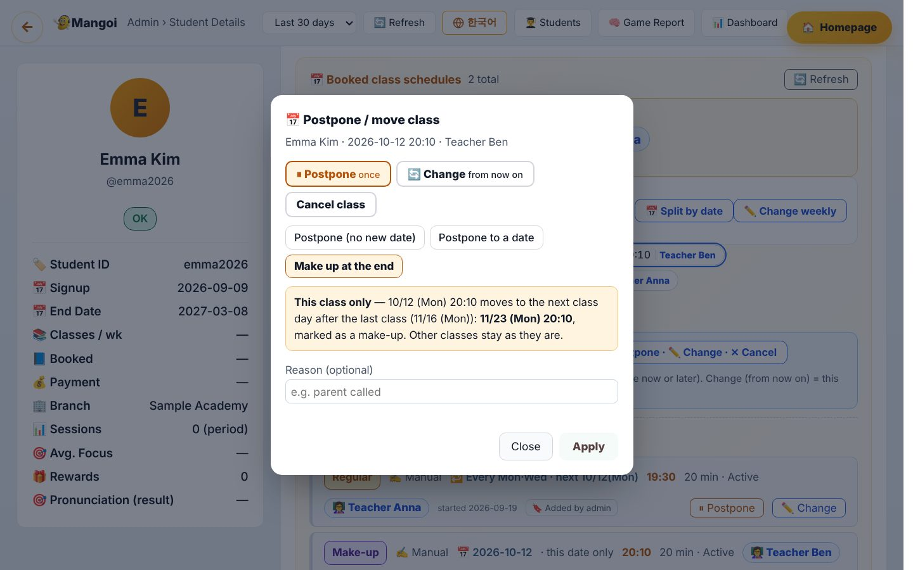
5. Postponing · Changing classes — Postpone ③ make up at the end
• Moves just this class to the next class day after the last class, marked “make-up”. The server works out the date.
• Other classes stay as they are.

Slide 32
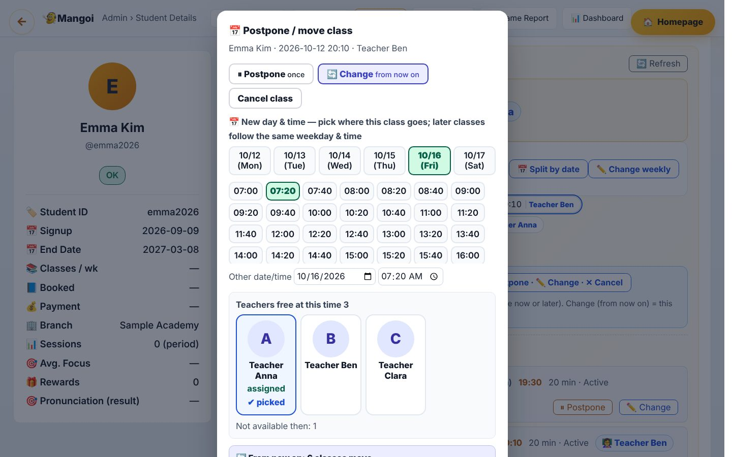
5. Postponing · Changing classes — Change (from now on)
• Pick a new day and time; a preview lists every later class that will move (“6 classes move”).
• If any date clashes, nothing moves and the clashing dates are shown.
• Check the preview, then press Apply.

Slide 33
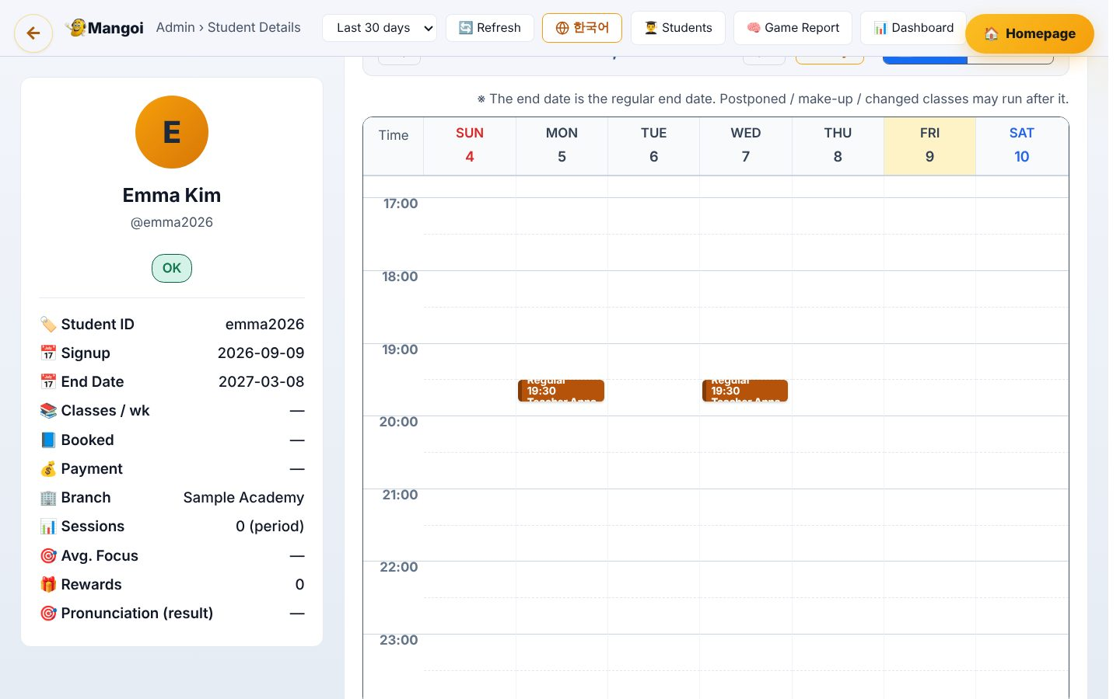
5. Postponing · Changing classes — Check the result in the calendar
• Below the 📅 Schedule tab: week/month calendar, cards coloured by type with the teacher’s name.
• Click a card to open the postpone/change window for that day.
• KR/PH public holidays are shown too.

Slide 34
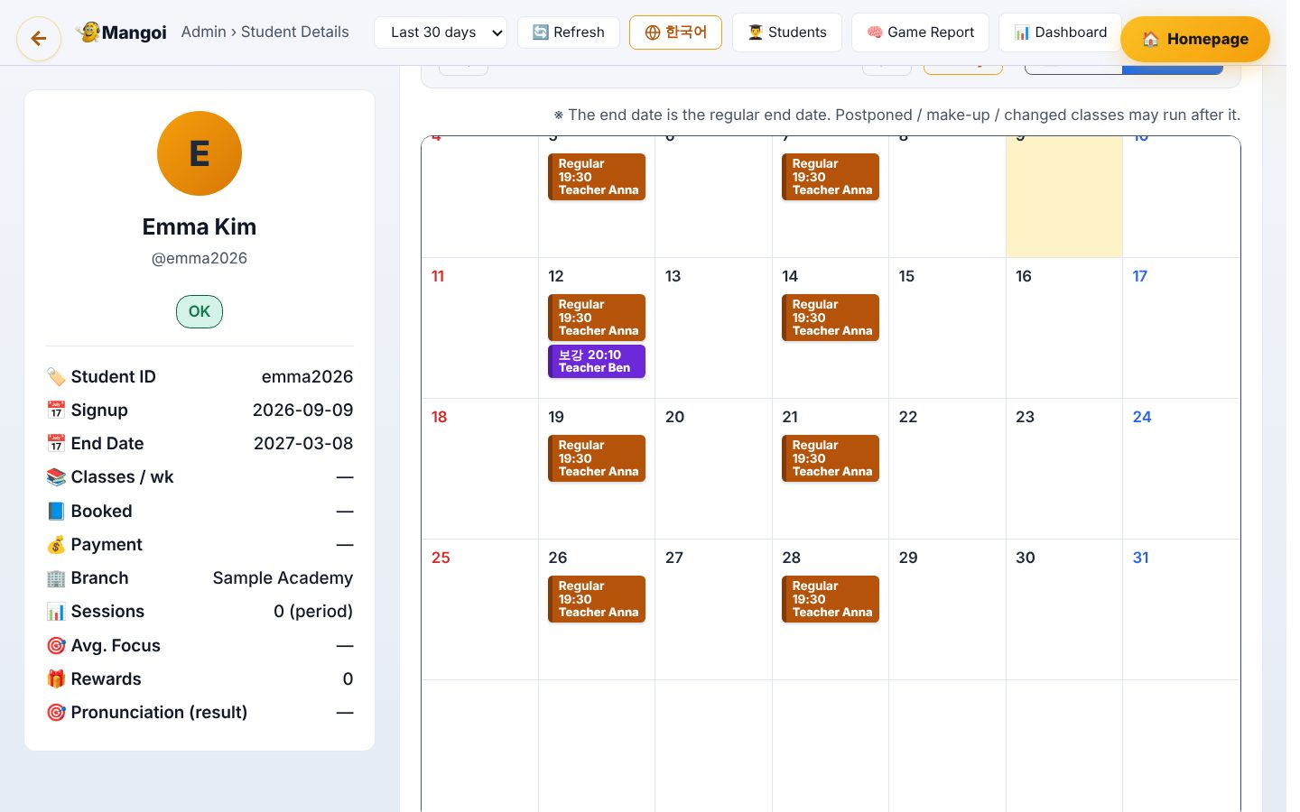
5. Postponing · Changing classes — Month view
• Press Month for a whole month at once.
• Enrollments without real classes are not drawn; a note above says how many were left out.

Slide 35
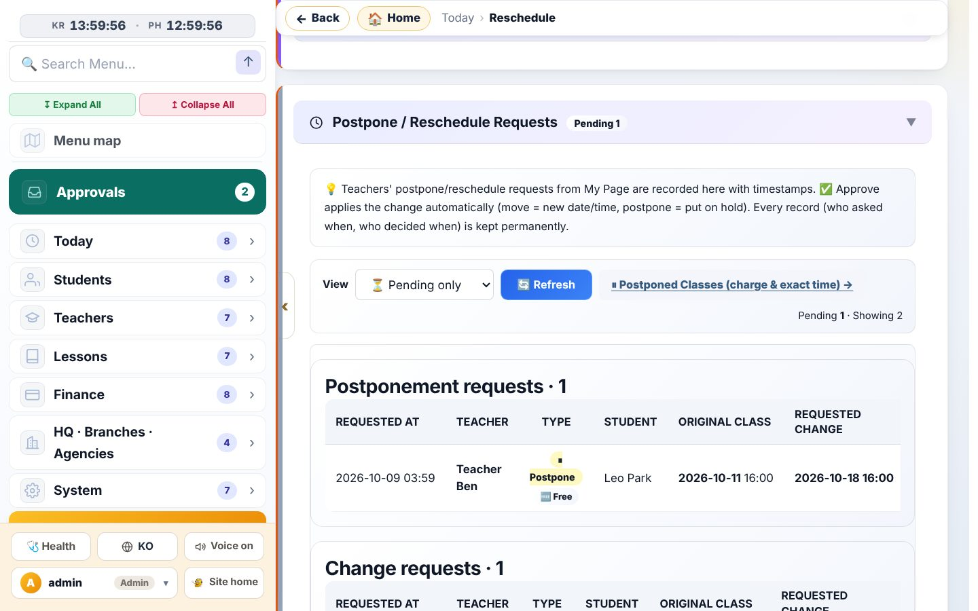
5. Postponing · Changing classes — Postpone/change history
• Menu Today › Reschedule: every request from teachers and students, and what admins did, with times.
• Students’ free postpone/change requests are applied immediately without approval and only recorded here.
• Pending requests: Approve / Reject. Approving updates the schedule automatically.

Slide 36
6. Cancelling classes
Cancelling is hard to undo. HQ accounts only, and you are asked to confirm.

Slide 37
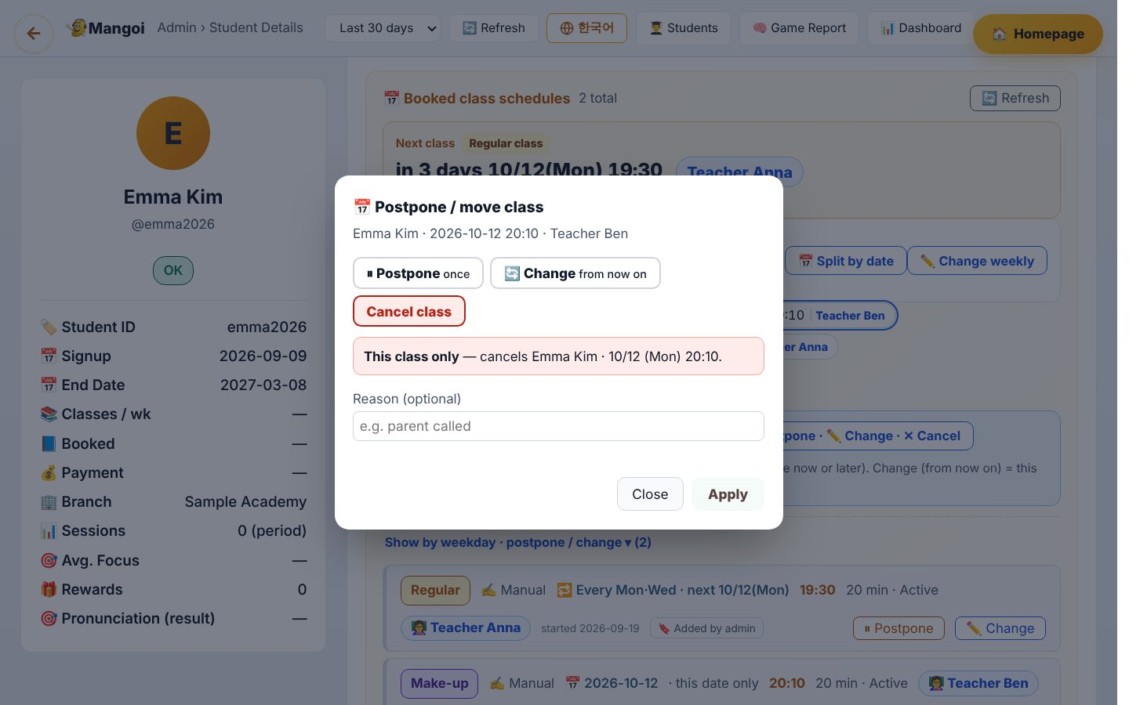
6. Cancelling classes — Cancel one class
• In the window: Cancel class → reason → Apply → confirm.
• A one-day class is cancelled; for a weekly class only that day is separated and cancelled (other weeks stay).
• An already postponed class can also be cancelled with ✕ Cancel this class.
• Cancelled classes stay in the history.

Slide 38
6. Cancelling classes — Cancel an enrollment → its remaining classes end too
• ✕ Cancel in the enrollment list also ends that enrollment’s future classes (“N remaining classes ended”).
• Weekly repeat rows without dates are kept (because of payroll) — tidy them in Student › 📅 Schedule.
• ↩ Restore brings back classes this cancel ended, if not past and not clashing. Add any that could not be restored by hand.

Slide 39
7. Timetable (weekly · daily)
Every teacher’s classes on one board; drag to move. It is locked by default to prevent mistakes.

Slide 40
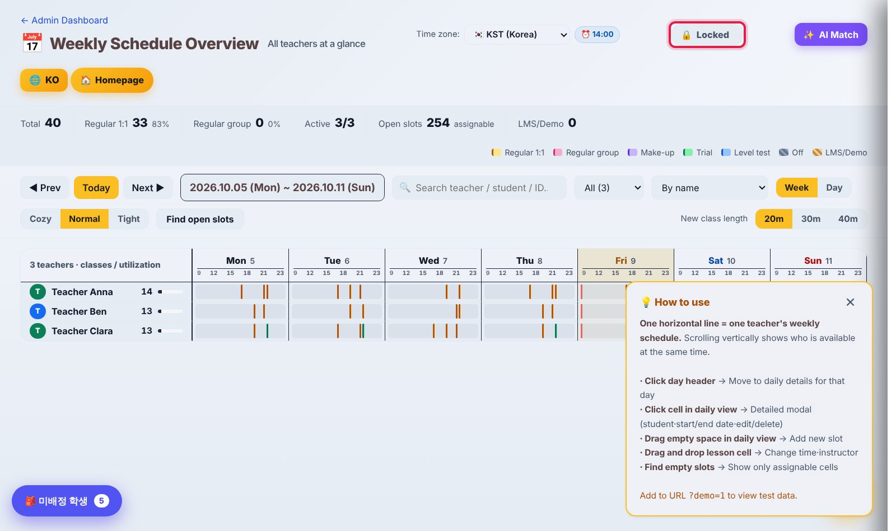
7. Timetable (weekly · daily) — Weekly timetable
• Menu Teachers › Schedule. Across = time, down = teachers.
• Colours: Regular amber · Group pink · Make-up purple · Trial green · Level test blue · Off hatched.
• Top numbers: total classes · regular · active teachers · free slots. Find free slot finds empty times.
• 🔒 Locked (top right): dragging does nothing while locked.

Slide 41
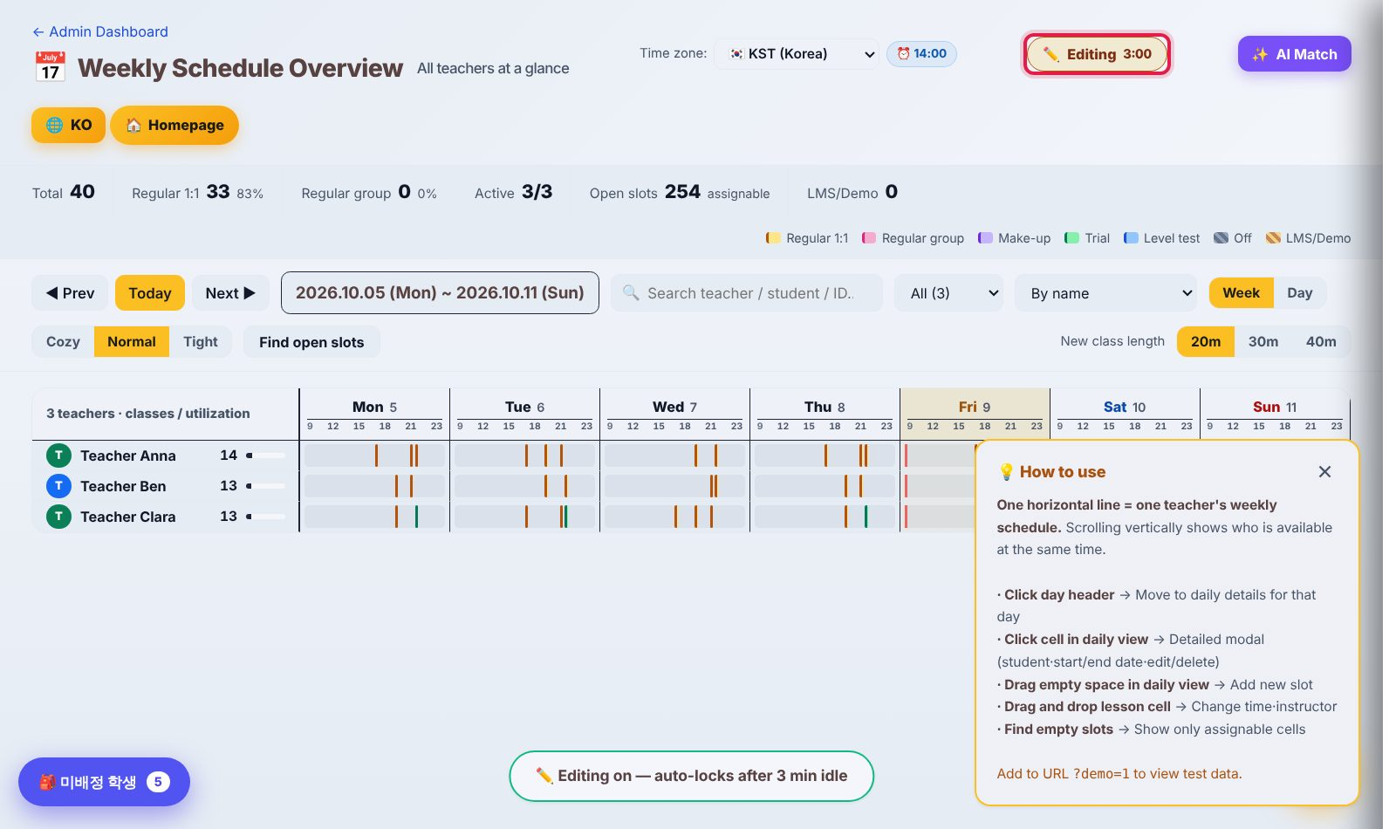
7. Timetable (weekly · daily) — Turn editing on
• Press 🔒 Locked → ✏️ Editing 3:00. It locks again after 3 minutes without a save.
• After a save, Undo is available for 15 seconds.

Slide 42
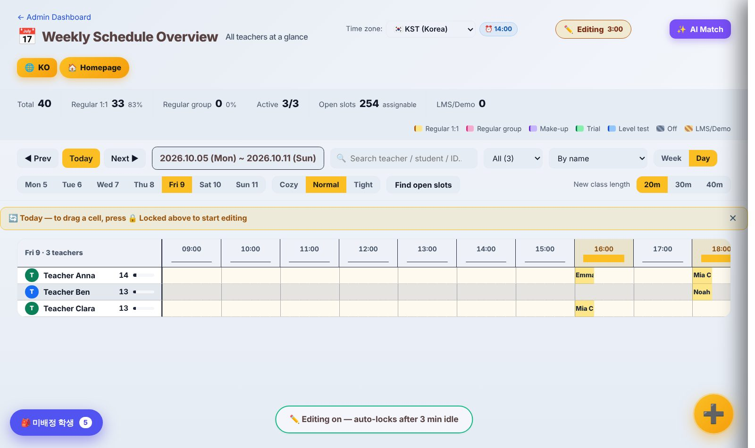
7. Timetable (weekly · daily) — Daily view · drag to move
• Day view (the first screen from the sidebar) shows today large.
• Drag a student card to another time or teacher; it asks “Postpone or Change?”.
• Postpone = that day only, Change = from now on.

Slide 43
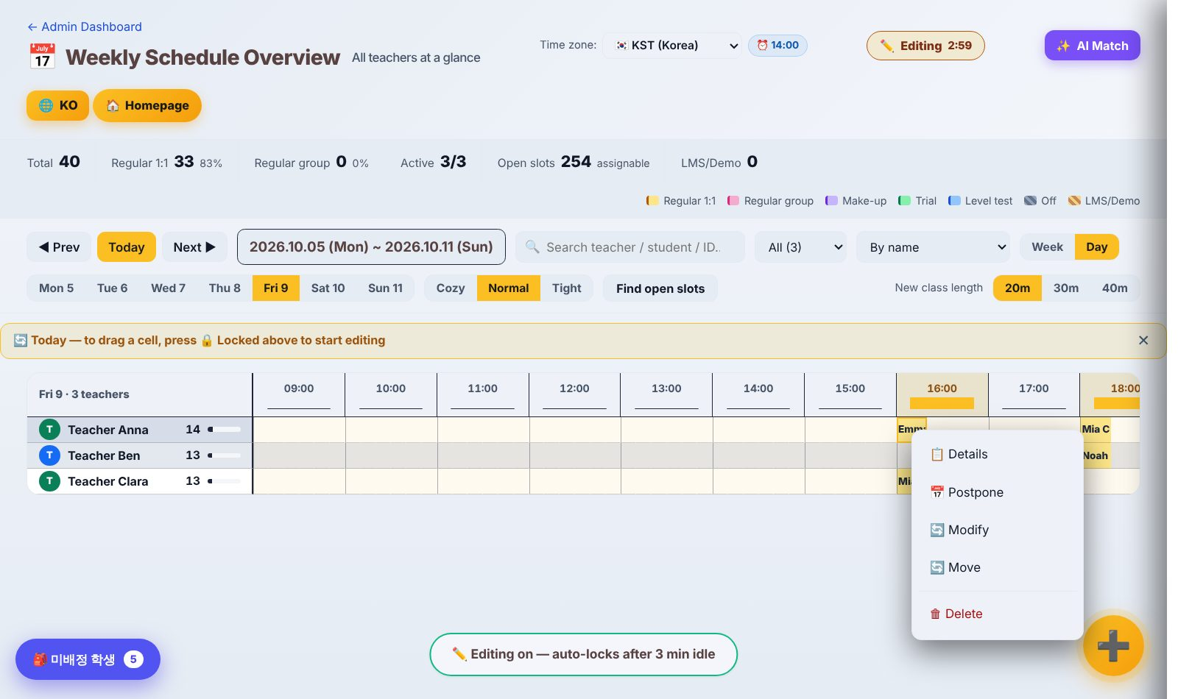
7. Timetable (weekly · daily) — Right-click menu
• Right-click a class: Details · Postpone · Change · Change time · Delete.
• Times are picked in 10-minute steps.

Slide 44
8. Payroll
Teacher pay is calculated automatically from real class records. Amounts are in ₱ (Philippine peso).

Slide 45
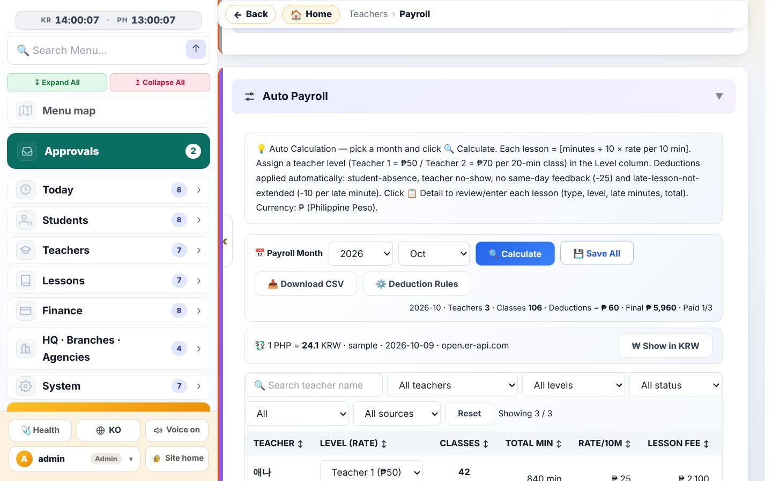
8. Payroll — Automatic payroll — calculate
• Menu Teachers › Payroll → 💼 Automatic teacher payroll.
• Choose the month and press 🔍 Calculate.
• Formula: class minutes ÷ 10 × rate per 10 min, added up per class. Rates by level (e.g. Teacher 1 = ₱50 / 20 min, Teacher 2 = ₱70 / 20 min).
• Summary: teachers · classes · deductions · final pay · paid. ₩ Show in KRW converts with the exchange rate.

Slide 46
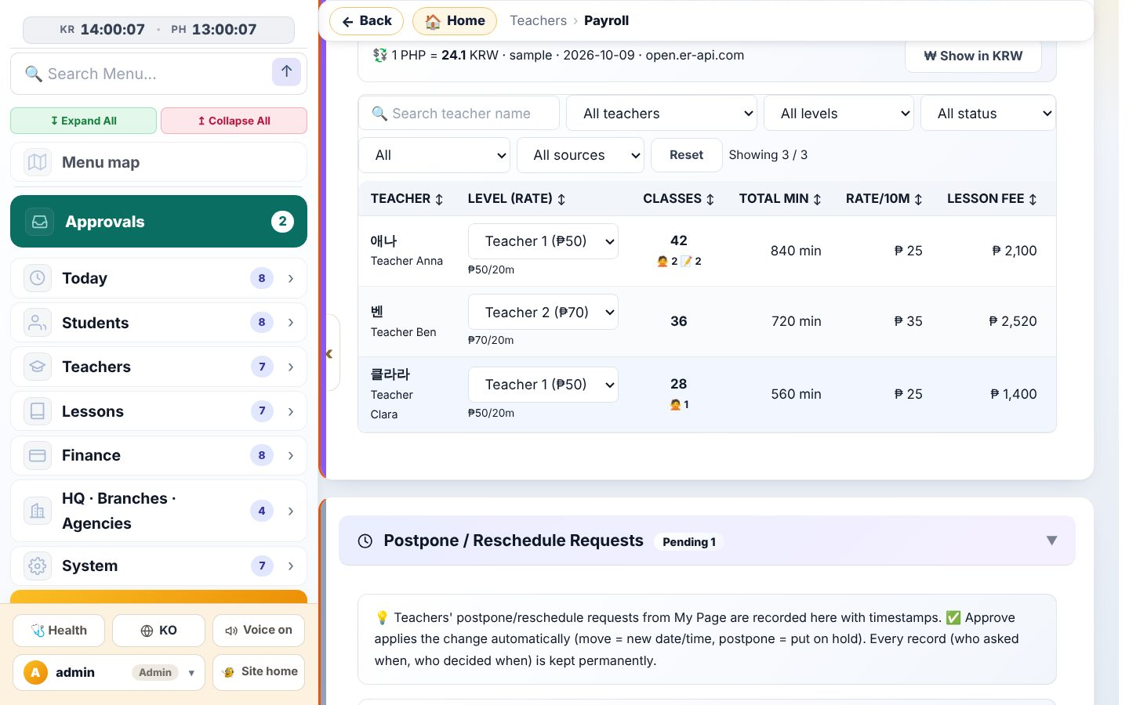
8. Payroll — Per-teacher table
• Per teacher: level (rate) · classes · minutes · rate per 10 min · lesson fee · deduction · final pay.
• Change the level right in the table (used from the next calculation).
• Enter an adjusted amount, press 💾 Save all; after paying press ✅ Mark paid.
• 📥 CSV downloads it. A “Cafe24” badge means the value came from the Cafe24 monthly sync.

Slide 47
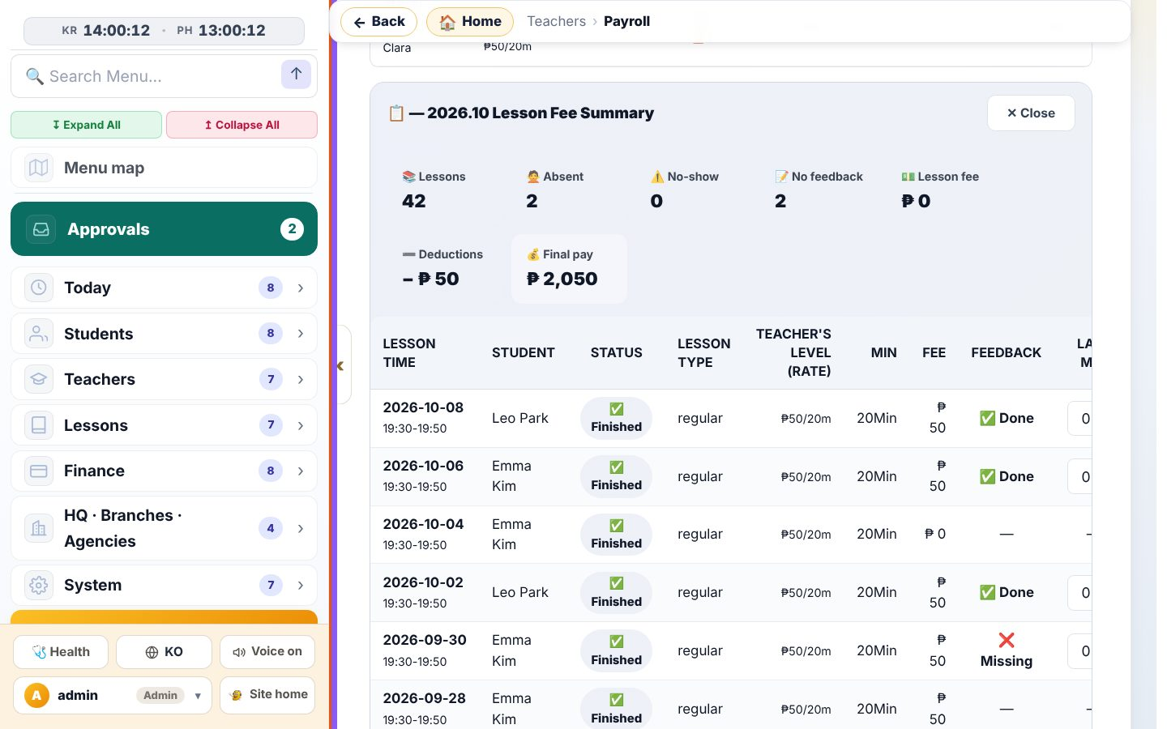
8. Payroll — Class by class (📋 Detail)
• 📋 Detail lists each class: date · student · status · minutes · fee · feedback · late minutes · deduction.
• Student absences, teacher no-shows and missing feedback are counted at the top.
• Late minutes can be entered here.

Slide 48
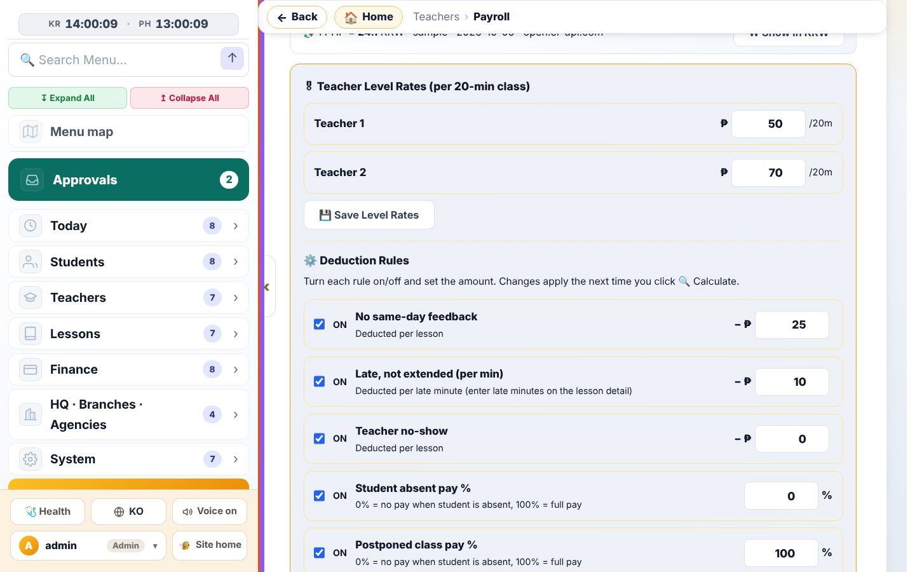
8. Payroll — Deduction rules and postponed-class pay
• ⚙️ Deduction rules: edit level rates and deductions, save, then Calculate again.
• No same-day feedback −₱25/class · late, not extended −₱10/min · teacher no-show.
• Student absent pay % (default 0%), Postponed class pay % (default 100%), Early postpone (30+ min before start) pay % (default 0%).
• So with the defaults, a class postponed within 30 minutes of start is paid; one postponed earlier is not.

Slide 49
9. Approvals · Daily handover
Spending goes through Approvals; daily work goes in the daily handover.

Slide 50
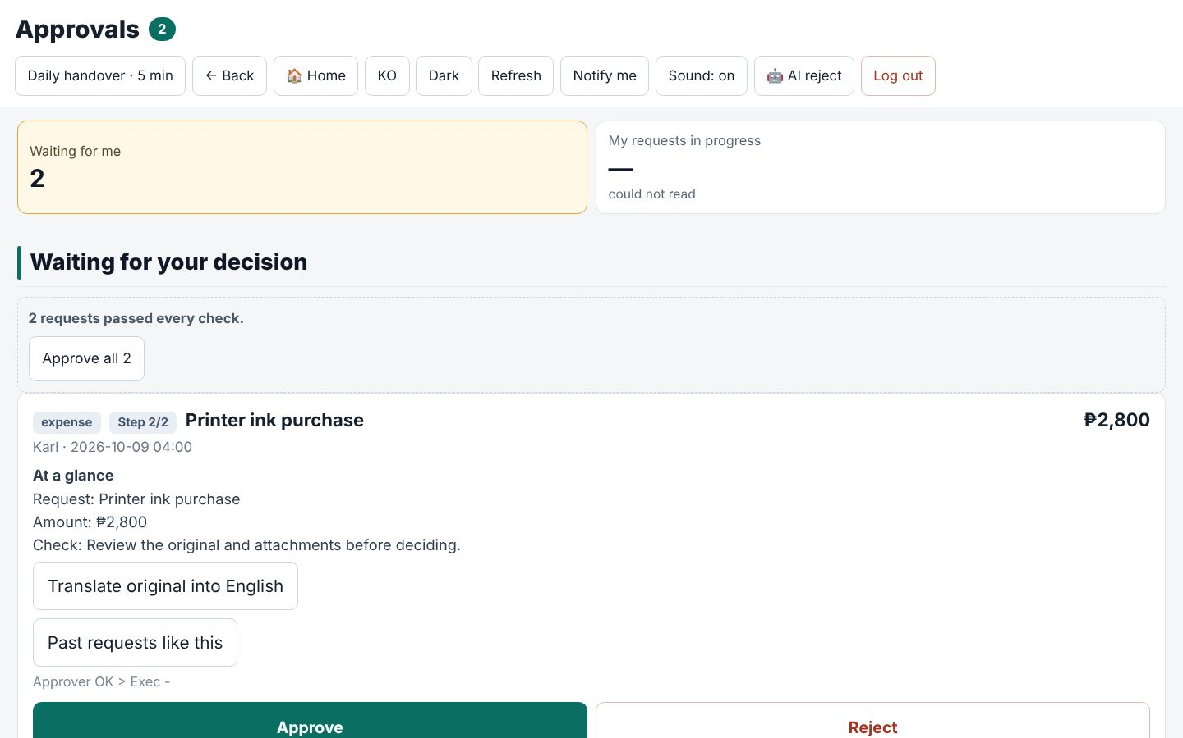
9. Approvals · Daily handover — Approvals
• Approvals at the top of the left menu (number = items waiting for you).
• For me to approve: check the content, amount and attachments, then Approve / Reject. Items that passed every check can be approved together.
• Supplies/expenses of ₱5,000 or more need the approver and then the CEO. Below that the approver decides and the CEO only “acknowledges”.
• If the AI receipt reading looks wrong (e.g. a date far in the past) it is not auto-rejected — it is only marked yellow.

Slide 51
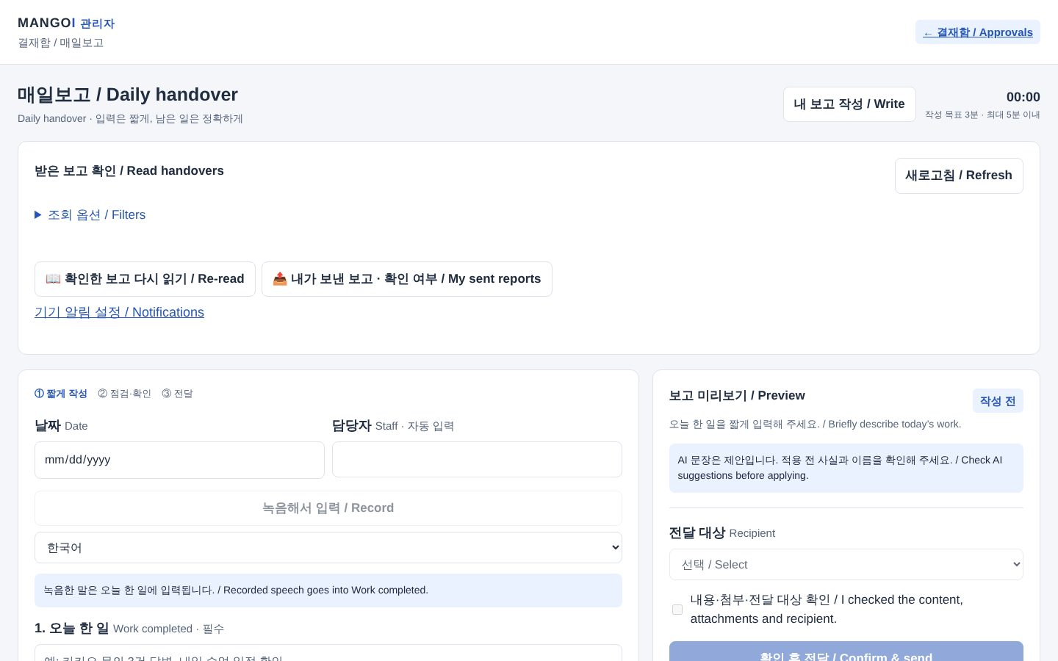
9. Approvals · Daily handover — Daily handover
• /daily-handover (also from the banner on the admin home).
• Write my report: work done · issues · follow-up → recipient → Confirm & send. You can also record your voice.
• Received reports can be read with “Translate to Korean”.
• AI flags lines that need approval; Move to approval starts one directly.
• If you skip a workday, you and the CEO get a reminder next morning (holidays excluded).

