Slide 1
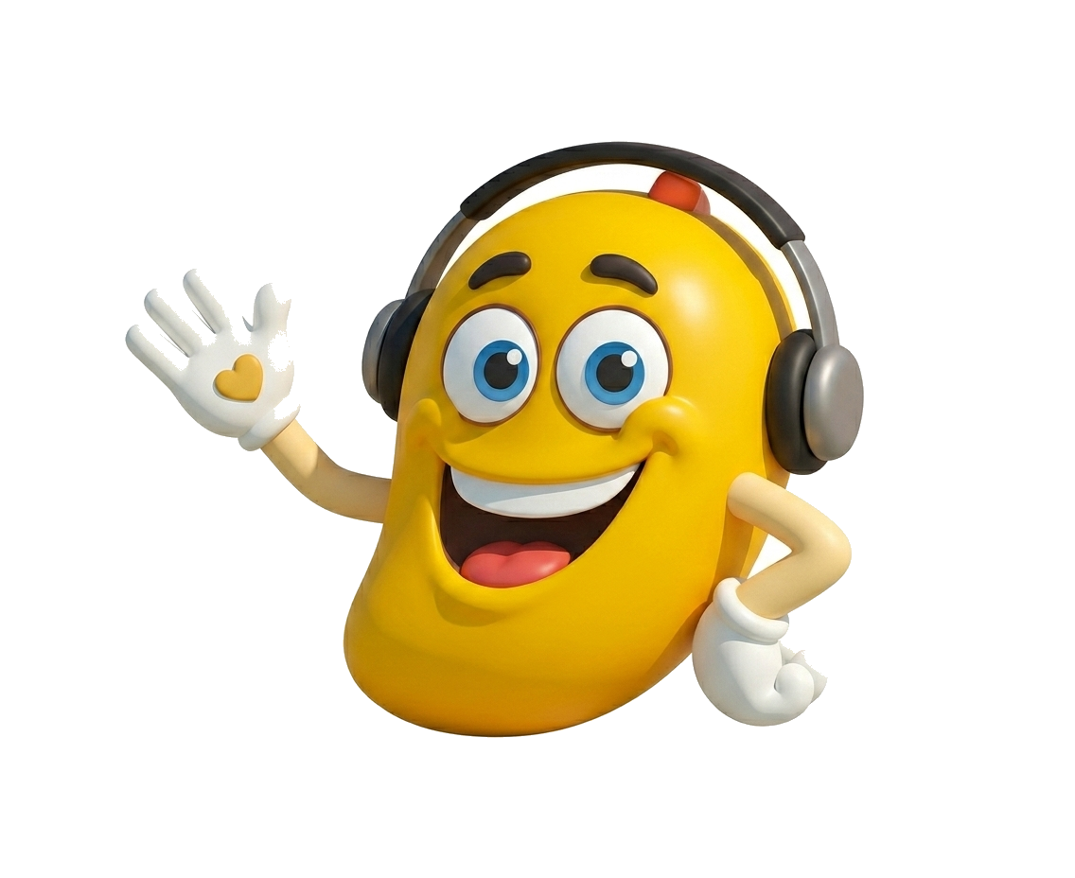
Mangoi Teacher Training Manual
The training bible for engaging kids & teens in online English class
v2.0
Engagement x Achievement — the practical training guide

Slide 2
Table of Contents
01 You're Not Just Changing a Test Score · p.3
02 Remember these 4 numbers before every class · p.4
03 01. Why This Manual Exists · p.5
04 02. The 5 Core Areas to Drive Engagement · p.6
05 1. Energy & Expression · p.7
06 2. Student Talk 60%+ · p.8
07 3. Make Achievement Visible, Instantly · p.9
08 4. Full Personalization · p.10
09 5. Rhythmic Transitions · p.11
10 At a Glance — a Do vs Avoid Quick-Reference Table · p.12
11 03. Age-Specific Teaching Tactics · p.13
12 03. Age-Specific Teaching Tactics · p.14
13 The Data Behind Engagement · p.15
14 Appendix A. The Engagement Cycle · p.16
15 Appendix A. The Engagement Cycle · p.17
16 Appendix B. Teacher Self-Check Checklist · p.18
17 Appendix C. Teacher Evaluation Rubric · p.19
18 Coaching Priority Guide by Total Score · p.20
19 04. Teacher Certification · p.21

Slide 3
01
You're Not Just Changing a Test Score
Whether a child grows up loving English for life, or dreading it, is decided not by how hard the textbook is, but by how much fun today's class actually was.
This manual is not a rulebook — it is an armory you can pull tools from mid-class. Master the 5 core areas, the engagement cycle, and age-specific tactics one at a time.
If you're reading this all the way through and planning to try it, you're already in the top 10% of teachers. Just try one new thing consciously in each class.
You're already a top-10% teacher

Slide 4
02
Remember these 4 numbers before every class
5 min
60%+
Age=Min
5-7 min
decides the child's engagement
the child must talk to improve
8yo = 8 min attention
switch the activity

Slide 5
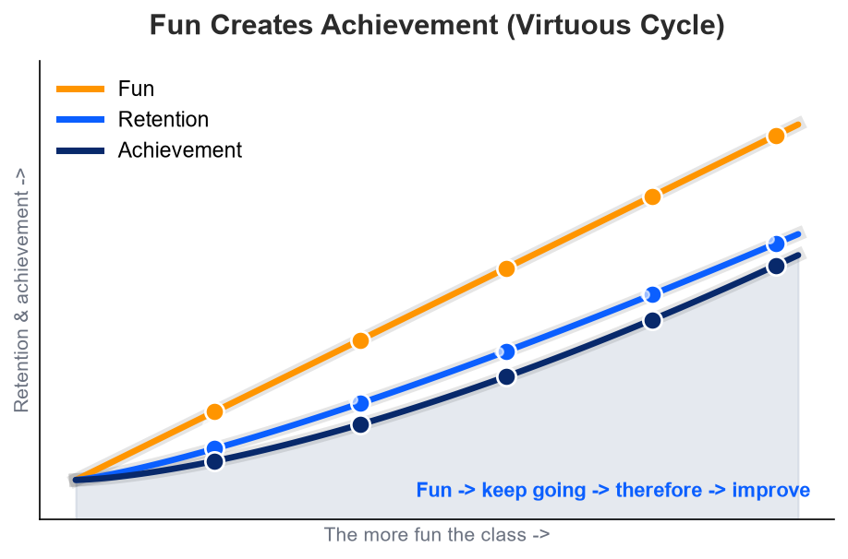
03
01. Why This Manual Exists
Most Mangoi students are curious, energetic children and teens with short attention spans. For them, it goes beyond “I won't learn if it's boring” — the harsher truth is “if I don't feel fun in the first 5 minutes, my mind has already logged out.”
On top of that, video calls filter out 30-40% of non-verbal signals — tone, expression, body language — compared to in-person. Perform with the same “calm classroom energy” and it lands as flat and boring, so the child reaches for a phone.
“We are not teachers force-feeding dry grammar. We are pacesetters who build an English playground and run alongside the child inside it.”
The more fun a class is (Fun), the more a child keeps coming (Retention), and the longer they stay, the greater their improvement (Achievement).

Slide 6
04
02. The 5 Core Areas to Drive Engagement
Each item gets its own slide next, with why it matters, exactly how to do it, and a real example
1
1. Energy & Expression
Warmth that reaches through the screen — react at roughly 1.5x your baseline.
2
2. Student Talk 60%+
The one who talks is the one who learns — wait 3 seconds after questions.
3
3. Make Achievement Visible, Instantly
The power of small rewards — stars, badges, and mascot reactions.
4
4. Full Personalization
“This class was made just for me” — weave in names and interests.
5
5. Rhythmic Transitions
Never leave room for boredom — switch activities every 5-7 minutes.

Slide 7
05
1. Energy & Expression
Why It Matters
Facial expressions and vocal energy carry far weaker through video than in person. If a teacher performs at their 'normal, comfortable' level, it reads as flat and boring. You need to react at roughly 1.5x your usual intensity for it to land as merely 'warm and friendly.'
What To Do
Don't hold back on non-verbal reactions — a thumbs-up, applause, wide eyes of surprise — the instant a child gets something right. Keep your vocal tone one notch brighter, and look directly into the camera often to maintain eye contact.
Real Example
Example: When a child answers a hard question correctly, react big — “Wow! Amazing! You are a genius!” — throw both hands up and clap.

Slide 8
06
2. Student Talk 60%+
Why It Matters
Language only truly becomes yours once spoken aloud. The easiest trap for a new teacher is talking too much. If the teacher keeps explaining alone, the child becomes a passive audience and both engagement and interest drop.
What To Do
Your target is 60%+ student talk time. After asking a question, never rush — silently count 'one, two, three' and wait the full 3 seconds while the child assembles a sentence in their mind.
Real Example
Example: Ask “What did you do yesterday?” and if the child hesitates, don't rush the answer — smile and quietly wait the full 3 seconds.

Slide 9
07
3. Make Achievement Visible, Instantly
Why It Matters
A child needs a clear signal that 'I'm doing well' to want to come back. A flat, soulless 'good job' loses impact fast. A sensory reward that flashes and bursts across the screen builds confidence far more powerfully.
What To Do
Make active use of star ratings, character badges, confetti effects, and the dancing Mango mascot. Build anticipation ahead of time: “If you get this right, Mango is going to dance for you!”
Real Example
Example: When the child answers correctly, shout “Yes! Look, Mango is dancing for you!” while showing the badge or star effect.

Slide 10
08
4. Full Personalization
Why It Matters
A child opens up fully when they feel this class was prepared specifically for them, not a generic script. Saying their name once or twice isn't enough — their own stories and interests must be woven in naturally.
What To Do
Call the child's name often and warmly. Slip their favorite interests — soccer, K-pop, games — into example sentences. Use the AI warm-up and mistake-personalization features to know what they tend to get wrong.
Real Example
Example: For a soccer fan, ask “If you were Son Heung-min, what would you say right after scoring a goal?”

Slide 11
09
5. Rhythmic Transitions
Why It Matters
A child's attention span roughly tracks their age in minutes (8yo ≈ 8 min). Push one activity past that window and the child will fidget or yawn without exception. Boredom builds up steadily, not all at once.
What To Do
Plan for no single activity to run past 5-7 minutes. Alternate rhythmically between different activity types so the child keeps getting fresh stimulation. The moment you spot a yawn, switch immediately.
Real Example
Example: If grammar explanation is about to run past 5 minutes, say “Okay, let's take a quick break and play a game!” and move to the game tab.

Slide 12
10
At a Glance — a Do vs Avoid Quick-Reference Table
The 5 core areas above, summarized for a mid-class glance.
Area | Why It Matters | DO | AVOID
Energy & Expression | Video filters 30-40% of emotion, so only exaggerated energy feels normal | Thumbs-up, clapping, surprise; tone up one notch | Blank face, monotone, eyes fixed down
Student Talk | The talker learns most; the child must speak to engage | 60%+ talk time, wait 3s after questions | Answering before the child thinks, long lectures
Visible Achievement | Physical feedback that says 'I'm doing well' sustains effort | Stars, badges, confetti, mascot actively used | Soulless praise, focusing only on errors
Personalization | Engaged only when it feels 'made for me' | Names often, interests woven in | Same script for all, forgetting past errors
Rhythm & Switching | Attention ≈ age in minutes; dragging guarantees boredom | Switch every 5-7 min, alternate learn/game | One task 15min+, ignoring fatigue signs

Slide 13
11
03. Age-Specific Teaching Tactics
Every age responds to a different code of fun — prepare the right tactic for the age you're about to teach
5-7 (Early Childhood)
8-10 (Lower Elementary)
~5-7 min
~8-10 min
This age responds far more strongly to bouncy sounds and moving images than text. Mix in puppets, upbeat action songs, and games with extremely simple rules. Build understanding through pictures and sound first.
Target their instinct to win and their drive to complete a mission. Make heavy use of short-round shooters or 3D battles, and emphasize the joy of collecting badges and items.

Slide 14
12
03. Age-Specific Teaching Tactics
11-13 (Upper Elementary)
14+ (Teenagers)
~12-15 min
~15-20 min
This is the age where kids slowly start needing a reason to learn. Showing news about favorite idols/YouTubers, or a ranking graph vs. peers, noticeably boosts focus.
Overly childish tones or exaggerated reactions can backfire. Treat them with adult-to-adult respect and win them over with practical payoffs like test scores or real conversational ability.

Slide 15
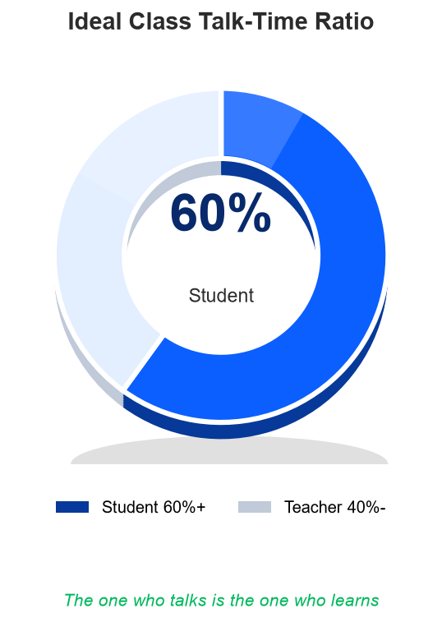
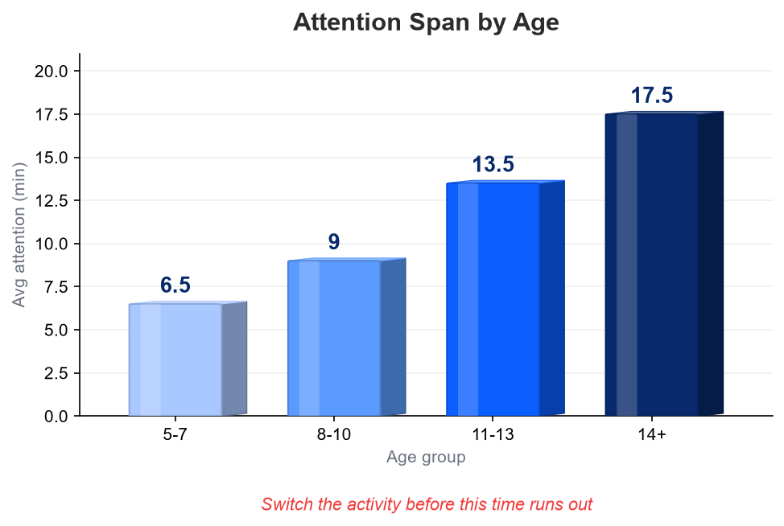
13
The Data Behind Engagement
Age = minutes of attention span
An ideal class: the child talks 60%+ of the time

Slide 16
14
Appendix A. The Engagement Cycle
Warm-up → Mission → Speaking → Game → Feedback → Next. One full loop is a complete engagement structure.
1
Warm-up
2
Mission
3
Speaking
Slip in a light question that naturally touches on last session's mistakes, folded casually into small talk. The goal is to lower psychological walls.
Declare one crystal-clear, visible target: “Master these 3 words today, get a bonus game!” This instills game-starting motivation.
Minimize explanation; repeat 'ask -> answer -> ask again' so the child produces their own speech. The teacher is a conversation partner, not a lecturer.
→
→

Slide 17
15
Appendix A. The Engagement Cycle
4
Game reward
5
Instant reward
6
Data continuity
Activate a pre-prepared game right as energy starts to dip, around the 10-minute mark. This gives attention a crisp refresh.
Say “Look, Mango is dancing for you!” with celebratory effects across the screen. This stamps 'I did well' clearly into memory.
Immediately note today's tricky pronunciation or pattern — it becomes the fuel for next class's warm-up.
→
→

Slide 18
16
Appendix B. Teacher Self-Check Checklist
Self-check aligned to the before/during/after flow of a class. Print it and keep it beside you.
Before
During
After
Name, errors, hobbies
Use as material for the opening conversation
Set micro-goal
One light mission like 'get 3 words right'
Camera & lighting
Check like a mirror that your face is bright
Laugh within 30s
Bold gestures + a warm call of their name
60%+ student talk
Compress explanation, hand over the floor
Wait 3 seconds
Trust the thinking silence, don't rush it
Switch every 5-7 min
Move to the next game before fatigue hits
Log scores instantly
Record mistakes/weak sounds while fresh
Note next class idea
Leave a hint made just for this child

Slide 19
17
Appendix C. Teacher Evaluation Rubric
Score 1-3 per item and sum. The lowest-scoring item is the next coaching priority.
Criterion | What to Check for This Item | Score
1. Energy & Expression | Do exaggerated smiles and rich reactions clearly reach through the screen, making the child naturally feel the fun? | ___
2. Driving Student Talk | Is teacher intervention minimized so the child gets 60% or more of the class as talk time? | ___
3. Visible Achievement | Are tools like stars, badges, and mascot reactions actively used so the child clearly feels achievement? | ___
4. Personalization | Are the child's name, interests, and past-session records woven in naturally so it feels like 'their own class'? | ___
5. Rhythm & Transitions | Are activities switched rhythmically every 5-7 minutes so the child's focus never has a chance to drift? | ___
6. Platform Mastery | Are the game tab, effect sounds, and integrated games handled smoothly, with no lag or fumbling? | ___

Slide 20
18
Coaching Priority Guide by Total Score
15-18 pts (Excellent)
Consistently excellent across every area. Worth recommending as a mentor for new teachers or a best-practice clip provider.
10-14 pts (Reliable Quality)
Generally reliable, but growth accelerates a lot with focused coaching on the 1-2 items that scored lowest.
Under 9 pts (Needs Coaching)
Improvement is urgently needed across multiple areas. A 1-on-1 mock-class feedback session is strongly recommended.

Slide 21
19
04. Teacher Certification
Manager and teacher jointly pledge adherence to this manual
“I have understood and mastered the 5 core behaviors, engagement cycle, and age-specific tactics in Mangoi's Manual v2.0, and commit to delivering boredom-free lessons to every student.”
Mangoi Training Lead
Certified Teacher
Teacher Success Lead
Professional Teacher
Your energy today becomes a child's lifelong English confidence.
© Mangoi English | Teacher Success Team

