Slide 1
IIOT Training
Jan-2024 Rev.A

Slide 2
Table of contents
Day1
Basic MIC IIOT Device
Day2
Modbus with HMI (GOT)
Day3
Arduino OOP(2)
Day4
Real time database
MQTT
Multitasking
Modbus
Arduino OOP (1)

Slide 3

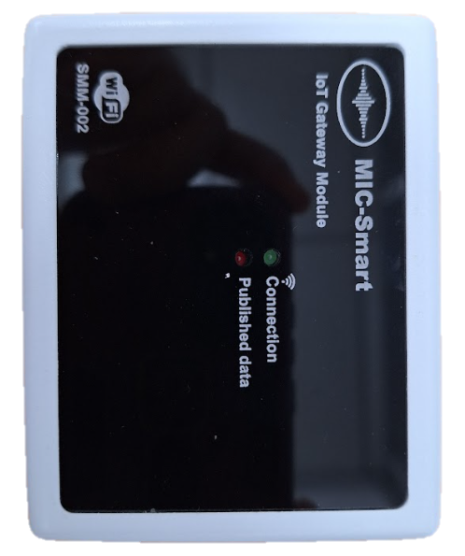
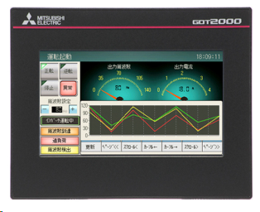





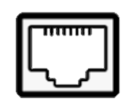
Basic MIC IIOT Device(1)
Diagram
RS232
Modbus protocol
HMI GOT 2000
Communication
protocol
MIC-SMM002
MIC SMM002 Interface
Input interface
Output interface
RS232
LAN

Slide 4
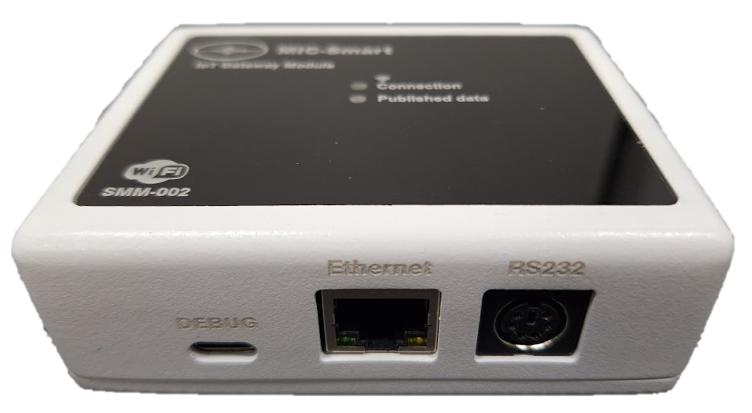
Basic MIC IIOT Device(2)
IIOT Device features
Application Features
IoT Gateway Module designed for seamless connectivity and communication.
Power Requirements:
Operates on 5VDC -1A
Microcontroller:
Powered by the ESP32-S2-wrover-i for efficient and versatile control.
Communication Ports:
Equipped with Ethernet and RS232 ports for flexible communication options.
Memory Storage
Supports SD Card for expanded storage capacity. Includes 4MB SPI Flash and 2MB PSRAM for efficient data handling.
Wireless Connectivity
Utilizes WiFi with a bit rate of 150 Mbps at the 2.4 GHz frequency.
Communication Protocols
Supports MQTT, ModbusTCP, and ModbusRTU for seamless integration with various systems

Slide 5
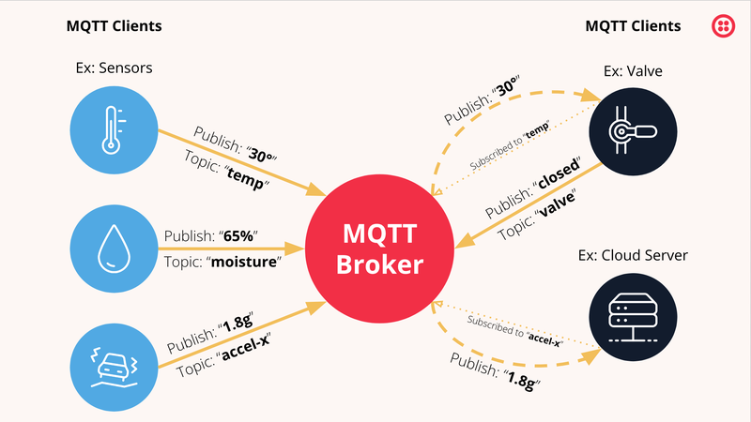
MQTT(1)
MQTT Concept

Slide 6
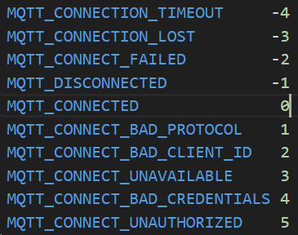
MQTT(2)
Arduino with MQTT
Library : PubSubClient
1.MQTT simple : https://drive.google.com/file/d/14ONiJswlLQkfvosV9_e0AGpCK5Qh3lGf/view?usp=drive_link
2.MQTT multi data : https://drive.google.com/file/d/1DHtyyoI58EQfIvn38ac2vvkxSERP5Jlh/view?usp=drive_link
Errors list for MQTT

Slide 7
Multitasking
Arduino with Mutitasking
Concept:
CPU0
CPU1
Priority 5
Priority 4
Priority …
Priority 0
Task A
Task A
Task A
Task A
Task B
Task B
Task B
Task B
xTaskCreatePinnedToCore(fTaskFunction,TaskName,StackDepth, PassParam,TaskPriority,TaskHandle,CPU);
Code : https://drive.google.com/file/d/1aQ1BOtpQ70SqpBalbzuQP453ZleV1zRN/view?usp=drive_link

Slide 8
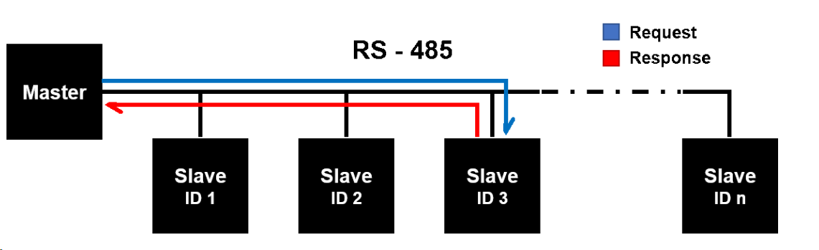
Modbus
Modbus RTU
Concept diagram
Type | Start address
Output coils | 000001
Input contacts | 100001
Input registers | 300001
Holding registers | 400001
Code : https://drive.google.com/file/d/1Dp_vIMGP63b8P4RrQrNveA2kc2_HTmfo/view?usp=drive_link

