Slide 1

Under the Esteemed Guidance of Dr. V. Lakshman Narayana Professor & HOD
Water Quality Prediction Using Long Short Term Memory
with Deep Deterministic Policy Gradient
Batch members
N. Naveena (21NN1A0544)
B. Sravya (21NN1A0505)
G.V.S.Sai Lakshmi (21NN1A0520)
K.S Manogna (21NN1A0528)
V. Navya Sree (22NN5A0506)

Slide 2
Index
Abstract
Introduction
Literature Survey
Research Gaps Identified
Proposed Work
System Architecture
Algorithm
Dataset Used
Results and Discussions
Conclusion
References

Slide 3
Abstract
Water quality prediction is important for public health and safety, as well as for managing water resources. Water quality is affected by many factors, including pollution, climate change, and human activities. Traditional Models like Long short term memory (LSTM ) uses a fixed learning approach and is unable to dynamically modify its predictions based on new data. Even Recurrent neural network (RNN) is created for sequential data, they are unable to learn long-term dependencies in water quality datasets due to vanishing gradient problems. Deep neural network (DNN) is not suitable for time-series data and have trouble with sequential dependencies. The main problem is that existing models fail to dynamically adapt to new data and struggle to capture the complex, long-term patterns in water quality datasets which are caused by factors like pollution, climate change, and human activities. In this project, LSTM with Deep Deterministic Policy Gradient (DDPG) is proposed. LSTM model extracts temporal dependencies and patterns within the dataset, capturing essential feature representations that influence water quality classification. These extracted features serve as input to the DDPG algorithm, which acts as a reinforcement learning framework to optimize decision-making. The proposed model achieves 98% accuracy in water quality prediction. This model is more effective than the traditional models and provides accurate, real-time predictions for water quality.

Slide 4
Introduction
Deep learning is used in water quality prediction because it can analyze complex patterns and relationships within large datasets, which traditional methods struggle to handle.
Water quality data consists of multiple parameters like pH, turbidity, solids, and conductivity, which are highly nonlinear and interdependent.
Deep learning models can efficiently process large datasets with multiple variables. Deep learning models can generalize well across different water bodies like rivers, lakes, ponds adapting to variations in water quality parameters.
Traditional models Like RNN and DNN struggle to capture long-term dependencies in such sequential data.
RNNs are better at handling short-term dependencies but fail to retain information over long sequences, which is critical for water quality prediction.
To overcome this challenge, LSTM networks, are widely used to processes past observations to predict future trends, making it suitable for time-series forecasting in water quality analysis.
LSTM networks can recognize complex patterns and trends in water quality data, allowing them to make more accurate predictions even in cases where historical data exhibits non-linear relationships.

Slide 5
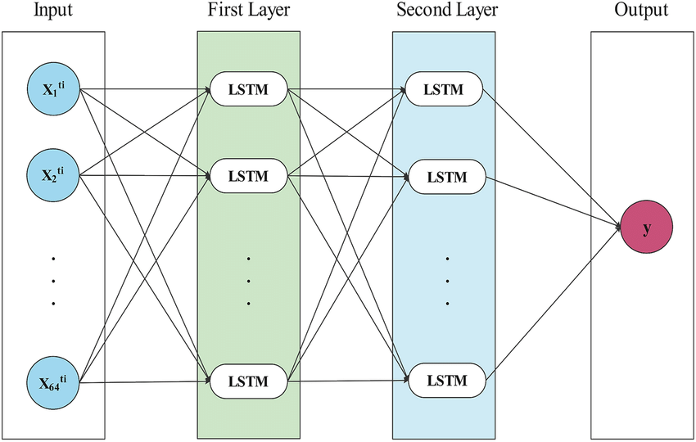
However, LSTM models have limitations in optimizing long-term decision-making, as they rely on past observations without an adaptive learning mechanism.
To overcome these limitations DDPG integrated with LSTM, enabling reinforcement learning-based optimization that dynamically adjusts predictions based on evolving patterns in water quality data. The training process of DDPG begins with the actor network taking the current state of water quality data and predicting an action.
The critic network valuating the quality of actions taken by the actor network. It provides feedback on how good or bad an action is, guiding the actor network to make better decisions.
Fig: LSTM Architecture

Slide 6
Literature Survey
REFERENCE | AUTHOR | MODEL | DESCRIPTION | MERITS | DEMERITS
1 | Sathya Preiya V. M. et al.., (2024) | Water Quality Index Prediction and Classification using Hyperparameter Tuned Deep Learning (WQIPC-HTDL) | It provides hybrid deep learning for aquaculture prediction. | It allows for continuous, real-time monitoring of water quality, offering faster predictions compared to manual testing methods. | The model's performance heavily relies on the availability of quality historical data. Inadequate data can lead to inaccurate predictions.
2 | Bhagavathi Perumal et al.., (2023) | Long Short-Term Memory (LSTM)–gray wolf optimization (GWO)–fish swarm optimization (FSO) | LSTM predicts waste water treatment quality. | Improve the accuracy of water quality predictions, especially in the presence of non-point source (NPS) pollution. | It needs regular updates with fresh data to maintain its accuracy and effectiveness. Without proper maintenance, the predictions may become outdated.
3 | Yunjeong Im et al.., (2022) | LSTM | It provides deep learning model to predict tap water quality. | It can cover all the major water treatment facilities in the country, ensuring a nationwide solution for monitoring water quality, not just localized systems. | It requires Technical expertise and can be complex, especially when integrating large-scale data from multiple sources.

Slide 7
REFERENCE | AUTHOR | MODEL | DESCRIPTION | MERITS | DEMERITS
4 | Archana Solanki et al.., (2020) | Denoising autoencoder | It provides Spatial-temporal hybrid model for WQI. | It can provide accurate predictions of water quality parameters like pH, dissolved oxygen, and turbidity, which helps in better water management. | Prone to overfitting, especially when trained on a relatively small dataset or when Hyper parameters are not optimized properly.
5 | Mohammad Ehteram et al.., (2024) | Convolutional neural network (CNN) | It provides CNN for water quality index prediction. | It allows the model to capture both spatial and temporal patterns, making it effective at analyzing complex water quality data with varying characteristics. | It can be very powerful, they may lack transparency and interpretability in comparison to simpler models, making it harder to understand the exact reasoning behind specific predictions.

Slide 8
REFERENCE | AUTHOR | MODEL | DESCRIPTION | MERITS | DEMERITS
6 | Nitzan Farhi et al.., (2021) | Long Short-Term Memory (LSTM) neural network | This study proposes a machine learning-based approach using Long Short-Term Memory (LSTM) networks to predict ammonia (NH₄⁺) and nitrate (NO₃⁻)concentrations in wastewater treatment plants (WWTP). | Prevents excessive nitrogen discharge, reducing eutrophication risks. | Accuracy relies on high-quality sensor and weather data.
7 | ZENING WU et al.., (2020) | Gradient boosting decision tree (GBDT) | This study focuses on predicting water accumulation at key flood-prone areas using the Gradient Boosting Decision Tree (GBDT) algorithm. | The model effectively predicts water accumulation with relatively low error rates. | It predicts water accumulation but does not consider other flood factors like drainage efficiency or topography.

Slide 9
Research Gaps Identified
RNNs struggle to learn long-term dependencies in water quality data due to the vanishing gradient problem, which makes it difficult to capture trends over extended periods.
RNNs are better at handling short-term dependencies but fail to retain information over long sequences, which is critical for water quality prediction.
DNNs are not inherently designed for time-series or sequential data, which is essential for water quality prediction.
While designed to handle long-term dependencies, it may still struggle with very long sequences or complex dependencies in water quality datasets.
Lacks a feedback mechanism to improve predictions based on errors or new data.

Slide 10
Proposed Work
In the proposed LSTM-DDPG model, a combination of LSTM networks and the DDPG algorithm is employed to enhance the accuracy and reliability of water quality prediction for human consumption.
These advanced deep learning and reinforcement learning techniques work together to extract meaningful patterns from time-series water quality data and dynamically improve prediction performance.
The combined LSTM-DDPG model works by integrating the strengths of both time-series analysis and adaptive decision-making to predict water quality with high accuracy.
The model efficiently processes and predicts water quality by combining historical data analysis with real-time adaptive learning, ensuring highly accurate and dynamic predictions.
This high accuracy in water quality prediction is crucial for ensuring reliable decision-making, minimizing risks, and optimizing resource management.
The LSTM-DDPG model, with its ability to achieve over 98% accuracy, provides significant advantages across multiple domains, particularly in agriculture, environmental monitoring, and public health.

Slide 11
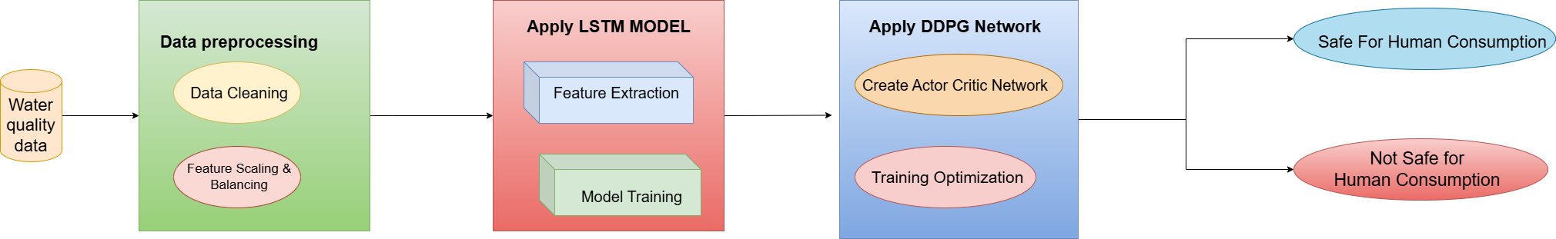
System Architecture

Slide 12
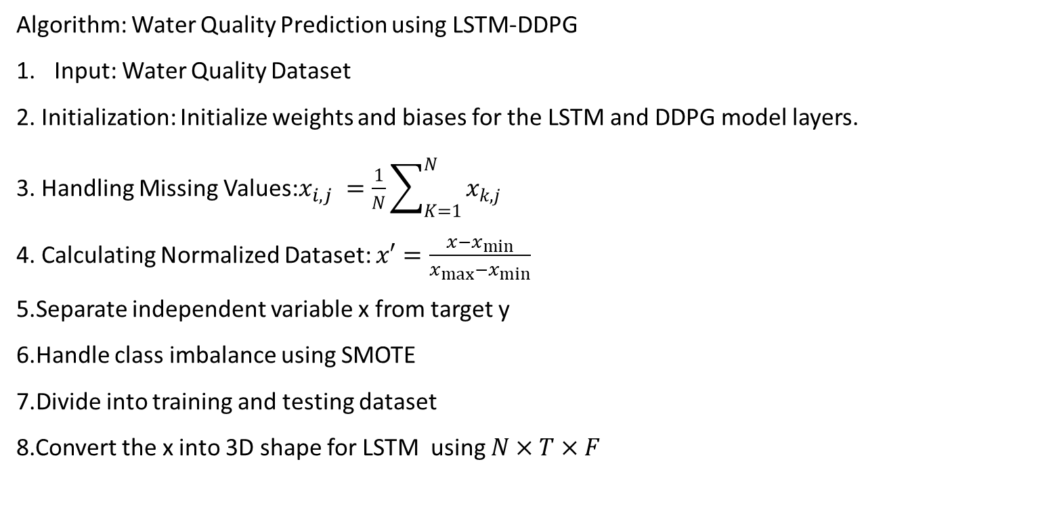
Algorithm

Slide 13
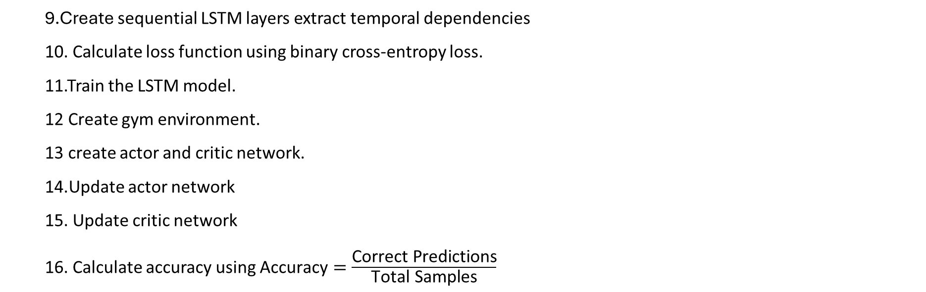
9.Create sequential LSTM layers extract temporal dependencies
10. Calculate loss function using binary cross-entropy loss.
11.Train the LSTM model.
12 Create gym environment.
13 create actor and critic network.
14.Update actor network
15. Update critic network
16. Calculate accuracy using $\text{Accuracy}=\frac{\text{Correct} \text{Predictions}}{\text{Total} \text{Samples}}$

Slide 14
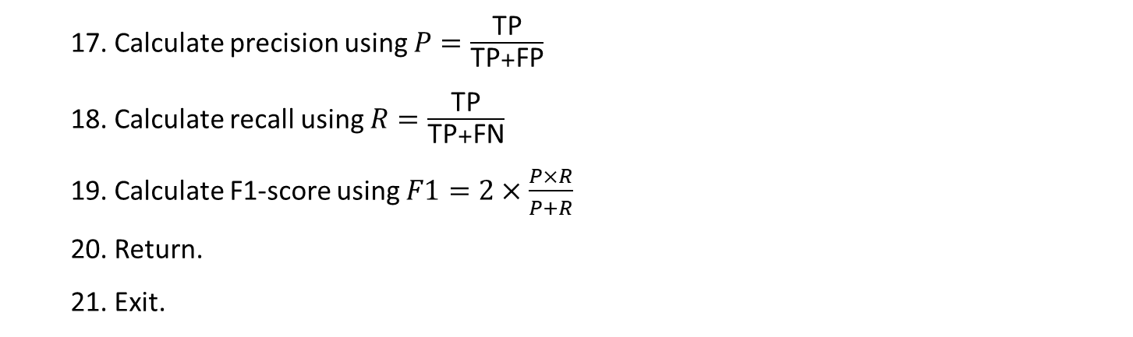
17. Calculate precision using $P=\frac{\text{TP}}{\text{TP}+\text{FP}}$
18. Calculate recall using $R=\frac{\text{TP}}{\text{TP}+\text{FN}}$
19. Calculate F1-score using $F1=2×\frac{P×R}{P+R}$
20. Return.
21. Exit.

Slide 15
Dataset Used
The dataset consists of 11,999 entries and five features, four of which are numerical water quality parameters, while the fifth is a categorical target variable indicating potability.
The following are features:
pH: Represents the pH level of water and measures the acidity or alkalinity of the water. The safe pH range for human consumption generally falls between 6.5 and 8.5
Solids: Represents the total dissolved solids in water. The concentration of solids in water affects its taste, appearance, conductivity, and potential health risks.
Conductivity: Helps assess the level of dissolved salts and potential contamination.
Turbidity: Turbidity refers to the cloudiness or haziness of water caused by suspended particles such as silt, clay, organic matter, bacteria, and algae. It is an important parameter in water quality prediction because it indicates the presence of contaminants and pollutants.
Potability: It is the target variable indicating whether the water is potable or not potable. 0 indicates not potable and 1 indicates Potable.
Dataset link: https://www.kaggle.com/code/imakash3011/water-quality-prediction-7-model

Slide 16
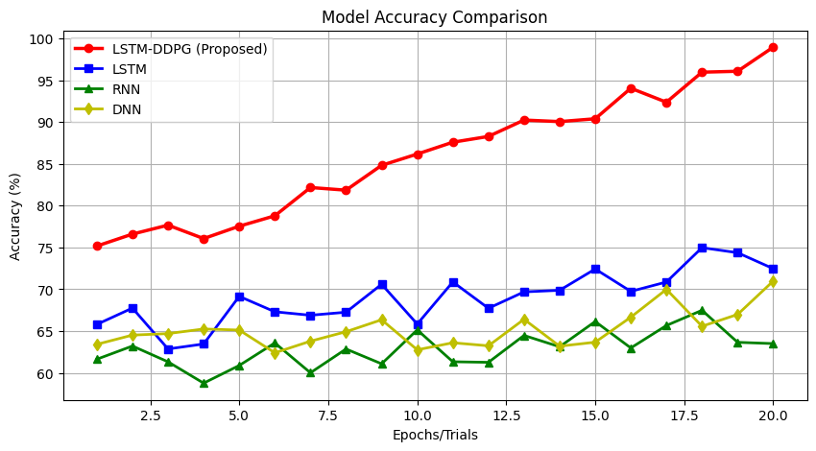
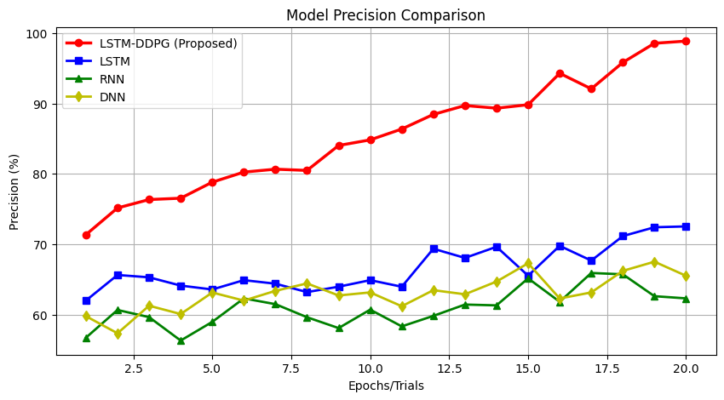
Results & Discussion
,
Fig1 Fig 2
Fig 1 shows the accuracy comparison of different models , showing that the LSTM-DDPG achieves higher accuracy with 98 %. LSTM, RNN, and DNN exhibit lower accuracy.
Fig 2 shows the precision comparison of different models, where the LSTM-DDPG demonstrates a significant improvement in precision compared to LSTM, RNN, and DNN. The LSTM-DDPG model reaching 98% precision, while the other models remain relatively lower.

Slide 17
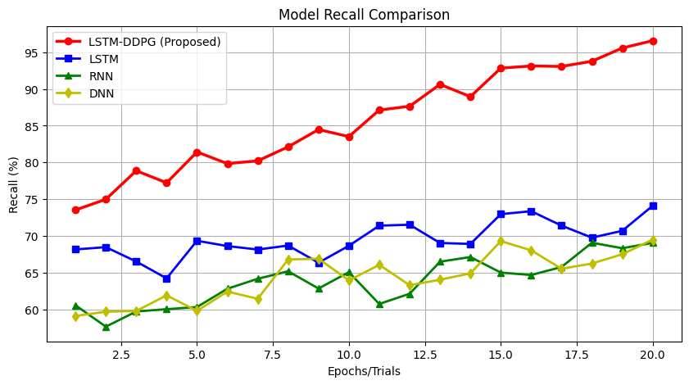
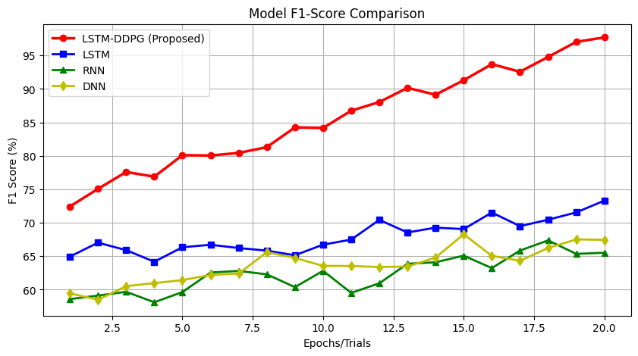
Fig 3 Fig 4
Fig-3 shows the recall comparison of different models. The LSTM-DDPG consistently improves and reaches 97%. Other models LSTM, RNN, DNN show lower recall.
Fig-4 shows the f1-score comparison of different models, where the LSTM-DDPG shows a steady increase, reaching around 98%. Other models LSTM, RNN, DNN shows lower F1-scores.

Slide 18
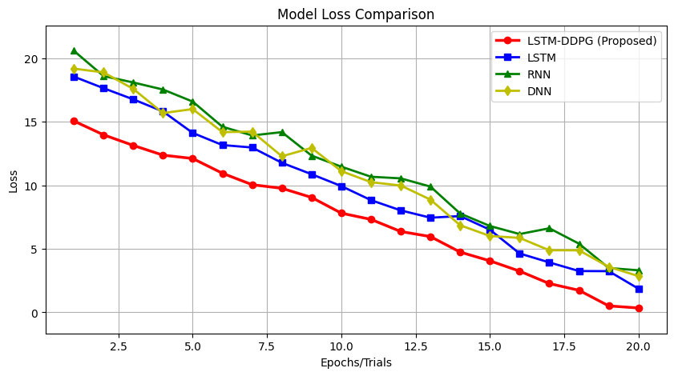
Fig 5
Fig-5 compares the loss values of different models, showing a decreasing trend for all models. The LSTM-DDPG achieves the lowest loss 20%, indicating better performance and faster convergence than LSTM, RNN, and DNN.

Slide 19
Conclusion& Future work
In this project water quality prediction explored using a combination LSTM networks with DDPG reinforcement learning. The LSTM model effectively captured the temporal dependencies in sequential water quality data, while DDPG optimized the prediction process by enhancing model accuracy through reinforcement learning-based decision-making.
In results demonstrate that the LSTM-DDPG model outperforms traditional deep learning approaches by improving prediction accuracy and adaptability in dynamic environments.
Proposed LSTM-DDPG model for water quality prediction, demonstrating its effectiveness in accurately classifying water quality for human consumption.
Proposed model achieved an impressive accuracy of 98%, outperforming traditional models such as RNN, DNN, and LSTM.
The model successfully identifies critical patterns in water quality parameters, making it a promising tool for real-time monitoring and decision support in water resource management.

Slide 20
References
Rasheed Abdul Haq, K. P., & Harigovindan, V. P. (2022). "Water quality prediction for smart aquaculture using hybrid deep learning models." IEEE Access, 10, 60078–60097
Im, Yunjeong, et al. "Deep Learning Methods for Predicting Tap-Water Quality Time Series in South Korea." Water 2022, 14, 3766. IEEE, 2022.
Sathya Preiya, V. M., Subramanian, P., Soniya, M., & Pugalenthi, R. (2024). "Water quality index prediction and classification using hyperparameter tuned deep learning approach." Global NEST Journal, 26(5), 05821
Perumal, Bhagavathi, et al. "Water Quality Prediction Based on Hybrid Deep Learning Algorithm." Advances in Civil Engineering, vol. 2023, Article ID 6644681, 2023
Chen, Jixuan, et al. "Deep Learning for Water Quality Prediction—A Case Study of the Huangyang Reservoir." Applied Sciences, vol. 14, no. 8755, 2024.
Mamatha, Donthula, Halavath Balaji, and Sreedhar Bhukya. "Enhancing Water Quality using Deep Learning with VGG19 Approach." International Journal of Intelligent Systems and Applications in Engineering, vol. 12, no. 3, 2024, pp. 3183–3189.

Slide 21
THANK YOU

