Slide 1

Project Title - Car Market Analysis
AICTE STU ID : STU6a606dac51ad41784704428
Chitturi Navya

Slide 2

PROBLEM STATEMENT
It is difficult to understand which factors have the greatest impact on a car's selling price.
Buyers and sellers need data-driven insights to evaluate a vehicle's fair market value.
This project analyzes historical Car Dekho data to identify important market trends and pricing patterns.
The goal is to provide meaningful insights that support better buying, selling, and pricing decisions.

Slide 3
Project Description
This project focuses on analyzing Car Dekho used-car data using Python, data analysis, and visualization techniques. The dataset contains information such as car name, manufacturing year, selling price, present price, kilometers driven, fuel type, seller type, transmission, and number of previous owners.
The analysis explores relationships between these variables and identifies important factors associated with used-car selling prices. The results help stakeholders understand pricing patterns and make informed decisions.

Slide 4

WHO ARE THE END USERS?
Car Buyers Compare cars and identify reasonable prices.
Car Sellers Estimate competitive selling prices.
Car Dealers Understand demand and pricing trends.
Used-Car Businesses Support inventory and pricing decisions.
Data Analysts / Business Teams Derive insights from automobile market data.

Slide 5

Technology Used
Python
Pandas
NumPy
Matplotlib
Seaborn

Slide 6
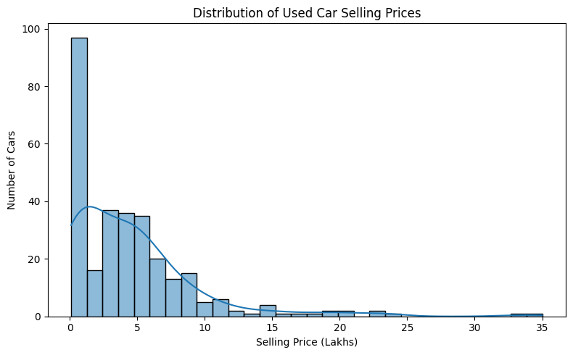
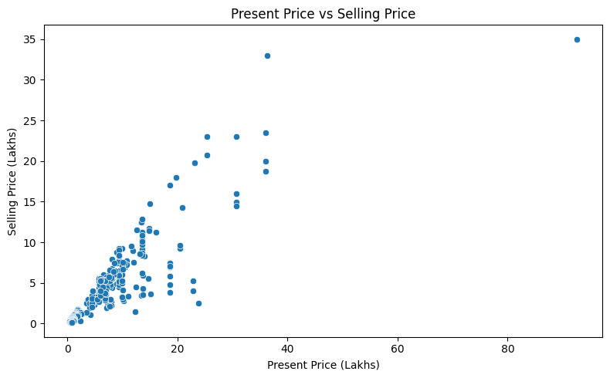
RESULTS – PRICE ANALYSIS
Selling Price Distribution
Present Price vs Selling Price
Most cars are sold at relatively lower prices, with a small number of high-priced cars.
Present Price has a strong positive relationship with Selling Price (correlation = 0.876).
Demo Link

Slide 7
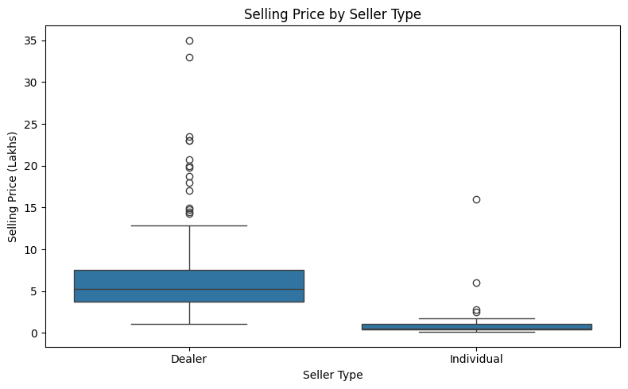
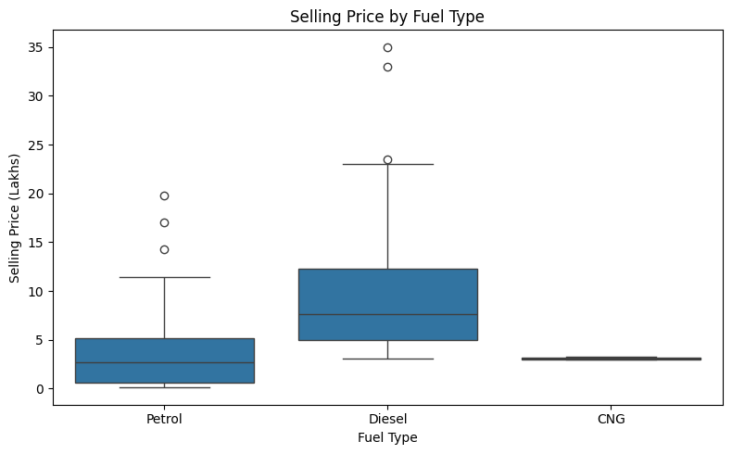
RESULTS - Fuel & Seller Analysis
Fuel Type vs Selling Price
Seller Type vs Selling Price
Dealer-sold cars have a higher average selling price (6.63 lakhs) than individually sold cars (0.87 lakhs).
Diesel cars have the highest average selling price (10.10 lakhs).
Demo Link

Slide 8
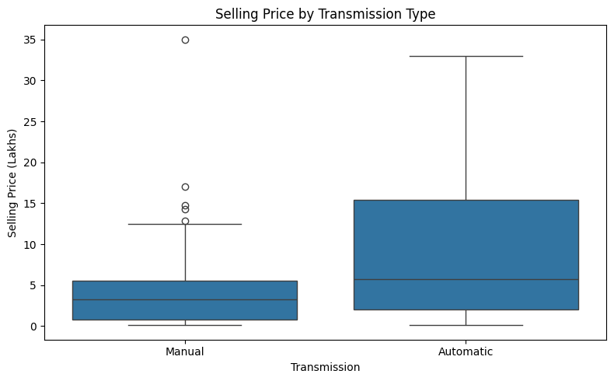
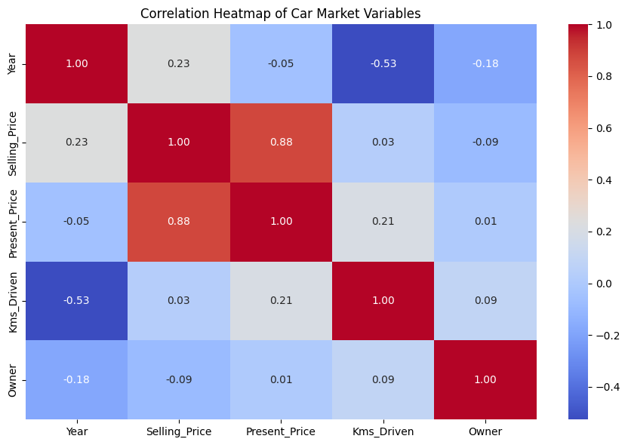
RESULTS - Transmission & Correlation
Selling Price by Transmission
Correlation Heatmap
Automatic cars have a higher average selling price (9.07 lakhs) than manual cars (3.92 lakhs).
Present Price has the strongest positive relationship with Selling Price (correlation = 0.876).
Demo Link

Slide 9
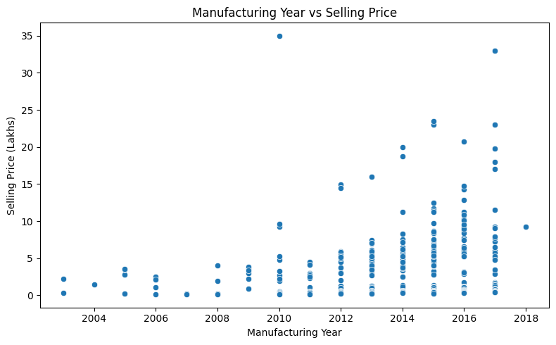
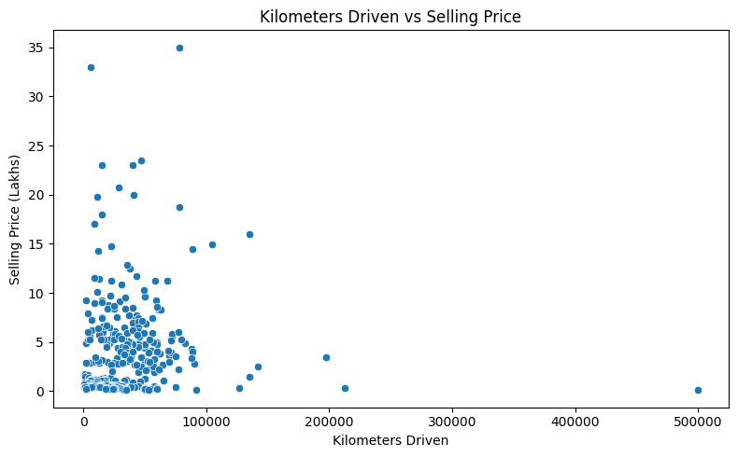
RESULTS - Additional Analysis
Manufacturing Year vs Selling Price
Kilometers Driven vs Selling Price
Newer vehicles generally tend to have higher selling prices than older vehicles.
Kms Driven has a very weak relationship with Selling Price (correlation = 0.029).
Demo Link

Slide 10
Thank you
.
.

