Slide 1
THREADS
-- By Navya

Slide 2
What is a Thread?
A thread is a light-weight process.
Light-Weight: A process that consumes of less amount of CPU and Memory.
Process: A program that is continuously under execution.

Slide 3
JVM Work
When we run a JAVA program, JVM internally creates 3 new thread.
They are:
Thread Scheduler
Garbage Collector
Main Thread
-Garbage Collector and Thread Scheduler are daemon threads.

Slide 4
Create Thread
We can create thread in 2 ways.
By extending thread class
By Implementing Runnable Interface.
Let’s see the examples…….

Slide 5
Thread.sleep()
Sleep() is a static method present in thread class.
Sleep() method is used by the programmer to pause program execution for a certain time interval.
Sleep() method is risky and may cause “Interrupted Exception”.
Let’s see example…..

Slide 6
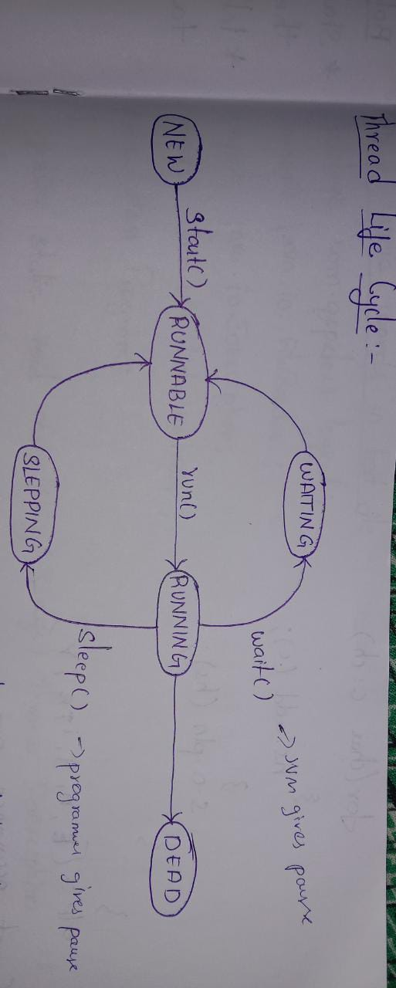
Thread LifeCycle

