Slide 1
FINANCIAL RESEARCH AUTOMATION (FRA)
Meta Platforms, Inc. (META)
Quarterly Financial Performance & Peer Benchmarking Report
Exchange: NASDAQ | Sector: Information Technology | Generated: September 18, 2026

Slide 2
Executive Financial Summary
Meta Platforms, Inc. (META) - Core Performance Indicators
QUARTERLY TOTAL
$60,801.0 M
Latest Revenue
PROFITABILITY
26.1%
Net Profit Margin
SHAREHOLDER RETURN
6.1%
Return on Equity (ROE)
LIQUIDITY BUFFER
2.23x
Current Ratio
Period | Report Date | Revenue ($M) | Net Income ($M) | YoY Growth | Net Margin | ROE
Q2 2025 | 2025-06-30 | 47,516.0 | 18,337.0 | N/A | 38.6% | 9.4%
Q3 2025 | 2025-09-30 | 51,242.0 | 2,709.0 | N/A | 5.3% | 1.4%
Q4 2025 | 2025-12-31 | 59,893.0 | 22,768.0 | N/A | 38.0% | 10.5%
Q1 2026 | 2026-03-31 | 56,311.0 | 26,773.0 | N/A | 47.5% | 11.0%
Q2 2026 | 2026-06-30 | 60,801.0 | 15,848.0 | +28.0% | 26.1% | 6.1%

Slide 3
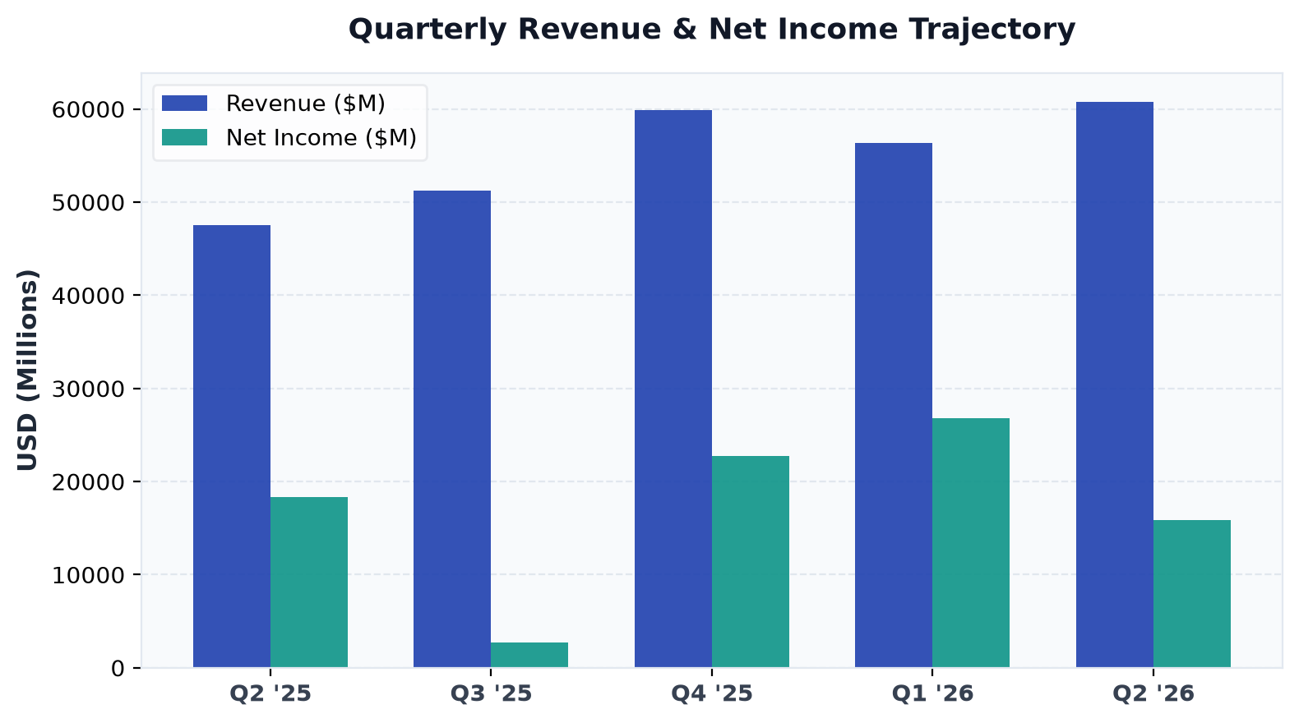
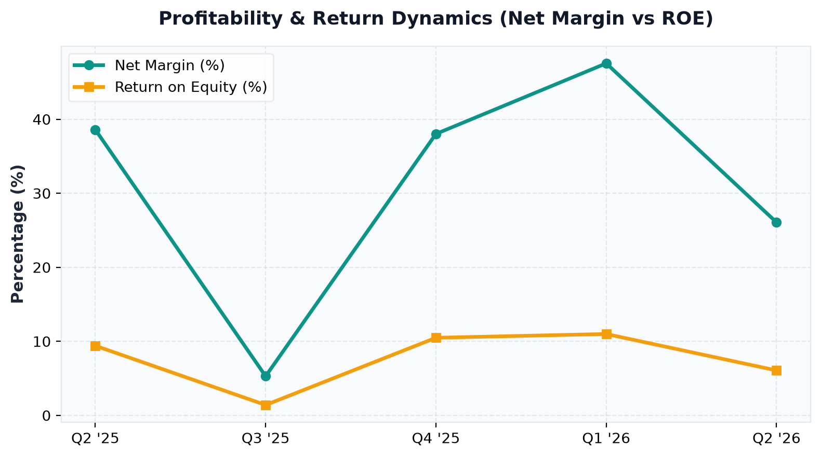
Financial Trajectory & Trends
Multi-quarter revenue, net income, and margin performance
Key Analytical Insights:
• META delivered $60,801.0M in latest quarterly revenue with a robust net margin of 26.1%.
• Balance sheet shows stable liquidity with consistent operating cash flow generation.

Slide 4
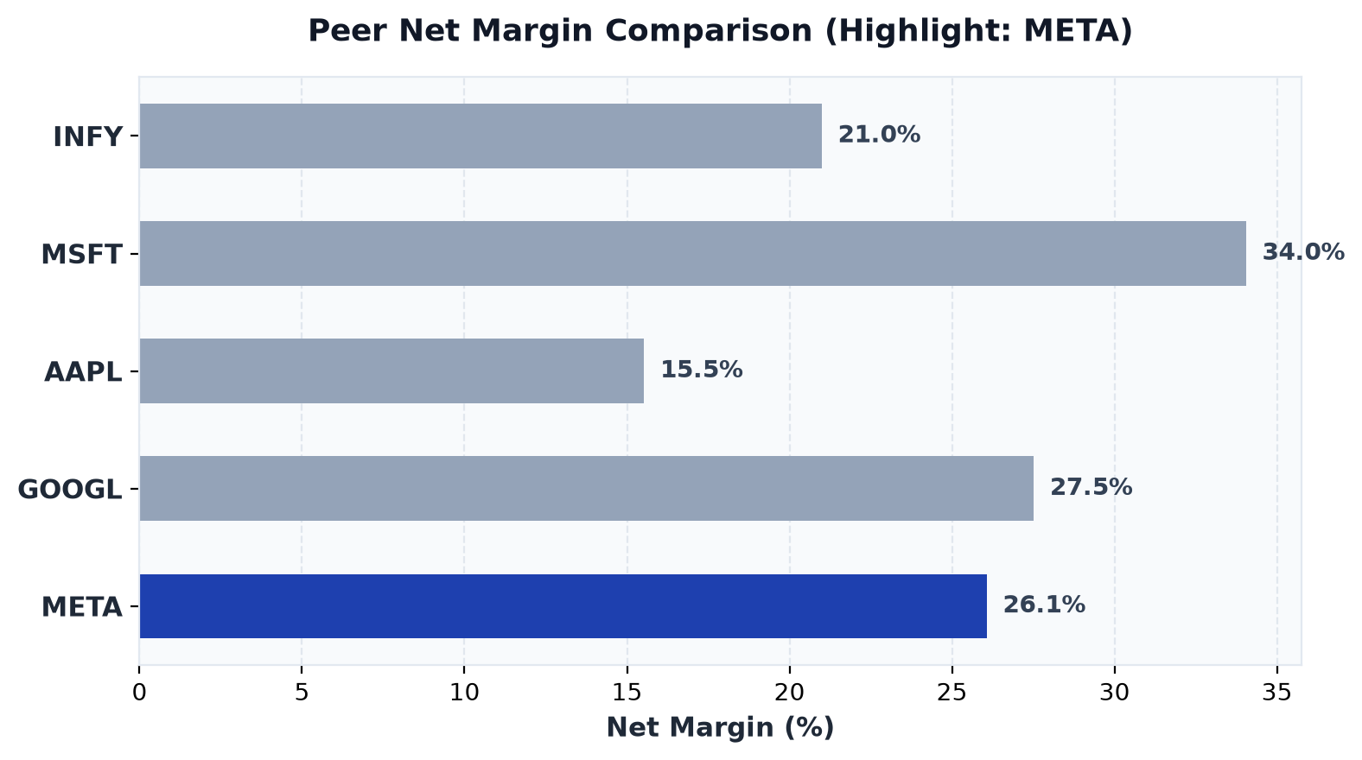
Peer Benchmark & Percentile Standing
META competitive position relative to industry peers
Ticker | Net Margin | ROE | Percentile Rank
INFY | 21.0% | 9.7% | 40th pct
MSFT | 34.0% | 8.2% | 100th pct
AAPL | 15.5% | 25.9% | 20th pct
GOOGL | 27.5% | 7.8% | 80th pct
META * | 26.1% | 6.1% | 60th pct

