Slide 1
FINANCIAL RESEARCH AUTOMATION (FRA)
UNKNOWN Corporation (AAPL)
Quarterly Financial Performance & Peer Benchmarking Report
Exchange: NASDAQ | Sector: Information Technology | Generated: September 18, 2026

Slide 2
Executive Financial Summary
UNKNOWN Corporation (AAPL) - Core Performance Indicators
QUARTERLY TOTAL
$5,520.0 M
Latest Revenue
PROFITABILITY
20.1%
Net Profit Margin
SHAREHOLDER RETURN
11.3%
Return on Equity (ROE)
LIQUIDITY BUFFER
2.61x
Current Ratio
Period | Report Date | Revenue ($M) | Net Income ($M) | YoY Growth | Net Margin | ROE
Q1 2024 | 2023-06-30 | 5,100.0 | 980.0 | N/A | 19.2% | 11.1%
Q2 2024 | 2023-09-30 | 5,250.0 | 1,020.0 | N/A | 19.4% | 11.2%
Q3 2024 | 2023-12-31 | 5,380.0 | 1,060.0 | N/A | 19.7% | 11.3%
Q4 2024 | 2024-03-31 | 5,520.0 | 1,110.0 | N/A | 20.1% | 11.3%

Slide 3
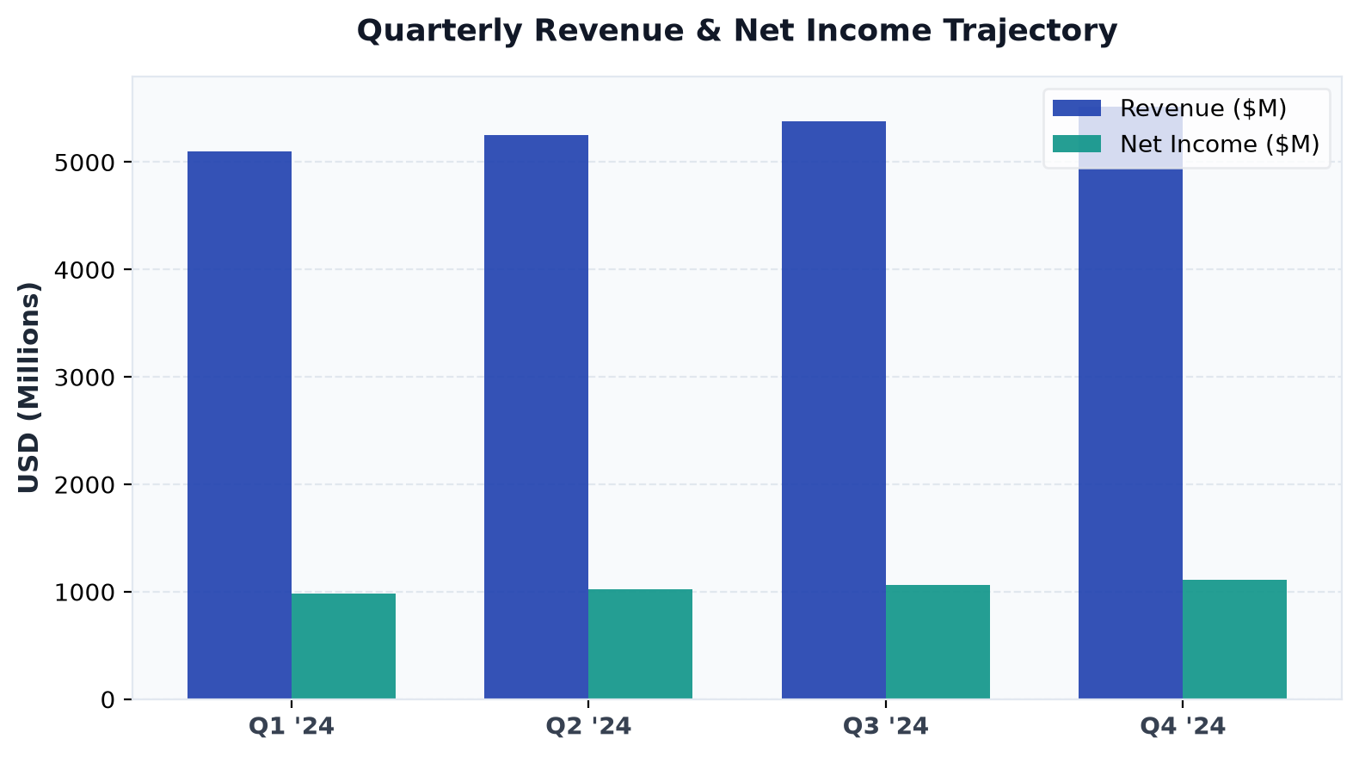
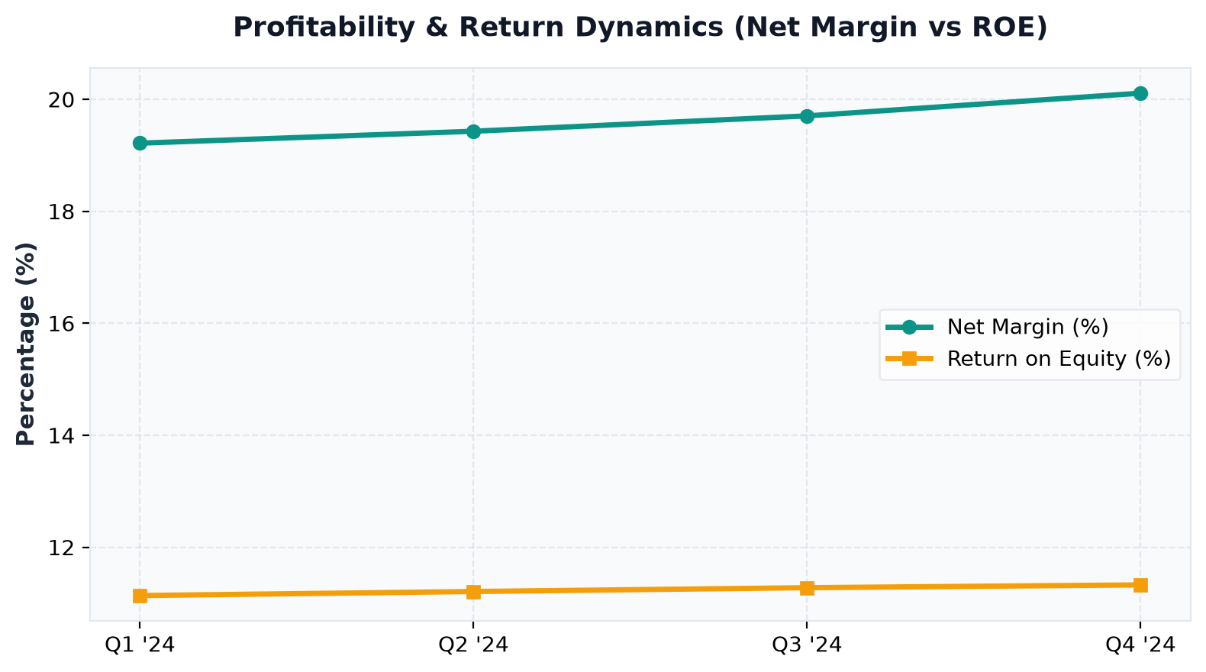
Financial Trajectory & Trends
Multi-quarter revenue, net income, and margin performance
Key Analytical Insights:
• AAPL delivered $5,520.0M in latest quarterly revenue with a robust net margin of 20.1%.
• Balance sheet shows stable liquidity with consistent operating cash flow generation.

Slide 4
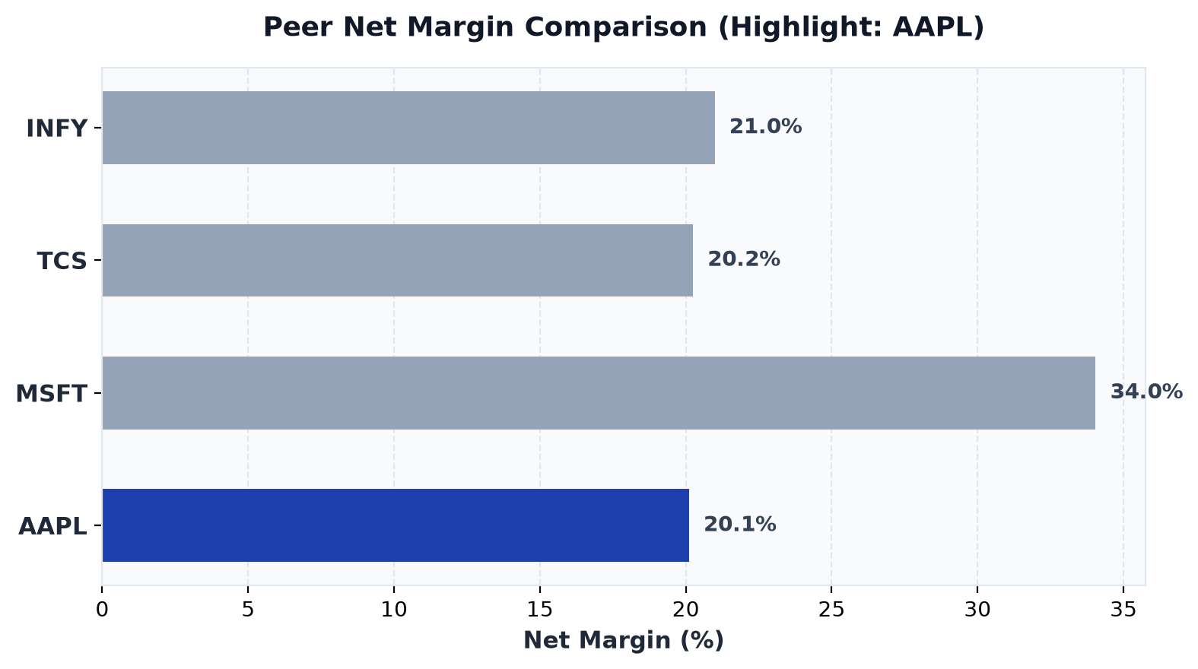
Peer Benchmark & Percentile Standing
AAPL competitive position relative to industry peers
Ticker | Net Margin | ROE | Percentile Rank
INFY | 21.0% | 9.7% | 75th pct
TCS | 20.2% | 12.4% | 50th pct
MSFT | 34.0% | 8.2% | 100th pct
AAPL * | 20.1% | 11.3% | 25th pct

