Slide 1
FINANCIAL RESEARCH AUTOMATION (FRA)
Infosys Limited (INFY)
Quarterly Financial Performance & Peer Benchmarking Report
Exchange: NASDAQ | Sector: Information Technology | Generated: September 18, 2026

Slide 2
Executive Financial Summary
Infosys Limited (INFY) - Core Performance Indicators
QUARTERLY TOTAL
$4,564.0 M
Latest Revenue
PROFITABILITY
21.0%
Net Profit Margin
SHAREHOLDER RETURN
9.7%
Return on Equity (ROE)
LIQUIDITY BUFFER
2.55x
Current Ratio
Period | Report Date | Revenue ($M) | Net Income ($M) | YoY Growth | Net Margin | ROE
Q1 2024 | 2023-06-30 | 4,617.0 | 724.0 | N/A | 15.7% | 7.9%
Q2 2024 | 2023-09-30 | 4,718.0 | 750.0 | N/A | 15.9% | 8.1%
Q3 2024 | 2023-12-31 | 4,663.0 | 732.0 | N/A | 15.7% | 7.8%
Q4 2024 | 2024-03-31 | 4,564.0 | 958.0 | N/A | 21.0% | 9.7%

Slide 3
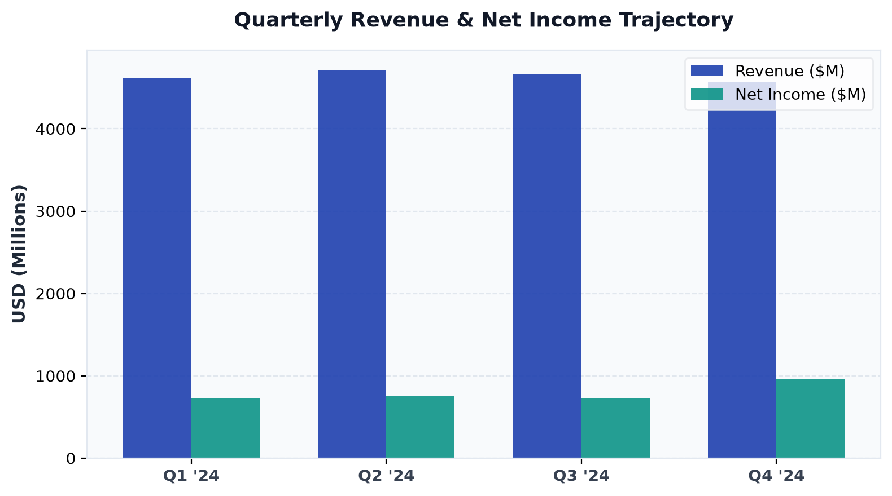
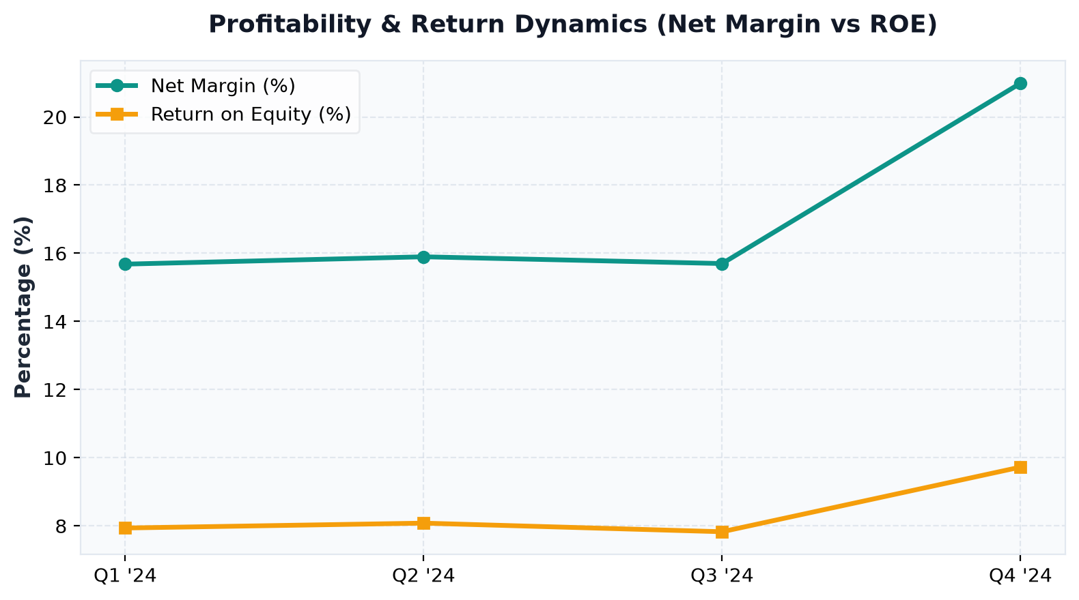
Financial Trajectory & Trends
Multi-quarter revenue, net income, and margin performance
Key Analytical Insights:
• INFY delivered $4,564.0M in latest quarterly revenue with a robust net margin of 21.0%.
• Balance sheet shows stable liquidity with consistent operating cash flow generation.

Slide 4
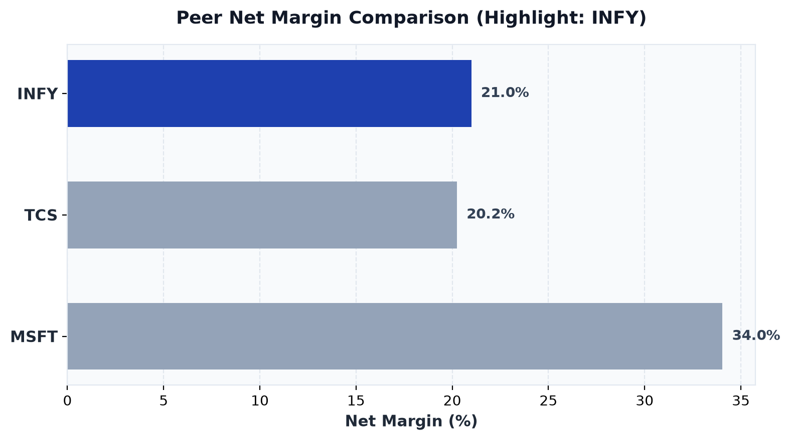
Peer Benchmark & Percentile Standing
INFY competitive position relative to industry peers
Ticker | Net Margin | ROE | Percentile Rank
INFY * | 21.0% | 9.7% | 67th pct
TCS | 20.2% | 12.4% | 33th pct
MSFT | 34.0% | 8.2% | 100th pct

