Slide 1
Launch widget delivery with city-specific playbooks — Doorlanta can launch selectively now; Dashattan first needs car-Dasher recruitment
EXECUTIVE SUMMARY
Two cities, one program, opposite constraints: Dashattan's bike-heavy fleet leaves ~8 widget-capable Dashers (one doing 62% of its car volume), while Doorlanta has ample car supply with wide reliability variance. Treating them identically breaks one market or under-protects the other.
1 · DASHER SELECTION
2 · SATCHEL DISTRIBUTION
3 · MEASURING SUCCESS
Two-stage funnel: hard gates (satchel-capable vehicle, experience, fraud review), then a performance score that counts only what Dashers control — on-time net of merchant holds, volume-weighted ratings. Same framework, city-calibrated bars: lower volume threshold + active recruiting in Dashattan; strict reliability bar in Doorlanta.
Match logistics to geography: central pickup hub with hands-on onboarding events in dense Dashattan (24x denser); ship-to-home with virtual training in sprawling Doorlanta. Both cities: deposit with earn-back, serial tracking, one universal ~30-min thermal spec (p90 trip ≈ 23 min in both).
Scorecard across all three marketplace sides, targets anchored to today's baselines (widget late ≤5% vs. 12–14% food), 30/60/90-day go/no-go gates, and guardrails so widgets don't degrade food delivery. Pre-launch fixes: no widget batching; add a promise buffer to scheduled orders.
8 vs 30
62%
2 in 5
27% vs 17%
~76
widget-capable Dashers today (Dashattan vs Doorlanta)
of Dashattan car deliveries ride on one Dasher
late deliveries trace to merchant holds >10 min, not Dashers
late rate, scheduled vs ASAP — scheduled quotes get no buffer
satchels needed per 1,000 daily food orders
SEQUENCING Pilot Doorlanta in Phase 1 with the strictest cohort while recruiting car Dashers in Dashattan; launch Dashattan in Phase 2 once supply clears ~15 qualified Dashers.

Slide 2
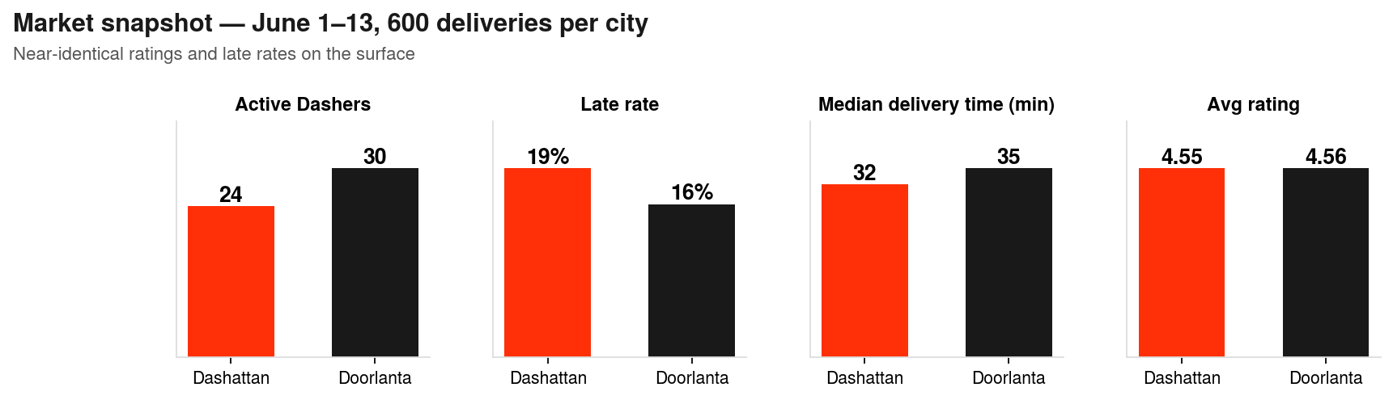
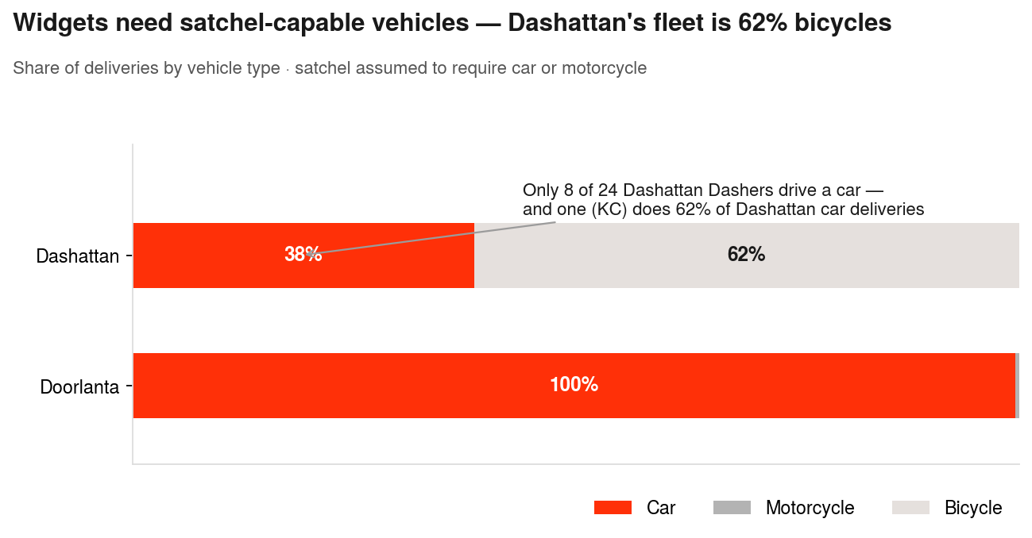
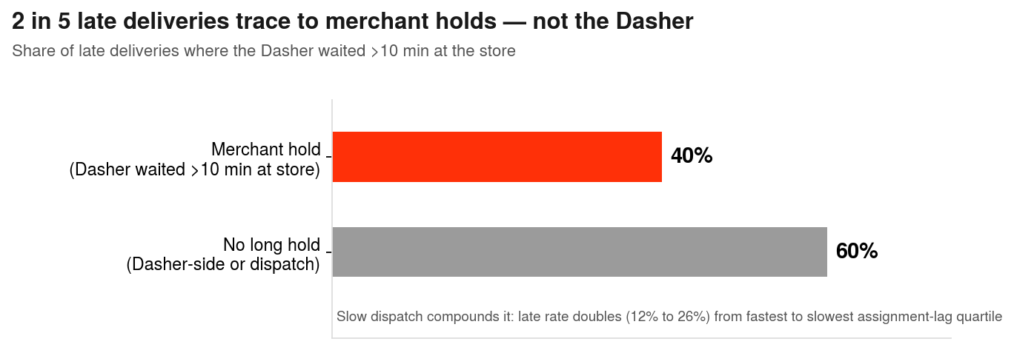
Service quality looks similar on the surface — underneath, the two markets face opposite constraints
WHAT THE DATA TELLS US
Lifecycle timestamps let us decompose every delivery (travel → wait → travel) and attribute lateness to its true cause.
SO WHAT Dashattan has a supply problem; Doorlanta has a selection problem — and any Dasher score must separate Dasher performance from merchant & dispatch delays.

Slide 3
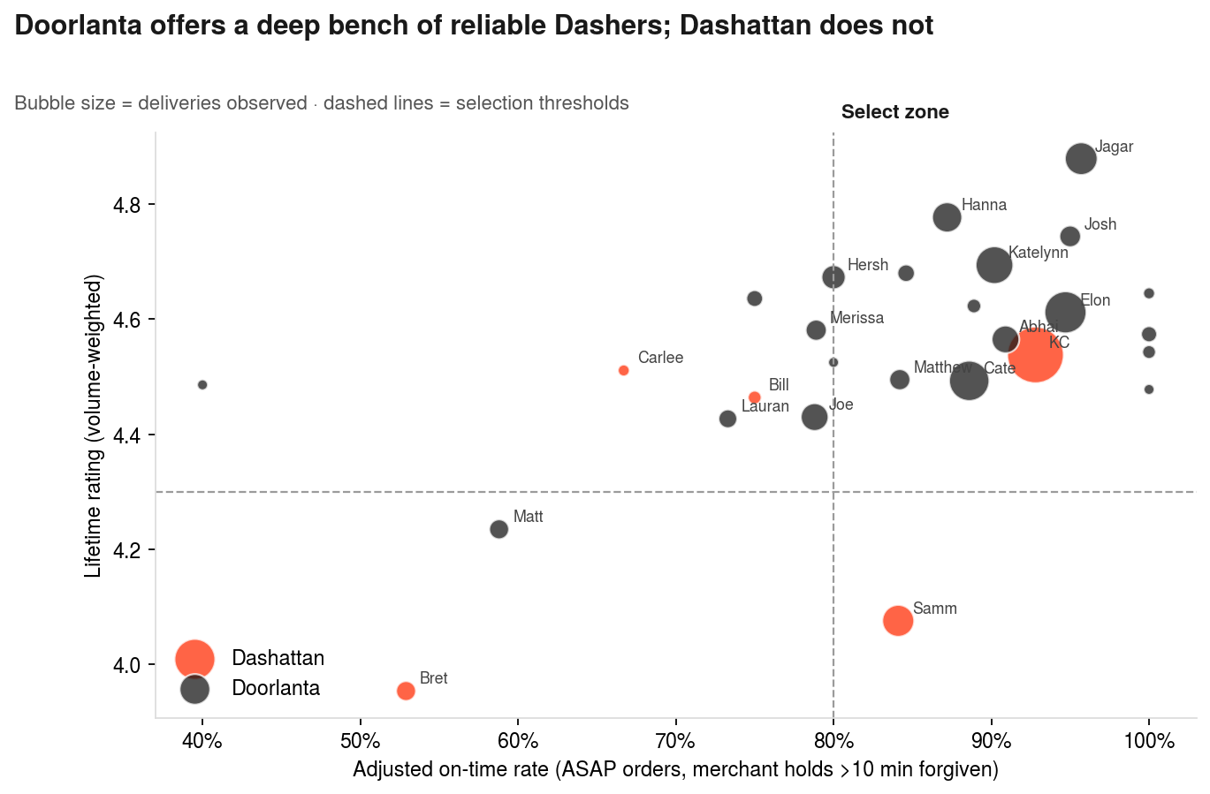
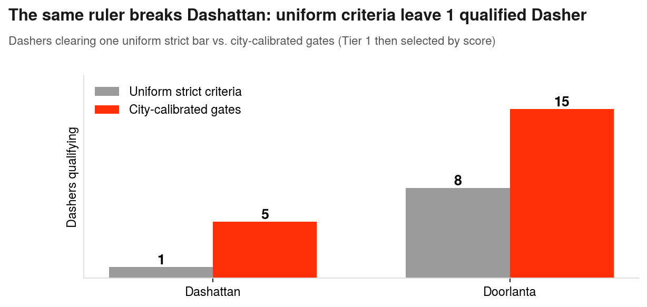
Select through a two-stage funnel — hard gates, then a fairness-adjusted score — calibrated differently by city
Q1 · SELECTING DASHERS
1 · GATE (binary)
2 · SCORE (0–100)
3 · TIER & PROBATION
Car/motorcycle · lifetime deliveries ≥100 (Dash.) / ≥300 (Door.) · ≥5/10 observed orders · fraud flags → manual review
Reliability 50 (adjusted on-time) + Quality 30 (volume-weighted rating) + Consistency 10 (severe-late control) + Professionalism 10 (app discipline)
Tier 1 launches (top 4 Dash. / top 10 Door.) · Tier 2 = trained bench (activation needs score ≥75) · first 20 widget orders monitored
KC risk: Dashattan's top pick carries 62% of its car volume and 2 fraud flags (1.4% of observed orders) — review, pair with recruitment, don't auto-exclude.
DASHATTAN 5 clear the gates; Tier 1 = 4. Recruit car Dashers; consider an e-cargo-bike satchel pilot.
DOORLANTA 15 clear the gates; Tier 1 = top 10 by score, with a 5-Dasher trained bench.

Slide 4
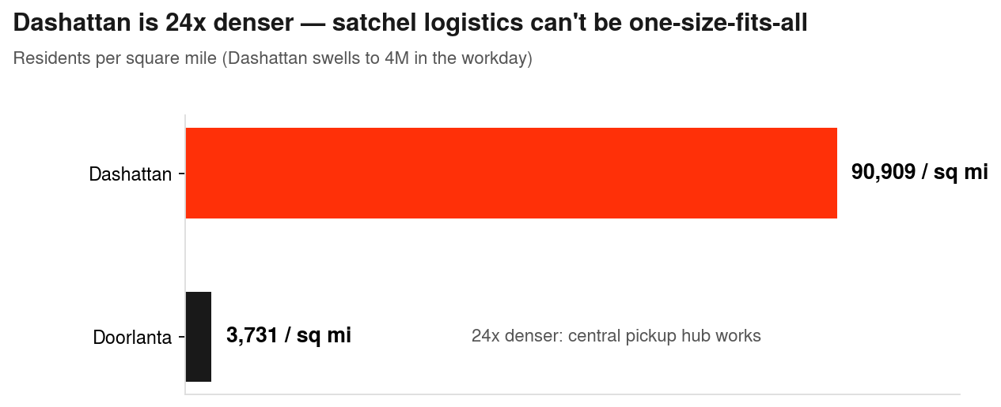
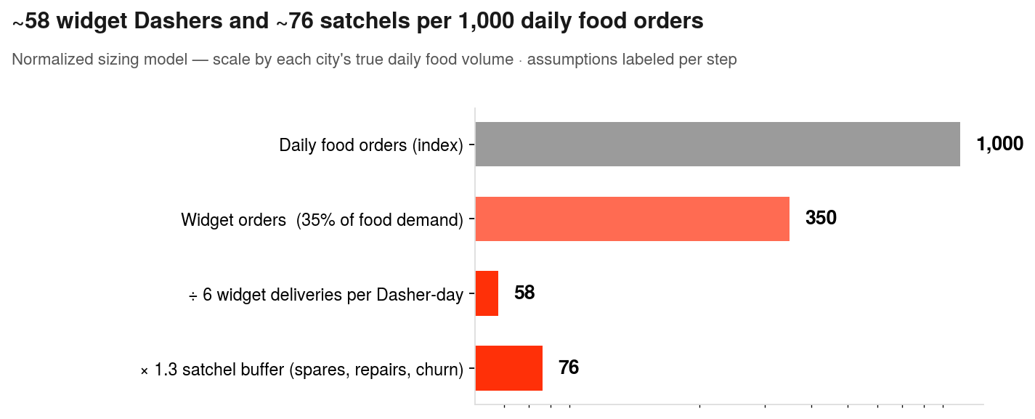
Hub pickup in dense Dashattan, ship-to-home in sprawling Doorlanta — one universal satchel spec
Q2 · DISTRIBUTING SATCHELS
DASHATTAN · HUB MODEL
DOORLANTA · SHIP MODEL
BOTH CITIES
Central pickup hub + 2–3 merchant-hosted points (22 sq mi)
Pop-up onboarding events: satchel + handling training + test run
Run events 9–11am / 2–5pm, off demand peaks (Appendix)
Ship satchels to selected Dashers' homes (134 sq mi — hub trips costly)
Virtual training + first-delivery check-in
Stage spares at 2–3 anchor merchants for swaps
Refundable deposit, earned back after 25 widget deliveries
QR/serial tracking · repair-and-replace loop
One satchel spec: ~30-min thermal hold covers p90 trip (~23 min) in both cities
DASHATTAN Density makes a hub cheap and personal onboarding feasible for a small cohort.
DOORLANTA Distance makes shipping cheaper than hub trips; spares live at anchor merchants.

Slide 5
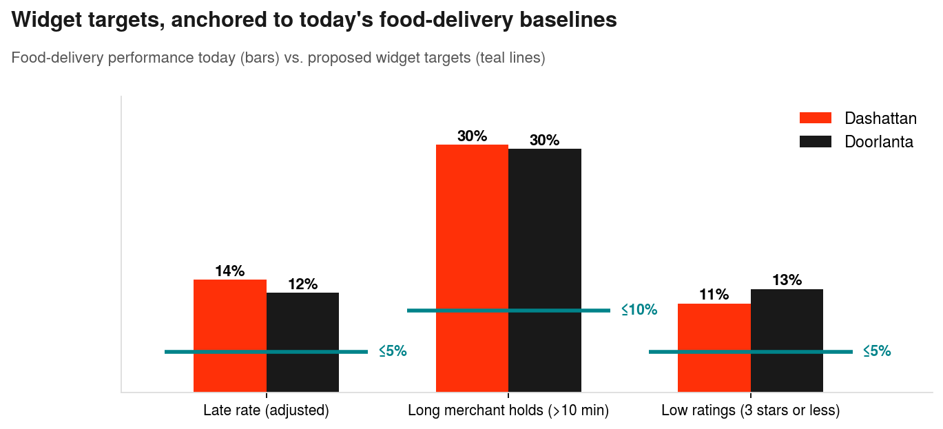
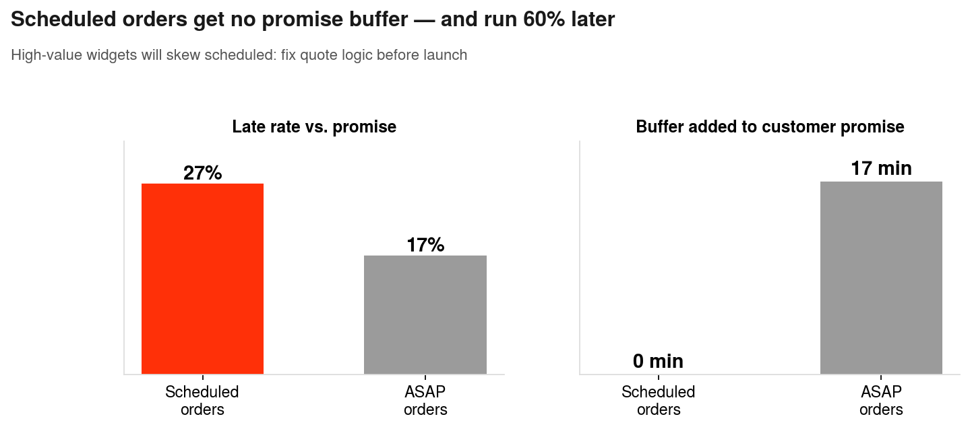
Measure all three marketplace sides against today's baselines — with two fixes before launch
Q3 · MEASURING SUCCESS
NORTH STAR
CUSTOMER
MERCHANT
DASHER
GUARDRAILS
% successful widget deliveries — on time, undamaged, in temp
On-time vs. quote · damage claims · low-rating share · repeat rate
Hold time >10 min · merchant retention · widget order growth
Widget $/hr vs. food · opt-in & retention · satchel utilization
Food delivery times & supply unchanged · fraud rate · satchel loss
PHASE GATES Day 30: ≥90% adjusted on-time, zero temp failures → expand cohort · Day 60: targets held at 2x volume, Dasher retention ≥80% → open scheduled widgets · Day 90: all targets + food guardrails intact → scale marketing & Dashattan Phase 2
DASHATTAN Watch food-supply guardrail hardest — widget pay pulls from a thin 24-Dasher pool.
DOORLANTA Watch reliability variance — enforce probation exits on the long late-tail.

Slide 6
AI accelerated the mechanics; the judgment calls and recommendations are my own
HOW I USED AI
ON THIS CASE
AI TOOLS I USE & THINGS I'VE BUILT
Python (pandas/matplotlib) for data cleaning, EDA, and chart production — with AI-assisted code generation (Claude)
AI as a thought partner to stress-test assumptions and pressure-test recommendation logic
All metric definitions, scoring design, thresholds, and recommendations reviewed and decided by me — every number traced to the dataset (reproducible notebook in supporting materials)
Day-to-day: Claude / Claude Code, Python ML stack, SQL, Streamlit, GCP
Built a 6-agent agentic AI workflow (Python) automating a multi-step 3D inspection & reporting process at Lawrence Livermore National Lab
Prototyped a chat-driven Streamlit dashboard keeping a human in the loop to flag uncertain model results
M.S. Computer Science (USC), machine learning focus — building the technical muscle to pair with pricing & GTM strategy
Principle: AI for speed on mechanics, humans for judgment — the same human-in-the-loop design I build into my own AI workflows.

Slide 7
Appendix
Data quality · methodology · Dasher scorecard · assumptions · supplementary analysis

Slide 8
Data quality notes & exclusions
APPENDIX A
Removed 6 junk trailing rows
Excluded NUM_ON_TIME_DELIVERIES
One contained a stray COMPOSITE_SCORE of 34.5 on an otherwise-empty row; a phantom 39th column with one stray value was dropped.
Missing on 41% of rows; where present it implies lifetime on-time rates of 1–77% (median 14%) — inconsistent with observed performance. On-time computed directly from quoted vs. actual timestamps instead.
Excluded COMPOSITE_SCORE
Excluded DASHER_TO_STORE_TIME_CATEGORY
Undocumented methodology; near-zero correlation with both rating columns (r ≈ 0.05–0.09). Not defensible as a selection input.
27% missing and bucketing rules unknown; raw durations used instead.
CANCELLED_AT 100% empty
FRAUDULENT attribution unknown
Completion/cancellation rate is unmeasurable in this extract — flagged as a required metric for the live program.
9 flagged deliveries; flag may originate customer- or Dasher-side → treated as manual-review trigger, not auto-exclusion.
Timezone handling
IS_FIRST_DELIVERY
All hour-of-day analysis uses local Galaxy A columns (UTC−4); daily counts use ACTIVE_DATE.
Only 7 first deliveries; excluded from performance comparisons.

Slide 9
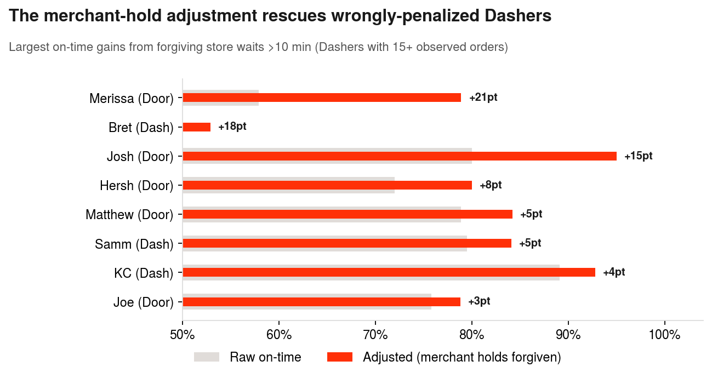
Scoring mechanism: gates, a 4-component score, tiers — measuring only what Dashers control
APPENDIX B
Stage 1 — Gates (binary, not scoreable)
A gate failure cannot be bought back by a high score. Vehicle · experience floor (city-calibrated) · minimum observed sample · fraud flags → manual review (attribution unknown).
Stage 2 — Score: Reliability (50 pts)
50 × adjusted on-time rate. Late only if (actual − quoted) − max(wait − 10 min, 0) > 0; ASAP orders only (scheduled quotes carry no buffer — a system issue). Unlogged waits (16%): no adjustment.
Stage 2 — Quality (30), Consistency (10), Professionalism (10)
Quality: 30 × shrunk rating/5, where rating is pulled toward market mean with k = 200 pseudo-deliveries. Consistency: 10 × (1 − severe-late rate / 30%). Professionalism: 10 × share of orders with store arrival logged.
Stage 3 — Tiers + sensitivity
Tier 1 launches; Tier 2 = trained bench, activation requires score ≥75 + probation. Tier-1 cohort stable across 5/10/15-min wait thresholds and weight shifts (60/20, 40/40): at most one swap at the margin.
Example: Josh (Doorlanta) rises from 80% raw to 95% adjusted on-time (rank 7 → 2) — his lateness was merchants holding him. Lauran & Matt barely move: their lateness is their own.

Slide 10
Dasher scorecard — all gate-passers, scored and tiered
APPENDIX C
Market | Dasher | ASAP n | Reliability /50 | Quality /30 | Consistency /10 | Professionalism /10 | Score /100 | Tier | Fraud
Dashattan | KC | 138 | 46.4 | 27.2 | 9.5 | 9.4 | 92.5 | Tier 1 | Review
Dashattan | Samm | 44 | 42.0 | 24.5 | 8.5 | 9.6 | 84.6 | Tier 1 | Review
Dashattan | Carlee | 6 | 33.3 | 27.1 | 10.0 | 10.0 | 80.4 | Tier 1 | —
Dashattan | Bill | 8 | 37.5 | 26.8 | 5.8 | 10.0 | 80.1 | Tier 1 | —
Dashattan | Bret | 17 | 26.5 | 23.7 | 0.2 | 10.0 | 60.4 | Tier 2 | Review
Doorlanta | Ajay | 11 | 50.0 | 27.4 | 10.0 | 10.0 | 97.4 | Tier 1 | —
Doorlanta | Josh | 20 | 47.5 | 28.5 | 10.0 | 9.5 | 95.5 | Tier 1 | —
Doorlanta | Jagar | 46 | 47.8 | 29.3 | 9.3 | 8.8 | 95.2 | Tier 1 | —
Doorlanta | Elon | 76 | 47.4 | 27.7 | 10.0 | 8.8 | 93.8 | Tier 1 | —
Doorlanta | Abhai | 33 | 45.5 | 27.4 | 10.0 | 8.2 | 91.1 | Tier 1 | —
Doorlanta | Hanna | 39 | 43.6 | 28.7 | 9.1 | 9.3 | 90.7 | Tier 1 | Review
Doorlanta | Katelynn | 61 | 45.1 | 28.2 | 9.5 | 7.8 | 90.5 | Tier 1 | Review
Doorlanta | Anisha | 13 | 42.3 | 28.1 | 10.0 | 8.5 | 88.8 | Tier 1 | —
Doorlanta | Cate | 70 | 44.3 | 27.0 | 8.6 | 6.8 | 86.6 | Tier 1 | —
Doorlanta | Hersh | 25 | 40.0 | 28.0 | 7.3 | 9.2 | 84.6 | Tier 1 | —
Doorlanta | Ash | 12 | 37.5 | 27.8 | 10.0 | 8.8 | 84.1 | Tier 2 | —
Doorlanta | Joe | 33 | 39.4 | 26.6 | 8.0 | 10.0 | 84.0 | Tier 2 | —
Doorlanta | Merissa | 19 | 39.5 | 27.5 | 4.7 | 9.5 | 81.2 | Tier 2 | —
Doorlanta | Lauran | 15 | 36.7 | 26.6 | 10.0 | 7.1 | 80.3 | Tier 2 | —
Doorlanta | Matt | 17 | 29.4 | 25.4 | 6.1 | 8.4 | 69.3 | Tier 2 | —
Score = Reliability (adjusted on-time) + Quality (volume-weighted rating) + Consistency (severe-late control) + Professionalism (arrival logging) · Tier 2 activation requires score ≥75 + probation · 'Review' = fraud flag(s) in sample → manual check, not auto-exclusion.

Slide 11
Assumptions log
APPENDIX D
Satchel requires car or motorcycle
Dataset is a sample, not census
Widgets are 'physically large'; bicycles assumed incapable. Mitigation if wrong/partial: e-cargo-bike satchel pilot in Dashattan would expand supply ~3x.
~46 deliveries/day/city can't be full volume for a 2M metro. All sizing expressed per 1,000 daily food orders; scale by true volume at launch.
Widget demand = 35% of food demand
6 widget deliveries per Dasher-day
Per case prompt; applied uniformly across cities and dayparts.
Below food productivity given handling care, satchel loading, no batching. Revisit with pilot actuals.
30% satchel buffer
10-min 'normal' merchant wait
Covers spares, repairs, Dasher churn during Phase 1.
Median wait is ~7 min even on on-time orders; excess beyond 10 min treated as merchant-caused. Sensitivity-tested at 5/15 min.
Fraud flags ambiguous
Widget orders will skew scheduled
Origin (customer vs. Dasher) unknown → review trigger. With internal attribution, gate on Dasher-attributed fraud only.
High-value items → customers schedule to be home. Drives the promise-buffer fix and the Day-60 scheduled-widget gate.

Slide 12
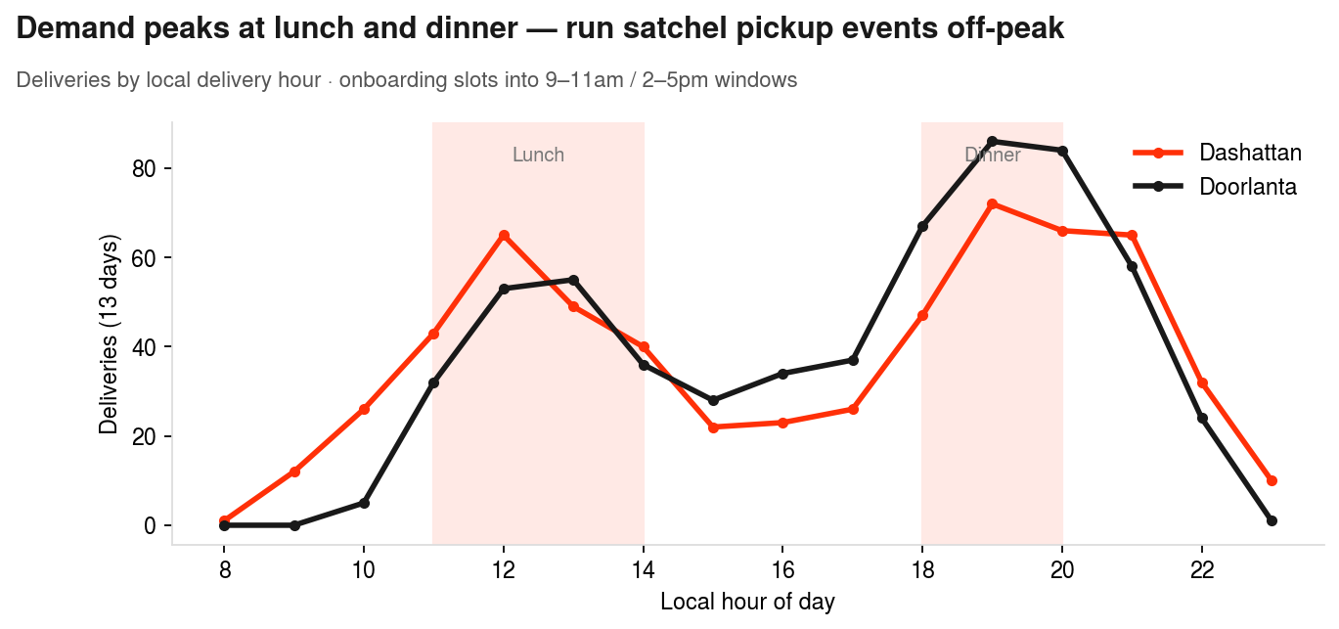
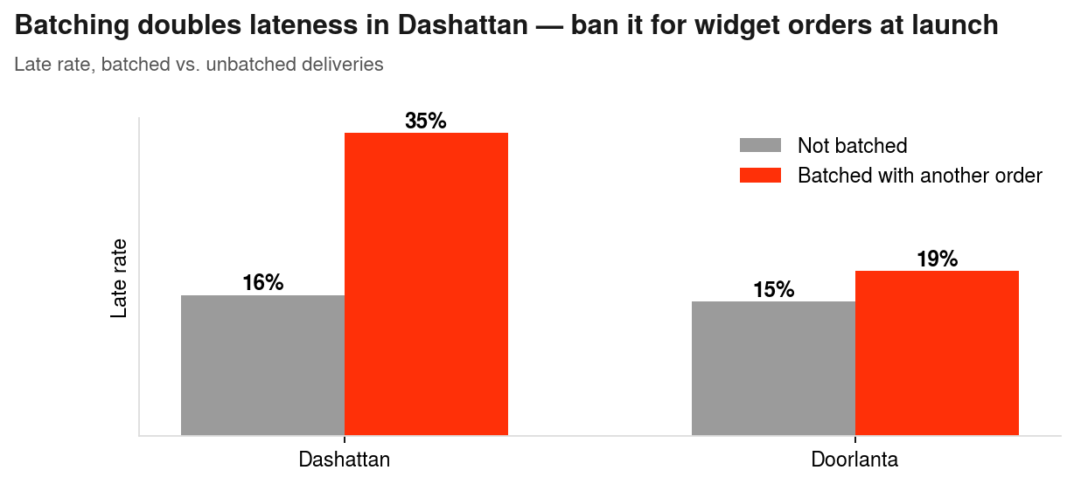
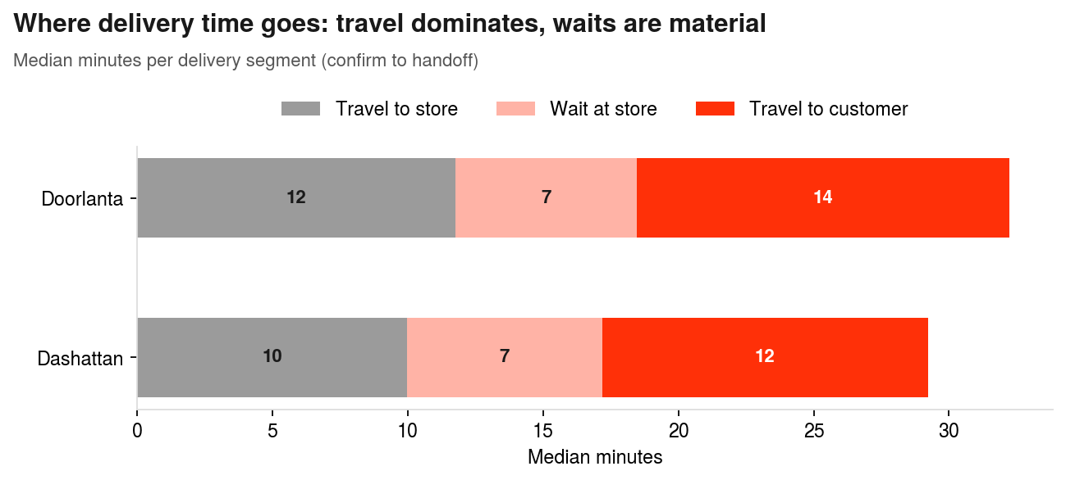
Supplementary analysis
APPENDIX E
Top left: demand peaks (lunch/dinner, local time) → satchel pickup events & onboarding run 9–11am / 2–5pm. Top right: batching doubles Dashattan lateness → widget orders excluded from batching at launch. Bottom: delivery-time decomposition by segment.

