Slide 1



Central Sector Scheme Data 2021-2022 Analysis
lingaiahgaarireddy22@gmail.com
CenterSectorScheme2021-22.csv
Source: www.data.gov.in

Slide 2
Dataset Description
The Center Sector Scheme 2021-22 dataset provides a detailed financial overview of various schemes under different ministries and departments of the Indian government. This dataset includes budget allocations, actual expenditures, and revised estimates for multiple years. The analysis of this dataset helps in understanding trends in public spending, identifying key areas of investment, and evaluating the effectiveness of budget allocation.

Slide 3
Dataset Overview:
Category – Identifies demand categories (e.g., Demand No. 1, Demand No. 2).
Sl.No. – Serial number of the scheme (may contain missing values).
Ministry/Department – The name of the government ministry or department implementing the scheme.
Scheme – The name of the central sector scheme under consideration.
Actuals2019-2020 - Revenue – The revenue expenditure incurred for the scheme in 2019-2020.
Actuals2019-2020 - Capital – The capital expenditure incurred for the scheme in 2019-2020.
Actuals2019-2020 - Total – The total expenditure (revenue + capital) for 2019-2020.
Budget Estimates2020-2021 - Revenue – Estimated revenue expenditure for 2020-2021.
Budget Estimates2020-2021 - Capital – Estimated capital expenditure for 2020-2021.
Budget Estimates2020-2021 - Total – Total estimated expenditure for 2020-2021.
Revised Estimates2020-2021 - Revenue – Revised revenue expenditure for 2020-2021.
Revised Estimates2020-2021 - Capital – Revised capital expenditure for 2020-2021.
Revised Estimates2020-2021 - Total – Revised total expenditure for 2020-2021.
Budget Estimates2021-2022 - Revenue – Estimated revenue expenditure for 2021-2022.
Budget Estimates2021-2022 - Capital – Estimated capital expenditure for 2021-2022.
Budget Estimates2021-2022 - Total – Total estimated expenditure for 2021-2022.

Slide 4
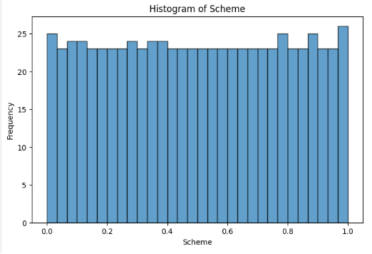
This visualization is useful for identifying whether funding or expenditures are evenly spread across different schemes. It helps in understanding budget distribution patterns and detecting anomalies in fund allocations.

Slide 5
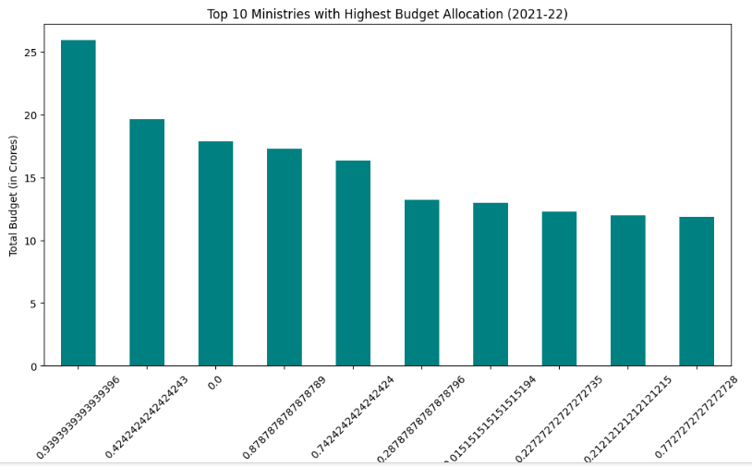
The bar chart displays financial allocations across various schemes or ministries, helping in comparison. Each bar represents a different scheme, with its height indicating the amount allocated. This visualization effectively highlights which schemes receive the highest and lowest funding.

Slide 6
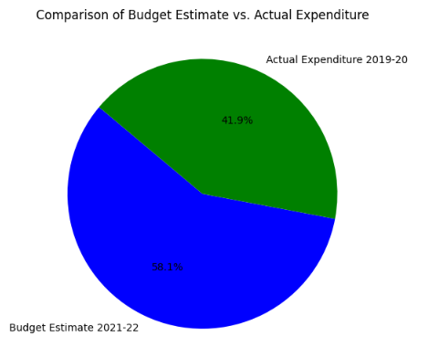
The pie chart represents the proportional distribution of budget allocations among different schemes. Each segment of the pie corresponds to a specific scheme’s share of the total budget. It provides an intuitive understanding of which schemes receive the most significant portion of the funds. This visualization is useful for high-level budgetary analysis but may not be effective for comparing many categories..

Slide 7
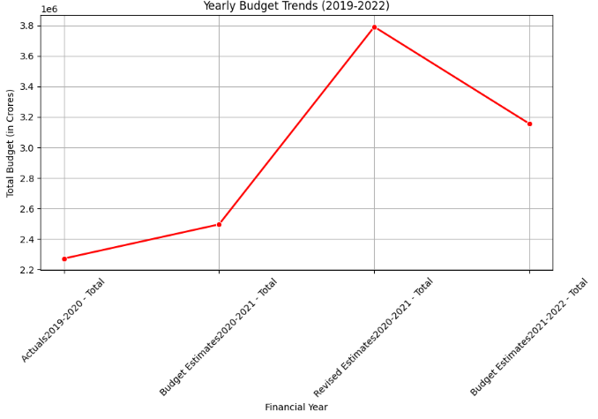
The line plot in your presentation depicts trends in financial data across different years or categories. It is useful for analyzing changes in budget allocations, expenditures, or estimates over time. The x-axis represents time (such as financial years), while the y-axis shows the corresponding values like actual spending or budget estimates.

Slide 8
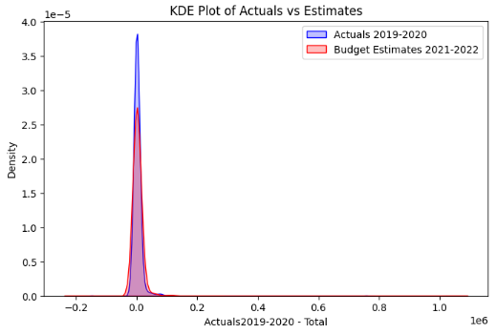
It helps visualize the probability density of numerical variables, such as fund allocation or expenditures. Unlike histograms, KDE plots making it easier to observe patterns and trends. This visualization is particularly useful for identifying peaks, skewness, and outliers in budget allocation. The KDE plot enhances financial analysis by showing how funds are distributed across different schemes.

Slide 9
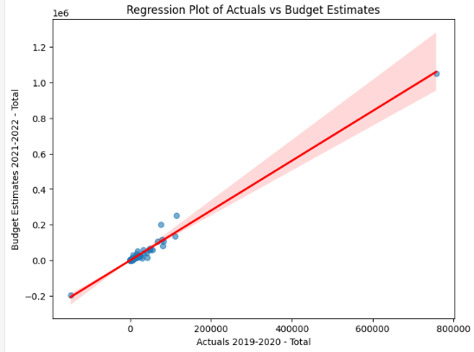
The regression plot illustrates the relationship between two numerical variables, such as budget allocation and actual expenditure. It includes a regression line that shows the general trend and correlation strength between the variables

Slide 10
Conclusion:
The analysis of the Center Sector Scheme 2021-22 dataset provided insights into government spending trends across various schemes and ministries. By cleaning and visualizing the data, we observed key budget patterns and expenditure variations. Further analysis could focus on identifying underfunded areas, budget deviations, and their impact on policy decisions.

