Slide 1
Impact to Business

Slide 2

Table of Contents
Team Details
Define – Your Problem Statement
Ideate – Solution
Impact to Business and Society
Technical Feasibility
Financial Feasibility
What makes your Idea Innovative
Testimony
Elevator Pitch – 1 to 2 mins

Slide 3
Team Details
Team Name | Member Names | Education Institute Name
Success | D.Navya kala | Ists women’s engineering college.
 | T.Tapasvi | Ists women’s engineering college.
 | NA | NA
 | NA | NA

Slide 4
Define - Advanced employee management system :
In an organization to simplify the process of record of maintenance it is designed a system of Employee management.
For HR function it helps to manage the employee’s information.
It can consider as a part of comprehensive Human Resource Management System to employee management system in general.
For improving effectiveness of workplace management an employee management system is implemented.
This employee management system manages the overall performance and different aspects of an employee in an organization.

Slide 5
Ideate – Solution
Especially in remote areas the employee management
system implementation can be challenging task. Although it
cannot deny the benefits. Using the employee management
systems provide an easy way to manage admin work and
better performance as a team.
Due to streamlines and organizes team management for
HR professionals, business owners and other managers it
can consider as a useful tool to an employee management
system. From payroll and onboarding to time off tracking
and performance is the range of this system, but it always
should cover the necessary HR feature. The employee
management system is design for saving money, time and
power and work well for the team also. Particularly in for
remote workers for managing the team it uses the regular
reporting through email. Although this method is messy
and cumbersome. It is a time consuming admin task to
optimize the performance of the team, so it can focus on
achieving the goal . Following the time spent on a
work will furnish with data that can use to advance every
working hour inside the association

Slide 6
Impact to Business and Society
The employee management system is essential for
business. The reason is as follows:
It allows confidentiality: The specific data of
employee sent through a private channel so it can keep the
information private so it can view by only head of the
organization or admin of the software. Subsequently, it is
more secure to have a employee management system in an
association, huge or little, than have financial balance data
lying in some cabinet. The software like sumHR effectively
accessible on the web. It can guarantee confidentiality,
efficiency, accuracy, availability, updates on time-bound
information etc.
Software such as sum HR is easily available online. It
can ensure availability, efficiency, accuracy, updates on
time-bound information, confidentiality etc.

Slide 7
Technical Feasibility
Reliable accuracy: Since the data is for the most part
sustained in by the representatives themselves it can be
certain the data is exact since it's directly from the source.
Also, a worker can get to their data at whenever. Along
these lines, he/she can keep it refreshed and right botches,
assuming any.
It provides a ready source of information: Between
the employee and organization Employee Management
System executes as a promptly accessible source of information. The most database systems that consist are
work schedule, salary information, education information,
posts, Contact information etc.

Slide 8
Financial Feasibility
When we use a performance management system of
employee like Hubstaff it can track the spending of time on
a particular task. So the managers and client can effectively
defined the time slot on a particular project and more
certainly agree on budget . Employee Management
System Integration with other Platform and Applications.
Combinations empower the management systems to
cooperate so it get all the usefulness that need to work at
pinnacle limit. Regardless of whether they're utilizing
Asana or other venture the executives apparatuses, for
example, Hubstaff Tasks, it ought to have the option to
incorporate consistently. Staying with one stage may spare
the issue of coordinating and bringing in undertakings,
ventures, and other data. In any case, mix causes it so it to
can utilize numerous devices all the while with little
exertion

Slide 9
What makes your solution/idea innovative?
when it stands out from the rest and truly makes the persons' lives easier.
A successful change that can convert knowledge and ideas into benefit – in the form of
new or improved products / services is capable of being innovative.

Slide 10
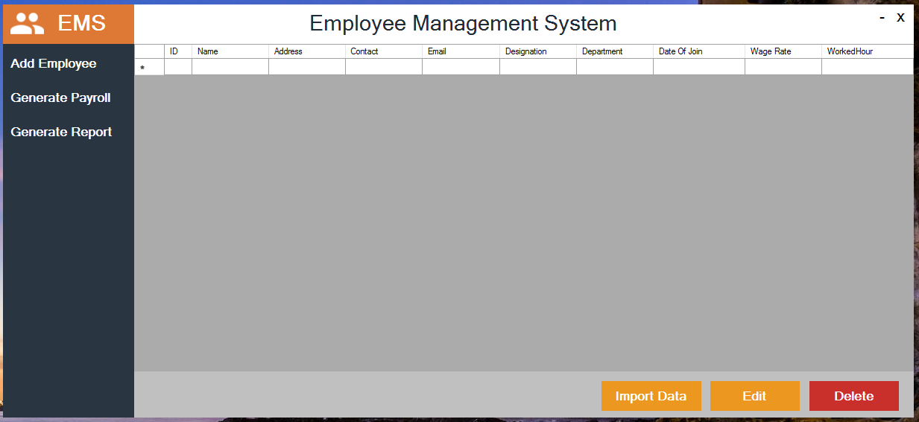
Testimony

Slide 11
Elevator Pitch (1-2 mins)
https://drive.google.com/file/d/1hUifZ1oyGc2T57xC621DIRTd13OCNNNS/view?usp=sharing

Slide 12
Conclusion
The employee management system is design for saving
money, time and power and work well for the team also. In
an organization to simplify the process of record of
maintenance it is designed a system of Employee
management. For HR function it helps to manage the
employee’s information. For improving effectiveness of
workplace management an employee management system
is implemented. This employee management system
manages the overall performance and different aspects of
an employee in an organization.

