Slide 1


Slide 2
What is MERN?

Slide 3
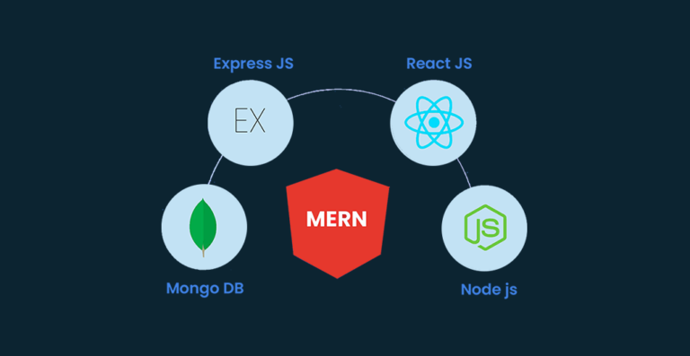

Slide 4
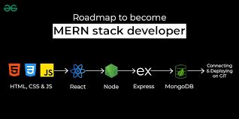

Slide 5
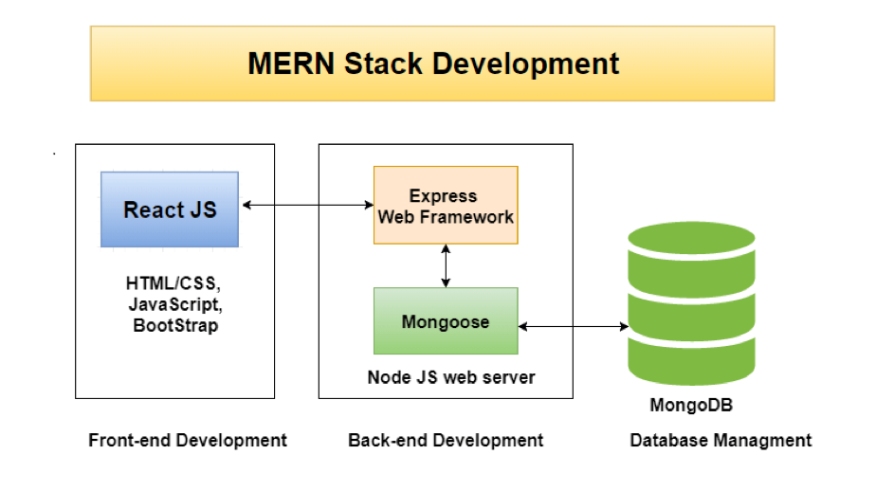

Slide 6


Slide 7


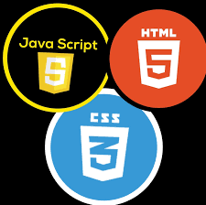


ReactJS, also known as React, is a popular JavaScript library for building user interfaces. It is also referred to as a front-end JavaScript library. It was developed by Facebook and is widely used for creating dynamic and interactive web applications. In this article, we’ll explore the key concepts of React.
React is a JavaScript library for building user interfaces (UIs) on the web. React is a declarative, component based library that allows developers to build reusable UI components and It follows the Virtual DOM (Document Object Model) approach, which optimizes rendering performance by minimizing DOM updates. React is fast and works well with other tools and libraries.
Prerequisite of React
For learning React first you have a clear understanding of HTML, CSS and JavaScript. As React is a JavaScript library and uses most of its concept so you really have to understands the major concepts of it.
HTML and CSS
JavaScript and ES6
JSX (Javascript XML) & Babel
Node+Npm
Git and CLI (Command Line Interface).

Slide 8
Installing Node.js on Windows
Step 1: Download Node.js
Go to the Node.js official website(https://nodejs.org/en/download/prebuilt-installer).
Choose either:
LTS (Long-Term Support): Recommended for most users, especially for production.
Current: Includes the latest features but may not be as stable.
Click the appropriate version for your system (most likely 64-bit).
Step 2: Install Node.js
Once downloaded, run the installer (.msi file).
Follow the installation wizard:
Accept the license agreement.
Choose the installation path (default path is recommended).
Choose components: Ensure that the Node.js runtime, npm package manager, and Add to PATH are selected.
Click "Next" and install.
Step 3: Verify Installation
Open Command Prompt or PowerShell.
Run the following commands to verify Node.js and npm installation:
bash
node –v
npm -v
This will display the installed version of Node.js and npm.

Slide 9

Moving on to the React documentation

Slide 10


