Slide 1


A J INSTITUTE OF ENGINEERING AND TECHNOLOGY
(A unit of Laxmi Memorial Education Trust®)
PRESENTATION ON
IDEASPARK
UNDER THE GUIDENCE
Dr. Antony PJ
HOD, Dept of CSE
AJIET, Mangalore
PRESENTED BY
GAURESH G PAI [4JK22CS016]
HIMANSHU HEGDE [4JK22CS018]
JNANESH [4JK22CS020]
MILAN C I [4JK22CS027]

Slide 2
PROBLEM STATEMENT
Growing Need for Effective AI Interaction:
There's a rising demand for AI that interacts efficiently in digital environments.
Difficulty in Crafting Clear AI Instructions:
It's challenging to create precise and impactful instructions for AI.
Wide Range of AI Application Scenarios:
Crafting prompts for AI is complicated due to their diverse applications across different fields.
Knowledge Gap in Prompt Formulation:
There's a significant gap in expertise between experienced and inexperienced prompt creators.
Enhancing AI Efficiency and User Experience:
Poor-quality prompts lead to inefficient AI usage and user frustration.

Slide 3
1. Growing Importance of AI Across Industries: Effective interaction with AI systems is increasingly crucial across various domains and industries.
2. Impact of Natural Language Processing Models: Models like ChatGPT and Gemini AI have transformed tasks in creative writing, customer support, data analysis, and software development.
3. Significance of Precise Prompt Crafting: Crafting precise and impactful prompts is essential to fully leverage AI tools.
4. Challenges Faced by Users: Many users struggle with creating effective prompts, resulting in inefficient AI usage and less-than-optimal outcomes.
5. IdeaSpark's Mission: IdeaSpark aims to bridge this gap by providing a platform for prompt experts to share their crafted prompts, empowering users to achieve their goals effectively.
INTRODUCTION

Slide 4
OBJECTIVE
IdeaSpark aims to bridge the knowledge gap with a collaborative platform for prompt engineers and users.
Experienced prompt engineers can submit their expertly crafted prompts on IdeaSpark.
Users can easily search and utilize pre-existing prompts to achieve desired outcomes.
IdeaSpark leverages the collective knowledge and creativity of the community.
The platform democratizes access to high-quality prompts, enhancing productivity and satisfaction for diverse AI users.

Slide 5
SCOPE
Prompt Repository Development
User Interface and Experience
Community Engagement and Collaboration
Educational Resources
Platform Integration and Accessibility

Slide 6
SOFTWARE AND HARDWARE USED
Hardware: Standard server infrastructure (VERCEL) for hosting the web application.
Software: React, Next.js, Tailwind CSS, Open AI, Next Auth with google authentication, MongoDB.

Slide 7
EXPECTED OUTCOME OF THE PROJECT
Enhanced Efficiency: Users can quickly find and utilize well-crafted prompts tailored to their specific needs, significantly improving their productivity and the effectiveness of their interactions with AI tools like ChatGPT.
Community Engagement: By allowing prompt experts to contribute their knowledge, IdeaSpark fosters a collaborative community that continuously enhances and expands the prompt library.
Quality and Versatility: With a diverse collection of prompts, users can address a wide range of tasks and challenges, from creative writing to technical problem-solving, ensuring versatile applications of AI.
Increased Accessibility: The platform democratizes access to expert-level prompts, making advanced AI capabilities more accessible to individuals and organizations regardless of their technical expertise.

Slide 8
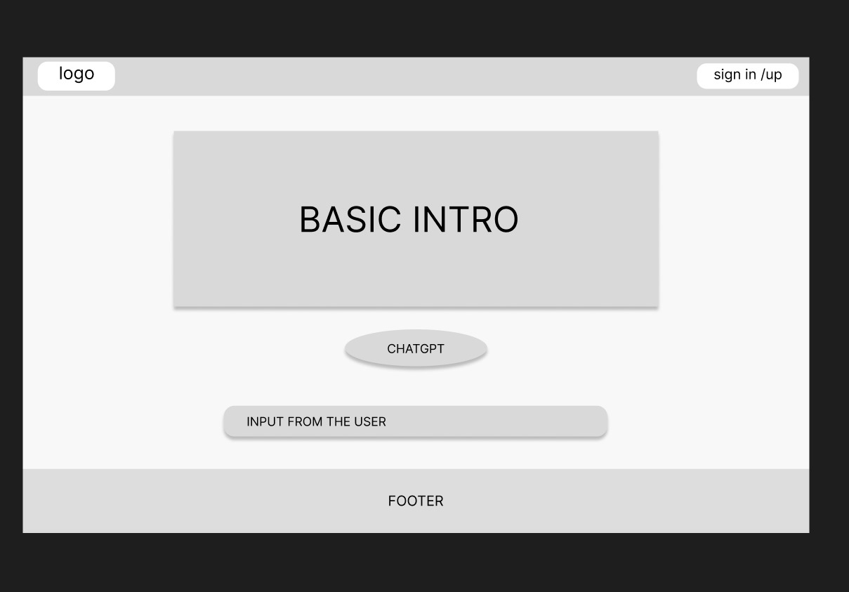

Slide 9
CONCLUSION
Optimizing AI Prompt Use: IdeaSpark creates a collaborative platform to optimize the use of AI prompts by connecting prompt experts and users.
Enhancing Efficiency: The project aims to enhance efficiency by providing users with easy access to effective prompts tailored to their needs.
Fostering Community Engagement: IdeaSpark encourages community engagement through the sharing and utilization of prompt expertise.
Increasing AI Accessibility: The platform seeks to increase accessibility to advanced AI capabilities for a wide range of users.
Addressing Challenges: To achieve its goals, IdeaSpark must address challenges such as quality control, search efficiency, scalability, user engagement, and adaptability.

