Slide 1
Graph Neural Network-Based
Network Congestion Prediction
Proactive Traffic Management in Computer Networks
A reproducible study using a packet-level simulator, temporal graph learning, and closed-loop routing
UNIVERSITY COMPUTER NETWORKS PROJECT
Notes:
Project scope and technical summary from README.md and DEMO_GUIDE.md. All measurements in the project are simulated.

Slide 2
Network simulation and prediction task
Topology
10 routers and 15 full-duplex links. Each direction has its own finite queue and capacity-bounded service.
Traffic
Five reproducible patterns: gradual ramp, sustained bottleneck, periodic, correlated, and sudden burst.
Measurements
At one-second intervals: utilization, queue occupancy, delay, packet loss, demand, and throughput.
Prediction target
From 10 steps of causal history, identify a first 85% utilization crossing within the next five steps.
Held-out test
Phase 3.6 grouped independent simulation seeds: 18 train, 4 validation, and 3 test.
The held-out split keeps all scenario variants from one seed together.
Notes:
Sources: README.md, Phase 3.6 DIAGNOSTIC_REPORT.md, and results/phase4/experiment_config.json. All measurements are simulated.

Slide 3
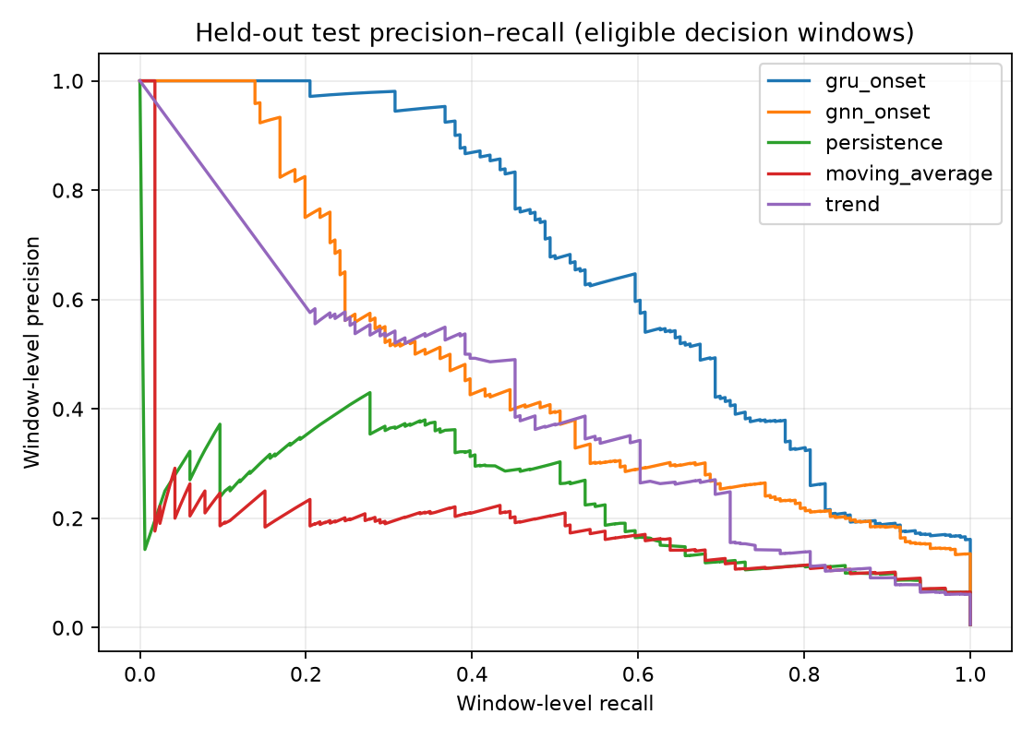
Temporal graph model
Graph representation
Each directed link is a graph node. Links connect when they share a router, so congestion context can pass across adjacent paths.
Temporal encoder
Graph convolution learns spatial relationships. A GRU summarizes each link’s recent sequence of network measurements.
Onset output
The GNN threshold was selected on validation (0.9643). It estimates risk of a future onset, not a guaranteed route improvement.
Held-out precision–recall curves. Window-level scores.
Notes:
Sources: Phase 3.6 DIAGNOSTIC_REPORT.md, results/phase3_6/test_metrics.csv, results/phase3_6/frozen_selection.json, and results/phase3_6/precision_recall.png. The plotted PR curve is decision-window level; event scores use episode matching.

Slide 4
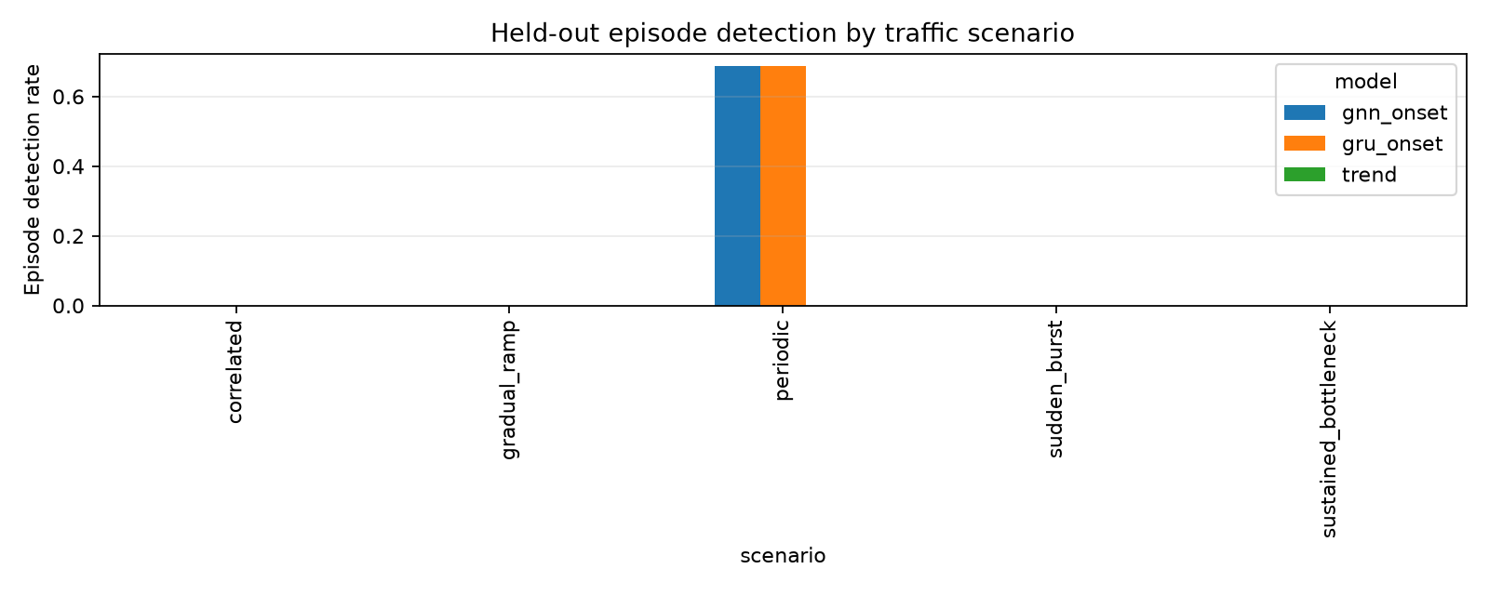
GNN onset detection varies by traffic pattern
GNN
11 of 40
eligible onsets detected
Episode precision 0.297
Episode recall 0.275
Episode F1 0.286
False alerts 1.73 / run
Detection was limited to periodic onsets in this test. The GNN detected none of the tested gradual, sustained, correlated, or sudden-burst episodes.
Useful lead averaged 3.18 steps for detected episodes; the assumed controller delay is 2 steps.
Notes:
Sources: results/phase3_6/DIAGNOSTIC_REPORT.md, results/phase3_6/test_metrics.csv, results/phase3_6/scenario_test_metrics.csv, and results/phase3_6/episode_detection_by_scenario.png. GNN and GRU event metrics are episode-level; PR-AUC is window-level. Test set has three held-out seeds.

Slide 5
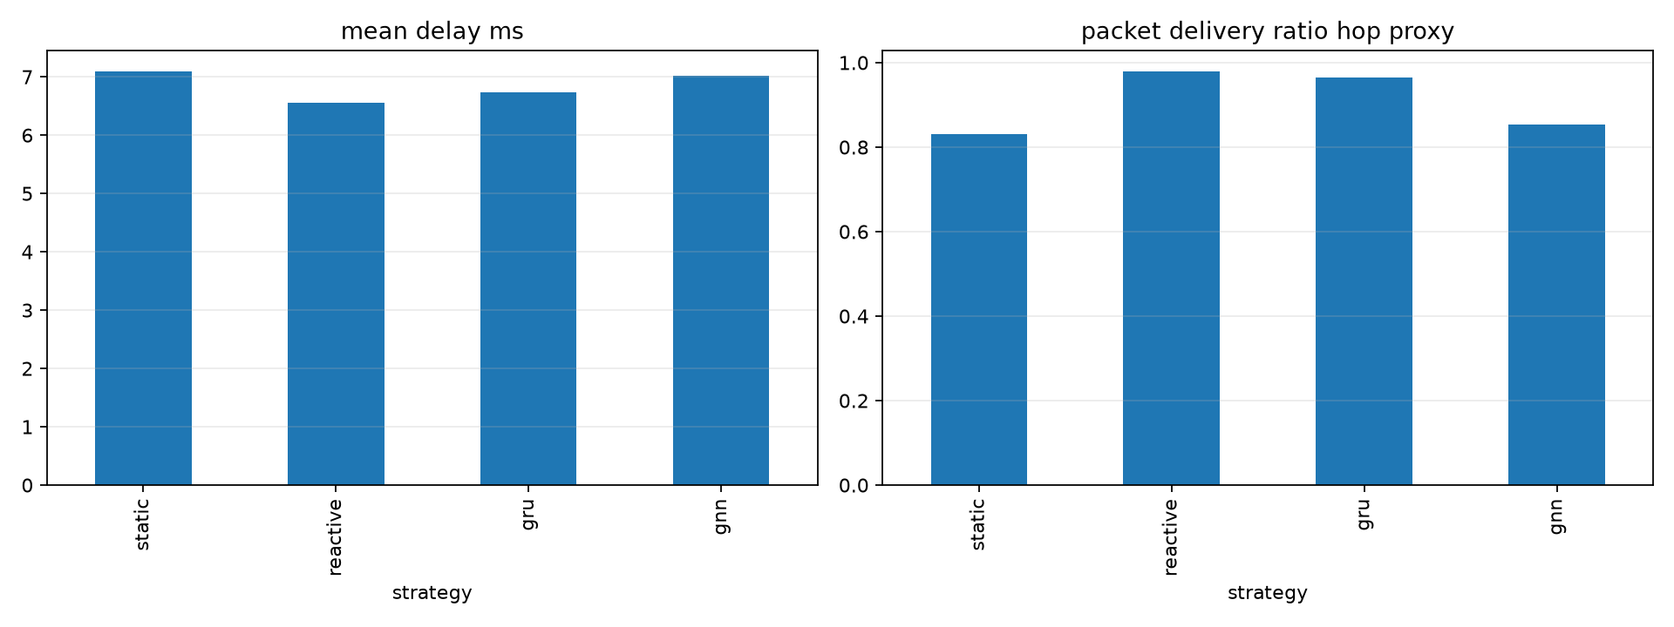
Routing results across 25 paired simulations
Mean delay (ms)
Static: 7.095 Reactive: 6.560 GRU: 6.729 GNN: 7.018
Mean congestion duration (steps): static 40.68, reactive 25.48, GRU 32.20, GNN 38.00. Reactive routing performed best on these averages.
Notes:
Sources: results/phase4/per_run_metrics.csv, results/phase4/scenario_summary.csv, results/phase4/experiment_config.json, and results/phase4/routing_comparison.png. Aggregate values below are arithmetic means over five scenarios and five common seeds. Delivery is a hop-level proxy; throughput sums link-hop Mbps.

Slide 6
Interactive dashboard and project conclusion
Dashboard
Launch
Replay or run a new simulation. Select scenario, seed, and strategy. Scrub, play, pause, reset, and replay measured steps.
python -m streamlit run dashboard/app.py
Limitations
Inspect
View both directions of each link, observed congestion, model risk, applied reroutes, controller events, and paired strategy results.
All results are simulated. Delivery and loss are hop-level proxies; throughput is a link-hop sum. Only three independent seeds form the Phase 3.6 test set. Models trained under static routes may face distribution shift after rerouting.
Conclusion
The GNN pipeline runs end to end, but held-out onset detection is weak outside periodic traffic. Reactive routing had lower average delay and congestion duration in the Phase 4 study.
Demo walkthrough: README.md and DEMO_GUIDE.md
Notes:
Sources: README.md and DEMO_GUIDE.md. The dashboard replays saved Phase 4 runs or runs a new 80-step simulation using the existing simulator and controller. Reported metrics remain simulated.

