Slide 1
SCAMSHIELD
Detect the scam before the victim makes the payment.
AI-POWERED, REAL-TIME CONVERSATION DEFENSE
PARTICIPANT DETAILS
Name: Navyashree L Manjushree Rakshitha D Harshitha P
Team Name: Hackstreet Girls
Track No: T.03
Notes:
Welcome judges. Scammers steal billions every year, not by hacking servers, but by deceiving people inside trusted messaging apps. ScamShield intercepts the threat at the conversation layer before money moves.

Slide 2

OUR SOLUTION
ScamShield turns conversation into intelligence
Paste or forward any suspicious chat. ScamShield instantly reconstructs the timeline, scores behavioral risk, isolates red-flag evidence, and provides safe, actionable steps.
01
Multi-turn context
Tracks intent drift across the entire dialogue.
02
Zero-trust assessment
Evaluates claimed authority against concrete indicators.
03
Transparent reasoning
Delivers evidence-backed warnings users actually trust.
Notes:
ScamShield doesn't just guess; it breaks down the entire dialogue history to expose the underlying psychological manipulation in plain language.

Slide 3





PIPELINE
From message to safe action
Five deliberate stages turn raw conversation into an immediate safety decision.
01
02
03
04
05
Input
Preprocess
Analyze
Explain
Act
Paste or forward the live chat.
Extract entities, links, and amounts.
Combine NLP reasoning with scam patterns.
Highlight exact signals and tactics.
Recommend verify, pause, or block.
Notes:
Walk through the pipeline: Ingestion, entity extraction, AI pattern matching, human-readable evidence synthesis, and finally clear, calm instruction on what to do next.

Slide 4






SYSTEM DESIGN
Architecture built for explainability
INPUT LAYER
NLP LAYER
AI LAYER
Text, pasted chat, or exported conversation
Entities, intent, urgency, and requests
Scam classification and contextual reasoning
KNOWLEDGE LAYER
RISK ENGINE
EXPLAINABILITY + PRIVACY LAYERS
Continuously updated scam-pattern library
Weighted evidence becomes a 0–100 score
Turn technical signals into human guidance while minimizing storage.

Slide 5
DECISION ENGINE
Data flow: evidence before alarm
Transparent synthesis avoids false alarms by grounding every risk assessment in clear signals.
01
02
03
04
Segment
Extract
Contextualize
Synthesize
Conversation is broken into an ordered timeline of sender and recipient exchanges.
Signals isolated: authority claims, time pressure, emotional levers, and credential asks.
Extracted triggers are combined with conversation context and historical fraud playbooks.
Engine returns overall risk level, likely scam category, verifiable evidence, and next steps.
Every alarm is paired with its contributing factors so the user understands the decision.
Notes:
We build user trust by showing our work. Before sounding an alarm, the system extracts concrete evidence so the person understands exactly why they should pause.

Slide 6
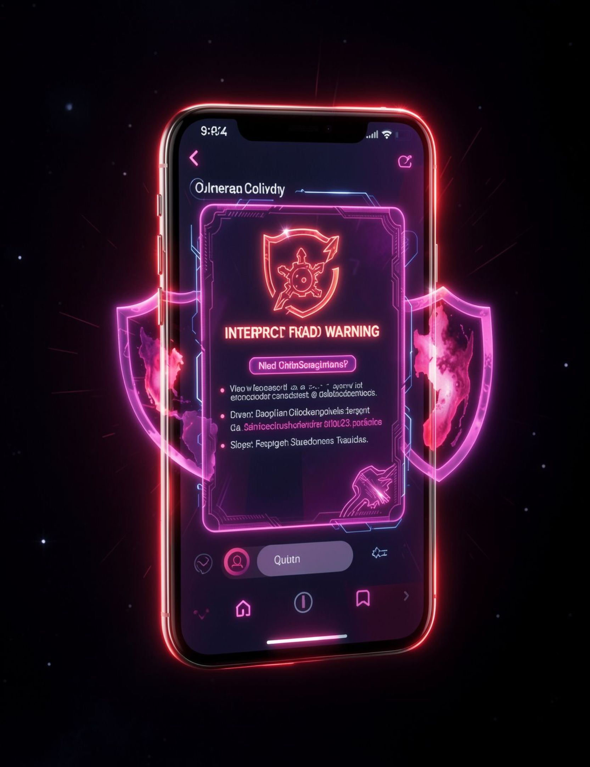
LIVE EVALUATION
Demo: one OTP request, three red flags
“I am from your bank security team.”
“Your account will be blocked today.”
“Please share the OTP to verify your identity.”
SCAMSHIELD VERDICT
HIGH RISK
Output: HIGH RISK — authority impersonation + fear/urgency + credential request.
Notes:
Notice this realistic three-message exchange. Individually, they mimic real support interactions. Together, they form an undeniable signature of credential theft.

Slide 7

INTERVENTION PHILOSOPHY
The warning should tell people what to do next
Risk: High risk — possible bank impersonation scam
Evidence: urgency + authority impersonation + OTP request
Action: do not share the OTP; contact the bank through its official channel
Design principle: interrupt the moment before compliance.
Notes:
An alarm without clear next steps induces panic, and panicked users comply with attackers. ScamShield gives users an immediate, safe off-ramp before money or credentials leave their control.

Slide 8

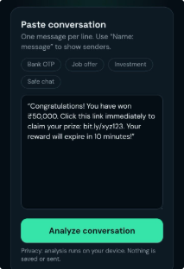
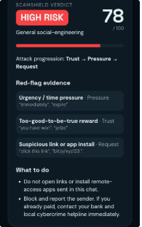
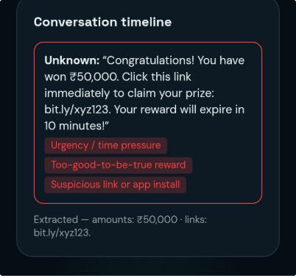
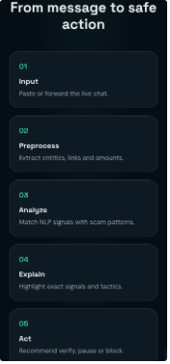
SCAMSHIELD · PRODUCT WALKTHROUGH
Project Screenshots — From Input to Safe Action
A five-step path from suspicious message to confident next move.
STEP 1
STEP 2
STEP 3
Open ScamShield
Start at the landing page.
Paste the conversation
Bring the suspicious exchange into view.
Receive the risk verdict
See the threat level at a glance.
STEP 4
STEP 5
Review highlighted evidence
Trace the red flags in the timeline.
Follow the safe-action flow
Know exactly what to do next.

Slide 9

SCAMSHIELD · STAY ALERT
Protected by awareness
Thank You
A moment of caution can stop the attack.
Pause before you click: verify the sender, inspect the request, and never share OTPs, passwords, or sensitive information.
Questions, ideas, or a message that does not feel right? Stop. Check. Protect.
Hackstreet Girls

