Slide 1
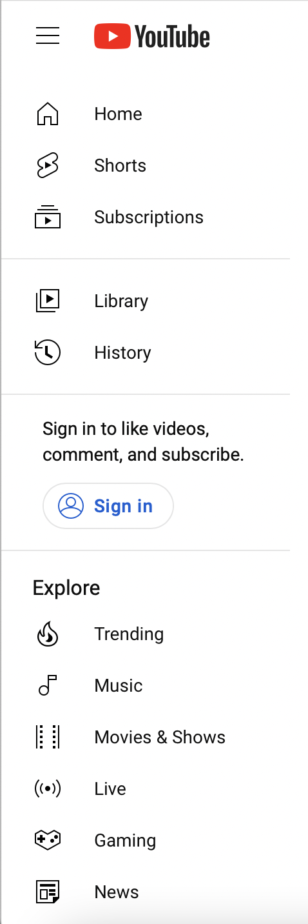





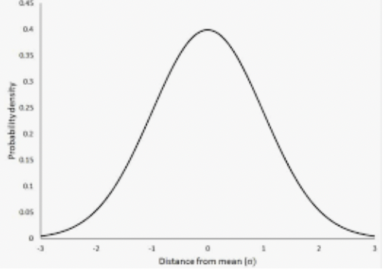
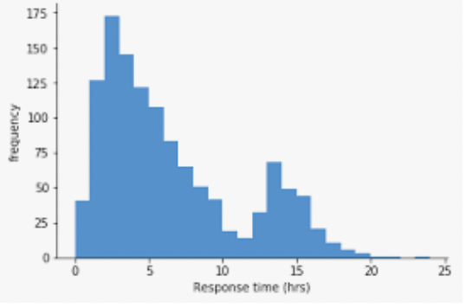






Trending YouTube Videos Analysis
Search results for Trending YouTube Videos Analysis
General Stats:
Mean and standard deviation
Overall Statistics of US Dataset
DataScience101
Want to know how many views, likes, and dislikes trending YouTube videos typically get?
Views and Likes Received Across Different Video Categories
DataScience101
I made distributions for characteristics of trending YouTube videos. Check it out !
Distributions
Ratio of Likes to Dislikes Versus Views
DataScience101
What is the most common proportion between likes and dislikes for a trending YouTube video?
By: Aiden Benise, Jason George, & Navya Bingi
Notes:
Navya

Slide 2
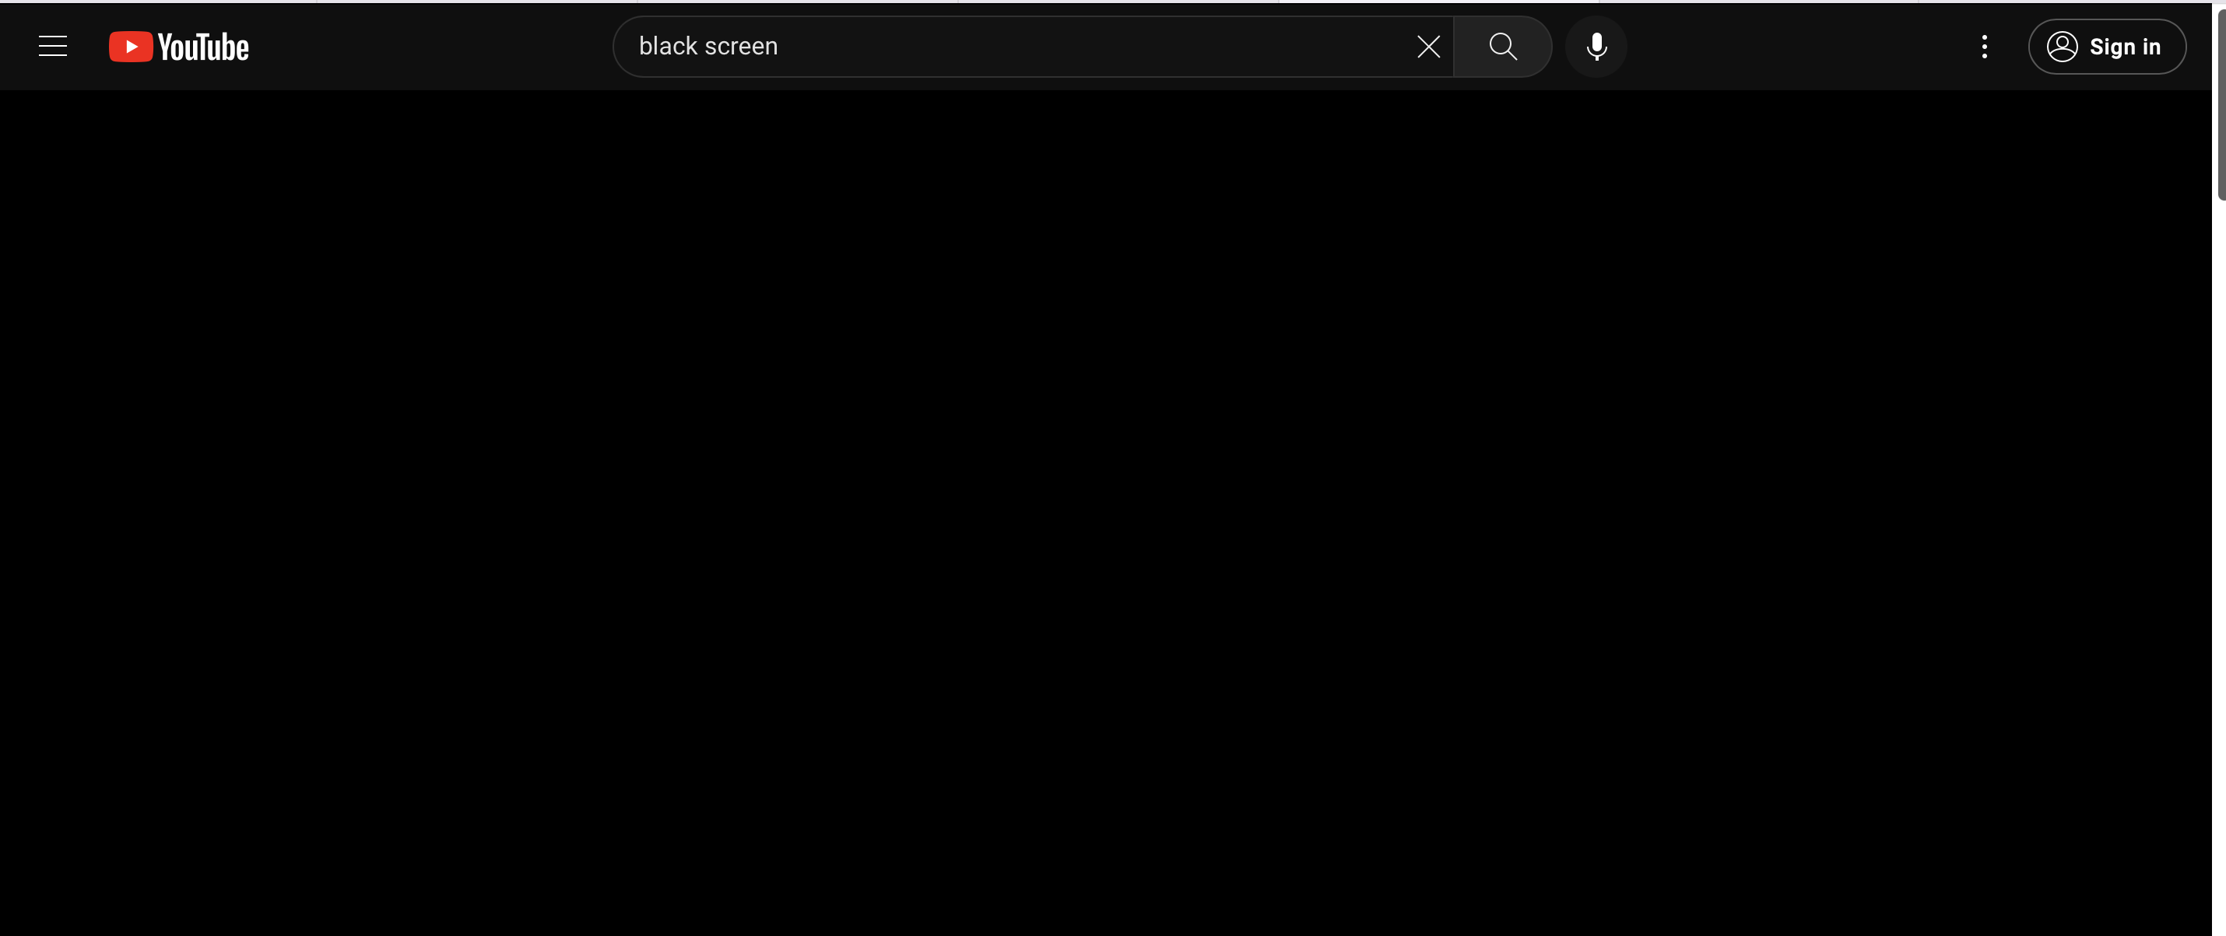

Trending YouTube Videos Analysis
Trending videos in the US from 2017-2018 had an average of:
2,360,785 Views
74,267 Likes
3,711 Dislikes
8,447 Comments
Most views received (225,211,923):
Childish Gambino - This Is America (Official Video)
Most likes received (5,613,827):
# BTS (Î∞©ÌÉÑÏÜåÎÖÑÎã®) 'FAKE LOVE' Official MV
Most dislikes received (1,674,420):
So Sorry. (Logan Paul Vlogs)
Overall Statistics of US Dataset
DataScience101
Notes:
Navya

Slide 3
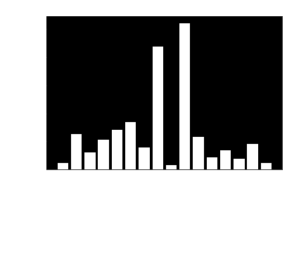
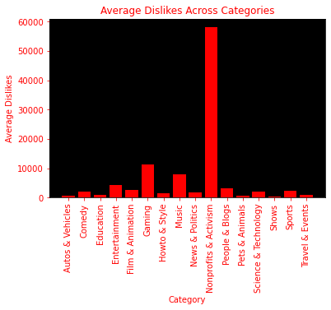
Trending YouTube Videos Analysis
Average Likes & Dislikes Received Across Different Video Categories
DataScience101
Notes:
Navya

Slide 4
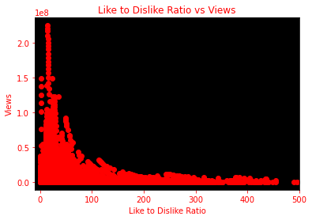
Trending YouTube Videos Analysis
A like to dislike ratio between 10-20 typically corresponds to more views.
After a ratio of around 50, views start to decrease as the number of likes surpasses the number of dislikes.
The right skew in the data indicates that high like to dislike ratio and lower views most likely represent the uncontroversial videos.
Ratio of Likes to Dislikes Versus Views
DataScience101
Notes:
Navya

Slide 5
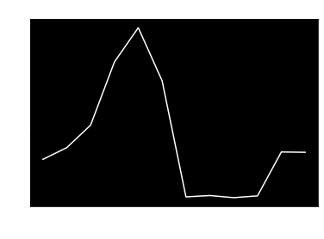
Trending YouTube Videos Analysis
Most trending videos in 2017-2018 were posted during the first half of the year .
As summer approaches, views severely drop after peaking in May (people are on summer vacation, traveling, etc.)
Views stay low as school/work starts back up during Aug-Sept as well as during the holiday season.
Mean of x axis
Publish Month vs Average Views for Trending Videos
DataScience101
Notes:
Navya

Slide 6
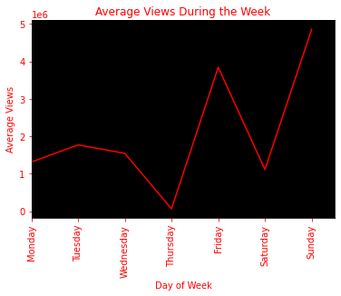
Trending YouTube Videos Analysis
Videos posted on a Friday or Sunday received more views than those posted at the beginning of the week.
Due to the fact that the majority of the audience is made up of young viewers, it makes sense that there is higher overall engagement towards the end of the week (a time to relax).
Publish Day of Week vs Average Views for Trending Videos
DataScience101
Notes:
Aiden

Slide 7
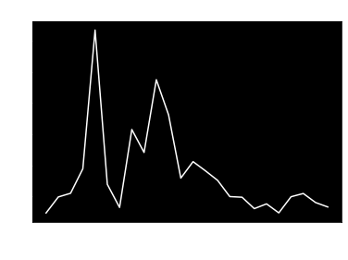
Trending YouTube Videos Analysis
In z-time there is an increase of views for the post around the time of 4 am and 8 am.
In Eastern time these hours are 12 am and 4 am.
In Pacific time these hours are 8 pm and 12 am.
Most likely, viewers are watching YouTube at midnight in their respective time zones. This would lead to an increase of views for videos posted around these hours.
This may also make sense since people will be busy with work during the day-time hours. At night, people will be alone and have time to themselves to watch videos.
Publish Time of Day vs Average Views for Trending Videos
DataScience101
Notes:
Aiden

Slide 8
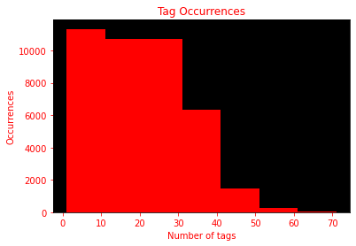
Trending YouTube Videos Analysis
A common range for the number of tags used in trending YouTube videos is 0-30 tags, with the average being 20 tags.
It is rare to use more than 30 tags, supported by the decrease in the number of videos posted.
Number of Tags for Trending Videos
DataScience101
Notes:
Aiden

Slide 9
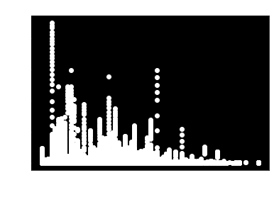
Trending YouTube Videos Analysis
Videos that stick to 0-10 tags typically receive more views than those that exceed 30 tags.
Because tags play a minimal role in the discovery of videos, limiting tags to 10 is sufficient for your video’s detection and does NOT lower the chance of it going viral.
Number of Tags vs Views for Trending Videos
DataScience101
Notes:
Jason

Slide 10
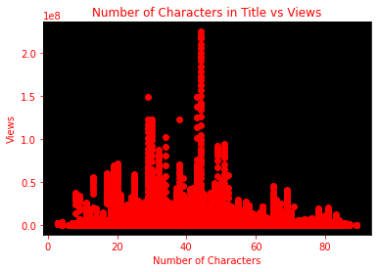
Trending YouTube Videos Analysis
Videos with titles limited to around 45 characters typically get more views.
Views stay on the lower side at both ends of the distribution: 0-20 characters and 70-80 characters (too less vs too much information).
The longest title was: “Jeffrey Tambor Fired From 'Transparent' Following Amazon Investigation Into Sexual Misconduct Allega” (89).
Lengths of Titles for Trending Videos
DataScience101
Notes:
Jason

Slide 11
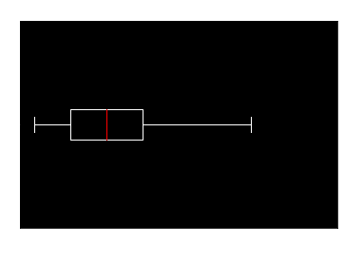
Trending YouTube Videos Analysis
On average, it takes about 2 days for a video to appear on the trending page for the first time after it is published.
Around 95.8% of videos took less than 6 days to become trending.
The longest a video has taken to get on the trending page was 4,215 days (biggest outlier)!
Number of Days to Become Trending
DataScience101
Notes:
Jason

Slide 12
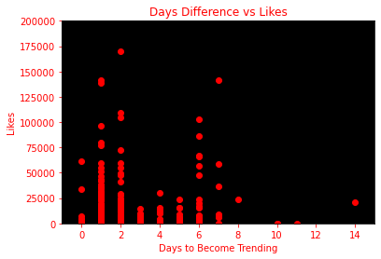
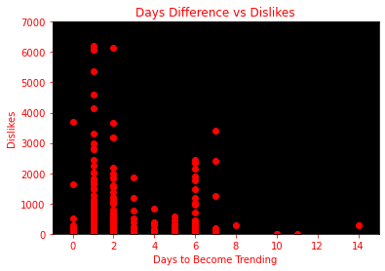
Trending YouTube Videos Analysis
Classification Report (testing):
precision recall f1-score support
0 0.78 0.74 0.76 232
1 0.55 0.61 0.58 122
accuracy 0.69 354
Confusion Matrix (testing):
[[172 60
[48 74]]
Logistic Regression Model: Using Likes and Dislikes to Predict # of Days Until Trending
DataScience101
Notes:
Navya

Slide 13
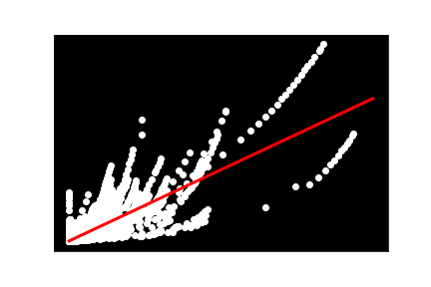
Trending YouTube Videos Analysis
This model shows the relationship between likes and views. As the likes increase, generally, the views increase at a constant rate.
Higher model regressions perform less favorably for these data features. R-squared values drop off quickly.
Hypothesis about the two tails: one is trending videos that had a high like/dislike ratio, the other is trending videos that had a low like/dislike ratio.
Training R-squared = 0.729
Testing R-squared = 0.713
Linear Regression Model
DataScience101
Notes:
Jason

Slide 14
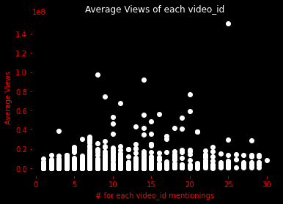
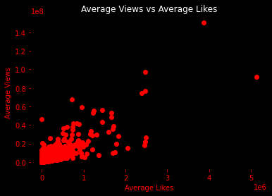
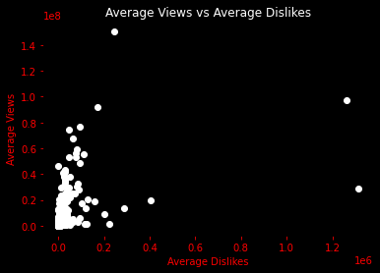
Trending YouTube Videos Analysis
Somewhat Normal Distribution
Positive Trend
Sharper Positive Trend
Training R-squared = 0.853
Testing R-squared = 0.701
3rd Degree Polynomial Regression Models
DataScience101
Notes:
Aiden

Slide 15
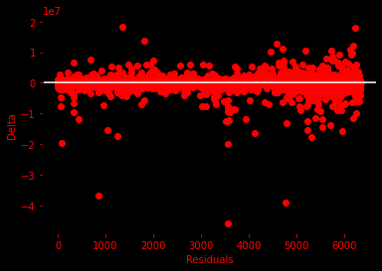
Trending YouTube Videos Analysis
Test Statistics:
Graph of Residuals
1 : 94882299030022.69
x0 : 0.0 *
x1 : 5982133016.470246
x2 : 15179734.081828814
x0^2 : 258293652158.9638
x0 x1 : -11150683.040961606
x0 x2 : 5897096.315830897
x1^2 : 60552804.34140256
x1 x2 : -0.9761724369853256 *
x2^2 : 162.60274766995133
x0^3 : -0.12635045147623894 *
x0^2 x1 : -367352.87185586547
x0^2 x2 : -143089686.8864948
x0 x1^2 : 59533.65290197431
x0 x1 x2 : -0.20301436371665063 *
x0 x2^2 : 844.8501039119936
x1^3 : -33.60934298959064
x1^2 x2 : 9.74633751257969e-07
x1 x2^2 : -0.00017167703961012114 *
x2^3 : 2.6548010865047323e-05
x0^2 x1^2 x2^2 : 0.002238992997730123 *
Mean Square Error = 3,132,143,652,795
Root Mean Square Error = 1,769,786
Polynomial Regression Model
DataScience101
Notes:
Aiden

Slide 16
Trending YouTube Videos Analysis
What characteristics do trending Youtube Videos with more views tend to share?
Music, Entertainment, or Nonprofits category
Posted at 4:00 am or 10:00 am (Z-time)
Like to Dislike Ratio of 10-20
Has 0-10 tags only
Title contains around 30 or 45 characters
Posted in April or May
Takes around 2 days (or less) to become popular
Posted on a Friday or Sunday
Conclusion: Characteristics of a Trending Video
DataScience101
Notes:
Jason

