Slide 1
Crime and Economy in Georgia
By: Aiden Benise, Max Maher, Navya Bingi

Slide 2
Purpose of Study
1. Identify and analyze how criminal activity and local economic status affect businesses in Georgia
2. How can we help companies, both big and small, thrive in areas with high crime or low GDP?
3. Help businesses and policy makers make more informed decisions on important business operations

Slide 3
Data Preprocessing
Group
Combine
Clean
Data Collection
Bin individual crimes into violent, property, & human trafficking
3 datasets: crime, population, and GDP 2019-2021
Matching up the data by year and county
Remove NaNs, keep outliers
02
01
03
Sources: BEA, Census Bureau, ATL PD

Slide 4
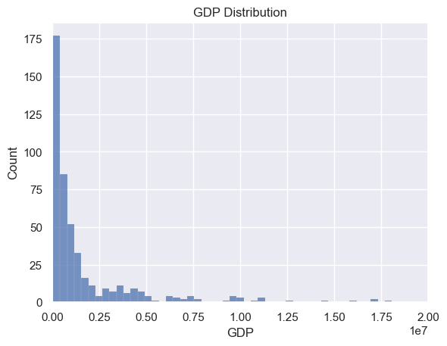
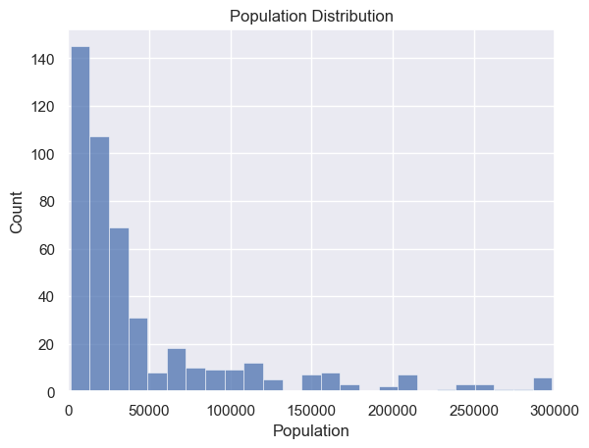
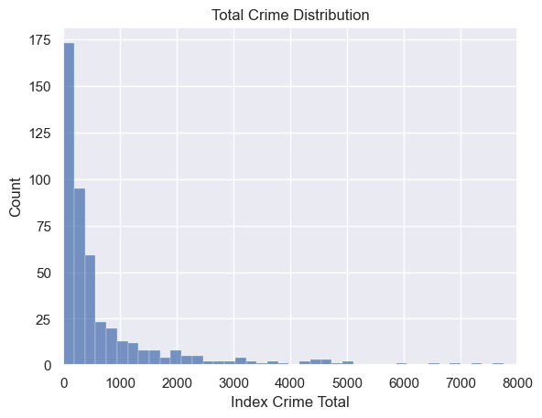
EDA Highlights (Distributions)
Mean = $3,502,196
Median = $642,464
Min = $25,236 (Taliaferro, 2020)
Max = $174,408,744
(Fulton, 2019)
Mean = 67,369
Median = 23,349
Min = 1,537 (Taliaferro, 2019)
Max = 1,069,370 (Fulton, 2020)
Mean = 1,183
Median = 304
Min = 0
Max = 32,903
(Fulton, 2021)

Slide 5
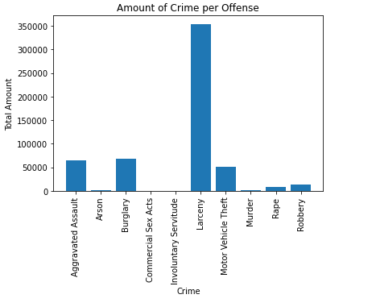
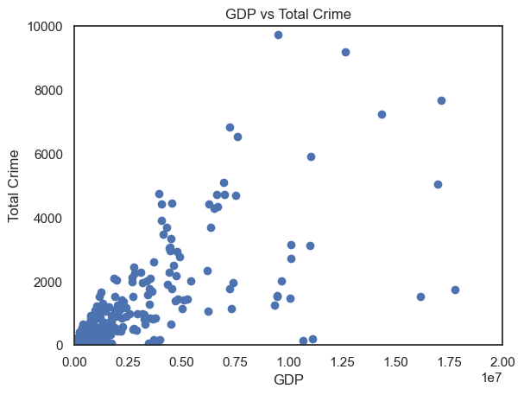
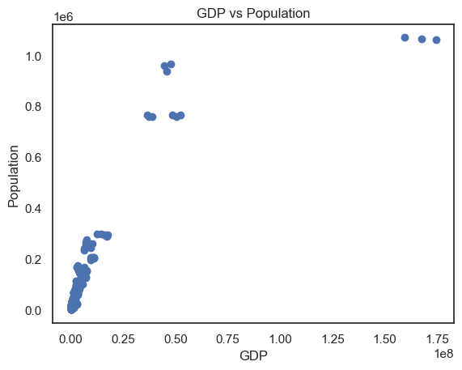
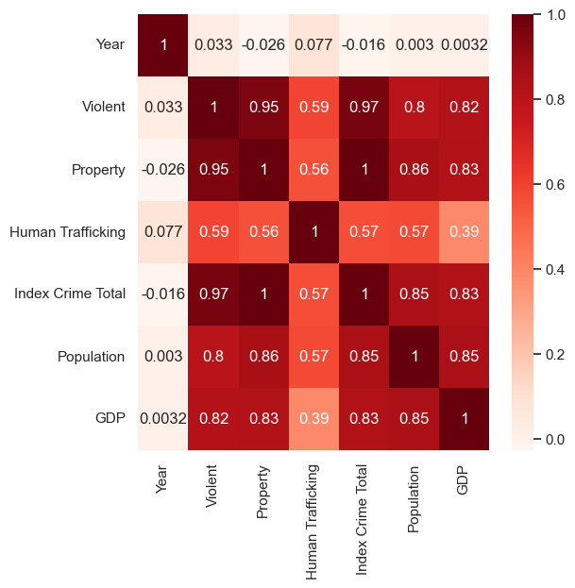
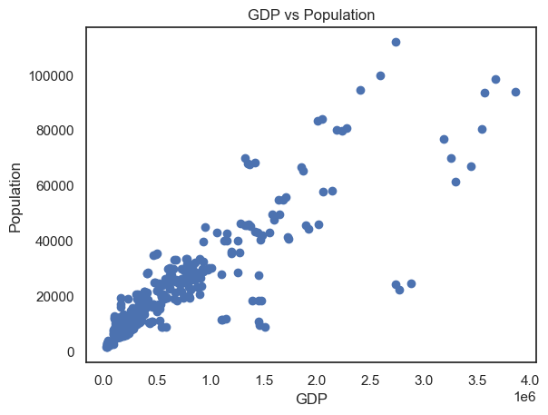
EDA Highlights (Correlations)
Correlation: 0.83
Correlation: 0.85

Slide 6
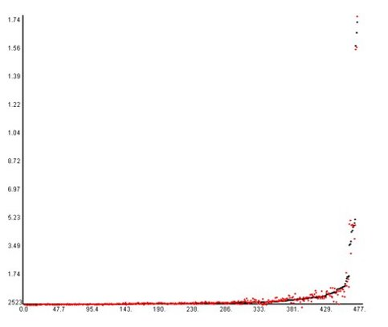
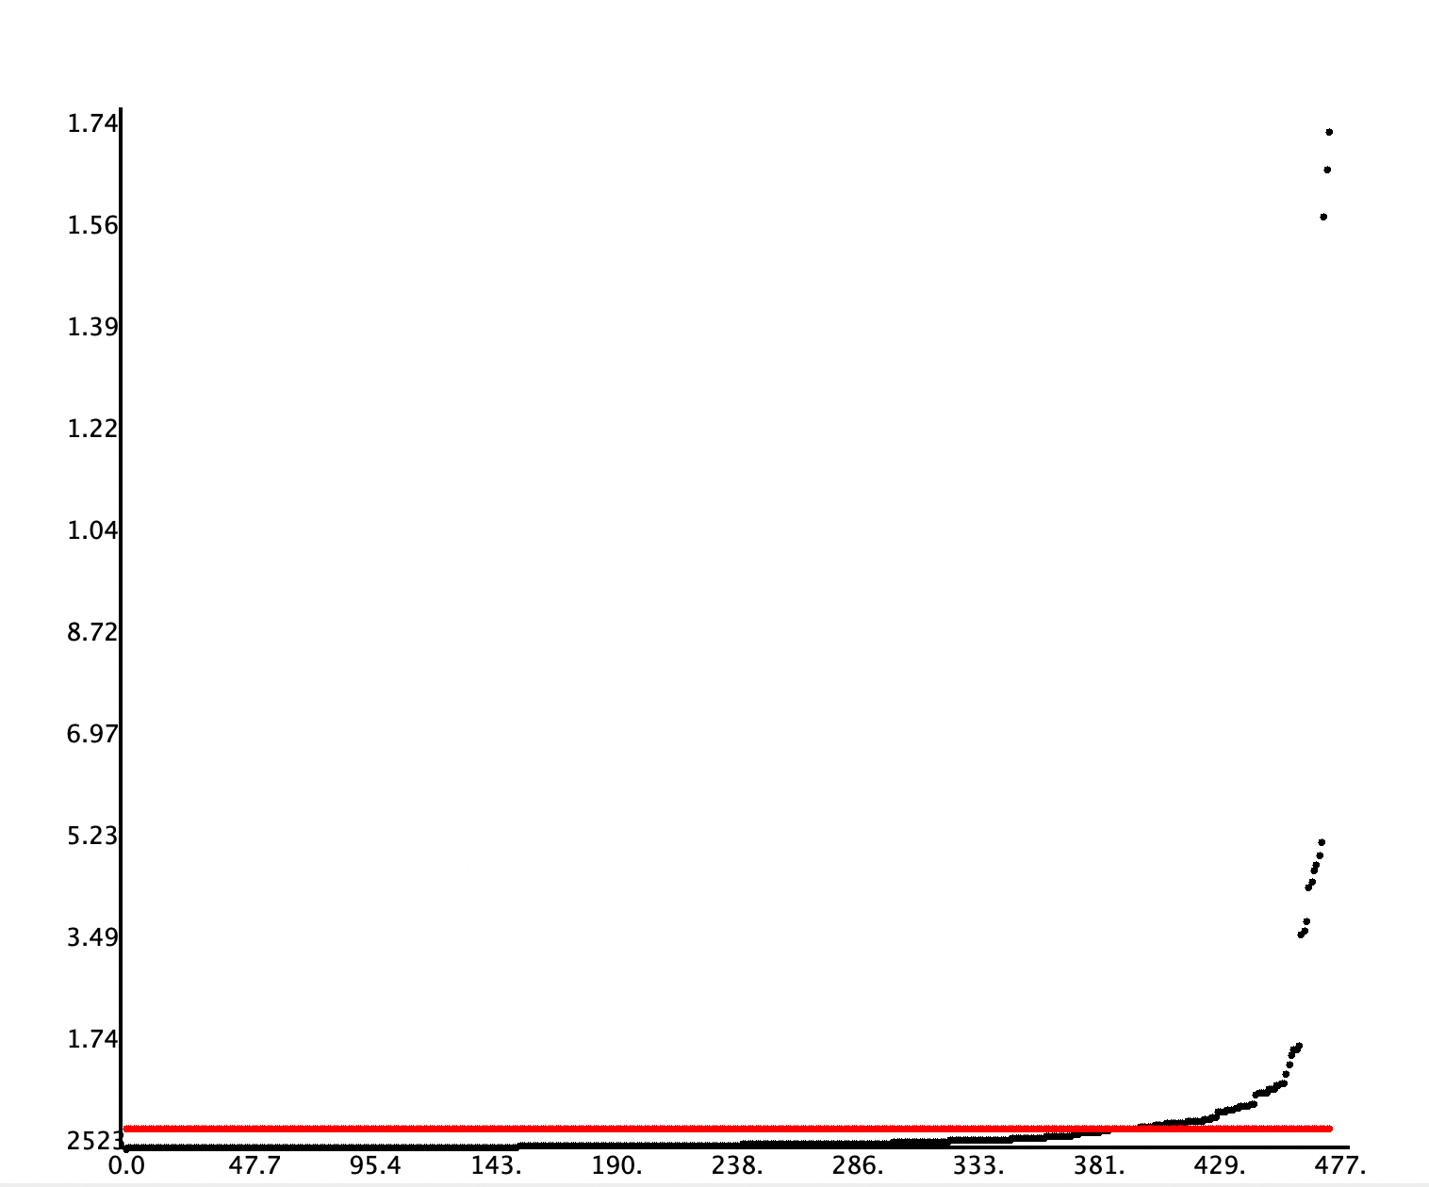
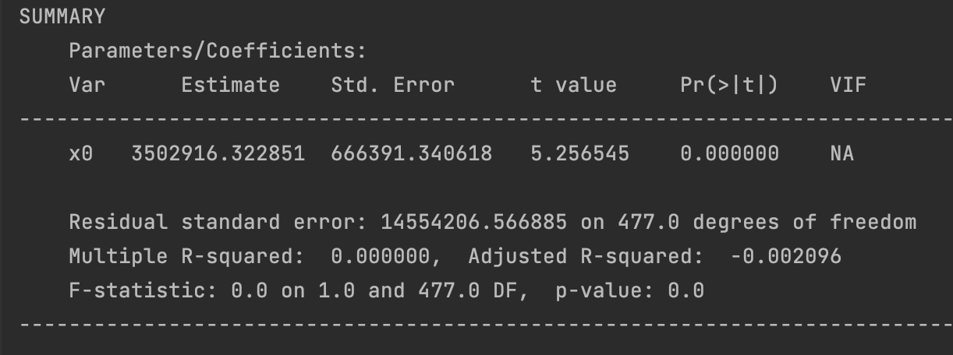
Null Model
Response mean:
3,502,196
R² = 0
SST = 101040491033569344
SSE = 101040491033569344
RMSE = 14554206.5
MAE = 4590903.6
SMAPE = 126.9
Linear Regression Model

Slide 7
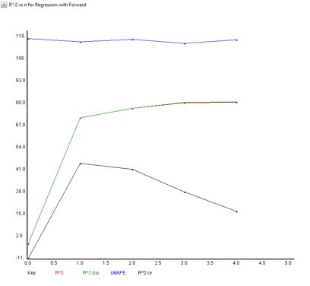
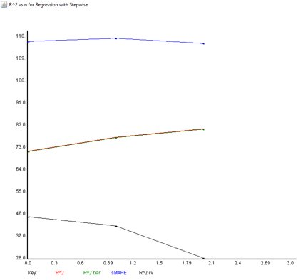
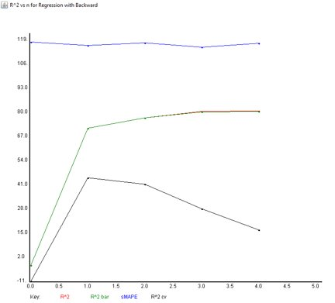
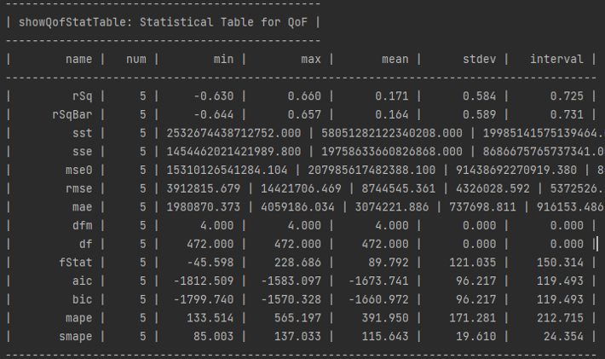
Linear Regression
R2 = 0.81
SST = 101040491033569344
SSE = 191566927546877044​
RMSE = 6337253
MAE = 2600127
SMAPE = 117.4

Slide 8
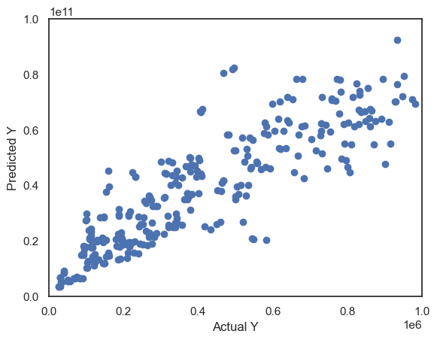
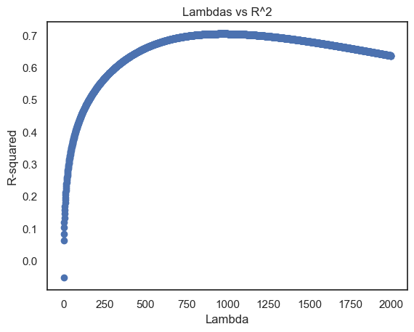
Ridge Regression
Forward Selection: ['Violent', 'Human Trafficking', 'Population']
Backward Elimination: ['Violent', 'Property', 'Population']
R² = 0.704
Lambda = 972
SSE = 6.91e25
RMSE = 3.81e11
MAE = 1.59e11
Betas = [5221.07413853, 2052416.47206121, 2012791.59481265, 354383.85316063, 2031253.73693909, 2292142.5961038]
Importance: property crime can directly harm businesses (loss of assets, expensive to fix, security investments)
**Zoomed in to ignore outliers
Cross Validation Scores: [0.90375849 0.24833669 0.70169987 0.85917207 0.80923363]

Slide 9
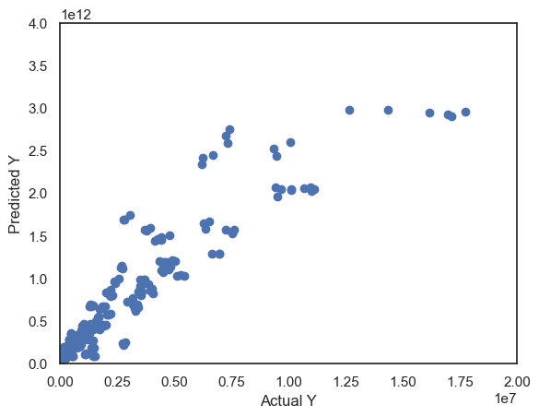
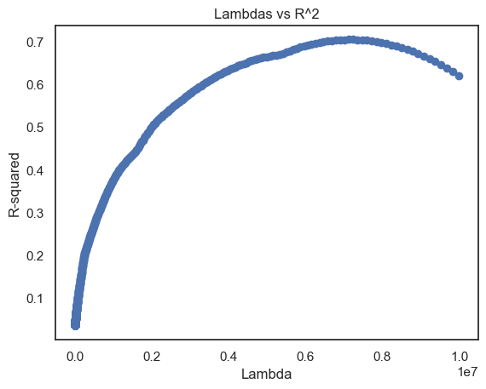
Lasso Regression
Forward Selection: ['Year', 'Index Crime Total', 'Population']
Backward Elimination: ['Year, 'Index Crime Total', 'Population']
L1 Regularization: ['Violent', Human Trafficking', 'Population']
R² = 0.814
Lambda = 257,787
SSE = 1.230e27
RMSE = 1605685281443
MAE = 673930361309
Betas = [0, 6321081.72315296, -0, -3311472.56048367, 0, 9986108.23570896]
Importance: more violent crimes can "scare" away investors and slow economic growth in an area. Higher population = more job opportunities = better GDP (Atlanta)
Cross Validation Scores: [0.80577759
0.59866041
0.70911513
0.8032077
0.75823502]

Slide 10
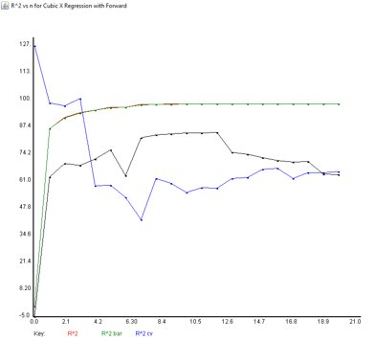
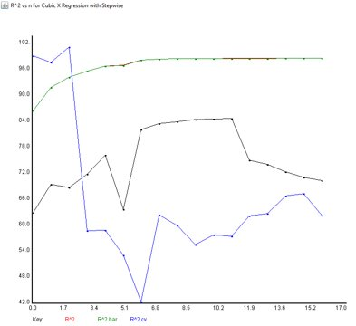
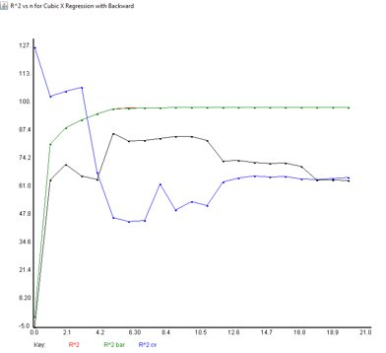
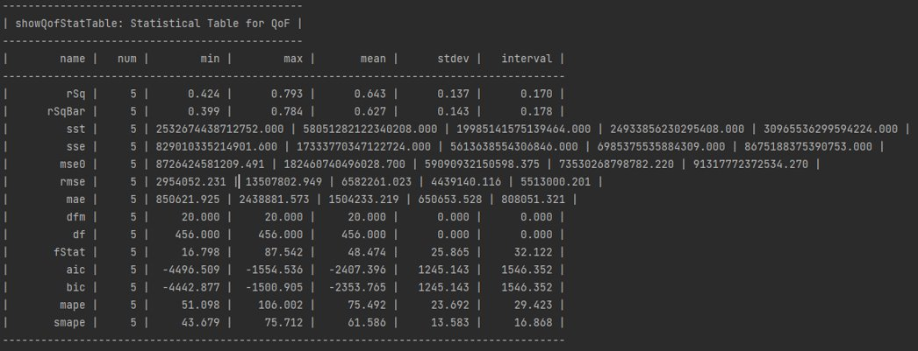
Symbolic (Powers: 1st and 3rd, w/ Intercept and Cross Interaction)
R² = 0.99
SST =1.01e17
SSE =1.34e15
MSE = 2.81e12
RMSE = 1675046
MAE = 749275
SMAPE = 64.9

Slide 11
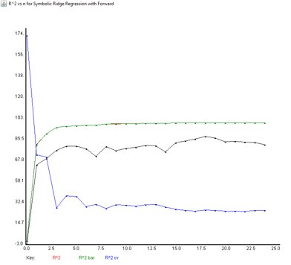
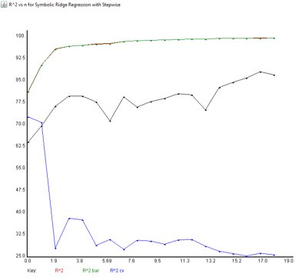
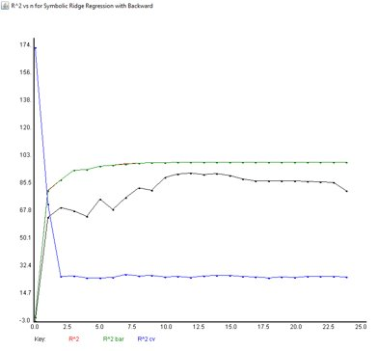
Symbolic Ridge (Powers: 1st, w/ Intercept, Cross, and Cross3 Interactions)
R² = 0.996
SST =1.01e17
SSE =3.8e14
MSE = 8.02e11
RMSE = 895461.6
MAE = 472250.6
SMAPE = 25.8

Slide 12
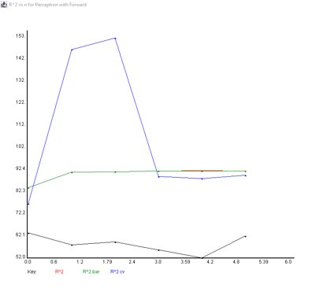
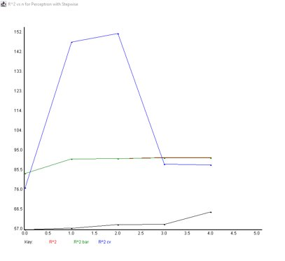
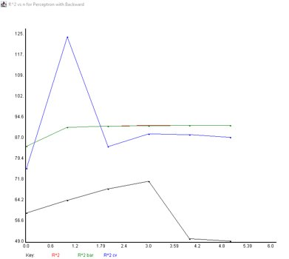
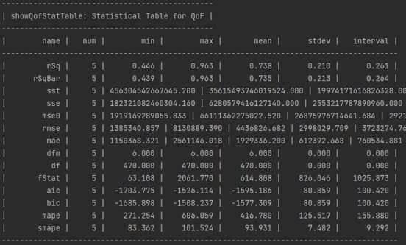
Perceptron
R² = 0.59
Adjusted R2 = 0.58
SST = 1.01e17
SSE = 4.17e16
MSE = 8.74e13
RMSE = 9.35e6
MAE = 2.9e6
SMAPE = 106.2

Slide 13
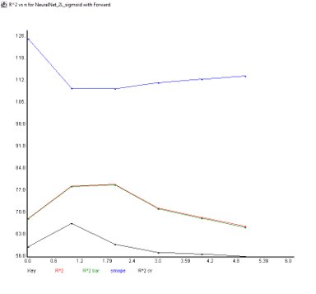
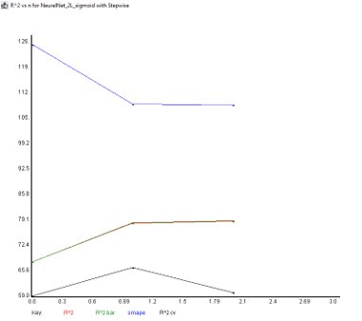
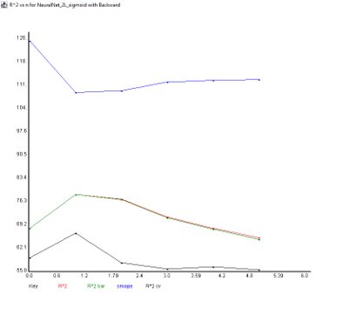
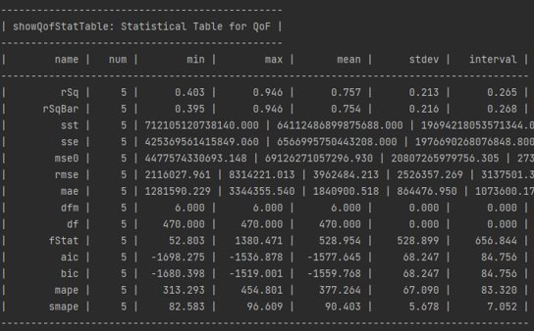
Neural Net 2L
R² = 0.85
Adjusted R2 = 0.848
SST = 1.01e17
SSE = 1.51e16
MSE = 3.17e13
RMSE = 5.63e6
MAE = 2.64e6
SMAPE = 112.3

Slide 14
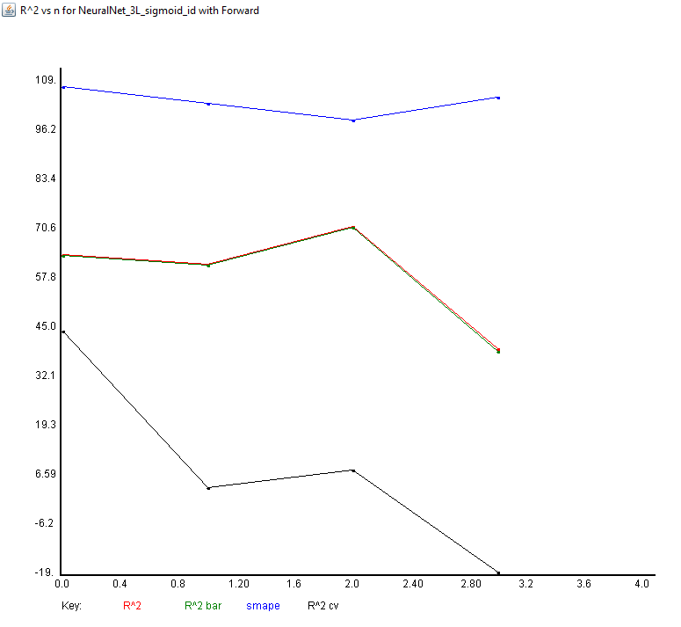
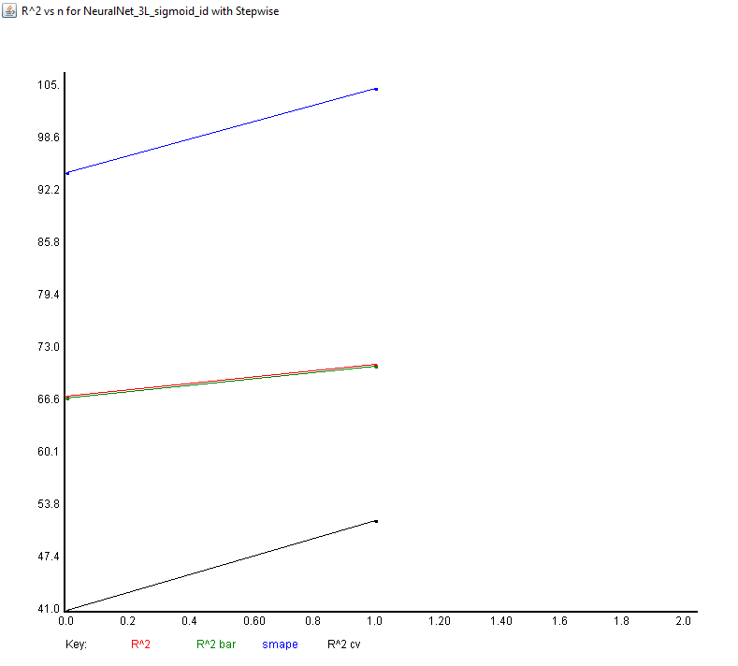
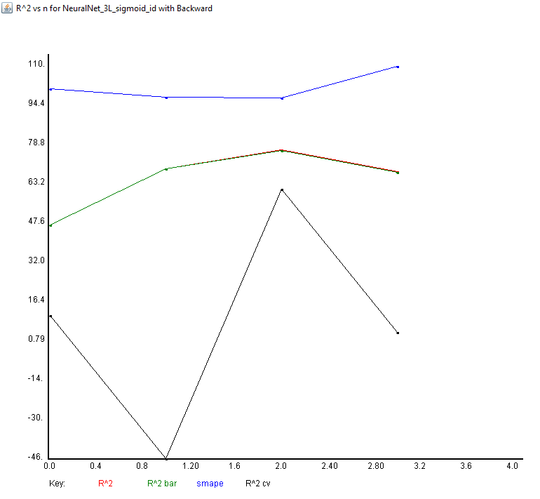
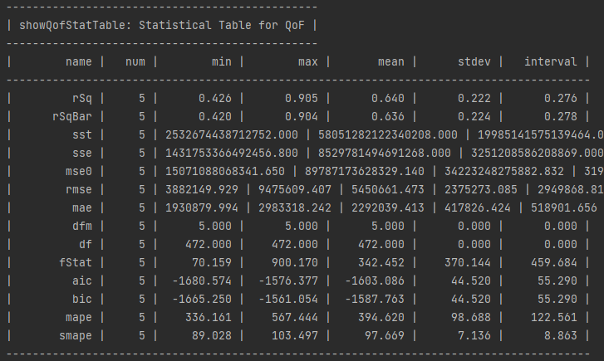
Neural Net 3L
R² = 0.69
Adjusted R2 = 0.689
SST = 1.01e17
SSE = 3.11e16
MSE = 6.51e13
RMSE = 8.07e6
MAE = 2.7e6
SMAPE = 106.1

Slide 15
Why Techniques Were Chosen?
Model | Why? | How well it worked? | Suggested changes
Ridge/Lasso | The correlations between the predictor variables were relatively high. Ridge/lasso can help reduce multicollinearity to help identify important features that affect local GDPs. | Ridge did not work as well, due to the MSE being around the same/higher than the linear model. Lasso was able to eliminate 3 features: year, property crime, and total crime, and also achieved lower MSE | Using more independent variables that could affect local GDP, since 5 might not be enough for sparsity effect of the lasso model
Symbolic models | To help model complex, nonlinear relationships between the variables. Penalty can help reduce multicollinearity. | Symbolic Regression and Symbolic Ridge Regression both performed very well, but in the general case, Symbolic Regression was simpler and had better quality of fit scores excluding the R². | More data could help improve our models by reducing overfitting. That way we could find the true relationships between Crime and GDP.
Neural Nets | Captures nonlinear relationships between the variables. Trained to minimize error so can be more accurate representations and predictions of GDPs (important for future years) | Neural Nets on average performed similar to/worse than the linear model. This may be due to the small dataset we had which caused them to overfit. | Gathering more data could help better train our models and reduce overfitting. Being more precise with tuning the learning rate with varying activations functions could also improve our fitness.

Slide 16
Interpretation of Results
Concluding that "richer" counties are safer to live in is not always practical. Fulton had the most offenses in the span of a year but is still thriving economically, for example.
The cost of repairs, insurance, etc. may not be affordable by some businesses, leading to closures and drop in profits. Higher occurrences of violent and property crimes lead to relocation
The local government's ability to make expenditures on security can lead to drop in violent crime. High GDP can be used to an advantage to invest in better security, leading to a drop in crimes and boost in population
Limited data, so less complex models provided better CV scores. More complex models can overfit on small datasets. More generalized models appeared to overcome this obstacle. (symbolic regression did better than Symbolic Ridge regression). Same with lasso

Slide 17
Recommendations of Study
More accurate crime statistics and economic data from years before 2019 and after 2021 of Georgia counties would help improve the accuracy of our models.
Can expand dataset to include data about additional states. Incorporate more predictor variables, such as education levels, political aspects, demographics, etc.
Focusing on smaller regions of Georgia could provide more relevant results as different counties have vastly different GDPs and crime rates i.e., Atlanta counties compared to south Georgia counties.
Validate/test the results of our study on data from other states to measure predictive performance (helps evaluate our models better to identify bugs/flaws

