Slide 1

Analytics Showcase Final Presentation
Navya Bingi
Fall 2024

Slide 2


Team Introduction
Undergrad:
Grad:
Major: Data Science
Major: Masters in Analytics (graduating in 2025)
In school, I do various DS projects that leverage machine learning, randomized optimization, modeling, and so much more!
During my internship this past summer, I was tasked with finding insights about marketing campaigns for an auto manufacturer. I had a lot of fun doing this, and this competition gave me a chance to perform a similar analysis for CarMax.

Slide 3
Agenda
Executive Summary
Method of Analysis
Methods
Major findings
4. Geospatial Visual Analysis
5. Exploratory Data Analysis
6. Modeling 1
7. Modeling 2
8. Recommendations/Conclusion

Slide 4
Executive Summary
Problem statement: CarMax is considering opening new stores in the United States. How should marketing and inventory strategy be approached to drive maximum sales depending on the location of the new store?
Optimal expansion strategy
Customer preferences and awareness
Key Takeaways:
There is an opportunity to personalize campaigns to specific customers in specific regions.
High correlation between purchases and service plan/finance customers
Regional differences in various features should be studied to further increase brand awareness.

Slide 5
Method of Analysis
Gain an overall understanding of the dataset using geospatial analysis
Data Cleaning
List questions that can be answered using EDA
Which campaign is popular for different regions?
Relationship between vehicle class and touchpoints?
Etc.
4. Modeling
Predicting purchase flag (using neural net and XGBoost)
Predicting unaided awareness (using logistic regression and KNN)

Slide 6
Geospatial Visual Analysis
Using geopandas

Slide 7
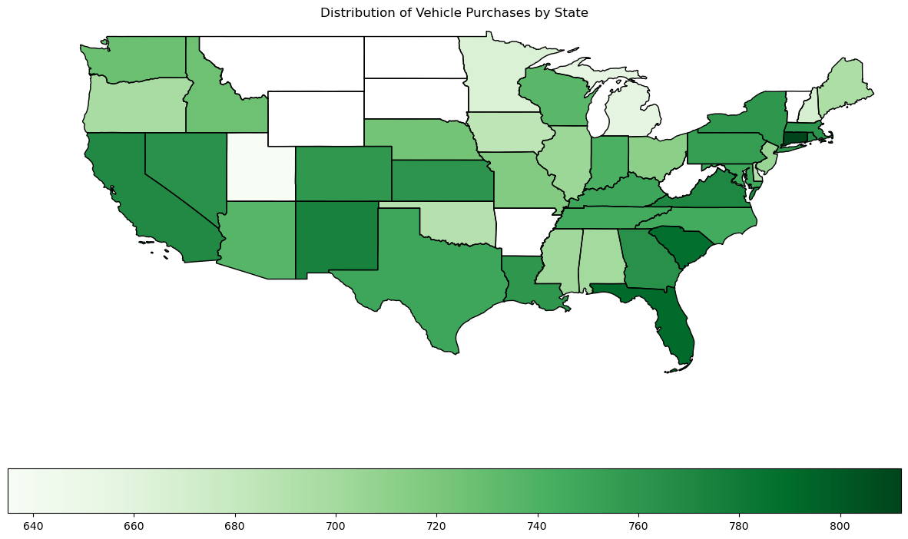
Distribution of Vehicle Purchases by State
Darker areas represent states that had more purchases. White states were not in the dataset.
Overall, there is an even distribution of total sales (at least 700) throughout the US, disregarding white states.

Slide 8
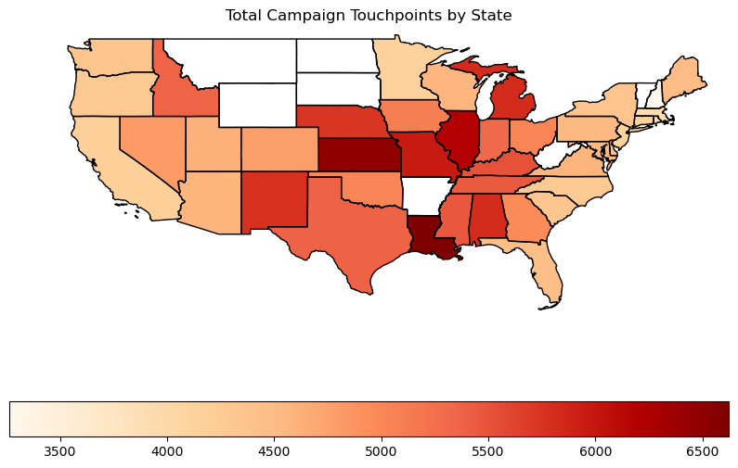
Total Campaign Touchpoints by State
Customers in the Midwest and South regions engage more with campaigns, compared to those in the east and west coasts.

Slide 9
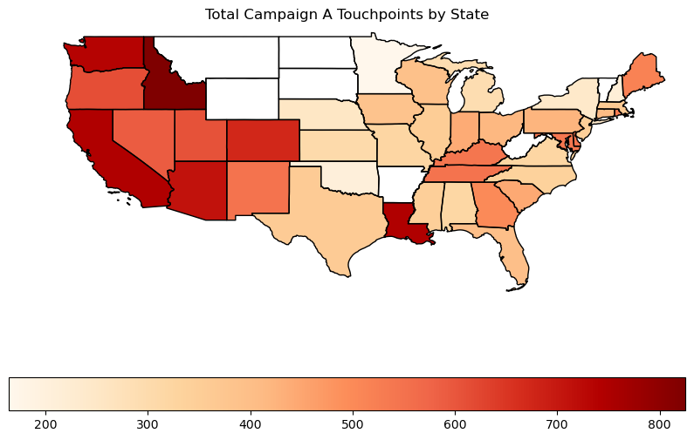
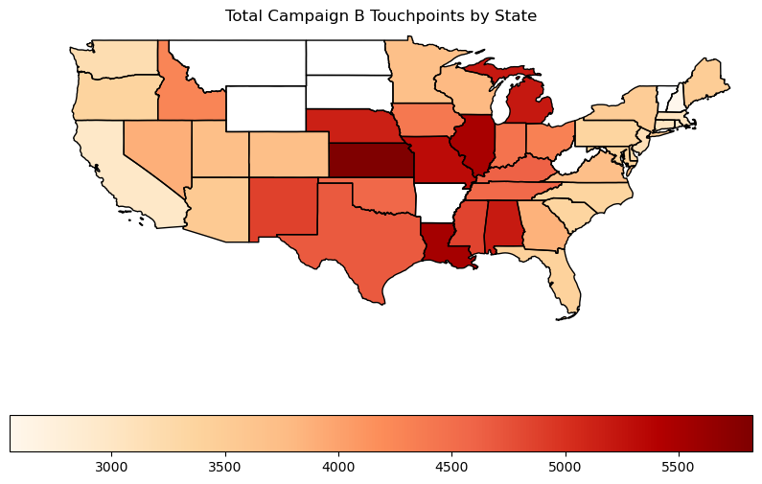
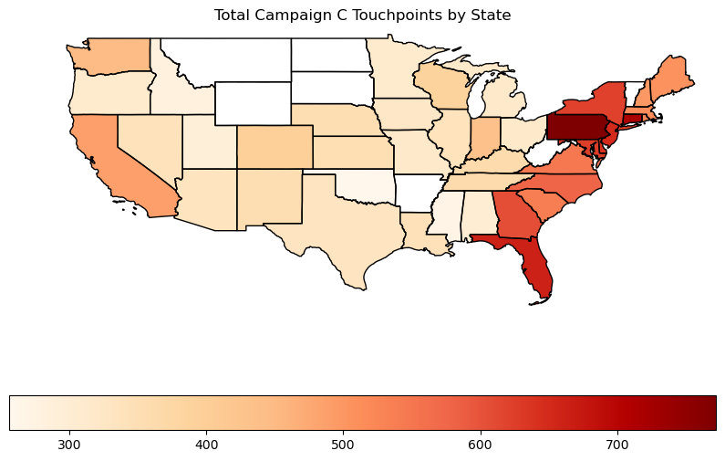
Specific Campaign Touchpoints by State
Customers in the west region respond more to Campaign A.
Customers in the Midwest and south regions respond more to Campaign B.
Customers in the east coast respond more to Campaign C.

Slide 10
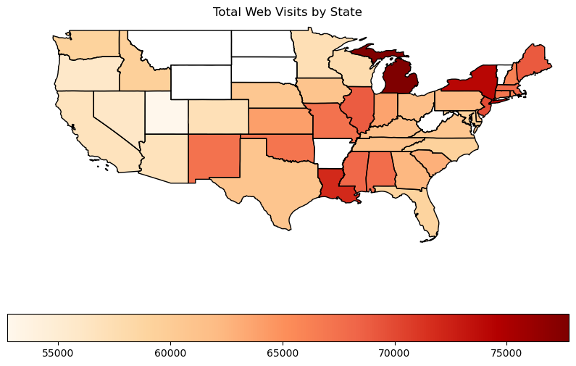
Total Web Visits by State
Customers in Michigan, New York, and Louisiana visited the website the most during their shopping journey.

Slide 11
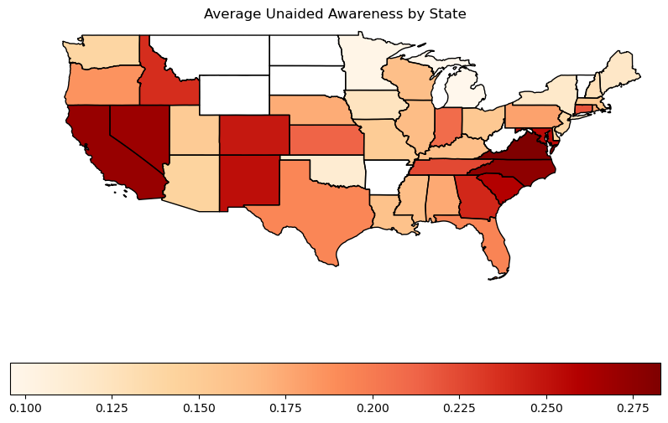
Average Unaided Awareness by State
Customers in California, Nevada, North Carolina, and Virginia had the highest average unaided awareness.
However, the highest average unaided awareness, which is measured on a scale of 0 to 1, was around 0.28.
The highest unaided awareness was 0.457 in Virginia.

Slide 12
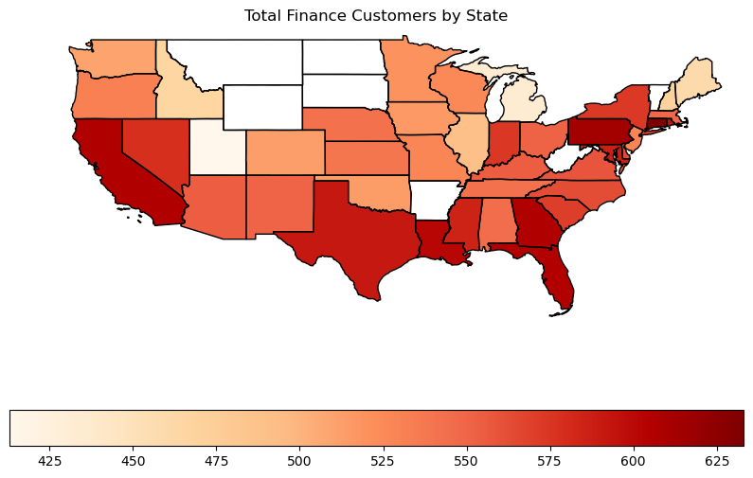
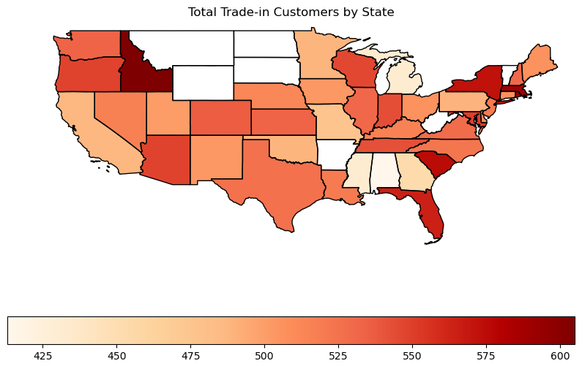
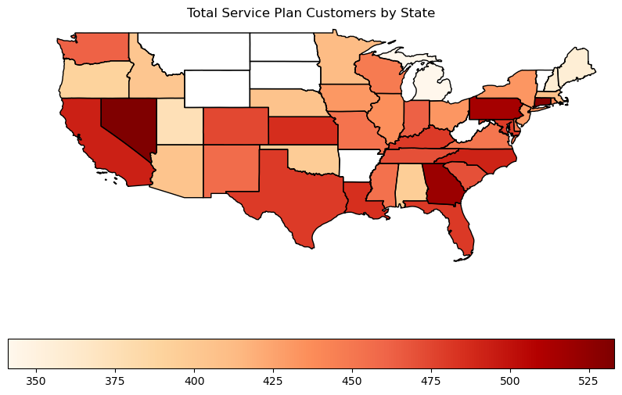
Total Types of Customers by State
Total Finance Customers:
Total Trade in Customers:
Total Service Plan Customers:
The South and Northeast regions had the most finance customers.
Trade in customers are somewhat evenly distributed, with Idaho having the most.
A similar pattern to total finance customers, but Nevada, Georgia, and Pennsylvania have the most service plan customers.

Slide 13
Exploratory Data Analysis (EDA)

Slide 14
Data Preprocessing Steps Taken
Mapped states to 4 regions (Northeast, Midwest, South, West)
Created dummy variables for regions
Mapped True/False columns to 0 or 1
Created dummy variables for vehicle class
Did not remove outliers, as they represent real data
(Scaling was performed for individual models)

Slide 15
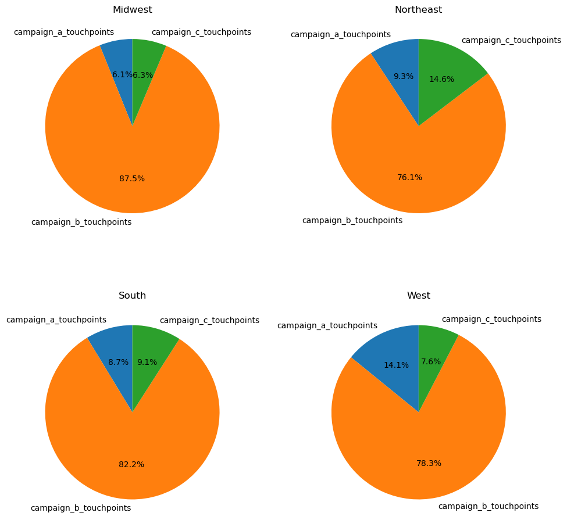
Which campaign is popular for different regions?
Evidently, Campaign B made up most of the total touchpoints for all 4 regions
The Northeast region had a relatively higher percentage of Campaign C touchpoints, while the West had the highest campaign A touchpoints.

Slide 16
Which regions tend to have more web visits? Did those who visit the website more end up buying a vehicle?
Region | Average Web Visits
Midwest | 26.189689
Northeast | 27.556763
South | 25.840698
West | 24.051522
Average web visits seem to be relatively similar across different regions, but overall, the Northeast had the highest number.
Interestingly, those who did not purchase a vehicle had slightly higher average web visits.

Slide 17
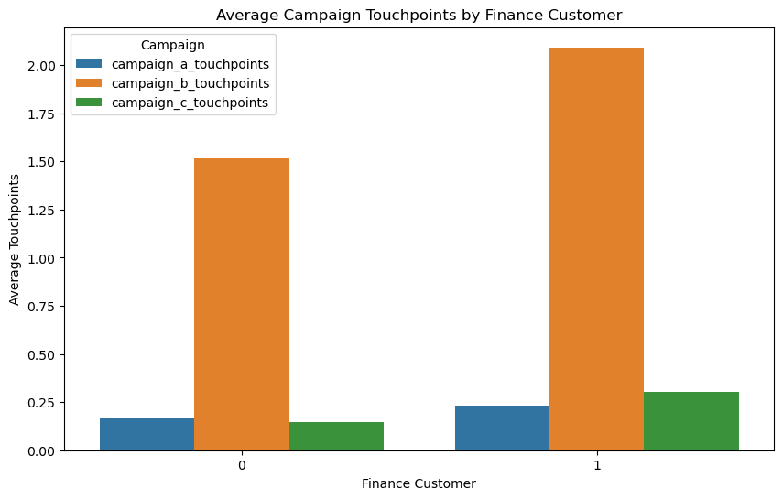
Is there a relationship between campaign/web touchpoints and finance customers?
Average campaign touchpoints do not vary as much based on whether a customer financed the vehicle.
People who did not finance their vehicle and purchased it outright had slightly more web visits, on average.

Slide 18
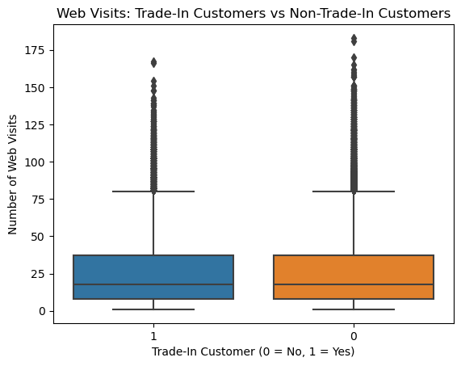
Are those who visit the website more people who sold a vehicle to CarMax (and therefore are more familiar with the website)?
 | Average web visits
Trade in Customer | 25.822657
Non Trade in customer | 26.072952
Trade in and non trade in customers visit the website equally, on average. Their distributions are also very similar. Therefore, there is no correlation between whether or not someone sold a vehicle to CarMax and the number of times they visit the website.

Slide 19
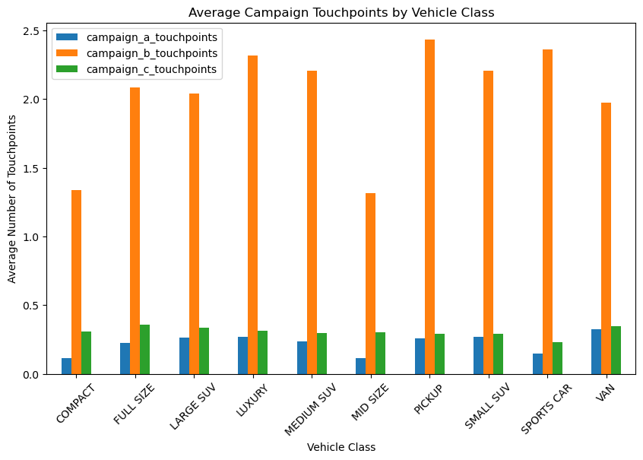
Is there a relationship between the vehicle class and average touchpoints?
Though there is not much variation between average campaign touchpoints for different vehicles, people who bought pickups responded to Campaign B the most.
Those who bought compact and mid-size vehicles had least campaign engagement, although this could indicate that not many of these vehicles were purchased.

Slide 20
Did trade-in customers buy a vehicle? If so, what campaign appealed most to these customers?
About 40% of trade in customers purchased a vehicle from CarMax (not shown, but calculated).
Trade in customers who purchased a vehicle engaged more with Campaign B. On average, these customers had 2 Campaign B touchpoints.

Slide 21
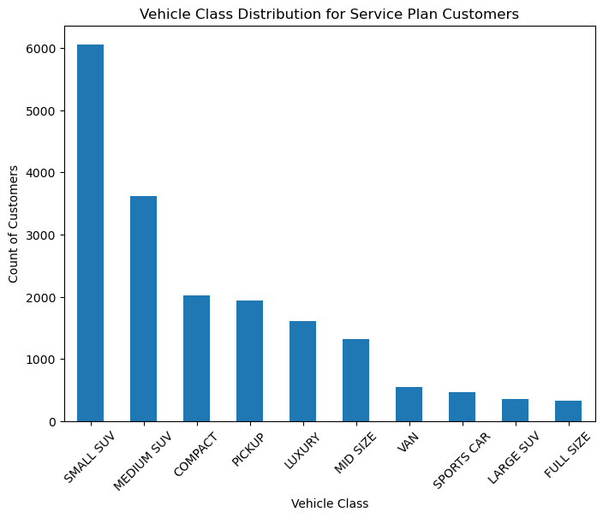
Do customers who purchase service plans buy different types of vehicles or respond to certain campaigns?
 | Average touchpoints (service plan customers)
Campaign A | 0.244485
Campaign B | 2.033175
Campaign C | 0.484535
Most customers who bought a service plan bought a small or medium SUV.
Customers who bought a service plan with their vehicle engaged more with Campaign B. On average, these customers had 2 Campaign B touchpoints.

Slide 22
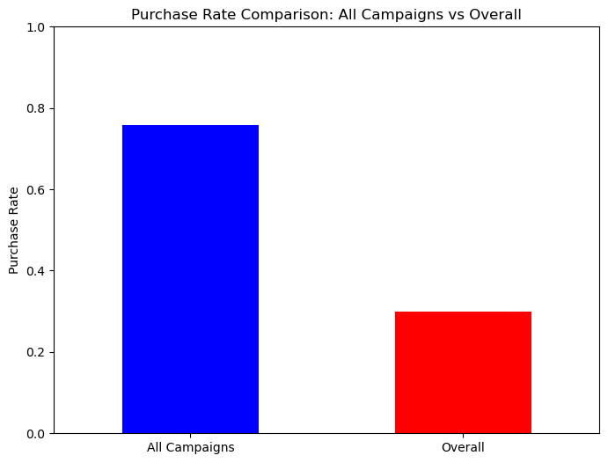
Did those who receive touchpoints from all campaigns buy a vehicle?
Those who engaged with all 3 campaigns had more than double the purchase rate than the overall purchase rate in the data.
About 80% of customers who responded to all 3 campaigns ended up buying a vehicle.

Slide 23
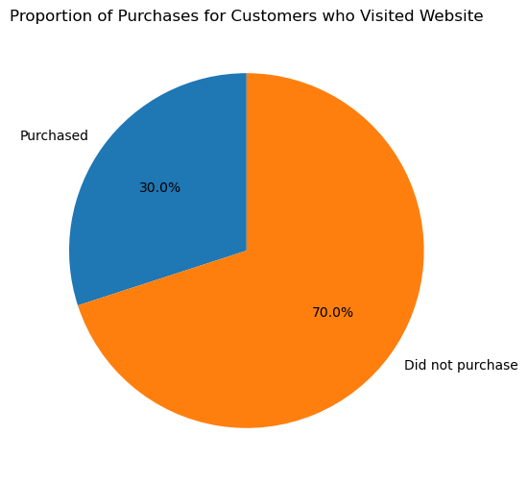
Among those who visited the website, what proportion actually made a purchase?
Exactly 30% of customers who visited the website at least once bought a vehicle.
Most did not end up buying a vehicle, so possibly just shopping around.

Slide 24
EDA Summarized
Customers are responding more to Campaign B than other campaigns.
Visiting the website more does not necessarily mean a person is more likely to purchase a vehicle.
Customers who did not finance their car visited the website slightly more, on average, than those who did.
Trade in customers are not too likely to purchase a CarMax vehicle (only 40%).
Most cars that were bought with a service plan were SUVs. They might require more maintenance, due to larger size, etc.
Sending out all 3 campaigns to customers seems to have a promising result: about 80% of customer who engaged with all campaigns bought a vehicle.
Most customers who visit the website are likely just browsing or might not have an intention to buy a car.

Slide 25
Modeling – Predicting Purchase Flag
Neural Network
XGBoost

Slide 26
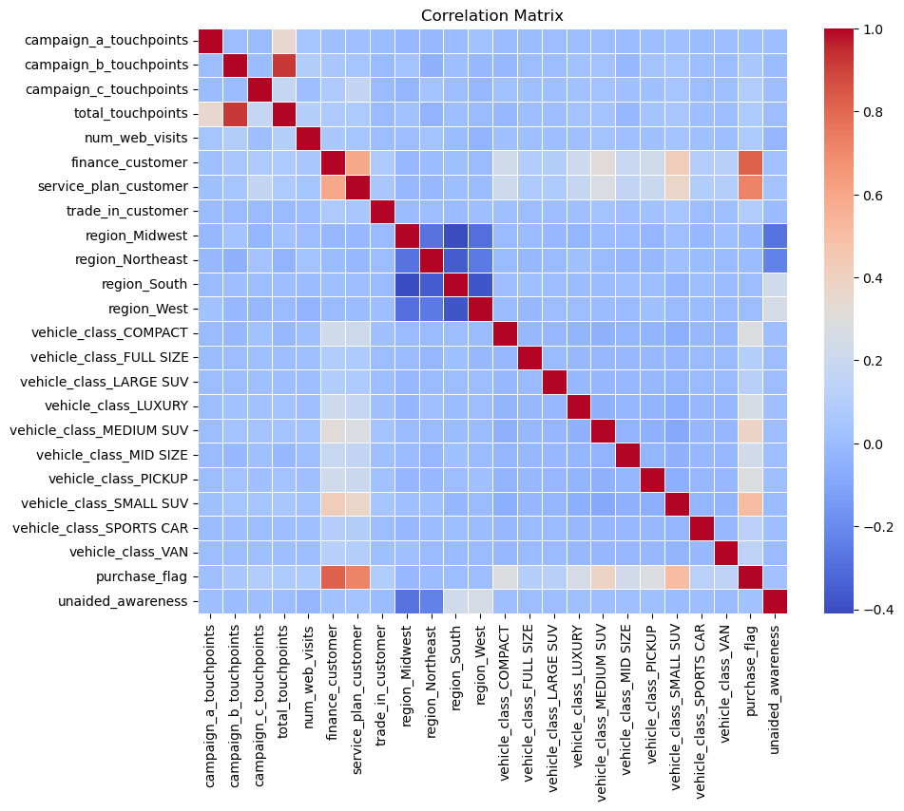
Correlation Matrix of Variables
Looking at the red box, there is not a very high correlation between the features and the target variables purchase flag and unaided awareness.
Finance and service plan customers are highly correlated with purchase flag, but this is obvious since only purchasers of a vehicle are qualified for these variables.

Slide 27
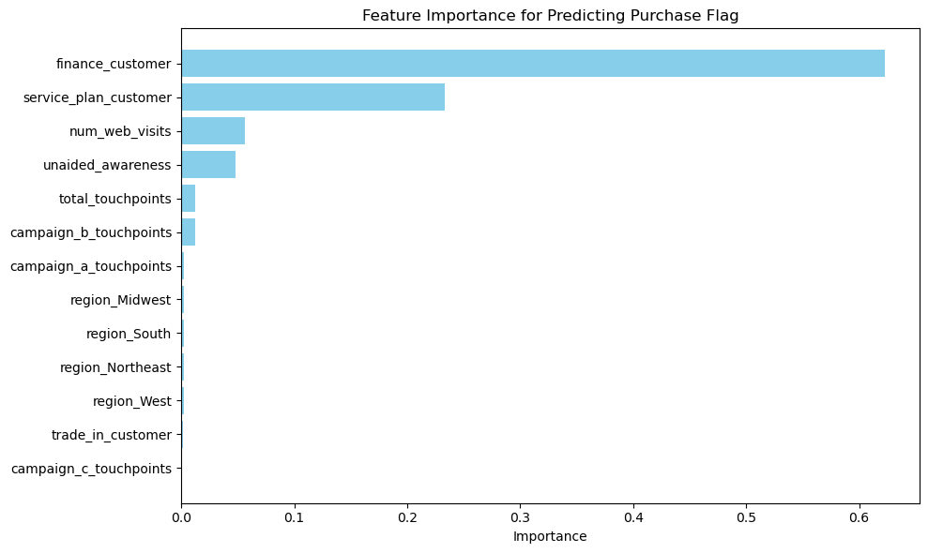
Feature Importance for Purchase Flag
Using a random forest regressor, features were ranked by importance pertaining to the target variable, purchase_flag.
finance_customer and service_plan_customers had the highest importance since these customers automatically count as purchasers of a vehicle.
These features were used to build a neural network, but with an extra component…

Slide 28
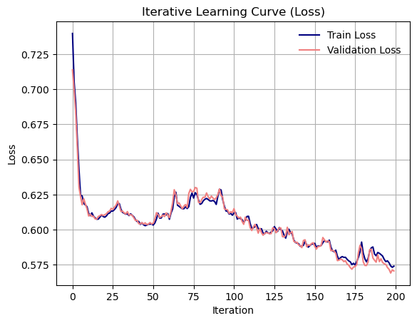
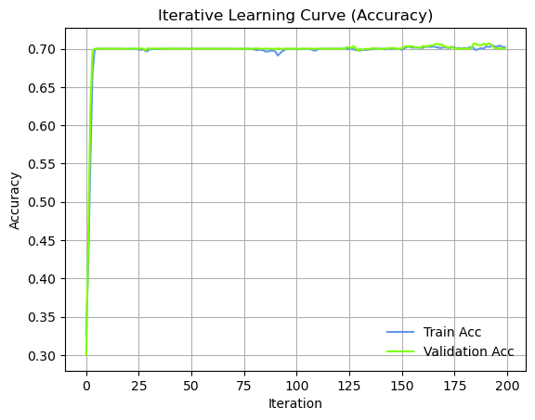
Predicting Purchase Flag Using a Neural Network
Model parameters:
Dropout percent = 0.05
Layer sizes: (23,12,6,1)
Learning rate = 0.01
Metrics:
Model accuracy: 0.70
Minimum loss = 0.58
The extra component applied to the NN was optimization, specifically Randomized Hill Climbing.
This algorithm explores a search space, such as weights in a NN, by applying small, random changes while moving towards the optimal solution.

Slide 29
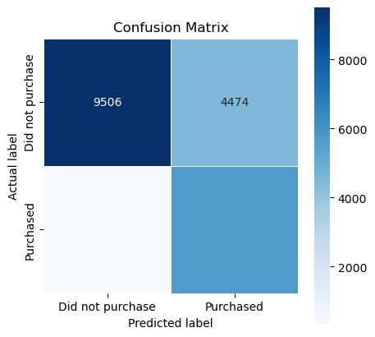
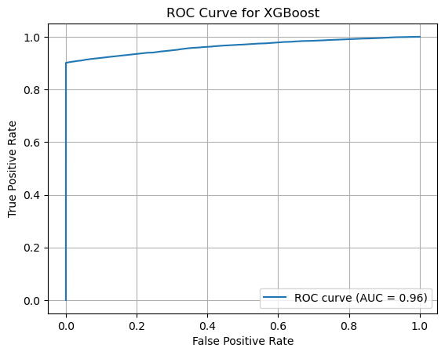
Predicting Purchase Flag Using XGBoost
Model parameters:
Max depth: 30
Learning rate: 0.8
Training rounds = 100
Metrics:
Model accuracy: 0.76
F1 score = 0.70
Precision = 0.56
250
5770
The XGBoost model performed well, achieving an accuracy of 0.76. The high AUC suggests that it distinguishes between purchasers and non-purchasers.
Precision is on the lower side. Some customers are being classified as purchasers when they are not.

Slide 30
Modeling – Predicting Unaided Awareness
Logistic Regression
K-Nearest Neighbors

Slide 31
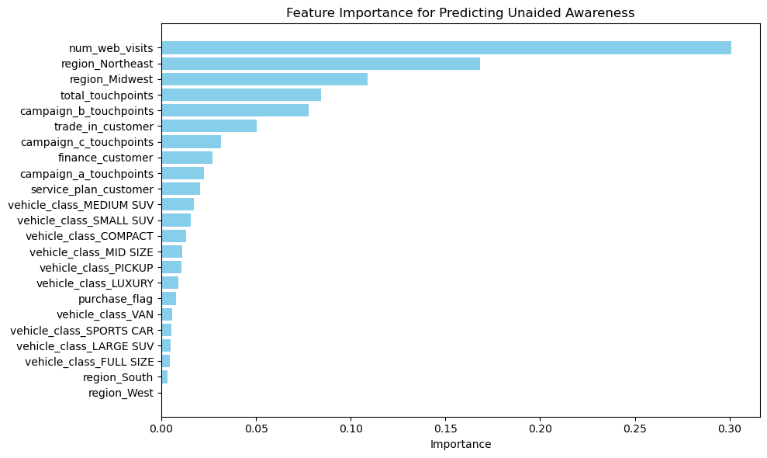
Feature Importance for Unaided Awareness
Using a random forest regressor, features were ranked by importance pertaining to the target variable, unaided awareness.
The number of website visits, customers in the Northeast and Midwest regions, and total touchpoints seem to be important predictors of unaided awareness.

Slide 32
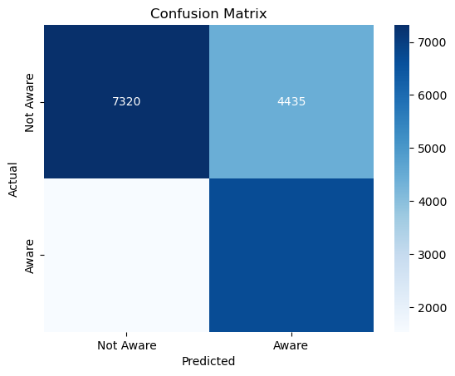
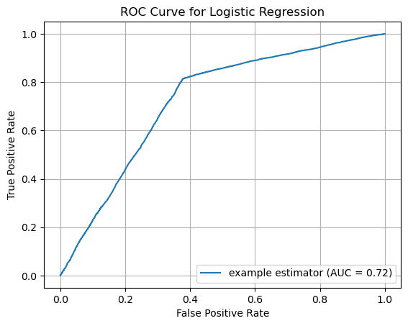
Predicting Unaided Awareness Using Logistic Regression
Model parameters:
Threshold = 0.18
Max iterations: 1000
Metrics:
Model accuracy: 0.70
F1 score = 0.69
Precision = 0.60
1537
6708
Unaided awareness followed a normal distribution, centered around 0.2.
A threshold of 0.18 was used to transform unaided awareness into a binary variable. An awareness higher than 0.18 was labeled as 1, otherwise 0.

Slide 33
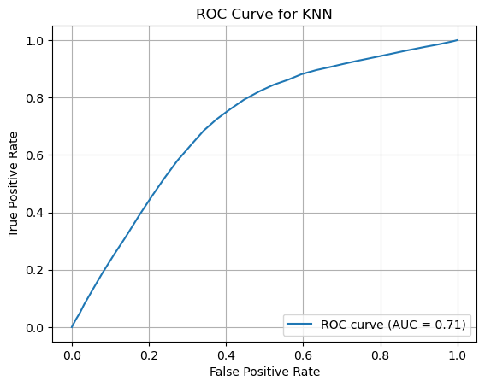
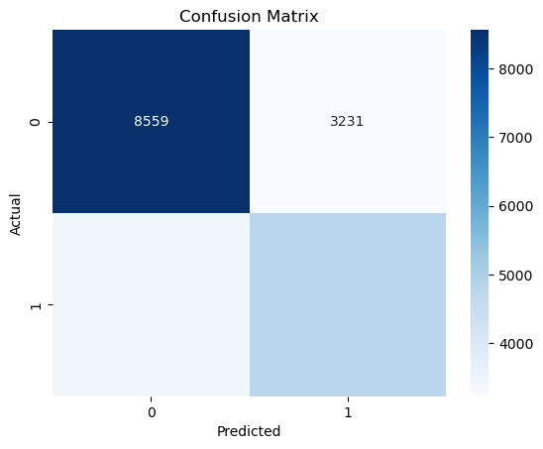
Predicting Unaided Awareness Using K-Nearest Neighbors
Model parameters:
Neighbors: 50
Metrics:
Model accuracy: 0.67
F1 score = 0.59
Precision = 0.60
1631
6708
3442
4768
A KNN model with 50 neighbors misclassified some samples, with the F1 score and precision being on the lower side for unaided awareness values greater than 0.18.

Slide 34
Recommendations & Opportunities

Slide 35
Recommendations
Promoting the website within the different campaigns can help increase web visits that result in purchases. Each campaign appeals to different regions, so this is likely to get all states engaging more with the website.
Improving website effectiveness → higher conversion rate of buyers
Focus on service plan marketing for SUV customers/owners.
Implementation plan:
Utilize website analytics to better understand customer behavior and increase sales.
Monitor unaided awareness and aided awareness (after priming)
For service plan marketing, identify SUV models that require more maintenance and promote CarMax’s service plan. Emphasize savings on repairs.
Further analyze regional differences in CarMax customer engagement with more data. For example, why are customers in the West responding the most to Campaign A? What part of the campaign appeals to West customers?

Slide 36
Opportunities & Insights Gained
Additional data:
Demographic data would be interesting to incorporate and improve customer segmentation.
People visited the website about 26 times on average. How exactly did they spend their time on the website? Data on timeline of interaction could help us better understand how to increase buyer conversion rate.
Personal reflections:
I’ve worked with auto campaign data before and learned that customer behavior is very hard to predict sometimes.
Specifically with this dataset, I found it challenging to deal with the large number of 0s for touchpoints. A deep dive into the EDA helped.
Some new skills I learned during this project: applying methods I learn in class to real-world data (optimization), forming many insights and connections between variables, presenting data analysis insights

Slide 37
Conclusion
Campaign B should be sent out more, as it is getting the most response.
Website analytics could even help decide what specific things to include in campaigns.
Predicting customer behavior can be difficult, so make room to account for misclassifications (prepare for the worst).
Digital marketing is trendy. Can be used to CarMax’s advantage to further promote the website and its features.
Studying individual vehicle classes, such as SUVs requiring more maintenance, can help personalize campaigns and attract specific customers.
Currently, without any priming, people’s awareness of the CarMax brand is on the low side. Implementing these strategies can reach more people and convince them of the superior quality of CarMax vehicles.

