Slide 1
EV Modeling
JuLy, 2024
Epsilon Data Science
Navya Bingi, Data Science Intern

Slide 2
Agenda
Demographics EDA
Data Preparation
Feature Selection
Modeling
Summary

Slide 3
Demographics EDA

Slide 4
Demographics Variables Used
ElectricVehiclePropensity
PresenceofChildren
HouseholdEducation
NarrowBandIncome
Income
HomeOwner
DwellingType
Occupation
FamilyComposition
NewVehiclePropensity
DealerServicePropensity

Slide 5
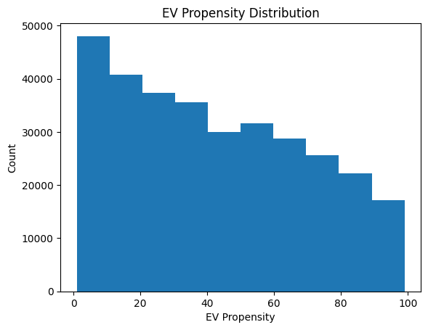
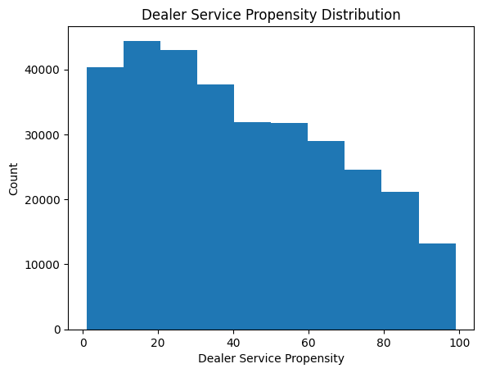
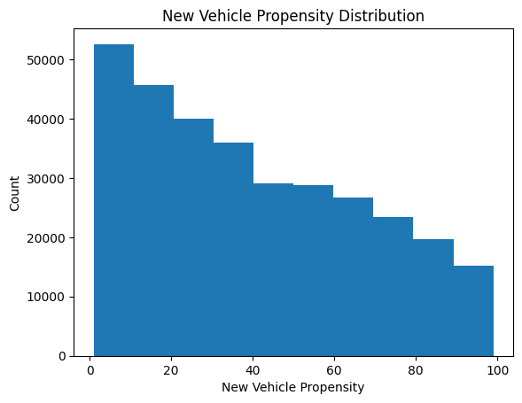
Propensity Distributions
EV Propensity (avg = 42)
Dealer Service Propensity (avg = 41.7)
New Vehicle Propensity (avg = 40)
The average propensity scores are around 40 for EV, new vehicle, and dealer service.

Slide 6
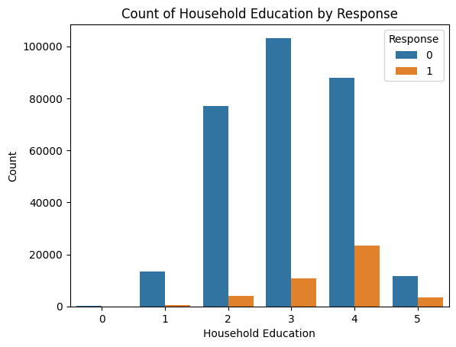
Performance Flag Count by Household Education
People who have a college degree responded the most

Slide 7
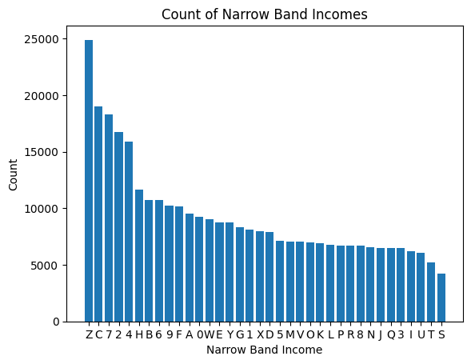
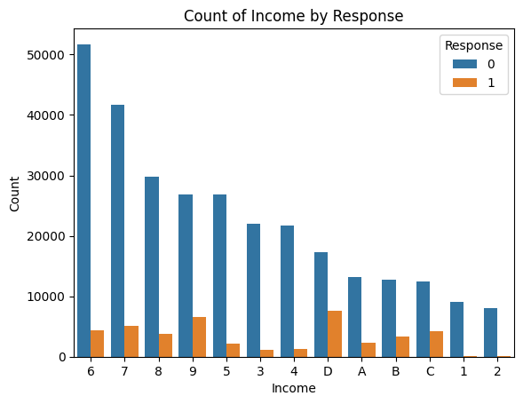
Income Counts
Most customers belong to a household income group of $50k to 100k
However, people who earn $250k or more responded the most
Most customers belong to a narrow band income group of $70k-$75k and >$250k

Slide 8
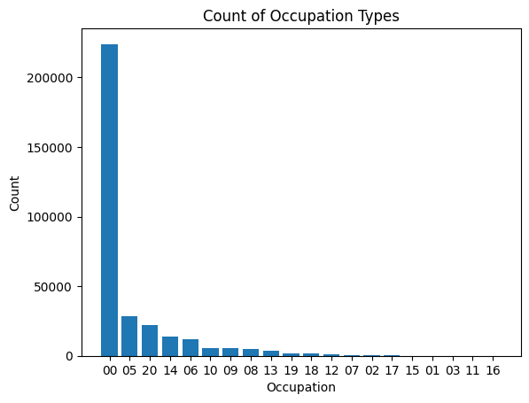
Count of Occupation Types
Unknown occupation was the most popular
Professional/technical was the second most popular occupation

Slide 9
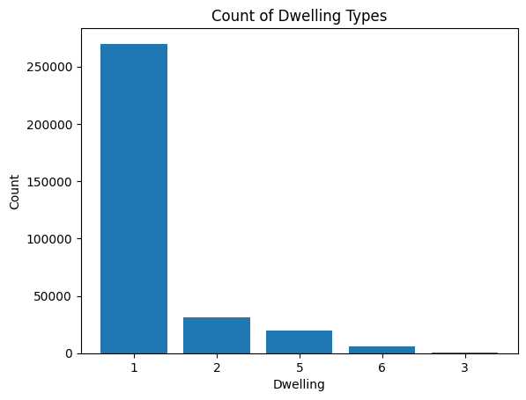
Count of Dwelling Types
Most customers reside in a household with structure “SFDU”, or Single Family Dwelling Unit

Slide 10
Modeling

Slide 11
Data Prep
CLEAN DATA FRAME
335847 rows, 1398 columns
Extract Feature Variables and Target Variable (PERFORMANCE_FLAG1)
Analyze Target Variable
Non-Response = 293,711
Response = 42,136
Overall Response Rate = 12.55%
X (335847 rows, 1397 columns)
Y (335847, 1)
Split Data into 80% Training Data and 20% Test Data
X_train (60676, 1397)
y_train
(60676, 1)
X_test (67170, 1397)
y_test
(67170, 1)
Stratify and undersampled
Undersample the training data, to prevent the model from focusing too much on majority class. The data is also balanced by COHORT_ID to ensure a representative population.
X_eval (6742, 1397)
y_eval
(6742, 1)

Slide 12
Preparing Data for Modeling
Feature Selection
Null Features (20% threshold)
Correlated Features (>0.80 correlation)
High Variance Inflation Factor (0.06 threshold)
Imputation
Mean values were imputed
Train Test Split
Size of original dataset: (335847,1398)
After undersampling and stratifying by y_train:
Training set: 60,676
Validation set: 6,742
Testing set: 67,170

Slide 13
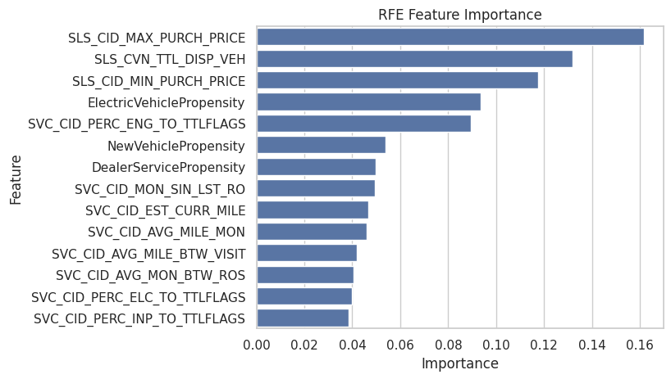
RFE Feature Importance
Top 3 Features:
Highest purchase price out of all the vehicles that a customer has bought
Total number of disposed vehicles per customer
Lowest purchase price out of all the vehicles that a customer has bought

Slide 14
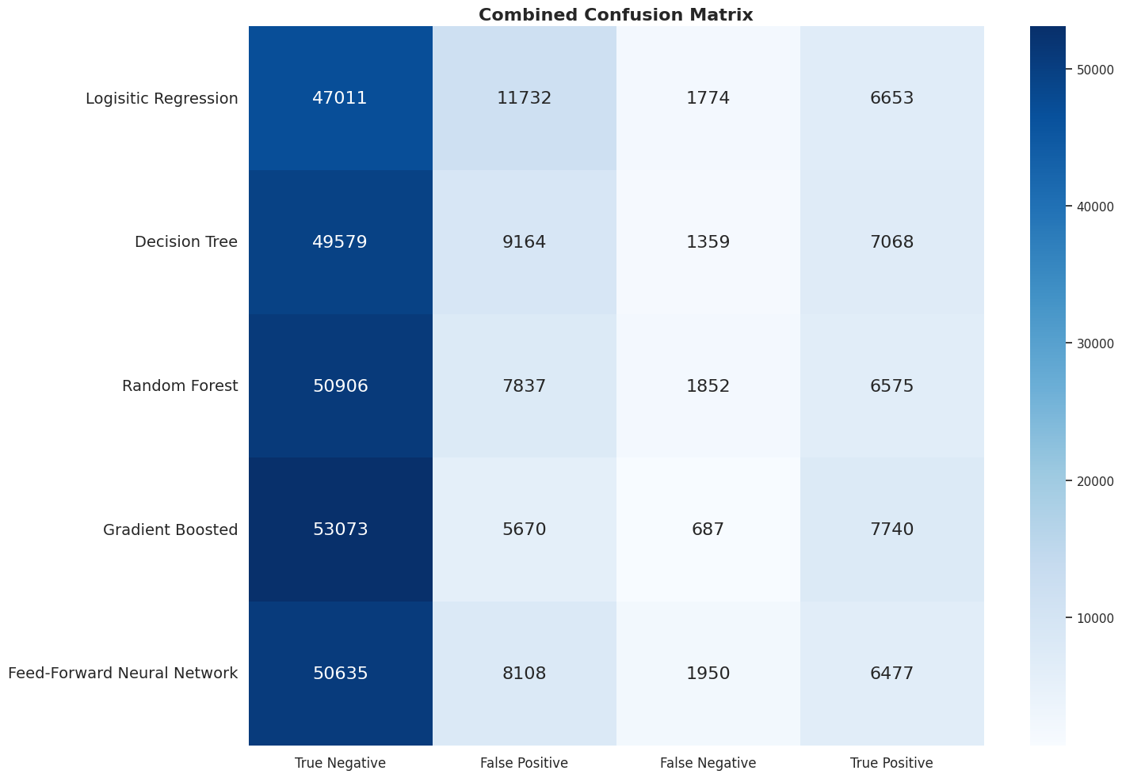
Combined Confusion Matrix
The Gradient Boosted model has the most correctly classified positive and negative responses

Slide 15
Model Selection
We’ll be analyzing the results of the following models:
Logistic Regression
Decision Tree
Random Forest
Gradient Boosting Classifier
Feed-Forward Neural Network

Slide 16
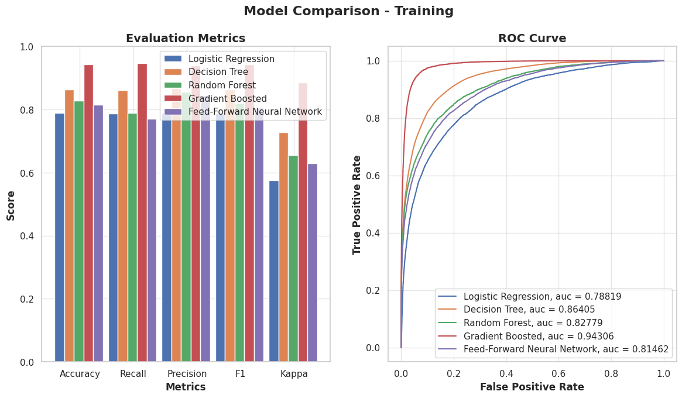
Training Results
Performance Ranking:
Gradient Boosted
Decision Tree
Random Forest
Neural Net
Logistic Regression

Slide 17
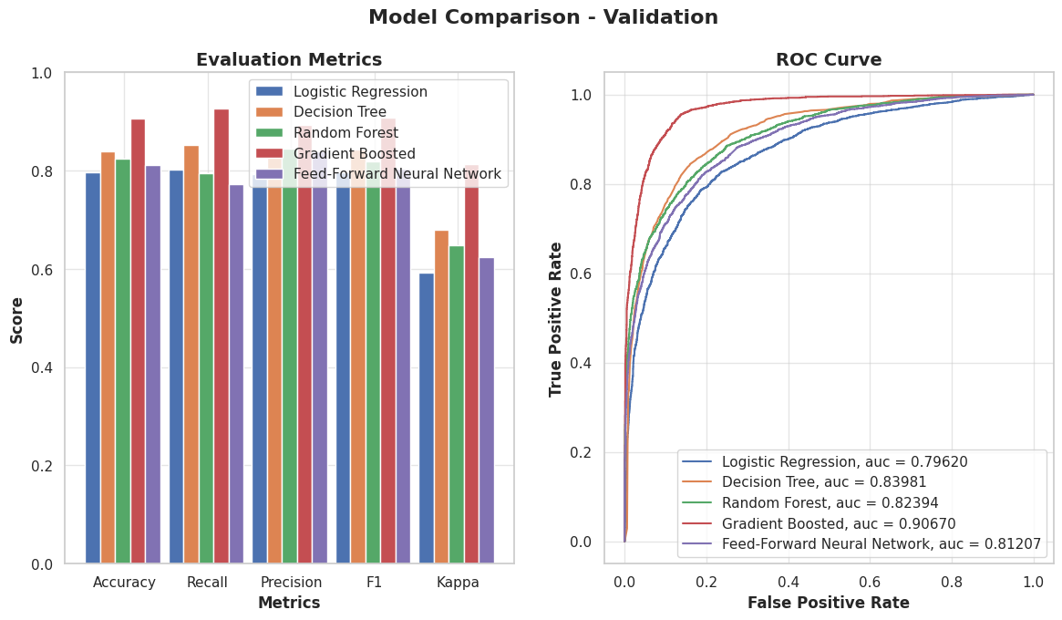
Validation Results
Performance Ranking:
Gradient Boosted
Decision Tree
Random Forest
Neural Net
Logistic Regression

Slide 18
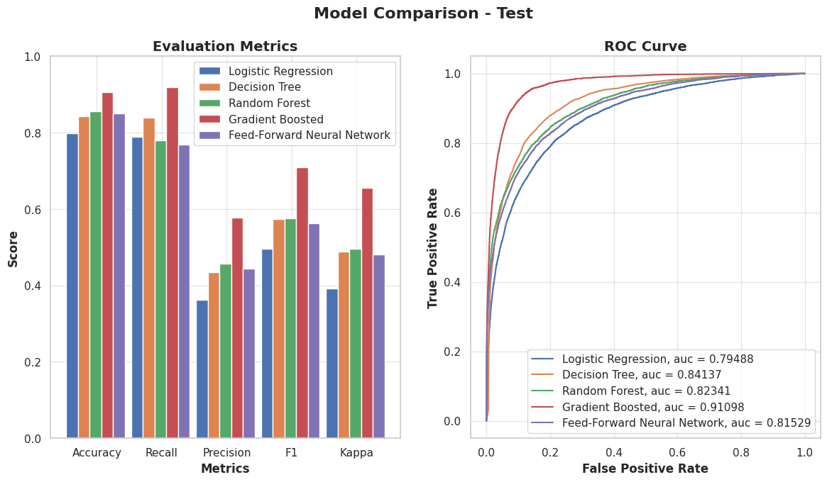
Test Results
Performance Ranking:
Gradient Boosted
Decision Tree
Random Forest
Neural Net
Logistic Regression

Slide 19
Interpreting Test Results
Metric | Log. Regression | Decision Tree | Random Forest | Gradient Boosted | Neural Network
Accuracy | 0.80 | 0.84 | 0.86 | 0.91 | 0.85
Recall | 0.79 | 0.84 | 0.78 | 0.92 | 0.77
Precision | 0.36 | 0.44 | 0.46 | 0.58 | 0.44
F1-score | 0.50 | 0.57 | 0.58 | 0.71 | 0.56
Kappa | 0.39 | 0.49 | 0.50 | 0.66 | 0.48
AUC_ROC | 0.79 | 0.84 | 0.82 | 0.91 | 0.82
Gradient Boosted has the highest AUC_ROC score and the least number of misclassified individuals

Slide 20
Interpreting Results with Lift
Decile | Logistic Regression | Decision Tree | Random Forest | Gradient Boosted | Neural Network
1 | 4.99 | 5.63 | 5.76 | 6.56 | 5.54
2 | 2.05 | 2.30 | 1.89 | 2.66 | 1.95
3 | 1.14 | 0.98 | 0.97 | 0.54 | 0.96
4 | 0.65 | 0.54 | 0.53 | 0.14 | 0.62
5 | 0.42 | 0.20 | 0.36 | 0.06 | 0.36
6 | 0.26 | 0.16 | 0.24 | 0.04 | 0.24
7 | 0.20 | 0.10 | 0.13 | 0.02 | 0.18
8 | 0.15 | 0.06 | 0.09 | 0.01 | 0.10
9 | 0.10 | 0.03 | 0.04 | 0.01 | 0.06
10 | 0.07 | 0.03 | 0.03 | 0.01 | 0.02
The gradient boosted classifier captures 6.56 times as many responders in the first decile compared with random selection.

Slide 21
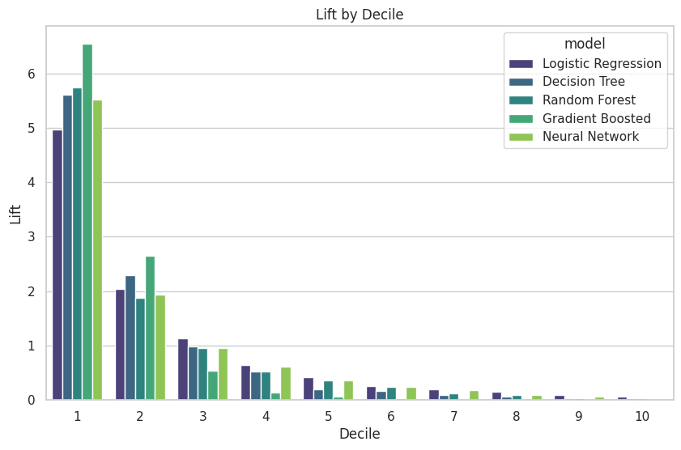
Interpreting Results with Lift
The gradient boosted classifier captures 6.56 times as many responders compared with random selection.

Slide 22
Interpreting Results with Interval Response Rate
Decile | Logistic Regression | Decision Tree | Random Forest | Gradient Boosted | Neural Network
1 | 62.4 | 70.4 | 72.0 | 82.0 | 69.2
2 | 25.6 | 28.8 | 23.6 | 33.3 | 24.4
3 | 14.3 | 12.3 | 12.1 | 6.8 | 12.0
4 | 8.1 | 6.7 | 6.6 | 1.8 | 7.7
5 | 5.3 | 2.5 | 4.5 | 0.7 | 4.5
6 | 3.3 | 2.0 | 3.0 | 0.5 | 3.0
7 | 2.5 | 1.3 | 1.6 | 0.2 | 2.2
8 | 1.9 | 0.8 | 1.1 | 0.1 | 1.3
9 | 1.2 | 0.4 | 0.5 | 0.1 | 0.8
10 | 0.9 | 0.4 | 0.4 | 0.1 | 0.3
In the top decile, the gradient boosted classifier results in an 82% response rate.

Slide 23
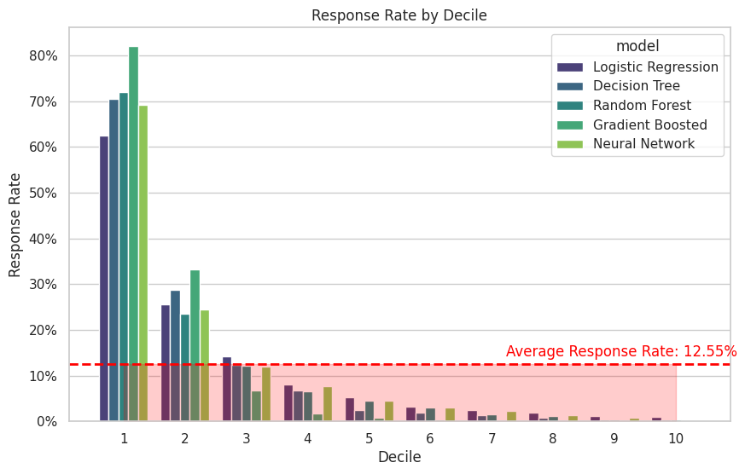
Interpreting Results with Interval Response Rate
In the top decile, the gradient boosted classifier results in an 82% response rate.

Slide 24
Interpreting Results with Gain
Decile | Logistic Regression | Decision Tree | Random Forest | Gradient Boosted | Neural Network
1 | 49.7 | 56.1 | 57.4 | 65.3 | 55.2
2 | 70.1 | 79.0 | 76.2 | 91.8 | 74.6
3 | 81.5 | 88.8 | 85.9 | 97.2 | 84.2
4 | 88.0 | 94.1 | 91.2 | 98.6 | 90.4
5 | 92.2 | 96.1 | 94.7 | 99.2 | 93.9
6 | 94.8 | 97.7 | 97.1 | 99.6 | 96.3
7 | 96.8 | 98.7 | 98.4 | 99.8 | 98.1
8 | 98.3 | 99.4 | 99.3 | 99.8 | 99.1
9 | 99.3 | 99.7 | 99.7 | 99.9 | 99.8
10 | 100.0 | 100.0 | 100.0 | 100.0 | 100.0
The gradient boosted classifier captures 65.3% of potential responders in the first decile.

Slide 25
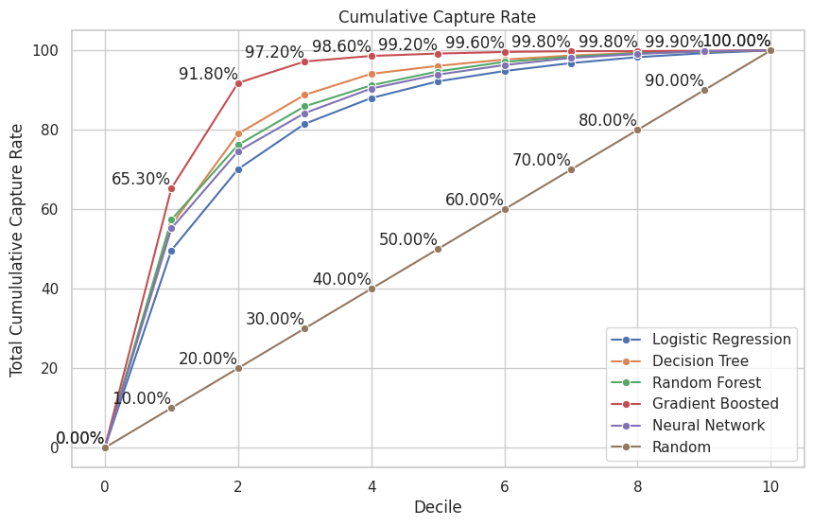
Interpreting Results with Gain
The gradient boosted classifier captures 65.3% of potential responders in the first decile.

Slide 26
Summary
Adding in demographic data (non-aggregated) did not result in that big of a difference in model efficiency
However, amongst all the demographic variables, the 3 propensity variables seemed to be the most important features as they were selected in RFE
This resulted in the gradient boosted model performing slightly better when propensity scores were considered.
Gradient boosted was the best model, with a testing AUC of 0.91

