Slide 1

SOCIAL MEDIA IMPACT ON BRAND AWARENESS
Team 4: Harita Patel, Navya Bingi, Tyra Silaphet, Deandra Kosen, Kavya Venkateswaran

Slide 2
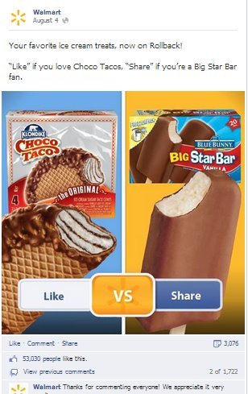
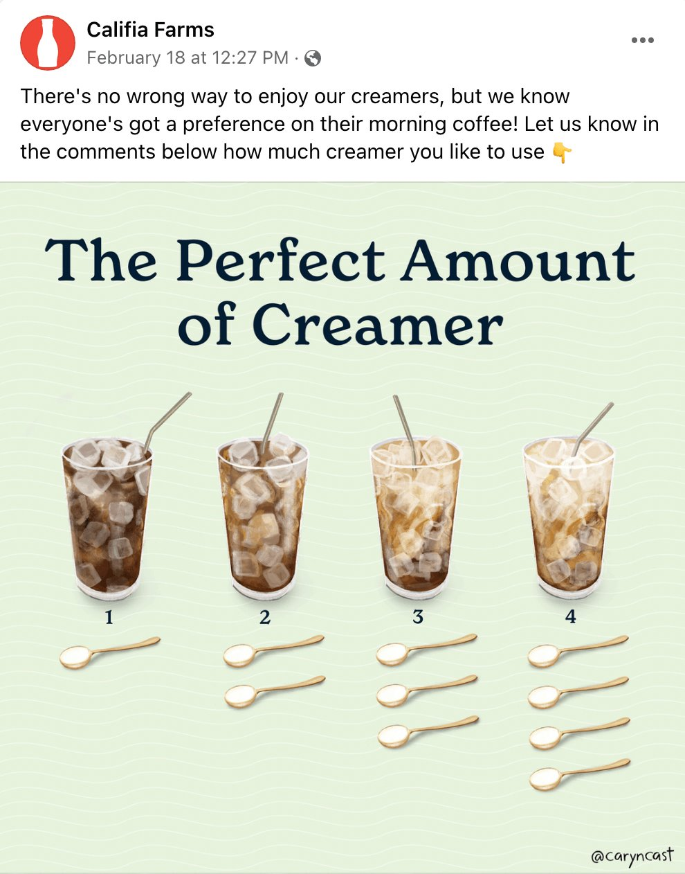
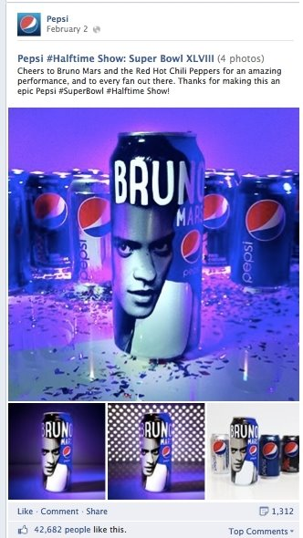
Facebook Posts – What can we analyze?
Like, comment, share
Day and time posted
Type of post

Slide 3

Problem Statement
Model Facebook performance metrics and understand impact on brand awareness​
Assess specific correlations between engagement and statistics such as, date published, type of post, etc.

Slide 4
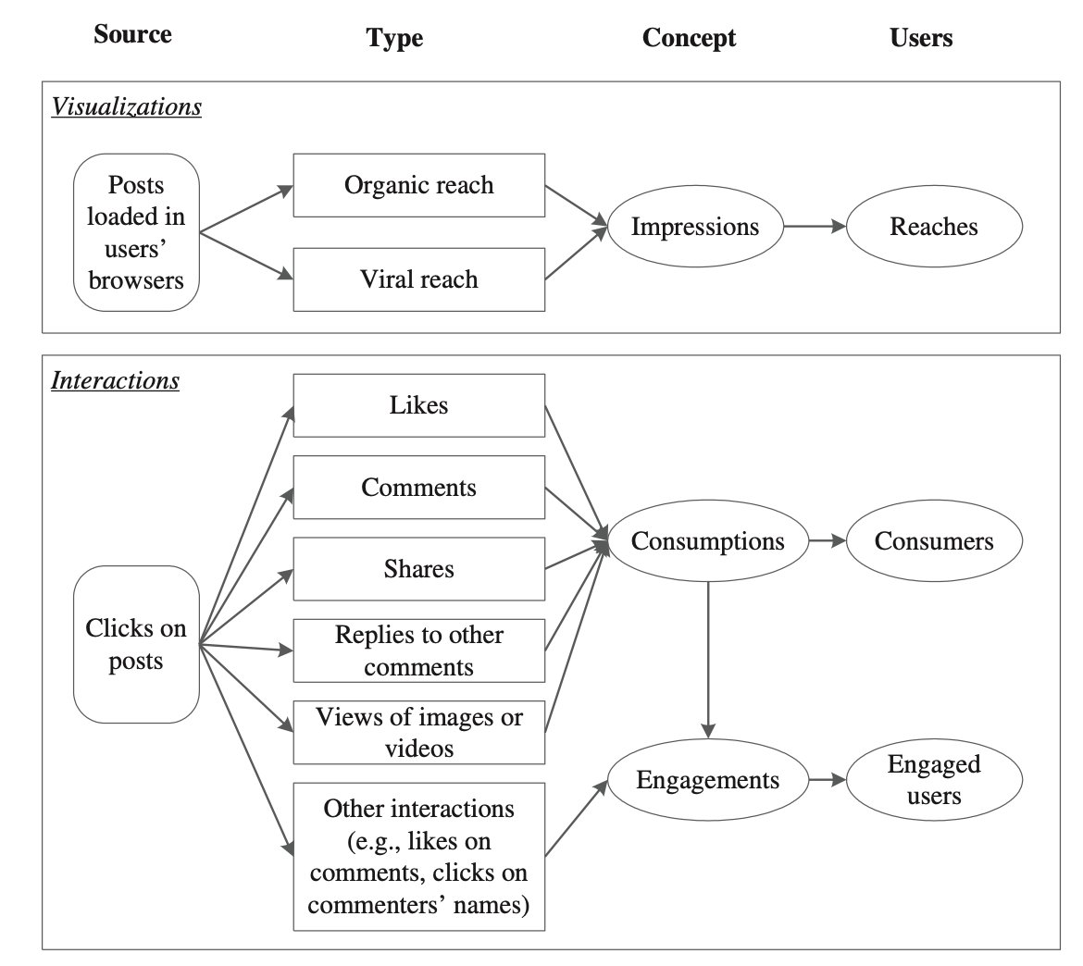
Dataset Description
Data on 500 posts published on a renowned cosmetics brand’s Facebook page in 2014
Contains 19 features total (5 categorical, 1 binary, 13 continuous)
http://www.math-evry.cnrs.fr/_media/members/aguilloux/enseignements/m1mint/moro2016.pdf

Slide 5
Variables in Dataset
Qualitative –
Category: action (special offers, contests), product (direct advertisement, explicit brand content), inspiration (non-explicit brand related content)
Type: Link, photo, video, status update
Post Month
Post Hour
Post Weekday
Paid: yes or no
Quantitative –
Total reach: # of people who saw a page post
Total impressions: # of times post from a page is displayed
Consumers: # of people who clicked anywhere in a post
Consumptions: # of clicks anywhere in a post
Impressions by people who liked the page
Post reach by people who liked a page
# of people who liked a page and engaged with a post
Likes, comments, shares

Slide 6
Key Questions
2. Does the month, day, or hour of the post influence how many likes the page gets? When is the best time to post?
1. What factors affect the performance of a post?
3. Does the type of post influence its performance? What posts are more engaging?
4. Is there a difference in performance of paid vs unpaid advertising?

Slide 7
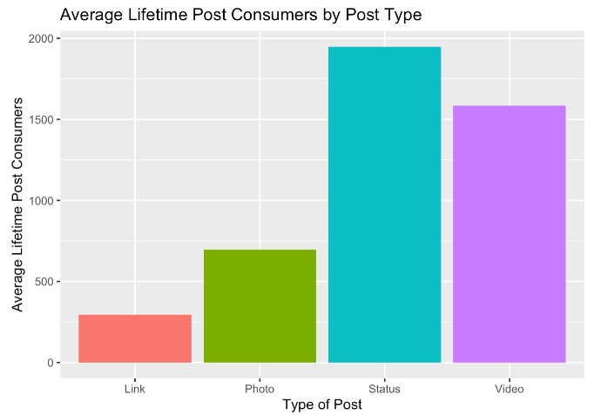
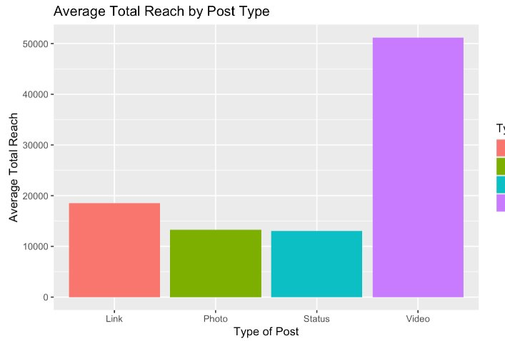
Type of Content: Does it Matter?
More people clicked on status update posts and posts with videos.
Posts with videos received significantly more views.

Slide 8
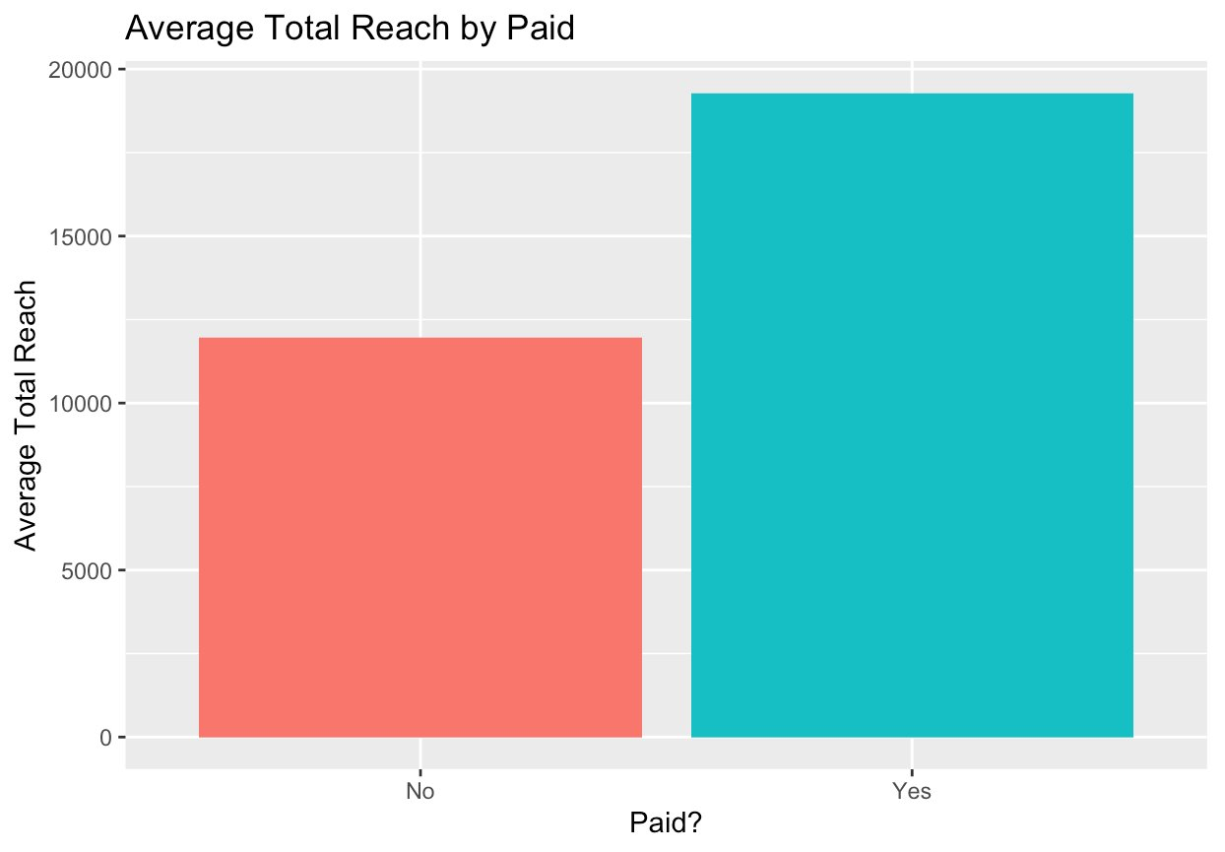
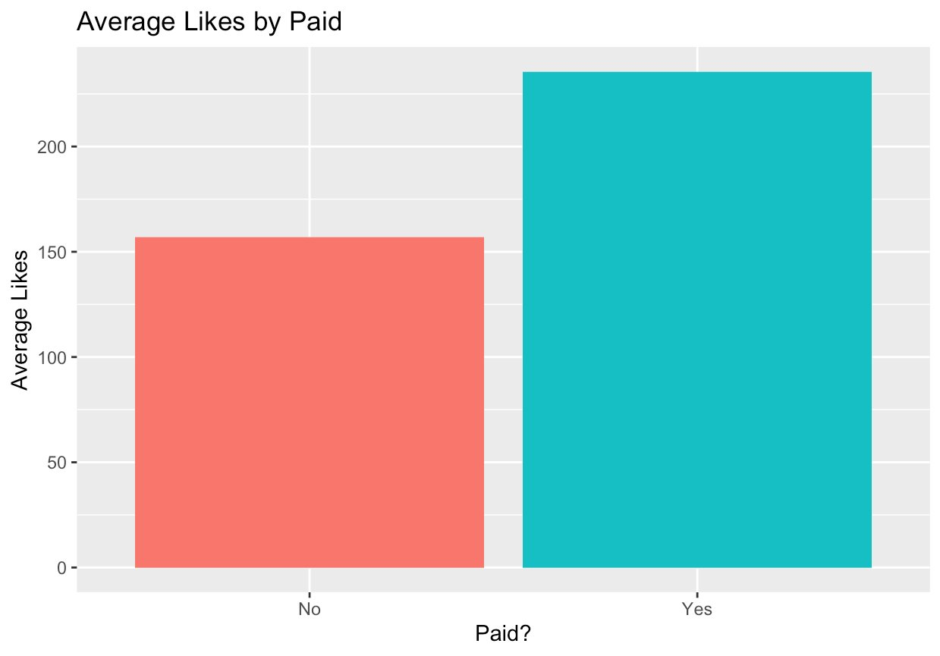
Paid vs Unpaid Advertising
A post that was paid to be published reaches more people and receives slightly more likes, on average.

Slide 9
Model 1: Multiple Linear Regression *predicting # of people who click anywhere in a post

Slide 10
Preprocessing Steps Taken
01
Check MLR assumptions
02
Remove outliers
03
Data transformation and feature scaling
04
Variable selection

Slide 11
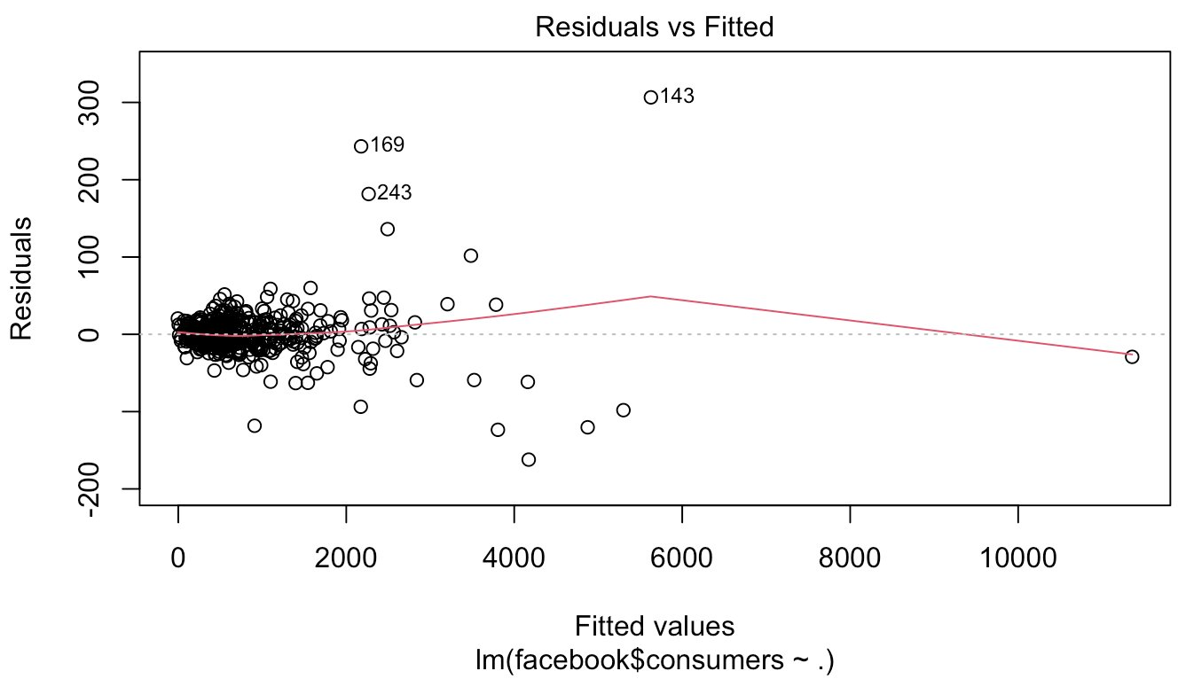
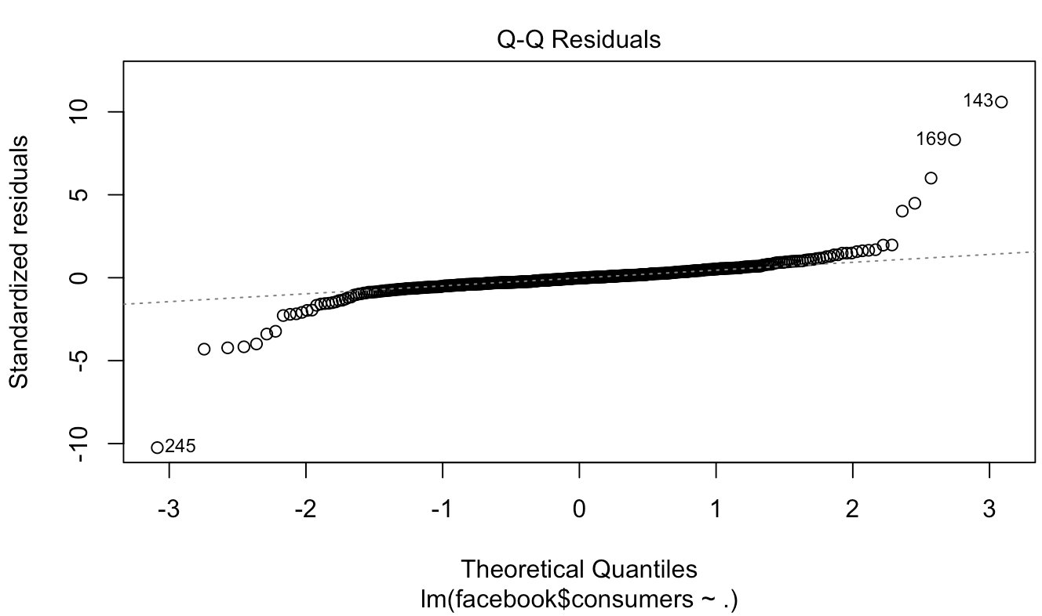
Checking MLR Assumptions
Steps ken
1. Linearity
2. Constant variance
3. Independence
4. Normality
1 variable had a nonlinear relationship with the response: comment.
Removed this variable
Errors are uncorrelated
Left skewed, but Box-Cox graph revealed that no transformation is needed

Slide 12
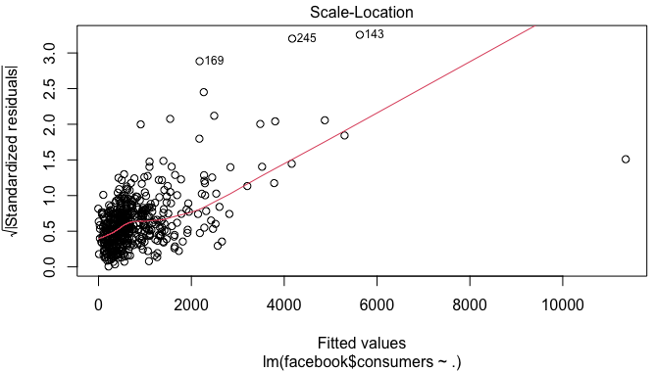
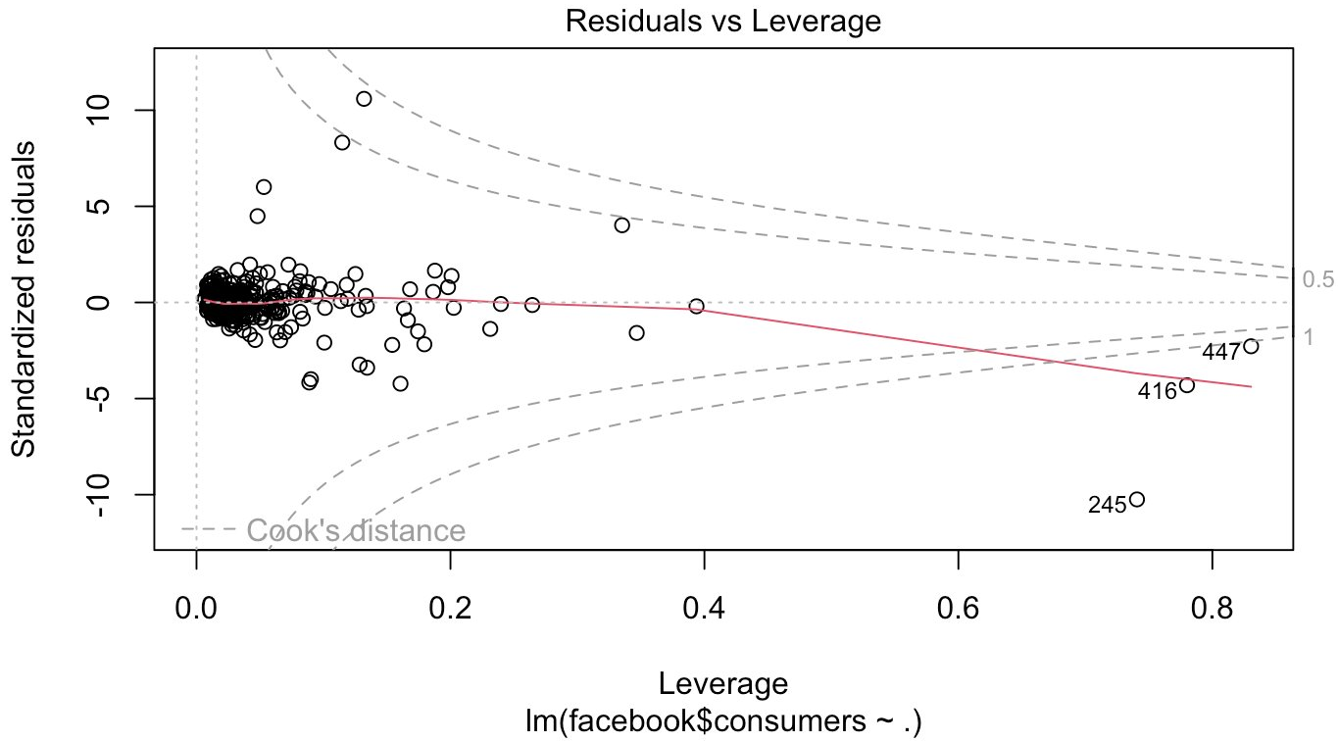
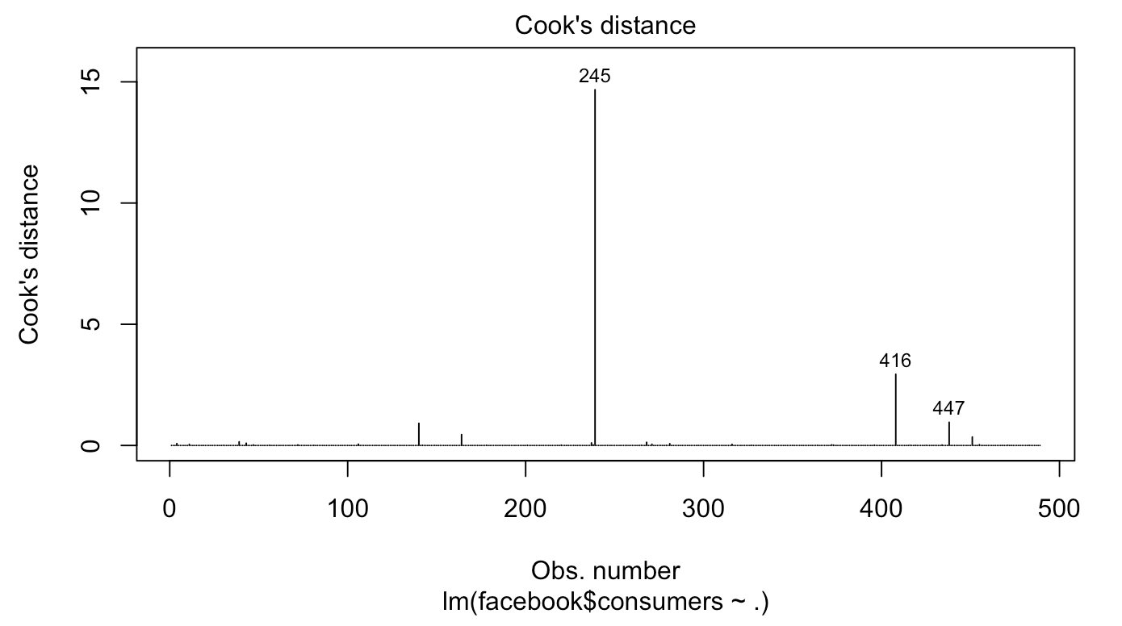
Remove Outliers
Scale-Location
Residuals vs Leverage
Cook’s Distance
Points 143, 169, 245, 243, 416, and 447 were identified as outliers and were removed.

Slide 13
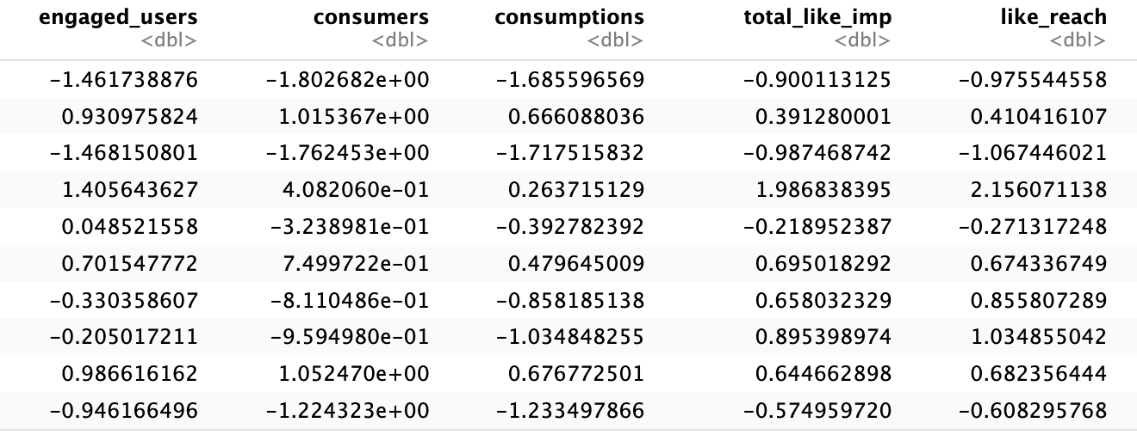
Predictor Transformations & Feature Scaling
Left skewed predictors:
Page.total.likes²
Right skewed predictors:
All other predictors were log transformed (with offset 1 for like and share)
Features were standardized

Slide 14
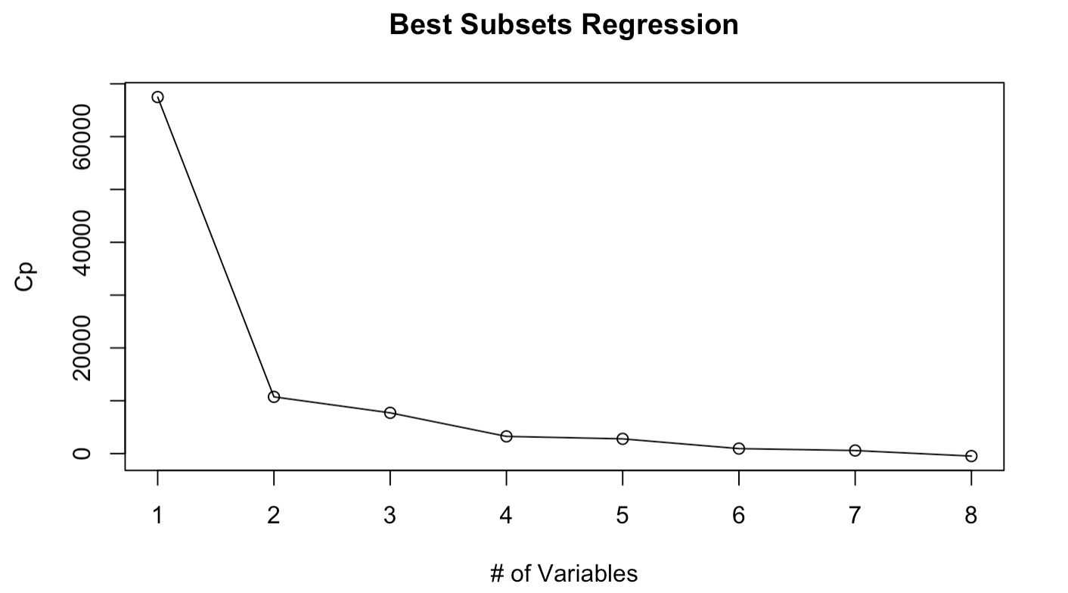
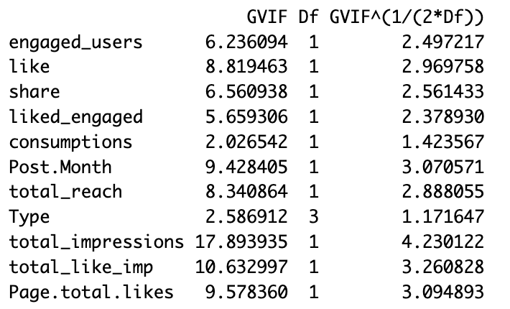
Variable Selection
Best Subsets Regression:
VIF:
Variables dropped in stepwise:
like_reach
TypeLink
Paid
Category
Post.Weekday
Post.Hour
Other:
total_impressions (high VIF)
total_like_imp (high VIF)
engaged_users (high Pearson coefficient)

Slide 15
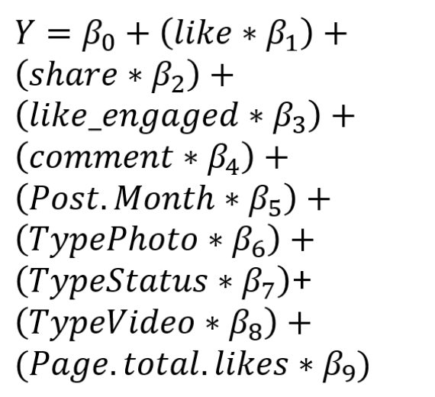
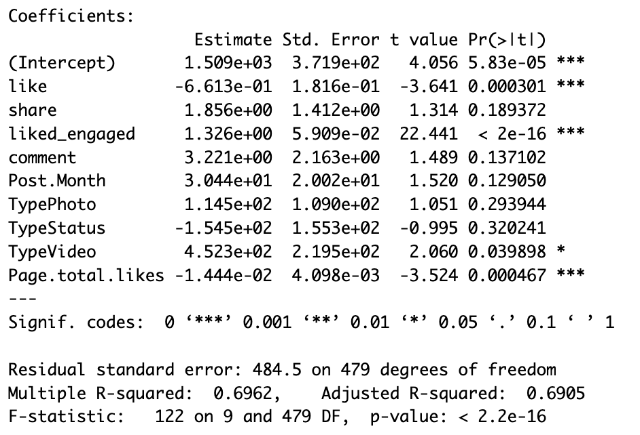
Final MLR Model
R² = 0.70

Slide 16
Model 2: Time Series Regression *predicting total number of likes on a page

Slide 17
We will talk about this first.
01
Add a brief introduction of your section here.
Let’s dive in and get to know some interesting facts about animals!

Slide 18
Did you know?
Did you know that elephants can sense storms?
Elephants may be able to detect a thunderstorm from hundreds of miles away, and will head towards it, looking for water.

Slide 19
Did you know?
Did you know that dogs can smell your feelings?
Dogs can pick up on subtle changes in your scent, which can help him figure out how you are feeling, such as by smelling your perspiration when you become nervous or fearful.
Did you know that a cat uses its whiskers as feelers to determine if a space is too small to squeeze through?
Also, cats love to sleep. A fifteen-year-old cat has probably spent ten years of its life sleeping.

Slide 20
Very interesting facts!

Slide 21

Sometimes you only need one image.

Slide 22
Key Conclusions
Type of post matters
Timing is significant
Paid advertisements may be worth it.
Video content reached larger audience​
Status updates had the most clicks
June and July had higher engagement​
The day of the week was not significant​
Hour 16 had low engagement
Paid posts had a broader reach and slightly better engagement metrics

Slide 23


Recommendations
Content Strategy
Prioritize video content​
Experiment with timing strategies with a focus on high-impact months​
Implement targeted paid advertising strategies to maximize post visibility
Future Direction
Expand analysis to other platforms​
Cost analysis for paid advertising

Slide 24
Presenting a website or an app?
9:32 am
If you are presenting a website, an internet product or an app, you can insert a screenshot of it here.

Slide 25
Presenting a website or an app?
If you are presenting a website, an internet product or an app, you can insert a screenshot of it here.

Slide 26
Thank you!

Slide 27
Editable Icons

