Slide 1
CNN_Models_Part_1

Slide 2
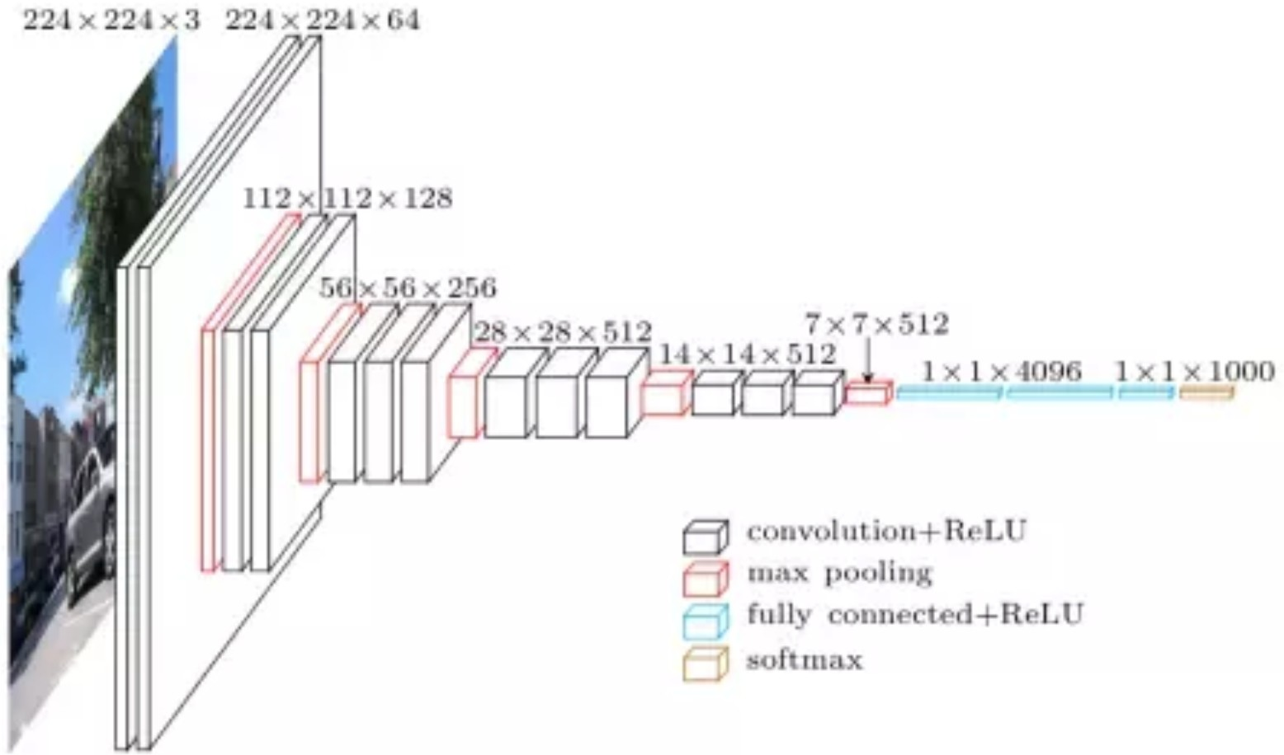
VGG
Slide credit: Alex Smola and Mu Li (Berkley)

Slide 3
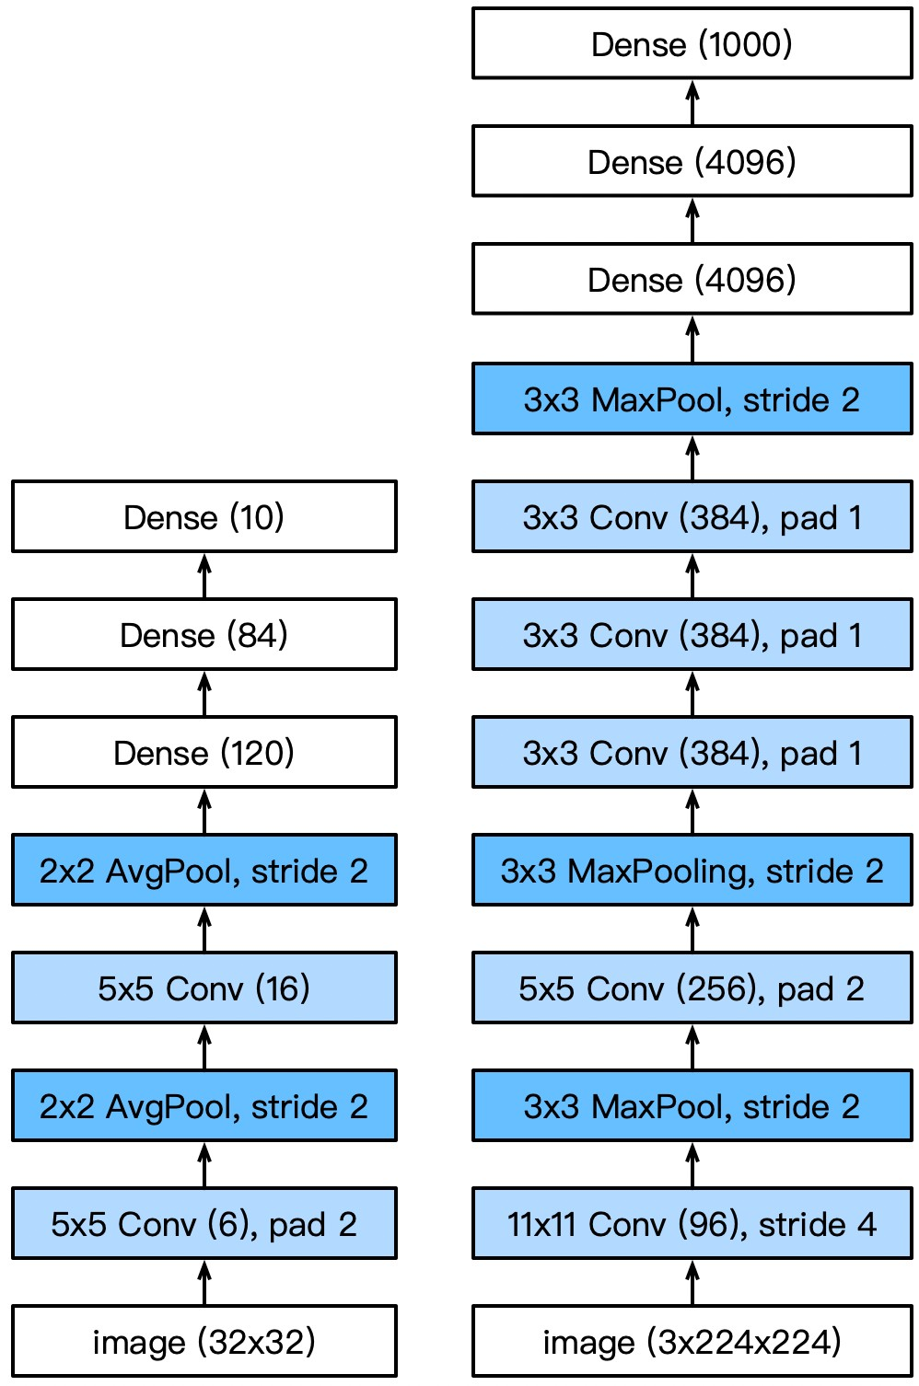

VGG
AlexNet is deeper and bigger than LeNet to get performance
Go even bigger & deeper?
Options
More dense layers (too expensive)
More convolutions
Group into blocks

Slide 4
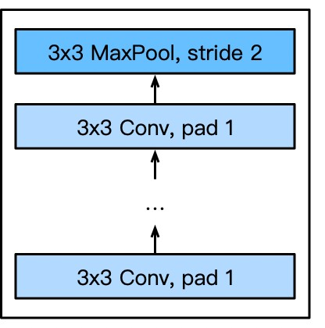
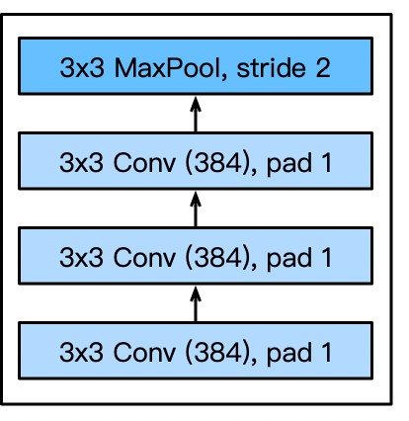
VGG Blocks
Deeper vs. wider?
5x5 convolutions
3x3 convolutions (more)
Deep & narrow better
VGG block
Part of AlexNet
VGG block
3x3 convolutions (pad 1)
(n layers, m channels)
2x2 max-pooling (stride 2)

Slide 5
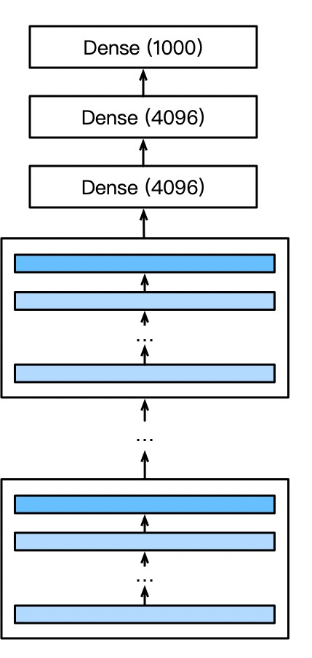
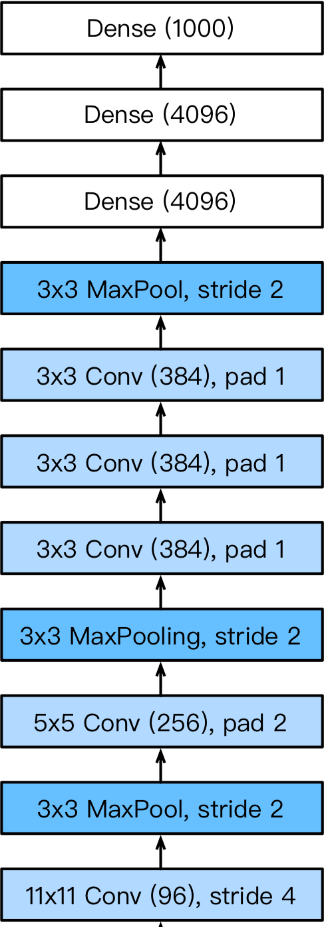
VGG Architecture
AlexNet
VGG
Multiple VGG blocks followed by dense layers
Vary the repeating number to get different architectures, such as VGG-16, VGG-19, …
AlexNet

Slide 6
Progress
LeNet (1995)
2 convolution + pooling layers
2 hidden dense layers
AlexNet
Bigger and deeper LeNet
ReLu, Dropout, preprocessing
VGG
Bigger and deeper AlexNet (repeated VGG blocks)

Slide 7
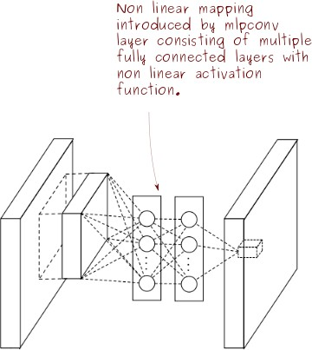

Network in Network
courses.d2l.ai/berkeley-stat-157

Slide 8
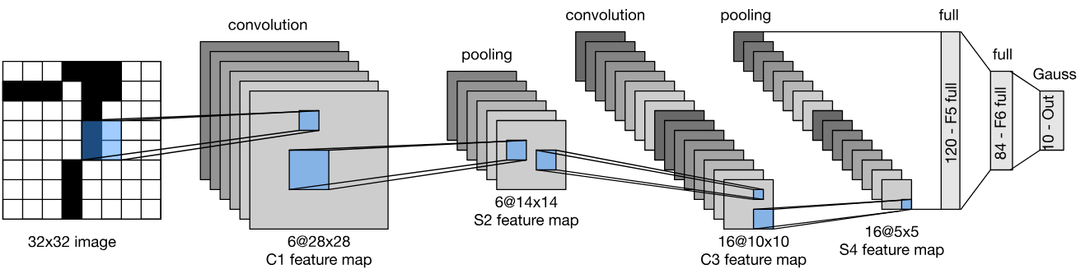
The Curse of the Last Layer(s)

Slide 9
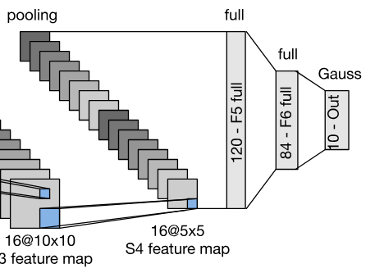
The Last Layer(s)
Convolution layers need relatively few parameters
c_{i} × c_{o} × k²
Last layer needs many parameters for n classes
c × m_{w} × m_{h} × n
LeNet 16x5x5x120 = 48k
AlexNet 256x5x5x4096 = 26M
VGG 512x7x7x4096 = 102M

Slide 10
VGG parameters
sequential1 output shape: (1, 64, 112, 112)
sequential2 | output | shape: | (1, | 128, 56, | 56)
sequential3 | output | shape: | (1, | 256, 28, | 28)
sequential4 | output | shape: | (1, | 512, 14, | 14)
sequential5 | output | shape: | (1, | 512, 7, 7)
dense0 output shape: |  |  | (1, | 4096)
dropout0 output shape: |  |  | (1, | 4096)
dense1 output shape: |  |  | (1, | 4096)
dropout1 output shape: |  |  | (1, | 4096)
dense2 output shape: |  |  | (1, | 10)

Slide 11
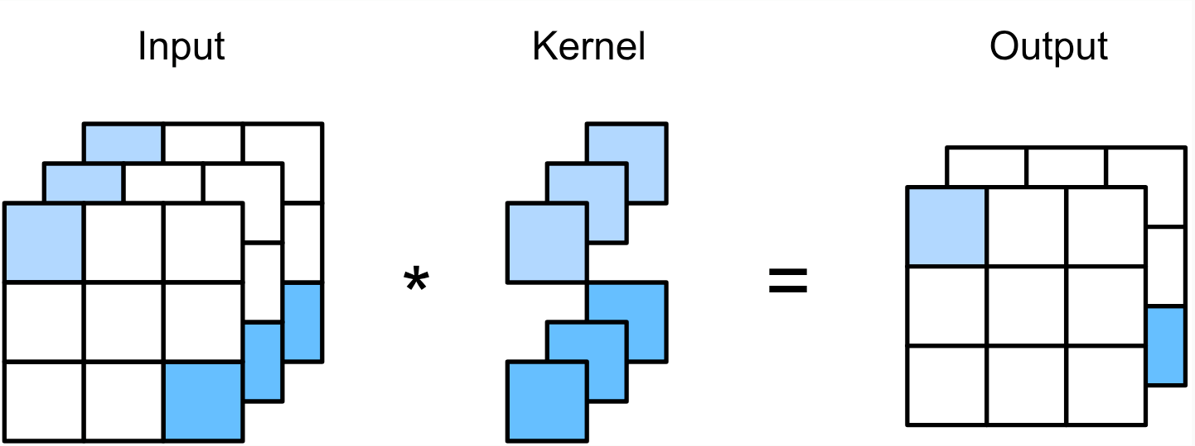
Breaking the Curse of the Last Layer
Key Idea
Get rid of the fully connected last layer(s)
Convolutions and pooling reduce resolution (e.g. stride of 2 reduces resolution 4x)
Implementation details
Reduce resolution progressively
Increase number of channels
Use 1x1 convolutions (they only act per pixel)
Global average pooling in the end
Slide credit: Alex Smola and Mu Li (Berkley)

Slide 12
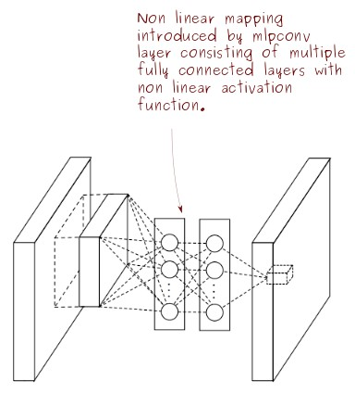
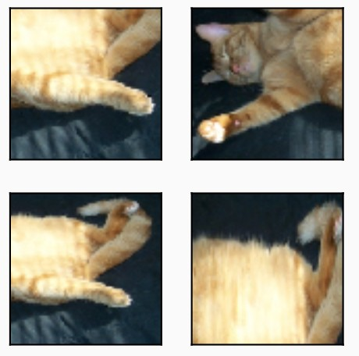
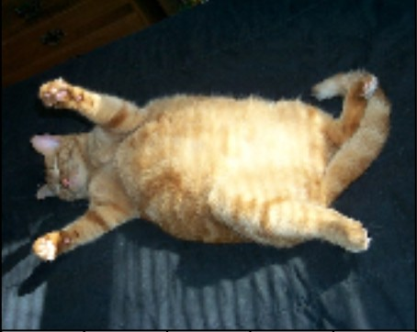
What’s a 1x1 convolution anyway?
Extreme case
1x1 image with n channels
Equivalent to MLP
Pooling allows for translation invariance of detection (e.g. 5x5)

Slide 13
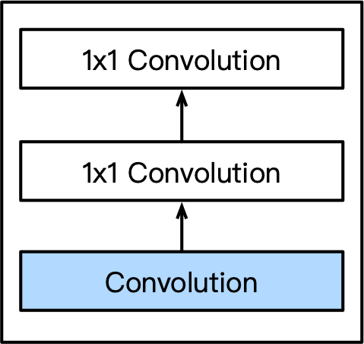
NiN Block
A convolutional layer
kernel size, stride, and padding are hyper-parameters
Following by two 1x1 convolutions
1 stride and no padding, share the same output channels as first layer
Act as dense layers

Slide 14
NiN Networks
VGG Net
NiN Net

Slide 15
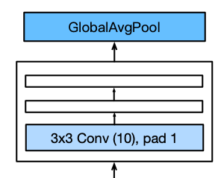
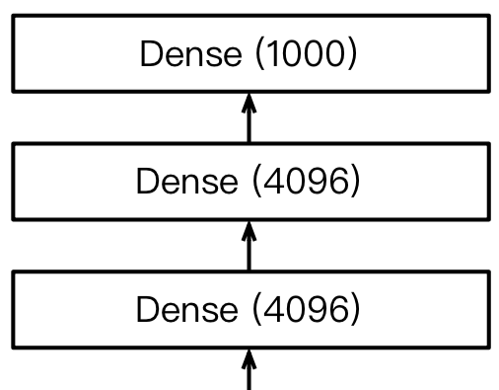
NiN Last Layers
Replaced AlexNet’s dense layers with a NiN block
Global average pooling layer to combine outputs
NiN AlexNet

Slide 16
Summary
Reduce image resolution progressively
Increase number of channels
Global average pooling for given number of classes
sequential1 output shape: | (96, 54, 54)
pool0 output shape: | (96, 26, 26)
sequential2 output shape: | (256, 26, 26)
pool1 output shape: | (256, 12, 12)
sequential3 output shape: | (384, 12, 12)
pool2 output shape: | (384, 5, 5)
dropout0 output shape: | (384, 5, 5)
sequential4 output shape: | (10, 5, 5)
pool3 output shape: | (10, 1, 1)
flatten0 output shape: | (10)
NIN dimension reduction
Slide credit: Alex Smola and Mu Li (Berkley)

Slide 17
Summary
LeNet (the first convolutional neural network)
AlexNet
More of everything
ReLu, Dropout, Invariances
VGG
Even more of everything (narrower and deeper)
Repeated blocks
NiN
1x1 convolutions + global pooling instead of dense
Slide credit: Alex Smola and Mu Li (Berkley)

Slide 18
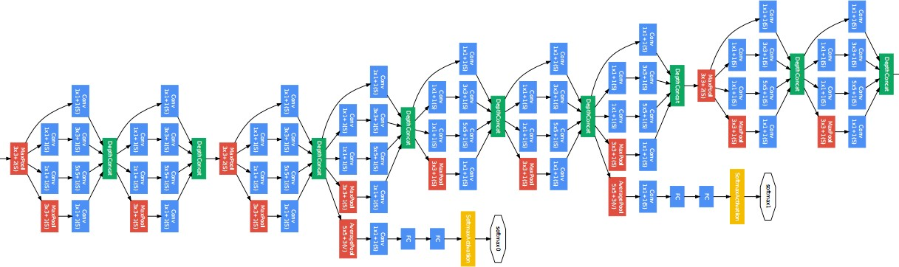
Inception
Slide credit: Alex Smola and Mu Li (Berkley)

Slide 19
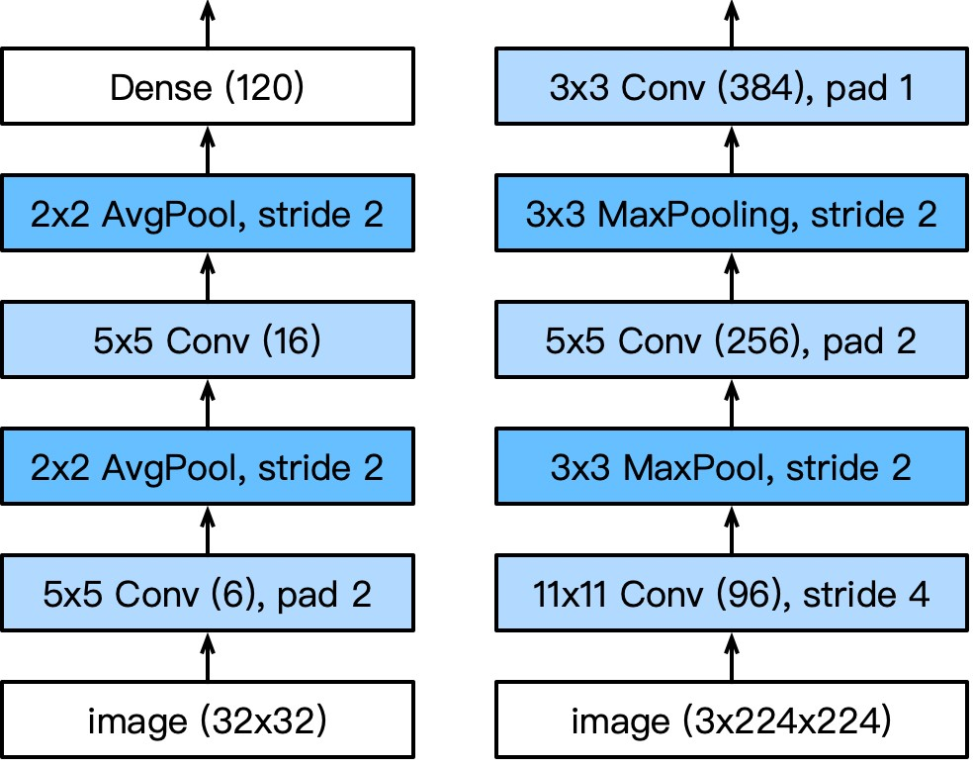
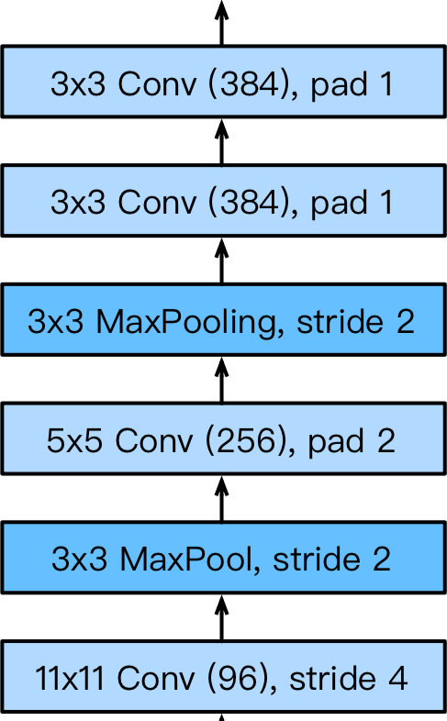
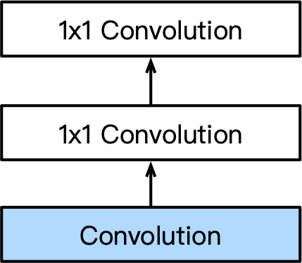
Picking the best convolution …
1x1 3x3 5x5 Max pooling
LeNet AlexNet VGG
Multiple 1x1
NiN
Slide credit: Alex Smola and Mu Li (Berkley)

Slide 20
Why choose? Just pick them all.
Slide credit: Alex Smola and Mu Li (Berkley)

Slide 21
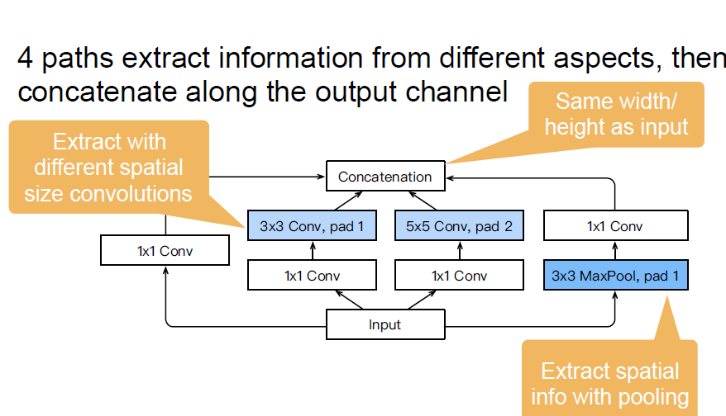
Inception Blocks
4 paths extract information from different aspects, then
concatenate along the output channel
Extract with
Same wdth/ height as input
different spatial
size convolutions

Slide 22
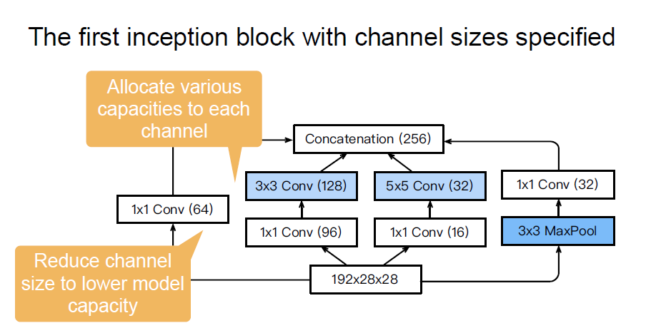
Inception Blocks
Slide credit: Alex Smola and Mu Li (Berkley)

Slide 23
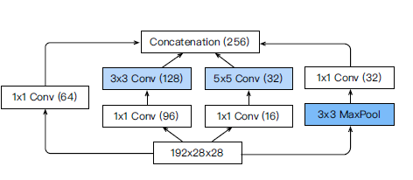
Inception Blocks
Inception blocks have fewer parameters and less computation complexity than a single 3x3 or 5x5 convolutional layer
Mix of different functions (powerful function class)
Memory and compute efficiency (good generalization)
 | #parameters
Inception | 0.16 M
3x3 Conv | 0.44 M
5x5 Conv | 1.22 M

Slide 24
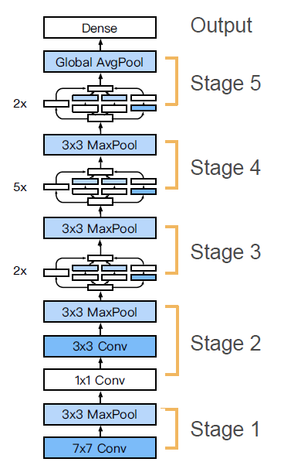
GoogLeNet
5 stages with 9 inceptions blocks

Slide 25
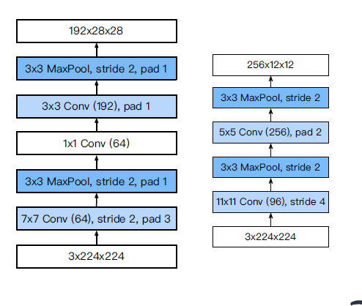
Stage 1 & 2
GoogLeNet
AlexNet
Smaller kernel size and output channels due to more layers

Slide 26
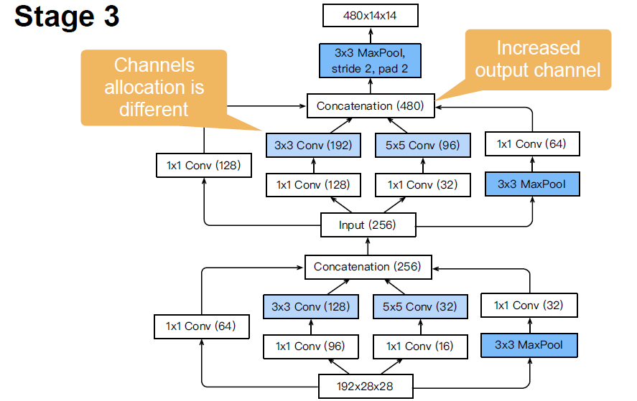

Slide 27





Stage 4 & 5
832[7[7
Slide credit: Alex Smola and Mu Li (Berkley)
3x3 MaxPool,
Stride 2, pad 2
Increased output channel
1024-dim feature to output layer
(832)
1024 x 1 x1
(512)
GlobalAvgPool
(1024)
Increased output channel
(512)
Increased output channel
(512)
(832)
(512)
832 x 7 x 7
480x14 x 14

Slide 28
The many flavors of Inception Networks
Inception-BN (v2) - Add batch normalization
Inception-V3 - Modified the inception block
Replace 5x5 by multiple 3x3 convolutions
Replace 5x5 by 1x7 and 7x1 convolutions
Replace 3x3 by 1x3 and 3x1 convolutions
Generally deeper stack
Inception-V4 - Add residual connections (more later)

Slide 29
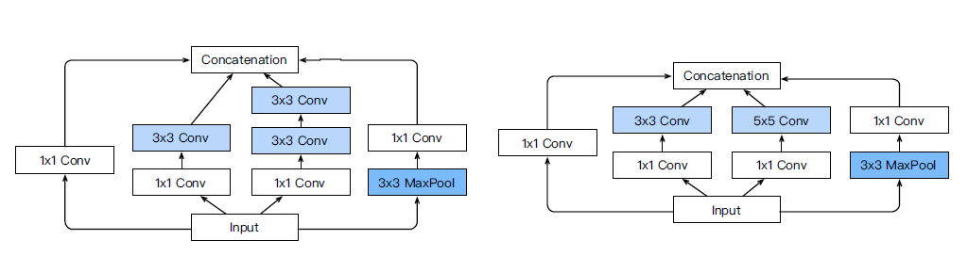
Inception V3 Block for Stage 3

Slide 30
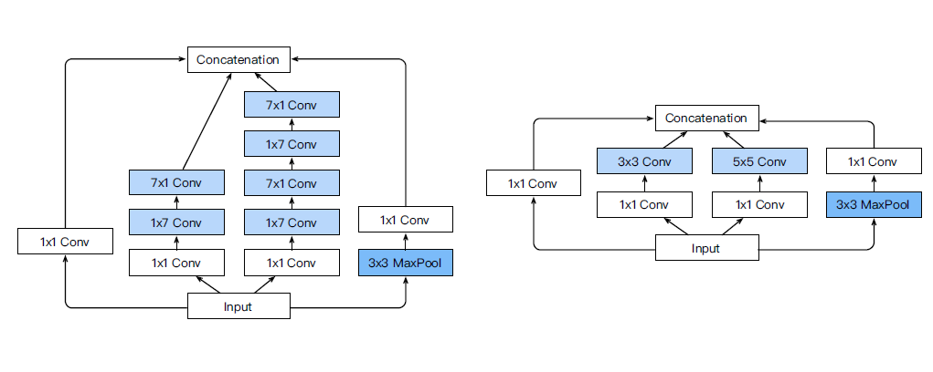
Inception V3 Block for Stage 4

Slide 31
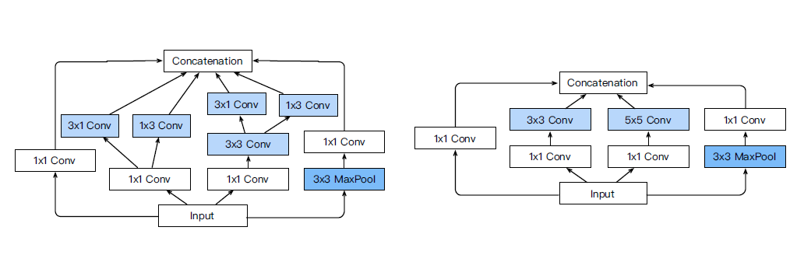
Inception V3 Block for Stage 5

Slide 32
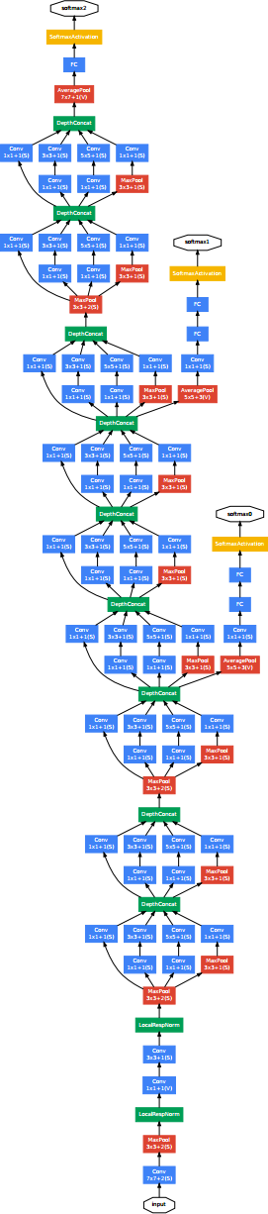

Batch Normalization
loss
Loss occurs at last layer
Last layers learn quickly
Data is inserted at bottom layer
Bottom layers change - everything changes
Last layers need to relearn many times
Slow convergence
This is like covariate shift
Can we avoid changing last layers while learning first layers?
data

Slide 33
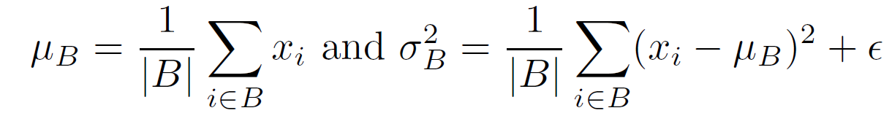
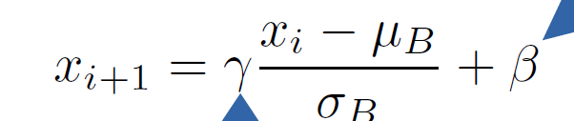
Batch Normalization
loss
Can we avoid changing last layers while learning first layers?
Fix mean and variance
and adjust it separately
mean
variance
data

Slide 34
This was the original motivation …

Slide 35
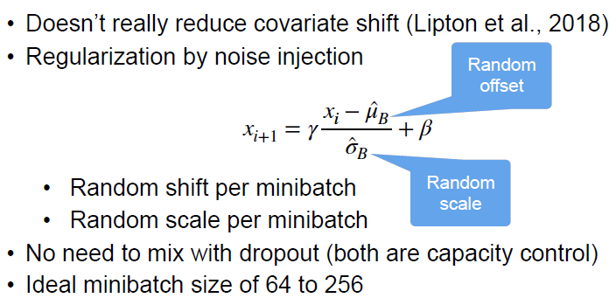
What Batch Norms really do

Slide 36
Details
torch.nn.BatchNorm(…)
Dense Layer
One normalization for all
Convolution
One normalization per channel
Compute new mean and variance for every minibatch
Effectively acts as regularization
Optimal minibatch size is ~128
(watch out for parallel training with many machines)

Slide 37


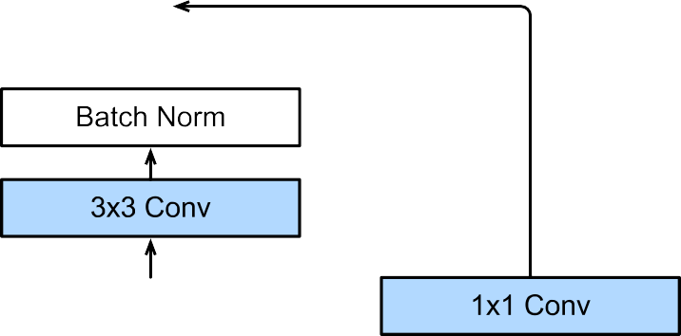
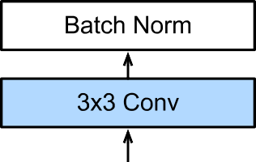
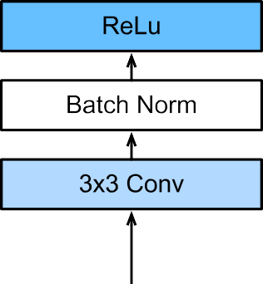

ResNet Block in detail

Slide 38
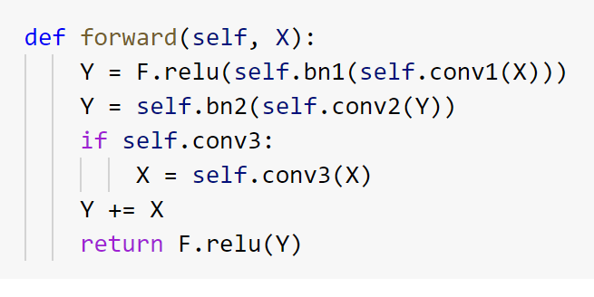
In code

Slide 39
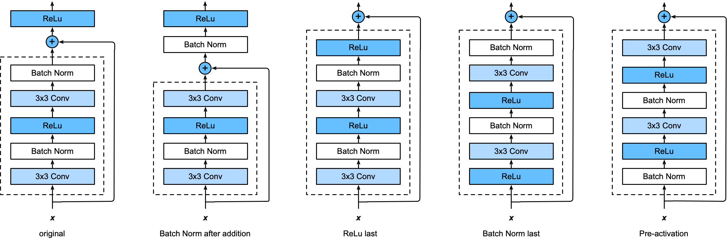
The many flavors of ResNet blocks
Try every permutation

Slide 40
Putting it all together
Same block structure as e.g. VGG or GoogleNet
Residual connection to add to expressiveness
Pooling/stride for dimensionality reduction
Batch Normalization for capacity control
… train it at scale …

Slide 41
Acknowledgement
All the slides in this presentation have been borrowed/inspired from course taught by Alex Smola and Mu Li (Berkley) in 2019. I would like to thank Alex Smola and Mu Li for generously sharing their course material and allowing me to use their material.

