Slide 1

Agenda
Intro NN part 2 (20 mins)
Intro NN part 3 (15 mins)
Auto-grad notebook (30 mins)
Refactor LR (15 mins)
HW2 Intro
Break 10 mins
Break 5 mins
Logistic Regression 20 mins
Torch NN module 30 minutes
In Class Quiz (Most Probably Next week)

Slide 2
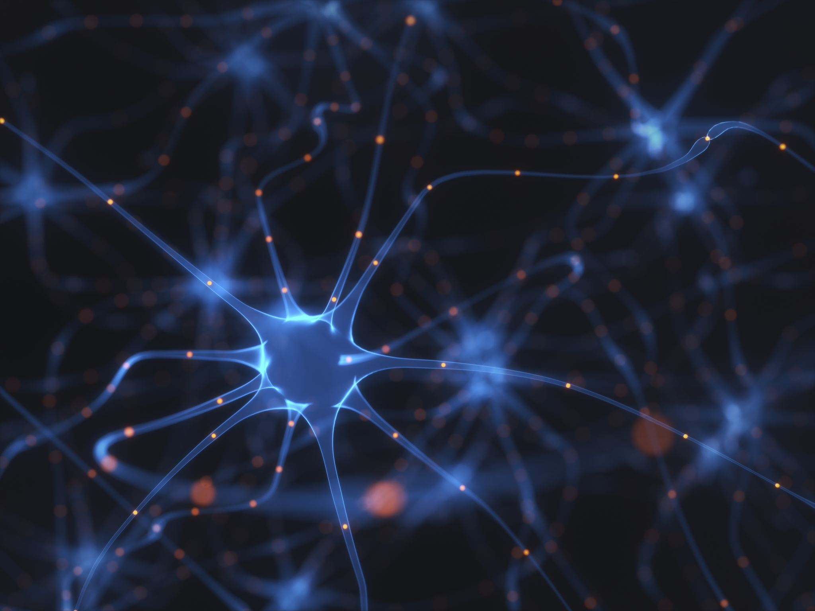
Back-Propagation- Auto-Diff
Harpreet Singh (Fall 2023)
Notes:
The last supervised model we will discuss in this course is Neural networks and deep learning.

Slide 3














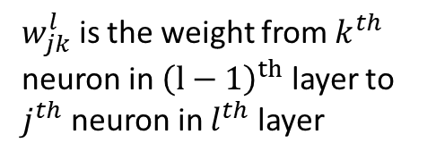



Notation – input/output
$w_{jk}^{l}$ is the weight from $k^{th }$ neuron in ${\left(l−1\right)}^{th}$ layer to $j^{th}$ neuron in $l^{th}$ layer
Layer 1
Layer 2
Layer 3
Layer 4
$$w_{11}^{2}$$
$$w_{11}^{3}$$
$$w_{11}^{4}$$
$$w_{12}^{4}$$
$$w_{21}^{4}$$
$$w_{22}^{2}$$
$$w_{22}^{3}$$
$$w_{22}^{4}$$
Layer 2
$$w_{11}^{2}$$
$$a_{1}^{1}$$
$$z_{1}^{2}$$
$$σ(z_{1}^{2})$$
$$a_{1}^{2}$$
${\text{Total} \text{Input} \text{to} \text{neuron}=z}_{1}^{2}=$ $w_{11}^{2}a_{1}^{1}+w_{12}^{2}a_{2}^{1}+b_{1}^{2}$
Output from neuron ${= a}_{1}^{2}=σ(z_{1}^{2})$
$$w_{12}^{2}$$
$$a_{1}^{2}$$
$$a_{2}^{1}$$

Slide 4


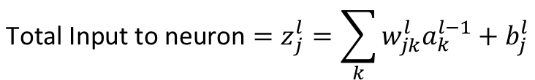

Notation input/output
$w_{jk}^{l}$ is the weight from $k^{th }$ neuron in ${\left(l−1\right)}^{th}$ layer to $j^{th}$ neuron in $l^{th}$ layer
Layer 1
Layer 2
Layer 3
Layer 4
$$w_{11}^{2}$$
$$w_{11}^{3}$$
$$w_{11}^{4}$$
$$w_{12}^{4}$$
$${\text{Total} \text{Input} \text{to} \text{neuron}=z}_{j}^{l}=\sum_{k}{w_{jk}^{l}a_{k}^{l−1}+b_{j}^{l}}$$
$$w_{21}^{4}$$
Matrix Notation
$$z_{j}^{l}≡w^{l}a^{l−1}+b_{j}^{l}$$
$$w_{22}^{2}$$
$$w_{22}^{3}$$
$$w_{22}^{4}$$
Layer 2
Output from neuron${= a}_{j}^{l}=σ(z_{j}^{l})$
$$w_{11}^{2}$$
$$a_{1}^{1}$$
$$z_{1}^{2}$$
$$σ(z_{1}^{2})$$
$$a_{1}^{2}$$
Matrix Notation
$$a^{l}=σ(z^{l})$$
$$w_{12}^{2}$$
$$a_{1}^{2}$$
$$a_{2}^{1}$$

Slide 5

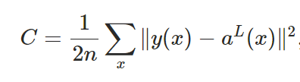




Notation- Cost
Layer 1
Layer 2
Layer 3
Layer 4
$$L=4$$
$$w_{11}^{2}$$
$$w_{11}^{3}$$
$$w_{11}^{4}$$
$$a_{1}^{L}$$
$$w_{12}^{4}$$
$$Cost C$$
$$w_{21}^{4}$$
$$a_{2}^{L}$$
$$w_{22}^{2}$$
$$w_{22}^{3}$$
$$w_{22}^{4}$$
For MSE (mean Squared Error)
For n observations

Slide 6







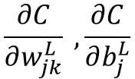




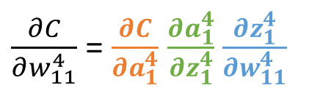




Calculations – Last layer (Output Layer)
Objective :
$$\frac{∂C}{∂w_{jk}^{L}} , \frac{∂C}{∂b_{j}^{L}}$$
For illustration we will use following :
$$\frac{∂C}{∂w_{11}^{4}} , \frac{∂C}{∂b_{1}^{4}}$$
$$Layer 4$$
$z_{1}^{4}=$ $w_{11}^{4}a_{1}^{3}+w_{12}^{4}a_{2}^{3}+b_{1}^{4}$
${ a}_{1}^{4}=σ(z_{1}^{4})$
$$w_{11}^{4}$$
$$a_{1}^{3}$$
$$a_{1}^{4}$$
$$w_{12}^{4}$$
$$Cost C$$
$$C=\frac{1}{2}\left\lfloor {\left(y_{1}−a_{1}^{4}\right)}^{2}+{\left(y_{2}−a_{2}^{4}\right)}^{2}\right\rfloor$$
$$a_{2}^{4}$$
$$a_{2}^{3}$$
$\frac{∂C}{∂w_{11}^{4}}$ = $\frac{∂C}{∂a_{1}^{4}}$ $\frac{∂a_{1}^{4}}{∂z_{1}^{4}}$ $\frac{∂z_{1}^{4}}{∂w_{11}^{4}}$
$$\frac{2}{2}\left(y_{1}−a_{1}^{4}\right)∗\left(−1\right)=(a_{1}^{4} −y_{1})$$
$$σ^{′}(z_{1}^{4})$$
$$a_{1}^{3}$$
error
Derivative of activation function

Slide 7
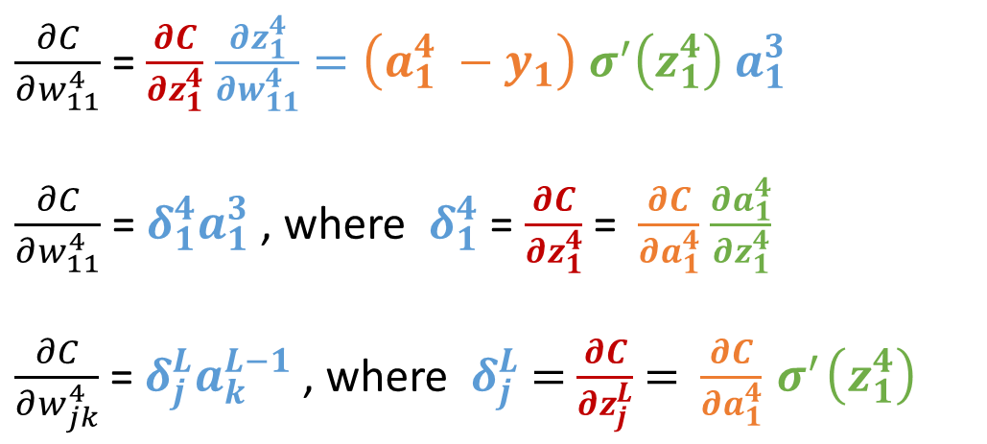
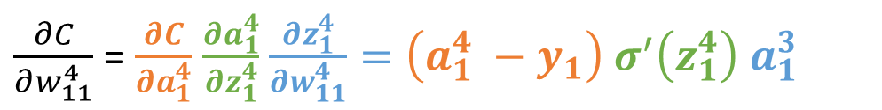

Calculations – Last layer (Output Layer)
Objective :
$$\frac{∂C}{∂w_{jk}^{L}} , \frac{∂C}{∂b_{j}^{L}}$$
For illustration we will use following :
$$\frac{∂C}{∂w_{11}^{4}} , \frac{∂C}{∂b_{1}^{4}}$$
$z_{1}^{4}=$ $w_{11}^{4}a_{1}^{3}+w_{12}^{4}a_{2}^{3}+b_{1}^{4}$
$$Layer 4$$
$$w_{11}^{4}$$
$\frac{∂C}{∂w_{11}^{4}}$ = $\frac{∂C}{∂a_{1}^{4}}$ $\frac{∂a_{1}^{4}}{∂z_{1}^{4}}$ $\frac{∂z_{1}^{4}}{∂w_{11}^{4}}=\left(a_{1}^{4} −y_{1}\right){ σ}^{′}\left(z_{1}^{4}\right)$ $a_{1}^{3}$
$$a_{1}^{3}$$
$$a_{1}^{4}$$
$$w_{12}^{4}$$
$$Cost C$$
$$a_{2}^{4}$$
$\frac{∂C}{∂w_{11}^{4}}$ = $\frac{∂C}{∂z_{1}^{4}}$ $\frac{∂z_{1}^{4}}{∂w_{11}^{4}}=\left(a_{1}^{4} −y_{1}\right){ σ}^{′}\left(z_{1}^{4}\right)$ $a_{1}^{3}$
$\frac{∂C}{∂w_{11}^{4}}$ = $δ_{1}^{4}a_{1}^{3}$, where $δ_{1}^{4}$ = $\frac{∂C}{∂z_{1}^{4}}$ = $\frac{∂C}{∂a_{1}^{4}}$ $\frac{∂a_{1}^{4}}{∂z_{1}^{4}}$
$\frac{∂C}{∂w_{jk}^{4}}$ = $δ_{j}^{L}a_{k}^{L−1}$, where $δ_{j}^{L}$ = $\frac{∂C}{∂z_{j}^{L}}$ = $\frac{∂C}{∂a_{1}^{4}}{ σ}^{′}\left(z_{1}^{4}\right)$
$$a_{2}^{3}$$

Slide 8

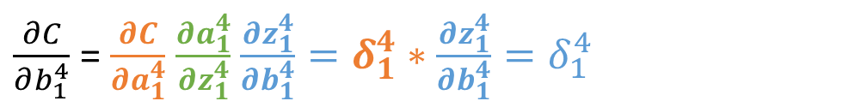
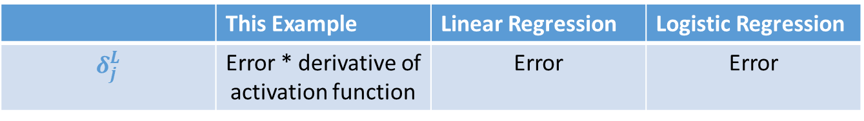
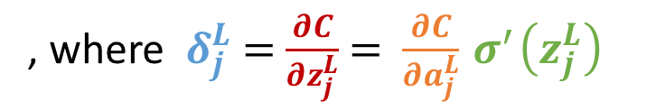
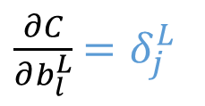
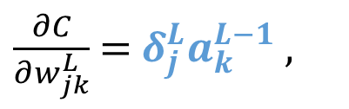
Calculations – Last layer (Output Layer)
Objective :
$$\frac{∂C}{∂w_{jk}^{L}} , \frac{∂C}{∂b_{j}^{L}}$$
For illustration we will use following :
$$\frac{∂C}{∂w_{11}^{4}} , \frac{∂C}{∂b_{1}^{4}}$$
$$Layer 4$$
$z_{1}^{4}=$ $w_{11}^{4}a_{1}^{3}+w_{12}^{4}a_{2}^{3}+b_{1}^{4}$
$$w_{11}^{4}$$
$$a_{1}^{3}$$
$$a_{1}^{4}$$
$$w_{12}^{4}$$
$\frac{∂C}{∂b_{1}^{4}}$ = $\frac{∂C}{∂a_{1}^{4}}$ $\frac{∂a_{1}^{4}}{∂z_{1}^{4}}$ $\frac{∂z_{1}^{4}}{∂b_{1}^{4}}=δ_{1}^{4}∗\frac{∂z_{1}^{4}}{∂b_{1}^{4}}=δ_{1}^{4}$
$$Cost C$$
$$a_{2}^{4}$$
$$a_{2}^{3}$$
$\frac{∂C}{∂w_{jk}^{L}}$ = $δ_{j}^{L}a_{k}^{L−1}$,
$\frac{∂C}{∂b_{l}^{L}}$ $=δ_{j}^{L}$
, where $δ_{j}^{L}$ = $\frac{∂C}{∂z_{j}^{L}}$ = $\frac{∂C}{∂a_{j}^{L}}{ σ}^{′}\left(z_{j}^{L}\right)$
Summary:
 | This Example | Linear Regression | Logistic Regression
$$δ_{j}^{L}$$ | Error * derivative of activation function | Error | Error

Slide 9


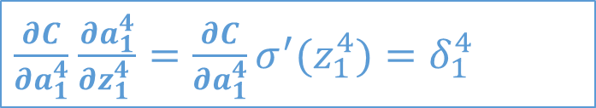
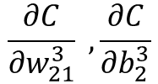



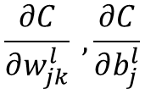






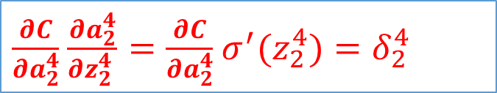
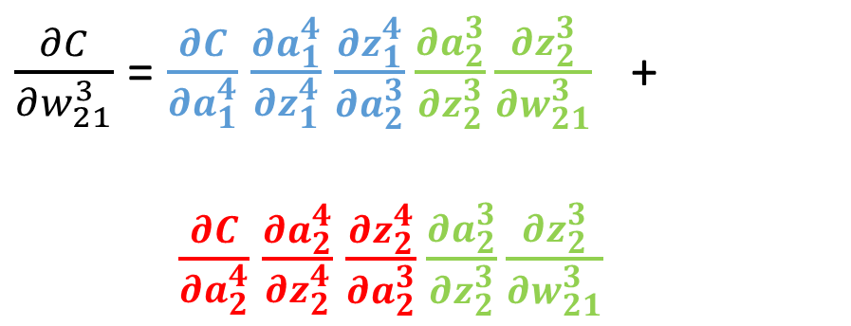


Calculations – Hidden layer
For illustration we will use following :
$$\frac{∂C}{∂w_{21}^{3}} , \frac{∂C}{∂b_{2}^{3}}$$
Objective :
$$\frac{∂C}{∂w_{jk}^{l}} , \frac{∂C}{∂b_{j}^{l}}$$
Layer 2
Layer 3
Layer 4
$$L=4$$
$\frac{∂C}{∂w_{21}^{3}}$ = $\frac{∂C}{∂a_{1}^{4}}$ $\frac{∂a_{1}^{4}}{∂z_{1}^{4}}$ $\frac{∂z_{1}^{4}}{∂a_{2}^{3}}\frac{∂a_{2}^{3}}{∂z_{2}^{3}}\frac{∂z_{2}^{3}}{∂w_{21}^{3}}$ +
$\frac{∂C}{∂a_{2}^{4}}$ $\frac{∂a_{2}^{4}}{∂z_{2}^{4}}$ $\frac{∂z_{2}^{4}}{∂a_{2}^{3}}\frac{∂a_{2}^{3}}{∂z_{2}^{3}}\frac{∂z_{2}^{3}}{∂w_{21}^{3}}$
$$a_{1}^{2}$$
$$z_{1}^{3}$$
$$a_{1}^{3}$$
$$z_{1}^{4}$$
$$a_{1}^{4}$$
$$w_{21}^{3}$$
$$Cost C$$
$$a_{2}^{2}$$
$$z_{2}^{3}$$
$$a_{2}^{3}$$
$$z_{2}^{4}$$
$$a_{2}^{4}$$
$\frac{∂C}{∂a_{1}^{4}}$ $\frac{∂a_{1}^{4}}{∂z_{1}^{4} }=\frac{∂C}{∂a_{1}^{4}}σ^{′}(z_{1}^{4})=δ_{1}^{4}$
$\frac{∂C}{∂a_{2}^{4}}$ $\frac{∂a_{2}^{4}}{∂z_{2}^{4} }=\frac{∂C}{∂a_{2}^{4}}$ $σ^{′}(z_{2}^{4})=δ_{2}^{4}$

Slide 10





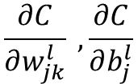






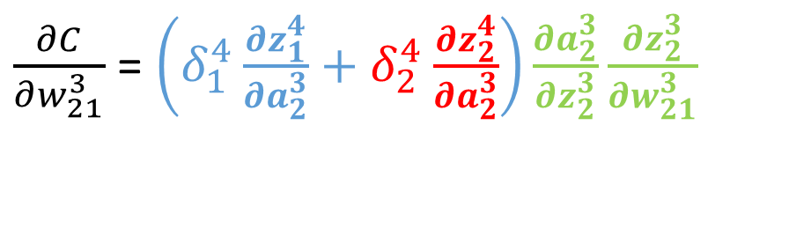


Calculations – Hidden layer
Objective :
For illustration we will use following :
$$\frac{∂C}{∂w_{jk}^{l}} , \frac{∂C}{∂b_{j}^{l}}$$
$$\frac{∂C}{∂w_{21}^{3}} , \frac{∂C}{∂b_{2}^{3}}$$
Layer 2
Layer 3
Layer 4
$$L=4$$
$$a_{1}^{2}$$
$$z_{1}^{3}$$
$$a_{1}^{3}$$
$$z_{1}^{4}$$
$$a_{1}^{4}$$
$$w_{21}^{3}$$
$$Cost C$$
$$a_{2}^{2}$$
$$z_{2}^{3}$$
$$a_{2}^{3}$$
$$z_{2}^{4}$$
$$a_{2}^{4}$$
$\frac{∂C}{∂w_{21}^{3}}$ = $\left(δ_{1}^{4}\frac{∂z_{1}^{4}}{∂a_{2}^{3}}+δ_{2}^{4}\frac{∂z_{2}^{4}}{∂a_{2}^{3}}\right)\frac{∂a_{2}^{3}}{∂z_{2}^{3}}\frac{∂z_{2}^{3}}{∂w_{21}^{3}}$

Slide 11


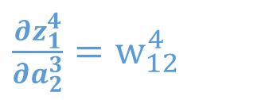
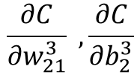
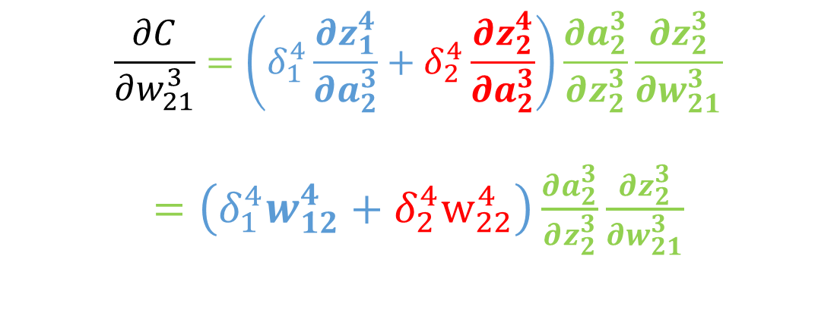



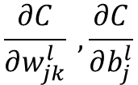

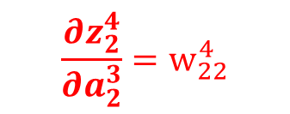









Calculations – Hidden layer
Objective :
For illustration we will use following :
Layer 2
Layer 3
Layer 4
$$L=4$$
$$\frac{∂C}{∂w_{jk}^{l}} , \frac{∂C}{∂b_{j}^{l}}$$
$$\frac{∂C}{∂w_{21}^{3}} , \frac{∂C}{∂b_{2}^{3}}$$
$$a_{1}^{2}$$
$$z_{1}^{3}$$
$$a_{1}^{3}$$
$$z_{1}^{4}$$
$$a_{1}^{4}$$
$$w_{21}^{3}$$
$$Cost C$$
$$a_{2}^{3}$$
$$z_{2}^{4}$$
$z_{1}^{4}=$ $w_{11}^{4}a_{1}^{3}+w_{12}^{4}a_{2}^{3}+b_{1}^{4}$
$$a_{2}^{2}$$
$$z_{2}^{3}$$
$$a_{2}^{4}$$
$\frac{∂z_{1}^{4}}{∂a_{2}^{3}}=w_{12}^{4}$
$$\frac{∂C}{∂w_{21}^{3}}=\left(δ_{1}^{4}\frac{∂z_{1}^{4}}{∂a_{2}^{3}}+δ_{2}^{4}\frac{∂z_{2}^{4}}{∂a_{2}^{3}}\right)\frac{∂a_{2}^{3}}{∂z_{2}^{3}}\frac{∂z_{2}^{3}}{∂w_{21}^{3}}$$
$=\left(δ_{1}^{4}w_{12}^{4}+{δ_{2}^{4}w}_{22}^{4}\right)\frac{∂a_{2}^{3}}{∂z_{2}^{3}}\frac{∂z_{2}^{3}}{∂w_{21}^{3}}$
$z_{2}^{4}=$ $w_{21}^{4}a_{1}^{3}+w_{22}^{4}a_{2}^{3}+b_{2}^{4}$
$$\frac{∂z_{2}^{4}}{∂a_{2}^{3}}=w_{22}^{4}$$

Slide 12
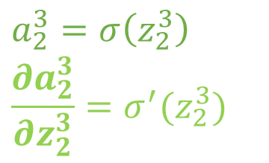
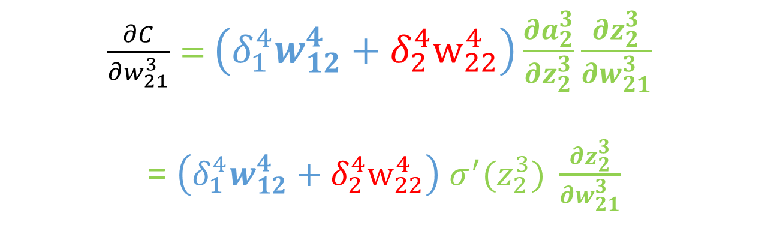
Calculations – Hidden layer
Objective :
For illustration we will use following :
Layer 2
Layer 3
Layer 4
$$L=4$$
$$\frac{∂C}{∂w_{jk}^{l}} , \frac{∂C}{∂b_{j}^{l}}$$
$$\frac{∂C}{∂w_{21}^{3}} , \frac{∂C}{∂b_{2}^{3}}$$
$$a_{1}^{2}$$
$$z_{1}^{3}$$
$$a_{1}^{3}$$
$$z_{1}^{4}$$
$$a_{1}^{4}$$
$$w_{21}^{3}$$
$$Cost C$$
$$a_{2}^{2}$$
$$z_{2}^{3}$$
$$a_{2}^{3}$$
$$z_{2}^{4}$$
$$a_{2}^{4}$$
$\frac{∂C}{∂w_{21}^{3}}=$ $\left(δ_{1}^{4}w_{12}^{4}+{δ_{2}^{4}w}_{22}^{4}\right)\frac{∂a_{2}^{3}}{∂z_{2}^{3}}\frac{∂z_{2}^{3}}{∂w_{21}^{3}}$
= $\left(δ_{1}^{4}w_{12}^{4}+{δ_{2}^{4}w}_{22}^{4}\right)$ $σ^{′}(z_{2}^{3}) \frac{∂z_{2}^{3}}{∂w_{21}^{3}}$
$$a_{2}^{3}=σ\left(z_{2}^{3}\right)$$
$$\frac{∂a_{2}^{3}}{∂z_{2}^{3}}=σ^{′}(z_{2}^{3})$$

Slide 13
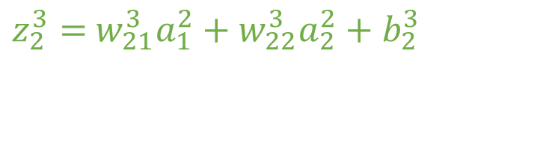
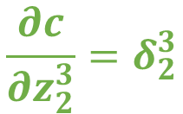

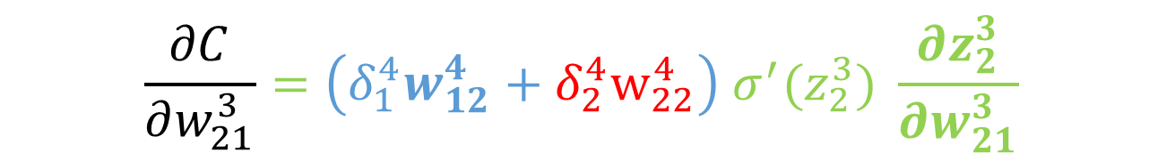
Calculations – Hidden layer
Objective :
For illustration we will use following :
Layer 2
Layer 3
Layer 4
$$L=4$$
$$\frac{∂C}{∂w_{jk}^{l}} , \frac{∂C}{∂b_{j}^{l}}$$
$$\frac{∂C}{∂w_{21}^{3}} , \frac{∂C}{∂b_{2}^{3}}$$
$$a_{1}^{2}$$
$$z_{1}^{3}$$
$$a_{1}^{3}$$
$$z_{1}^{4}$$
$$a_{1}^{4}$$
$$w_{21}^{3}$$
$$Cost C$$
$z_{2}^{3}=$ $w_{21}^{3}a_{1}^{2}+w_{22}^{3}a_{2}^{2}+b_{2}^{3}$
$$a_{2}^{2}$$
$$z_{2}^{3}$$
$$a_{2}^{3}$$
$$z_{2}^{4}$$
$$a_{2}^{4}$$
$$\frac{∂z_{2}^{3}}{∂w_{21}^{3}}= a_{1}^{2}$$
$$\frac{∂C}{∂w_{21}^{3}}=\left(δ_{1}^{4}w_{12}^{4}+{δ_{2}^{4}w}_{22}^{4}\right) σ^{′}(z_{2}^{3}) \frac{∂z_{2}^{3}}{∂w_{21}^{3}}$$
$$\frac{∂c}{∂z_{2}^{3}}=δ_{2}^{3}$$

Slide 14


Calculations – Hidden layer
Objective :
For illustration we will use following :
Layer 2
Layer 3
Layer 4
$$L=4$$
$$\frac{∂C}{∂w_{jk}^{l}} , \frac{∂C}{∂b_{j}^{l}}$$
$$\frac{∂C}{∂w_{21}^{3}} , \frac{∂C}{∂b_{2}^{3}}$$
$$a_{1}^{2}$$
$$z_{1}^{3}$$
$$a_{1}^{3}$$
$$z_{1}^{4}$$
$$a_{1}^{4}$$
$$w_{21}^{3}$$
$$Cost C$$
$$a_{2}^{2}$$
$$z_{2}^{3}$$
$$a_{2}^{3}$$
$$z_{2}^{4}$$
$$a_{2}^{4}$$
$$\frac{∂C}{∂w_{21}^{3}}=\left(δ_{1}^{4}w_{12}^{4}+{δ_{2}^{4}w}_{22}^{4}\right) σ^{′}(z_{2}^{3}) \frac{∂z_{2}^{3}}{∂w_{21}^{3}}$$
$$\frac{∂c}{∂z_{2}^{3}}=δ_{2}^{3}$$
= weighted sum of deltas from previous layer * derivative of activation function

Slide 15
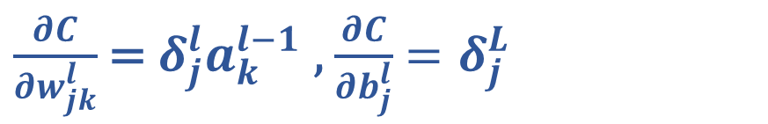
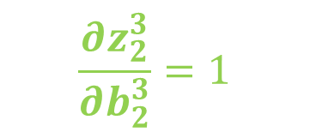

Calculations – Hidden layer
Objective :
For illustration we will use following :
Layer 2
Layer 3
Layer 4
$$L=4$$
$$\frac{∂C}{∂w_{jk}^{l}} , \frac{∂C}{∂b_{j}^{l}}$$
$$\frac{∂C}{∂w_{21}^{3}} , \frac{∂C}{∂b_{2}^{3}}$$
$$a_{1}^{2}$$
$$z_{1}^{3}$$
$$a_{1}^{3}$$
$$z_{1}^{4}$$
$$a_{1}^{4}$$
$$w_{21}^{3}$$
$$Cost C$$
$z_{2}^{3}=$ $w_{21}^{3}a_{1}^{2}+w_{22}^{3}a_{2}^{2}+b_{2}^{3}$
$$a_{2}^{2}$$
$$z_{2}^{3}$$
$$a_{2}^{3}$$
$$z_{2}^{4}$$
$$a_{2}^{4}$$
$$\frac{∂z_{2}^{3}}{∂w_{21}^{3}}= a_{1}^{2}$$
$$\frac{∂z_{2}^{3}}{∂b_{2}^{3}}=1$$
$\frac{∂C}{∂w_{21}^{3}}=δ_{2}^{3}\frac{∂z_{2}^{3}}{∂w_{21}^{3}}$ = $δ_{2}^{3}a_{1}^{2}, \frac{∂C}{∂b_{2}^{3}}=δ_{2}^{3}\frac{∂z_{2}^{3}}{∂b_{2}^{3}}$ = $δ_{2}^{3}$
$\frac{∂C}{∂w_{jk}^{l}}$ = $δ_{j}^{l}a_{k}^{l−1}$, $\frac{∂C}{∂b_{j}^{l}}$ $=δ_{j}^{L}$

Slide 16
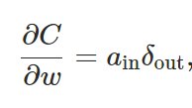
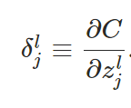

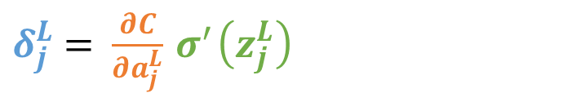
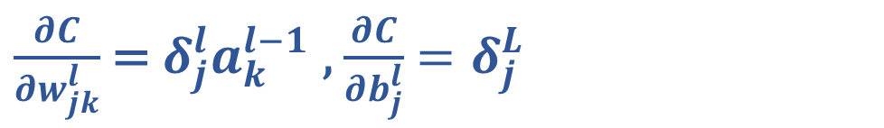

Gradient Update Rule
$$\frac{∂C}{∂w}=$$
$$a_{in} ×{ δ}_{out}$$
$\frac{∂C}{∂w_{jk}^{l}}$ = $δ_{j}^{l}a_{k}^{l−1}$, $\frac{∂C}{∂b_{j}^{l}}$ $=δ_{j}^{L}$
Delta
= weighted sum of deltas from previous layer * derivative of activation function
Hidden Layer
$δ_{j}^{L}$ = $\frac{∂C}{∂a_{j}^{L}}{ σ}^{′}\left(z_{j}^{L}\right)$
Output Layer
 | This Example | Linear Regression | Logistic Regression
$$δ_{j}^{L}$$ | Error * derivative of activation function | Error | Error

Slide 17
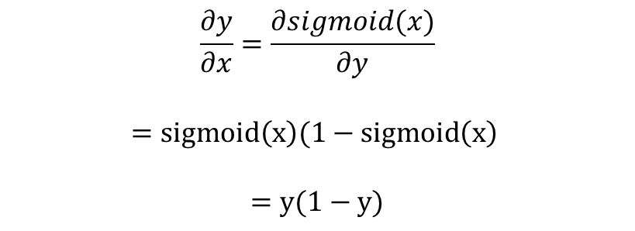



Simple Neural Network
Implement One pass of forward
Implement backward pass the update the circled values
3
Use sigmoid activation function for both hidden layer and output layer
$a_{1}^{1}=1$
4
1
Correct Output = t = 1.0
3
-5
2
Useful Formulae:
$a_{2}^{1}=0$
-2
-4
$$y=sigmoid\left(x\right)=1/(1+e^{−x})$$
-2
$$\frac{∂y}{∂x}=\frac{∂sigmoid(x)}{∂y}$$
$$=sigmoid\left(x\right)(1−sigmoid\left(x\right)$$
$$=y(1−y)$$
1
1

