Slide 1

Back-Propagation
Harpreet Singh (Fall 2023)

Slide 2





Simple Example – Hidden Unit Computations
3
4
1
3
-5
2
-2
-4
-2
1
1

Slide 3

Forward Pass

Slide 4
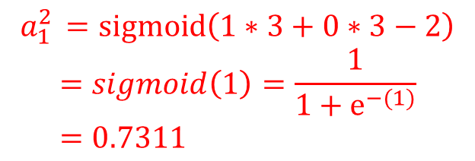
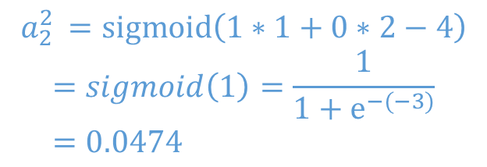
Simple Example – Forward Hidden Layer
3
4
1
3
-5
2
-2
-4
-2
1
1

Slide 5
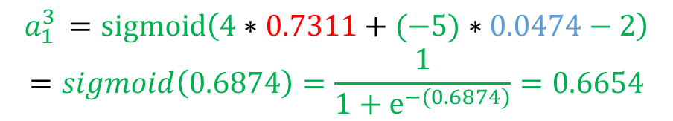


Simple Example – Forward Output Layer
3
4
1
3
-5
2
-2
-4
-2
1
1

Slide 6





Simple Example – Network after Forward Pass
3
4
1
3
-5
2
-2
-4
-2
1
1

Slide 7
Backward Pass

Slide 8
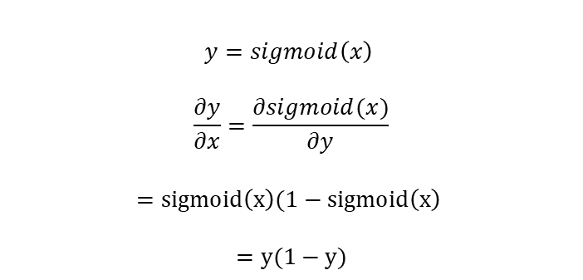




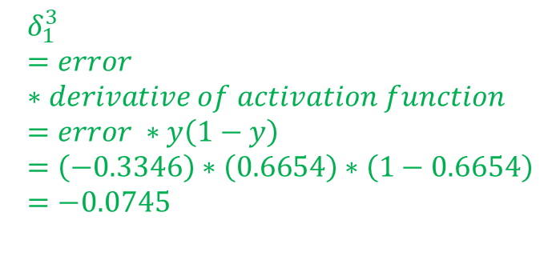
Simple Example – Delta Output Layer
Derivative : sigmoid activation function
3
4
1
3
-5
2
-2
-4
-2
1
1

Slide 9
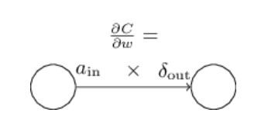


Simple Example – Weight Update Output layer
3
4
1
3
-5
2
-2
-4
-2
1
1

Slide 10


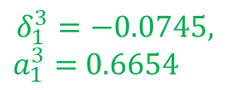


Simple Example – Weight Update Output layer
3
4.46
4
1
3
-4.96
-5
2
-2
-1.255
-4
-2
1
1

Slide 11
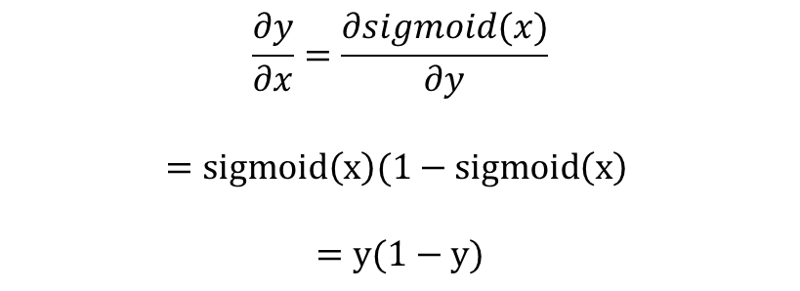


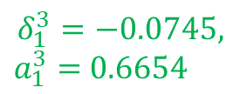
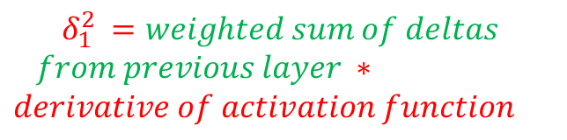


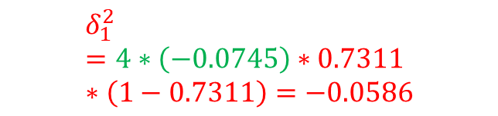
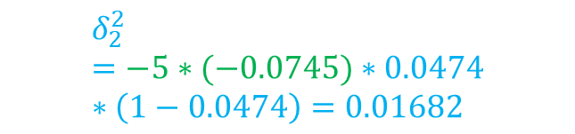
Simple Example – Delta for Hidden Layer
3
4.46
4
1
3
-4.96
-5
2
-2
-1.255
-4
-2
1
1
NOTE – We are not using the updated weights to calculate delta for hidden layer.
All the calculations are done based on weights from previous iteration.

Slide 12





Simple Example – Delta for Hidden Layer
3
4.46
4
1
3
-4.96
-5
2
-1.255
-2
-4
-2
1
1

Slide 13













Simple Example – Weight update for Hidden Layer
gradient =
4.46
4
-4.96
-5
-1.255
-2
1
1
NOTE – We are not using the updated weights to calculate delta for hidden layer.
All the calculations are done based on weights from previous iteration.

Slide 14
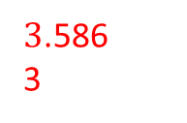

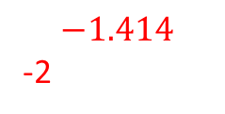
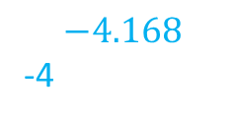
Simple Example – Network after one iteration
4.46
0.832
1
4
-4.96
-5
2
-1.255
-2
1
1

