Slide 1

Agenda
Training NN PPT (45 mins)
Numerical Stability Notebook(15 mins)
Understanding dropout Batch Norm Notebook(20 mins)
Efficient DataLoaders – 30 minutes
Break 10 mins
FMNIST-Pytorch (Model Creation) – 30 minutes

Slide 2

Training Neural Network

Slide 3

Deep Vs. Wide

Slide 4

Wide Vs Deep Networks
Narrow and Deep
Wide and Shallow

Slide 5
Wide and Shallow
Given enough data, a shallow network with one hidden layer can approximate any arbitrary function.
Disadvantages:
Needs a lot of neurons in the hidden layer
Is prone to overfitting (memorization vs. learning

Slide 6
Narrow and Deep
Advantages:
Needs fewer Units
Generalizes better
Disadvantages
Harder to train

Slide 7

Numerical Stability

Slide 8
Recap- Gradient Descent
Forward Pass
Backward Pass
Calculate Loss
Calculate Gradients
Initialize weights
Predict
Update Weights
Stop
Goal: Optimize model performance by finding suitable weights.
Define a loss function - a lower value indicates better model performance.
Calculate gradients - these represent the change in loss with respect to weights. Positive gradients imply a decrease in weight to minimize loss, while negative gradients indicate an increase in weight.
Utilize gradients to guide weight adjustments, leading to continuous improvement in model performance.

Slide 9

Forward Pass

Slide 10





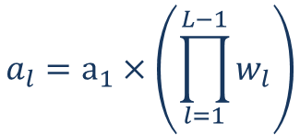










Five layers, one neuron in each layer, no bias, and linear activation function
$$w_{1}$$
$$w_{2}$$
$$w_{3}$$
$$w_{4}$$
$$a_{1}$$
$$z_{2}=w_{1}a_{1}$$
$$=a_{2}$$
$$z_{3}=a_{2}w_{2}=w_{1}w_{2}a_{1}$$
$${=a}_{3}$$
$$z_{4}=a_{3}w_{3}=w_{1}w_{2}w_{3}a_{1}$$
$$=a_{4}$$
$$z_{5}=a_{4}w_{4}=w_{1}w_{2}w_{3}w_{4}a_{1}$$
$${=a}_{5}$$
$$L$$
$$a_{l}=a_{1}×\left(\prod_{l=1}^{L−1}{w_{l}}\right)$$
$$a_{5}=w_{1}w_{2}w_{3}w_{4}a_{1}$$

Slide 11
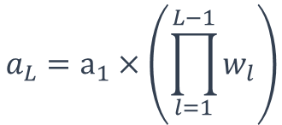



Exploding Activations
$$a_{L}=a_{1}×\left(\prod_{l=1}^{L−1}{w_{l}}\right)$$
$$a_{1}=1, L=101$$
$${w_{1}=w_{2}⋯=w}_{L−1}=w=0.5$$
$$a_{2}={\left(w\right)}^{1}=1.5$$
$$a_{6}={\left(w\right)}^{5}=7.6$$
$$a_{101}={\left(w\right)}^{100}={\left(1.5\right)}^{100}=4.06×{\left(10\right)}^{17}$$

Slide 12

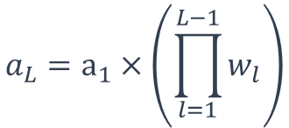



Vanishing Activations
$$a_{L}=a_{1}×\left(\prod_{l=1}^{L−1}{w_{l}}\right)$$
$$a_{1}=1, L=101$$
$${w_{1}=w_{2}⋯=w}_{L−1}=w=0.5$$
$$a_{2}={\left(w\right)}^{1}=0.5$$
$$a_{6}={\left(w\right)}^{5}=0.03125$$
$$a_{101}={\left(w\right)}^{100}={\left(0.5\right)}^{100}=8×{\left(10\right)}^{−31}≈0$$

Slide 13
Backward Pass

Slide 14





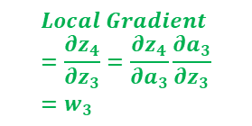



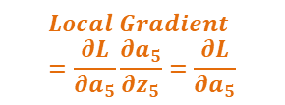

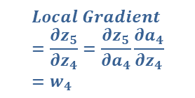
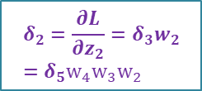






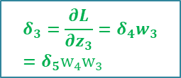



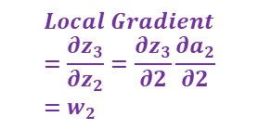


Five layers, one neuron in each layer, no bias, and linear activation function
$$w_{1}$$
$$w_{2}$$
$$w_{3}$$
$$w_{4}$$
$$a_{1}$$
$$z_{2}=w_{1}a_{1}$$
$$=a_{2}$$
$$z_{3}=a_{2}w_{2}=w_{1}w_{2}a_{1}$$
$${=a}_{3}$$
$$z_{4}=a_{3}w_{3}=w_{1}w_{2}w_{3}a_{1}$$
$$=a_{4}$$
$$z_{5}=a_{4}w_{4}=w_{1}w_{2}w_{3}w_{4}a_{1}$$
$${=a}_{5}$$
$$L$$
$$\frac{∂z_{3}}{∂a_{2}}\frac{∂a_{2}}{∂z_{2}}=w_{2}$$
$$\frac{∂z_{4}}{∂a_{3}}\frac{∂a_{3}}{∂z_{3}}=w_{3}$$
$$\frac{∂z_{5}}{∂a_{4}}\frac{∂a_{4}}{∂z_{4}}=w_{4}$$
$$\frac{∂L}{∂a_{5}}\frac{∂a_{5}}{∂z_{5}}=\frac{∂L}{∂a_{5}}$$
$$w_{2}$$
$$w_{3}$$
$$w_{4}$$
$$δ_{2}=\frac{∂L}{∂z_{2}}=δ_{3}w_{2}=δ_{5}w_{4}w_{3}w_{2}$$
$$δ_{3}=\frac{∂L}{∂z_{3}}=δ_{4}w_{3}=δ_{5}w_{4}w_{3}$$
$$δ_{4}=\frac{∂L}{∂z_{4}}=δ_{5}w_{4}$$
$$δ_{5}=\frac{∂L}{∂z_{5}}=\frac{∂L}{∂a_{5}}\frac{∂a_{5}}{∂z_{5}}=\frac{∂L}{∂a_{5}}$$
$$Local Gradient=\frac{∂z_{3}}{∂z_{2}}=\frac{∂z_{3}}{∂2}\frac{∂a_{2}}{∂2}=w_{2}$$
$$Local Gradient=\frac{∂z_{4}}{∂z_{3}}=\frac{∂z_{4}}{∂a_{3}}\frac{∂a_{3}}{∂z_{3}}=w_{3}$$
$$Local Gradient=\frac{∂z_{5}}{∂z_{4}}=\frac{∂z_{5}}{∂a_{4}}\frac{∂a_{4}}{∂z_{4}}=w_{4}$$
$$Local Gradient=\frac{∂L}{∂a_{5}}\frac{∂a_{5}}{∂z_{5}}=\frac{∂L}{∂a_{5}}$$

Slide 15

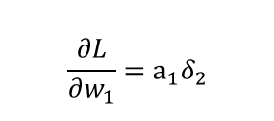


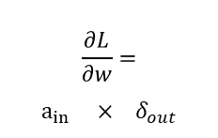

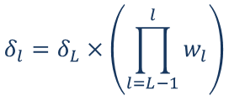


Five layers, one neuron in each layer, no bias, and linear activation function
$$w_{1}$$
$$w_{2}$$
$$w_{3}$$
$$w_{4}$$
$$a_{1}$$
$$z_{2}=w_{1}a_{1}$$
$$=a_{2}$$
$$z_{3}=a_{2}w_{2}=w_{1}w_{2}a_{1}$$
$${=a}_{3}$$
$$z_{4}=a_{3}w_{3}=w_{1}w_{2}w_{3}a_{1}$$
$$=a_{4}$$
$$z_{5}=a_{4}w_{4}=w_{1}w_{2}w_{3}w_{4}a_{1}$$
$${=a}_{5}$$
$$L$$
$$w_{2}$$
$$w_{3}$$
$$w_{4}$$
$$δ_{2}=\frac{∂L}{∂z_{2}}=δ_{3}w_{2}=δ_{5}w_{4}w_{3}w_{2}$$
$$δ_{3}=\frac{∂L}{∂z_{3}}=δ_{4}w_{3}=δ_{5}w_{4}w_{3}$$
$$δ_{4}=\frac{∂L}{∂z_{4}}=δ_{5}w_{4}$$
$$δ_{5}=\frac{∂L}{∂z_{5}}=\frac{∂L}{∂a_{5}}\frac{∂a_{5}}{∂z_{5}}=\frac{∂L}{∂a_{5}}$$
$$\frac{∂L}{∂w_{1}}=a_{1}δ_{2}$$
$$δ_{2}={δ_{5}w}_{4}w_{3}w_{2}$$
$$\frac{∂L}{∂w}=$$
$$a_{in} ×{ δ}_{out}$$
$$δ_{l}=δ_{L}×\left(\prod_{l=L−1}^{l}{w_{l}}\right)$$

Slide 16




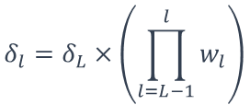
Exploding Gradients
$$δ_{l}=δ_{L}×\left(\prod_{l=L−1}^{l}{w_{l}}\right)$$
$$δ_{101}=1, L=101$$
$${w_{1}=w_{2}⋯=w}_{L−1}=w=1.5$$
$$δ_{100}={δ_{101}\left(w\right)}^{1}=1.5$$
$$a_{96}={δ_{101}\left(w\right)}^{5}=7.6$$
$$δ_{1}={\left(w\right)}^{100}={\left(1.5\right)}^{100}=4.06×{\left(10\right)}^{17}$$

Slide 17



Vanishing Gradients
$$δ_{l}=δ_{L}×\left(\prod_{l=L−1}^{l}{w_{l}}\right)$$
$$δ_{101}=1, L=101$$
$${w_{1}=w_{2}⋯=w}_{L−1}=w=0.5$$
$$δ_{100}={δ_{101}\left(w\right)}^{1}=0.5$$
$$a_{96}={δ_{101}\left(w\right)}^{5}=0.03125$$
$$δ_{1}={\left(w\right)}^{100}={\left(1.5\right)}^{100}=8×{\left(10\right)}^{−31}≈0$$

Slide 18

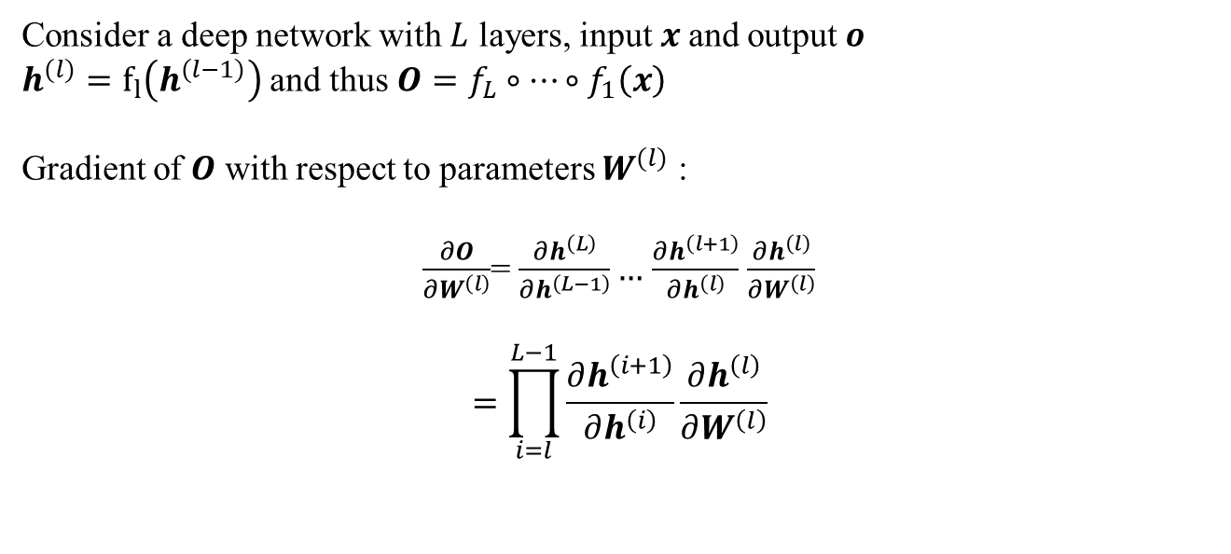
Gradients for Neural Networks
Consider a deep network with $L$ layers, input $x$and output $o$
$h^{(l)}=f_{l}\left(h^{(l−1)}\right)$ and thus $O=f_{L}∘…∘f_{1}\left(x\right)$
Gradient of $O$ with respect to parameters $W^{(l)}$ :
$\frac{∂O}{∂W^{\left(l\right)}}$= $\frac{∂h^{\left(L\right)}}{∂h^{\left(L−1\right)}}…$ $\frac{∂h^{\left(l+1\right)}}{∂h^{\left(l\right)}}$ $\frac{∂h^{\left(l\right)}}{∂W^{\left(l\right)}}$
$$=\prod_{i=l}^{L−1}{\frac{∂h^{\left(i+1\right)}}{∂h^{\left(i\right)}}\frac{∂h^{\left(l\right)}}{∂W^{\left(l\right)}}}$$
Multiplication of $L−l$matrices

Slide 19
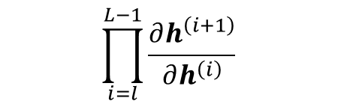
Issues with Gradients for Deep Neural Networks
$$\prod_{i=l}^{L−1}{\frac{∂h^{\left(i+1\right)}}{∂h^{\left(i\right)}}}$$
Gradient Exploding
Vanishing Gradients

Slide 20
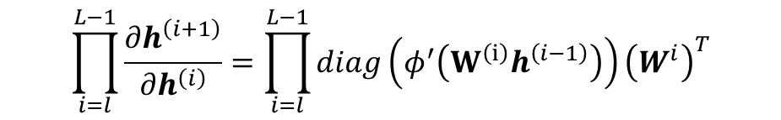
Gradients for Neural Networks
Let us assume MLP (without bias for simplicity)
$h^{(l)}=f_{l}\left(h^{(l−1)}\right)=φ\left(W^{\left(l\right)}h^{\left(l−1\right)}\right)$ where $φ$ is the activation function
Chain rule for vectors:$\frac{∂f(g\left(x\right))}{∂x}=\frac{∂f}{∂g}\frac{∂g}{∂x}$
$\frac{∂h^{(l)}}{∂h^{\left(l−1\right)}} =diag\left(φ^{′}\left(W^{\left(l\right)}h^{\left(l−1\right)}\right)\right){\left(W^{l}\right)}^{T}$ , here $φ^{′}$ is the gradient of $φ$
$$\prod_{i=l}^{L−1}{\frac{∂h^{\left(i+1\right)}}{∂h^{\left(i\right)}}}=\prod_{i=l}^{L−1}{diag\left(φ^{′}\left(W^{\left(i\right)}h^{\left(i−1\right)}\right)\right){\left(W^{i}\right)}^{T}}$$

Slide 21
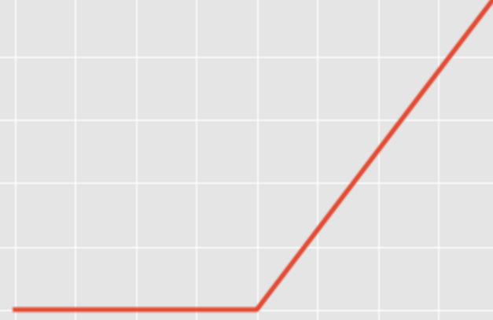
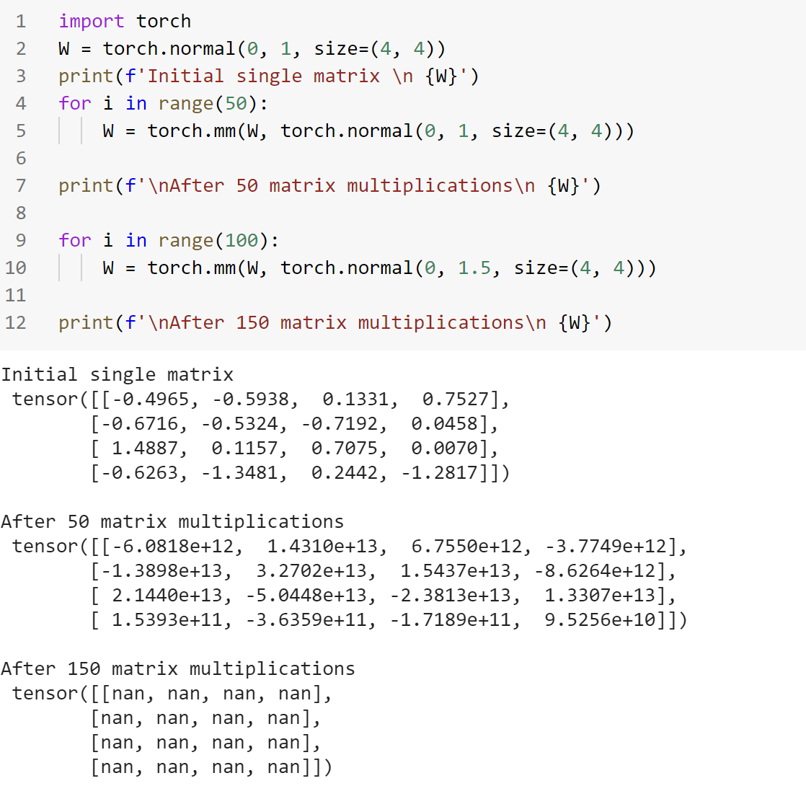
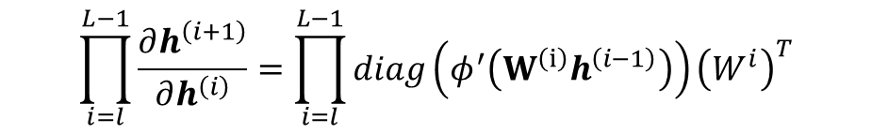
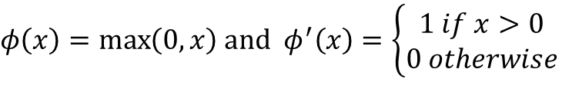
Gradient Exploding
ReLU Activation Function
$φ\left(x\right)=\max\left(0,x\right)$ and $φ^{′}\left(x\right)=\left\{\begin{aligned}1 if x>0 \\ 0 otherwise\end{aligned}\right.$
$$\prod_{i=l}^{L−1}{\frac{∂h^{\left(i+1\right)}}{∂h^{\left(i\right)}}}=\prod_{i=l}^{L−1}{diag\left(φ^{′}\left(W^{\left(i\right)}h^{\left(i−1\right)}\right)\right){\left(W^{i}\right)}^{T}}$$
Other Issues with ReLU:
Many ReLU units die as gradients become zero forever

Slide 22
Issues with Gradient Exploding
Value out of range infinity value
Sensitive to learning rate (LR)
Notes:
Sensitive to learning rate (LR)
Not small enough LR -> large weights -> larger gradients
Too small LR -> No progress
May need to change LR dramatically during training

Slide 23
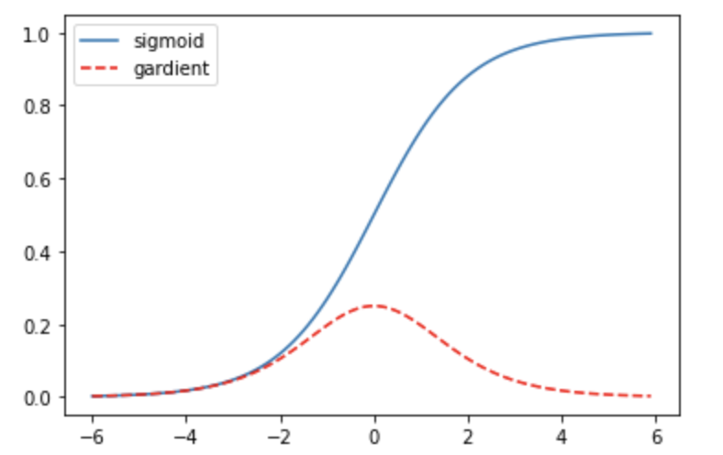
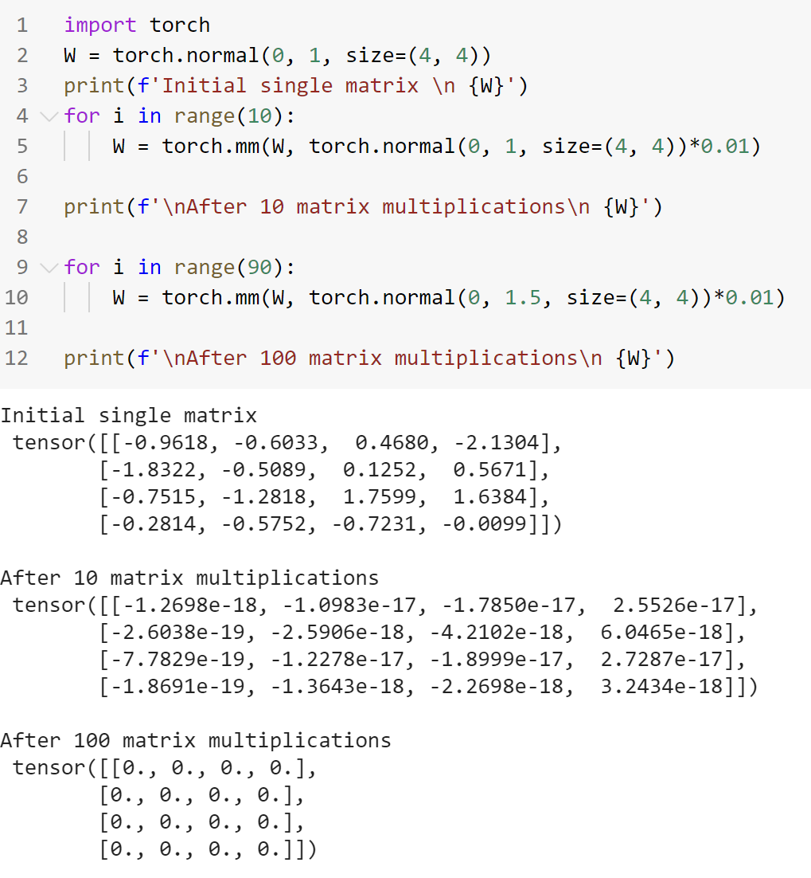
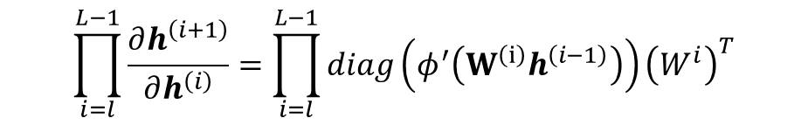
Gradient Vanishing
Sigmoid Activation Function
$φ\left(x\right)=\frac{1}{1+e^{−x}}$ and $φ^{′}\left(x\right)=φ(x)\left(1−φ\left(x\right)\right)$
Small gradients
$$\prod_{i=l}^{L−1}{\frac{∂h^{\left(i+1\right)}}{∂h^{\left(i\right)}}}=\prod_{i=l}^{L−1}{diag\left(φ^{′}\left(W^{\left(i\right)}h^{\left(i−1\right)}\right)\right){\left(W^{i}\right)}^{T}}$$

Slide 24
Issues with Gradient Vanishing
No progress in training
Irrespective of learning rate
Severe with bottom layers
Only top layers are well trained

Slide 25

Stabilize Training

Slide 26
Stabilize Training
Proper Weight Initialization
Normalize
Batch Normalization
Gradient clipping

Slide 27
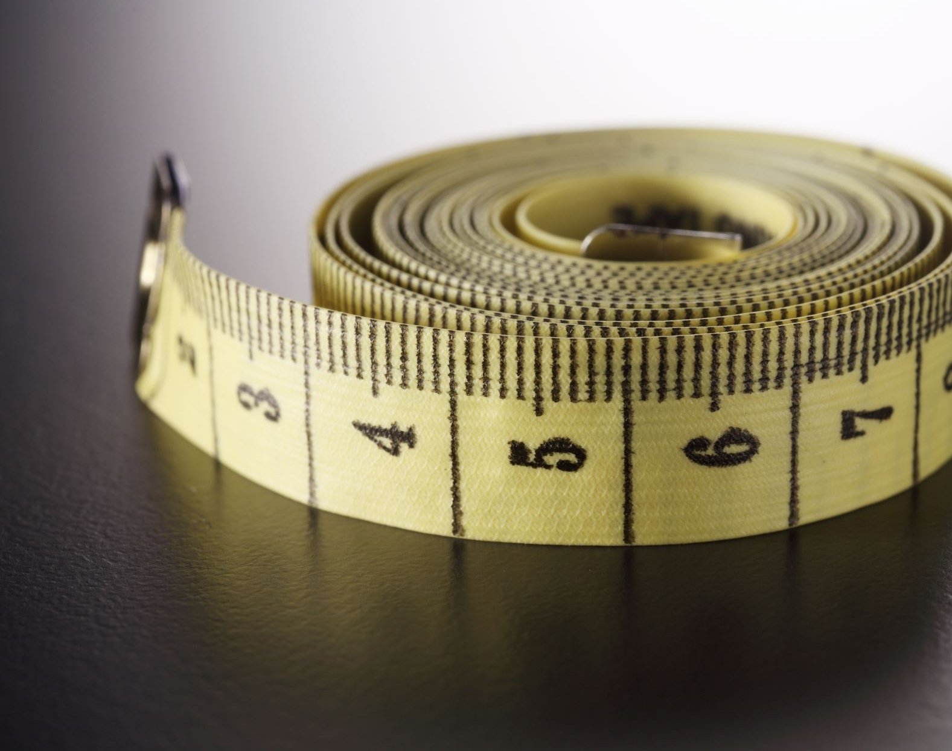
Weight Initialization

Slide 28
Weight initialization
Constant Initialization: Set all weights to C
Normal Initialization: Set all weights to random small numbers
Every neuron in the network computes different output → computes different gradient → different parameter updates
"Symmetry breaking“
Problem: variance that grows with the number of inputs.
Every neuron in the network computes the same output → computes the same gradient → same parameter updates
Initializing according to $𝒩\left(0,0.01\right)$ works well for small networks, but not guaranteed to work for deep neural networks
Initializing according to 𝒩(0,0.01) works well for small networks, but not guaranteed to work for deep neural networks

Slide 29
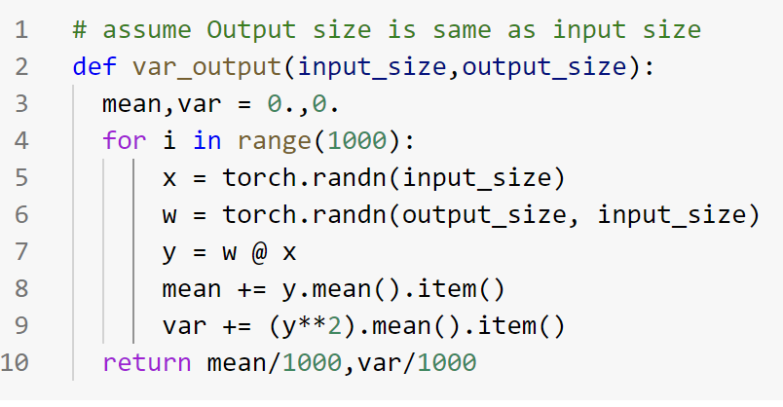
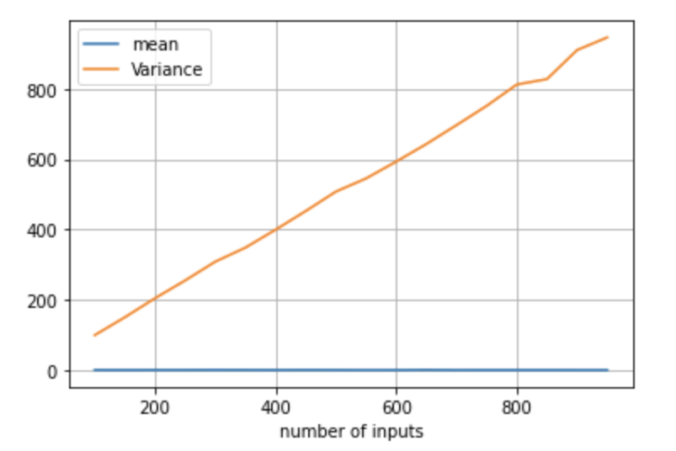
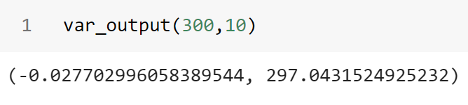
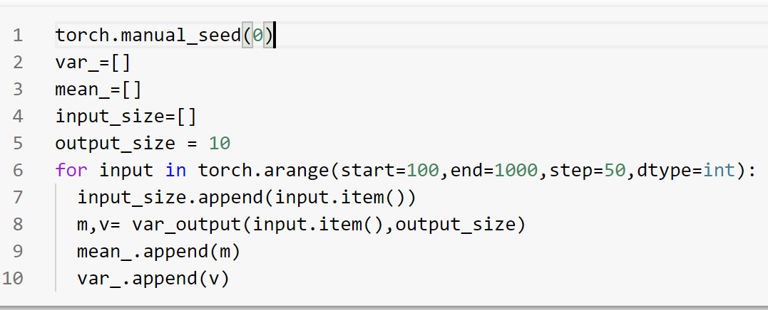
Variance grows with the number of inputs

Slide 30
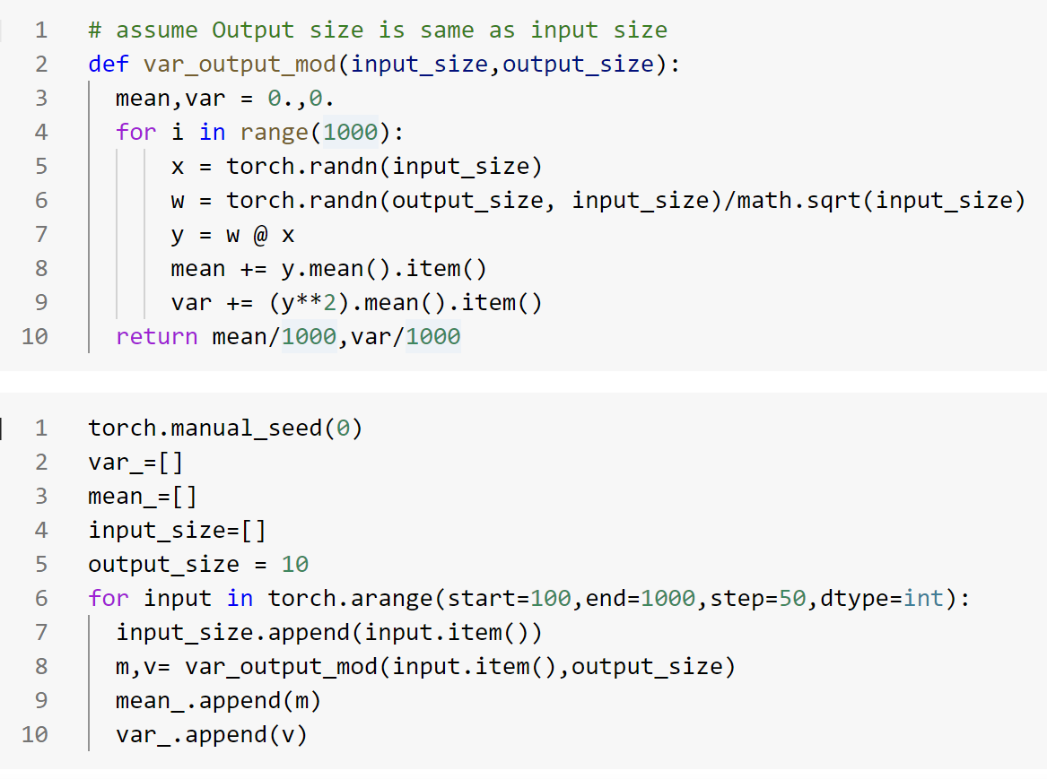
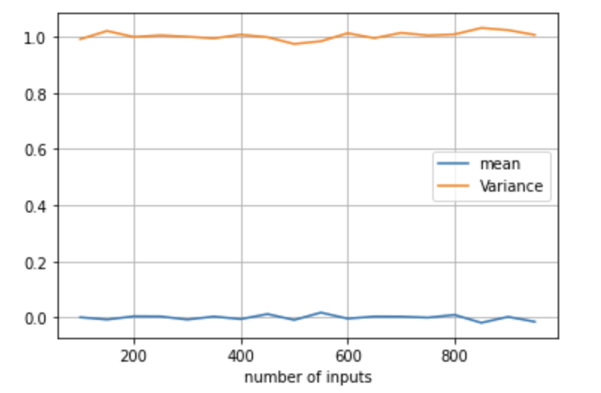
Variance grows with the number of inputs

Slide 31
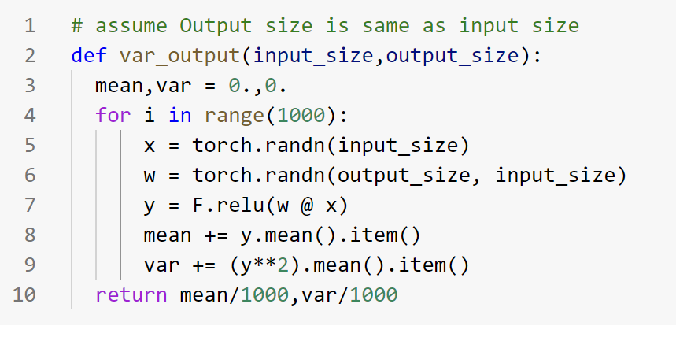
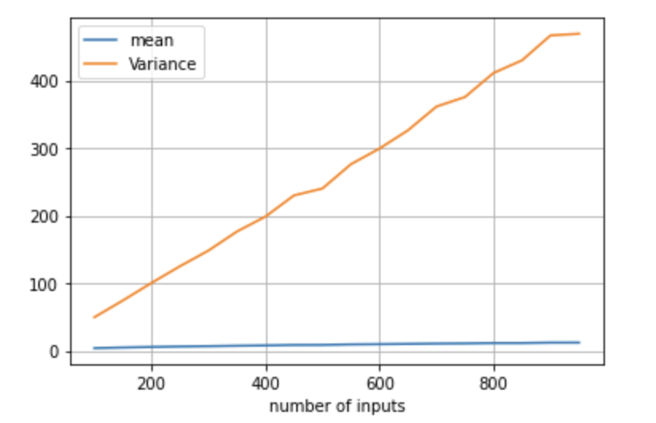
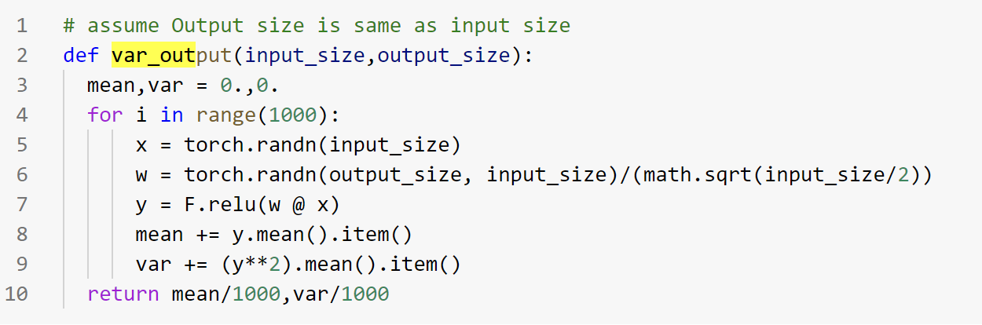
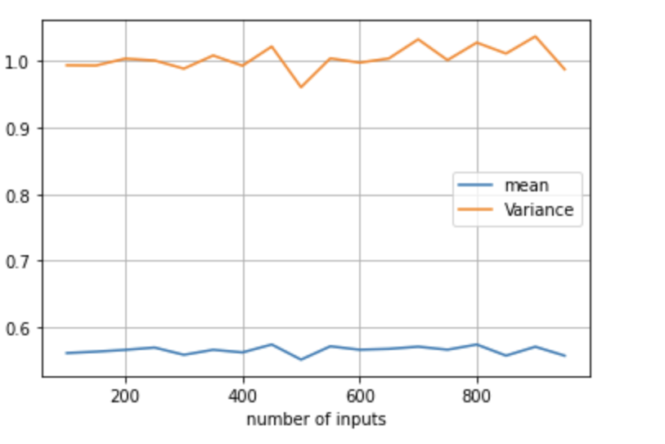
Variance grows with the number of inputs

Slide 32
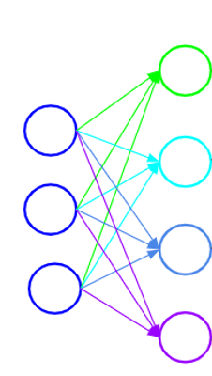
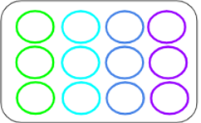













Intuition : Xavier Initialization
$$a^{(1)}$$
$$a^{(2)}$$
$$δ^{(1)}$$
$$δ^{(2)}$$
$$input (1,3)$$
$$output (1,4)$$
$$output (1,3)$$
$$input (1,4)$$
$$W (4, 3)$$
$$a^{(2)}=a^{(1)}W^{T}$$
$$δ^{(1)}=δ^{(2)}W$$
Number of inputs =3
Number of inputs =4
$$W=torch.randn(4,3)/sqrt(3)$$
$$W=torch.randn(4,3)/sqrt(4)$$
Xavier Initialization:
$$W=torch.randn(4,3)/sqrt((3+4)/2)$$

Slide 33
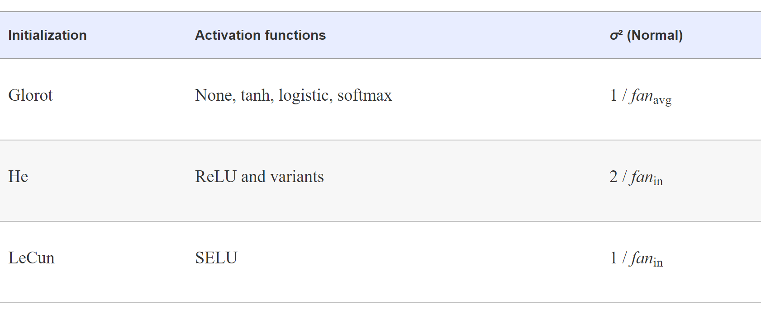
Initialization for each type of activation function

Slide 34

Intuition for Xavier initialization
Make the mean and variance for each layer’s output (both for forward and backward pass) constant.
Forward pass:
$Ε\left[h_{i}^{l}\right]=0$ and $Var\left[h_{i}^{l}\right]=a ∀ i, l$
Backward pass:
$Ε\left[\frac{∂ℓ}{∂h_{i}^{l}}\right]=0$ and $Var\left[\frac{∂ℓ}{∂h_{i}^{l}}\right]=b ∀ i, l$

Slide 35
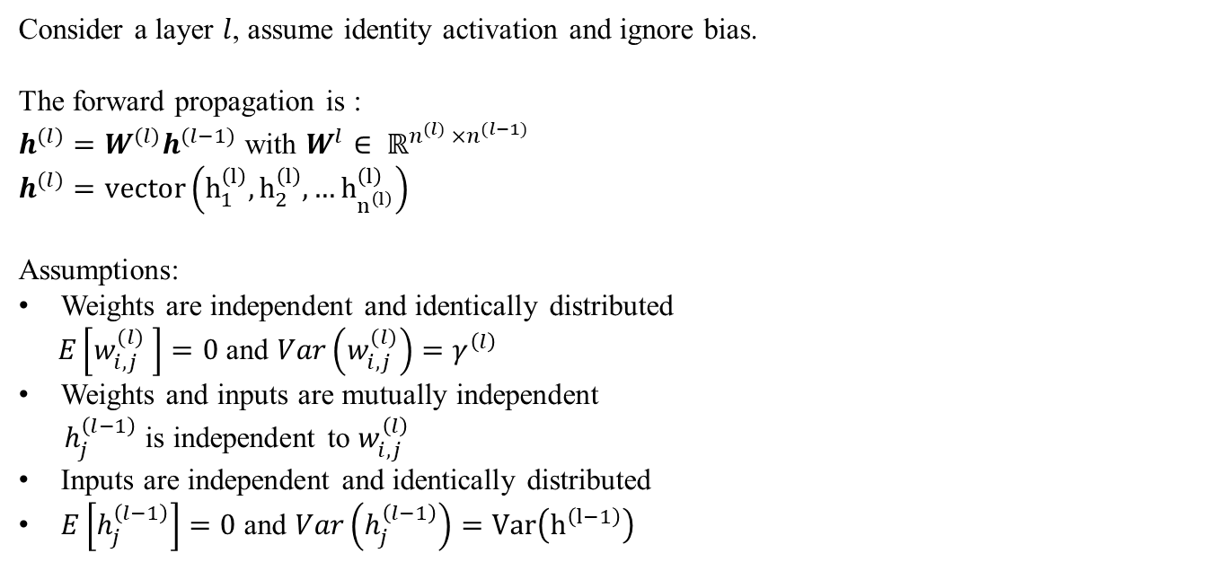
Forward Pass
Consider a layer $l$, assume identity activation and ignore bias.
The forward propagation is :
$h^{(l)}=W^{(l)}h^{(l−1)}$ with $W^{l}∈ ℝ^{n^{(l)} ×n^{(l−1)}}$
$$h^{(l)}=vector\left(h_{1}^{\left(l\right)},h_{2}^{\left(l\right)},…h_{n^{\left(l\right)}}^{\left(l\right)}\right)$$
Assumptions:
Weights are independent and identically distributed
$E\left[w_{i,j}^{(l)} \right]=0$ and $Var\left(w_{i,j}^{(l)}\right)=γ^{\left(l\right)}$
Weights and inputs are mutually independent
${ h}_{j}^{\left(l−1\right)}$ is independent to $w_{i,j}^{\left(l\right)}$
Inputs are independent and identically distributed
$E\left[h_{j}^{\left(l−1\right)}\right]=0$ and $Var\left(h_{j}^{\left(l−1\right)}\right)=Var\left(h^{\left(l−1\right)}\right)$

Slide 36
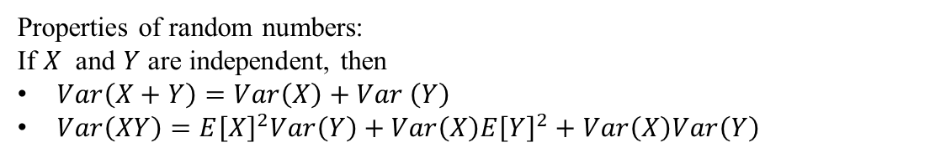
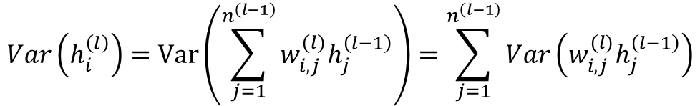
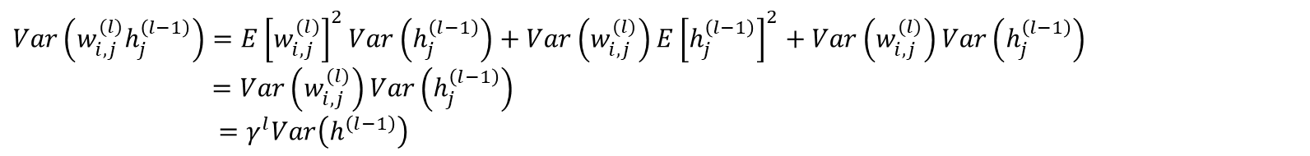
Forward Pass
Properties of random numbers:
If $X$ and $Y$ are independent, then
$Var\left(X+Y\right)=Var\left(X\right)+Var \left(Y\right)$
$Var\left(XY\right)=E{\left[X\right]}^{2}Var\left(Y\right)+Var\left(X\right)E{\left[Y\right]}^{2}+Var\left(X\right)Var\left(Y\right)$
$$Var\left(h_{i}^{\left(l\right)}\right)=Var\left(\sum_{j=1}^{n^{\left(l−1\right)}}{w_{i,j}^{(l)}h_{j}^{\left(l−1\right)}}\right)=\sum_{j=1}^{n^{\left(l−1\right)}}{Var\left(w_{i,j}^{(l)}h_{j}^{\left(l−1\right)}\right)}$$
$$Var\left(w_{i,j}^{(l)}h_{j}^{\left(l−1\right)}\right)=E{\left[w_{i,j}^{(l)}\right]}^{2}Var\left(h_{j}^{\left(l−1\right)}\right)+Var\left(w_{i,j}^{(l)}\right)E{\left[h_{j}^{\left(l−1\right)}\right]}^{2}+Var\left(w_{i,j}^{(l)}\right)Var\left(h_{j}^{\left(l−1\right)}\right)$$
$=Var\left(w_{i,j}^{(l)}\right)Var\left(h_{j}^{\left(l−1\right)}\right)$
$=γ^{l}Var\left(h^{\left(l−1\right)}\right)$

Slide 37
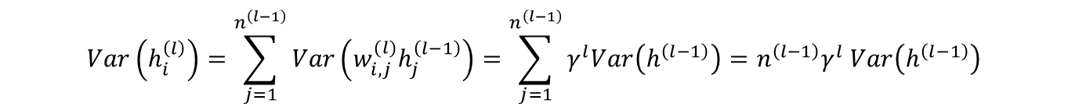
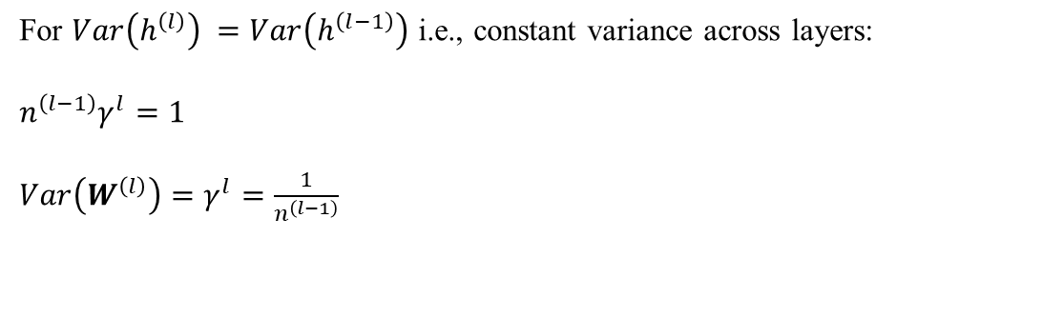
Forward Pass
$$Var\left(h_{i}^{\left(l\right)}\right)=\sum_{j=1}^{n^{\left(l−1\right)}}{Var\left(w_{i,j}^{(l)}h_{j}^{\left(l−1\right)}\right)=\sum_{j=1}^{n^{\left(l−1\right)}}{γ^{l}Var\left(h^{\left(l−1\right)}\right)}}=n^{\left(l−1\right)}γ^{l} Var\left(h^{\left(l−1\right)}\right)$$
$$Var\left(h^{\left(l\right)}\right)=n^{\left(l−1\right)}γ^{l} Var\left(h^{\left(l−1\right)}\right)$$
For $Var\left(h^{\left(l\right)}\right) =Var\left(h^{\left(l−1\right)}\right)$ i.e., constant variance across layers:
$n^{\left(l−1\right)}γ^{l}=1$
${Var\left(W^{\left(l\right)}\right)=γ}^{l}=\frac{1}{n^{\left(l−1\right)}}$

Slide 38
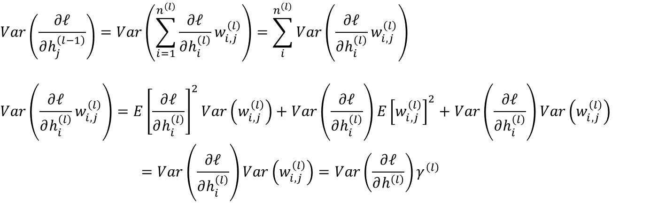

Backward Pass
$$\frac{∂ℓ}{∂h^{\left(l−1\right)}}=\frac{∂ℓ}{∂h^{\left(l\right)}}\frac{∂h^{(l)}}{∂h^{\left(l−1\right)}}=\frac{∂y}{∂h^{\left(l\right)}}W^{\left(l\right)}$$
$$Var\left(\frac{∂ℓ}{∂h_{j}^{\left(l−1\right)}}\right)=Var\left(\sum_{i=1}^{n^{\left(l\right)}}{\frac{∂ℓ}{∂h_{i}^{\left(l\right)}}}w_{i,j}^{\left(l\right)}\right)=\sum_{i}^{n^{\left(l\right)}}{Var\left(\frac{∂ℓ}{∂h_{i}^{\left(l\right)}}w_{i,j}^{\left(l\right)}\right)}$$
$$Var\left(\frac{∂ℓ}{∂h_{i}^{\left(l\right)}}w_{i,j}^{\left(l\right)}\right)=E{\left[\frac{∂ℓ}{∂h_{i}^{\left(l\right)}}\right]}^{2}Var\left(w_{i,j}^{\left(l\right)}\right)+Var\left(\frac{∂ℓ}{∂h_{i}^{\left(l\right)}}\right)E{\left[w_{i,j}^{\left(l\right)}\right]}^{2}+Var\left(\frac{∂ℓ}{∂h_{i}^{\left(l\right)}}\right)Var\left(w_{i,j}^{\left(l\right)}\right)$$
$$=Var\left(\frac{∂ℓ}{∂h_{i}^{\left(l\right)}}\right)Var\left(w_{i,j}^{\left(l\right)}\right)=Var\left(\frac{∂ℓ}{∂h^{\left(l\right)}}\right)γ^{\left(l\right)}$$

Slide 39

Backward Pass
$$Var\left(\frac{∂ℓ}{∂h_{j}^{\left(l−1\right)}}\right)=\sum_{i}^{n^{\left(l\right)}}{Var\left(\frac{∂ℓ}{∂h^{\left(l\right)}}\right)γ^{\left(l\right)}=n^{\left(l\right)}}Var\left(\frac{∂ℓ}{∂h^{\left(l\right)}}\right)γ^{\left(l\right)}$$
$$Var\left(\frac{∂ℓ}{∂h^{\left(l−1\right)}}\right)=Var\left(\frac{∂ℓ}{∂h^{\left(l\right)}}\right){n^{\left(l\right)}γ}^{\left(l\right)}$$
For constant variance across layers : ${n^{\left(l\right)}γ}^{\left(l\right)}=1$
${Var\left(W^{\left(l\right)}\right)=γ}^{l}=\frac{1}{n^{\left(l\right)}}$

Slide 40


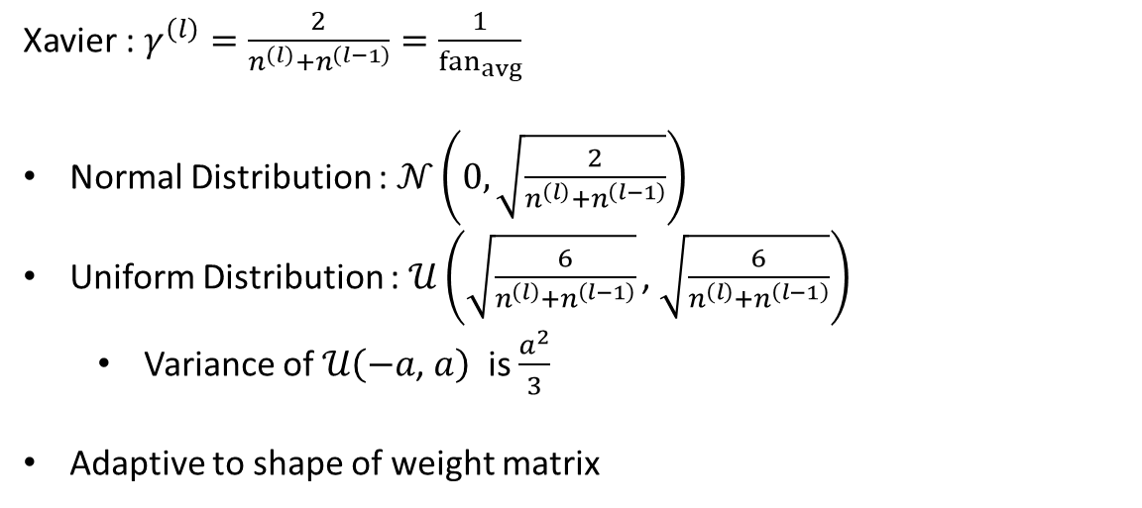
Xavier Initialization
Forward Pass: $γ^{\left(l\right)}=\frac{1}{n^{\left(l\right)}}$
Backward Pass: $γ^{\left(l\right)}$ $=\frac{1}{n^{\left(l−1\right)}}$
Cannot satisfy both conditions
Xavier : $γ^{\left(l\right)}=\frac{2}{n^{\left(l\right)}+n^{\left(l−1\right)}}=\frac{1}{{fan}_{avg}}$
Normal Distribution : $𝒩\left(0,\sqrt{\frac{2}{n^{\left(l\right)}+n^{\left(l−1\right)}}}\right)$
Uniform Distribution : $𝒰\left(\sqrt{\frac{6}{n^{\left(l\right)}+n^{\left(l−1\right)}}}\text{, }\sqrt{\frac{6}{n^{\left(l\right)}+n^{\left(l−1\right)}}}\right)$
Variance of $𝒰\left(−a\text{, }a\right)$ is $\frac{a^{2}}{3}$
Adaptive to shape of weight matrix

Slide 41

Normalization

Slide 42
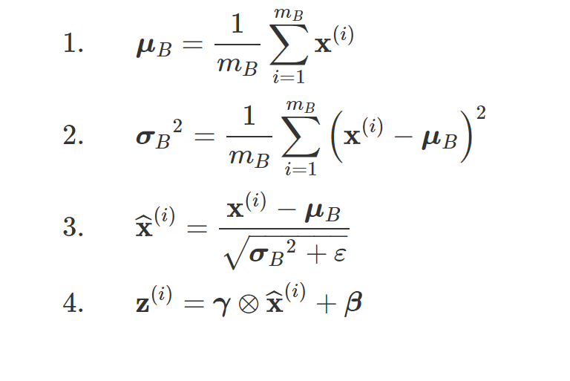
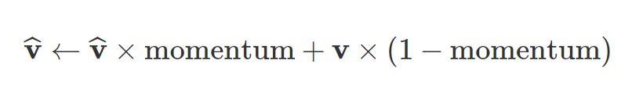
Batch Normalization

Slide 43
Batch Normalization- Benefits
Faster model convergence
Use higher learning Rate
Use large learning rate decay
Mitigates the problems with non-zero centered activation functions
Improves stability and Quality
Better regularization (sometimes you do not need to use dropout)

Slide 44
Gradient Clipping
Gradient Clipping -Clip the gradients during backpropagation so that they never exceed some threshold.
This technique is most often used in recurrent neural networks, as Batch Normalization is tricky to use in RNNs,
For other types of networks, BN is usually sufficient.

Slide 45

Regularization

Slide 46
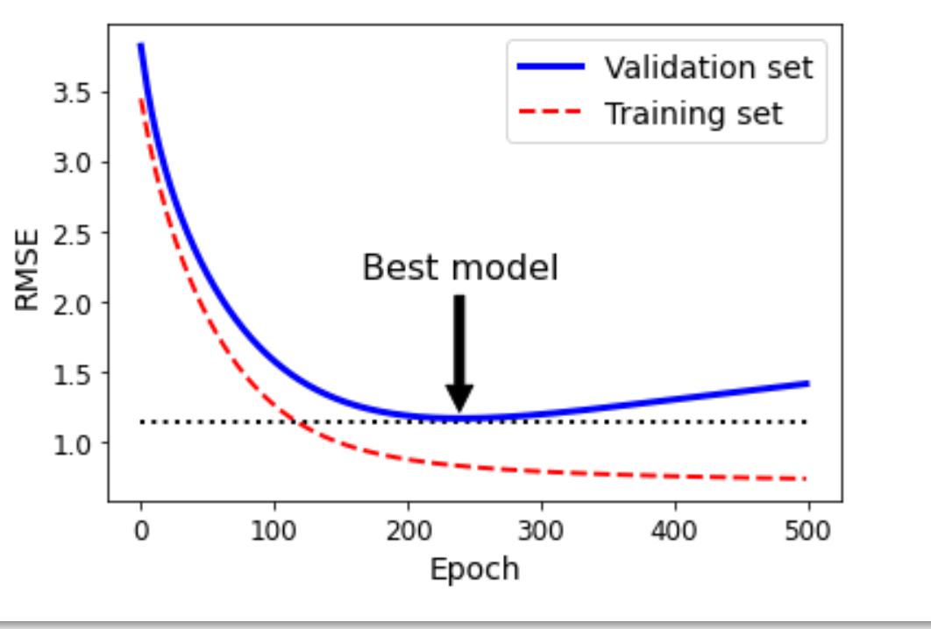
Early Stopping

Slide 47
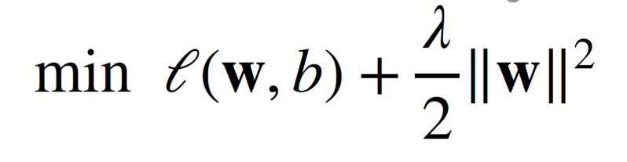

L2-Norm

Slide 48

L2-Norm

Slide 49
Dropout - Motivation
A good model should be robust under modest changes in the input
Training with input noise equals to Tikhonov Regularization
Dropout: inject noises into internal layers

Slide 50

Dropout - Motivation

Slide 51

Dropout

Slide 52

Dropout

