Slide 1

Neural Network Introduction
Harpreet Singh (Fall 2023)

Slide 2

Activation Functions

Slide 3

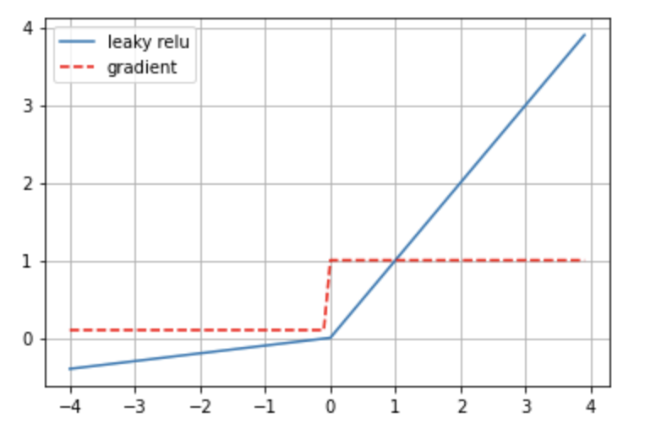
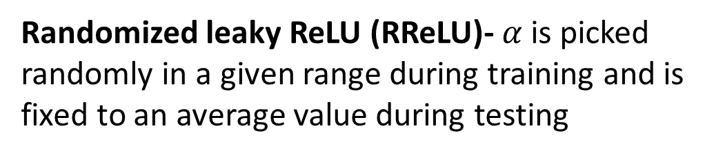
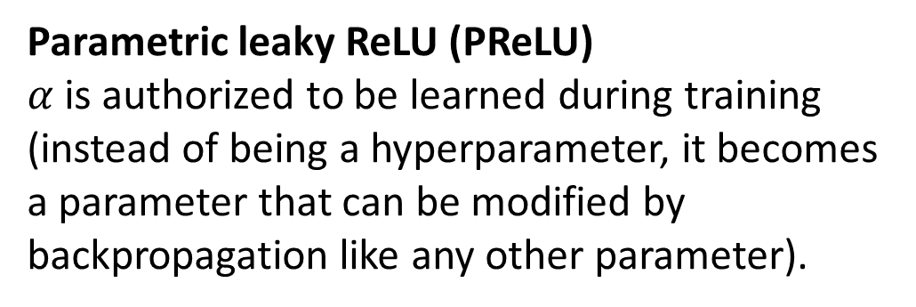
Leaky ReLU
Leaky ReLUα(z) = $\max\left(αz,z\right),$ $α$typically set to 0.01
Randomized leaky ReLU (RReLU)- $α$is picked randomly in a given range during training and is fixed to an average value during testing
Parametric leaky ReLU (PReLU)
$α$is authorized to be learned during training (instead of being a hyperparameter, it becomes a parameter that can be modified by backpropagation like any other parameter).

Slide 4
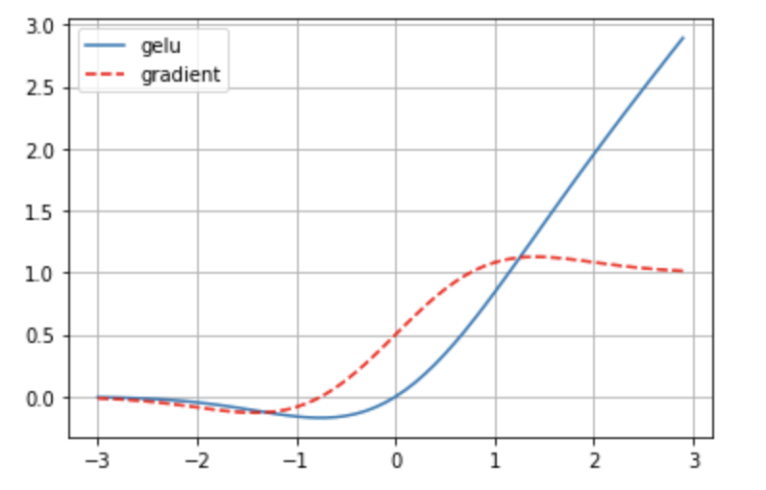
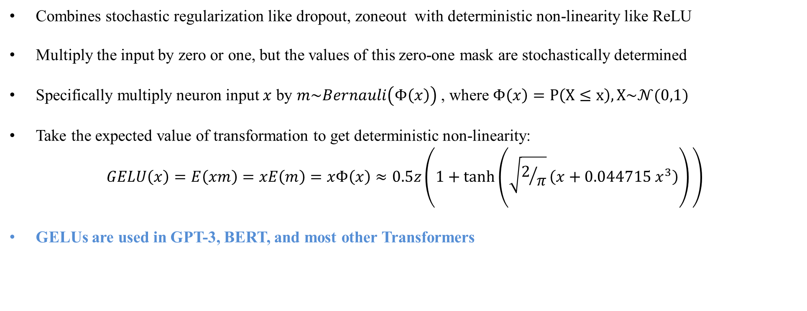
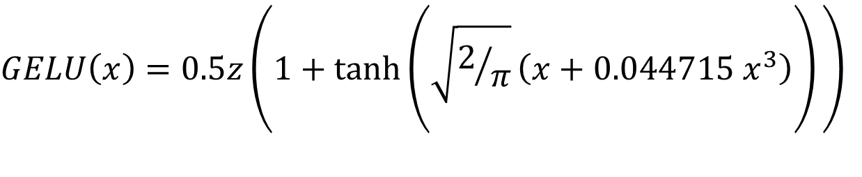
Gaussian Error Linear Unit (GELU)
$$GELU\left(x\right)=0.5z\left(1+tanh\left(\sqrt{2/π}\left(x+0.044715{ x}^{3}\right)\right)⁡\right)$$
Combines stochastic regularization like dropout, zoneout with deterministic non-linearity like ReLU
Multiply the input by zero or one, but the values of this zero-one mask are stochastically determined
Specifically multiply neuron input $x$ by $m\sim Bernauli\left(Φ\left(x\right)\right)$ , where $Φ\left(x\right)=P\left(X≤x\right), X\sim 𝒩(0,1)$
Take the expected value of transformation to get deterministic non-linearity:
$$GELU\left(x\right)=E\left(xm\right)=xE\left(m\right)=xΦ\left(x\right)≈0.5z\left(1+tanh\left(\sqrt{2/π}\left(x+0.044715{ x}^{3}\right)\right)⁡\right)$$
GELUs are used in GPT-3, BERT, and most other Transformers

Slide 5
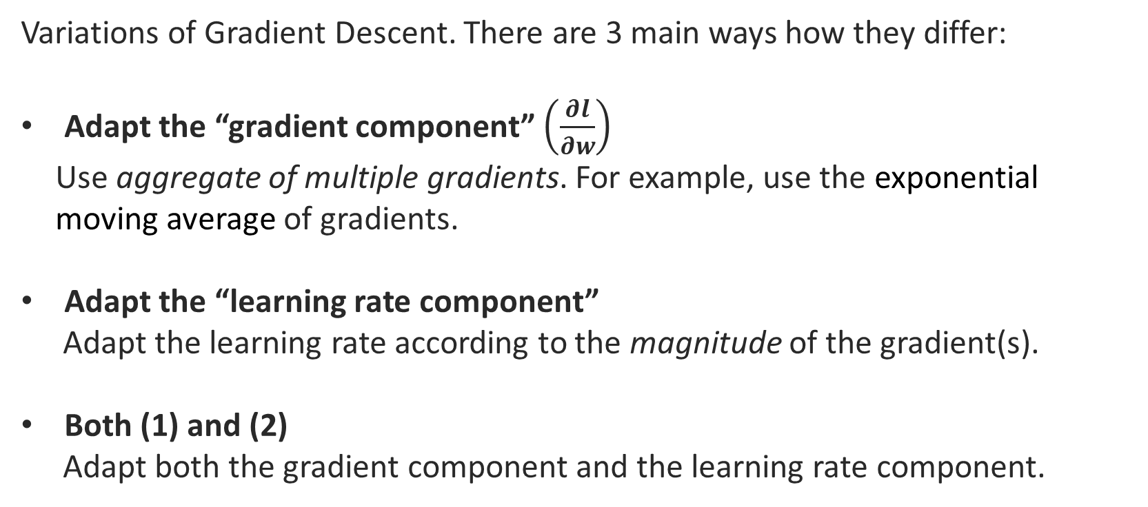
Faster Optimizers
Variations of Gradient Descent. There are 3 main ways how they differ:
Adapt the “gradient component” $\left(\frac{∂l}{∂w}\right)$
Use aggregate of multiple gradients. For example, use the exponential moving average of gradients.
Adapt the “learning rate component”
Adapt the learning rate according to the magnitude of the gradient(s).
Both (1) and (2)
Adapt both the gradient component and the learning rate component.

Slide 6
Faster Optimizers
Class | Year | Learning Rate | Gradient
Momentum | 1964
AdaGrad | 2011
RMSprop | 2012
Adadelta | 2012
Nestrov | 2013
Adam | 2014
Nadam | 2015
AdaMax | 2015
AMSGrad | 2018

Slide 7
Comparison
Class | Convergence Speed | Convergence Quality
SGD | * | ***
SGD(momentum=…) | ** | ***
SGD(momentum=…, nesterov=True) | ** | ***
Adagrad | *** | *(stops too early)
RMSprop | *** | **or***
Adam | *** | **or***
Nadam | *** | **or***
AdaMax | *** | **or***

Slide 8
Learning Rate Schedule and Optimal Learning Rate
Use SGD with Learning Rate schedule (One cycle LR is state of the art at the moment).
Optimal Learning Rate

Slide 9

References
Hands-On Machine Learning with Scikit-Learn, Keras, and TensorFlow, 2nd Edition by Aurélien Géron
Dive into Deep Learning :https://d2l.ai/
by Aston Zhang and Zachary C. Lipton and Mu Li and Alexander J. Smola

