Slide 1

Neural Network Introduction
Harpreet Singh (Fall 2023)

Slide 2

Artificial Neural Network (Feed Forward neural Network

Slide 3
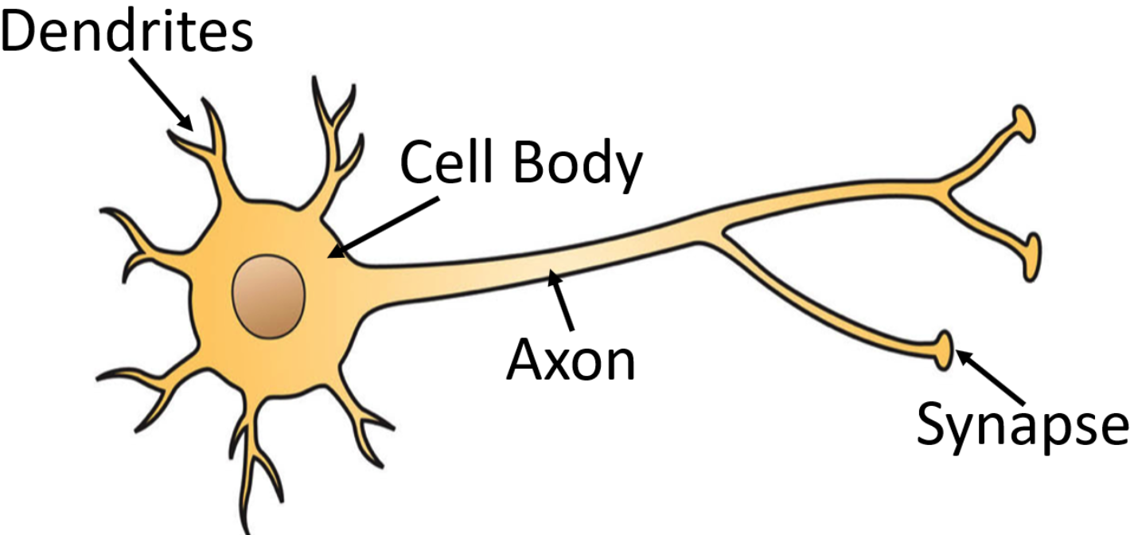
Biological Neural Networks
Biological neurons refer to a collection of interconnected nerve cells organized in layers, which communicate with one another when specific conditions are met.
A biological neuron consists of three primary components:
Dendrites
Soma (or cell body)
Axon
Dendrites receive signals from other neurons.
The soma performs the summation of incoming signals.
Once sufficient input is received, the neuron fires by transmitting a signal over its axon to other cells

Slide 4
Artificial Neurons
The properties of biological neurons inspire the processing elements in ANN in several ways:
The processing element receives multiple signals.
These signals can be adjusted by weights at the receiving connection points.
The processing element calculates the weighted sum of the inputs.
When the conditions are appropriate (sufficient input), the neuron transmits a single output.
The output from a particular neuron can be connected to many other neurons

Slide 5
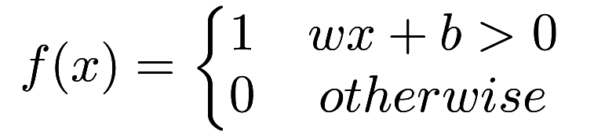








Perceptron
The Perceptron is one of the simplest ANN architectures, invented in 1957 by Frank Rosenblatt.
1
$$b$$
Weighted Sum of inputs
Linear threshold units can be used for simple binary classification.
It computes a linear combination of the inputs and if the results exceeds a threshold, it outputs the positive class or else outputs the negative class.
$$x_{1}$$
Output
$$w_{1}$$
$$∑$$
$$w_{n−1}$$
Step Function
$$x_{n−1}$$
$$w_{n}$$
$$x_{n}$$

Slide 6


Artificial Neuron
W
Neuron
INPUTS
W
$$∑$$
$$f(z)$$
Outputs
W
Activation
Function
W
W=Weight

Slide 7
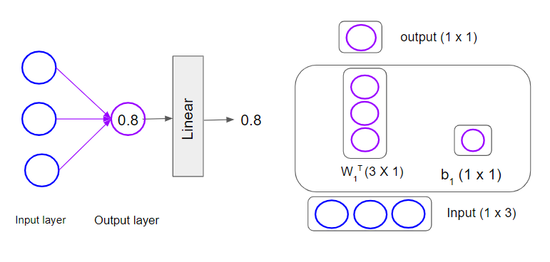
Linear Regression as a Single-layer Neural Network
In Pytorch, shape of W:
(# of Outputs, # of inputs) = (1, 3)
One for each output
Number of Neurons in Output Layer: One
Activation Function for output Layer : Linear (None)
Prediction $\hat{y}=b+{\hat{w}}_{1}x_{1}+{\hat{w}}_{2}x_{2}+ ⋯+{\hat{w}}_{n}x_{n}$
Prediction 𝑦 ̂=𝑏+𝑤 ̂_1 𝑥_1+𝑤 ̂_2 𝑥_2+ ⋯+𝑤 ̂_𝑛 𝑥_𝑛
Loss Function: Mean Squared Error

Slide 8
Recap- Gradient Descent
Calculate Loss
Calculate Gradients
Initialize weights
Predict
Update Weights
Stop
Goal: Optimize model performance by finding suitable weights.
Define a loss function - a lower value indicates better model performance.
Calculate gradients - these represent the change in loss with respect to weights. Positive gradients imply a decrease in weight to minimize loss, while negative gradients indicate an increase in weight.
Utilize gradients to guide weight adjustments, leading to continuous improvement in model performance.

Slide 9









Binary Classification (pick one from two labels)
$$\hat{y}=b+w_{1}x_{1}+w_{2}x_{2}+ ⋯+w_{n}x_{n}$$
Dog or No Dog
C = 2
Samples
$$x_{1}$$
Labels
$$[1]$$
$$[0]$$
$$[0]$$
$$x_{2}$$

Slide 10
Math (Logistic Regression)
$p$: probability of class “1”
𝑝: probability of class “1”
Need to relate $p$ to predictors with a function that guarantees $0≤p≤1$
Need to relate 𝑝 to predictors with a function that guarantees 0≤𝑝≤1
The standard linear function does not
Fix: logistic response function (logit/sigmoid)
$$\hat{z}=\hat{b}+{\hat{w}}_{1}x_{1}+{\hat{w}}_{2}x_{2}+ ⋯+{\hat{w}}_{n}x_{n}$$
𝑧 ̂=𝑏 ̂+𝑤 ̂_1 𝑥_1+𝑤 ̂_2 𝑥_2+ ⋯+𝑤 ̂_𝑛 𝑥_𝑛
$$\hat{p}=σ(\hat{z})=\frac{e^{\hat{z}}}{1+e^{\hat{z}}}=\frac{1}{1+e^{−\hat{z}}}$$
𝑝 ̂=𝜎(𝑧 ̂)=𝑒^𝑧 ̂ /(1+𝑒^𝑧 ̂ )=1/(1+𝑒^(−𝑧 ̂ ) )

Slide 11
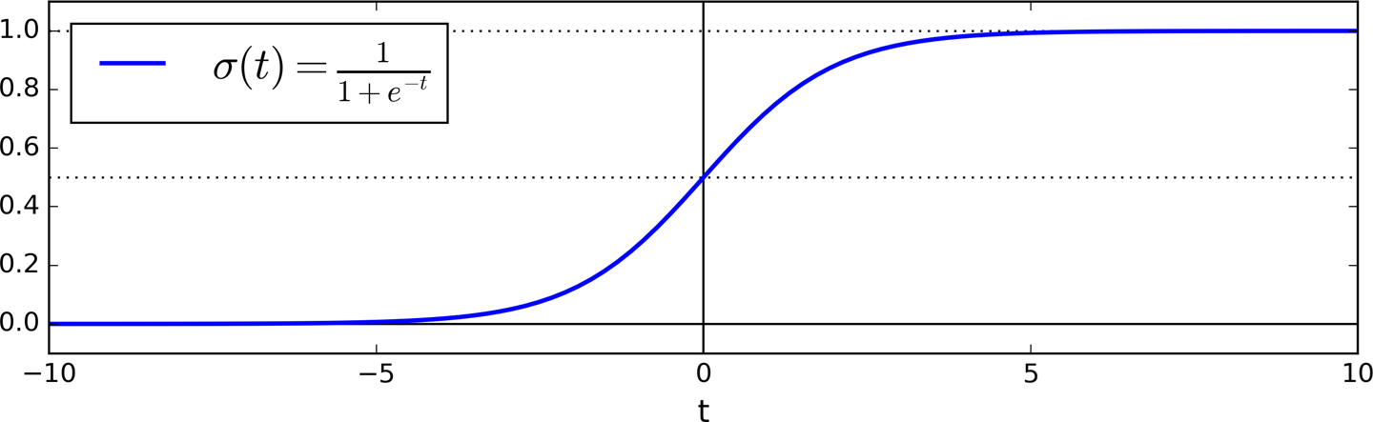
Logit (Sigmoid) Function
Logit (sigmoid) function is a function that returns the result between 0 and 1.
Prediction $\hat{y}=\left\{\begin{aligned}0 if \hat{p}<threshold \\ 1 if \hat{p}≥threshold \end{aligned}\right.$, typically, $threshold$ = 0.5
Prediction 𝑦 ̂={█(0 𝑖𝑓 𝑝 ̂<𝑡ℎ𝑟𝑒𝑠ℎ𝑜𝑙𝑑@1 𝑖𝑓 𝑝 ̂≥𝑡ℎ𝑟𝑒𝑠ℎ𝑜𝑙𝑑 )┤, typically, 𝑡ℎ𝑟𝑒𝑠ℎ𝑜𝑙𝑑 = 0.5
$$\hat{p}<0.5 , when z<0$$
𝑝 ̂<0.5 , 𝑤ℎ𝑒𝑛 𝑧<0
$$\hat{p}≥0.5 when z≥0$$
𝑝 ̂≥0.5 𝑤ℎ𝑒𝑛 𝑧≥0
This means Logistic Regression predicts 1 if $z$ is positive and 0 if it is negative
This means Logistic Regression predicts 1 if 𝑧 is positive and 0 if it is negative

Slide 12


Binary Cross Entropy Loss/Logistic Loss function
Loss function single training instance :
$$c\left(θ\right)=\left\{\begin{aligned}−\log\left(\hat{ p}\right) if y=1 \\ −\log\left(1−\hat{p}\right) if y=0 \end{aligned}\right.$$
Alternatively:
$$c\left(θ\right)=−y\log\left(\hat{p}\right)−\left(1−y\right)\log\left(1−\hat{p}\right)$$
The cost function over the whole triaging set:
$$J\left(θ\right)=−\frac{1}{m}\sum_{i=1}^{m}{\left[y^{(i)}\log\left({\hat{p}}^{(i)}\right)+(1−y^{(i)})\log\left(1−{\hat{p}}^{(i)}\right)\right]}$$
Intuition
$c\left(θ\right)=0 , if \hat{p}=y$,
$c\left(θ\right)→∞,$ if $y=1 and \hat{p}→0$
$c\left(θ\right)→∞,$ if $y=0 and \hat{p}→1$
Intuition: Minimizing the loss will maximize the probability of the true label (class)

Slide 13
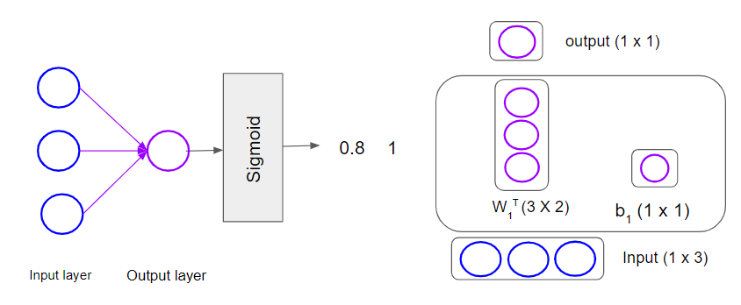


Logistic Regression as a Single-layer Neural Network
$$\hat{p}$$
$$\hat{y}$$
Number of Neurons in Output Layer: One
Activation Function for output Layer : Sigmoid
Prediction $\hat{y}=\left\{\begin{aligned}0 if \hat{z}<0 \\ 1 if \hat{z}≥0\end{aligned}\right. =\left\{\begin{aligned}0 if \hat{p}<0.5 \\ 1 if \hat{p}≥0.5\end{aligned}\right.$
Prediction 𝑦 ̂={█(0 𝑖𝑓 𝑧 ̂<0@1 𝑖𝑓 𝑧 ̂≥0)┤ ={█(0 𝑖𝑓 𝑝 ̂<0.5@1 𝑖𝑓 𝑝 ̂≥0.5)┤
Loss Function : Binary Cross Entropy Loss (Logistic Loss Function)

Slide 14









Multiclass Classification (Softmax Regression)
(pick one from more than two labels)
Binary Classification
Multi-class Classification
Dog or No Dog
Dog or Cat or Hen
C = 2
Samples
C = 3
Samples
Labels
Labels
$$[1]$$
$$[0]$$
$$[0]$$
$$[100]$$
$$[010]$$
$$[001]$$
$$x_{1}$$
$$x_{1}$$
$$x_{2}$$
$$x_{2}$$

Slide 15
Multiclass Classification (Softmax Regression)
(pick one from more than two labels)
Generalization of Logistic regression:
${\hat{z}}_{k}(x) = {\hat{\text{b}}}^{k}+ {\hat{w}}_{1}^{k}x_{1}+…+{\hat{w}}_{n}^{k}x_{n}$, each class has set of weights and bias.
Generalization of Logistic regression:
𝑧 ̂_𝑘 (𝑥) =" " "b" ̂^𝑘+ 𝑤 ̂_1^𝑘 𝑥_1+…+𝑤 ̂_𝑛^𝑘 𝑥_𝑛, each class has set of weights and bias.
Softmax Function:
${\hat{p}}_{k}=\frac{e^{z_{k}\left(x\right)}}{\sum_{j=1}^{k}{e^{z_{j}(x)}}}$ $,{for k=2: p}_{1}=\frac{e^{z_{1}\left(x\right)}}{e^{z_{1\left(x\right)}}+e^{z_{2\left(x\right)}}},p_{2}=\frac{e^{z_{2}\left(x\right)}}{e^{z_{1\left(x\right)}}+e^{z_{2\left(x\right)}}}$
Softmax Function:
𝑝 ̂_𝑘=𝑒^(𝑧_𝑘 (𝑥) )/(∑_(𝑗=1)^𝑘▒𝑒^(𝑧_𝑗 (𝑥)) ) ,〖𝑓𝑜𝑟 𝑘=2: 𝑝〗_1=𝑒^(𝑧_1 (𝑥) )/(𝑒^(𝑧_1(𝑥) )+𝑒^(𝑧_2(𝑥) ) ),𝑝_2=𝑒^(𝑧_2 (𝑥) )/(𝑒^(𝑧_1(𝑥) )+𝑒^(𝑧_2(𝑥) ) )
$$\hat{y}=\underset{k}{argmax} {\hat{z}}_{k}(x)=\underset{k}{argmax} {\hat{p}}_{k}(x)$$
𝑦 ̂=(𝑎𝑟𝑔𝑚𝑎𝑥)┬𝑘 𝑧 ̂_𝑘 (𝑥)=(𝑎𝑟𝑔𝑚𝑎𝑥)┬𝑘 𝑝 ̂_𝑘 (𝑥)

Slide 16
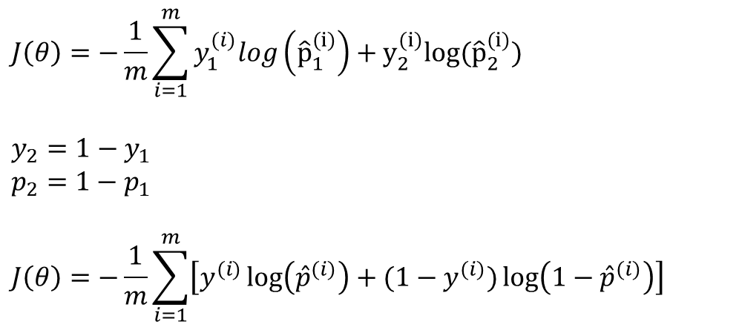
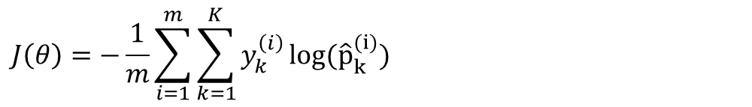
Negative Log Likelihood Loss/Cross Entropy Loss
$$J\left(θ\right)=−\frac{1}{m}\sum_{i=1}^{m}{\sum_{k=1}^{K}{y_{k}^{\left(i\right)}}}log({\hat{p}}_{k}^{(i)})$$
For two classes:
$$J\left(θ\right)=−\frac{1}{m}\sum_{i=1}^{m}{y_{1}^{(i)}log}\left({\hat{p}}_{1}^{(i)}\right)+y_{2}^{(i)}log({\hat{p}}_{2}^{(i)})$$
$$y_{2}=1−y_{1}$$
$$p_{2}=1−p_{1}$$
$$J\left(θ\right)=−\frac{1}{m}\sum_{i=1}^{m}{\left[y^{(i)}\log\left({\hat{p}}^{(i)}\right)+(1−y^{(i)})\log\left(1−{\hat{p}}^{(i)}\right)\right]}$$
Binary Cross Entropy Loss

Slide 17
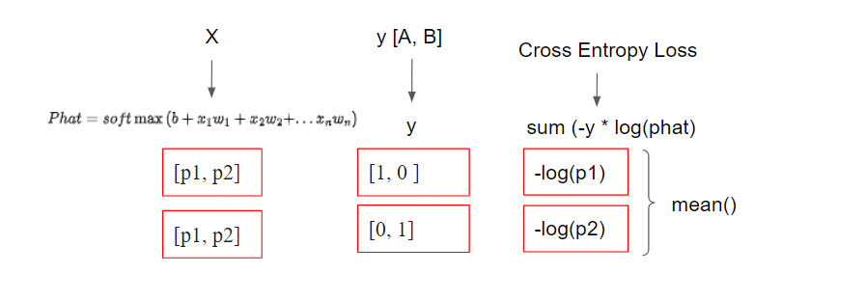
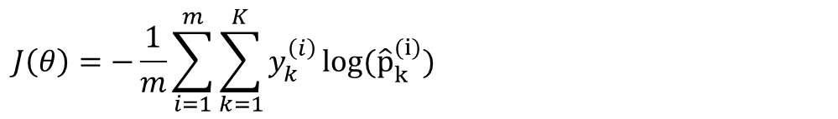
Negative Log Likelihood Loss/Cross Entropy Loss
$$J\left(θ\right)=−\frac{1}{m}\sum_{i=1}^{m}{\sum_{k=1}^{K}{y_{k}^{\left(i\right)}}}log({\hat{p}}_{k}^{(i)})$$
Example for two observations, m = 2 and two classes, k = 2
Observation # 1
Observation # 2
Intuition: Minimizing the loss will maximize the probability of the true label (class)

Slide 18
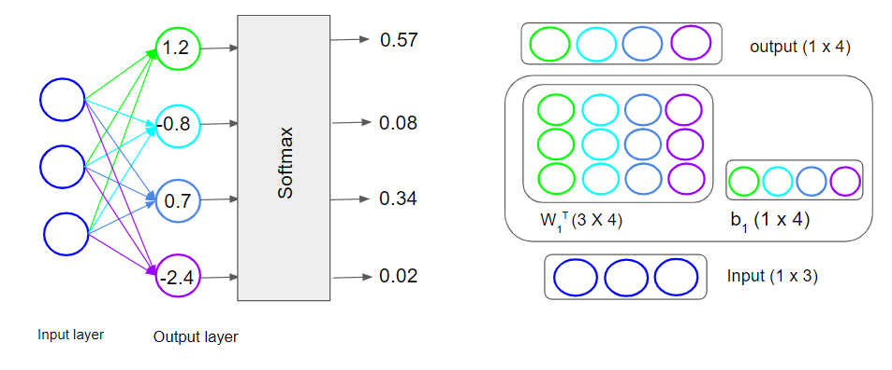


Multiclass Classification as a Single-layer Neural Network
In Pytorch, shape of W:
(# of Outputs, # of inputs) = (3, 4)
$$\hat{p}$$
$$\hat{y}$$
1
0
0
0
Probabilities will sum to 1
One for each output
Number of Neurons in Output Layer: Number of Classes
Activation Function for output Layer : Softmax Function
Prediction $\hat{y}=\underset{k}{argmax} z_{k}\left(x\right) (Class which has the maximum probbaility value or z_{k} value)$
Prediction 𝑦 ̂=(𝑎𝑟𝑔𝑚𝑎𝑥)┬𝑘 𝑧_𝑘 (𝑥) (𝐶𝑙𝑎𝑠𝑠 𝑤ℎ𝑖𝑐ℎ ℎ𝑎𝑠 𝑡ℎ𝑒 𝑚𝑎𝑥𝑖𝑚𝑢𝑚 𝑝𝑟𝑜𝑏𝑏𝑎𝑖𝑙𝑖𝑡𝑦 𝑣𝑎𝑙𝑢𝑒 𝑜𝑟 𝑧_𝑘 𝑣𝑎𝑙𝑢𝑒)
Loss Function : Cross Entropy Loss

Slide 19
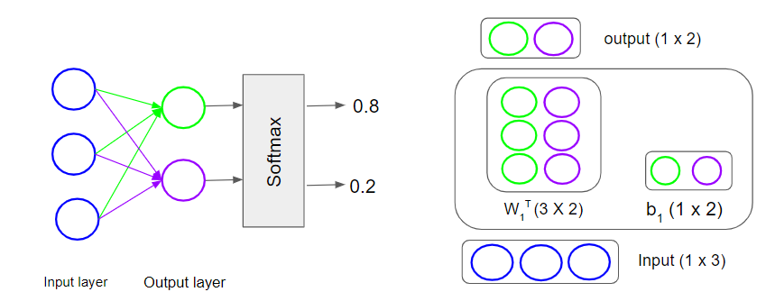


Binary Classification with Softmax and Cross Entropy Loss function
$$\hat{p}$$
$$\hat{y}$$
0
1
Number of Neurons in Output Layer: Two
Activation Function for output Layer : Softmax Function
Prediction $\hat{y}=\underset{k}{argmax} z_{k}\left(x\right) (Class which has the maximum probbaility value or z_{k} value)$
Prediction 𝑦 ̂=(𝑎𝑟𝑔𝑚𝑎𝑥)┬𝑘 𝑧_𝑘 (𝑥) (𝐶𝑙𝑎𝑠𝑠 𝑤ℎ𝑖𝑐ℎ ℎ𝑎𝑠 𝑡ℎ𝑒 𝑚𝑎𝑥𝑖𝑚𝑢𝑚 𝑝𝑟𝑜𝑏𝑏𝑎𝑖𝑙𝑖𝑡𝑦 𝑣𝑎𝑙𝑢𝑒 𝑜𝑟 𝑧_𝑘 𝑣𝑎𝑙𝑢𝑒)
Loss Function : Cross Entropy Loss

Slide 20










Multilabel Classification (Softmax Regression)
Binary Classification
Multi-class Classification
Multi-label Classification
Dog or No Dog
Dog or Cat or Hen
Dog or Cat or Hen
C = 2
Samples
C = 3
Samples
C = 3
Samples
Labels
Labels
Labels
$$[1]$$
$$[0]$$
$$[0]$$
$$[100]$$
$$[010]$$
$$[001]$$
$$[110]$$
$$[011]$$
$$[101]$$
$$x_{1}$$
$$x_{1}$$
$$x_{1}$$
$$x_{2}$$
$$x_{2}$$
$$x_{2}$$

Slide 21
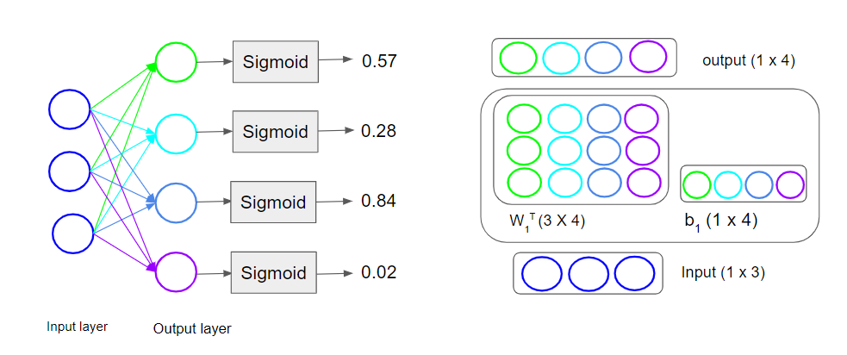


Multilabel Classification as a Single-layer Neural Network
$$\hat{p}$$
$$\hat{y}$$
1
0
1
0
Probabilities will not sum to 1
Number of Neurons in Output Layer: Number of Classes
Activation Function for output Layer : Sigmoid
Prediction $\hat{y}=\left\{\begin{aligned}0 if \hat{z}<0 \\ 1 if \hat{z}≥0\end{aligned}\right. =\left\{\begin{aligned}0 if \hat{p}<0.5 \\ 1 if \hat{p}≥0.5\end{aligned}\right.$
Prediction 𝑦 ̂={█(0 𝑖𝑓 𝑧 ̂<0@1 𝑖𝑓 𝑧 ̂≥0)┤ ={█(0 𝑖𝑓 𝑝 ̂<0.5@1 𝑖𝑓 𝑝 ̂≥0.5)┤
Loss Function : Binary Cross Entropy Loss (Logistic Loss Function)

Slide 22
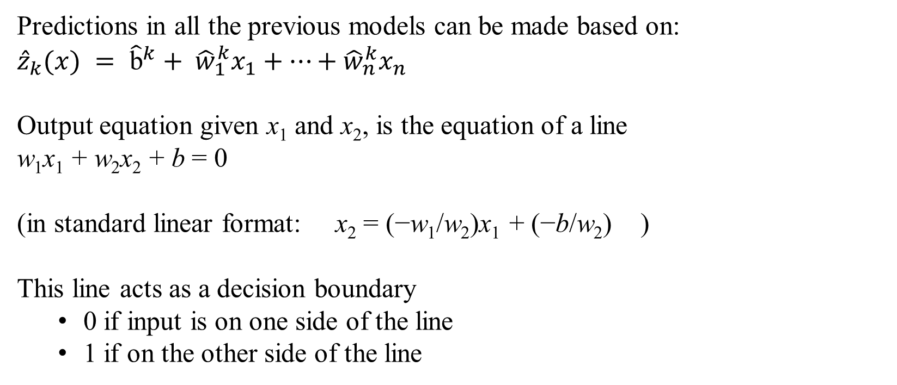
Linear Classifiers
Predictions in all the previous models can be made based on:
$${\hat{z}}_{k}(x) = {\hat{\text{b}}}^{k}+ {\hat{w}}_{1}^{k}x_{1}+…+{\hat{w}}_{n}^{k}x_{n}$$
Output equation given x₁ and x₂, is the equation of a line
w₁x₁ + w₂x₂ + b = 0
(in standard linear format: x₂ = (−w₁/w₂)x₁ + (−b/w₂) )
This line acts as a decision boundary
0 if input is on one side of the line
1 if on the other side of the line

Slide 23
Decision Boundaries
XOR is not a linearly separable function!
Slide Credit: https://web.stanford.edu/~jurafsky/slp3/

Slide 24
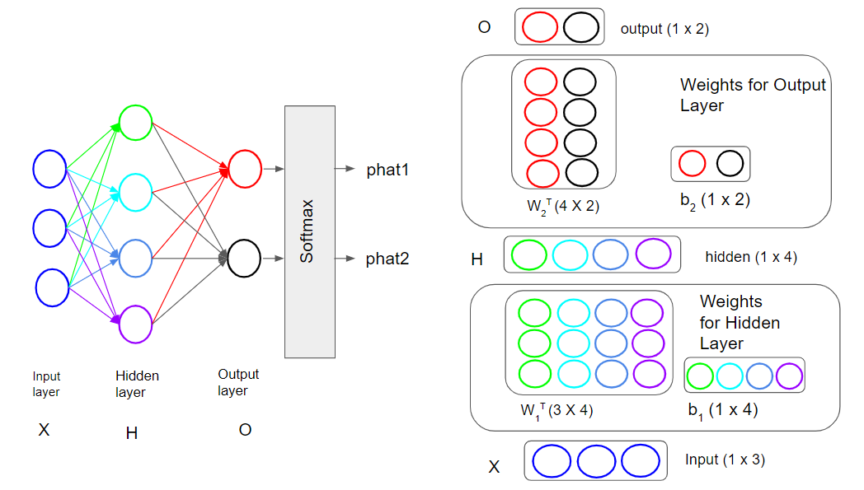
Multilayer Perceptron

Slide 25
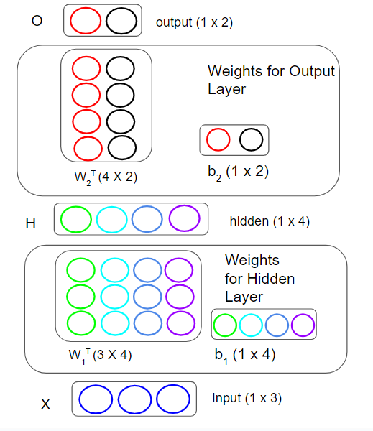









Multilayer Perceptron
$$H=XW_{1}^{T}+b_{1}$$
$$O=HW_{2}^{T}+b_{2}$$
$$O=(XW_{1}^{T}+b_{1}{)W}_{2}^{T}+b_{2}$$
$$O=XW_{1}^{T}W_{2}^{T}+b_{1}W_{2}^{T}+b_{2}$$
$$O=XW+b$$
W$=W_{1}^{T}W_{2}^{T}$
$$b=b_{1}W_{2}^{T}+b_{2}$$
Apply Non-Linear Function to Hidden Layers
$H= σ(XW_{1}^{T}+b_{1}$)
$$O=HW_{2}^{T}+b_{2}$$

Slide 26
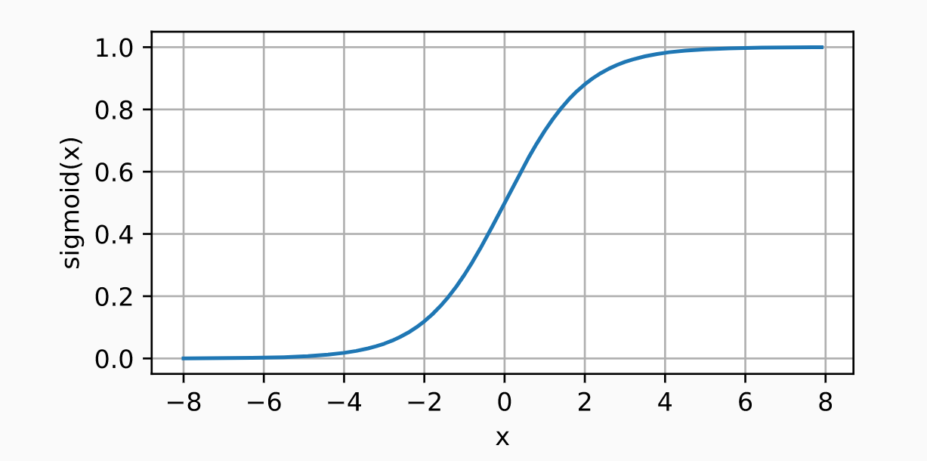
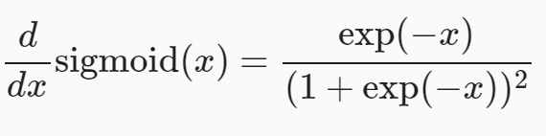
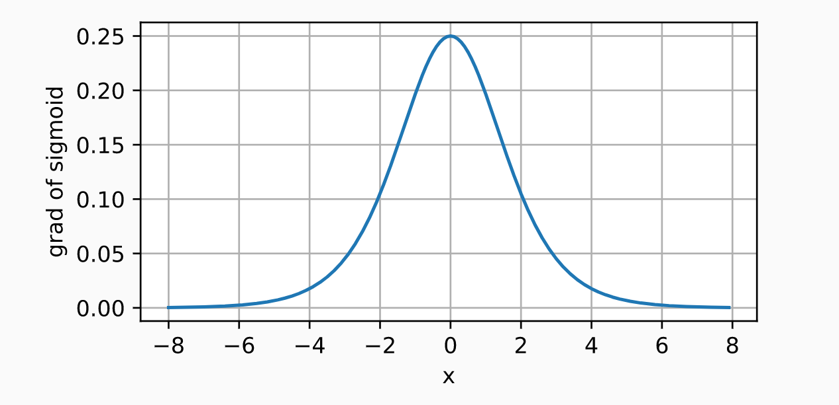
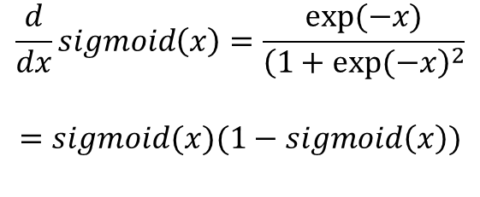
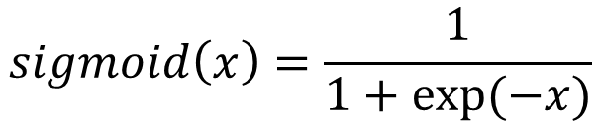
Sigmoid Activation
$$sigmoid\left(x\right)=\frac{1}{1+exp⁡(−x)}$$
$$\frac{d}{dx}sigmoid\left(x\right)=\frac{exp⁡(−x)}{{\left(1+exp⁡(−x\right)}^{2}}$$
$$=sigmoid(x)(1−sigmoid\left(x\right))$$

Slide 27
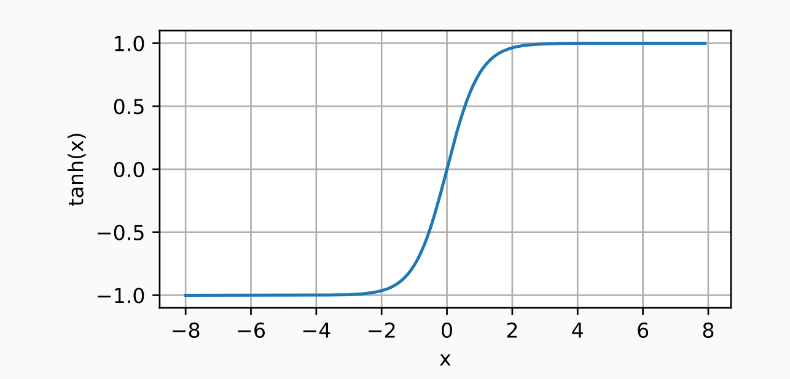
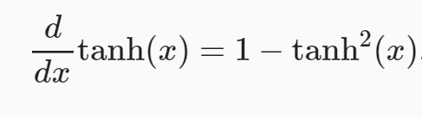
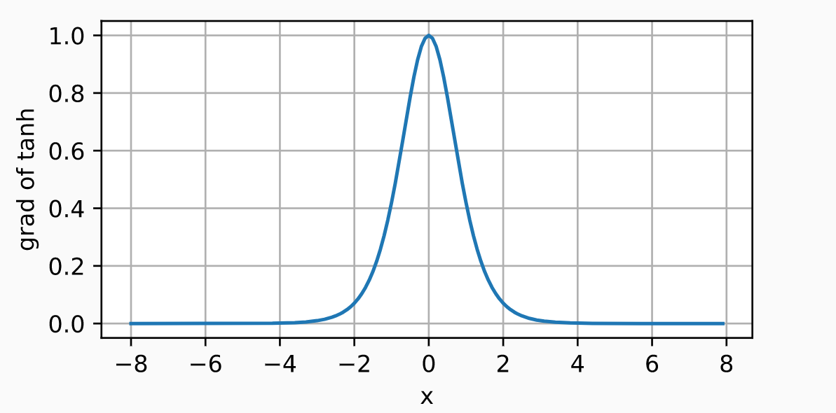

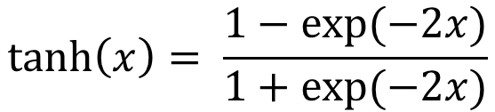
Tanh Activation
$$\tanh\left(x\right)= \frac{1−exp⁡(−2x)}{1+exp⁡(−2x)}$$
Output value ranges from –1 to 1 (instead of 0 to 1 in the case of the sigmoid function).
That range tends to make each layer’s output more or less centered around 0 at the beginning of training, which often helps speed up convergence
$$\frac{d}{dx}\tanh\left(x\right)=1−\tanh^{2}{(x)}$$

Slide 28
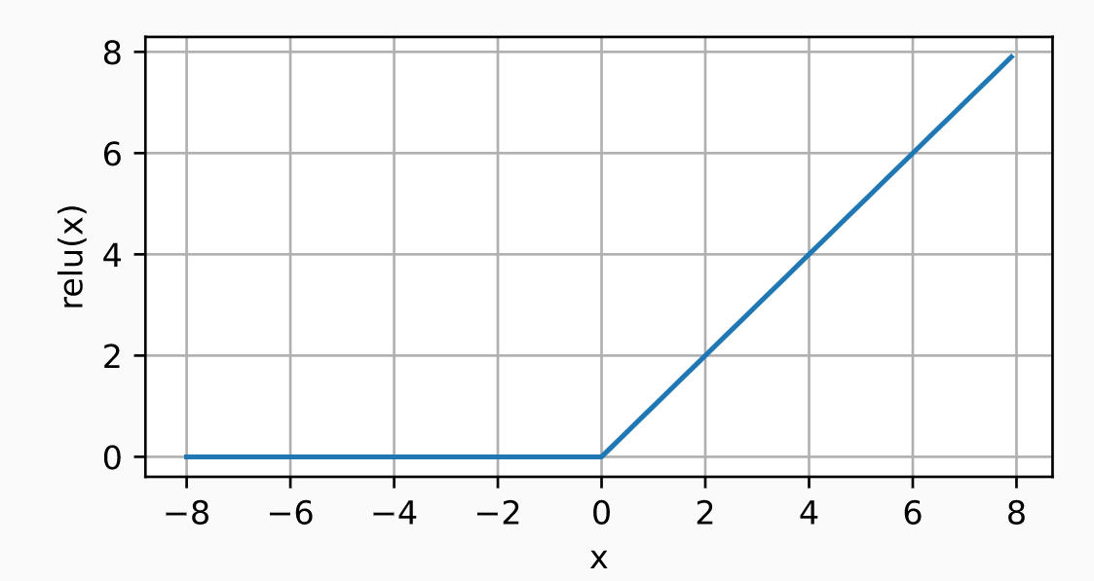
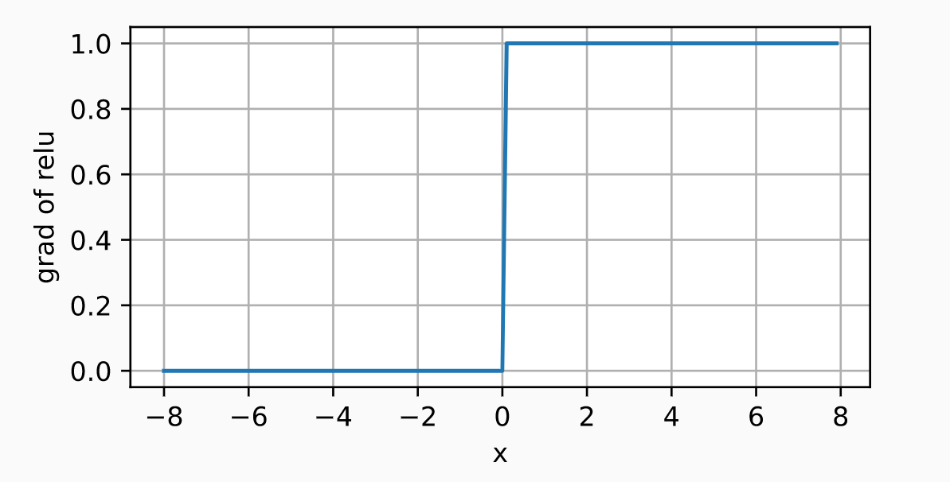
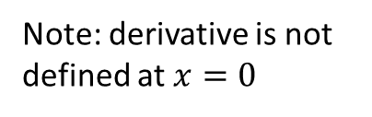
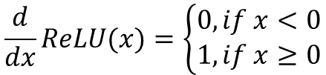

ReLU Activation
$$ReLU\left(x\right)=max⁡(x, 0)$$
It works very well and has the advantage of being fast to compute, so it has become the default.
$$\frac{d}{dx}ReLU(x)=\left\{\begin{aligned}0, if x<0 \\ 1, if x≥0\end{aligned}\right.$$
Note: derivative is not defined at $x=0$

Slide 29
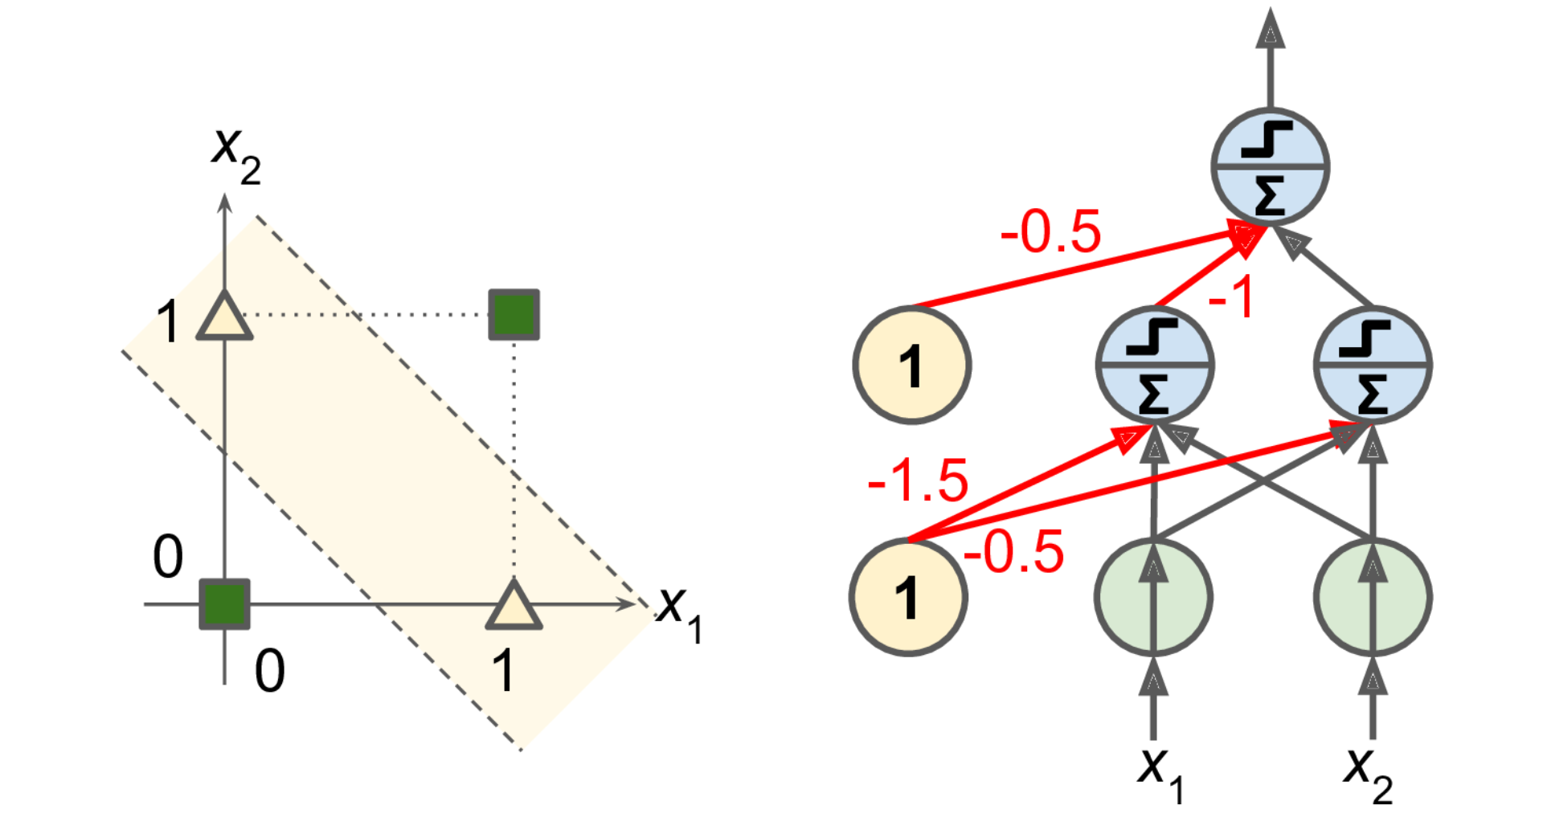

MLP that solves XOR problem
with inputs (0, 0) or (1, 1), the network outputs 0.
and with inputs (0, 1) or (1, 0) it outputs 1.
All connections have a weight equal to 1, except the four connections where the weight is shown.

Slide 30
Decision Boundary
0 hidden layers: linear classifier
Hyperplanes

Slide 31
Decision Boundary
1 hidden layer with nonlinear activation
Boundary of convex region (open or closed)
Notes:
We saw with XOR

Slide 32
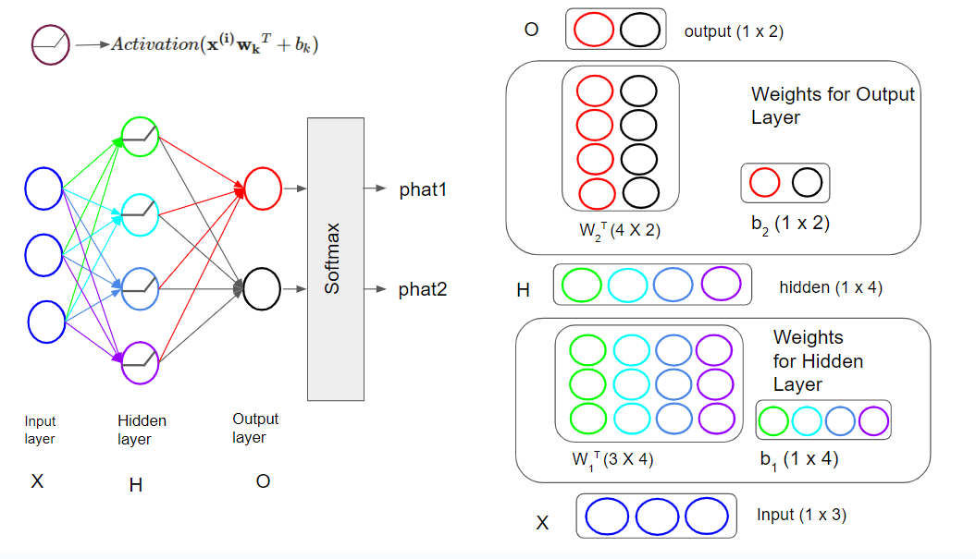



Multiclass Classification
$H= σ(XW_{1}^{T}+b_{1}$)
$$O=HW_{2}^{T}+b_{2}$$
$$\hat{P}=Softmax(O)$$

Slide 33
Summary – Layers/Activations/Loss Functions
 | Regression | Binary Classification | Multi-class Classification | Multi-class Classification | Multi Label Classification
# input neurons | Depends on the problem (your data) (Number of input variables – ( e.g. for 28x28 black & White images = 28*28 =784) | Depends on the problem (your data) | Depends on the problem (your data) |  | Depends on the problem (your data)
# hidden layers | Depends on problem (Hyperparameter) | Depends on the problem (hyperparameter
# neurons per hidden layer | Depends on problem (Hyperparameter)
# output neurons | One | One (Two) | Number of Classes |  | Number of Classes
Hidden activation | Hyperparameter (sigmoid, tanh, ReLU, SELU, GELU, MISH etc.)
Output activation | None | Sigmoid (Softmax) | Softmax |  | Sigmoid
Loss Function | MSE | Binary Cross Entropy (Cross-Entropy) | Cross-Entropy |  | Binary Cross Entropy

Slide 34
A Recipe for Machine Learning
1. Given training data:
3. Define goal:
2. Choose each of these:
Decision function
Loss function
4. Train with SGD:
(take small steps opposite the gradient)

Slide 35
Computation Graph – Efficient way to calculate gradients
A computation graph is a directed acyclic graph (DAG) used to represent mathematical expressions and operations in a structured manner. Each node in the graph represents an operation, like addition or multiplication, and the edges represent the data flow between these operations, typically carrying tensors or matrices.
Key benefits include:
Modularity: Easy to break down complex expressions into simpler parts.
Differentiation: Facilitates the process of computing gradients efficiently.

Slide 36









Computation graph – Logistic Regression
Computations:
$$w$$
$$u=w ∗x$$
multiplication
$$z=u+b$$
$$w∗x$$
$$b$$
$a=sigmoid(z$)
$$L=−(y∗\log\left(a\right)+\left(1−y\right)∗\log\left(1−a\right))$$
$$u+b$$
Addition
$$sigmoid(z)$$
$$BinaryCrossEntrop(a,y)$$
L

Slide 37
















Logistic Regression – Forward Pass
Initial Model Parameters
$$w=2$$
$$w$$
$$w=2$$
$$b=0$$
multiplication
Forward Pass
$$w∗x$$
$$b$$
Data
u$=2$
b$=0$
$$x=1$$
$$y=1$$
$$u+b$$
Addition
z$=2$
$$sigmoid(z)$$
a$=0.8808$
$$BinaryCrossEntrop(a,y)$$
L$=0.1269$
L

Slide 38

Logistic Regression – Forward Pass
Computations:
$$u=w ∗x$$
$$z=u+b$$
$a=sigmoid(z$)
$$L=−(y∗\log\left(a\right)+\left(1−y\right)∗\log\left(1−a\right))$$
What we want - Minimize Loss using Gradient descent
What we need:
$$\frac{∂L}{∂w},\frac{∂L}{∂b}$$
The derivative $∂L/∂w$, tells us how much a small change in $w$ affects $L$, while holding the other parameters constant

Slide 39
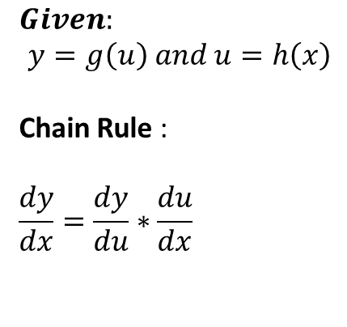
Computation graph – Chain Rule
y
$$Given:$$
$$y=g\left(u\right) and u=h\left(x\right)$$
Chain Rule :
$$\frac{dy}{dx}=\frac{dy}{du}∗\frac{du}{dx}$$
u
x
Backpropagation is just repeated application of the chain rule

Slide 40


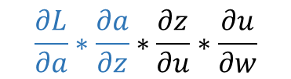



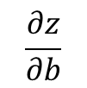
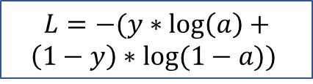

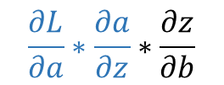





Chain Rule
$$u=f_{1}\left(x\right) , z=f_{2}\left(u\right), a=f_{3}\left(z\right), L=f_{4}(a)$$
$$\frac{∂z}{∂b}$$
b
$$L=−(y∗\log\left(a\right)+$$
$$\left(1−y\right)∗log⁡(1−a))$$
$$w$$
$$u=w ∗x$$
$$z=u+b$$
$a=sigmoid(z$)
$$\frac{∂u}{∂w}$$
$$\frac{∂z}{∂u}$$
$$\frac{∂a}{∂z}$$
$$\frac{∂L}{∂a}$$
$$\frac{∂L}{∂w}=$$
$$\frac{∂L}{∂a}∗\frac{∂a}{∂z}∗\frac{∂z}{∂u}∗\frac{∂u}{∂w}$$
$$\frac{∂L}{∂b}=$$
$$\frac{∂L}{∂a}∗\frac{∂a}{∂z}∗\frac{∂z}{∂b}$$

Slide 41



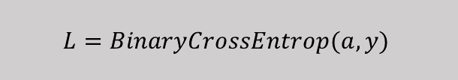


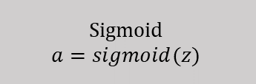





$$w$$
Forward pass
$$w=2$$
multiplication
$$b$$
Backward pass
$$u=w∗x$$
u$=2$
b$=0$
$$z=u+b$$
Addition
z$=2$
Sigmoid
$$a=sigmoid(z)$$
a$=0.8808$
$$L=BinaryCrossEntrop(a,y)$$
L$=0.1269$
L

Slide 42

$$w$$
Forward pass
$$w=2$$
multiplication
$$b$$
Backward pass
$$u=w∗x$$
u$=2$
b$=0$
$$z=u+b$$
Addition
z$=2$
Sigmoid
$$a=sigmoid(z)$$
a$=0.8808$
$$L=BinaryCrossEntrop(a,y)$$
$$delta1=\frac{∂L}{∂L}$$
L$=0.1269$
L

Slide 43
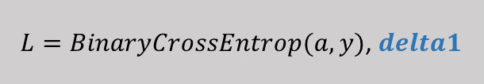


$$w$$
Forward pass
$$w=2$$
multiplication
$$b$$
Backward pass
$$u=w∗x$$
u$=2$
b$=0$
$$z=u+b$$
Addition
z$=2$
Sigmoid
$$a=sigmoid(z)$$
$$delta2=delta1∗local gradient=\frac{∂L}{∂L}\frac{∂L}{∂a}=\frac{∂L}{∂a}$$
a$=0.8808$
$$Local Grtadient=\frac{∂L}{∂a}$$
$L=BinaryCrossEntrop(a,y)$, $delta1$
$$delta1=\frac{∂L}{∂L}$$
L$=0.1269$
L

Slide 44
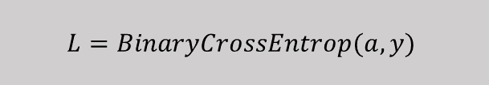



$$w$$
Forward pass
$$w=2$$
multiplication
$$b$$
Backward pass
$$u=w∗x$$
u$=2$
b$=0$
$$z=u+b$$
Addition
$$delta3=delta2∗local gradient= \frac{∂L}{∂a}\frac{∂a}{∂z}=\frac{∂L}{∂z}$$
z$=2$
$$Local Grtadient= \frac{∂a}{∂z}$$
Sigmoid
$$a=sigmoid(z)$$
$$delta2=delta1∗local gradient=\frac{∂L}{∂L}\frac{∂L}{∂a}=\frac{∂L}{∂a}$$
a$=0.8808$
$$Local Grtadient=\frac{∂L}{∂a}$$
$$L=BinaryCrossEntrop(a,y)$$
$$delta1=\frac{∂L}{∂L}$$
L$=0.1269$
L

Slide 45




$$w$$
Forward pass
$$w=2$$
multiplication
$$b$$
Backward pass
$$u=w∗x$$
$$delta5=\frac{∂L}{∂z}\frac{∂z}{∂b}=\frac{∂L}{∂b}$$
$$delta4=delta3∗local gradient\frac{∂L}{∂z}\frac{∂z}{∂u}=\frac{∂L}{∂u}$$
u$=2$
b$=0$
$$z=u+b$$
$$Local Grtadient= \frac{∂z}{∂u},\frac{∂z}{∂b}$$
Addition
$$delta3=delta2∗local gradient= \frac{∂L}{∂a}\frac{∂a}{∂z}=\frac{∂L}{∂z}$$
z$=2$
$$Local Grtadient= \frac{∂a}{∂z}$$
Sigmoid
$$a=sigmoid(z)$$
$$delta2=delta1∗local gradient=\frac{∂L}{∂L}\frac{∂L}{∂a}=\frac{∂L}{∂a}$$
a$=0.8808$
$$Local Grtadient=\frac{∂L}{∂a}$$
$$L=BinaryCrossEntrop(a,y)$$
$$delta1=\frac{∂L}{∂L}$$
L$=0.1269$
L

Slide 46






$$w$$
Forward pass
$$delta6=delta4∗local gradient\frac{∂L}{∂u}\frac{∂u}{∂w}=\frac{∂L}{∂w}$$
$$w=2$$
multiplication
$$b$$
Backward pass
$$Local Grtadient= \frac{∂u}{∂w}$$
$$u=w∗x$$
$$delta5=\frac{∂L}{∂z}\frac{∂z}{∂b}=\frac{∂L}{∂b}$$
$$delta4=delta3∗local gradient\frac{∂L}{∂z}\frac{∂z}{∂u}=\frac{∂L}{∂u}$$
u$=2$
b$=0$
$$z=u+b$$
$$Local Grtadient= \frac{∂z}{∂u},\frac{∂z}{∂b}$$
Addition
$$delta3=delta2∗local gradient= \frac{∂L}{∂a}\frac{∂a}{∂z}=\frac{∂L}{∂z}$$
z$=2$
$$Local Grtadient= \frac{∂a}{∂z}$$
Sigmoid
$$a=sigmoid(z)$$
$$delta2=delta1∗local gradient=\frac{∂L}{∂L}\frac{∂L}{∂a}=\frac{∂L}{∂a}$$
a$=0.8808$
$$Local Grtadient=\frac{∂L}{∂a}$$
$$L=BinaryCrossEntrop(a,y)$$
$$delta1=\frac{∂L}{∂L}$$
L$=0.1269$
L

Slide 47
$$w$$
Forward pass
$$delta6=delta4∗local gradient\frac{∂L}{∂u}\frac{∂u}{∂w}=\frac{∂L}{∂w}$$
$$w=2$$
multiplication
$$b$$
Backward pass
$$Local Grtadient= \frac{∂u}{∂w}$$
$$u=w∗x$$
$$delta5=\frac{∂L}{∂z}\frac{∂z}{∂b}=\frac{∂L}{∂b}$$
$$delta4=delta3∗local gradient\frac{∂L}{∂z}\frac{∂z}{∂u}=\frac{∂L}{∂u}$$
u$=2$
b$=0$
$$z=u+b$$
$$Local Grtadient= \frac{∂z}{∂u},\frac{∂z}{∂b}$$
Addition
$$delta3=delta2∗local gradient= \frac{∂L}{∂a}\frac{∂a}{∂z}=\frac{∂L}{∂z}$$
z$=2$
$$Local Grtadient= \frac{∂a}{∂z}$$
Sigmoid
$$a=sigmoid(z)$$
$$delta2=delta1∗local gradient=\frac{∂L}{∂L}\frac{∂L}{∂a}=\frac{∂L}{∂a}$$
a$=0.8808$
$$Local Grtadient=\frac{∂L}{∂a}$$
$$L=BinaryCrossEntrop(a,y)$$
$$delta1=\frac{∂L}{∂L}$$
L$=0.1269$
L

Slide 48





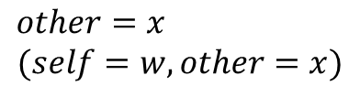





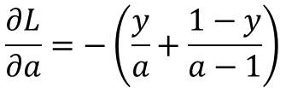
Local Gradients
Need to save from forward pass
Addition
$$\frac{∂f}{∂x}=1, \frac{∂f}{∂y}=1$$
$$1$$
$$f\left(x,y\right)=x+y$$
Multiplication
$$f\left(w\right)=w∗x$$
$$\frac{∂f}{∂w}=x$$
$$other=x$$
$$(self=w, other=x)$$
Sigmoid
$$\frac{∂f}{∂z}=sigmoid\left(z\right)∗(1−sigmoid\left(z\right))$$
$$result=sigmoid\left(z\right)=a$$
$$f\left(z\right)=sigmoid\left(z\right)$$
Binary Cross entropy
$$L=−(y∗\log\left(a\right)+\left(1−y\right)∗\log\left(1−a\right))$$
$$a, y$$
$$\frac{∂L}{∂a}=−\left(\frac{y}{a}+\frac{1−y}{a−1}\right)$$

Slide 49





$$w$$
Forward pass
$$w=2$$
multiplication
$$b$$
Backward pass
$$\frac{∂u}{∂w}=x$$
$$u=w∗x$$
u$=2$
b$=0$
$$z=u+b$$
$$\frac{∂z}{∂u}=\frac{∂z}{∂b}=1$$
Addition
z$=2$
$$\frac{∂a}{∂z}=a(1−a)$$
Sigmoid
$$a=sigmoid(z)$$
a$=0.8808$
$$Local Grtadient=\frac{∂L}{∂a}=−1/a$$
$$L=BinaryCrossEntrop(a,y)$$
$$\frac{∂L}{∂L}=1$$
L$=0.1269$
L

Slide 50




$$w$$
Forward pass
$$w=2$$
multiplication
$$b$$
Backward pass
$$\frac{∂u}{∂w}=x$$
$$u=w∗x$$
u$=2$
b$=0$
$$z=u+b$$
$$\frac{∂z}{∂u}=\frac{∂z}{∂b}=1$$
Addition
z$=2$
$$\frac{∂a}{∂z}=a(1−a)$$
Sigmoid
$$a=sigmoid(z)$$
$$\frac{−1}{a}$$
a$=0.8808$
$$Local Grtadient=\frac{∂L}{∂a}=−1/a$$
$$L=BinaryCrossEntrop(a,y)$$
$$\frac{∂L}{∂L}=1$$
L$=0.1269$
L

Slide 51



$$w$$
Forward pass
$$w=2$$
multiplication
$$b$$
Backward pass
$$\frac{∂u}{∂w}=x$$
$$u=w∗x$$
u$=2$
b$=0$
$$z=u+b$$
$$\frac{∂z}{∂u}=\frac{∂z}{∂b}=1$$
Addition
$$(a−1)$$
z$=2$
$$\frac{∂a}{∂z}=a(1−a)$$
Sigmoid
$$a=sigmoid(z)$$
$$−\frac{1}{a}$$
a$=0.8808$
$$Local Grtadient=\frac{∂L}{∂a}=−1/a$$
$$L=BinaryCrossEntrop(a,y)$$
$$\frac{∂L}{∂L}=1$$
L$=0.1269$
L

Slide 52


$$w$$
Forward pass
$$w=2$$
multiplication
$$b$$
Backward pass
$$\frac{∂u}{∂w}=x$$
$$u=w∗x$$
$$(a−1)$$
u$=2$
b$=0$
$$(a−1)$$
$$z=u+b$$
$$\frac{∂z}{∂u}=\frac{∂z}{∂b}=1$$
Addition
$$(a−1)$$
z$=2$
$$\frac{∂a}{∂z}=a(1−a)$$
Sigmoid
$$a=sigmoid(z)$$
$$−\frac{1}{a}$$
a$=0.8808$
$$Local Grtadient=\frac{∂L}{∂a}=−1/a$$
$$L=BinaryCrossEntrop(a,y)$$
$$\frac{∂L}{∂L}=1$$
L$=0.1269$
L

Slide 53
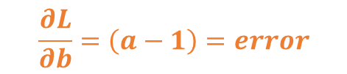
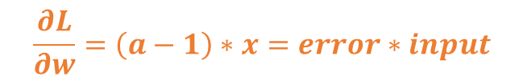


$$w$$
Forward pass
$$\left(a−1\right)∗x$$
$$w=2$$
multiplication
$$b$$
Backward pass
$$\frac{∂u}{∂w}=x$$
$$u=w∗x$$
$$(a−1)$$
u$=2$
b$=0$
$$(a−1)$$
$$z=u+b$$
$$\frac{∂z}{∂u}=\frac{∂z}{∂b}=1$$
Addition
For Logistic Regression
$$(a−1)$$
z$=2$
$$\frac{∂L}{∂w}=\left(a−1\right)∗x=error∗input$$
$$\frac{∂a}{∂z}=a(1−a)$$
Sigmoid
$$a=sigmoid(z)$$
$$\frac{∂L}{∂b}=\left(a−1\right)=error$$
$$−\frac{1}{a}$$
a$=0.8808$
$$Local Grtadient=\frac{∂L}{∂a}=−1/a$$
$$L=BinaryCrossEntrop(a,y)$$
$$\frac{∂L}{∂L}=1$$
L$=0.1269$
L

Slide 54




Computation graph – Backward pass
y
$$Path1=\frac{∂y}{∂u_{1}}∗\frac{∂u_{1}}{∂x}$$
$$Path2=\frac{∂y}{∂o_{1}}∗\frac{∂o_{1}}{∂u_{2}}∗\frac{∂u_{2}}{∂x}$$
_{O1}
_{O2}
$$Path3=\frac{∂y}{∂o_{2}}∗\frac{∂o_{2}}{∂u_{3}}∗\frac{∂u_{3}}{∂x}$$
u₁
u₂
u₃
$$\frac{∂y}{∂x}=\frac{∂y}{∂u_{1}}∗\frac{∂u_{1}}{∂x}+\frac{∂y}{∂o_{1}}∗\frac{∂o_{1}}{∂u_{2}}∗\frac{∂u_{2}}{∂x}+\frac{∂y}{∂o_{2}}∗\frac{∂o_{2}}{∂u_{3}}∗\frac{∂u_{3}}{∂x}$$
x
Backpropagation is just the repeated application of the chain rule

