Slide 1
FILE SYSTEM CREATION
C. Navya Dass(022)
Pooja R. Dalaya(026)

Slide 2
OBJECTIVE of the project:-
The objective of this project is to understand the underlying concepts of file system.
To understand the working of directory and files and how a file is saved and retrieved from the file system.

Slide 3
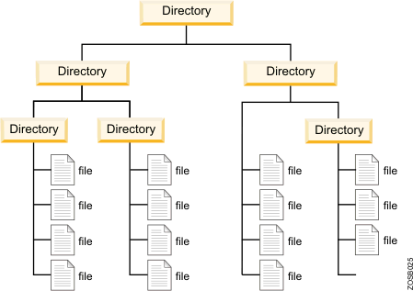
What is a file system?
A file system is used to control how information is stored or retrieved. It represents the hierarchical structure in which files will be stored.

Slide 4
Platform used:-
We made use of JAVA as our language because of the following features of JAVA:-
Simplicity, Object oriented, Security, Robust, High Performance and User friendliness.

Slide 5
Behind the scenes:- Miniproj.java:-
Contains the main class which calls the MainGUI frame by instantiating an object of that class.
It invokes the object that creates the GUI, thereby making the file system user friendly.

Slide 6
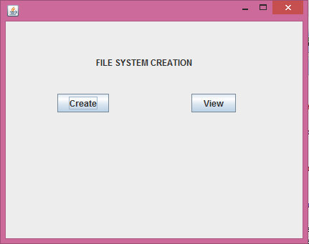
MainGUI.java
Contains the code for navigating from one page to another page by making use of two buttons create and view.
In action performed the code for navigation is present which navigates to CreateGUI for “create” button and Inode for “view” button.

Slide 7
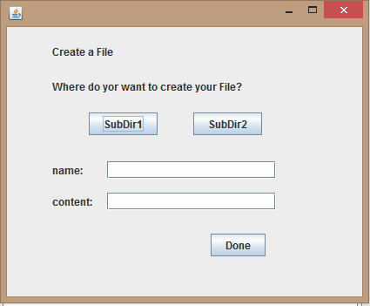
CreateGUI.java
In this class we have the GUI for taking the desired filename and location from the user.
In the action performed event of the button “Done”, the user actually creates his/her desired file.

Slide 8
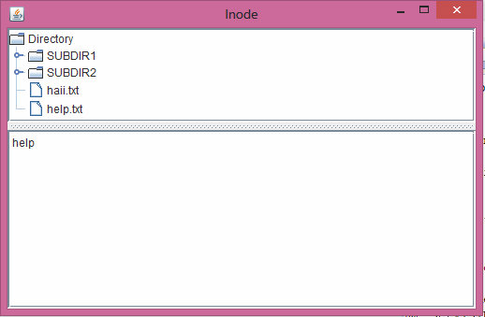
Inode.java
This class is instantiated when the view button is clicked and is used to browse through the file system.
The DefaultMutableTreeNode is the specific class used to implement the tree structure of the file system.

Slide 9
Brief Summary:-
Thus, the user is given the opportunity to give his/her own file name and location.
The respective file is placed in the desired location.
The user can also browse through the file system to view his/her files.

Slide 10
Brief Summary:-
Thus, the user is given the opportunity to give his/her own file name and location.
The respective file is placed in the desired location.
The user can also browse through the file system to view his/her files.

