Slide 1
FILE SYSTEM CREATION
C. Navya Dass(022)
B. Neha Singh(023)
Pooja R. Dalaya(026)

Slide 2
OBJECTIVE of the project:-
The objective of this project is to understand the underlying concepts of file system.
To understand the working of directory and files and how a file is saved and retrieved from the file system.

Slide 3
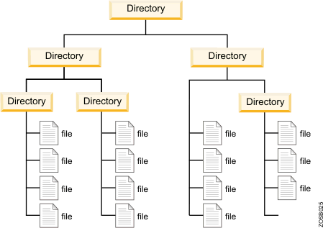
What is a file system?
A file system is used to control how information is stored or retrieved. It represents the hierarchical structure in which files will be stored.

Slide 4
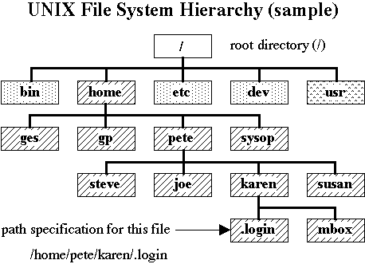
Existing File Systems:-

Slide 5
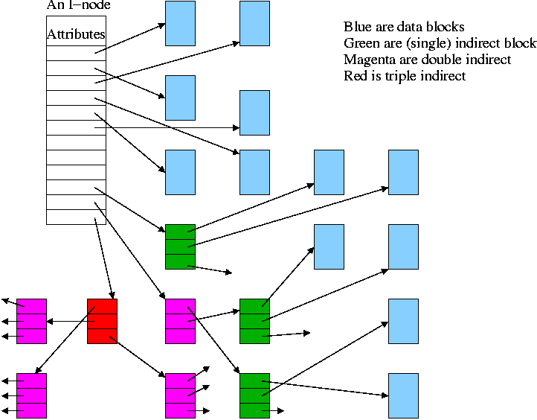
NTFS:-

Slide 6
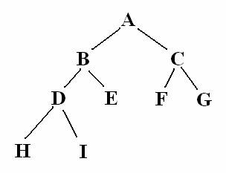
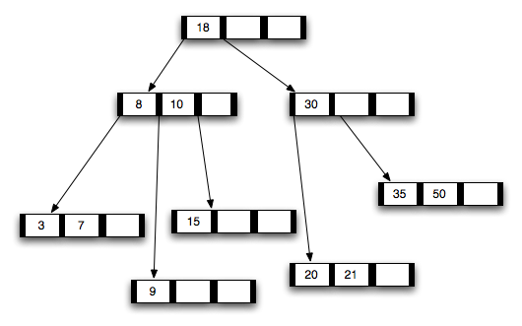
Comparison between UFS and NTFS
UFS can be implemented by means of a TREE data structure where one root node gives rise to children jus like the root directory of UFS.
NTFS makes use of a B-TREE to store the files into its file system. Here the directories are maintained as the base nodes and under them come various folders and files.

Slide 7
Proposed File system:-
We have made use of the basic principles of the UNIX file system, that is, the UFS.
Thereby, we have a root directory under which we have subdirectories which contain the files.
The data structure used is TREE data structure.

Slide 8
Platform used:-
We made use of JAVA as our language because of the following features of JAVA:-
Simplicity, Object oriented, Security, Robust, High Performance and User friendliness.

Slide 9
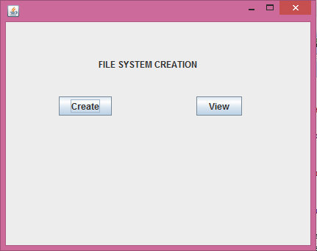
Project:- GUI part Main page:-

Slide 10
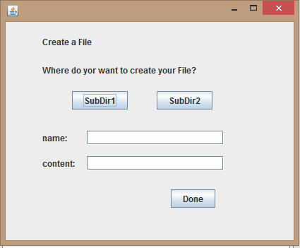
Create Page:-

Slide 11
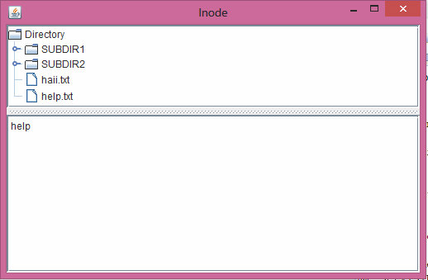
View Page:-

Slide 12
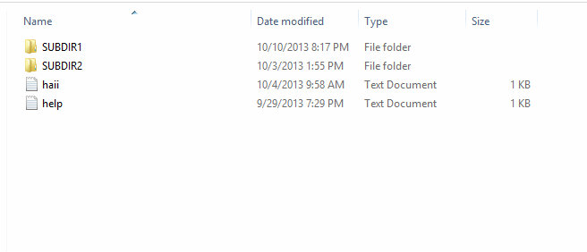
File system:-

Slide 13
Behind the scenes:- Miniproj.java:-
Contains the main class which calls the MainGUI frame by instantiating an object of that class.
It invokes the object that creates the GUI, thereby making the file system user friendly.

Slide 14
MainGUI.java
Contains the code for navigating from one page to another page by making use of two buttons create and view.
In action performed the code for navigation is present which navigates to CreateGUI for “create” button and Inode for “view” button.

Slide 15
CreateGUI.java
In this class we have the GUI for taking the desired filename and location from the user.
In the action performed event of the button “Done”, the user actually creates his/her desired file.

Slide 16
Inode.java
This class is instantiated when the view button is clicked and is used to browse through the file system.
The DefaultMutableTreeNode is the specific class used to implement the tree structure of the file system.

Slide 17
Brief Summary:-
Thus, the user is given the opportunity to give his/her own file name and location.
The respective file is placed in the desired location.
The user can also browse through the file system to view his/her files.

Slide 18
Insights from the project:-
Learnt the basic intricacies of a file system and how to implement it.
Gained knowledge of creating a user friendly interface.
Gained opportunity to explore the vast knowledge of JAVA.

Slide 19
Thank You…..!!

