Slide 1
EV Dynamic Tariff Optimization
What improved
A reproducible analytics pipeline for demand forecasting, bounded tariff decisions, and monitoring feedback in EV charging networks.
+4.09%
net revenue gain
98.2%
demand retained
2.03%
wait proxy reduction
$0.3181/kWh
pricing efficiency
Random Forest
+4.62%
+2.7%
best demand model
flat revenue comparison
off-peak uplift
R2 0.9183
ACN baseline
UrbanEV proxy
OP'26 Analytics submission | latest generated outputs

Slide 2
01 | Objective and approach
The project answers three operational questions
Demand
Tariff
Monitoring
When and where will charger utilization rise?
When should prices rise, stay flat, or offer discounts?
Did the policy improve revenue without damaging demand?
1
Preprocess
2
Explore demand
3
Predict utilization
4
Set tariff
5
Monitor KPIs
The system is deliberately bounded: tariff changes are modest and evaluated with customer response assumptions.
Outputs are kept as CSVs so the final results can be inspected without rerunning the full pipeline.
OP'26 Analytics | EV dynamic tariffs | 2

Slide 3
02 | Data landscape and preprocessing
Two datasets are used for different parts of the problem
Dataset
Used for
Why it fits
UrbanEV
Forecasting, utilization, off-peak uplift, wait proxy
Large 5-minute urban charging data with spatial demand patterns
ACN
Revenue, customer response, pricing efficiency
Session-level workplace charging with energy delivered and timing
Preprocessing choices
Main engineered signals
Aligned UrbanEV to hourly utilization tables while retaining zone and time features.
Hour, day-of-week, weekend flag, lag utilization, rolling utilization, rolling volume.
Converted ACN sessions into clean duration, energy, idle-time, and hourly demand features.
Utilization thresholds for pricing: surge above 80%, discount below 30% for UrbanEV.
Kept currency contexts separate: UrbanEV for utilization behavior, ACN for USD revenue.
ACN thresholds are calibrated separately because workplace charging has a different utilization scale.
OP'26 Analytics | EV dynamic tariffs | 3

Slide 4
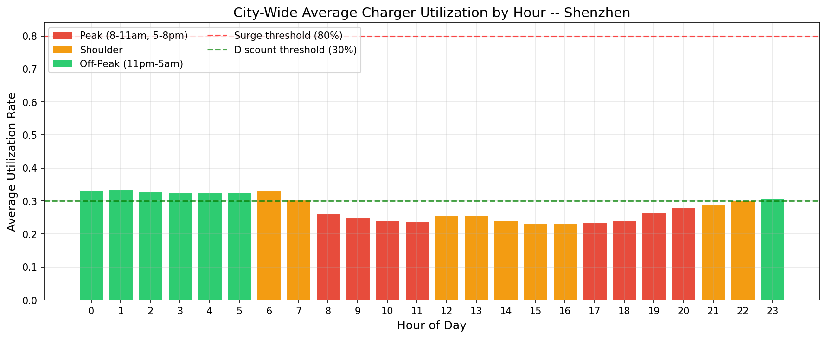
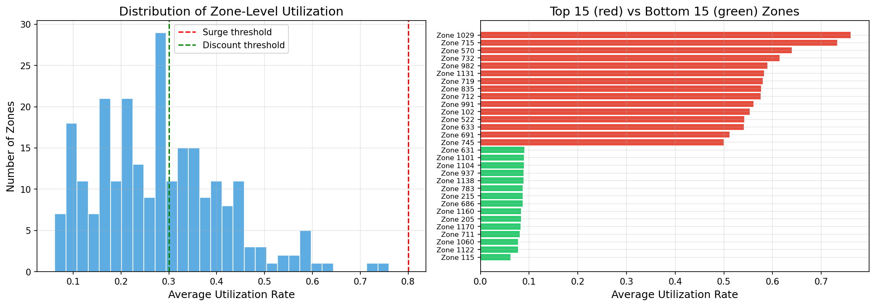
03 | EDA findings
Demand behavior supports time-aware and zone-aware pricing
UrbanEV demand has clear intraday structure, with predictable peak and off-peak windows.
Zone utilization is uneven, so one flat price is unlikely to balance the network well.
Discounts are only useful when spare capacity exists; otherwise they can worsen congestion.
OP'26 Analytics | EV dynamic tariffs | 4

Slide 5
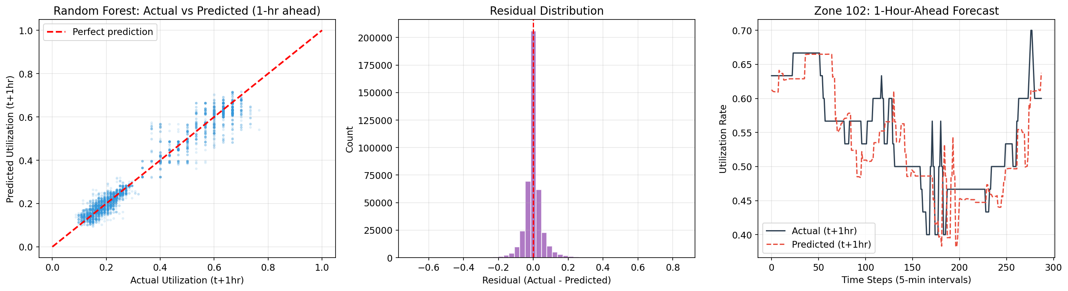
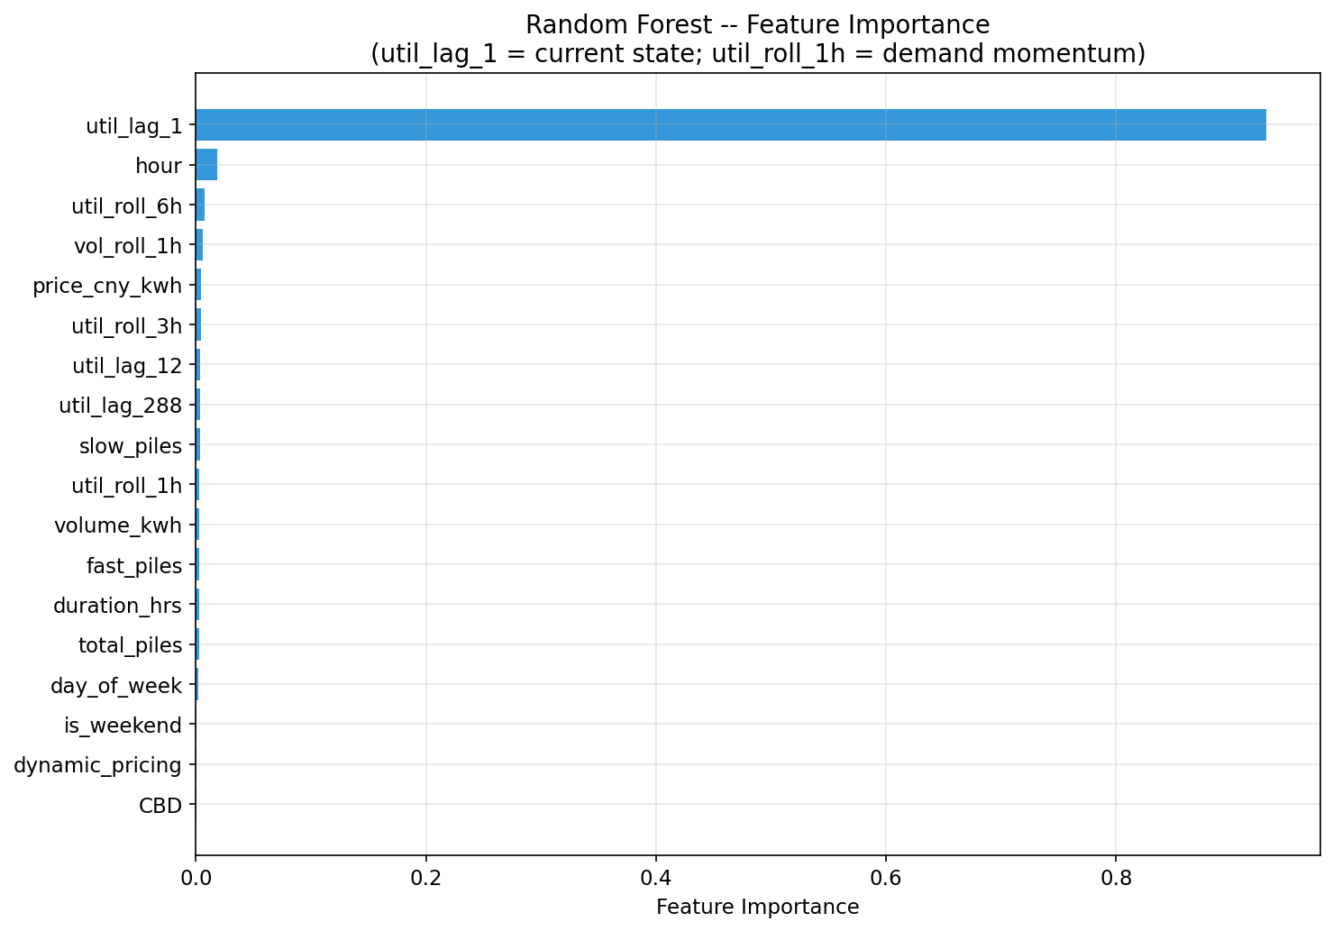
04 | Demand prediction
XGBoost gives the strongest one-hour-ahead utilization forecast
Model comparison
0.0505
0.0299
0.9183
RMSE
MAE
R2 score
XGBoost
91.8
lower is better
average error
variance explained
LightGBM
91.2
Random Forest
90.6
OP'26 Analytics | EV dynamic tariffs | 5

Slide 6
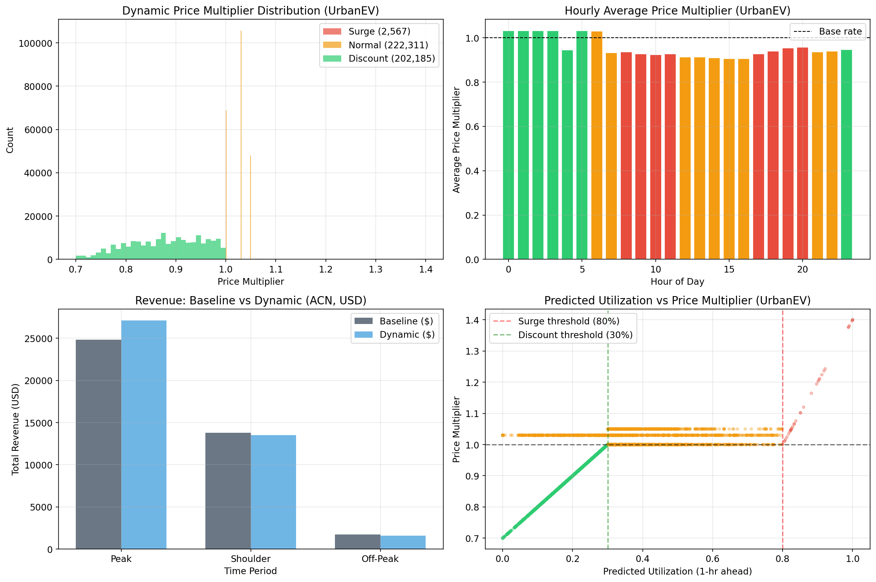
05 | Dynamic pricing logic and outcomes
Tariffs are bounded, rule-based, and tied to predicted utilization
Surge
Normal
Discount
>80% predicted utilization
30-80% predicted utilization
<30% predicted utilization
Shift some demand away from overloaded periods
Avoid unnecessary price changes
Use spare capacity during low-demand periods
+4.62%
+2.7%
ACN revenue gain
UrbanEV off-peak uplift
flat baseline comparison
low-utilization periods
A congestion guard prevents discounting hours that are already under pressure.
The pricing policy avoids unrealistic price jumps, which keeps the result more acceptable.
OP'26 Analytics | EV dynamic tariffs | 6

Slide 7
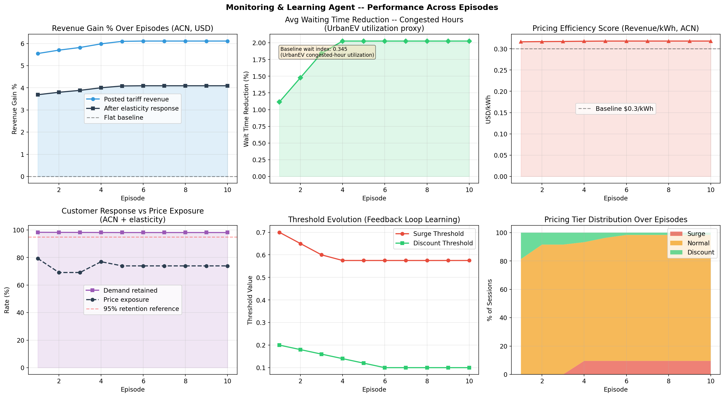
06 | Monitoring and learning agent
The monitoring loop improves revenue while keeping demand response stable
+4.09%
98.2%
net revenue gain
demand retained
after elasticity
customer response proxy
$0.3181/kWh
2.03%
pricing efficiency
wait proxy reduction
ACN final episode
UrbanEV congested hours
Final thresholds: surge 0.575, discount 0.1
Final tier mix: 9.5% surge, 1.6% discount, remainder normal.
OP'26 Analytics | EV dynamic tariffs | 7

Slide 8
07 | Implications and limits
What this means for an EV charging operator
Operational takeaways
Limits to state clearly
Forecast-led pricing can help spread demand without relying on extreme tariffs.
Waiting time is a proxy based on utilization, not directly observed queue time.
Station and zone differences matter; flat network-wide rules miss local underuse and congestion.
Customer response is simulated using elasticity, not measured in a live experiment.
Monitoring should track both business metrics and user-side metrics before tightening prices.
ACN and UrbanEV are different contexts, so results are reported separately.
Bottom line
The project shows a practical dynamic-pricing workflow: predict utilization, apply bounded tariff rules, and update the policy using transparent KPIs instead of optimizing revenue alone.
Recommended next checks: fairness by user group/site, sensitivity to elasticity, and validation on a future holdout period.
OP'26 Analytics | EV dynamic tariffs | 8

