Slide 1
EV Dynamic Tariff Optimization
This project builds a practical pricing workflow for EV charging networks: forecast utilization, apply bounded dynamic tariffs, and monitor whether the policy improves revenue and congestion without losing too much demand.
1. Predict
2. Price
3. Monitor
Estimate one-hour-ahead charger utilization from UrbanEV time, zone, price, and lag features.
Convert predicted utilization into surge, normal, or discount signals with guardrails.
Track revenue, demand retained, wait proxy, and pricing efficiency over learning episodes.
My approach is a three-stage agentic pipeline for EV charging tariff optimization. First, I preprocess and analyze the ACN and UrbanEV datasets to understand demand patterns, utilization, and session behavior. UrbanEV is used for demand forecasting and congestion/off-peak analysis, while ACN is used for revenue and pricing-efficiency evaluation. Next, I build a Demand Prediction Agent using features like hour, day, zone, price, lag utilization, and rolling demand. The best model’s predicted utilization is then used by the Tariff Pricing Agent to assign bounded surge, normal, or discount prices. Finally, a Monitoring Agent evaluates the policy using revenue gain, customer response, pricing efficiency, and a waiting-time proxy, then refines the pricing thresholds over learning episodes.
EV Dynamic Tariff Optimization | 1

Slide 2
01 | Problem framing
Why a dynamic tariff is needed
Flat per-kWh pricing treats every charging session the same, even though charger demand changes strongly by hour, day, and location. This creates two problems at the same time: some periods face congestion while other periods have unused charging capacity.
Project objectives
Forecast future charging utilization so the tariff decision is based on expected demand, not only historical averages.
Recommend bounded dynamic tariffs that can increase revenue while discouraging demand in congested periods.
Encourage off-peak usage when utilization is low, without discounting periods that are already congested.
Evaluate the policy through a monitoring loop using revenue gain, customer response, waiting-time proxy, and pricing efficiency.
Design choice: the project uses explainable rule-based tariff actions on top of ML forecasts, rather than a black-box price optimizer. This makes the result easier to justify in a business/policy setting.
EV Dynamic Tariff Optimization | 2

Slide 3
02 | Data and preprocessing
The two datasets are used for different evidence
Dataset
Role in project
Reason for use
UrbanEV / ST-EVCDP
Demand forecasting, EDA, charger utilization, off-peak uplift, waiting-time proxy
Large-scale urban charging data with time, zone, price, occupancy, and volume signals
ACN-Data
Revenue gain, customer response simulation, pricing efficiency
Session-level charging data with energy delivered, connection time, duration, and station/user behavior
Preprocessing decisions
UrbanEV records are converted into utilization features by timestamp and zone, then aggregated for hourly demand forecasting.
ACN sessions are cleaned into energy, duration, idle-time, and hourly session-demand features for tariff revenue evaluation.
Currencies are kept separate: UrbanEV is used for utilization behavior and ACN revenue is reported in USD.
The processed files are generated locally by Notebook 1; large processed CSVs are not pushed to GitHub.
Why this is acceptable
The problem statement allows the datasets to be used according to relevance. This project uses each dataset where it is strongest instead of forcing them into one combined country/currency model.
EV Dynamic Tariff Optimization | 3

Slide 4
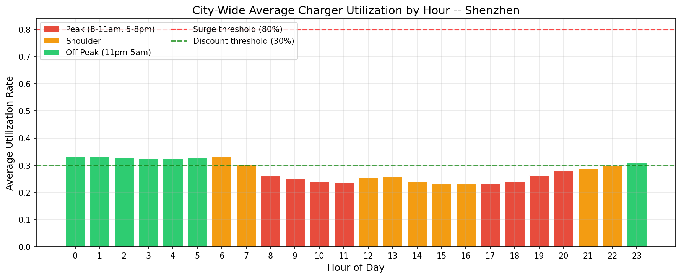
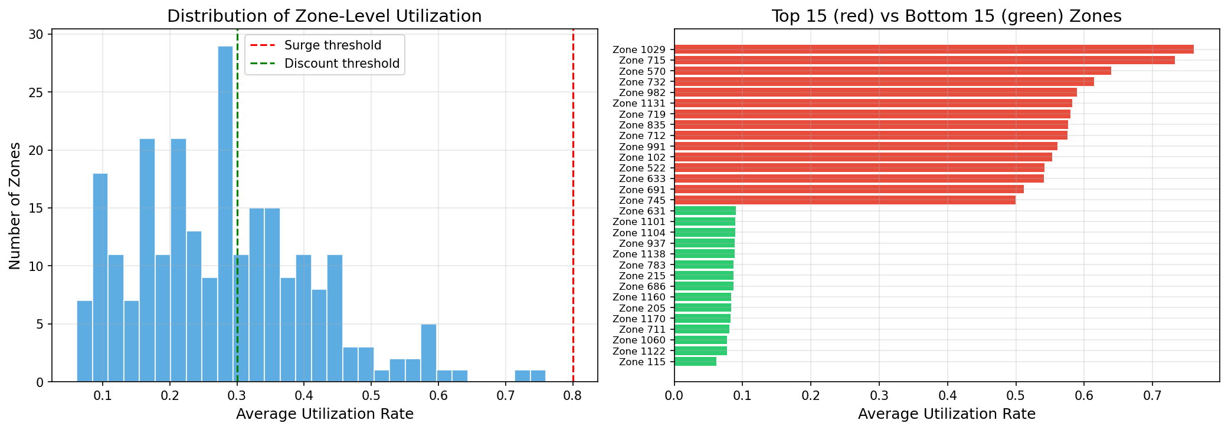
03 | EDA insights
Demand is predictable enough for tariff rules, but not uniform
What the EDA shows
Charging utilization follows a clear intraday pattern, so time-aware pricing has a meaningful signal to work with.
Weekday/weekend behavior differs, which supports using temporal features instead of a single average demand level.
Zone-level utilization is uneven: many zones are persistently underused, while short intervals can still become congested.
The policy therefore needs both discounts for spare capacity and surge signals for peak pressure.
EV Dynamic Tariff Optimization | 4

Slide 5
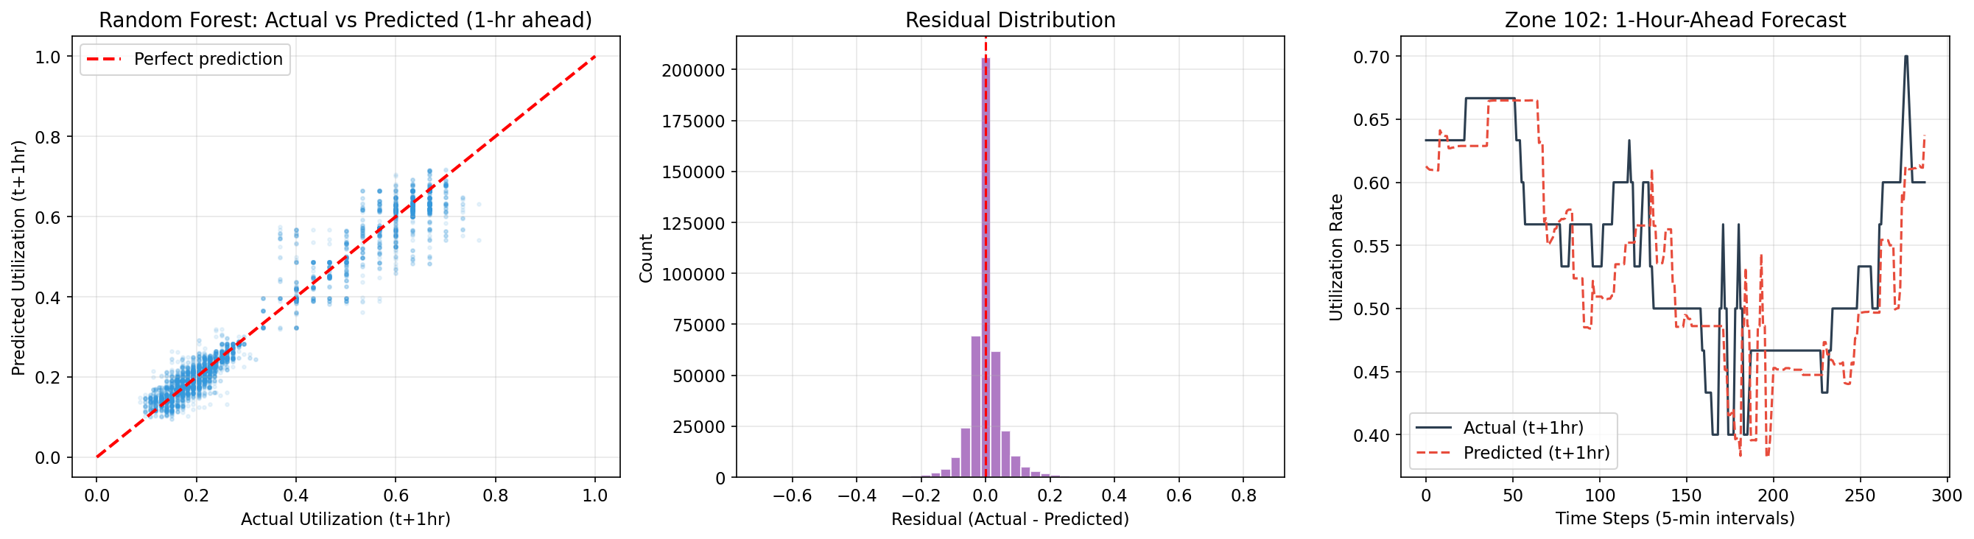
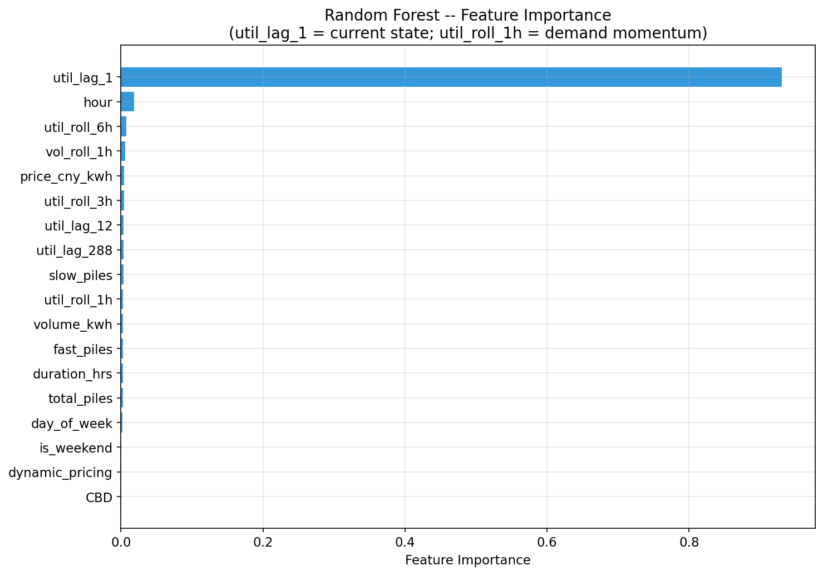
04 | Demand prediction agent
Forecasted utilization becomes the input to pricing
The demand prediction agent predicts one-hour-ahead utilization from time, zone, price, lag utilization, rolling utilization, and rolling volume features. Three models were compared so the final model choice is evidence-based rather than assumed.
0.0505
0.0299
0.9183
The best model is Random Forest. The R2 score above 0.91 indicates that the demand signal is strong enough to support rule-based tariff decisions, while still requiring monitoring because forecasting error remains.
RMSE
MAE
R2 score
large errors penalized
average absolute error
variance explained
EV Dynamic Tariff Optimization | 5

Slide 6
05 | Tariff pricing agent
The pricing logic is intentionally bounded and transparent
The tariff agent translates predicted utilization into three actions: surge, normal, or discount. The key idea is not simply to maximize revenue; it is to shift demand away from pressure periods and use spare capacity in low-utilization periods.
Surge
Normal
Discount
Predicted utilization > 80%
Predicted utilization between 30% and 80%
Predicted utilization < 30%
Signals congestion risk and raises price moderately to discourage some peak demand.
Keeps price stable when the network is not clearly overloaded or underused.
Encourages charging during low-demand windows, but a congestion guard blocks discounts in pressured periods.
+4.62%
+2.7%
+0.05 pp
Interpretation: the gain is positive but not extreme, which is important because unrealistic price jumps would be unacceptable for users and difficult to justify operationally.
ACN revenue gain
UrbanEV off-peak uplift
utilization change
vs flat baseline
discount response proxy
average UrbanEV change
EV Dynamic Tariff Optimization | 6

Slide 7
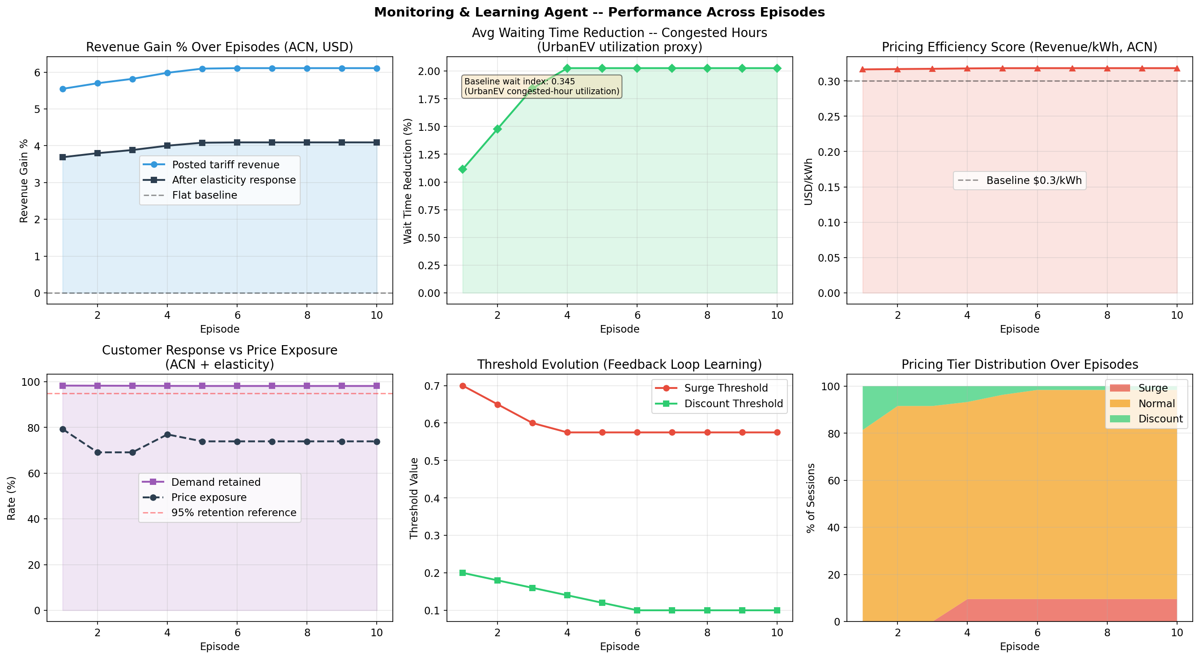
06 | Monitoring and learning agent
The feedback loop checks whether pricing remains balanced
The monitoring agent evaluates the policy across 10 simulated episodes. It tunes the ACN pricing thresholds using a balanced score that rewards net revenue and wait-time reduction, while penalizing excessive price exposure and protecting demand retained.
Final episode performance
+4.09%
98.2%
net revenue gain
demand retained
after elasticity
customer response proxy
$0.3181/kWh
2.03%
pricing efficiency
wait proxy reduction
baseline was $0.3000
UrbanEV congested hours
Final thresholds: surge 0.575, discount 0.1. Final tier mix remains reasonable, with about 9.5% surge and 1.6% discount sessions.
EV Dynamic Tariff Optimization | 7

Slide 8
07 | Business implications and limitations
The model is useful as a decision-support tool, not a final deployment system
Business and operational implications
Assumptions and limitations
A forecast-led tariff can improve revenue while still keeping customer demand largely retained.
Waiting time is not directly observed, so high-utilization UrbanEV periods are used as a proxy.
The network should not use one blanket price: time and zone patterns both matter.
Customer response is simulated using price elasticity, not measured in a live A/B test.
Monitoring should include user-side metrics, not only revenue, because aggressive pricing can reduce acceptance.
ACN and UrbanEV come from different contexts, so the project reports metrics separately.
Discounts should be targeted to genuinely underused periods; otherwise they can increase congestion.
Real deployment would require policy review, fairness checks, and live validation.
Final takeaway
The project demonstrates a complete and transparent workflow: use data to predict demand, apply bounded dynamic tariffs, and keep improving the policy through monitoring rather than optimizing revenue alone.
EV Dynamic Tariff Optimization | 8

