Slide 1
EMPLOYMENT NOW!
An analysis on improving unemployment in NYC Boroughs
BY- Navya Jammalamadaka

Slide 2
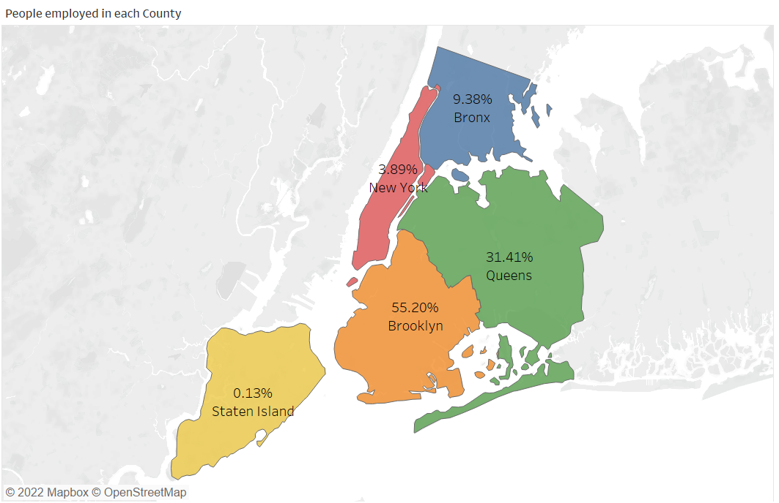
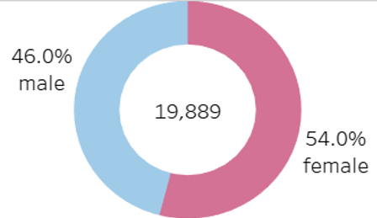
OVERVIEW OF THE PROGRAM
Program has 46% Male and 54% of Female participants
$9.89
29.73 hrs
Average wage of the participants
Average working hours per week
Majority of the participants are from Brooklyn and Queens
~36 years
Average age of the participants

Slide 3
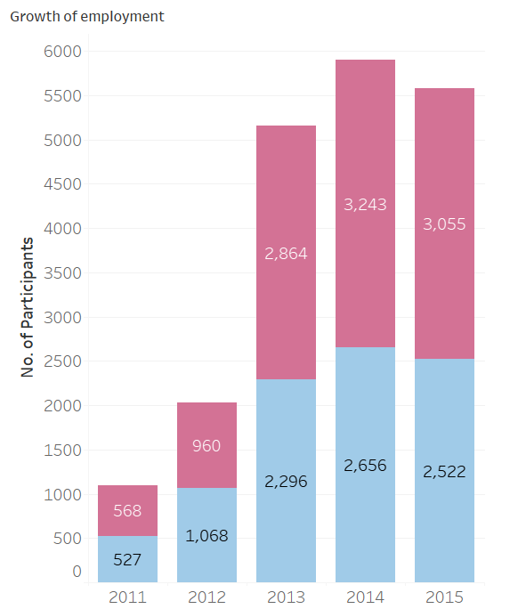
EMPLOYMENT GROWTH
The program has started in the year 2011 and 568 female participants, 527 male participants got HIRED.
Over, the years, Continuous growth in participants hired has been observed.
This contributes to the SUCCESS of the program.
10,690
No. of Female participants got hired from 2011-2015
9069
No. of Male participants got hired from 2011-2015

Slide 4
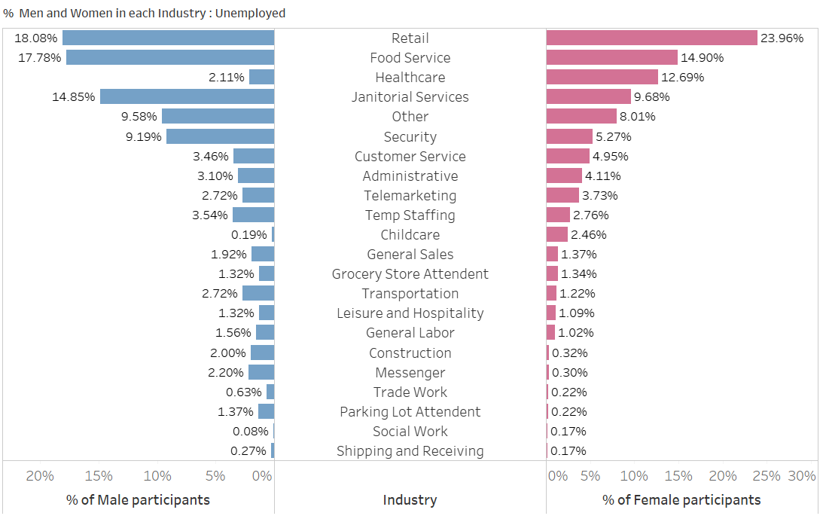
ANALYSIS BASED ON INDUSTRY
Major termination of jobs is observed in Food service, Retail, Healthcare industries and has grown across the years from 2011-2015.
18.08% of Male and 23.96% Female Participants are unemployed in Retail, which has laid-off the more employees.

Slide 5
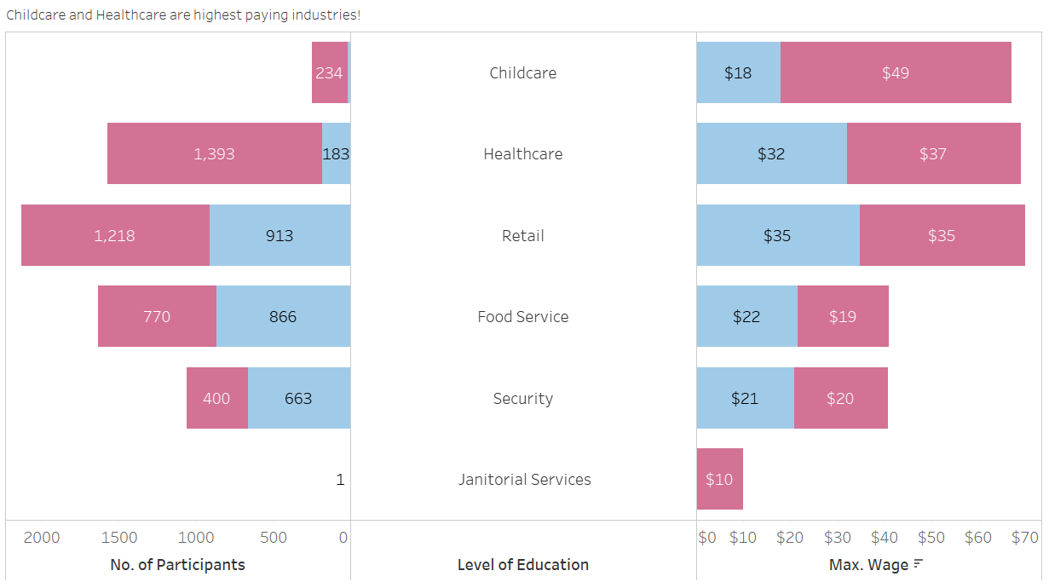
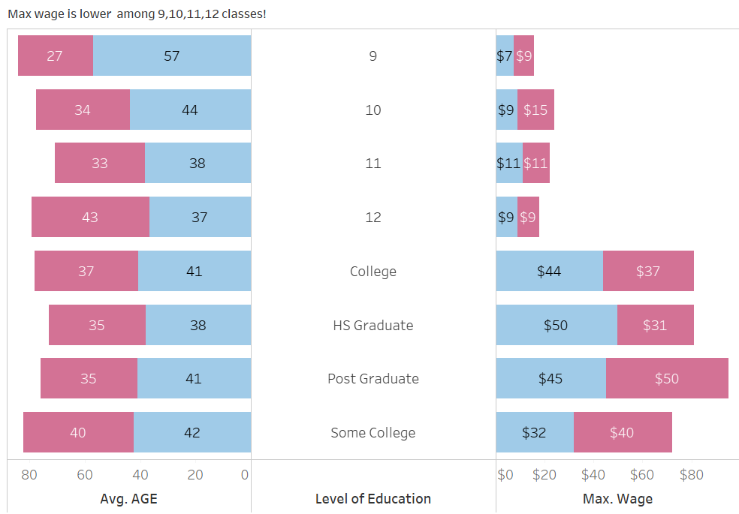
WAGE-Education Vs Industry
Women participants are paid more in Childcare and Healthcare.
Females tend to assume more positions than males in major sectors and are paid high wages!
Men from College and HS Graduates are paid more.
Males reported high average age but received less wage when education level is Below 12th grade.

Slide 6
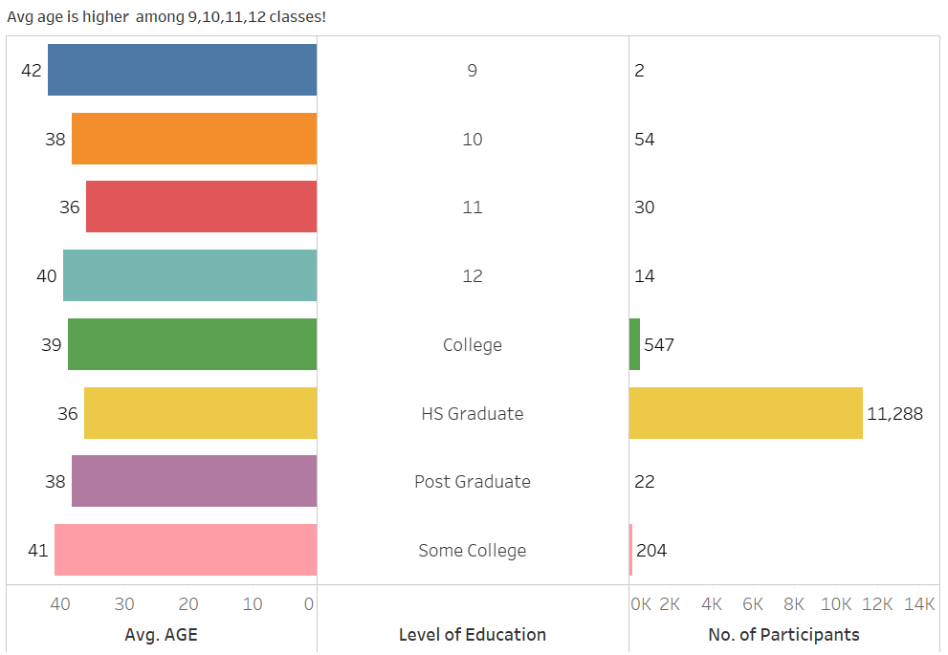
AGE AND EDUCATION ANALYSIS
Classes 9,10,11,12 are very unlikely to get employed though their age is high.
Major strength of participants employed belong to High School graduate.
Similarly, employees with education qualification less than 12th grade are being paid less and have major job termination rate. (can be verified with the Employment status filter)

Slide 7
TAKEAWAYS
The following recommendations can be implemented in order to contribute towards EMPLOYMENT NOW’s SUCCESS
First Recommendation
The Employment Now program can concentrate in getting its participants employed in industries like Childcare, Transportation or General Sales where the job termination is marked less.
Second Recommendation
Programs concentrating males in different sectors must be promoted. Healthcare and Childcare are to be considered as decent paying sector for Women
Third Recommendation
The program can take an initiative to conduct skill-based trainings for classes 9,10,11,12 in the trending technologies to increase employment.

