Slide 1
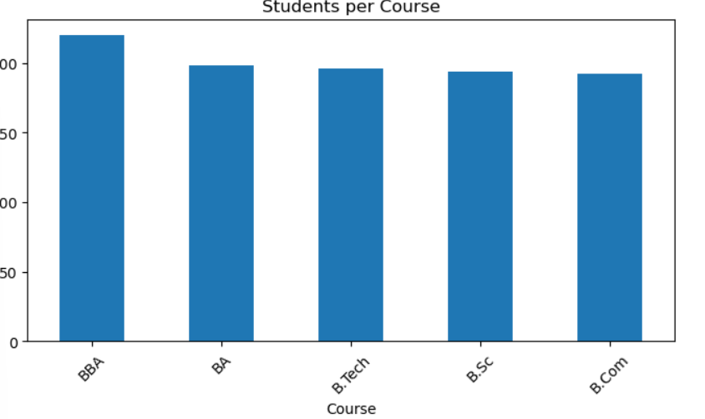
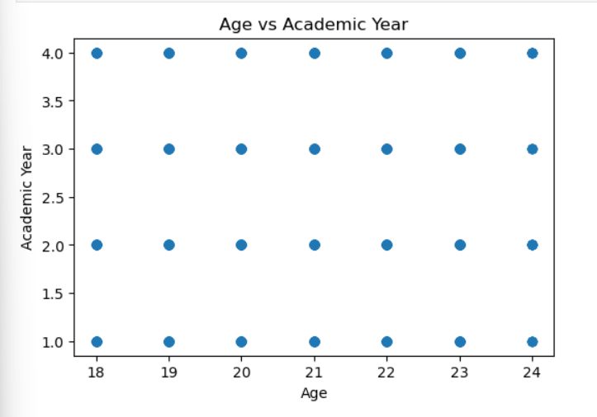
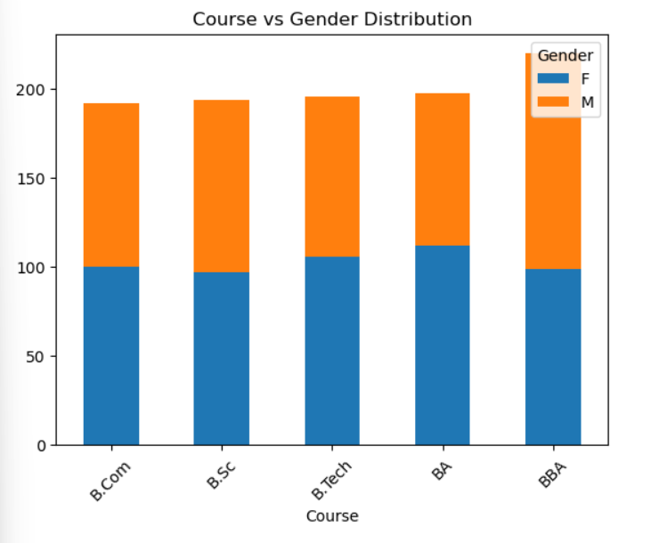
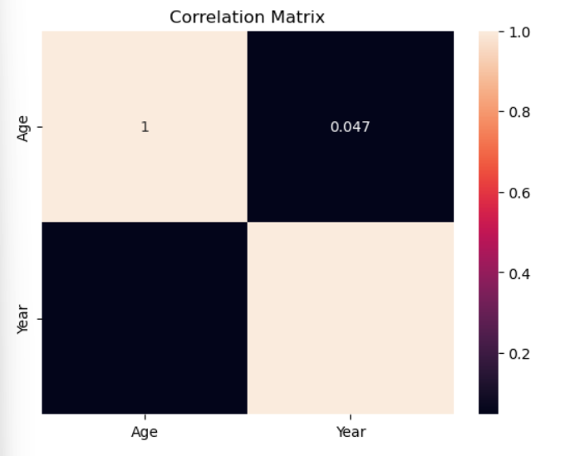
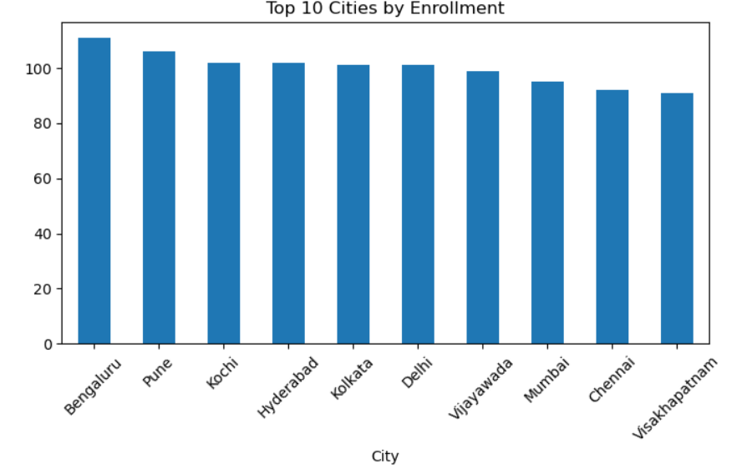
Walmart Sales Dashboard
💰 Total Students | 🏆Top Course | ⚠️Gender ratio| 🎉Top City 1000 BBA 514:486 Hyderabad
Course Distribution:
Age vs Year:
Course vs Gender
Correlation Matrix
City Distribution

