Slide 1

VeritasAI: Your AI-Powered Truth Verification Platform
In an age saturated with information, distinguishing truth from fabrication has become paramount. VeritasAI offers a revolutionary solution, leveraging advanced artificial intelligence to combat the spread of misinformation and empower you with clarity.

Slide 2

The Rising Tide of Misinformation
Misinformation spreads rapidly across digital platforms, eroding trust and impacting critical decisions in every aspect of life. From social media rumors to sophisticated deepfakes, discerning what's real and what's not has never been more challenging and crucial.

Slide 3

Introducing VeritasAI: Your Trusted Guardian of Truth
VeritasAI is an advanced, AI-powered platform designed to empower individuals, journalists, and content moderators alike. It provides the tools to quickly and accurately verify the authenticity of online content, fostering a more informed and trustworthy digital environment.

Slide 4



Seamless Content Upload & Analysis
Text Upload
Image Upload
Video Upload
Effortlessly paste or type any textual content for immediate analysis and verification.
Upload images, graphics, or memes to uncover visual manipulations and verify their origin.
Submit video clips for comprehensive scrutiny, detecting deepfakes or altered footage.
Our intuitive interface makes it simple to submit various content types for rapid, AI-driven verification.

Slide 5

The Intelligent VeritasAI Verification Engine
At the core of VeritasAI is a sophisticated AI engine that meticulously analyzes every uploaded piece of content. It processes vast amounts of data, cross-references reliable sources, and applies advanced algorithms to determine accuracy.
True
Misleading
Content aligns with verified facts and reputable sources (Green light).
Content contains elements of truth but lacks crucial context or is presented to deceive (Yellow warning).
False
Content is factually incorrect and not supported by evidence (Red alert).

Slide 6
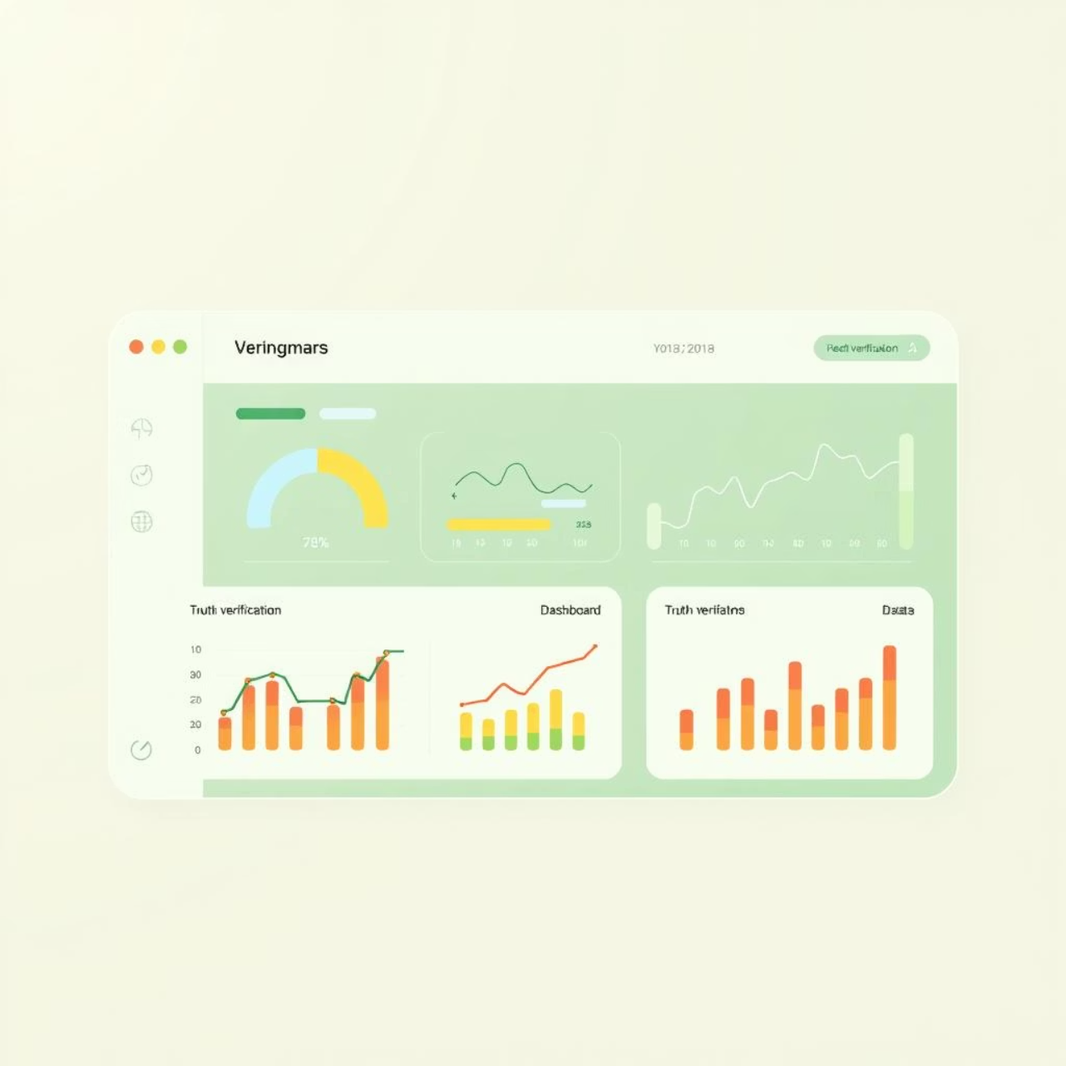
Clear & Actionable Insights
Instant, Understandable Results
Our dashboard-style results page provides an immediate, color-coded truth meter indicating the content's veracity. This visual simplicity ensures that anyone can quickly grasp the findings.
Easy-to-read output for rapid assessment.
Direct links to multiple reliable sources for independent verification.
Comprehensive context explaining the 'why' behind the verdict.

Slide 7
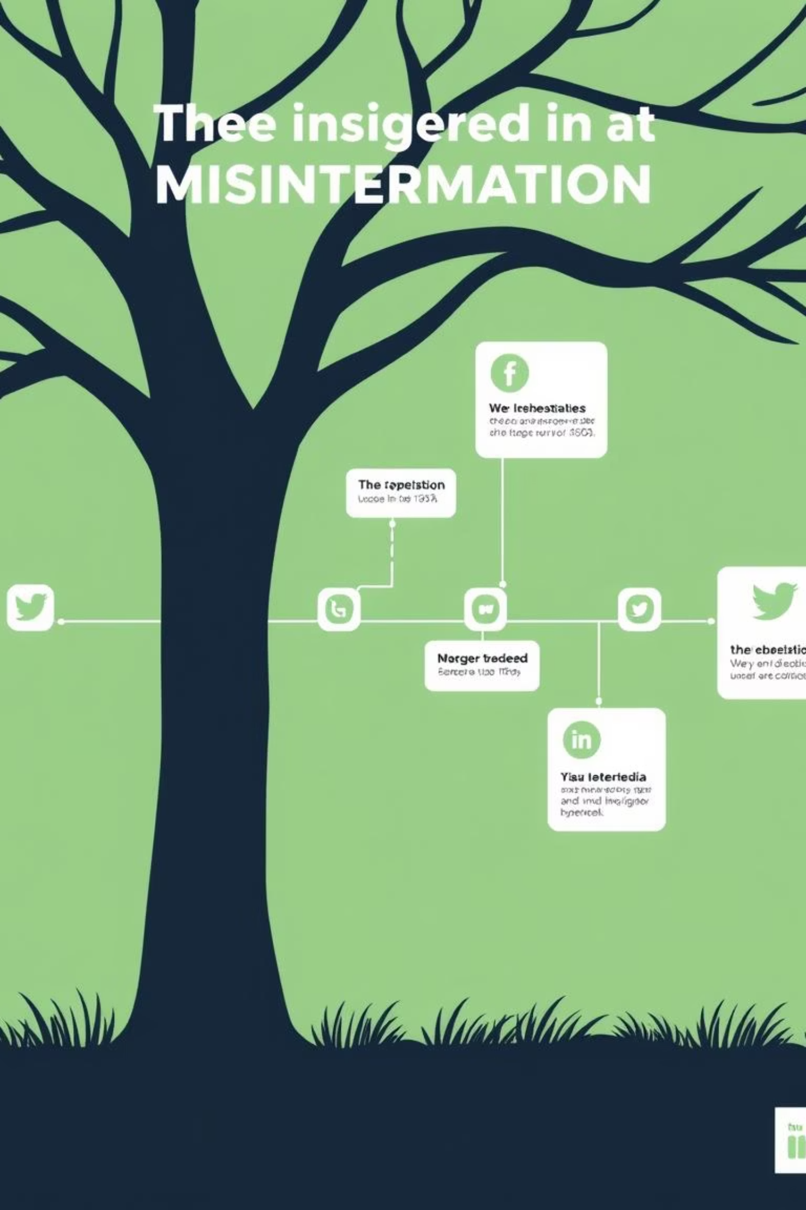
The Journey of Misinformation
Unveiling the Evolution of Claims
VeritasAI goes beyond a simple 'true' or 'false.' Our unique visual storytelling feature charts the lifecycle of a claim, illustrating its origin, how it was fact-checked, and its spread across various platforms over time. It's a compelling "journey of misinformation."
1
Origin Point
Initial appearance and source of the claim.
2
Fact-Checked
When and by whom the claim was first debunked or verified.
3
Widespread Propagation
How the claim gained traction and spread across different platforms.

Slide 8



Protecting Your Privacy, Always
Your privacy is paramount. VeritasAI is built with robust privacy protection features to ensure sensitive information remains confidential during the verification process.
Sensitive Element Detection
Our AI automatically identifies private elements like faces, identification documents, and intimate visuals within uploaded content.
Automatic Anonymization
Detected sensitive content is automatically blurred or masked, and a warning message is sent to the content owner, ensuring compliance and safeguarding privacy.

Slide 9




Global Accessibility & Empowerment
VeritasAI is committed to making truth accessible to everyone, everywhere. Our platform supports diverse communication methods and empowers users with vital knowledge.
Voice Input/Output
Speak your claim, and let the app check and speak the result back to you, highly useful for accessibility and convenience.
Multi-Language Support
Fact-checking capabilities are available across multiple languages with automatic translation, crucial for diverse regions.
Digital Literacy Tips
A dedicated section provides key safety tips on detecting fake news, protecting privacy, and reporting harmful content, enhancing digital literacy.

Slide 10

Join the Movement for Truth
VeritasAI is more than just a tool; it's a commitment to fostering a digital environment built on accuracy, trust, and informed decision-making. Be part of the solution in the ongoing fight against misinformation.
Empower yourself and others with VeritasAI. Together, we can build a more trustworthy online world.

