Slide 1

Coursera Capstone Project
By Navya S Nambiar

Slide 2


INTRODUCTION
By Islam Nader 3

Slide 3

Problem Description
◦ My young cousin will move to New York City to start studying at Manhattan college engineering ,we face a lot of problem in find suitable flat for rent special he doesn’t eligible to stay at university housing. so that I try to find best flat for rent around undergrounds that can walking to the station.
◦ My cousin need the following conditions at new flat .
◦ Apartment with min 1 bedroom and Max bedrooms
◦ Rent not to exceed $1500/month
◦ Max 10 minutes to walling till underground metro station
◦ Fully live place a lot of restaurants , gum, cafes, and more at night live to be save for living ◦ Our comparison will be with Stratford city at London last beautiful place was visit this
year “MOXY LONDON STRATFORD”
By Islam Nader
12/11/2019
4

Slide 4
Audience
◦ First Audience will be any person who plans to move to New York City or any other major cities.
◦ And the second Dataone is Data Science training that needs a powerful case study to train his / her skill
By Islam Nader
12/11/2019
5

Slide 5
DATA
The heart of our project
By Islam Nader 6

Slide 6
Data Sources and Processing
◦ Manhattan neighborhoods were obtained from Wikipedia and organized by Neighborhoods with geodata via Nominatim for mapping with Folium.
◦ https://en.wikipedia.org/wiki/List_of_New_York_City_Subway_stations_in_Manhattan
◦ List of Subway stations was obtained via Wikipedia, NY Transit web site and Google map
◦ https://www.google.com/maps/search/manhattan+subway+metro+stations/@40.7837297,-74.1033043,11z/data=!3m1!4b1
◦ List of apartments for rent was consolidated from web-scraping real estate sites for MH. The geolocation(lat,long) data was found with algorithm coding and using Nominatim.
◦ http://www.rentmanhattan.com/index.cfm?page=search&state=results
◦ Folium map was the basis of mapping with various features to consolidate all data in ONE map where one can visualize all details needed to make a selection of apartment
By Islam Nader
12/11/2019
7

Slide 7
METHODOLOGY
The heart of our project
By Islam Nader 8

Slide 8
Methodology
◦ Our Methodology is primarily based on described our data on MAP, in order to facilitate locations for rent ◦ All information will consolidate on one MAP, where my cousin can see all rental statistics in one place
◦ Map exhibit two famous places around apartment and subway station records
By Islam Nader
12/11/2019
9

Slide 9
Data science Applied tools
◦ Web-scraping of sites is used to consolidate data-frame information which was saved as csv files for convenience and to simply the report.
◦ Geodata was obtained by coding a program to use Nominatim to get latitude and longitude of subway stations and also for each apartments for rent listed.
Execution
◦ Geopy_distance and Nominatim were used to establish relative distances.
◦ Seaborn graphic was used for general statistics on rental data.
◦ Matplotlib used CM module that provides a large set of colormaps, functions for registering new colormaps and for getting a colormap by name, and a mixin class for adding color mapping functionality.
◦ Sklearn used KMeans for applying cluster on generated Data
◦ Maps with popups labels allow quick identification of location, price and feature, thus making the selection very easy
By Islam Nader
12/11/2019
10

Slide 10
EXECUTION
Run our codebase
By Islam Nader 11

Slide 11
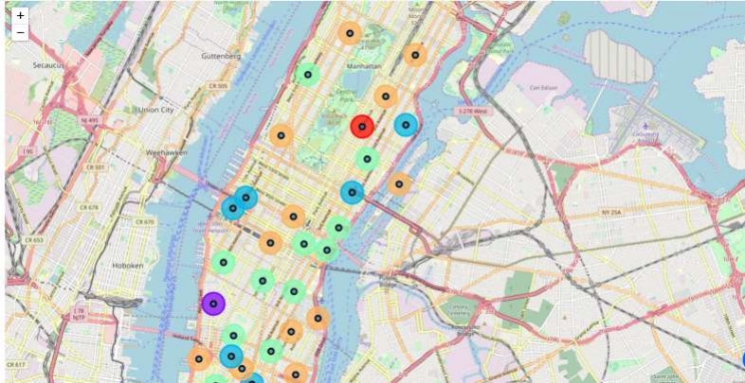
Manhattan University Map
By Islam Nader
12/11/2019
12

Slide 12
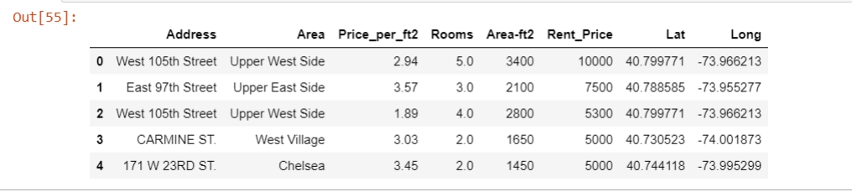
Offred flats for rent
By Islam Nader
12/11/2019
13

Slide 13
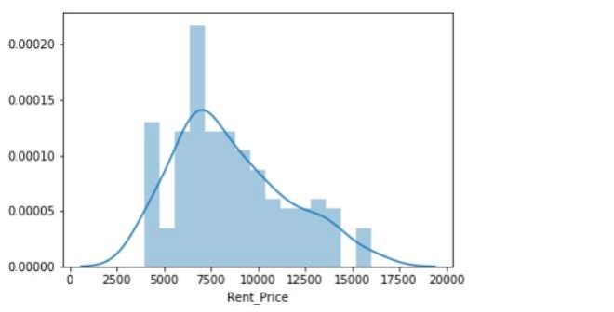
Offred flats for rent per rent price
By Islam Nader
12/11/2019
14

Slide 14
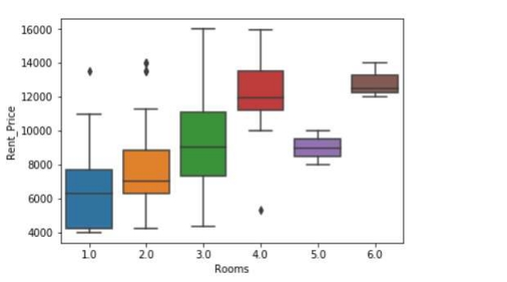
Offred flats for rent price vs No. of rooms
By Islam Nader
12/11/2019
15

Slide 15
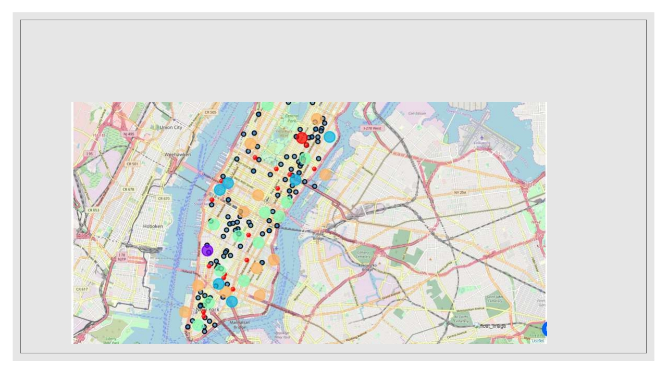
Final Flat for rent and subway stations
Map key
• Subway
• Flat
By Islam Nader
12/11/2019
16

Slide 16
CONCLUSION
By Islam Nader 17

Slide 17
Conclusion
◦ In general, I am thankful IBM for wonderfully Certification Course that improve all my thinning and data analysis thinning ◦ Folium is a very powerful technique to consolidate information and make the analysis and decision with integration with
Foursquare API . I would recommend for use in similar situations .
◦ One must keep abreast of new tools for DS that continue to appear for app
◦ For my all class-met it’s recommenced to continue study Advanced Data Science with IBM Specialization
.
By Islam Nader
12/11/2019
18

