Slide 1
Activity Recommendation System
Avaljot Khurana (ask150930)
Swaroop (skp150330)
Avikaran (asb150330)
Navya Paladugu (nxp153030)
Neeharika Cheruku (nxc151230)

Slide 2
Introduction
Often this is the case with finding enjoyable activities where users end up browsing the things that might interest them without taking the weather conditions into account.
This project solves the problem by recommending best activity in the vicinity taking weather conditions into account.

Slide 3
Datasets
Two datasets from National Climatic Data Center were used to predict the weather
1. GHCN Dataset
For Temperature prediction.
Daily Summary
2. ISD Dataset
For Pressure prediction.
Hourly observations
3. OpenStreetMap Dataset
provided available places for activity
actively refreshed by Openstreetmap community.

Slide 4
Modules
User Enter Location
End Result is Recommended Activities
Application
MongoDB
Weather Prediction
MongoDB
Recommendation System
User Location
JSON Data

Slide 5
Machine Learning Model
Temperature:
In order to predict the values for the minimal and maximal temperature following are the approaches:
1. Second degree kernelized Linear Regression:
Modeled the temperature only by the current date.
Trained a regression model with a second degree kernel.
Unfortunately this model did not give a good result at all.
2. Decision tree Regression model:
chose to use a Decision tree because it can capture non-linearity.
Learning steps of Decision tree are simple and fast.
Tested three different number of bins in order to find the optimal amount that give the best prediction.
In our case the best number of bins was 50.

Slide 6
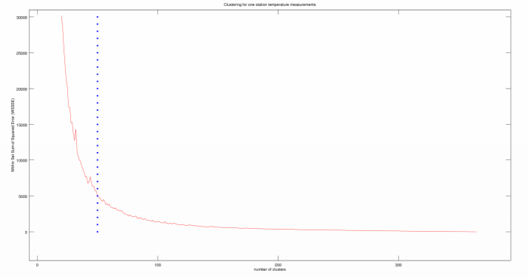
Decision Tree:
We see that the error decreasing rate is almost zero when the number of bins goes over 60.

Slide 7
TEMPERATURE PREDICTION
Temperature can be predicted by looking at the previous measurements.
In order to know how many days are to be taken to account, we used a moving window of size n to get the n previous temperature values and use them as features to predict the temperature for day n + 1.
The final value we empirically selected is 7. Therefore, we used the seven previous days to determine the eighth one.

Slide 8
PRESSURE PREDICTION
Pressure is ranging from 960 to 1070.
Our initial idea was to predict the pressure for the day and use it to predict the weather afterward.
We used the same moving-window model as employed for the temperature prediction.
But this method gave very high error (RMSE).

Slide 9
PRESSURE PREDICTION(Cont..)
Classified the pressure values into classes
Employed Random Forest Classifier and fed it the pressure classes.
The model would return the class instead of the pressure.
By applying cross-validation and testing for different range of previous day we found that by only using the weather class of just the previous day, the model could perform well.
Pressure | Weather
Smaller than 980 | Storm
Between 980 and 1000 | Rain
Between 1000 and 1025 | Change
Between 1025 and 1050 | Fair
Greater than 1050 | Very Dry

Slide 10
Random Forest Classifier
Add an additional layer of randomness to bagging.
In standard trees, each node is split using the best split among all variables. In a random forest, each node is split using the best among a subset of predictors randomly chosen at that node.
This turns out to perform very well compared to many other classifiers, including discriminant analysis, support vector machines and neural networks, and is robust against overfitting.

Slide 11
Recommendation System
Our Recommendation System is responsible for retrieving activities based on two criteria:
1. The activity should be in the vicinity of the user;
2. The proposed interesting points should be filtered according to the weather conditions.
This module relies on the weather predictor and the MongoDB that contains the geo-localized activities

Slide 12
Recommendation System(Cont..)
Search for nearest activities
For searching the nearest stations from the user location the NoSQL database MongoDB is used.
Reason for using MongoDB system is built-in support work with geospatial indexes.
Query MongoDB to search nearest stations
Predict the temperature and pressure.

Slide 13
Recommendation System(Cont..)
Inside Activities
We simply output the interesting point to the user, as an inside activity is almost never influenced by weather conditions.
Outside Activities
Activities are classified as follows:
1. Winter sports to lower temperatures (below 1 degree Celsius)
2. Normal activities to normal temperatures (from 10 to 20 degree)
3. Extreme or water activities to highest temperatures (from 20 degrees and above)

Slide 14
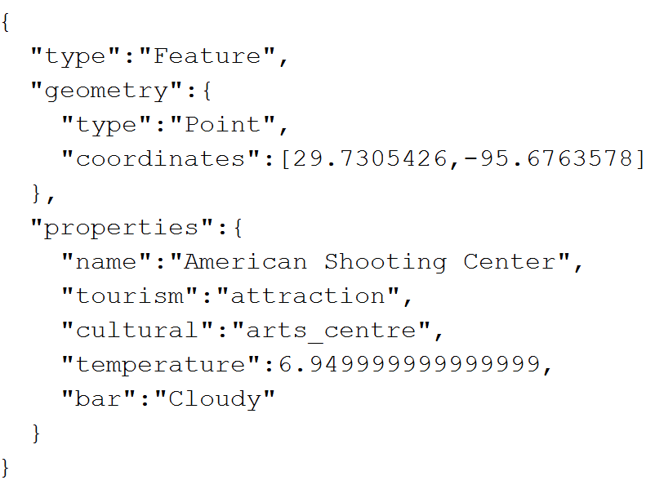
Recommended Activity
Following is one of the activity that our system has recommended
Converted to JSON.

Slide 15
THANK YOU

